Slide 1
Live Case
01/26/2022

Slide 2
63 y.o. male with history of PAD and two failed vascular bypass in left lower extremity, now presents with non healing left toe ulcer.
PMH : HTN, HLD, A-fib, heavy smoker, ischemic cardiomyopathy with EF 30%, CAD s/p multiple prior PCIs.
Medications: asa 81 mg, Lipitor 80 mg, Losartan 25 mg, Toprol XL 50 mg BID, Amiodarone 200 mg daily, Torsemide 60 mg daily, Eliquis
Labs: Hgb/hct 13.7/41, Cr 1.0, LDL 44, INR 1

Slide 3
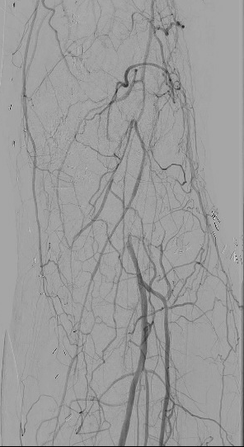

Slide 4
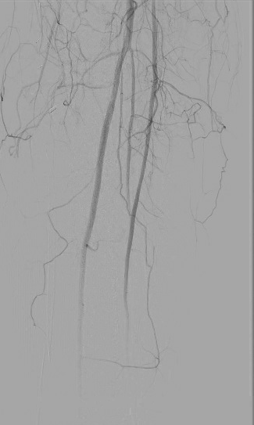
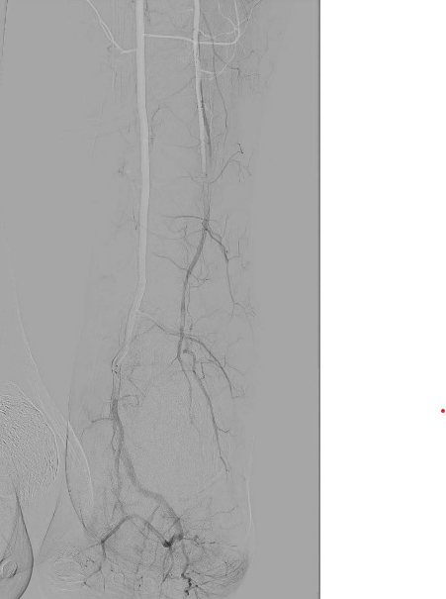

Slide 5
Catheter Directed Thrombolysis (CDT)
Direct delivery of the thrombolytic agent into thrombus.
Preferred for acute limb ischemia, DVT, AV graft occlusions.
Alteplase (recombinant tissue plasminogen activator [rt-PA]) is the most commonly used agent.

Slide 6
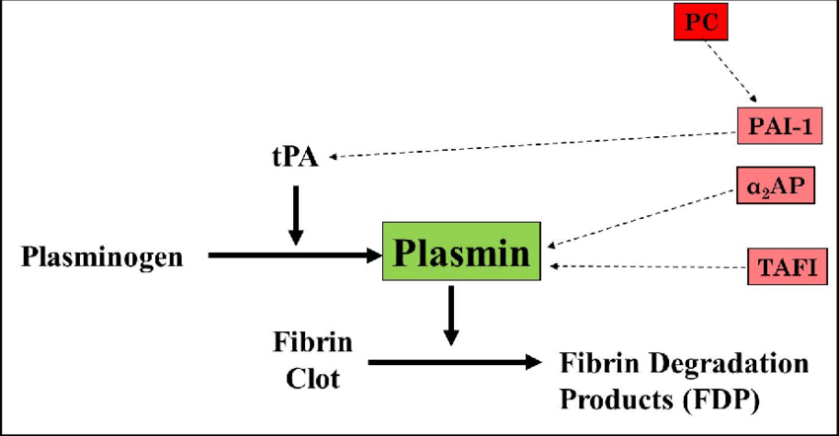

Slide 7
Absolute Contraindications
Active bleeding disorder
Gastrointestinal bleeding within 10 days
Cerebrovascular event within 6 months
Intracranial or spinal surgery within 3 months
Head injury within 3 months
Relative Contraindications
Major surgery or trauma within 10 days
Systolic >180 mm Hg or diastolic >110 mm Hg
CPR within 10 days
Intracranial tumor
Pregnancy
Diabetic hemorrhagic retinopathy
Recent eye surgery
Hepatic failure
Bacterial endocarditis

Slide 8
Rochester trial
114 patients with ALI to thrombolysis with urokinase (57 patients) or to immediate operation (57 patients).
Thrombolytic therapy resulted in dissolution of the occluding thrombus in 70% patients
Cumulative limb salvage rate was similar in the two treatment groups
Cumulative survival rate was significantly improved in patients randomized to the thrombolysis group (84% vs 58% at 12 months, p = 0.01)
Ouriel K, J vasc Surg, 1994

Slide 9
Surgery versus Thrombolysis for Ischemia of the Lower Extremity (STILE) trial
393 patients were randomly assigned to surgery or to thrombolysis with either rtPA or urokinase.
Follow up 6 mnths
Among patients with symptoms of longer duration (>14 days) , the surgical group had lower amputation rates than thrombolysis group (3% vs. 12%).
Among patients with symptoms of shorter duration (< 14 days), patients assigned to thrombolysis had lower amputation rates than surgical patients (11% vs. 30%).
Ann Surg, 1994

Slide 10
Thrombolysis or Peripheral Arterial Surgery (TOPAS) trial
544 patients with < 14 days symptoms randomized to rUK therapy and primary operation.
Amputation-free survival rates at 6 months were not significantly different: 71.8% rUK and 74.8% in surgery group
1-year mortality rate (14% in rUK vs 16% in surgery) or amputation-free survival rate (75% in rUK vs 65% in surgery) did not differ significantly.
Ouriel K, J vasc Surg, 1996

Slide 11
Catheter Directed Thrombolysis (CDT)
Standard infusion catheter systems
- Unifuse catheter
- Micromewi
- Crag McNamara
Pharmacomechanical
Rheolytic (AngioJet)
Aspiration (Penumbra)
Ultrasound-enhanced thrombolysis catheters
EKOS (Ekosonic Endovascular system)

Slide 12
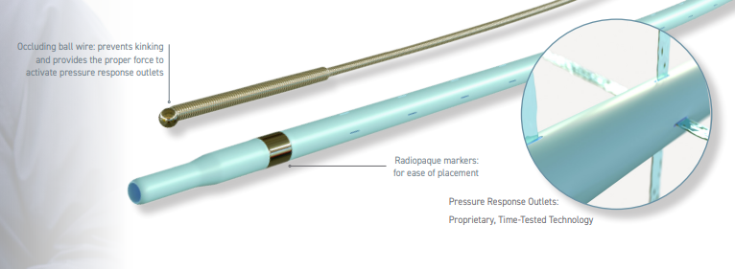
Uni-fuse (Angiodynamics)
Infusion catheters
4, 5 fr catheters
035 wire compatible
Shaft length – 45, 90, 135 cm
Infusion lengths – 2, 5, 10, 15, 20, 30, 40, 50 cm
Pressure response outlets
Ball-valve occlusion wire occludes the catheter -> directs flow out the side holes.

Slide 13
Micro Mewi Infusion Catheter
(Medtronic)
2.9 Fr catheter
018 wire compatible
Shaft length – 150, 180 cm
Infusion lengths – 5 cm, 10 cm
Flexible and trackable distal segment to navigate tortuosity.
Multiple side holes.
Platinum radiopaque markers for precise placement.

Slide 14
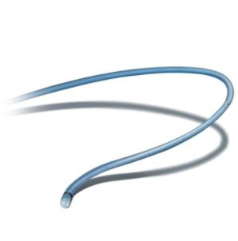
Cragg-McNamara Valved Infusion Catheter
(Medtronic)
4,5 Fr catheter
035, 038 wire compatible
Shaft length – 40, 65, 100, 135
Infusion lengths – 5 - 50 cm
Can infuse with or without guidewire

Slide 15
Pro stream infusion wire
(Medtronic)
035, 038 wire
Small profile to reach distal vessels
Wire lengths - 145, 175
Infusion lengths – 6, 9, 12 cm
1 Polyimide tube
2 Outer Teflon layer
3 Integral core wire
4 Platinum radiopaque markers
5 Spiral-patterned sideholes
6 Stainless steel core

Slide 16
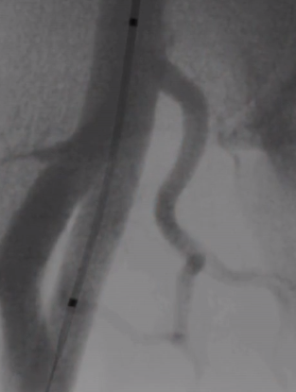
Fountain Infusion Catheter
(Merit Medical Systems)
4 Fr catheter
Shaft length - 90 or 135 cm
infusion lengths - 5 to 50 cm
Multiple side holes (distribute the lytic agent throughout the thrombus).
Ball-valve occlusion wire

Slide 17
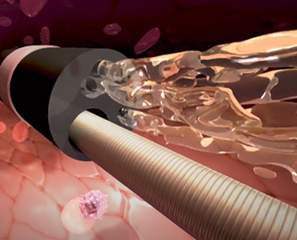
ND (Nabil Dib)
Translational Research Institute (TRI)
6 fr Catheter
014 compatible
Expandable balloon to control blood flow during infusion through a multilumen spray tip
TAPAS (Targeted Adjustable Pharmaceutical Administration system)
THERMOPEUTIX, INC
7 Fr catheter
014 wire compatible

Slide 18
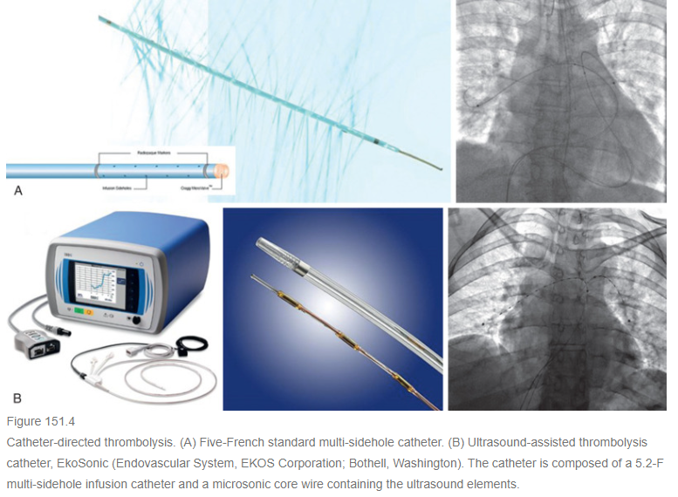

Slide 19
Catheter Directed Thrombolysis (CDT)
Continuous infusion/low dose →
1-5 mg bolus, followed by a continuous infusion of 0.5 to 1 mg/h for 18-24 hrs (max 72) (~ 25–50 cc/hour of a 10 mg/500cc normal saline solution).
Heparin is administered through the proximal side port of the sheath at 300 to 500 units/h.
If there is no progress in recanalization of the lesion, dosage could be increased by 1 mg/h
Perform check angiogram the following day.

Slide 20
High-dose/pulse spray regimen
10-mg in 50 ccs bolus of tPA over 5 minutes
Continuous infusion at 0.05 mg/kg/hr with a maximum dose of 4 mg/h.
Repeat angiography in 6 hours
Allowed to dwell for 20 minutes and aspirated
Catheter should remain intraluminal.

Slide 21
Monitoring
Intensive care unit monitoring
Hourly neurovascular checks
Labs every 4-6 hr
Hemoglobin, platelet count, fibrinogen, aPTT, FDP.
Discontinue if fibrinogen level drops to less than 100 mg/dL
Discontinue if FDP > 400

Slide 22
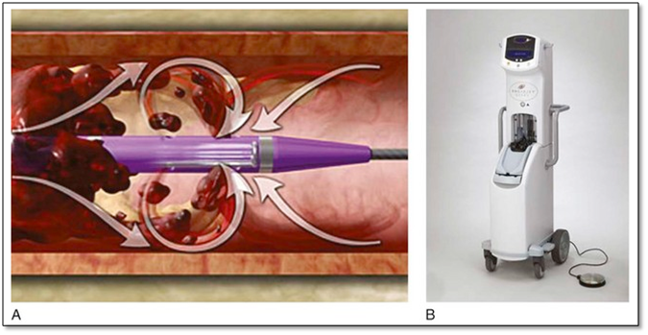
AngioJet combines rheolytic thrombectomy and power pulse spray
Catheter is primed in its “thrombectomy mode” with normal saline.
Lytic bag is created by adding either 10mg tPA to
50cc of normal saline
Advance the RT catheter slowly, at 0.5 to 1.0 mm increments through the entire thrombosed segment
Single foot pedal pump/pulse per advanced increment.
Allowed to lyse for 30 minutes

Slide 23
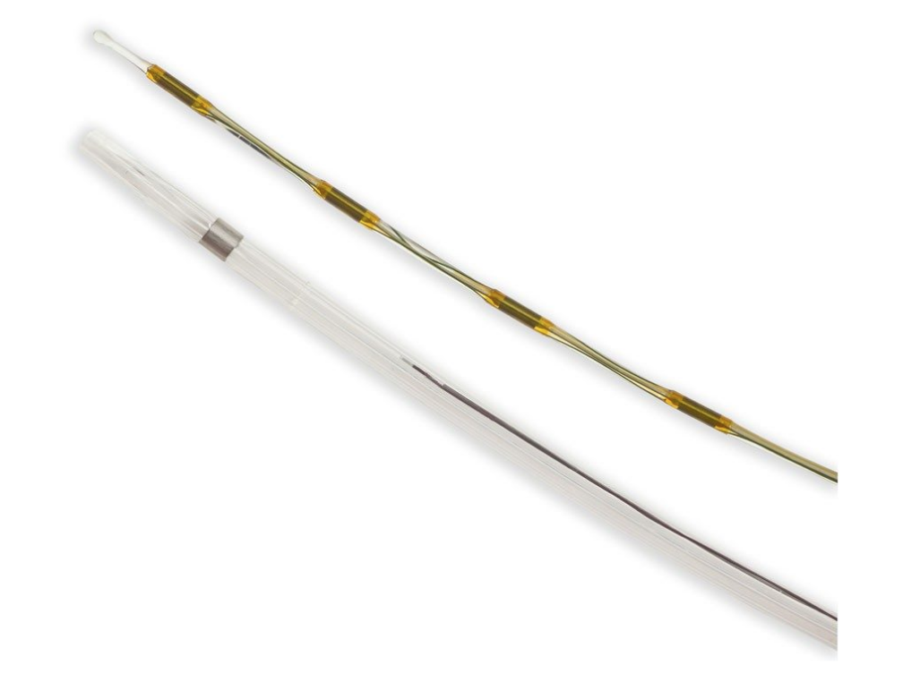
Ultrasound Enhanced Thrombolysis
EkoSonic Endovascular System (EKOS)
Multi-sidehole drug infusion catheter + multielement ultrasound core wire
5.4 Fr catheter
Catheter length: 106 cm, 135 cm
Treatment zone: 6, 12, 18, 20, 24, 30, 40, 50 cm

Slide 24
Thank you!

