Slide 1
Cardiac Cath Lab Volume at MSH
Procedures Over Last Five Years
Total Cath Lab Procedure Volume
Cath Only
Interventions
Biopsies
4.3%
N
3.3%

Slide 2
Interventional Volume & Major Complications 2017-21
Coronary Interventions (PCI)
Endovascular Interventions (PTA)
Major complication: N = 24 32 25 13 16
Major complication: N = 1 0 0 1 0
3.4%
1.0%
N
N
Valvuloplasty (BAV/BMV)
TAVR/TAVI
Major complication: N = 3 2 3 4 1
Major complication: N = 8 10 10 15 9
Septal Ablation = 4
MitraClip = 52
TMVR = 3
TriClip = 5
TTVR = 3
PFO/ASD Closure = 24
22.4%
N
10.5%
N
BMV-18 BMV-16 BMV-13 BMV-8 BMV-5

Slide 3
Safety of PCI at MSH Cath Lab
MSH: Temporal Trends in Complications of PCI
2017 (n= 3347)
2018 (n= 3415)
2019 (n= 3701)
2020 (n= 2989)
2021 (n= 3829)
For last 5 yrs+;
<0.5% in-hospital mortality
<0.1% need for urgent CABG
<1.0% major complications of PCI
3816 of 3829 pts in 2021 were discharged alive
%
n=11
n=10
n=8
n=8
n=13
In-hospital death Urgent CABG Q-wave/Large MI Major Complications
(death, uCABG, MI, CVA)

Slide 4
PCI Complications: MSH vs. NY State Hospitals
Mount Sinai Hospital (N=3782) 2021
NY State Hospitals (N=51,979) 2017
%

Slide 5
PCI Complications: MSH vs. ACC-NCDR Hospitals
2020Q3 - 2021Q2
Mount Sinai Hospital (N=3616)
ACC-NCDR Hospitals (N=1,095,111)
%
Risk-adjusted In-hosp death eCABG Stroke Major compl Risk LOS (days)
In-hosp death STEMI pts of PCI standardized
all pts bleeding

Slide 6
National PCI Outcome Metrics; Major Complications
Composite: Proportion of PCI Patients with Death, eCABG, Stroke or eTVR; MSH vs. ACC-NCDR (n=1600 hospitals) for 2020Q3 - 2021Q2
<15% of the national average
%
(n= 3616) (n=1,095,111)

Slide 7
Complex Coronary Interventions 2021
Atherectomy Cases
Impella Cases
%
N
(n=822) (n=748) (n=854) (n=540) (n=934)

Slide 8
Complex Coronary Cases Supported by:
Abbott Vascular Inc.
Boston Scientific Corp.
Terumo Vascular Corp.
Cardiovascular Systems Inc.
Abiomed Inc.
Chiesi Inc.
Shockwave Medical Inc.
Cardinal Health Cordis Inc.

Slide 9
Disclosures
Samin K. Sharma, MD, MSCAI, FACC
Speaker’s Bureau – BSC, Abbott, CSI
Annapoorna S. Kini, MD, MRCP, FACC
Nothing to disclose
Sameer Mehta, MD, FACC (Moderator)
Nothing to disclose

Slide 10
CCC Live Case # 151
Patient Demographics
68 yrs, Female s/p PCI 2005
Present Clinical Presentation
Presented with new onset CCS class III angina for few months and strongly + SPECT MPI for multivessel ischemia
CAD Risk Factors
Controlled Hypertension
Controlled Hyperlipidemia
SAQ-7: 52
Obese
Clinical Variables
Known CAD s/p PCI of mLAD 2005. Stable since then on MT
Medications
Aspirin, Clopidogrel, Metoprolol XL, Losartan-HCTZ, Atorvastatin, Ezetimibe
Cath: Cath on 12/20/2021 revealed 3 V+LM CAD and patent mLAD PCI site: 80% distal LM (1,0,0) with 70% proximal LAD, 90% prox LCx, 95% prox RCA and 90% RPDA, LVEF 60% and Syntax score 32. After Heart team discussion, pt opted for MV staged PCI and underwent successful PCI of 2 lesions of RCA using Promus Elite DES. Now rSS is 26. Pt still has CCS class II angina on added MT of Amlodipine.
Plan: Now planned for staged imaging guided DES PCI of LMCA and LAD/LCx lesions with Mini-Crush technique.

Slide 11
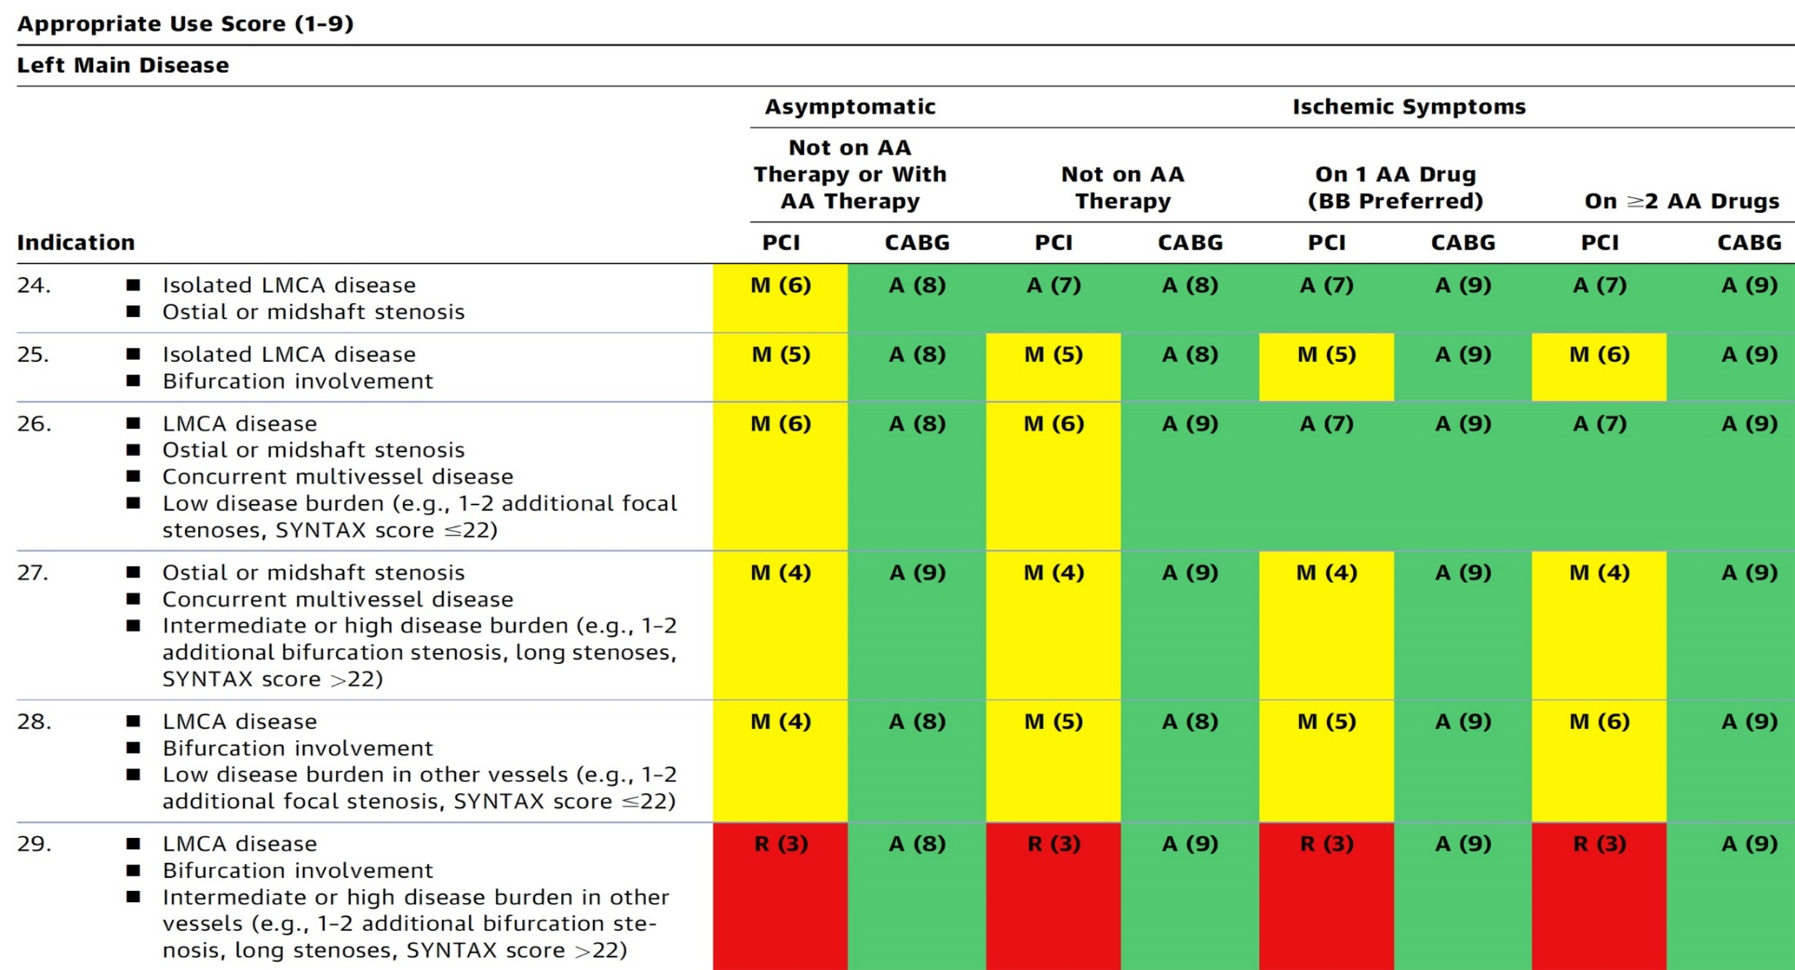
AUC 2017: Left Main Coronary Artery Stenosis
After Heart team discussion: A
Patel et al., J Am Coll Cardiol 2017;69:2212

Slide 12
Latest Issues in Coronary Intervention
Interventional Presentations TCT/AHA 2021;
OPTIMUM registry, DES vs CABG in LM CAD,
Ultrathin vs Newer 2nd Gen DES meta-analysis
Focused review of the month
Impact of Lesion Ca++ on mortality:
10-Year all-cause mortality following PCI or CABG in
patients with heavily calcified lesions

Slide 13
Latest Issues in Coronary Intervention
Interventional Presentations TCT/AHA 2021;
OPTIMUM registry, DES vs CABG in LM CAD,
Ultrathin vs Newer 2nd Gen DES meta-analysis
Focused review of the month
Impact of Lesion Ca++ on mortality:
10-Year all-cause mortality following PCI or CABG in
patients with heavily calcified lesions

Slide 14
Outcomes of Percutaneous RevascularizaTIon for Management of SUrgically Ineligible Patients with Multivessel or Left Main Coronary Artery Disease: Primary Results from the OPTIMUM Registry

Slide 15
OPTIMUM Registry: Perspective - Surgical Ineligibility & Complex Left Main/Multivessel Coronary Disease
Increasing prevalence: 1 in 5 patients with left main and/or multivessel disease may be deemed surgically ineligible¹
Increasing sensitivity to public reporting of outcomes and physician metrics
Historical sense of PCI as default therapy
Many factors that influence decision for operative ineligibility not captured in risk models
Societal guidelines offer limited, if any, decision making in complex coronary disease when surgery is not an option
Surgical turndown patients are systematically excluded from clinical trials; no data regarding health status outcomes following PCI procedures in these pts
When selected for PCI, no consensus regarding goals of interventional revascularization (e.g, complete revascularization versus ‘targeted’ PCI)
¹Waldo et al., Circulation 2014;130:2295; ²Brennan et al., J AM Coll Cardiol Intv 2013;6:790

Slide 16
OPTIMUM Registry Study Design Outcomes of Percutaneous Revascularization for Management of Surgically Ineligible Patients with Multivessel or Left Main Disease
750 surgically ineligible patients by Heart Team
enrolled at 22 US centers
PCI, N=726
Medical Therapy, N=24
1º Objective: 30-day/in-hospital mortality in PCI cohort compared with predicted STS surgical risk
Key 2º Objectives
30-day/in-hospital mortality in PCI cohort compared with (1) EuroSCORE II and (2) Surgeon’s predicted risk
SAQ, KCCQ at 6 and 12 months
12 month SAQ PCI complete vs incomplete revascularization
Additional Endpoints:
Reasons for determination of CABG ineligibility
Completeness of revascularization and predictors
Predictors of survival and health status
30-day, 6 month and 1 year clinical, health status and economic outcomes
Survival through 5 years

Slide 17
OPTIMUM Registry: Key Enrollment Criteria and Trial Conduct
Inclusion Criteria
Age ≥ 18 years
Unprotected left main stenosis of ≥50%, 3 vessel disease (stenoses ≥70%) or 2 vessel coronary disease (≥70%) with one lesion involving the proximal left anterior descending artery
Patients with prior bypass surgery: ≥2 epicardial coronary distributions subtended by a severe native coronary stenosis with either no bypass graft supplying the vessel, a severely diseased (≥70% angiographic stenosis) bypass graft supplying the affected vessel
Heart Team determination for coronary bypass surgery ineligibility
Exclusion Criteria
Presentation with STEMI, ventricular arrhythmia or hemodynamic instability
Expected survival of <1 year or any condition that would preclude ability for 1-year follow-up
Clinical events site reported with source document verification and adjudication of 30-day events
Patient-reported health status outcomes at 6 months and 1 year
Independent Angiographic Core Laboratory: Cardiovascular Research Foundation, NY, NY
Independent Clinical Events Adjudication: Mid America Heart Institute, Kansas City, MO
Kandazari D, TCT 2021

Slide 18
OPTIMUM: Risk Characteristics and Reasons for Surgical Ineligibility
 | N= 726
Poor distal target/conduit | 18.9%
Severe LV dysfunction/non-viable myocardium | 16.8%
Severe lung disease | 10.1%
Frailty/immobility | 9.7%
Prior sternotomy | 8.7%
Advanced age | 6.1%
Prior stroke/severe cerebrovascular disease | 3.9%
Severe aortic calcification | 3.4%
Renal impairment | 3.2%
End-stage liver disease | 2.2%
Morbid obesity | 1.9%
Malignancy | 1.5%
Systemic infection | 1.4%
Other | 12.4%
Kandazari D, TCT 2021

Slide 19
OPTIMUM Registry: Angiographic and Procedural Characteristics
Angiographic Characteristics | N= 726
Calcification, severe | 82.5%
Bifurcation | 80.2%
CTO | 56.9%
Any lesion ≥20 mm | 78.5%
Total lesion length (mm) | 74.2 ± 46.4
SYNTAX Score (baseline) | 32.4 ± 12.2
Low (0-22) | 21.8%
Intermediate (23-32) | 32.8%
High (≥33) | 45.3%
Procedural Characteristics | N= 726
Stents/patient | 3.2 ± 1.9
Left main PCI | 38.2%
CTO PCI | 20.3%
Atherectomy | 32.0%
Hemodynamic support | 27.0%
Intravascular imaging* | 63.9%
Procedural complications (MI, CIN, perforation, emergency surgery, bleed) | 9.8%
Kandazari D, TCT 2021

Slide 20
OPTIMUM Registry: Procedural Outcomes
Baseline and Post-PCI Total SYNTAX Scores
Baseline and Post-PCI SYNTAX Scores
50
100
9.3
40
80
15
45.3
30
32.4
60
Syntax Score
Percent of Patients (%)
20
40
32.8
75.7
15
10
20
21.8
0
0
Pre
Post
Pre
Post
Post SYNTAX Score ≤8 34.3%
Post SYNTAX Score 0 11.4%
Low (≤22)
Intermediate (23-32)
High (≥33)
*p-value represents McNemar-Bowker Test
Kandazari D, TCT 2021

Slide 21
OPTIMUM Registry: Surgical Risk Prediction,
30-Day / In-Hospital Mortality
 | N= 726
STS Predicted Mortality | 5.3 ± 5.7
EuroSCORE II Predicted Mortality | 5.7 ± 5.4
Surgeon’s Predicted Mortality | 10.4 ± 12.3
Data expressed as percent
Kandazari D, TCT 2021

Slide 22
OPTIMUM Registry: Surgical Risk Prediction,
30-Day / In-Hospital Mortality
 | N= 726
STS Predicted Mortality | 5.3 ± 5.7
EuroSCORE II Predicted Mortality | 5.7 ± 5.4
Surgeon’s Predicted Mortality | 10.4 ± 12.3
Observed 30-day/In-hospital Mortality | 5.6
Data expressed as percent
Kandazari D, TCT 2021

Slide 23
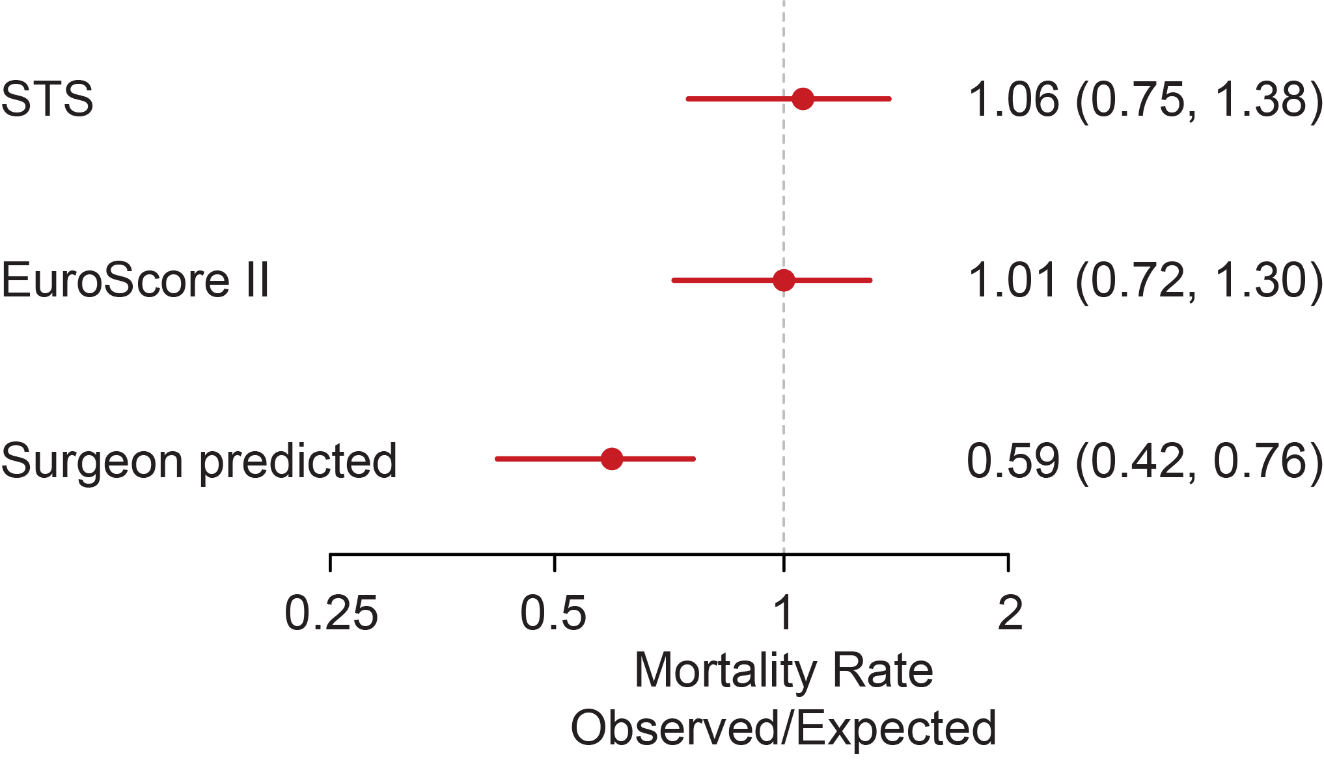
OPTIMUM Registry: 30-Day/In-Hospital Mortality and Observed/Expected Estimates
 | N= 726
Death, 30 Days | 5.6%
In-hospital | 3.0%
Post-discharge | 2.6%
Death, 6 Months | 12.3%
Kandazari D, TCT 2021

Slide 24
OPTIMUM Registry: Patient-Reported Health Status
Baseline and 6-Month Health Status
Baseline and 6-Month SAQ Angina Frequency
p<0.0001
p<0.0001
p<0.0001
p<0.0001
%
Kandazari D, TCT 2021

Slide 25
OPTIMUM Registry: 30-Day Mortality and 6-Month Change in Health Status According to Completeness
of Revascularization (rSS)
%
%
rSYNTAX score ≤8
rSYNTAX score >8
Kandazari D, TCT 2021

Slide 26
OPTIMUM Registry: Risk Characteristics of
30-Day/In-Hospital Death and Survival Alive
 | Death N= 41 | Alive N= 685 | P value
Age | 73.5 ± 8.5 | 69.8 ± 11.0 | 0.03
STS Mortality | 9.0 ± 8.7 | 5.1 ± 5.3 | <0.001
EuroScore II | 9.2 ± 8.4 | 5.5 ± 5.1 | <0.001
Surgeon’s Mortality Estimate | 14.1 ± 17.0 | 10.2 ± 11.9 | 0.055
Hemodynamic Support | 61.0% | 24.7% | <0.001
Prior MI | 70.7% | 46.9% | 0.002
NYHA Class III/IV Heart Failure | 94.1% | 65.3% | 0.014
LVEF | 36.4 ± 15.9 | 43.0 ± 16.3 | 0.03
NSTEMI | 84.0% | 64.2% | 0.04
Procedural Complications | 19.5% | 9.2% | 0.050
Chronic Kidney Disease | 51.2% | 36.4% | 0.055
Prior CABG | 9.8% | 16.8% | 0.24
Mod/severe Mitral Regurgitation | 31.6% | 22.9% | 0.22
History of Stroke | 7.3% | 14.2% | 0.22
Chronic Lung Disease | 36.6% | 32.0% | 0.54
Residual SYNTAX Score <8 | 24.3% | 34.9% | 0.19
Kandazari D, TCT 2021

Slide 27
OPTIMUM Registry: Outcomes of PCI revascularization
for Management of Surgically Ineligible Patients with Multivessel or Left Main Disease
Patients deemed prohibitive risk for CABG who undergo PCI have complex clinical profiles and high disease burden that are incompletely represented by surgical prediction models
Following complex PCI, short-term mortality rates are similar to predicted mortality using surgical risk models, but considerably lower than the evaluating surgeon’s estimates
PCI is associated with significant, meaningful improvements in patients’ symptom burden, physical function and quality of life
Findings underscore the potential of PCI to improve patients’ health status if it can be performed safely, even if surgery is not an option
These findings inform decision making and outcomes for a high-risk and largely unstudied patient population relative to risk/benefit, procedural strategies and completeness of revascularization with complex PCI
Kandazari D, TCT 2021

Slide 28
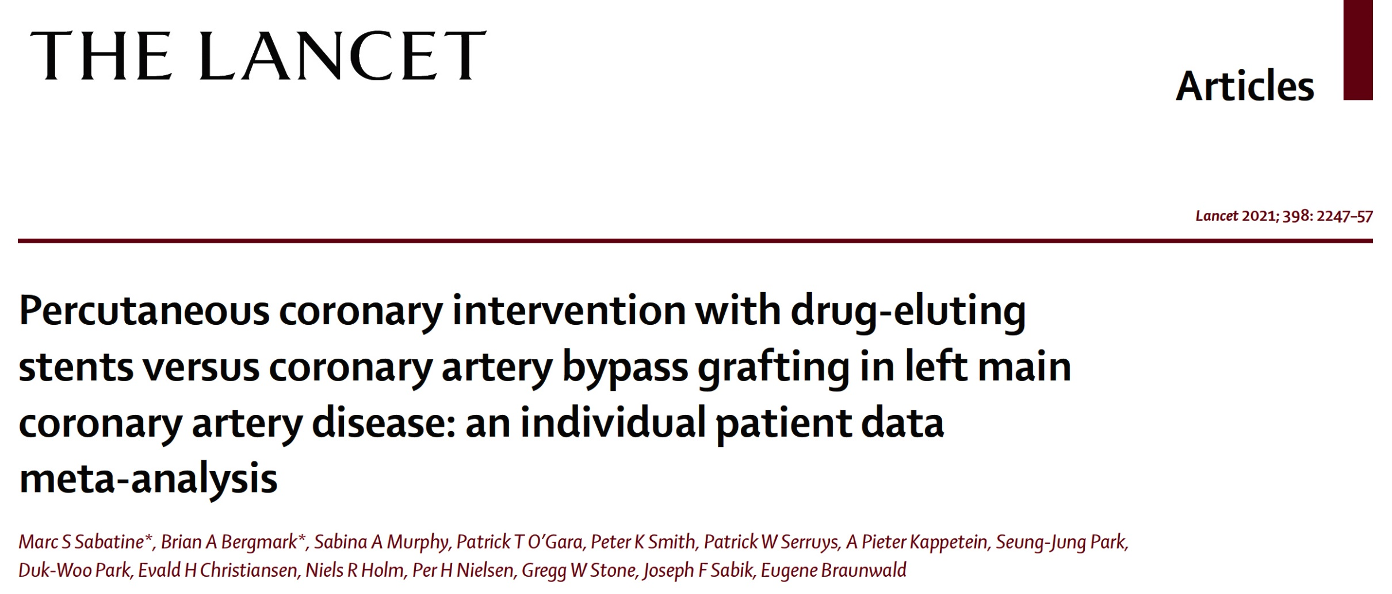
4 RCT of LM CAD: SYNTAX, PRECOMBAT, NOBLE, EXCEL
4394 pts, median Syntax score 25, 5-10yrs F/U

Slide 29
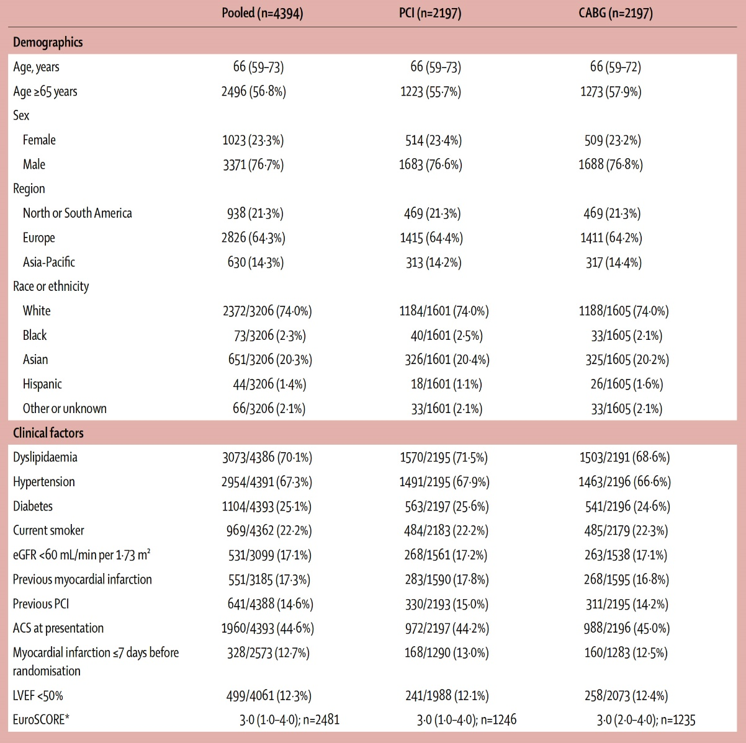
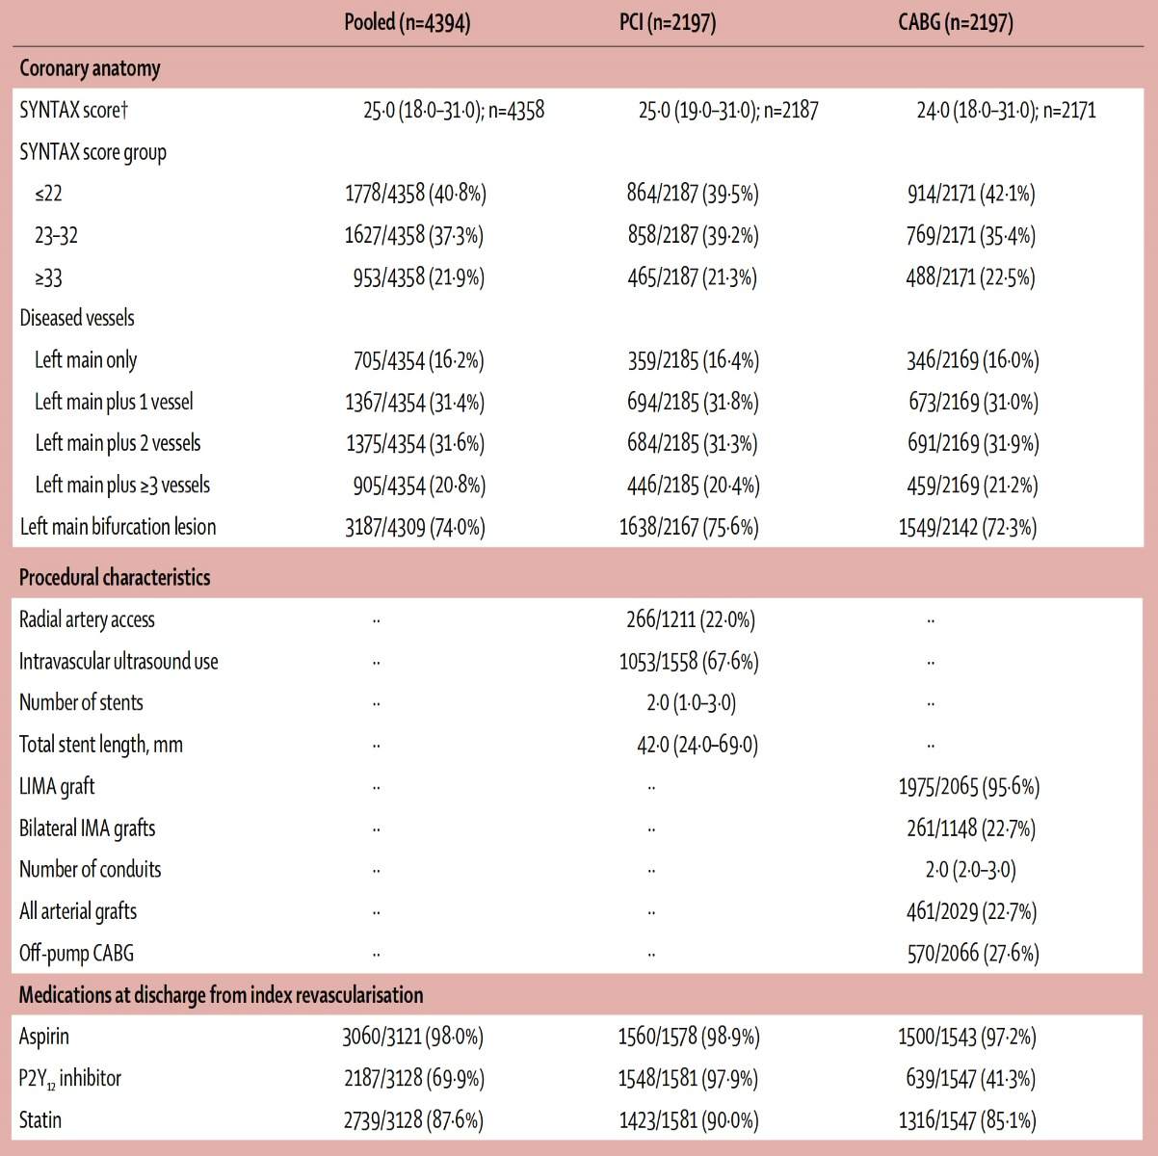
Baseline Patient Characteristics
PCI DES vs CABG in LM CAD
Sabatine et al., Lancet 2021;398:2247

Slide 30
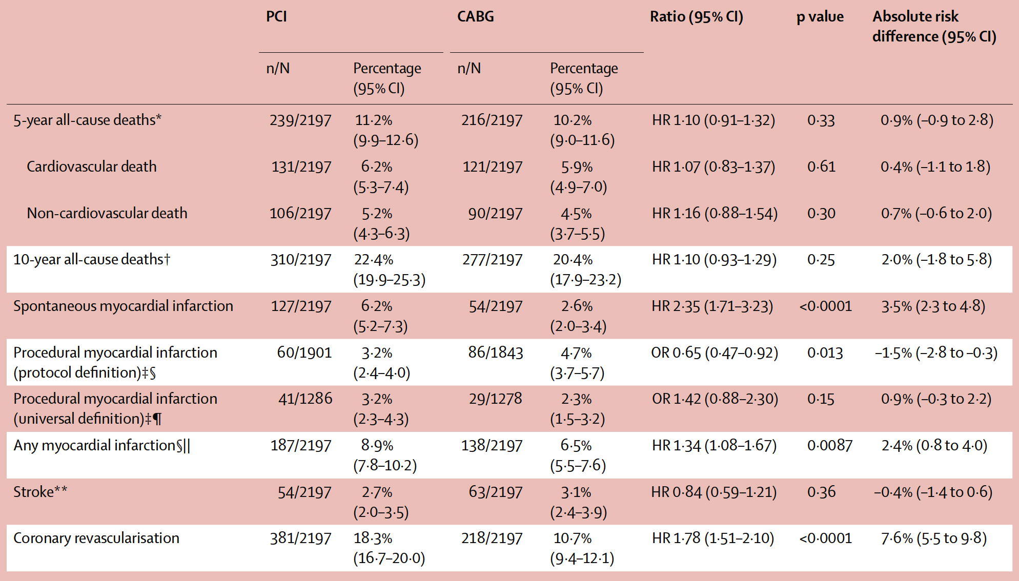
Long-term Clinical Outcomes
PCI DES vs CABG in LM CAD
Sabatine et al., Lancet 2021;398:2247

Slide 31
Long-term Clinical Outcomes
PCI DES vs CABG in LM CAD
p=0.25
p<0.0001
p=0.33
p=0.009
%
p=0.36
Sabatine et al., Lancet 2021;398:2247

Slide 32
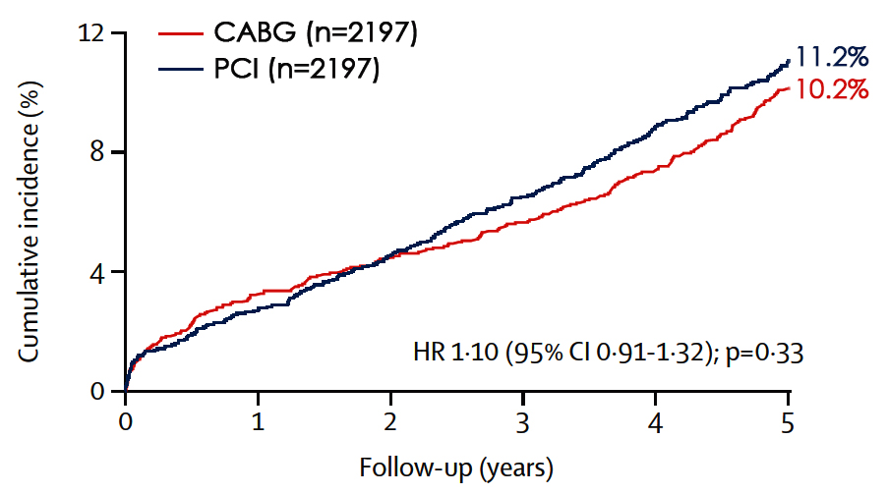
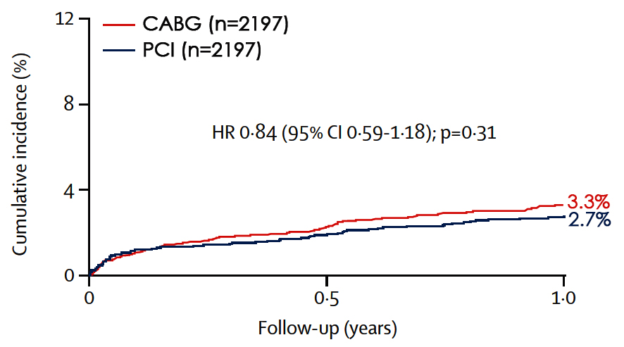
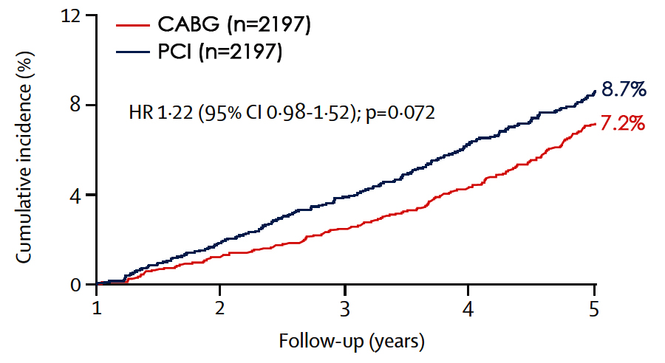
Cumulative Incidence of All-Cause Death
0-5 Years
0-1 Year
1-5 Years
Sabatine et al., Lancet 2021;398:2247

Slide 33
Long-term Clinical Outcomes
PCI DES vs CABG in LM CAD
p=0.25
p<0.0001
p=0.33
p=0.009
%
p=0.36
Sabatine et al., Lancet 2021;398:2247

Slide 34
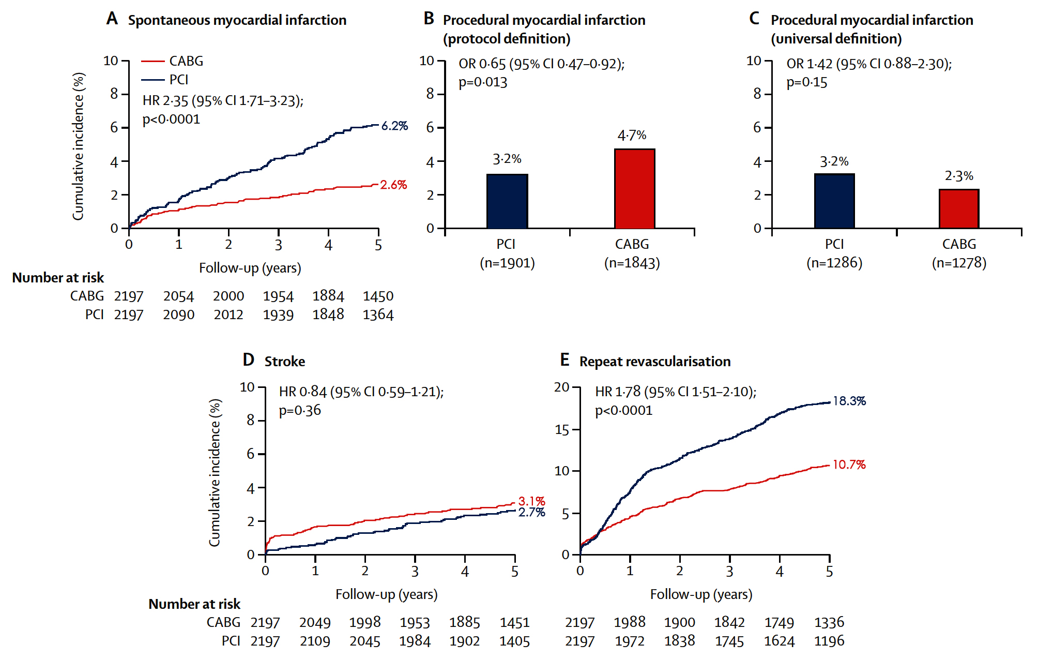
Cumulative Incidence of Key Clinical Outcomes
Sabatine et al., Lancet 2021;398:2247

Slide 35
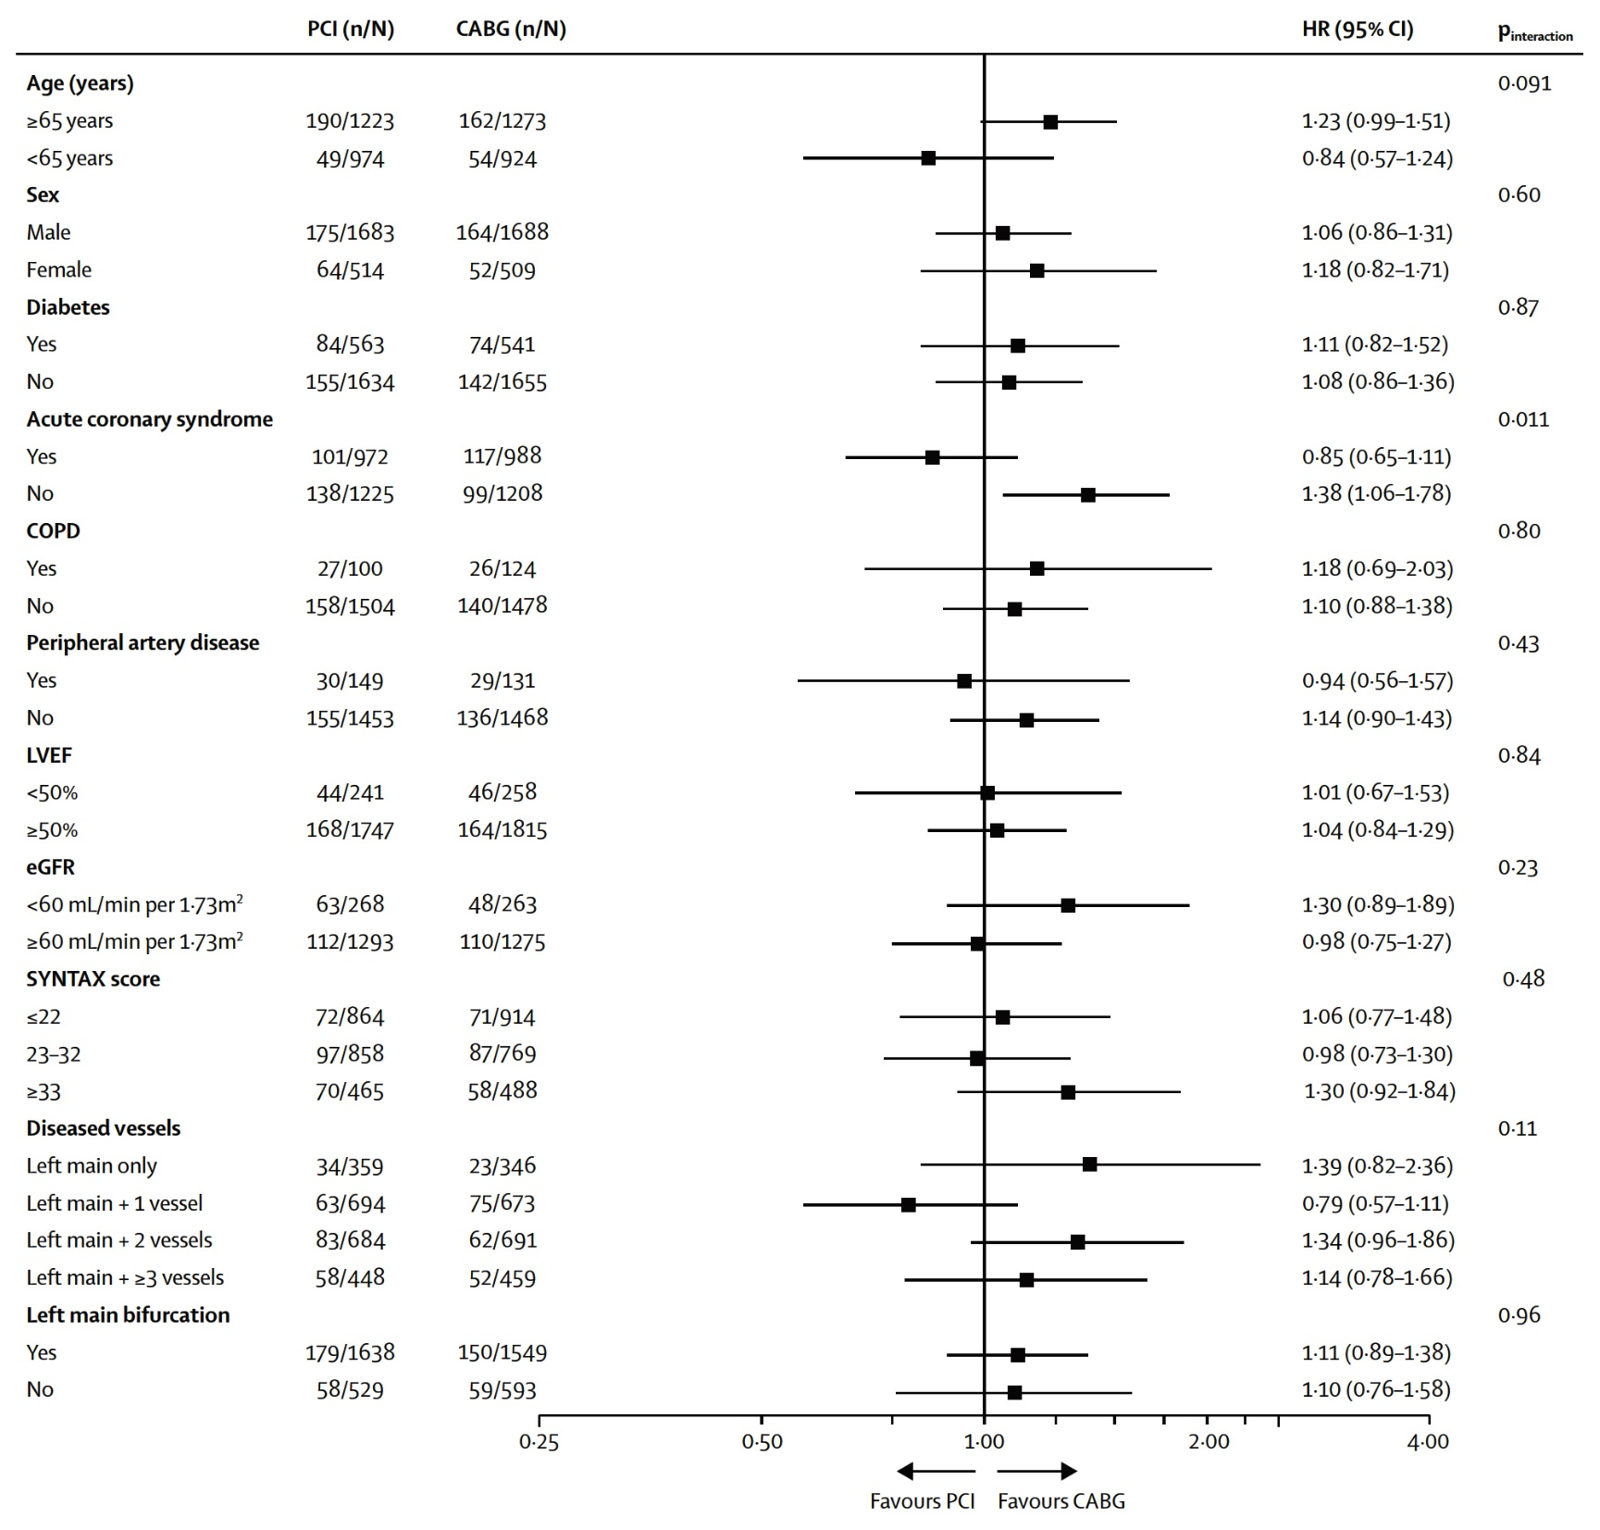
5-Year All-Cause Deaths in Key Subgroup
Sabatine et al., Lancet 2021;398:2247

Slide 36
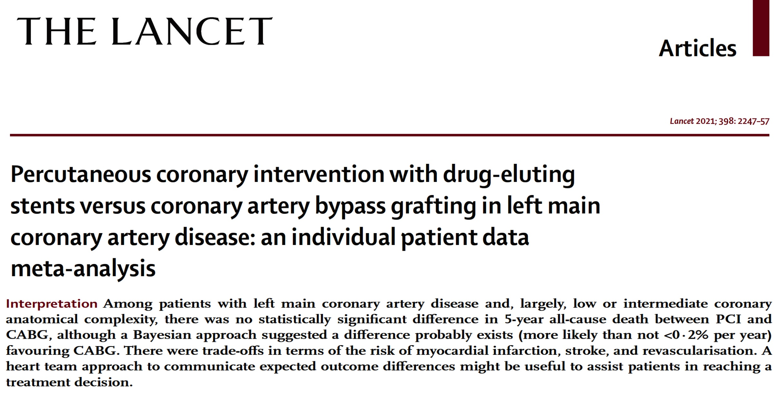

Slide 37
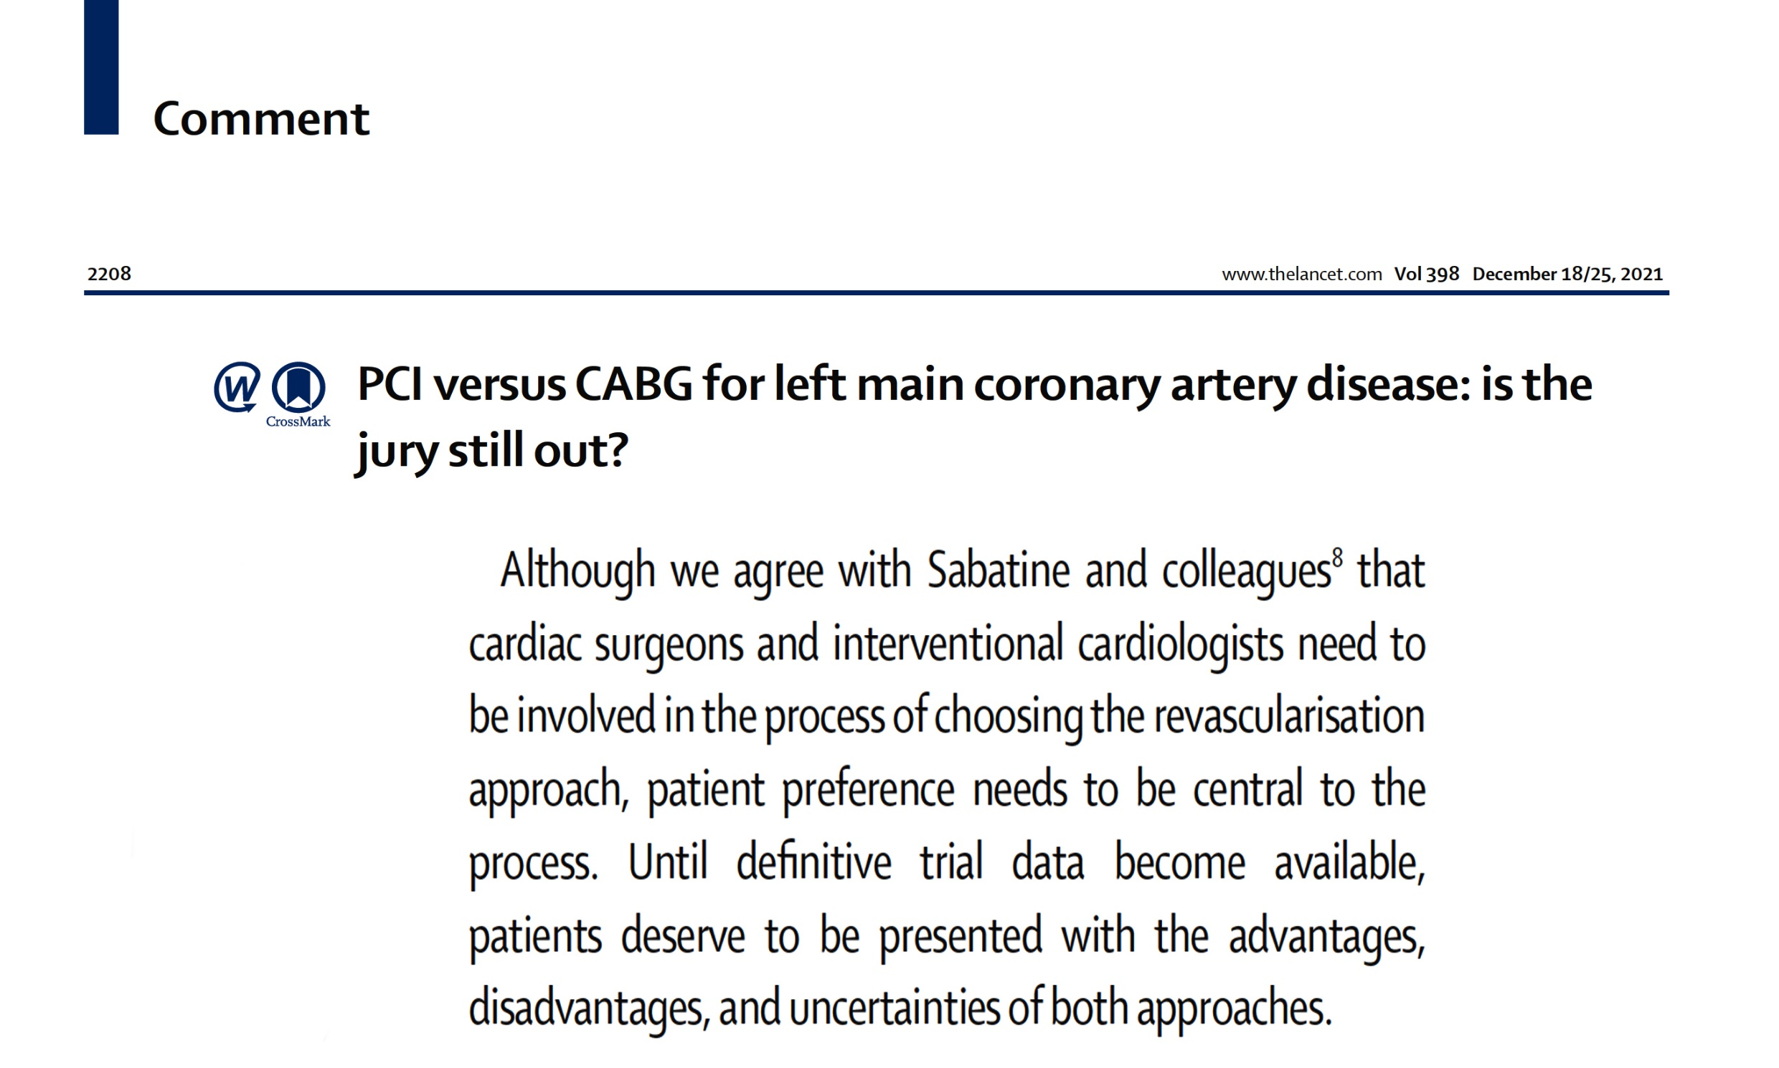

Slide 38
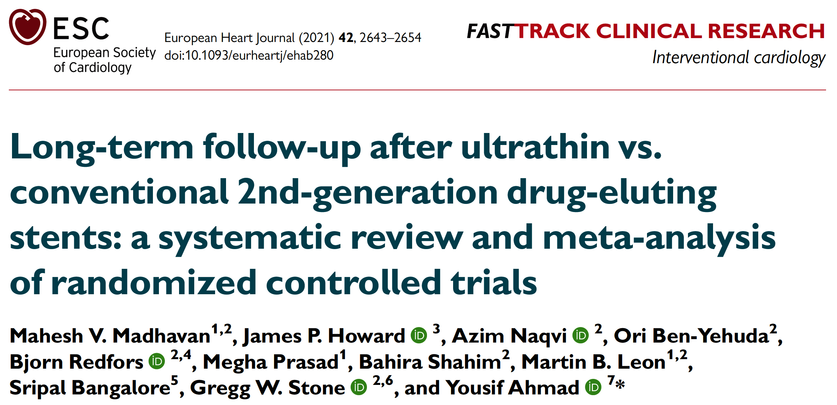

Slide 39
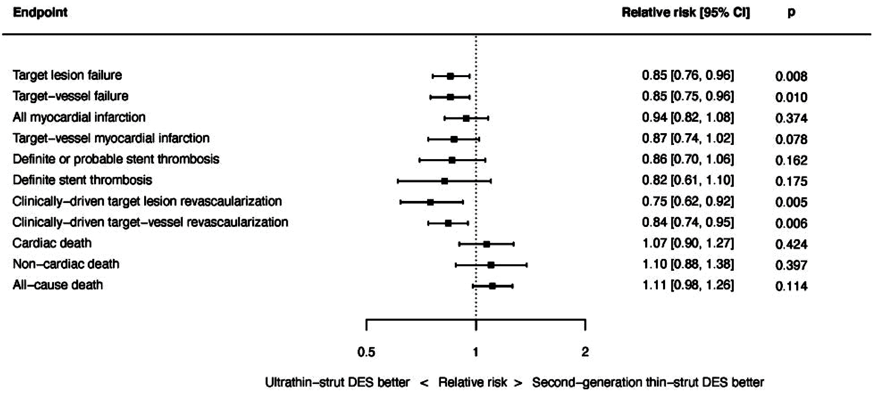
Ultrathin (<70 µm) vs Newer (thinner) 2nd Generation DES
16 Eligible Trials and 20,701 Patients with Mean Follow-up of 2.5 Years
Madhavan et al., Eur Heart J 2021;42:2643

Slide 40
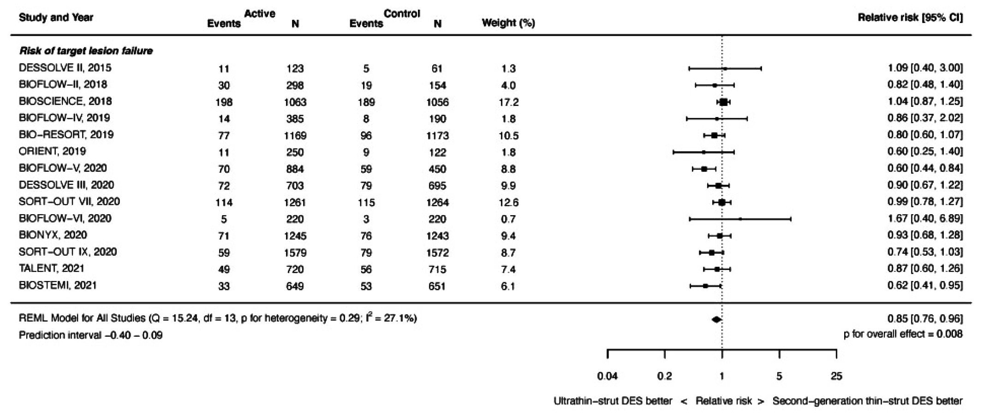
Risk of TLR at Latest Follow-Up
Madhavan et al., Eur Heart J 2021;42:2643

Slide 41
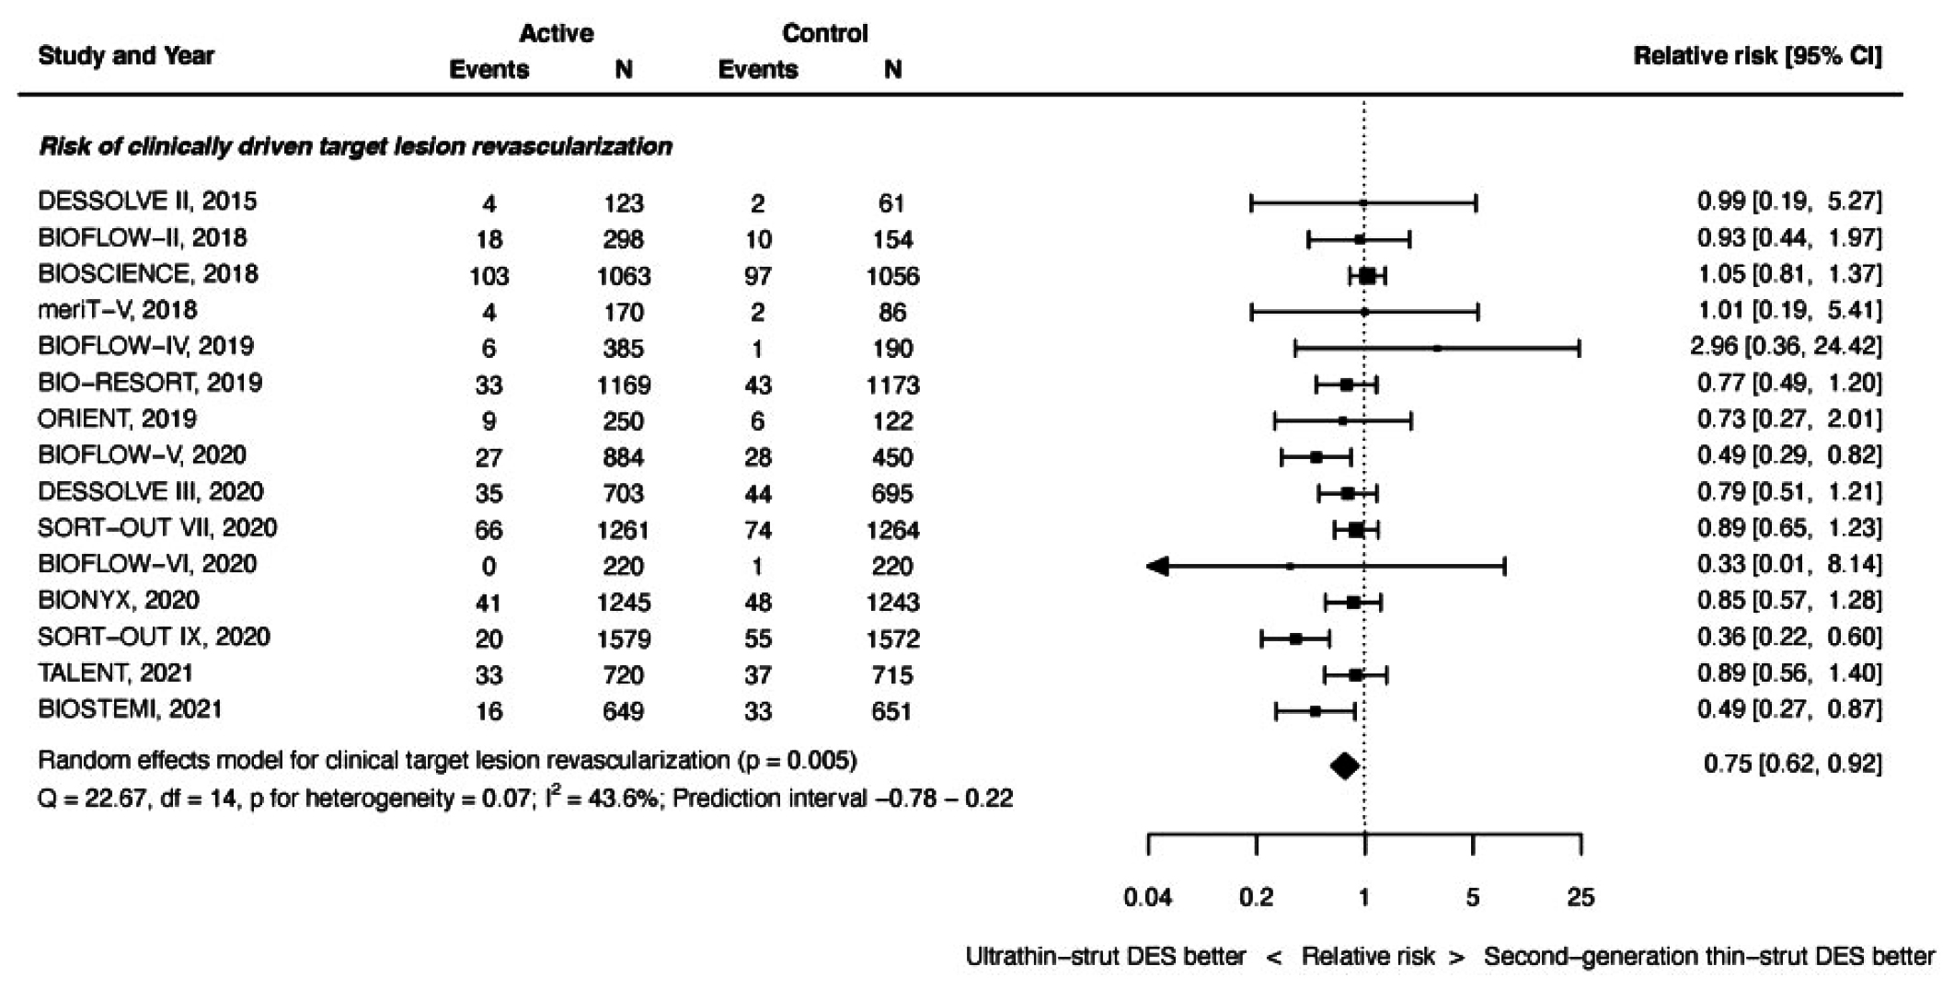
Risk of CD-Revasc at Latest Follow-Up
Madhavan et al., Eur Heart J 2021;42:2643

Slide 42
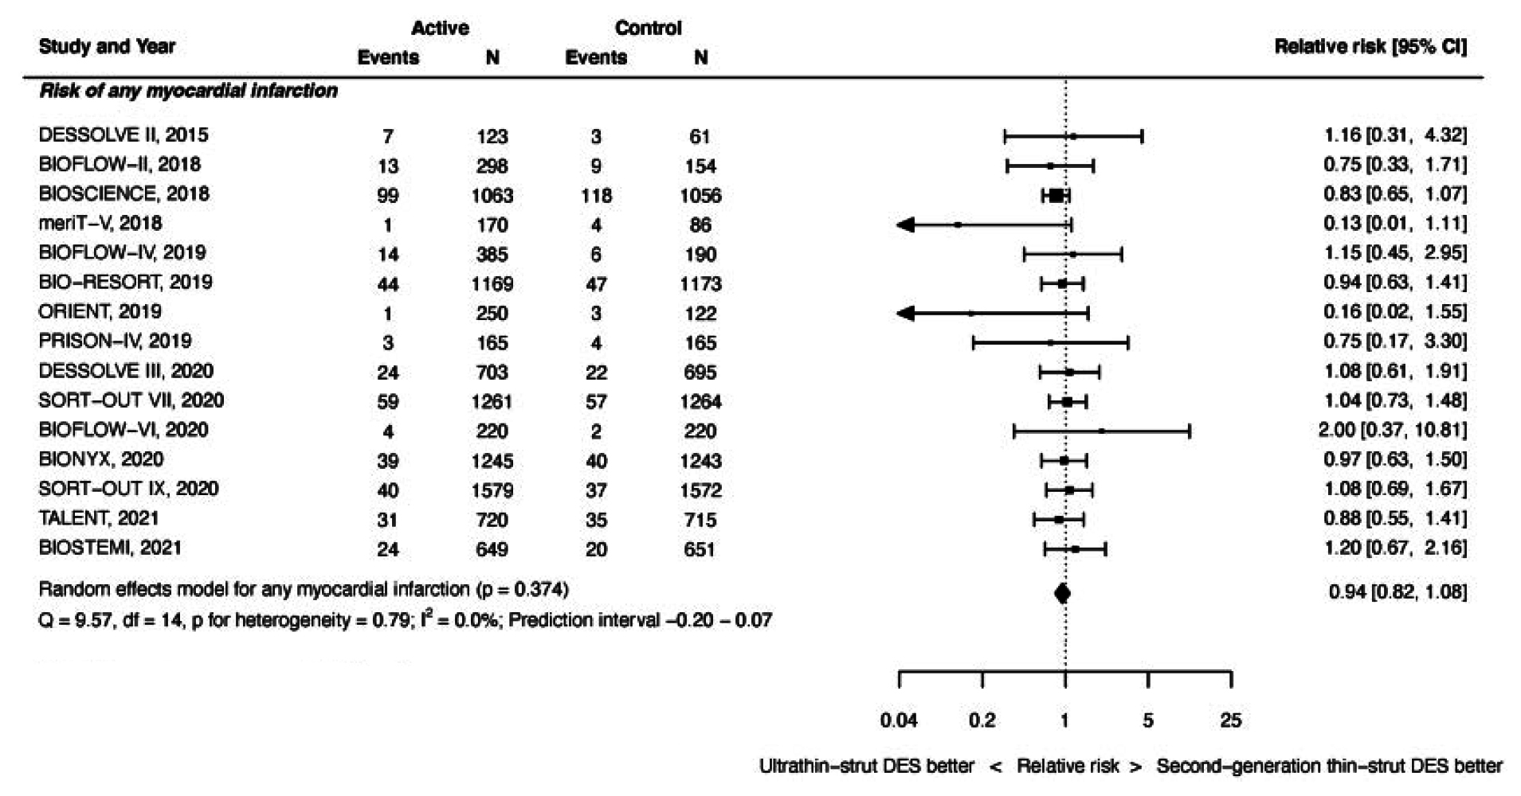
Risk of MI at Latest Follow-Up
Madhavan et al., Eur Heart J 2021;42:2643

Slide 43
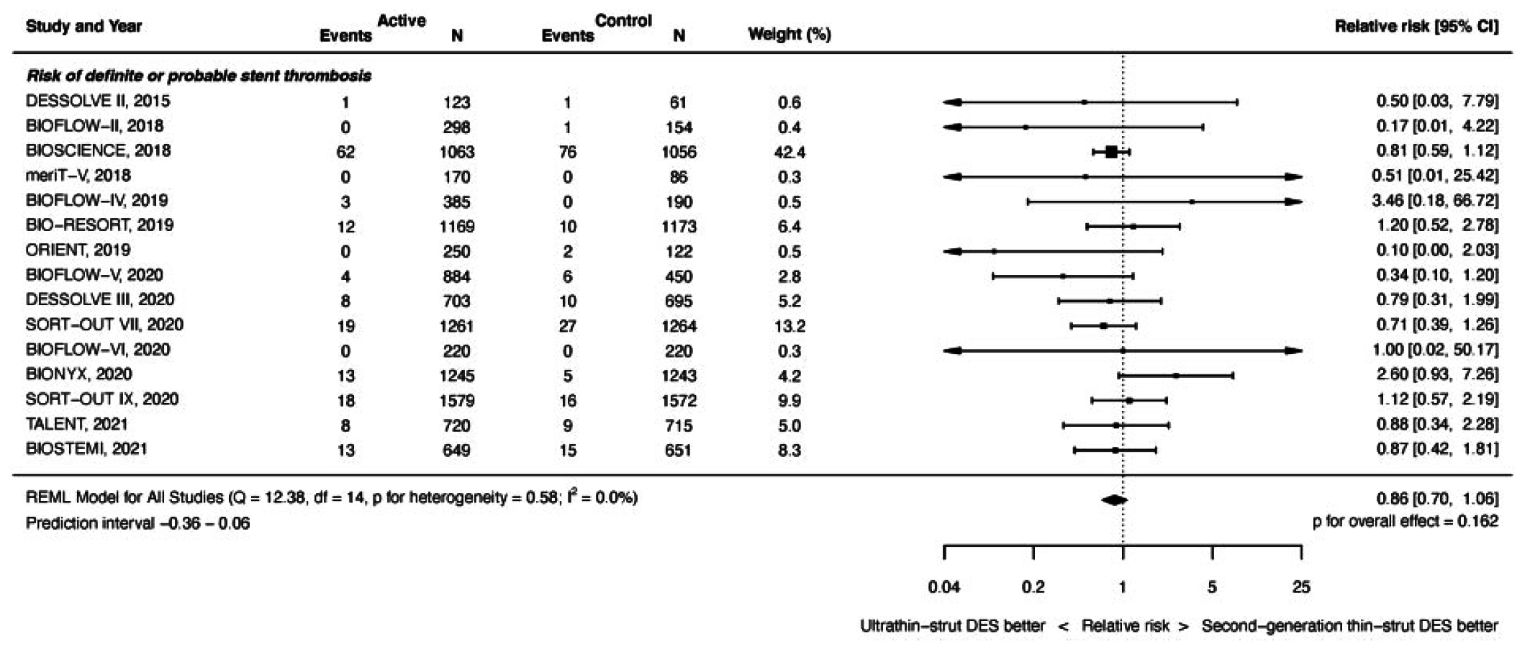
Risk of Def/Prob ST at Latest Follow-Up
Madhavan et al., Eur Heart J 2021;42:2643

Slide 44
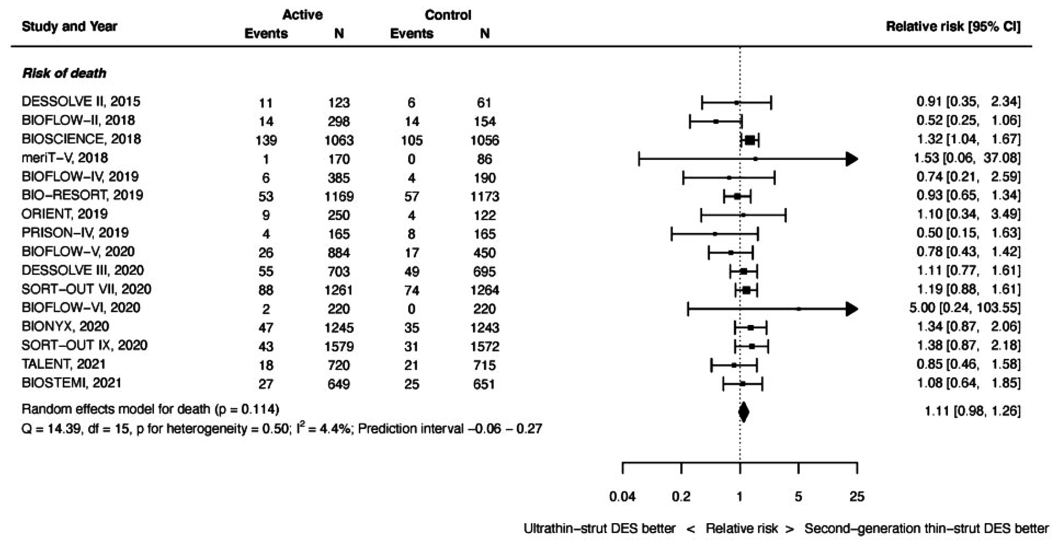
Risk of Death at Latest Follow-Up
Madhavan et al., Eur Heart J 2021;42:2643

Slide 45
Ultrathin (<70 µm) vs Newer (thinner) 2nd Generation DES
16 Eligible Trials & 20,701 Patients with Mean Follow-up of 2.5 Yrs
Madhavan et al., Eur Heart J 2021;42:2643

Slide 47
Latest Issues in Coronary Intervention
Interventional Presentations TCT/AHA 2021;
OPTIMUM registry, DES vs CABG in LM CAD,
Ultrathin vs Newer 2nd Gen DES meta-analysis
Focused review of the month
Impact of Lesion Ca++ on mortality:
10-Year all-cause mortality following PCI or CABG in
patients with heavily calcified lesions

Slide 48
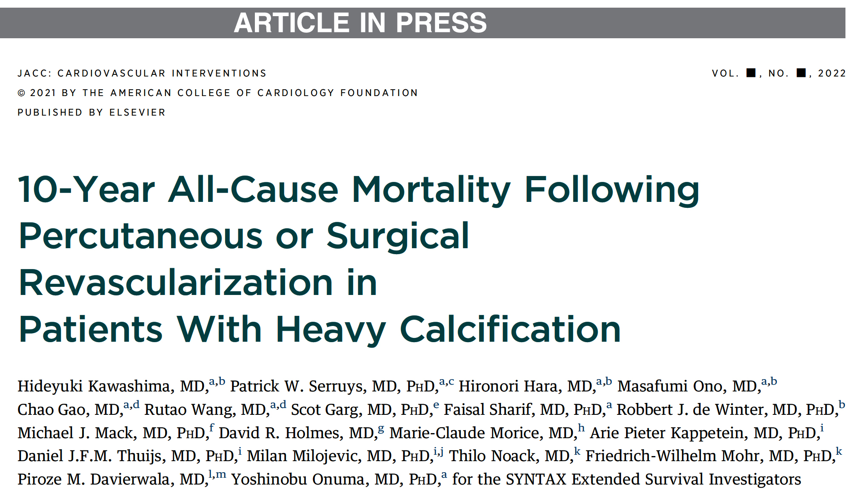

Slide 49
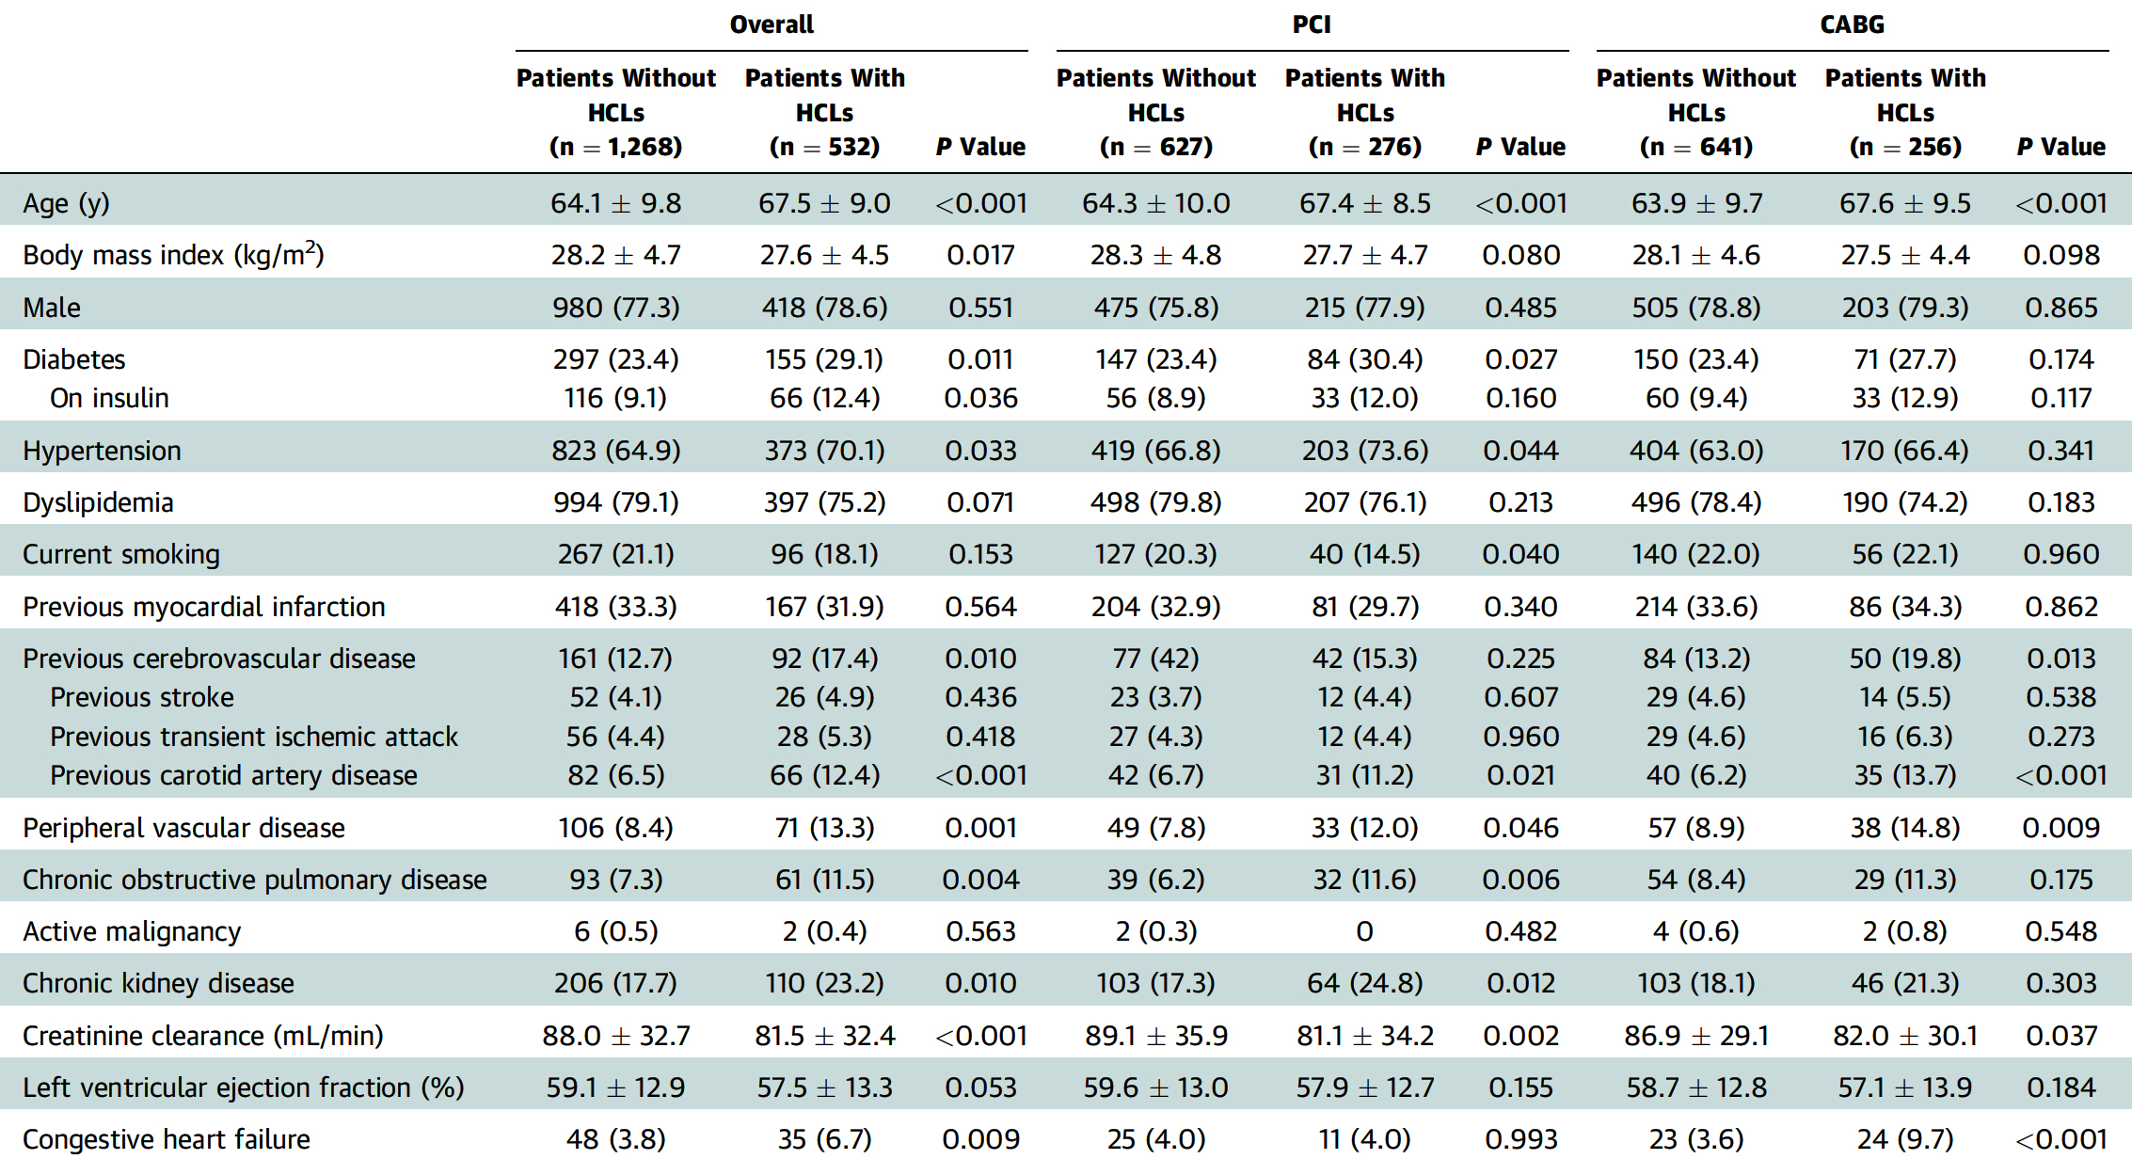
Baseline and Postprocedure Characteristics and
MT at Discharge in Pts With or Without HCLs
Kawashima et al., J Am Coll Cardiol 2021 Dec 20 Epub ahead of print

Slide 50
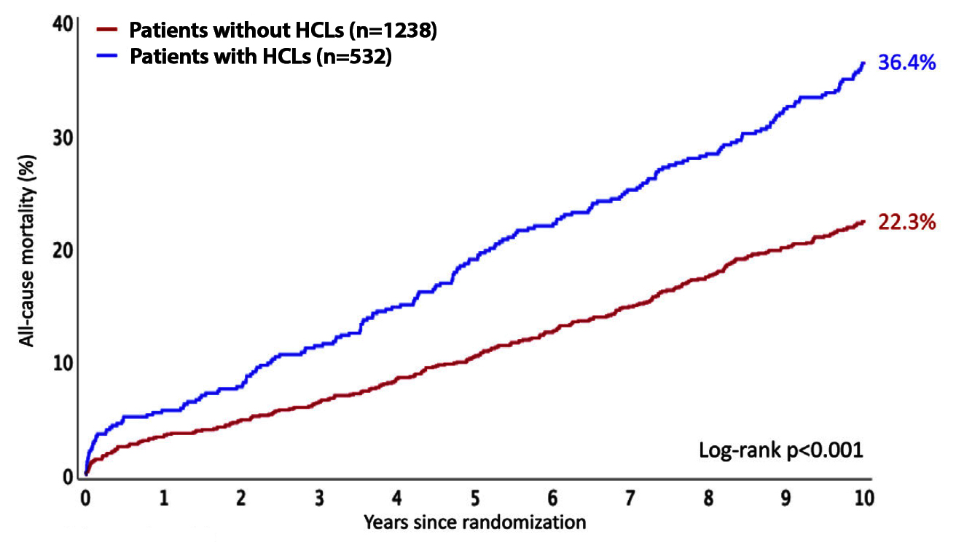
K-M Curves of All-Cause Mortality at 10 Years According to the Presence of at Least 1 HCL (n=1,800)
; approx. 30%; RA use 3%
Kawashima et al., J Am Coll Cardiol 2021 Dec 20 Epub ahead of print

Slide 51
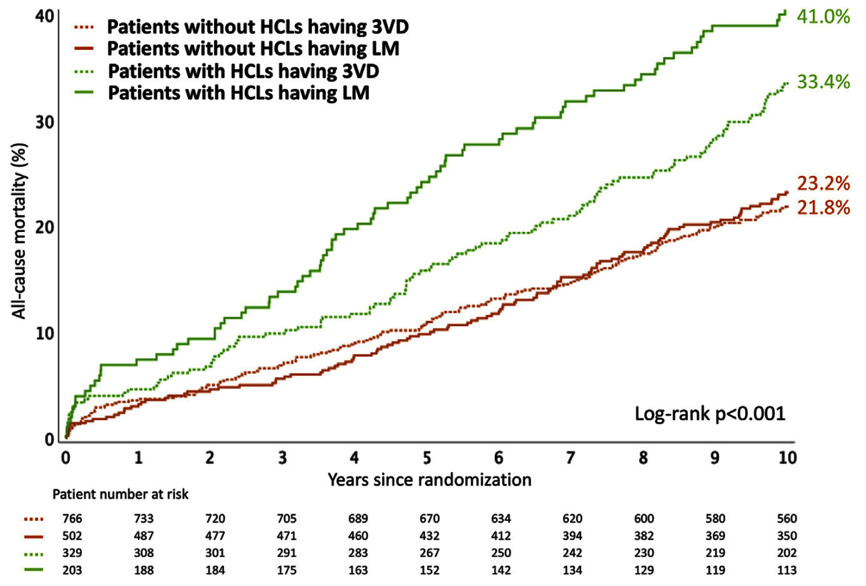
K-M Curves of All-Cause Mortality at 10 Years
Stratified to the Presence of at Least 1 HCL and Disease Type (3VD or LM Disease) (n=1,800)
Kawashima et al., J Am Coll Cardiol 2021 Dec 20 Epub ahead of print

Slide 52
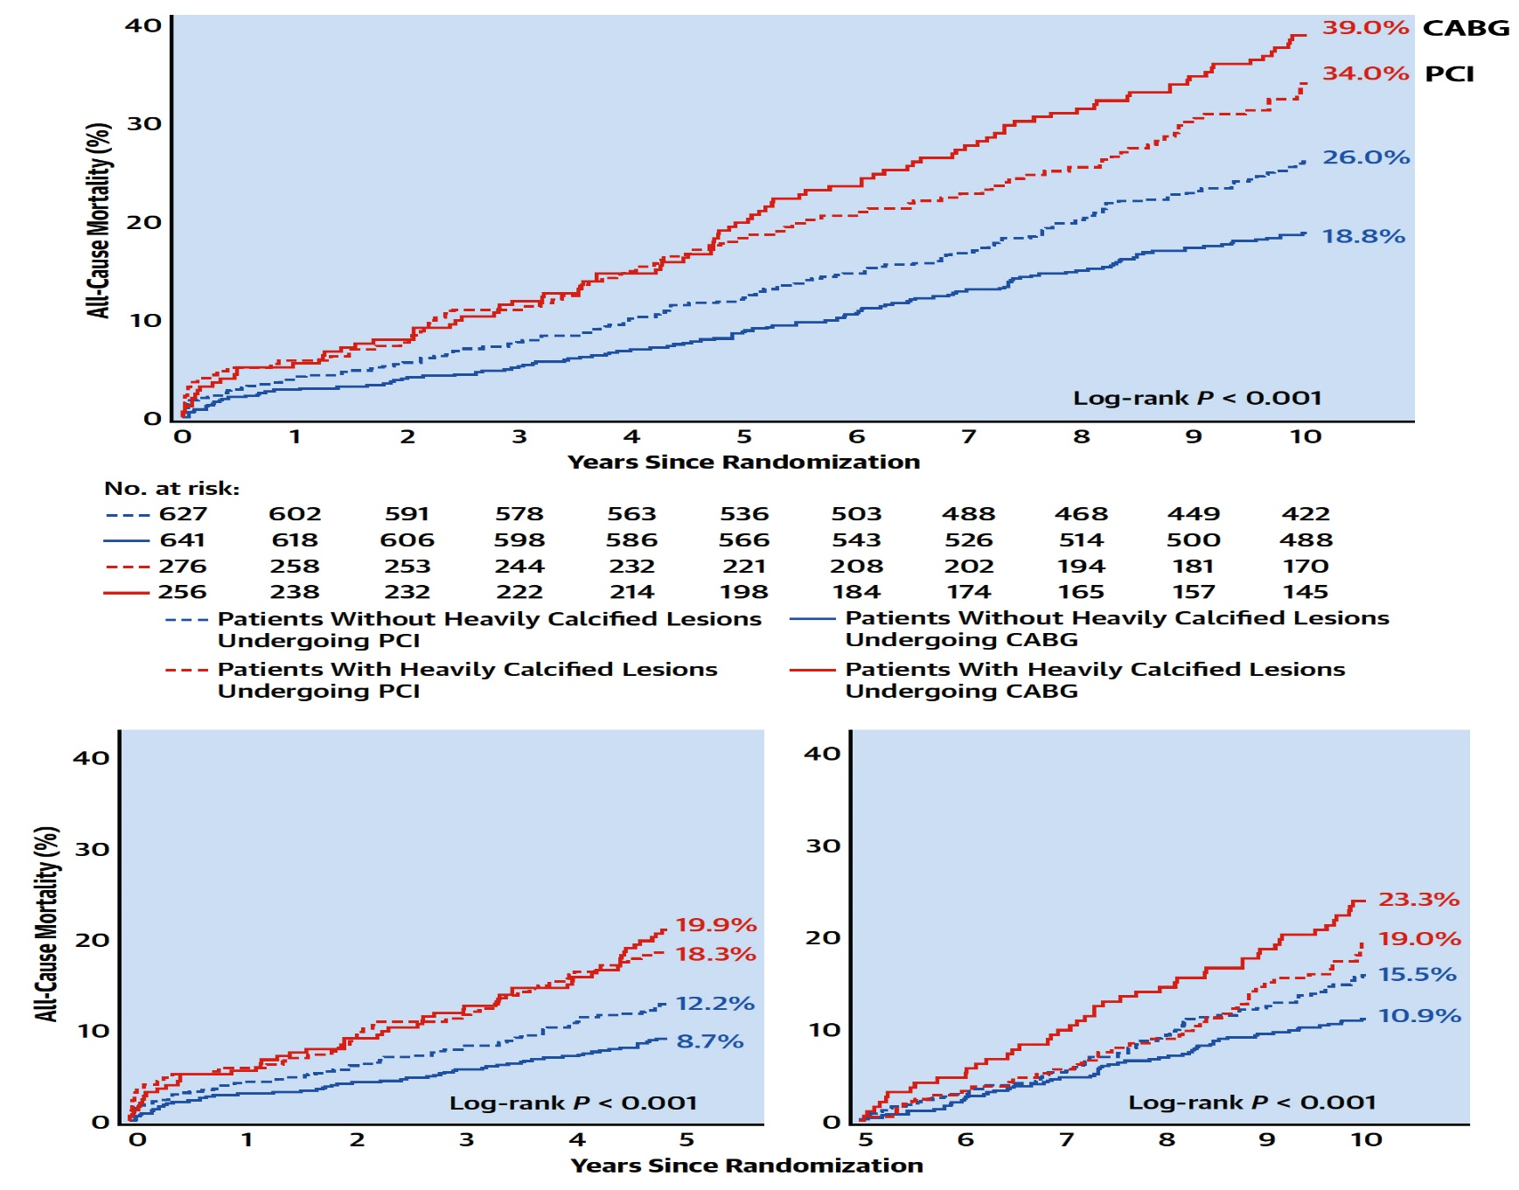
K-M Curves of All-Cause Mortality According to the Presence of at Least 1 HCL and Randomized Treatment with PCI or CABG (N=1,800)
PCI
CABG
Kawashima et al., J Am Coll Cardiol 2021 Dec 20 Epub ahead of print

Slide 53
Association Between Randomized Treatment with PCI or CABG and All-Cause Mortality According to the Presence of at Least 1 HCL (N=1,800)
Kawashima et al., J Am Coll Cardiol 2021 Dec 20 Epub ahead of print

Slide 54
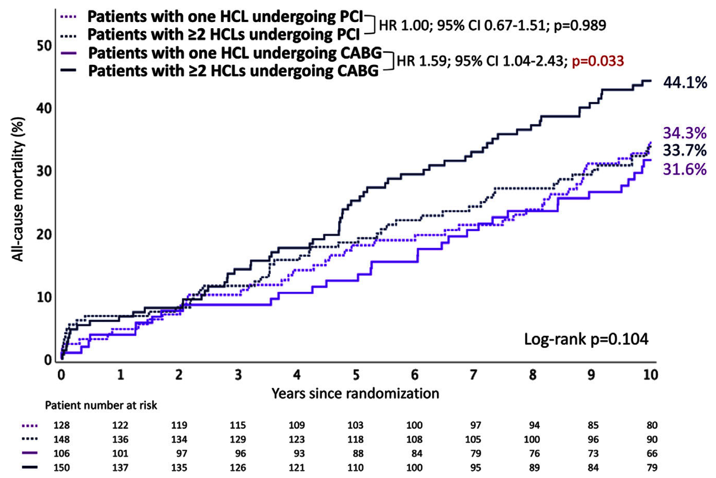
K-M Curves of All-Cause at Mortality at 10 Years
According to the Number of HCL and Randomized Treatment with PCI or CABG (N=532)
Kawashima et al., J Am Coll Cardiol 2021 Dec 20 Epub ahead of print

Slide 55
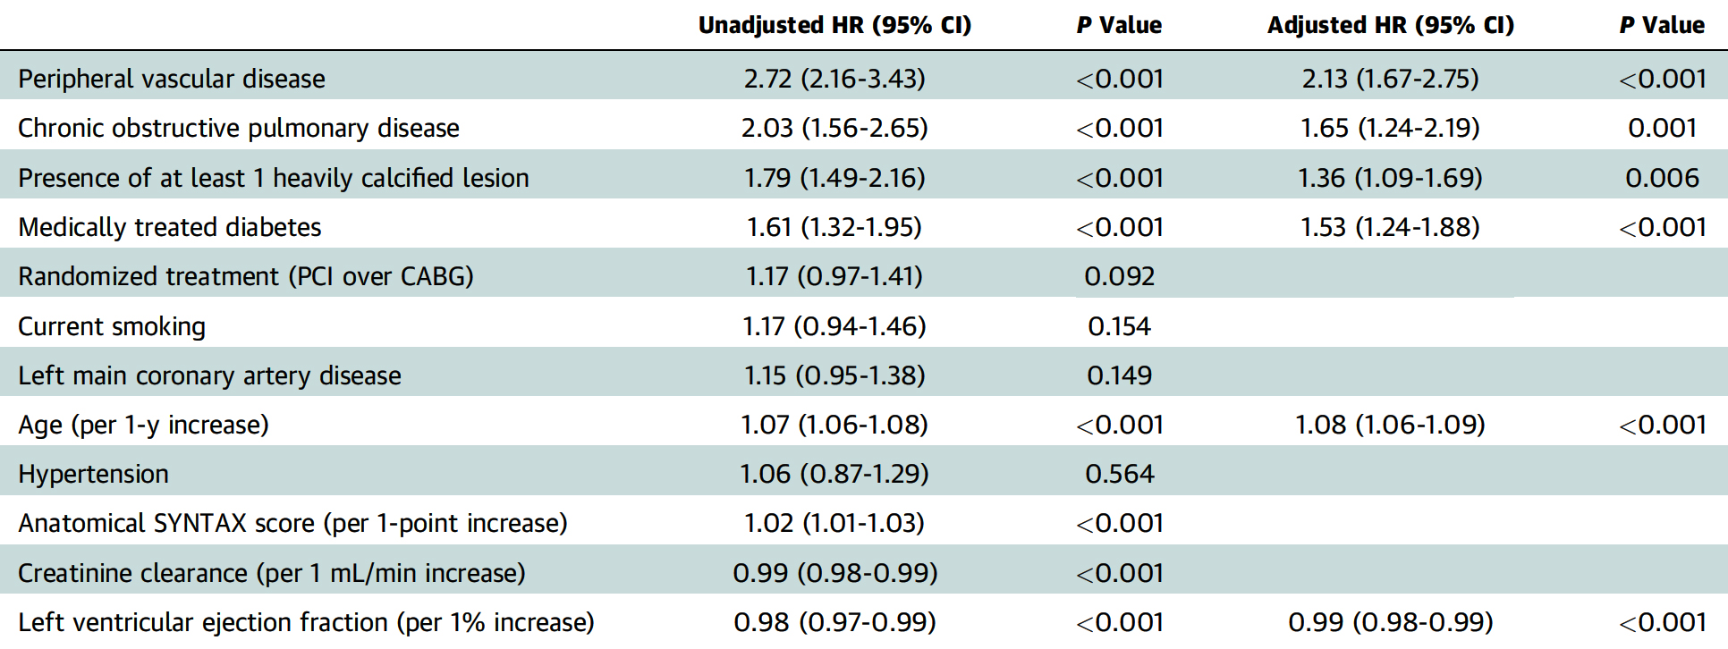
Predictors of All-Cause Mortality at 10 Years
Kawashima et al., J Am Coll Cardiol 2021 Dec 20 Epub ahead of print

Slide 56
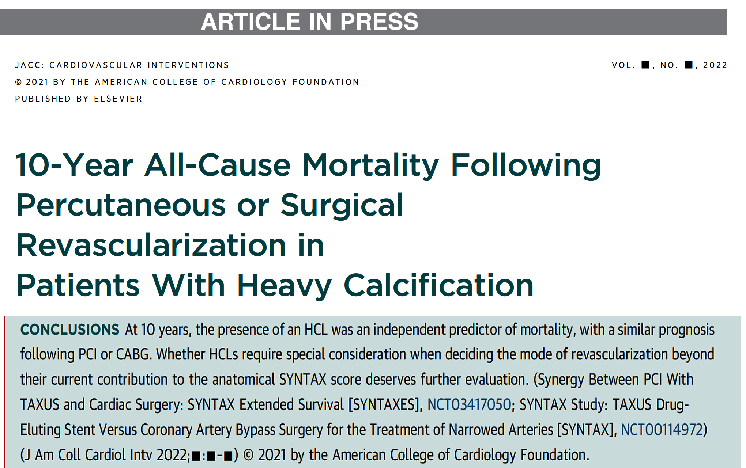
Potential explanation of no mortality
benefit of CABG over PCI in HCLs:
- Older with more comorbidities/COPD/PVD
- Possibility of poor/incomplete surgical anastomosis
- Post hoc analysis of chance finding

Slide 57
Take Home Message: Interventional presentations TCT/AHA 2021 and Differential impact of Lesion Ca++ on long-term mortality after CABG or PCI
PCI outcomes in surgically turned down cases:
Mortality after PCI vs CABG for LM CAD:
Spontaneous MI and TLR lower with CABG vs PCI in LMCAD:
Ultrathin vs Thin newer 2nd gen DES for lower TLR:
Presence of heavily Ca++ lesion (HCLs) is an independent predictor of 10-year mortality after both PCI or CABG revascularization. Only a small number of highly calcified lesions (3-6%) undergo atherectomy procedures. Long-term mortality is lower with CABG vs PCI in non HCLs, while on the contrary, CABG was associated with numerically higher mortality in HCLs. These data calls for better, improved and simple interventional treatment of HCLs (? can IVL fill this gap).
Notes:
HbA1c

Slide 58
Question # 1
Following statements are true regarding the results of PCI in the OPTIMUM registry except;
30-day mortality is in accordance with STS predicted mortality
6-month mortality is 10-15% in these pts
Better health outcome parameters at 6M F/U
30-day mortality is similar in low or high rSS group
E. Majority of pts are angina free at 6-momths
The correct answer is D

Slide 59
Question # 2
Following statements are true regarding the results of individual patient data meta-analysis comparing PCI vs CABG in LM CAD except;
A. No difference in 5-yr all cause mortality between PCI vs cABG
B. No difference in 10-yr all cause mortality between PCI vs cABG
C. No difference in spontaneous MI between PCI vs CABG
D. TLR is significantly higher in PCI vs CABG gp
E. Stroke rates are similar in PCI vs CABG group
The correct answer is C

Slide 60
Question # 3
Following statements are true regarding the 10-year mortality outcomes of heavily calcified lesions (HCLs) after CABG vs PCI in SYNTEXESS study except:
Higher mortality in HCLs vs non HCLs
Higher mortality after PCI vs CABG in HCLs
Higher mortality after PCI vs CABG in non HCLs
Higher mortality in LM and 3 V CAD pt in HCLs vs non HCLs
Medical comorbidities remain independent predictors of mortality
The correct answer is B

