Slide 1
Structural Heart Live Cases
Supported by:
Medtronic Incorp
Cook Incorp
Terumo Medical
B-Braun

Slide 2
Faculty Involved and Disclosures
Samin K. Sharma, MD, FACC, MSCAI
Speaker’s Bureau – BSC, Abbott Vascular Inc, CSI
Annapoorna S. Kini, MD, FACC
Nothing to disclose
Farzan Filsoufi, MD, FACC
Nothing to disclose
Stamatios Lerakis, MD, PhD, FACC, FAHA (Imaging)
Nothing to disclose
Gilbert Tang, MD, MSC, MBA, FACC [Moderator]
Physician proctor for Medtronics
Cardiac Anesthesiologist
M Chen MD

Slide 3
Structural Heart Live Case # 45: RS, 78 y/o M
Presentation: Worsening NYHA Class III symptoms of heart failure
PMH: HTN, HLD, IDDM, stage III CKD, AF/AFL, TIA, carotid stenosis s/p left ICA stent, CAD s/p CABG X 4 in 1997 & then s/p redo sternotomy in 2020 with CABG X 1 (SVG to RPDA), MVR (27mm Magna Ease) and TVR (28mm Triad), s/p multiple PCIs, HFrEF with EF 30%, and variable degree of AS.
Medications: Apixaban, Clopidogrel, ISMN, Atorvastatin, Carvedilol, Empagliflozin, Insulin and Sacubitril-valsartan
Labs: Hgb 10.6, PLT 173K, K 4.4, Cr 1.42, INR 1.3
EKG (12/10/21): Sinus rhythm at 64 bpm
TTE (11/16/21): Severe LF-LG AS (PG/MG/AVA/PV: 31/17/0.8/2.8), LVEF 32%
DSE (12/7/21): Adequate contractile reserve (↑ in stroke volume 23%)
Cath (12/7/21): Patent LIMA to LAD, Patent SVG to RPDA, patent SVG to OM2, Occluded SVG to D2 and s/p DES to pLAD & then to LCx in last 3M.

Slide 4
Transthoracic Echocardiogram
Parasternal long axis showing severe AS
Parasternal short axis showing severe AS

Slide 5
Transthoracic Echocardiogram
2D Doppler gradients showing severe AS

Slide 6
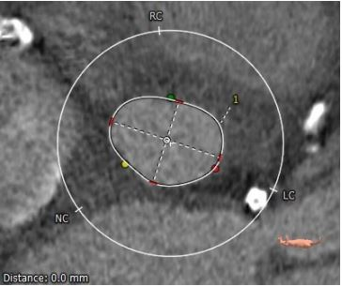
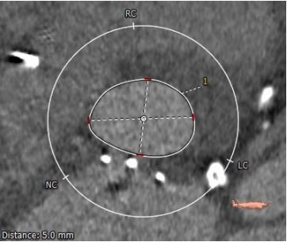
CTA: Aortic Annulus, LVOT
Aortic Annulus
Max: 25.4 mm
Min: 18.9 mm
Mean: 22.2 mm
Perimeter = 70.7 mm
Area = 380.8 mm²
LVOT
Max: 27.5 mm
Min: 20.0 mm
Mean: 23.7 mm
Perimeter = 75.8 mm
Area = 434.9 mm²

Slide 7
CTA: STJ and SOV
STJ
Min 26.9 mm
Max 28.2 mm
Mean 27.5 mm
Sinus of Valsalva
RCC 31.1 mm
LCC 31.2 mm
NCC 31.1 mm

Slide 8
CTA: Coronary heights
Coronary Heights
LM – 8.1 mm
RCA – 13.1 mm

Slide 9
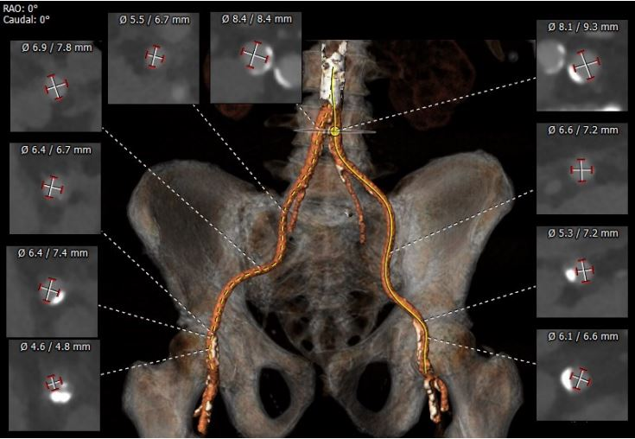
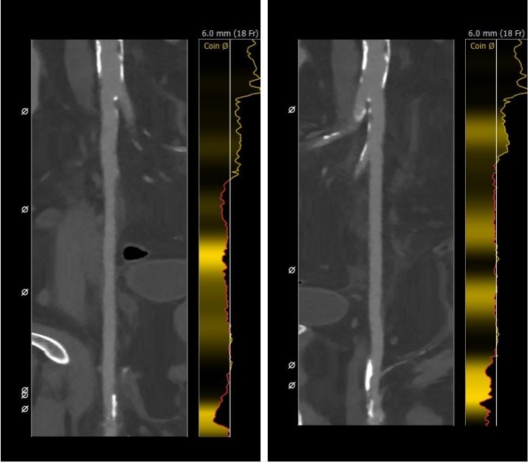
CTA: Femoral Arterial Access
Longitudinal View
Right Iliac/Femoral
Longitudinal View
Left Iliac/Femoral
Access 3D

Slide 10
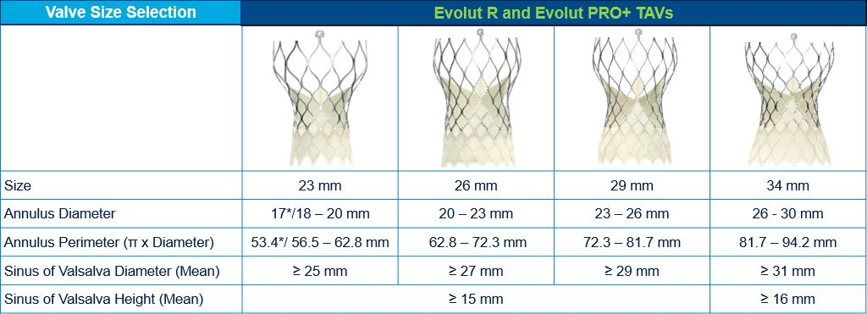
Medtronic Evolut PRO+ Patient Selection
Our Patient
Annulus
Max: 25.4mm
Min: 18.9 mm
Mean: 22.2 mm
Perimeter: 70.9 mm
SOV diameter: 31.2mm
SOV Height: 23.0mm

Slide 11
Summary of Case
Presentation: 78 year old male with NYHA Class III HF for 4-5 months
TTE: Severe low flow-low gradient aortic stenosis (PG/MG/AVA/PV:31/17/0.81/2.8), LVEF 32%
STS risk mortality: 13.8%
Course: Patient was evaluated by Heart Team and determined to be high risk for surgical AVR due to medical comorbidities and 2nd redo sternotomy
Plan: TF TAVR using 26mm Evolut Pro+ via right percutaneous femoral artery with possible Sentinel Cerebral Embolic Protection Device

Slide 12
Latest Issues in Transcatheter Structural Heart Interventions
Current status of diagnosis, prognosis and management of LF-LG Aortic Stenosis

Slide 13
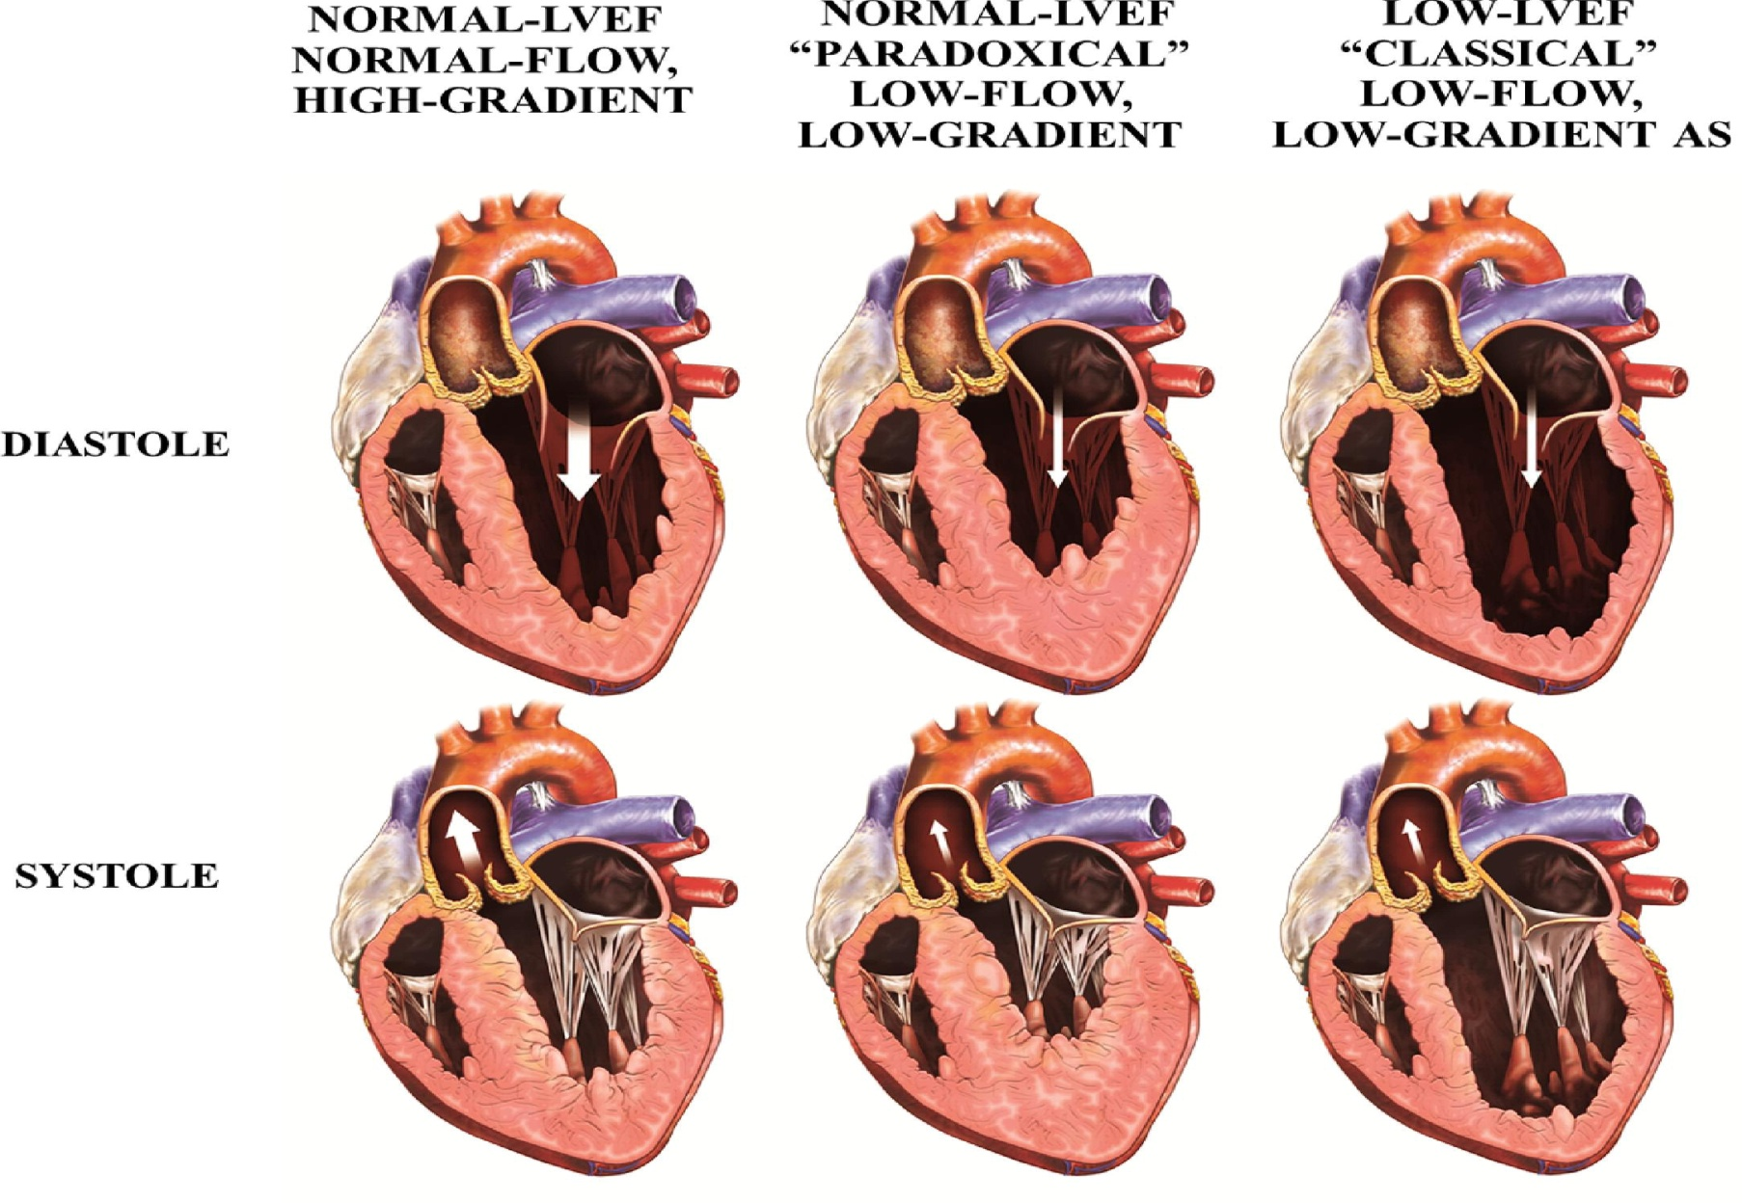
Different Patterns of Severe AS According to Flow, Gradient, and LV Geometry
AVA <1cm2
MG >40 mmHg
LVEF >40%
Pibarot et al., J Am Coll Cardiol 2012;60:1845
Notes:
13
Key Message: XIENCE V® provides the right combination of technology with a deliverable, efficacious, and safe platform.
Throughout this section you will present the key features of XIENCE V®, including the Multi-Link vision stent, the Multi-Link Vision stent delivery system, the everolimus elution profile, and the fluorinated copolymer. You will also show how these features work together to provide deliverability, efficacy, and safety.

Slide 14
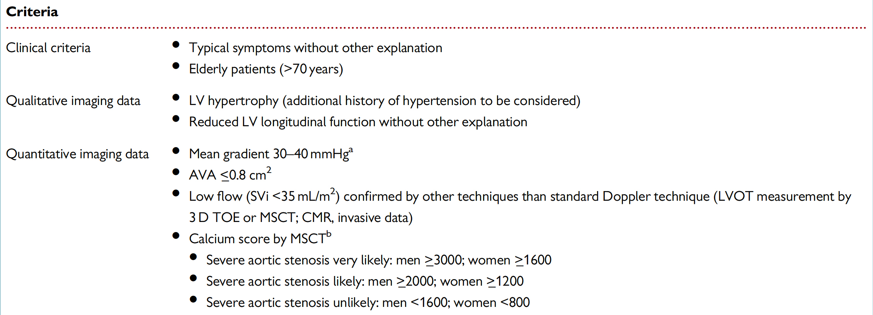
Criteria that Increase the Likelihood of Severe AS in Pts with AVA <1.0 cm² and Mean Gradient <40 mmHg in the Presence of Preserved EF
2017ESC/EACTS Guidelines for the Management of Valvular Heart Disease
Baumgartner et al., Eur Heart J 2017;38:2739
Malcolmson et al., Eur Heart J Qual Care Clin Outcomes 2021;7:327

Slide 15
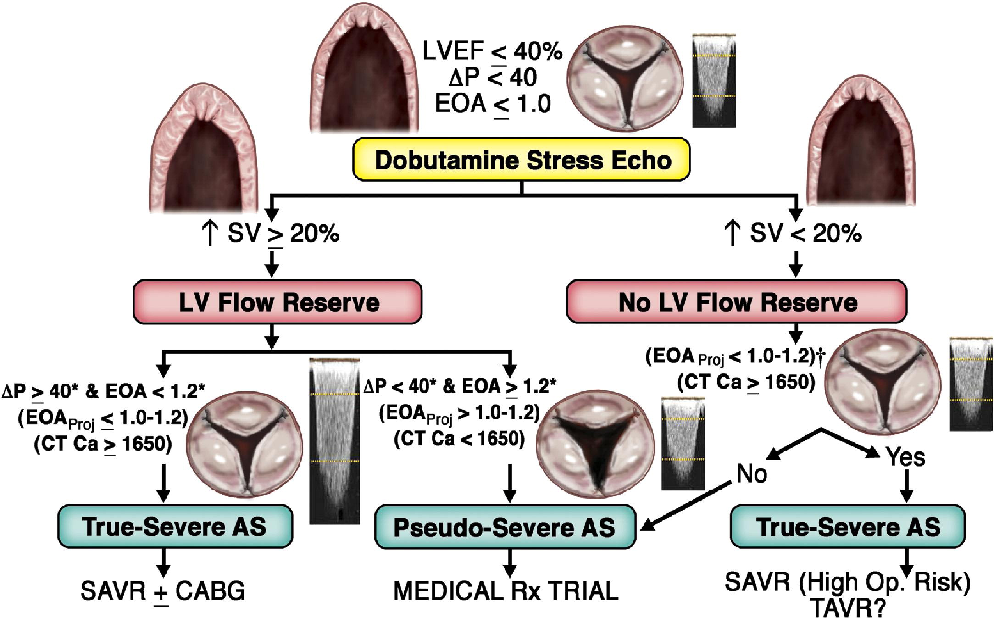
Clinical Decision Making Process in Low LVEF, LF-LG Severe AS
Contractile reserve +
Contractile reserve -
Pibarot et al., J Am Coll Cardiol 2012;60:1845
Notes:
15
Key Message: XIENCE V® provides the right combination of technology with a deliverable, efficacious, and safe platform.
Throughout this section you will present the key features of XIENCE V®, including the Multi-Link vision stent, the Multi-Link Vision stent delivery system, the everolimus elution profile, and the fluorinated copolymer. You will also show how these features work together to provide deliverability, efficacy, and safety.

Slide 16
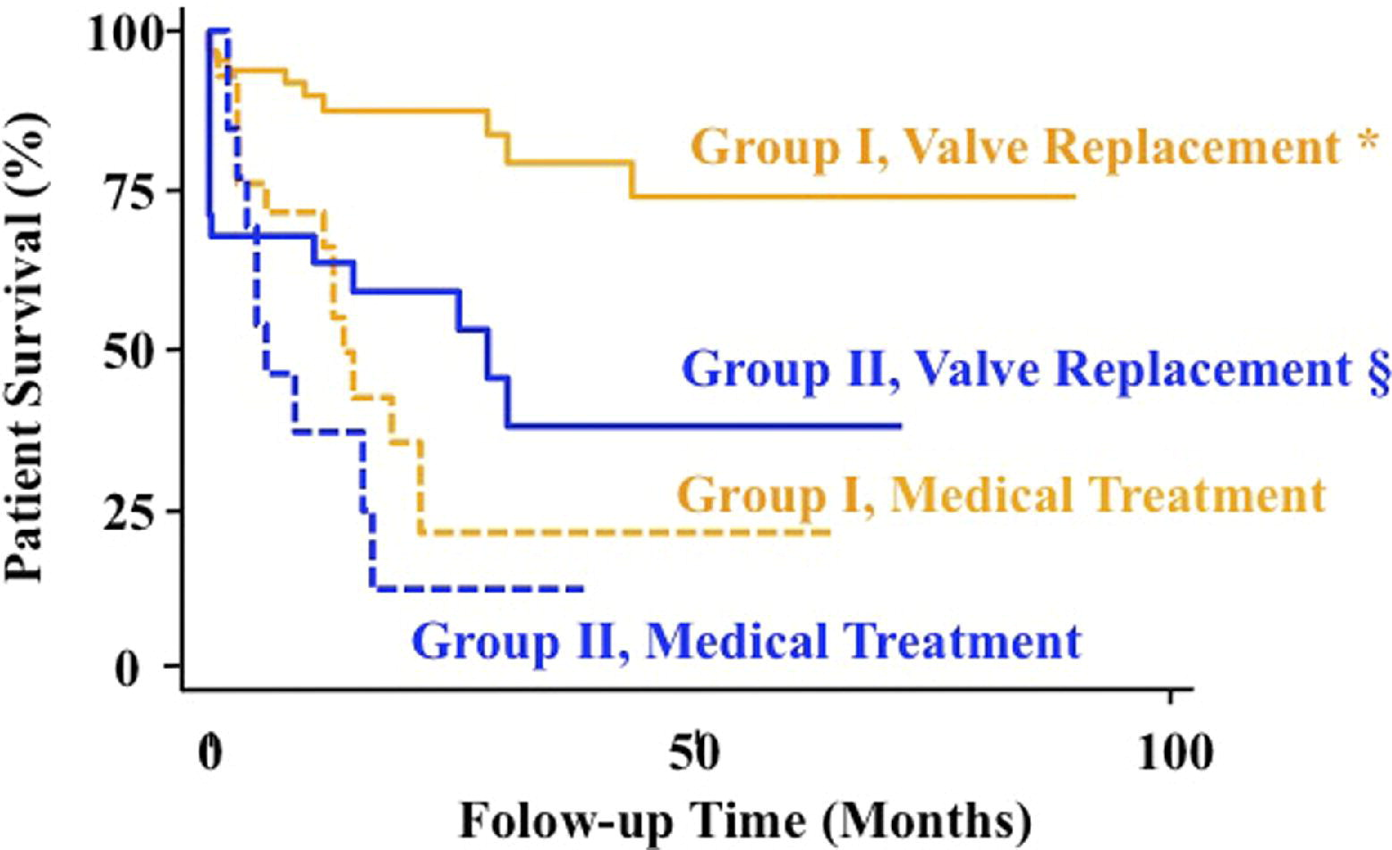
Survival of Patients With Low LVEF, LF-LG AS According to Presence of LV Flow Reserve and Type of Treatment
LV flow reserve +
LV flow reserve -
Pibarot et al., J Am Coll Cardiol 2012;60:1845
Notes:
16
Key Message: XIENCE V® provides the right combination of technology with a deliverable, efficacious, and safe platform.
Throughout this section you will present the key features of XIENCE V®, including the Multi-Link vision stent, the Multi-Link Vision stent delivery system, the everolimus elution profile, and the fluorinated copolymer. You will also show how these features work together to provide deliverability, efficacy, and safety.

Slide 17
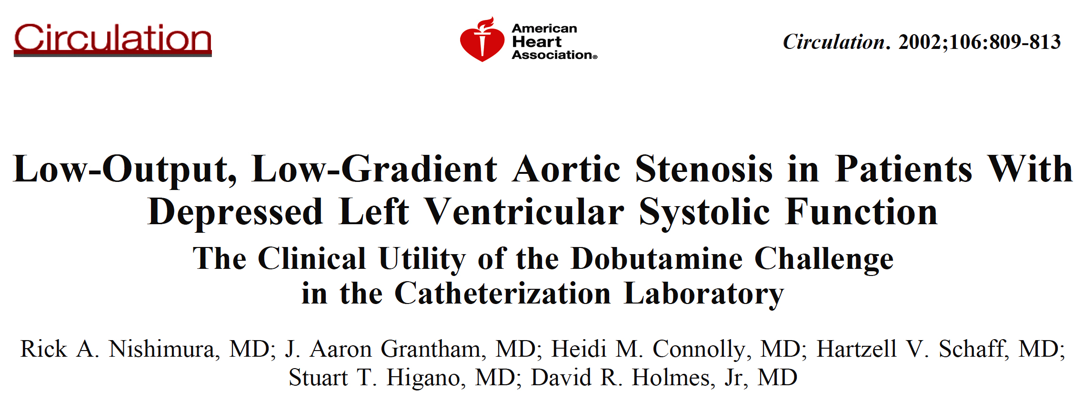

Slide 18
Hemodynamic Tracings from 3 Pts Representing
3 Different Responses to IV Dobutamine
Pt responded to dobutamine infusion with an increase in CO and increase in valvular mean gradient from 24 to 47 mmHg
AVA remained 0.8 cm²
Severe AS at time of AVR and is alive in NYHA Class I after operation
Pt responded to dobutamine infusion with an increase in cardiac output and increase in valvular mean gradient from 17 to 20 mmHg
Final AVA = 0.7 cm²
Mild AS at time of AVR operation
Pt had no change in CO and mean aortic valvular gradient decreased from 37 to 26 mmHG in response to dobutamine
Test terminated due to hypotension
Severe AS at time of AVR but died 2 yrs post SAVR due to HF
Nishimura et al., Circulation 2002;106:809

Slide 19
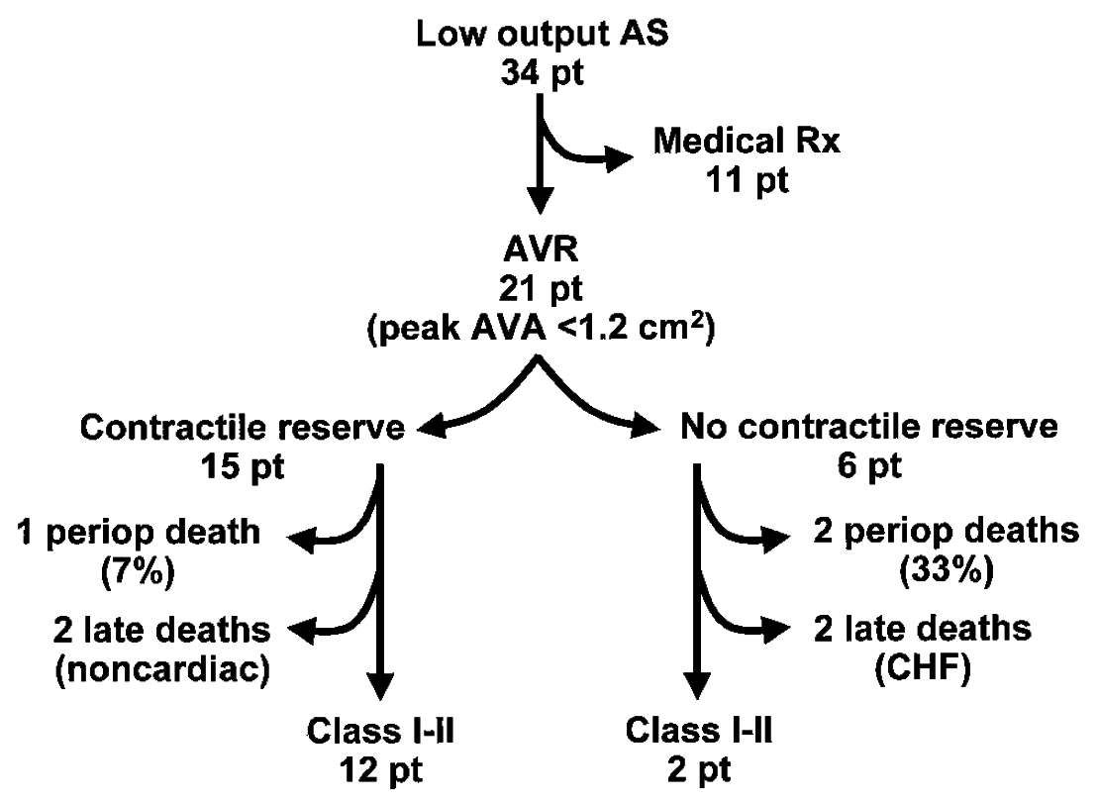
Clinical Outcome of Patients with Low-Output AS
( SV >20%)
( in SV <20%)
20%--mortality--66%
Nishimura et al., Circulation 2002;106:809

Slide 21
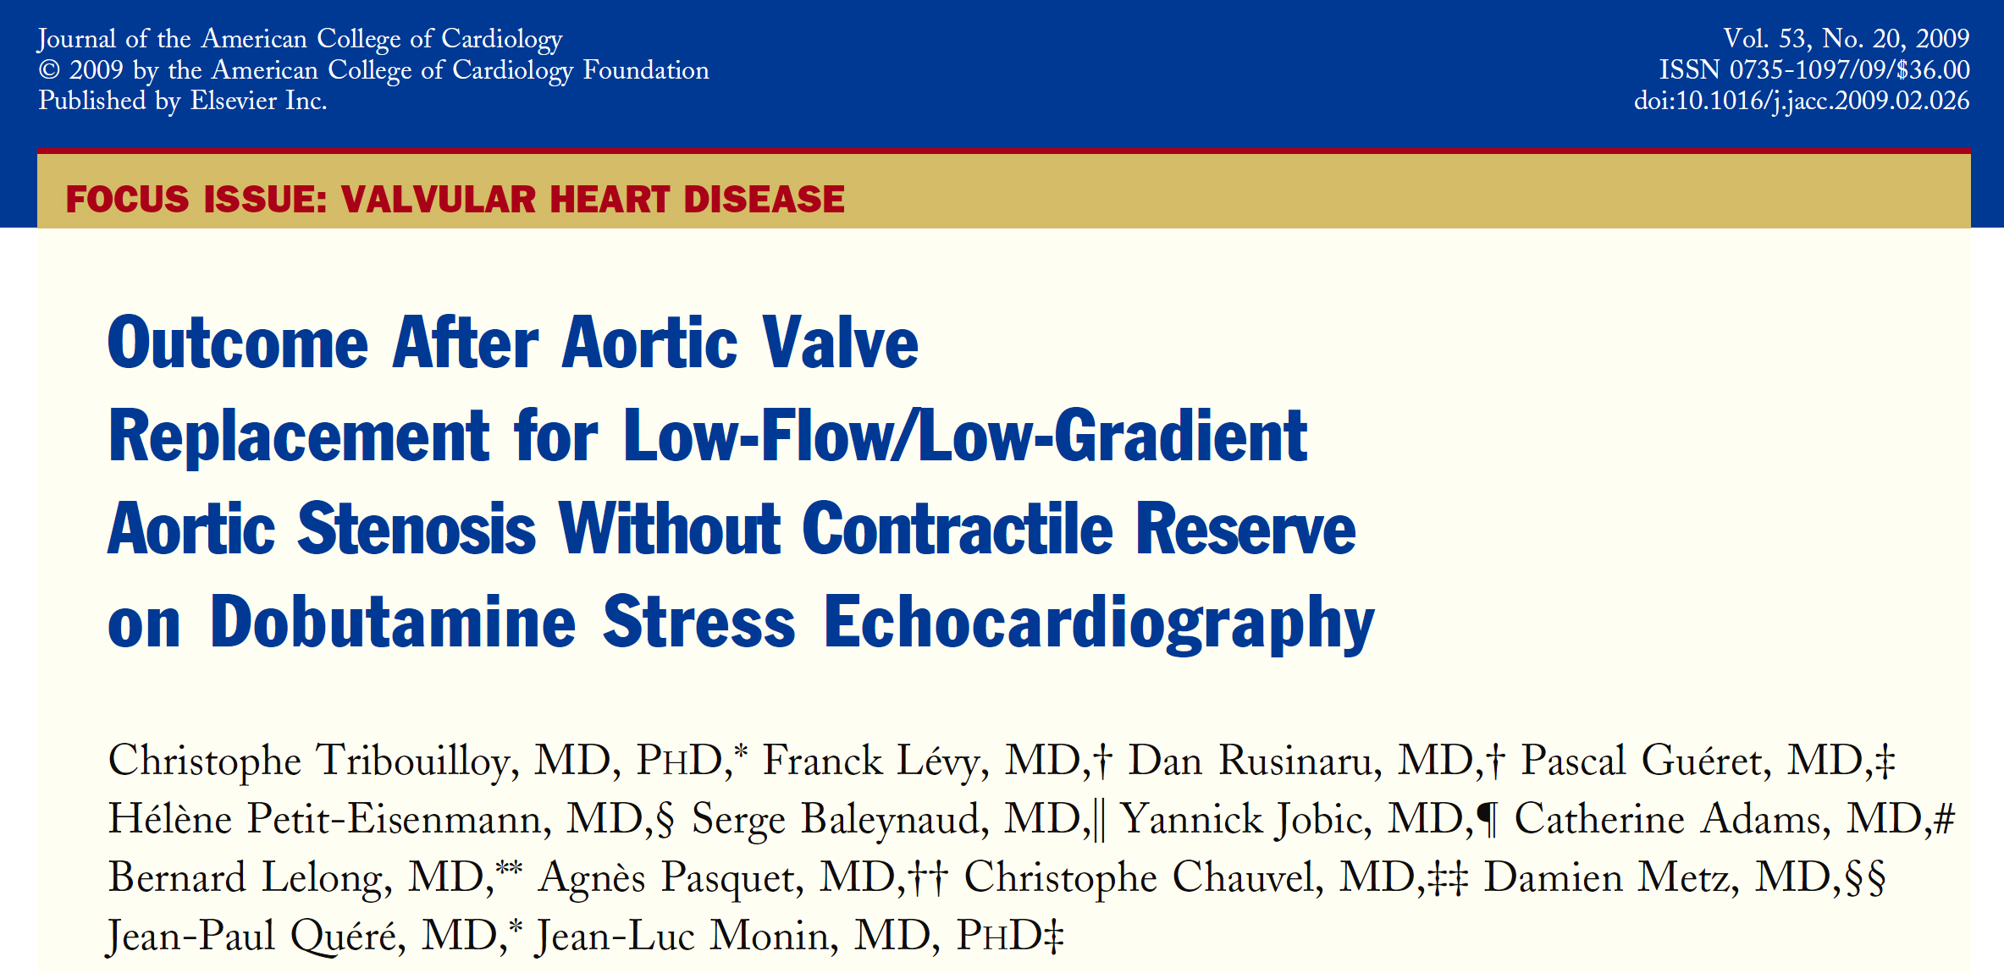

Slide 22
Tribouilloy et al., J Am Coll Cardiol 2009;53:1865

Slide 23
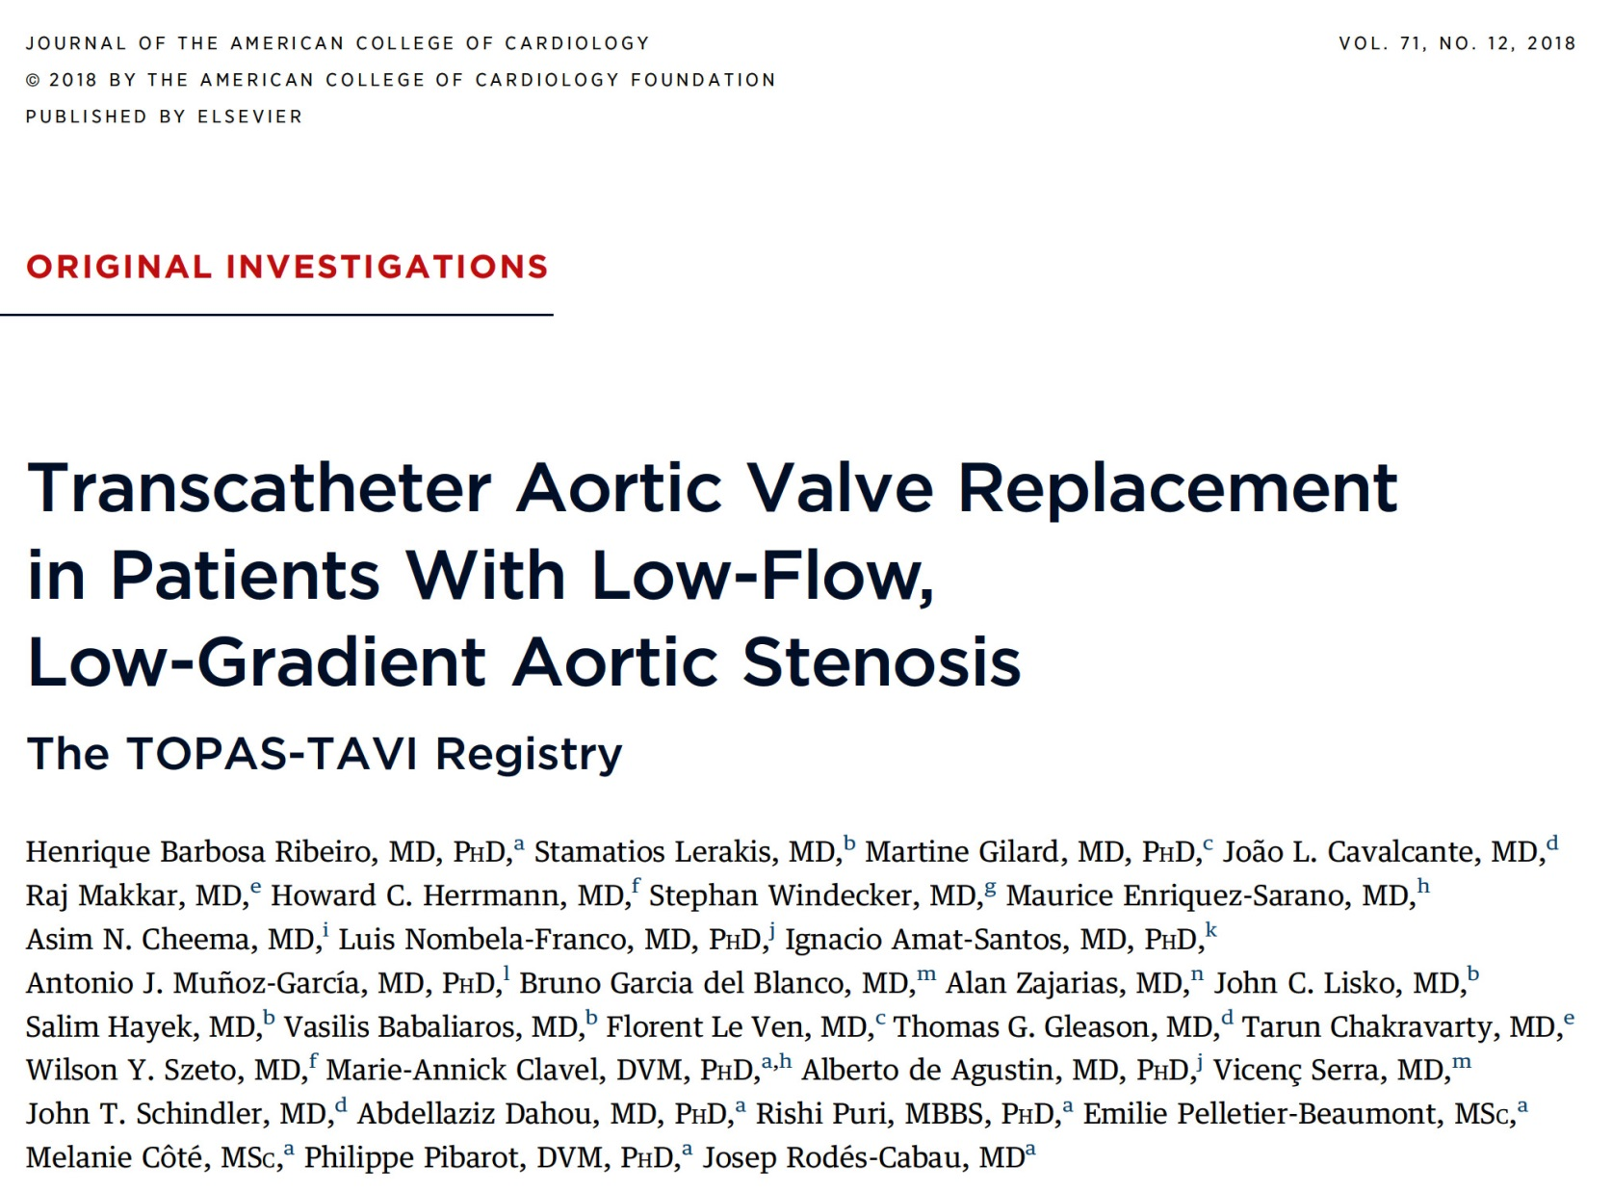

Slide 24
TOPAS-TAVI: Dobutamine Stress Echocardiogram (DSE) Data
 | Baseline Echocardiography (n=234) | Peak Dobutamine (n=234) | Deta Mean (95% CI) | P Value
Median dobutamine peak dose, μg/kg/min | - | 14 (11-17) | - | -
LVEF, % | 29.5 ± 9.1 | 36.8 ± 12.3 | 7.3 (5.9-8.7) | <0.001
Mean aortic gradient, mmHg | 24.5 ± 6.3 | 36.7 ± 10.7 | 12.1 (10.8-13.4) | <0.001
Aortic valve area, cm² | 0.77 ± 0.21 | 0.81 ± 0.26 | 0.04 (0.01-0.08) | 0.02
Stroke volume, ml | 53.4 ± 15.3 | 62.6 ± 19.1 | 10.0 (7.9-12.1) | <0.001
Stroke volume index, ml/m² | 29.0 ± 7.9 | 33.8 ± 9.8 | 5.3 (4.2-6.4) | <0.001
Increase in stroke volume, % | - | 17 (14-35) | - | -
Contractile reserve | - | 86/193 (44.6) | - | -
Moderate/severe MR | 95/229 (41.5) | 39/151 (25.8) | - | -
Ribeiro et al., J Am Coll Cardiol 2018;71:1297

Slide 25
TOPAS-TAVI: Mortality Rates (N=287)
Mean LVEF - 30 ± 10 mmHg
Transvalvular gradient - 25 ± 7 mmHg
Median STS Risk Score – 7.7%
Multivariable analysis:
COPD – p=0.02
Lower hemoglobin values – p<0.001
Moderate-severe AR post-TAVR
%
Ribeiro et al., J Am Coll Cardiol 2018;71:1297

Slide 26
TOPAS-TAVI: Cumulative Late Outcomes at 2 Yrs Follow-Up (N=287)
%
MI Stroke Endocarditis PPM PPM-defib Rehosp Cardiac Global
for HF death death
Ribeiro et al., J Am Coll Cardiol 2018;71:1297

Slide 27
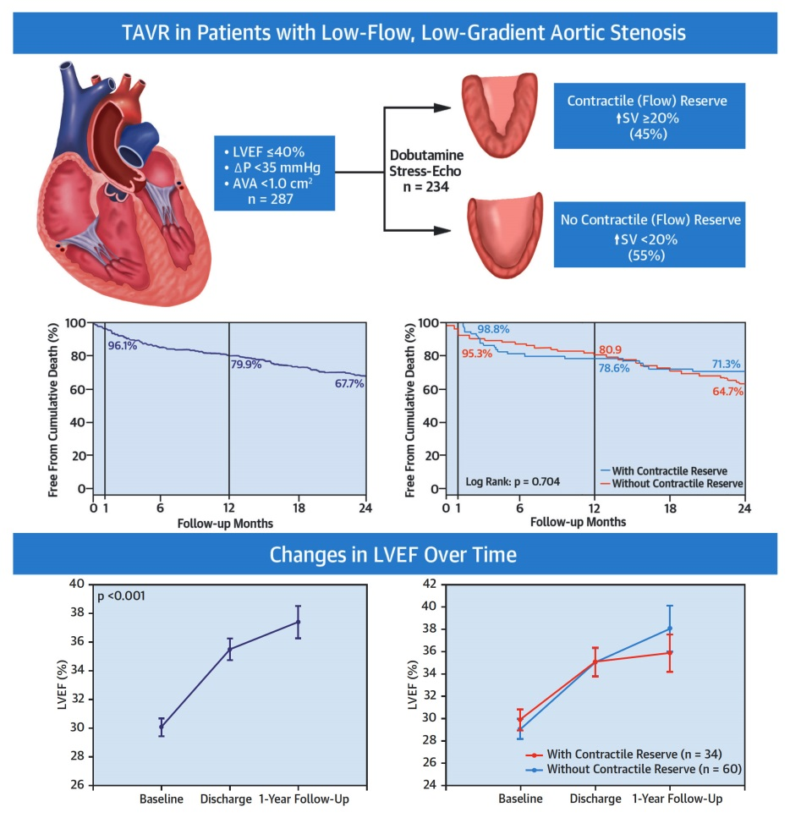
TOPAS-TAVI: Clinical Outcomes and LV Changes
Following TAVR in Patients with LFLG-AS
Ribeiro et al., J Am Coll Cardiol 2018;71:1297

Slide 29
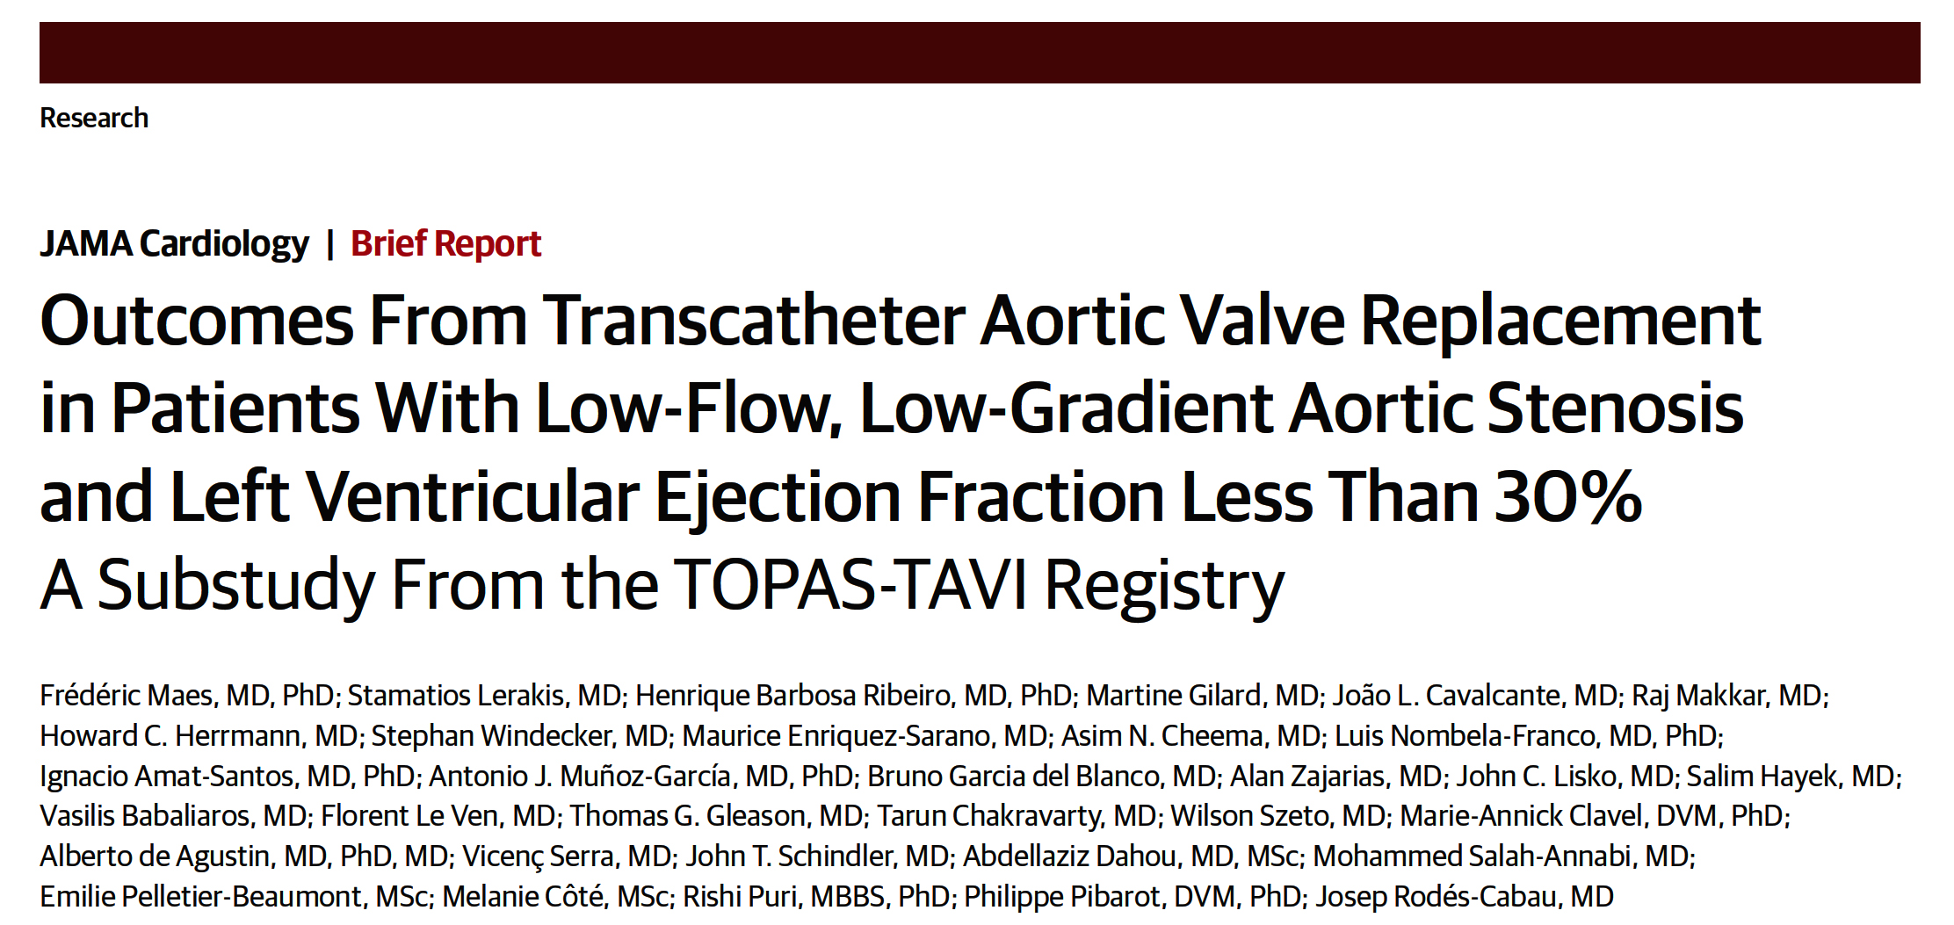

Slide 30
TOPAS-TAVI Substudy: Overall Outcomes and According to the Severity of LV Dysfunction
Variable | All patients (n=293) | VL-LVEF (<30%) (n=128) | L-LVEF (≥30-40%) (n=165) | HR (95% CI) | P Value
Cumulative Outcomes
Stroke | 5.1% | 5.5% | 4.8% | 1.14 (0.40-3.22) | 0.81
MI | 3.8% | 2.3% | 4.8% | 0.47 (0.12-1.81) | 0.27
Re-hospitalization | 28.3% | 29.7% | 27.3% | 1.13 (0.68-1.88) | 0.65
Overall death | 45.1% | 44.5% | 45.5% | 0.96 (0.61-1.53) | 0.88
Cardiac death | 20.8% | 24.2% | 18.2% | 1.44 (0.82-2.53) | 0.21
Maes et al., JAMA Cardiol 2019;4:64

Slide 31
TOPAS-TAVI Substudy Clinical Outcomes
30-Day Mortality Rate
1-Year Mortality Rate
p=0.65
p=0.88
%
%
Very low LVEF <30%
Low LVEF 30-40%
Very low LVEF <30%
Low LVEF 30-40%
Maes et al., JAMA Cardiol 2019;4:64

Slide 32
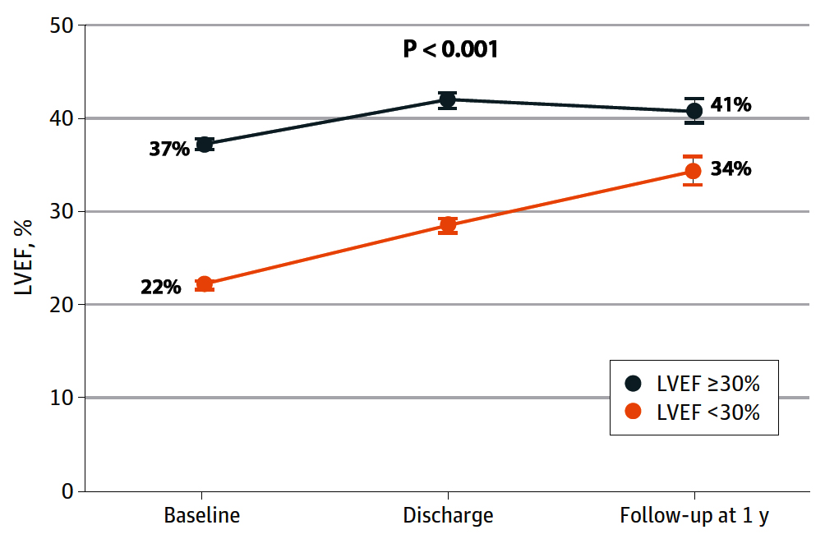
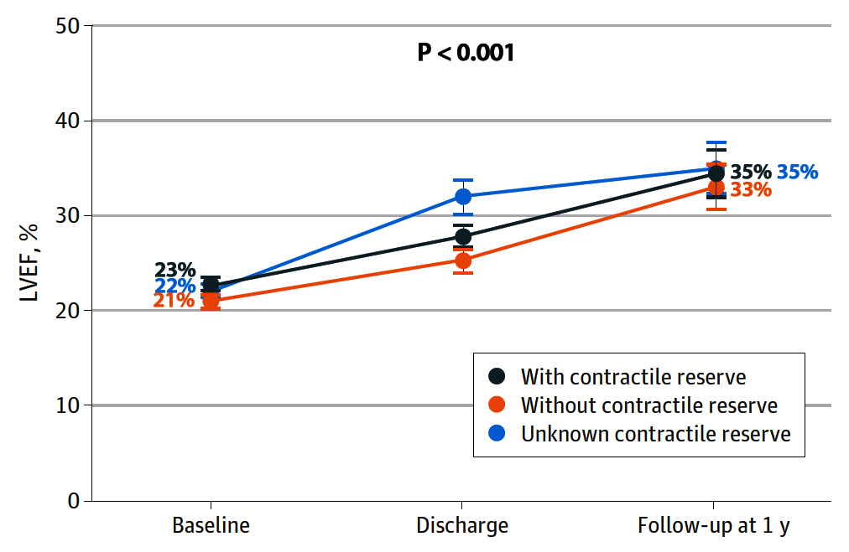
TOPAS-TAVI Substudy: Changes in LVEF Over Time
Changes in LVEF Over Time in
All Patients
Changes in LVEF Over Time in Patients with LVEF <30%
Maes et al., JAMA Cardiol 2019;4:64

Slide 34
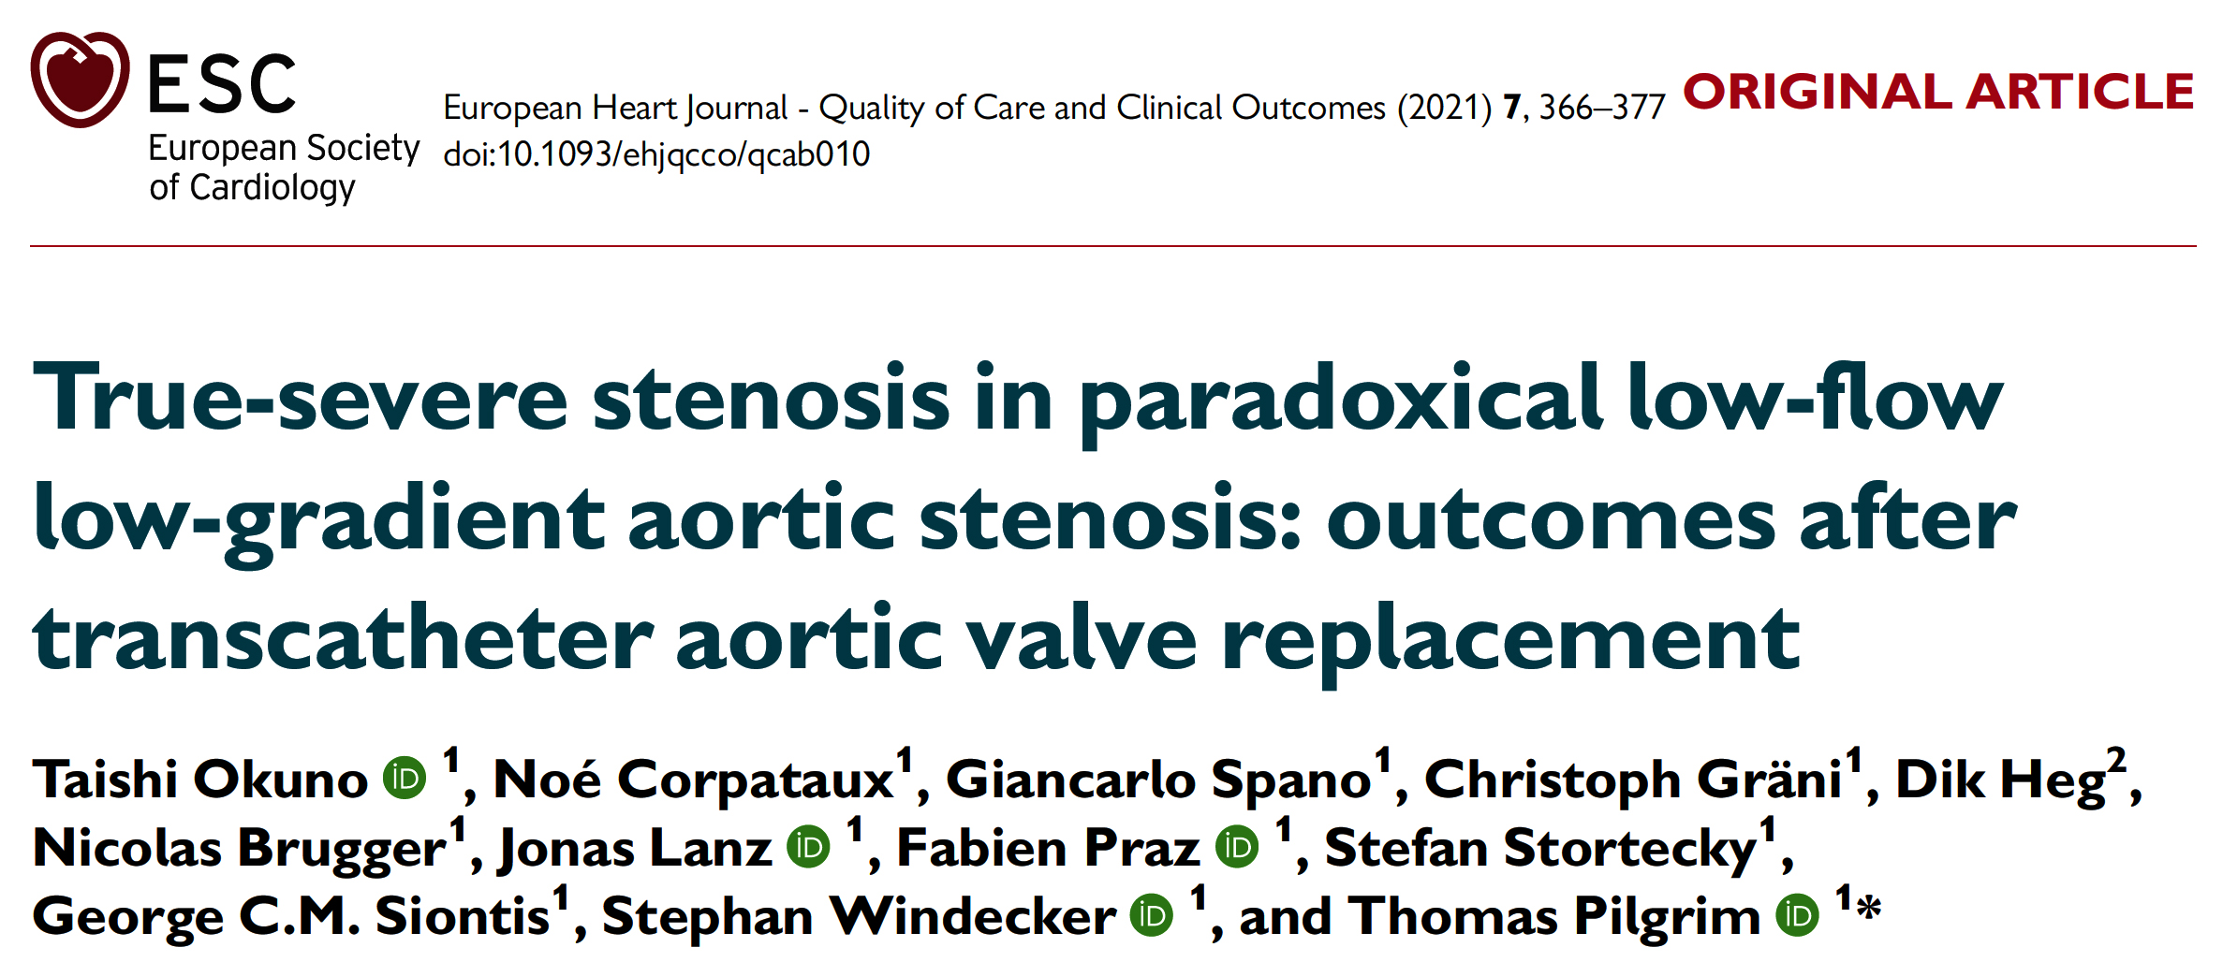

Slide 35
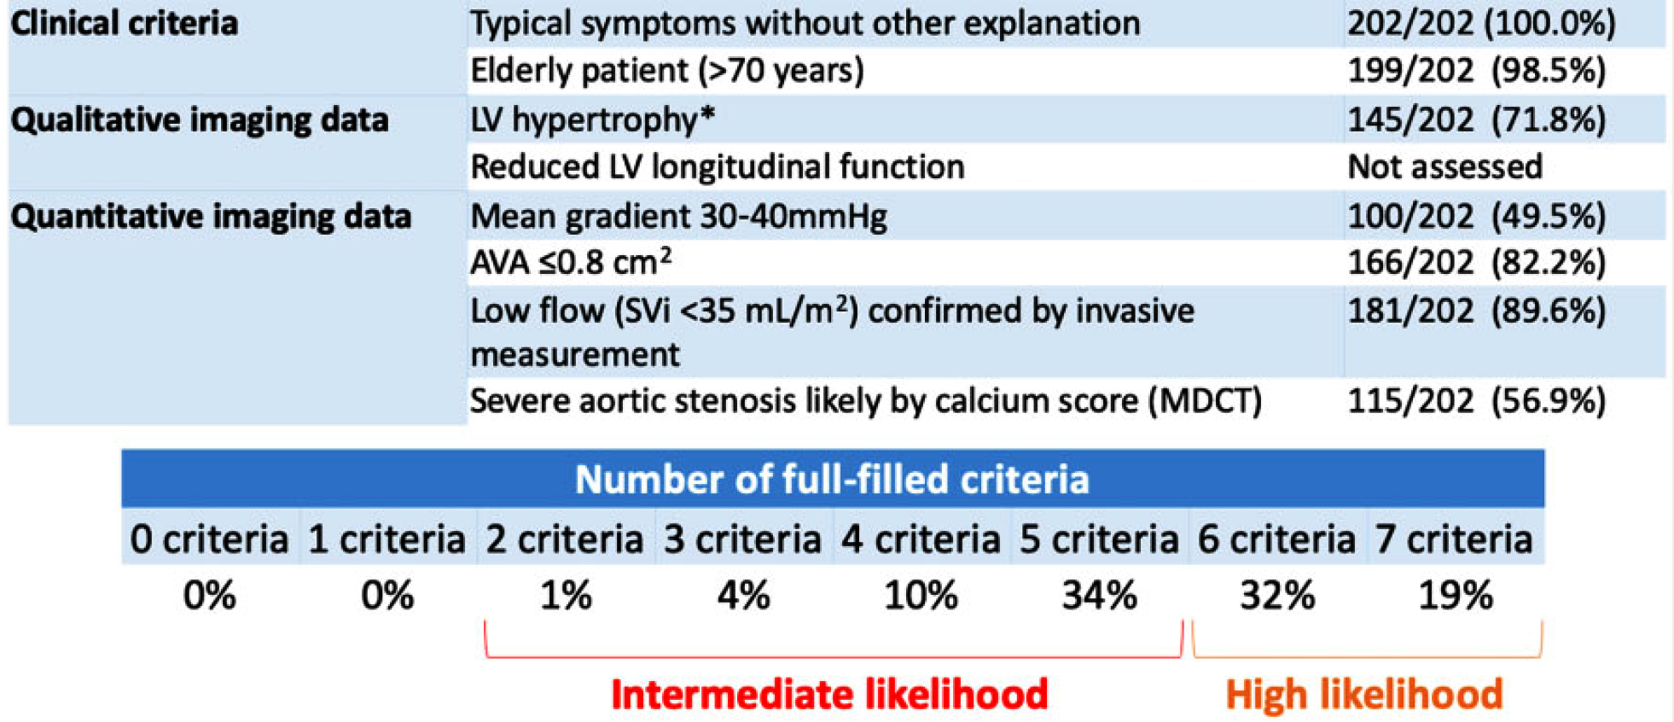
Criteria That Increases the Likelihood of True-Severe AS Proposed by the ESC/EACTS Guidelines
Okuno et al., Eur Heart J Qual Care Clin Outcomes 2021;7:366

Slide 36
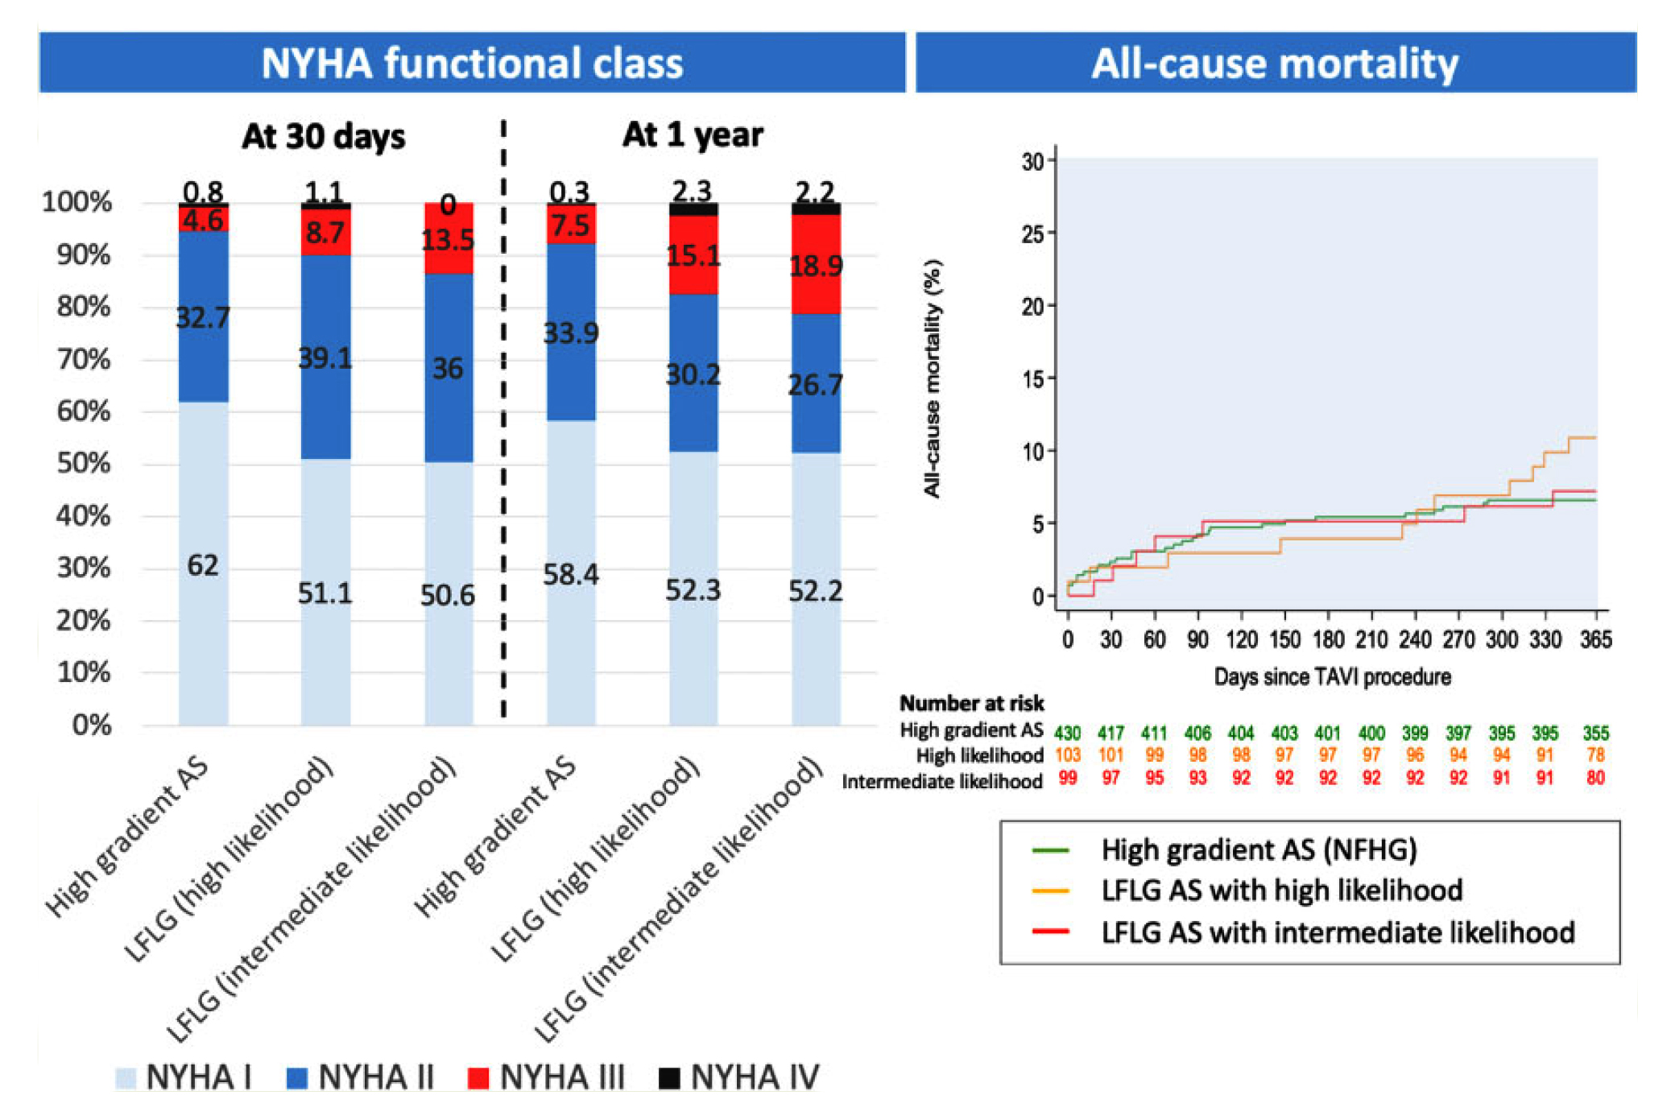
Criteria That Increases the Likelihood of True-Severe AS Proposed by the ESC/EACTS Guidelines
Okuno et al., Eur Heart J Qual Care Clin Outcomes 2021;7:366

Slide 37
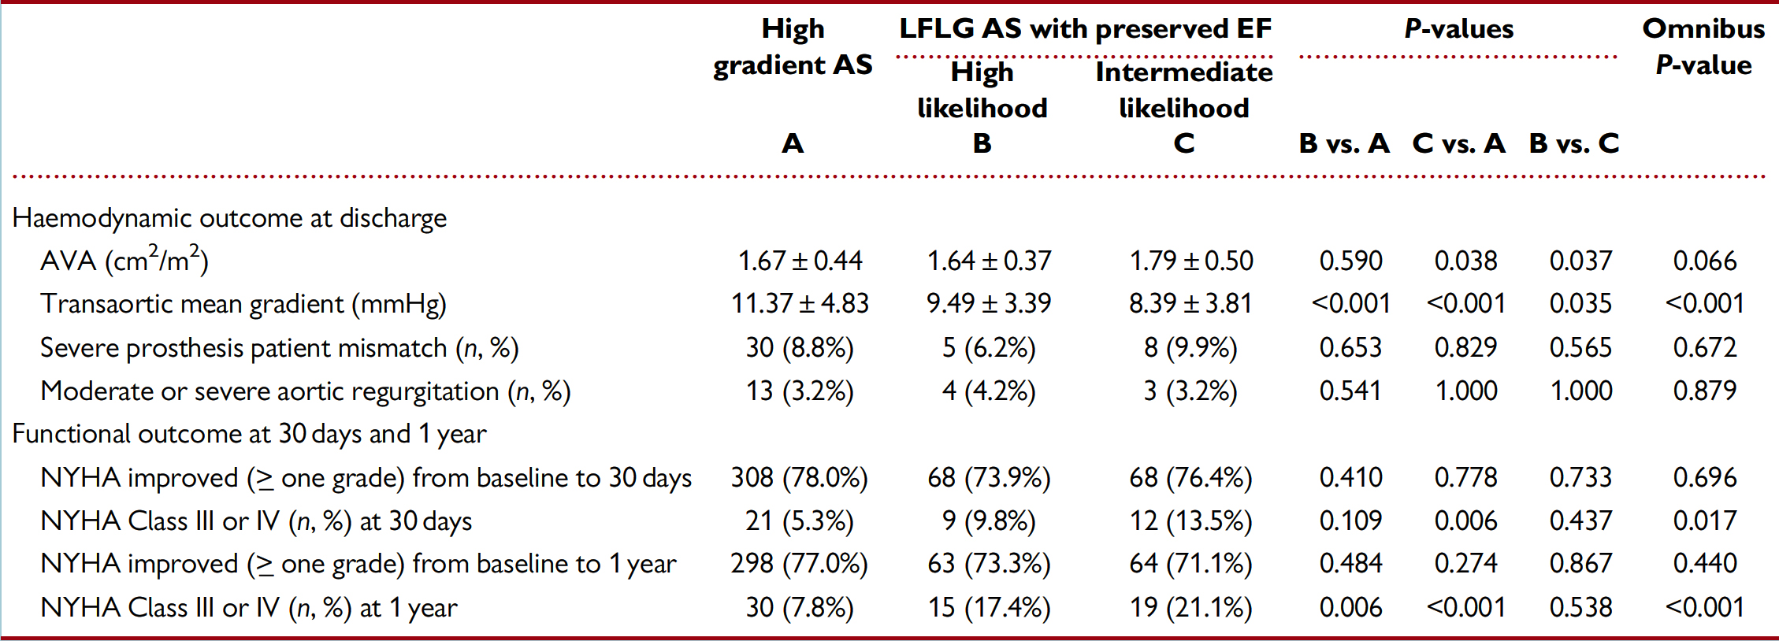
Hemodynamic and Functional Outcome
Okuno et al., Eur Heart J Qual Care Clin Outcomes 2021;7:366

Slide 38
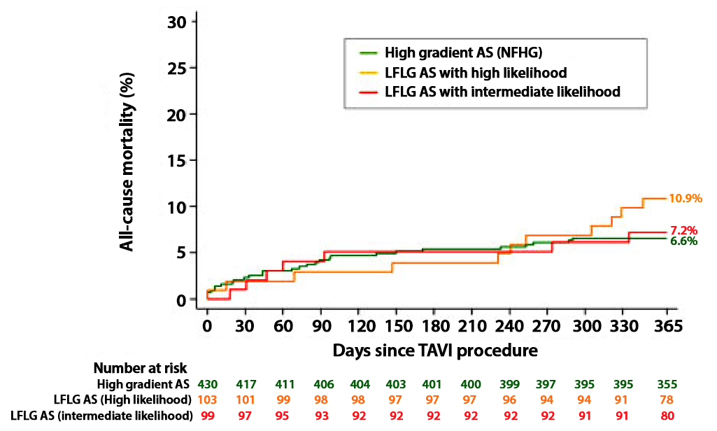
Cumulative Incidence Curve for All-Cause Mortality for Both Low-Flow Low-Gradient AS
Okuno et al., Eur Heart J Qual Care Clin Outcomes 2021;7:366

Slide 41
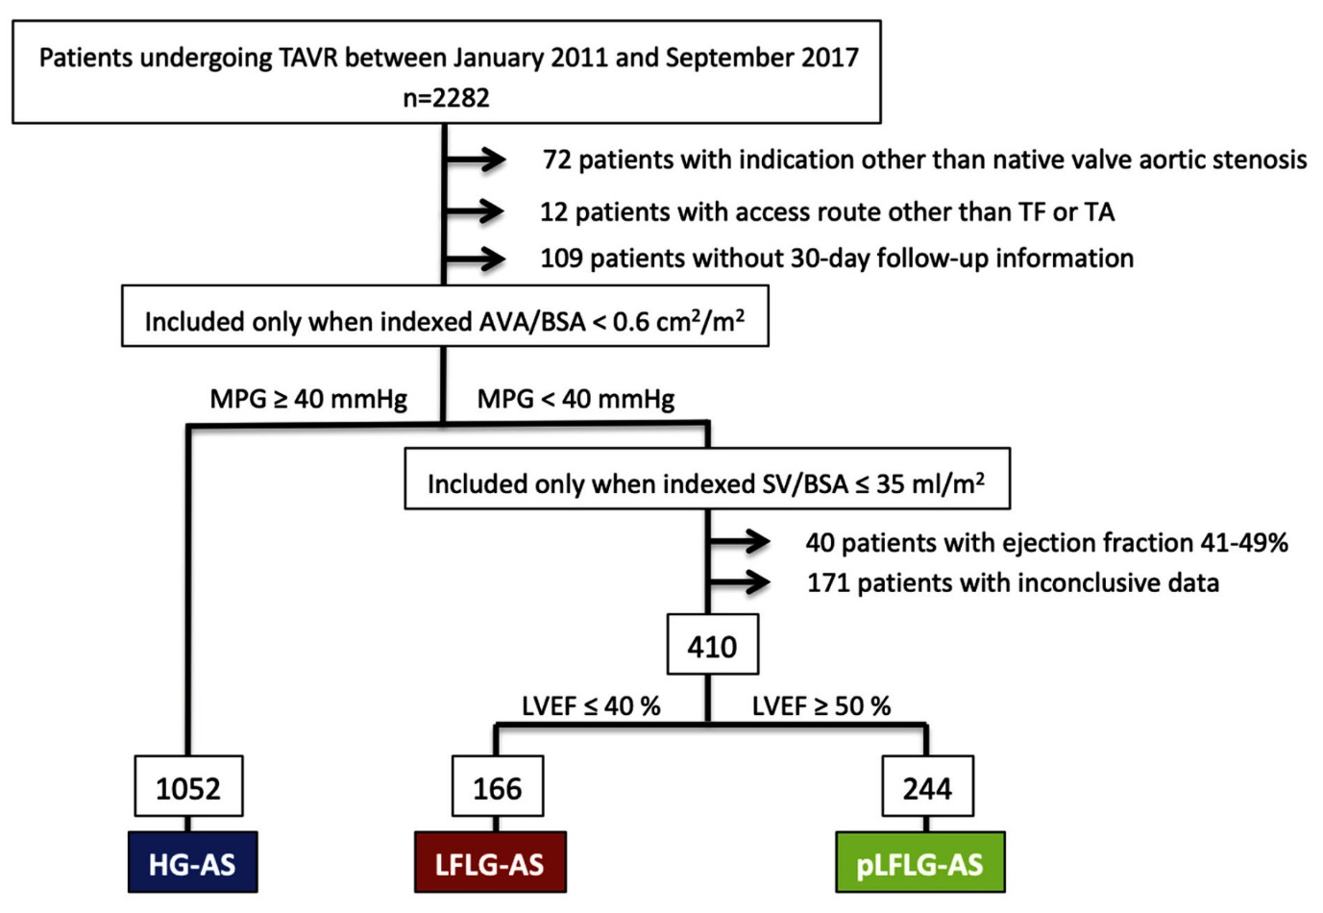
Flow Chart Illustrating the 3 Groups Derived
from the Entire Patient Population
Fischer-Rasokat et al., J Am Coll Cardiol Intv 2019;12:752

Slide 42
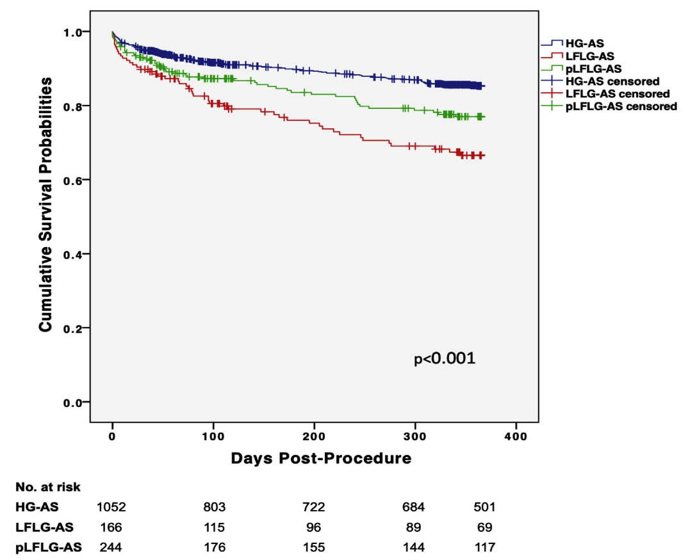
Survival Curves Based on All-Cause Mortality for Patients in the Overall (Unmatched) Study Population
Kaplan-Meier Survival Estimates for All-Cause Mortality
Fischer-Rasokat et al., J Am Coll Cardiol Intv 2019;12:752

Slide 43
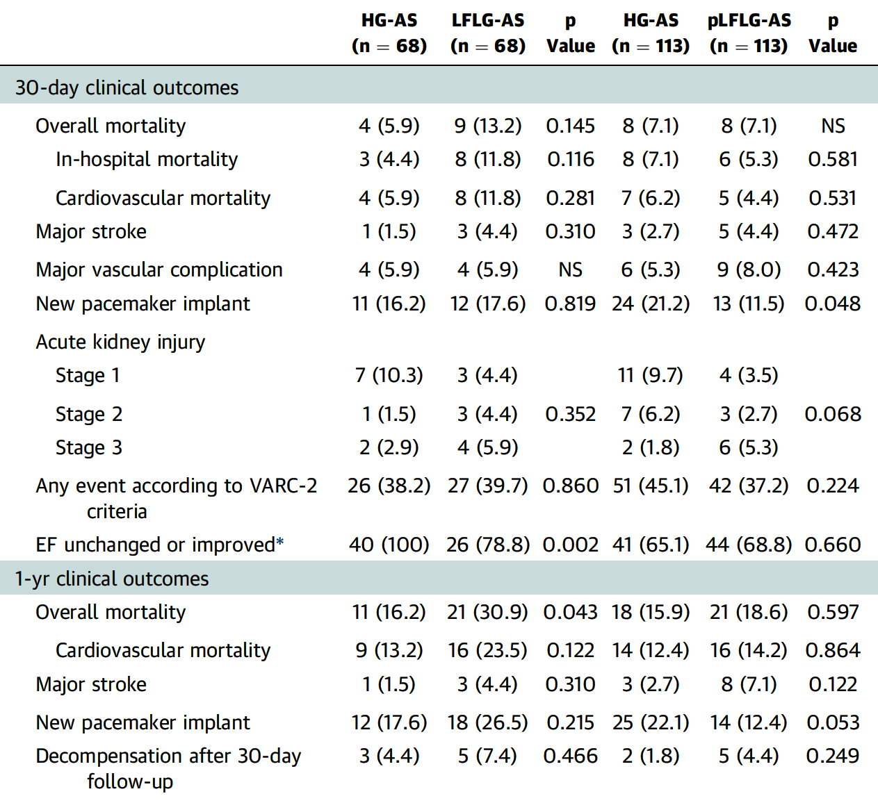
Clinical Outcomes
Fischer-Rasokat et al., J Am Coll Cardiol Intv 2019;12:752

Slide 44
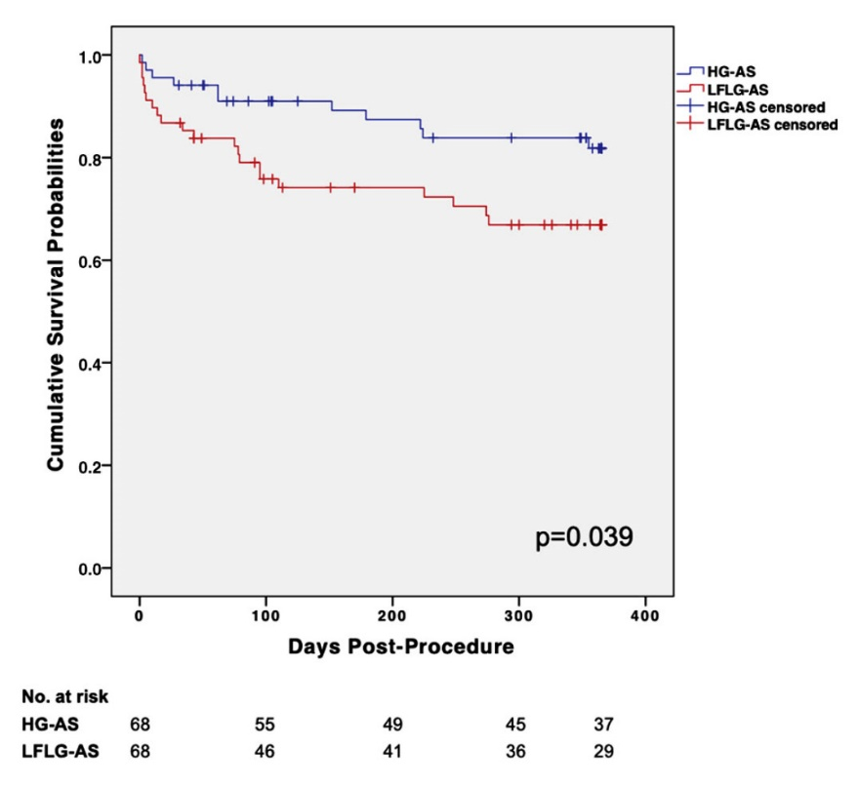
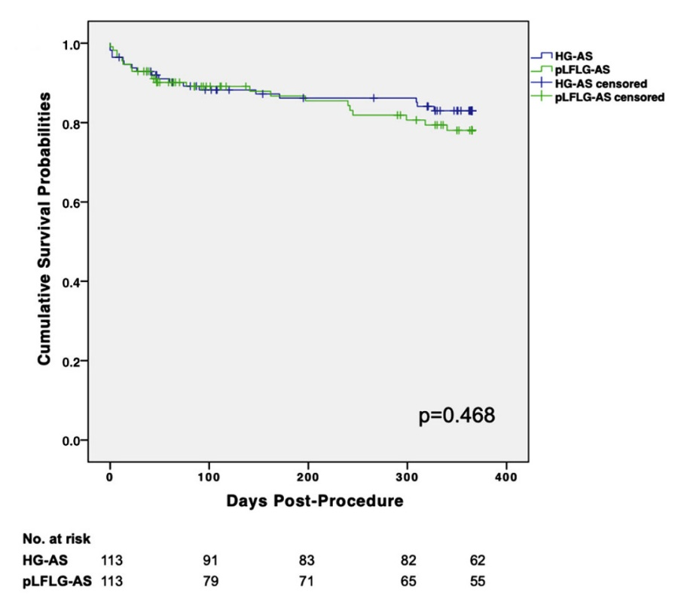
Survival Curves of Matched Study Populations
All-Cause Mortality of Matched Pts with HG-AS and LFLG-AS
All-Cause Mortality of Matched Pts with HG-AS and pLFLG-AS
Fischer-Rasokat et al., J Am Coll Cardiol Intv 2019;12:752

Slide 46
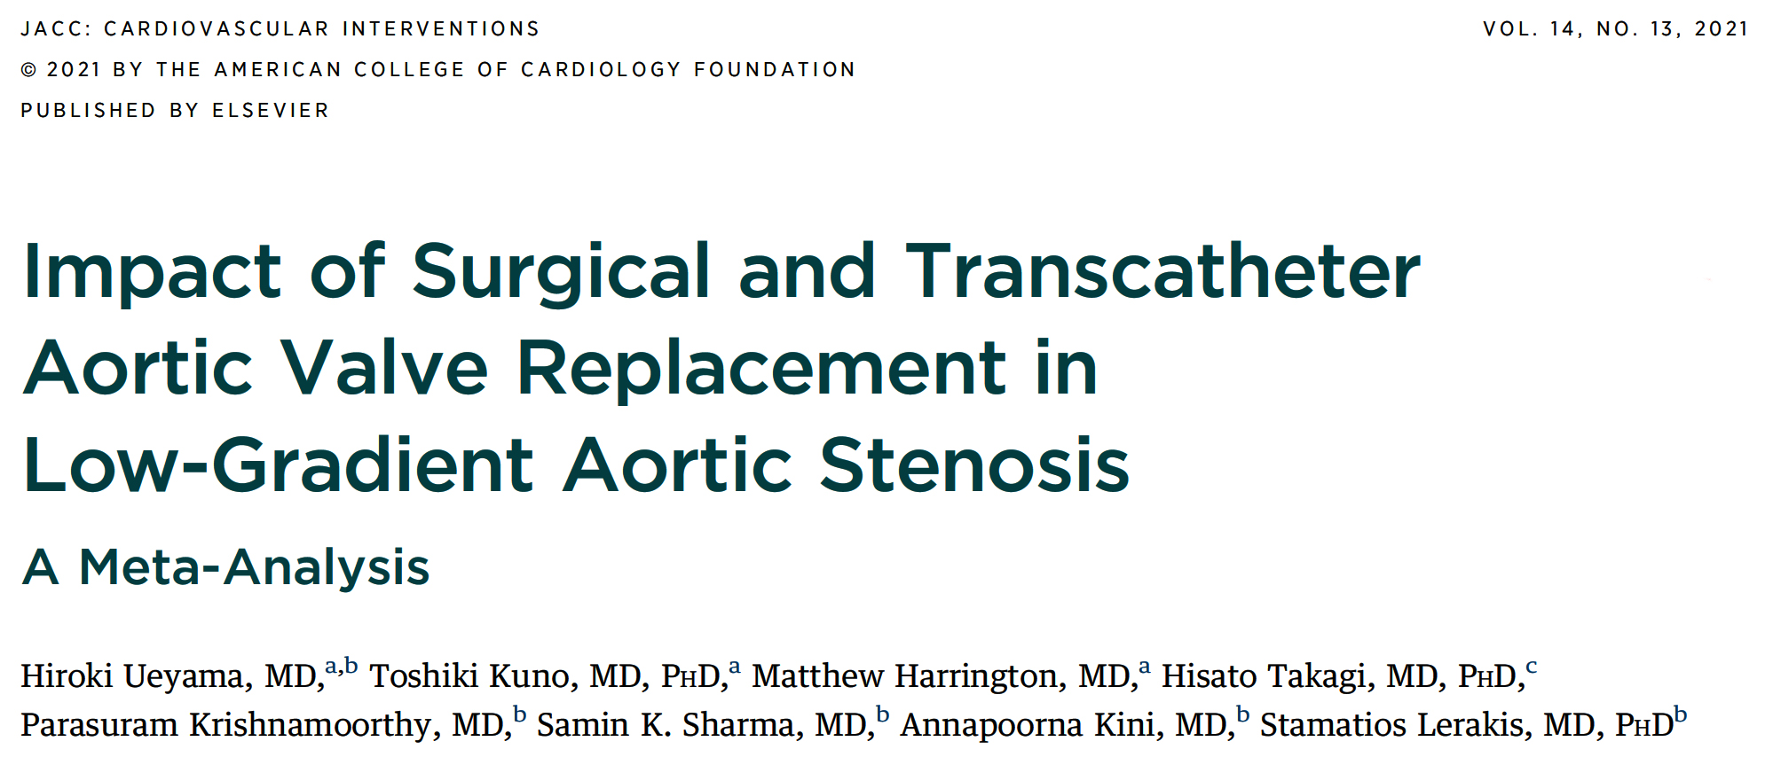

Slide 47
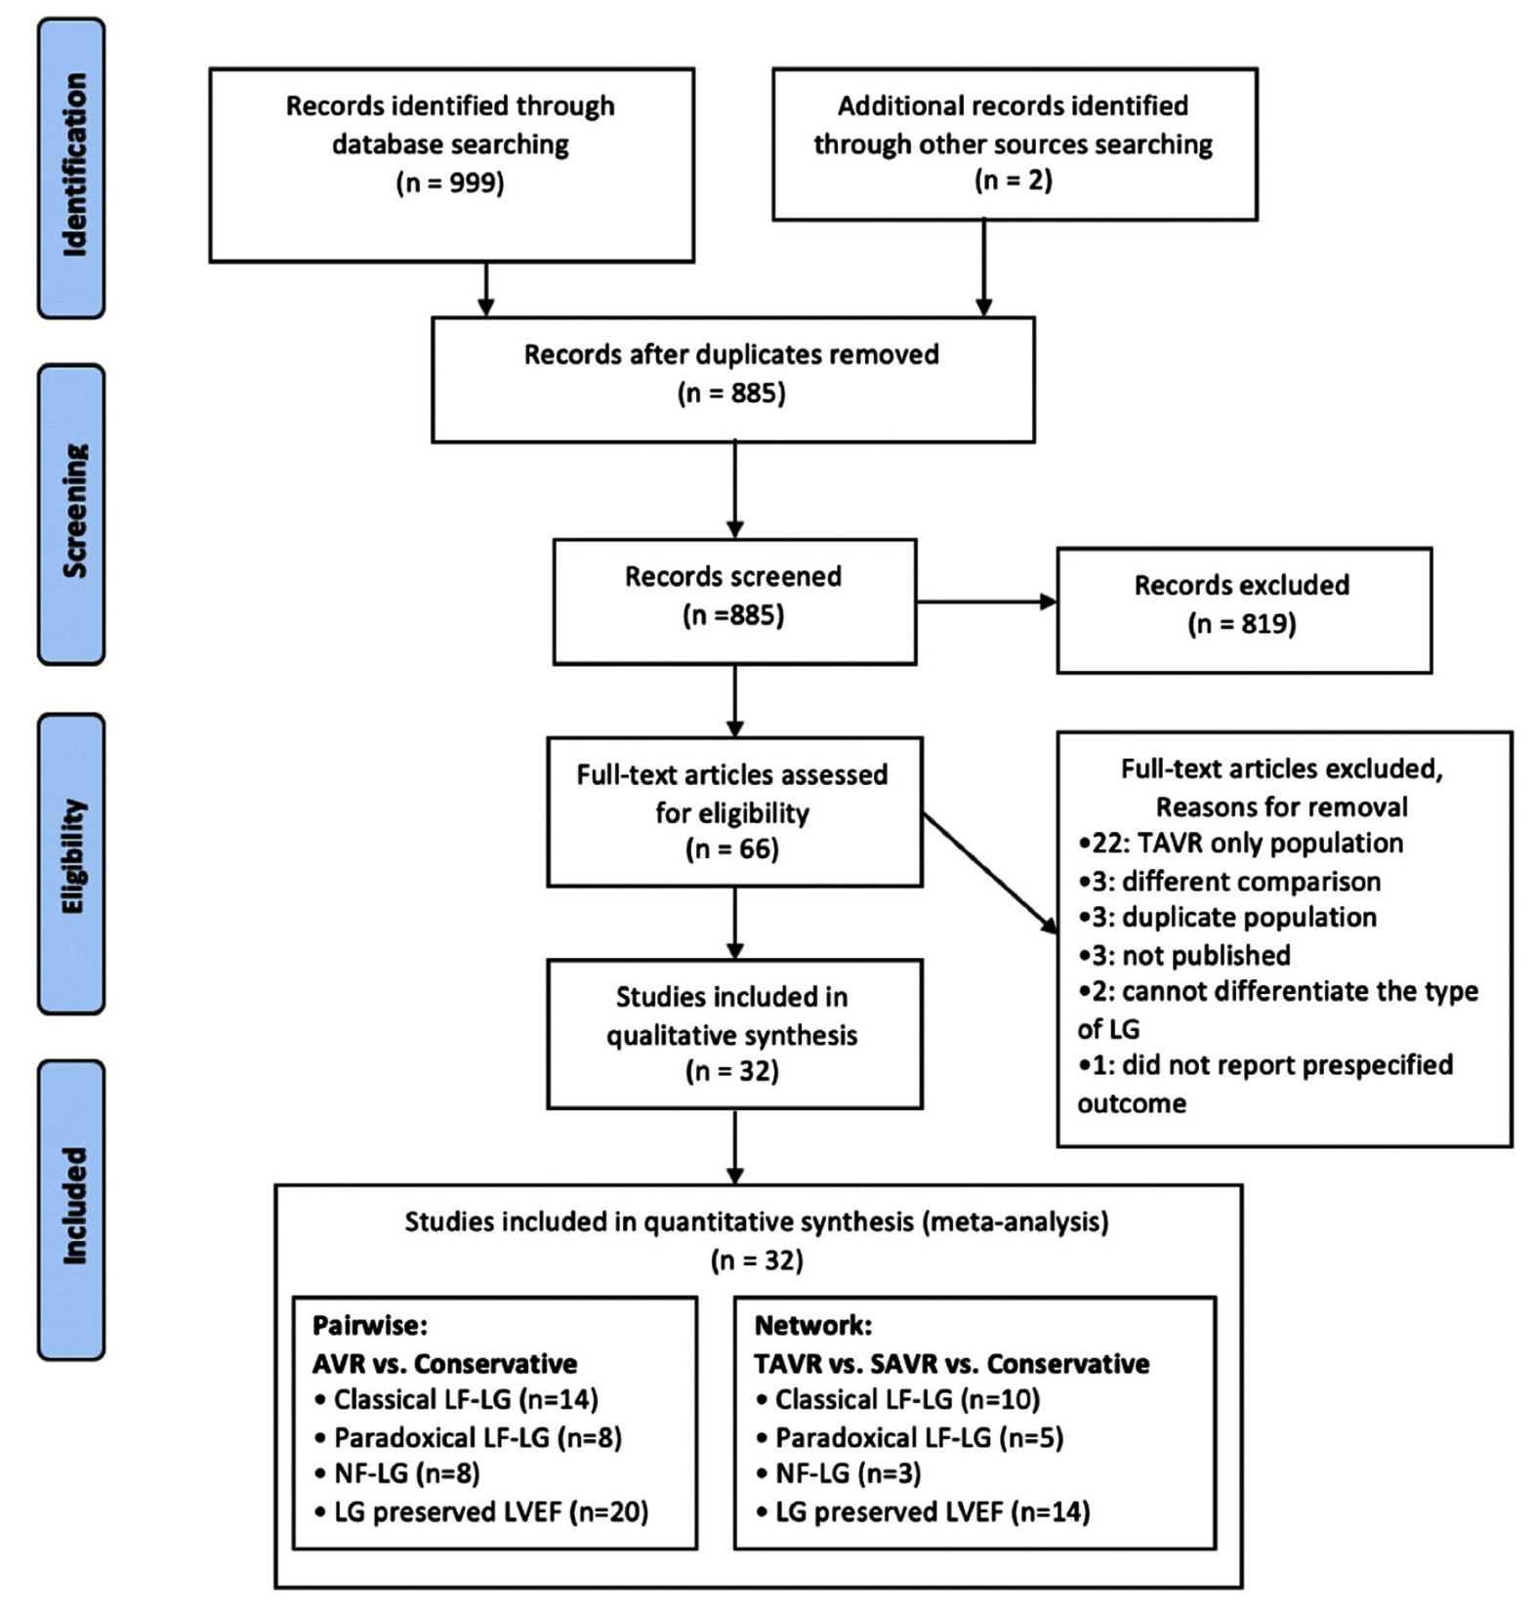
Preferred Reporting Items for Systematic Reviews and Meta-Analyses Flow Diagram of Study Selection
Ueyama, Sharma, Kini, Lerakis et al., J Am Coll Cardiol Intv 2021;14:1481

Slide 48
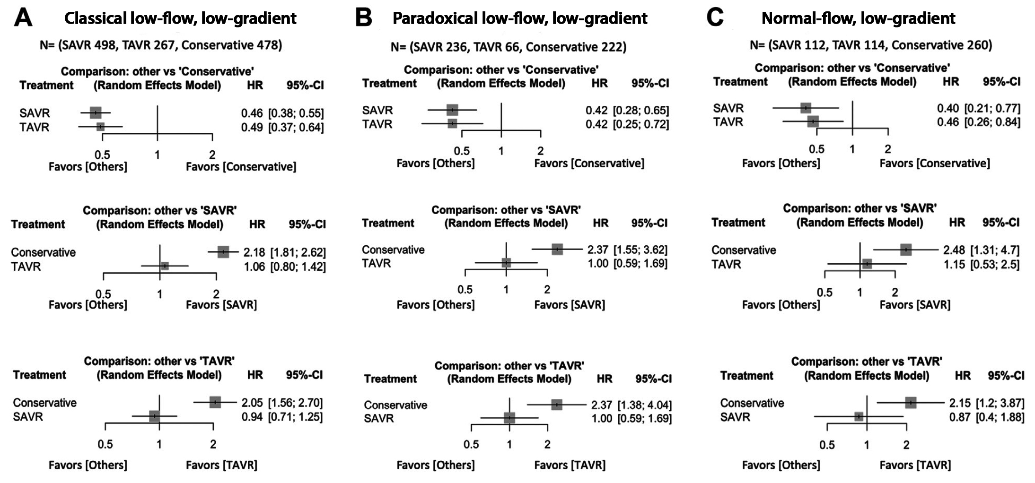
Effect of Intervention on All-Cause Mortality for
Each Subclass of Low-Gradient AS
Ueyama, Sharma, Kini, Lerakis et al., J Am Coll Cardiol Intv 2021;14:1481

Slide 49
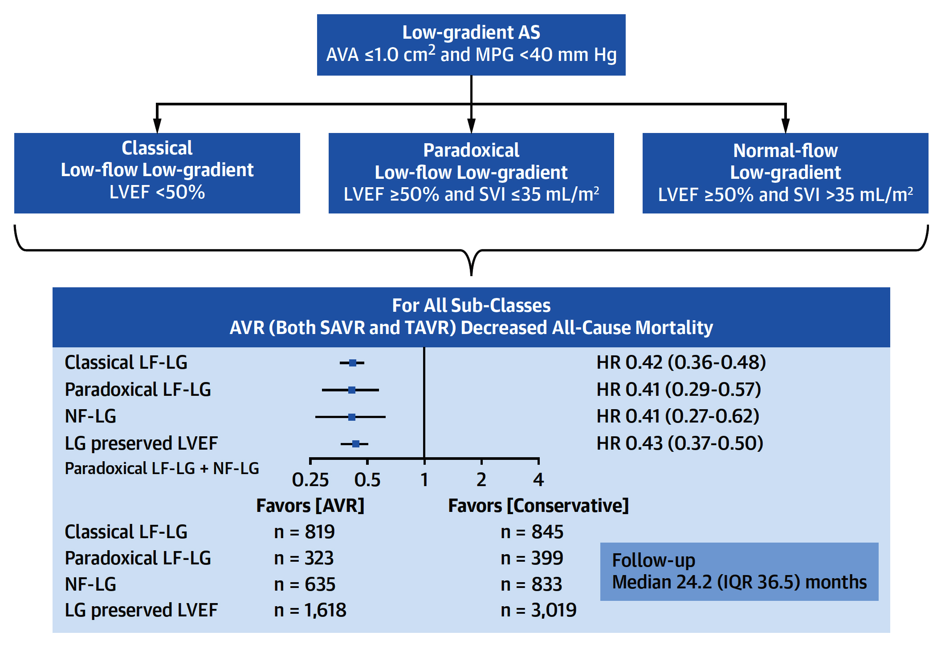
Meta-Analysis of Treatment Strategies for LG Severe AS (N=6,515)
Ueyama, Sharma, Kini, Lerakis et al., J Am Coll Cardiol Intv 2021;14:1481

Slide 51
Proposed Decision Tree Algorithm for Patients Presenting with Classic (EF <40%) Low-Flow, Low-Gradient AS
EOA <1 cm^{2,} MG <40 mmHg, and LVEF <40%
$$μ$$
Dobutamine stress echocardiogram (10-40 cg/kg/min)
Increase SV ≥20%
MG ≥40 mmHg
EOA ≤1.0 cm²
Increase SV ≥20%
MG <40 mmHg
EOA >1.0 cm²
Increase SV <20%
(no contractile
Reserve)
Ture severe AS
Pseudo severe AS
FAVOR TAVR if AS deemed severe
By MDCT Ca²⁺
≥1,200, ≥2,000
Heart team risk assessment
Medical therapy vs. consider enrollment in TAVR-unload trial
Intermediate, high, or extreme risk
Low risk for SAVR
TAVR vs. SAVR depending on overall medical comorbidities
Favor TAVR if non-inferior
TAVR
Généreux P J Am Coll Cardiol 2018;71:1309

Slide 52
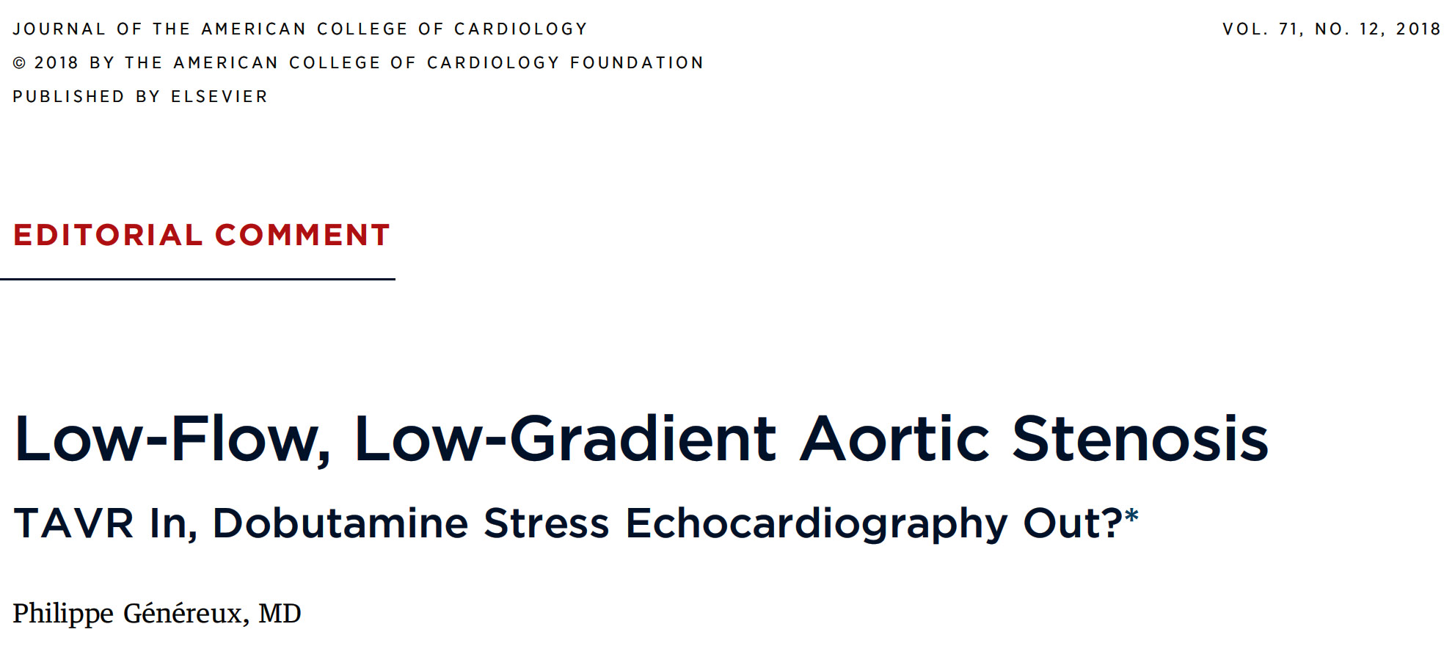

Slide 53
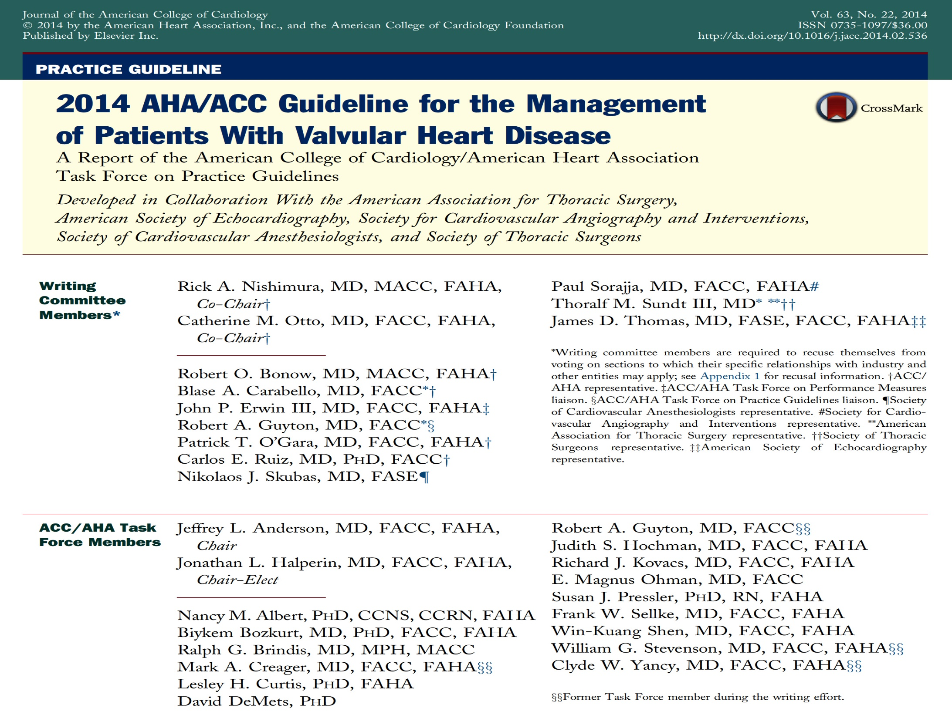

Slide 54
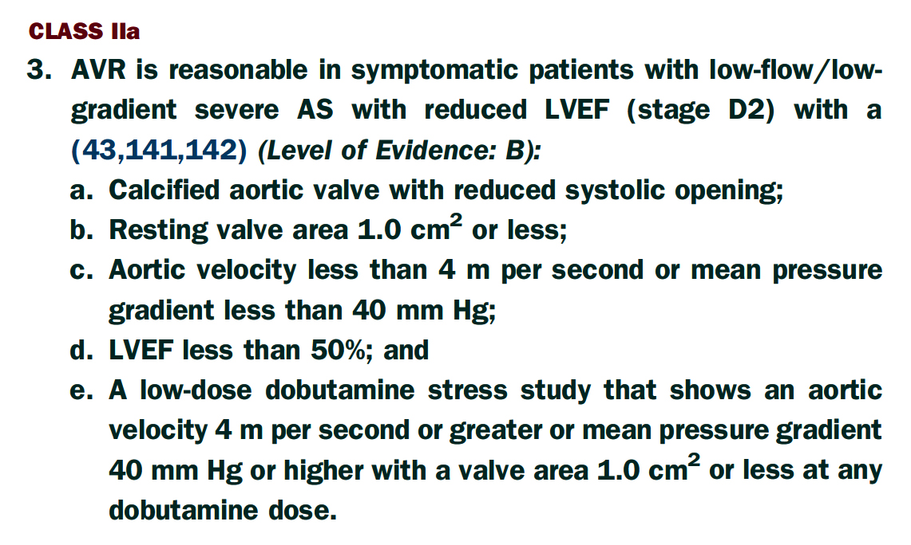
Recommendations for Patients with Low-Flow/
Low-Gradient AS with Reduced LVEF
Nishimura et al., J Am Coll Cardiol 2014;63:e57

Slide 55
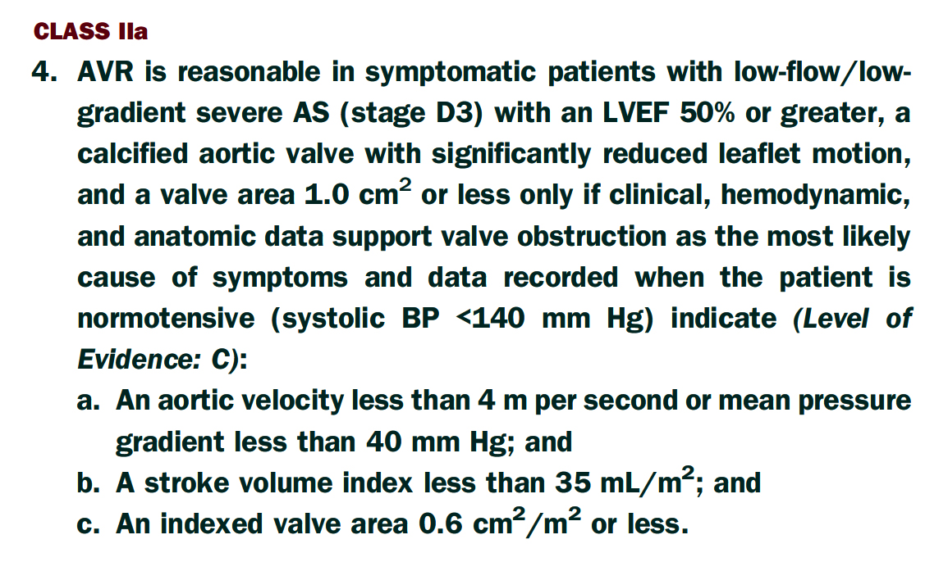
Recommendations for Patients with Low-Flow/
Low-Gradient AS with Preserved LVEF
Nishimura et al., J Am Coll Cardiol 2014;63:e57

Slide 56
Take Home Messages
Current Concepts in LF-LG Severe AS
Most of the studies have shown higher mortality and higher HF class in pts with LF-LG AS compared to traditional NF-HG AS. Aortic valve intervention with either TAVR or SAVR is associated with better outcomes compared to conservative (medical) therapy in all subgroups of LG severe AS.
In pts with LF-LG severe AS, presence or absence of contractile reserve does not predict LV function improvement or follow-up mortality upto 2.5yrs. Therefore true severe LF-LG AS should undergo AV replacement either by surgery or by Transcatheter approach (preferred) irrespective of contractile reserve.

Slide 57
Question # 1
Following are true statements regarding the LF-LG AS except:
LF-LG severe AS usually have higher mortality vs NG AS
LF-LG AS are appropriate for AV intervention
LF-LF AS can have increase in EF after AV intervention
All LF-LG AS pts should undergo dobutamine stress testing routinely
Correct answer: D

Slide 58
Question # 2
Following statements regarding LF-LG AS are true except:
These pts makes upto 20-40% of severe AS population
Diagnosis should be based after considering other factors such as HTn, other Valvular diseases
LF-LG pts with LVEF <30% don’t derive benefit from TAVR
Nonrandomized data have shown similar benefit of SAVR and TAVR in LF-LG AS
Correct answer: C

Slide 59
Question # 3
Following statements are true regarding the status of contractile reserve assessment in LF-LG severe AS pts except:
A. Contractile reserve usually predicts follow-up mortality
B. Contractile reserve does not predict LVEF improvement
C. Decision to intervene in pts with no contractile reserve can be done by assessing CT Ca++ score of the AV
D. Dobutamine challenge can with be done with echo (DSE) or in the cath lab by gradual titration of infusion
Correct answer: A

