Slide 1
Live Case
12/2021

Slide 2
61 y.o. male presents with exertional bilateral hip pain for past few months.
Lifestyle limiting claudication (Rutherford class II/category 4)
PMH: HTN, HLD, CAD, known PAD s/p left SFA PTA
Medications: Aspirin, Atorvastatin, Plavix, Cilostazole, Metoprolol

Slide 3
Labs: Hgb/Hct 13.2/39.3, Plts 201, INR 1.2
ABI: R 0.71 L 0.62
Arterial duplex: Suggestive of bilateral aortoiliac and SFA disease.

Slide 4
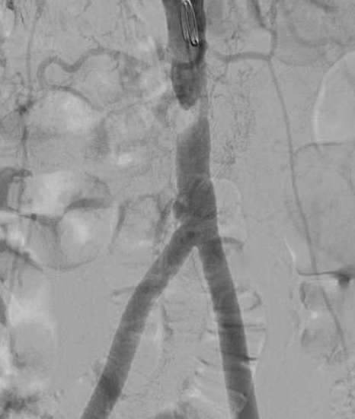

Slide 6
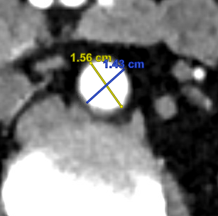
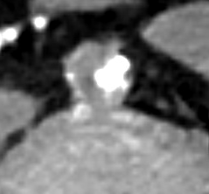
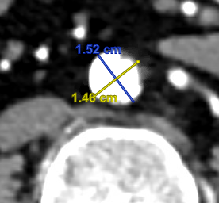
CTA
Focal near complete occlusion of the distal abdominal aorta
Abdominal aorta at celiac origin: 1.8 cm
Infrarenal aorta: 1.5 cm
Proximal vessel reference diameter
Focal occlusion
Distal vessel reference
diameter

