Slide 1
Complex Coronary Case
Supported by:
Boston Scientific (BSc)
Heal Conclave: Left Main Bifurcation Conclave

Slide 2
Disclosures
Samin K. Sharma, MD, MSCAI, FACC
Speaker’s Bureau – BSC, Abbott, CSI
Annapoorna S. Kini, MD, MRCP, FACC
Nothing to disclose

Slide 3
Live Case # 1: WA 77yrs F
Patient Demographics
77 yrs, F with NSTEMI
Present Clinical Presentation
Presented new onset CCS class IV angina and
+ TnI (peak 2.3U) for NSTEMI and heart failure.
Pt was initially managed medically on OMT and underwent cath revealing 3V+LM CAD
CAD Risk Factors
Controlled Hyperlipidemia
Controlled Hypertension
COPD/Asthma, SAQ-7: 34
+F/H, Hypothyroidism
Clinical Variables
High risk noninvasive testing, EF 40%
Medications
Aspirin, Rosuvastatin, Losartan, Furosemide, Multiple Inhalers
Cath: Cath on Dec 1st 2021 revealed calcified 3 V+LM bifurcation CAD: 70% calcified LM bifurcation, 80% pLAD, 70% pLCx, 100% severely calcified mRCA, Syntax score 33 and LVEF 40%. Pt was referred for CABG, but declined by the CTS due to super-obesity.
Plan: Now planned for high-risk complex dLM bifurcation with Mini-Crush technique using Rotational Atherectomy and IVUS for stent optimization.

Slide 4
AUC 2017: Revascularization to Improve Survival
Compared with Medical Therapy
Syntax score 33; STS score 3.2
Patel et al., J Am Coll Cardiol 2017;69:2212

Slide 5
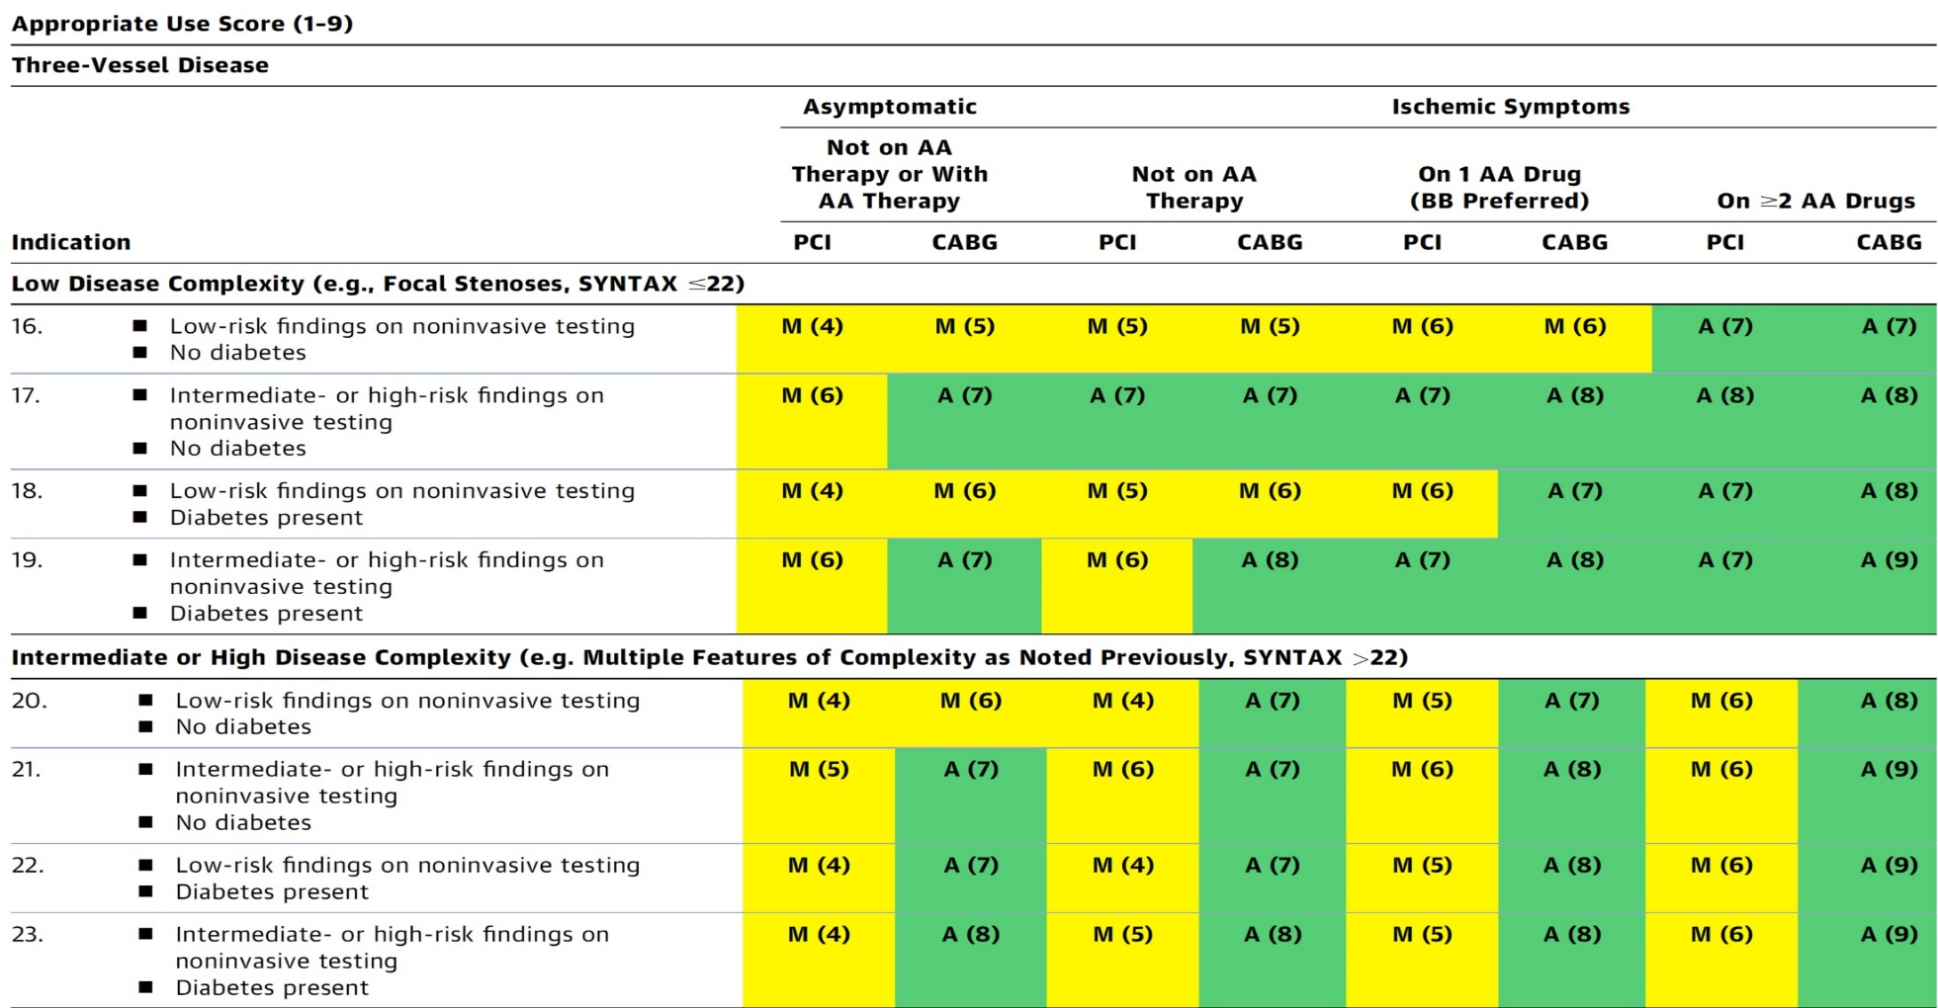
AUC 2017: Left Main + 3 V CAD
After Heart team discussion: A
Patel et al., J Am Coll Cardiol 2017;69:2212

Slide 6
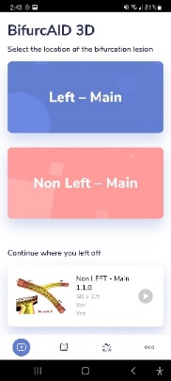
BifurcAID
App
3D
3D
WebApp
Key Features:
Left Main and Non-Left Main bifurcation lesions
Secondary view highlighting key points such as stent crush
Android, iOS and WebApp
Many techniques:
DK Crush
Mini Crush
Culotte
Provisional Stenting
Bailout Techniques
Key video shortcut (on WebApp)
Available for free on Android Google Play Store and Apple App Store in addition to our WebApp version on: www.CardiologyApps.com/
BifurcAID-3D

Slide 7
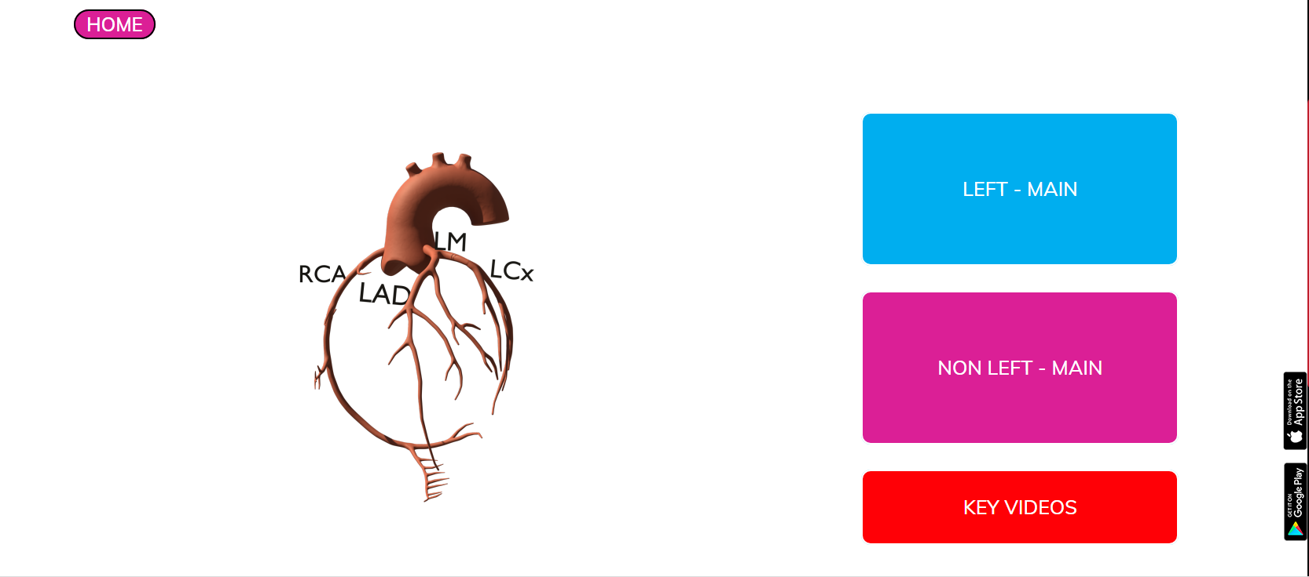
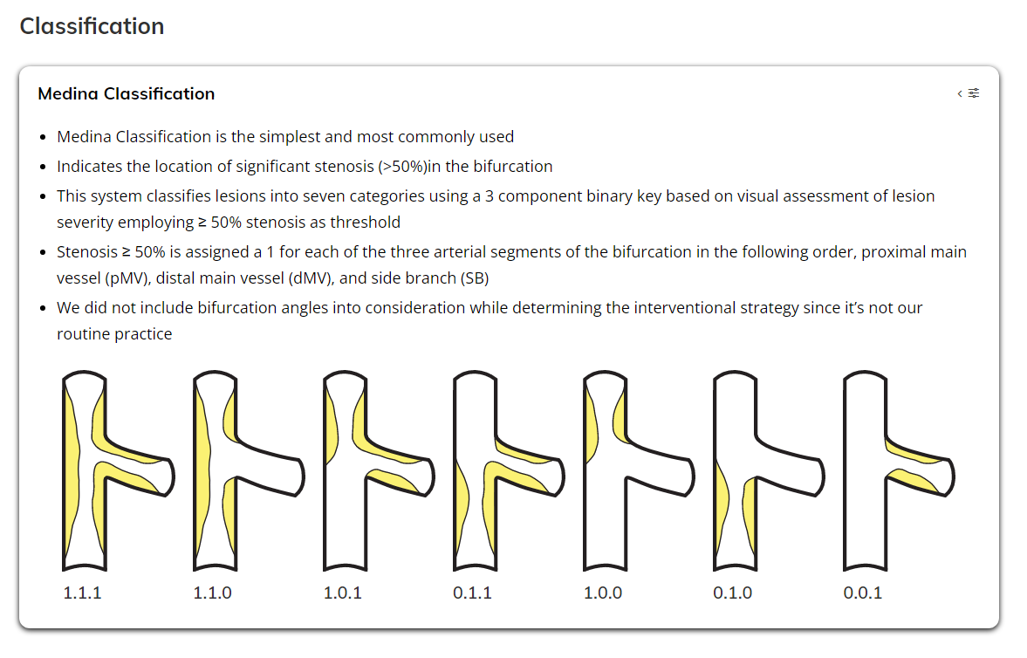
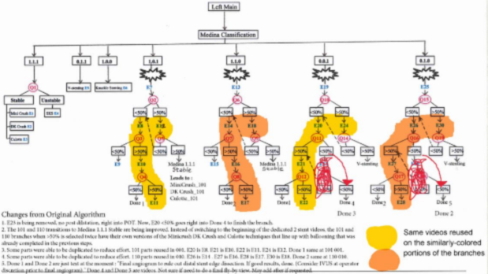
www.CardiologyApps.com/BifurcAID-3D
Complex Left Main and
Non-Left Main Algorithms
Shortcuts to
Techniques

Slide 8
Available for Free Download Now
iOS
&
Android
2x

Slide 9
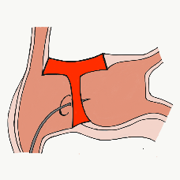
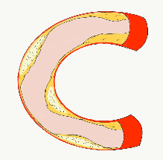
More than 38,000 unique downloads
Last Updates:
*iOS Since
03/28/21
Android Since
12/20/20
Cath Lab Apps CardiologyApps.com
iOS ★ 5/5
10648 downloads
Android ★ 4.5/5
7292 downloads
Released sept 2017
iOS ★ 5/5
6567 downloads
Android ★ 4.7/5
4891 downloads
Released June 2018
iOS ★ 5/5
3077 downloads
Android ★ 5/5
678 downloads
Released March 2019
iOS ★ 5/5
1795 downloads
Android ★ N/A
538 downloads
Released Sept 2018
iOS ★ 5/5
1145 downloads
Android ★ 5/5
1239 downloads
Released June 2019
Large Update Q3 19
Large Update Q1 21
BifurcAID
OCTAID
TAVRcathAID
TranseptAID
CalcificAID
*Also available
as WebApp
*Also available
as WebApp
Download Apps
For Free on Both:
WebApps available free on
www.CardiologyApps.com
Apple ® and App Store® are registered trademarks of Apple Inc.
Notes:
These are the apps we have created which will provide digital algorithms for our future ambitious projects to make our cath labs smarter.

Slide 10
More than 38,000 unique downloads
Last Updates:
*iOS Since
03/28/21
Android Since
12/20/20
‡ 12/10/21
Cath Lab Apps CardiologyApps.com
WebApp Only*
15,430 page views
www.cardiologyapps.com/ComplicAID
iOS ★ 5/5
>600 downloads
Android ★ 4.8/5
1032 downloads ‡
Released June 2021
Clinical Care
Application
For Heart Attack
Patient Transfers
Released Aug 2020
*Brand New*
Diwali Special
Android ★ N/A
329 downloads ‡
Released Nov 2021
Released August 2020
ComplicAID
BifurcAID 3D
STEMIcathAID
GuidewireAID
*Also available
as WebApp
*Also available
as WebApp
Download Apps
For Free on Both:
WebApps available free on
www.CardiologyApps.com
Apple ® and App Store® are registered trademarks of Apple Inc.
Notes:
These are the apps we have created which will provide digital algorithms for our future ambitious projects to make our cath labs smarter.

