Slide 1





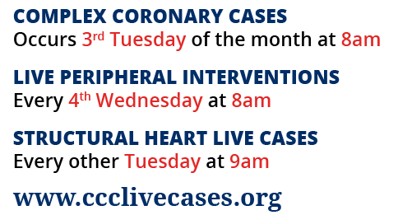
www.ccclivecases.org

Slide 2
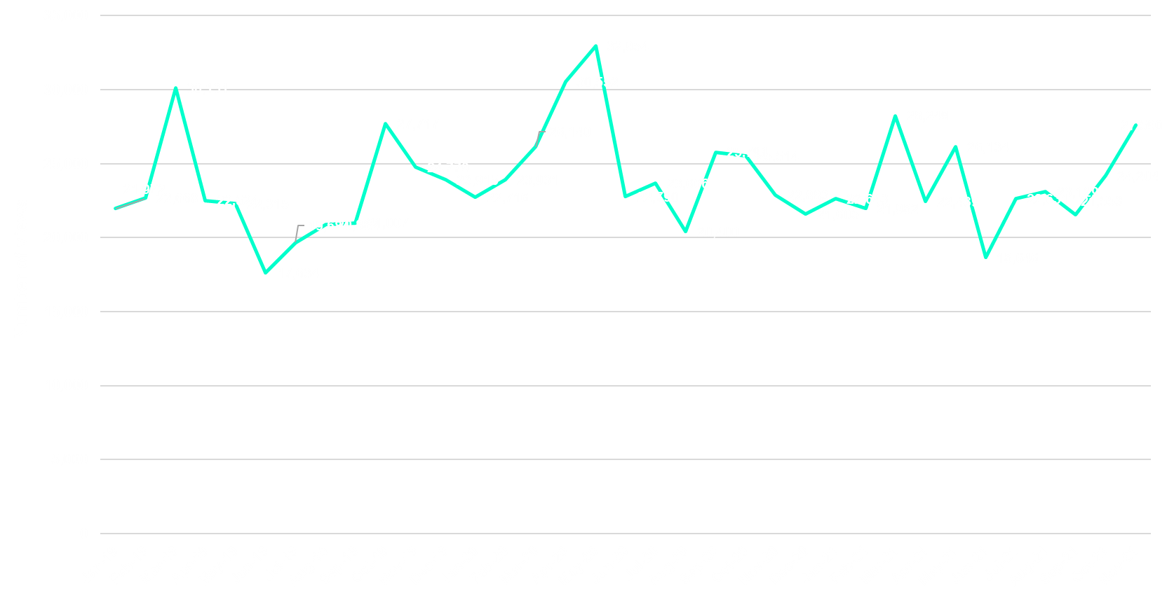
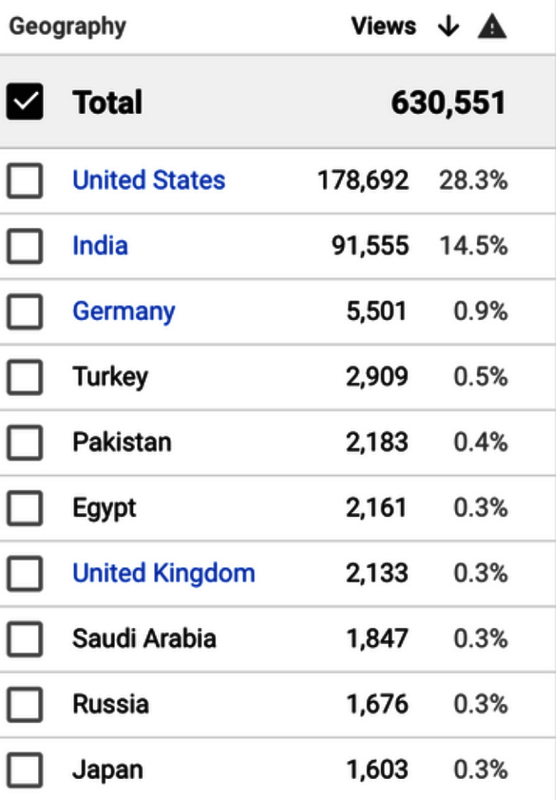
Total Page Views per Month
(Past 2 Years)
168 countries

Slide 3
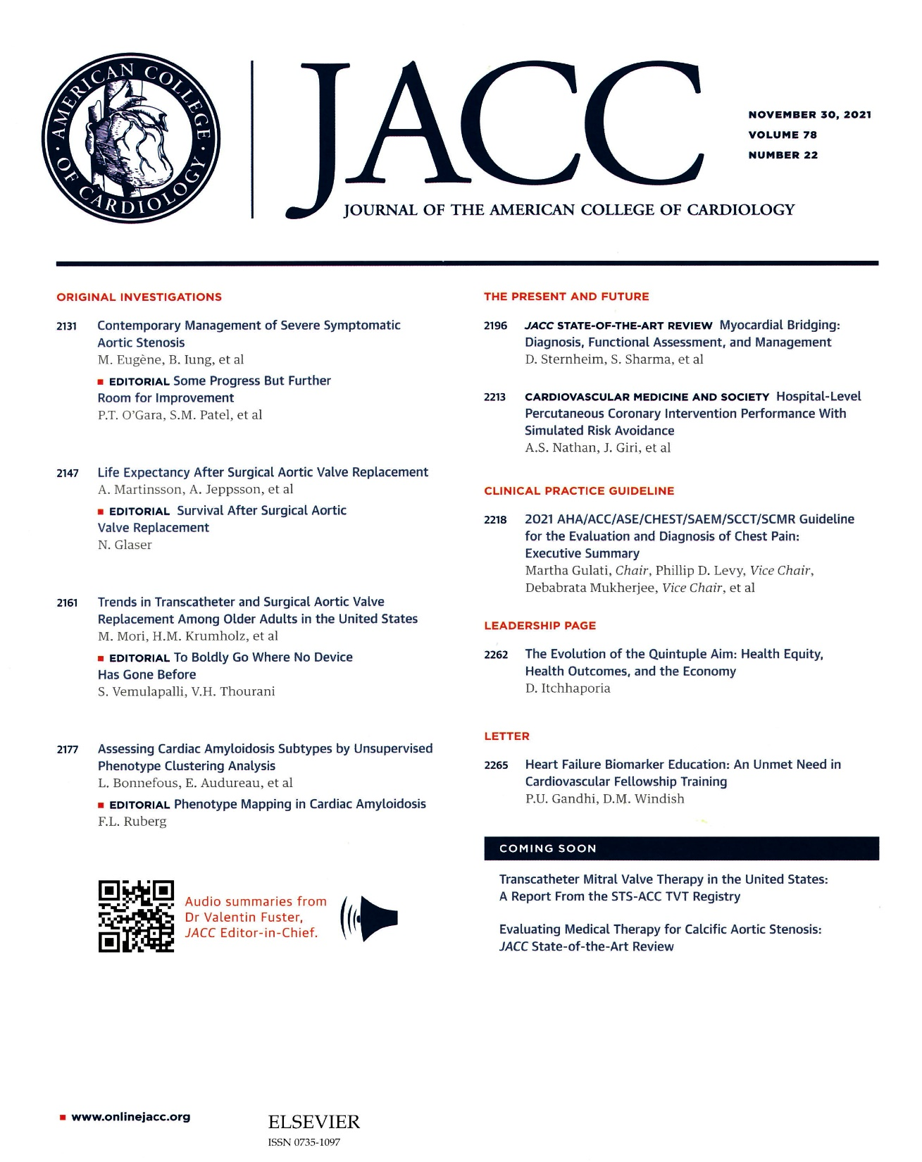

Slide 4

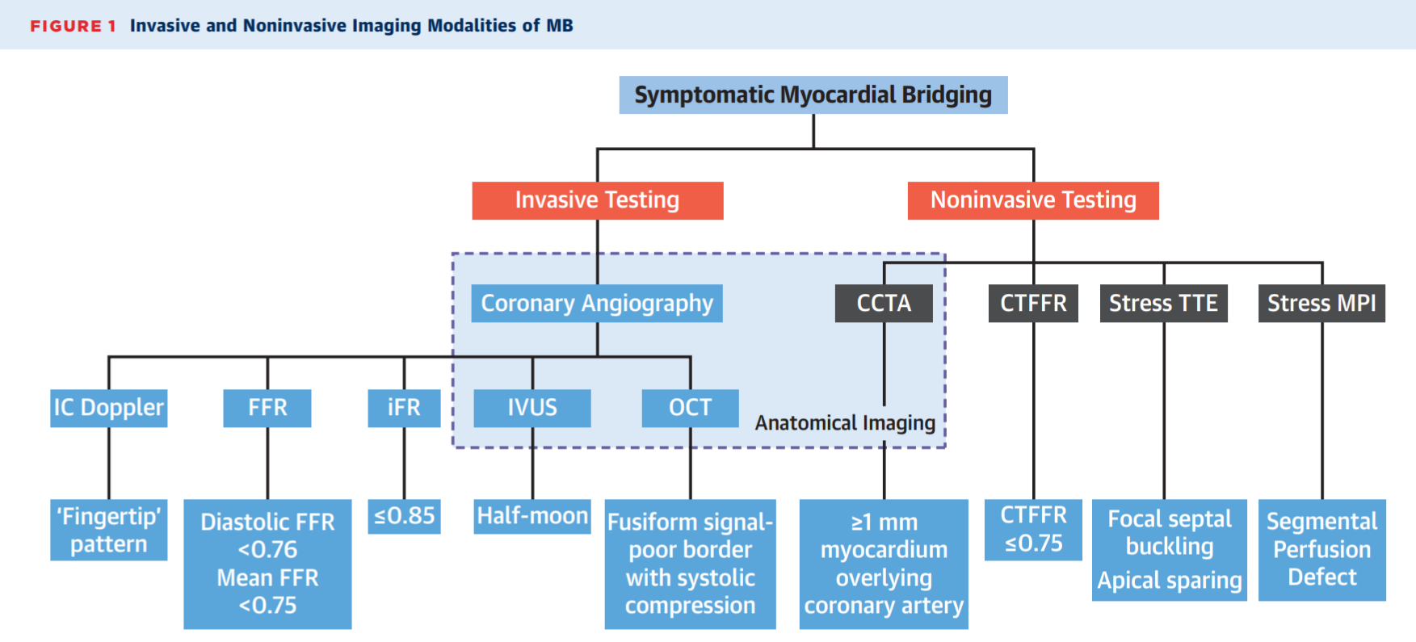
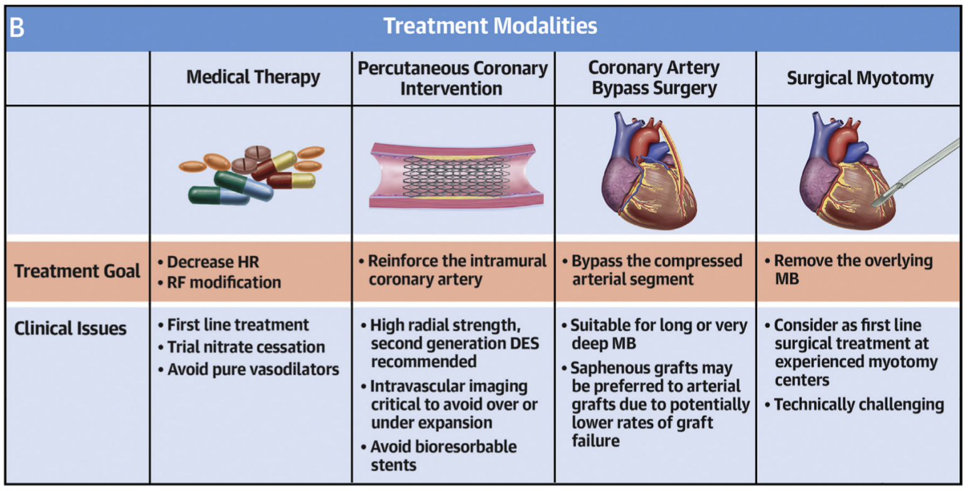
Diagnosis
Myocardial Bridging
Treatment
Sternheim D, Power D, Sharma S, et al. JACC 2021:78;2196-2212

Slide 5

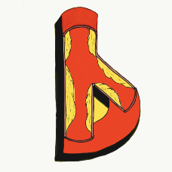


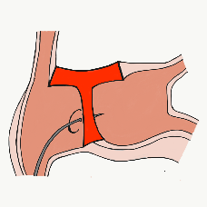
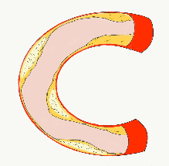


50,219 unique downloads and counting!
(Up 14,000 in 2021)
Data Updated on Nov 21 2021*
Cath Lab Apps CardiologyApps.com
iOS ★ 5/5
11,906 downloads
Android ★ 4.96/5
9,072 downloads
Released sept 2017
iOS ★ 4.6/5
7,620 downloads
Android ★ 4.29/5
5,821 downloads
Released June 2018
iOS ★ 5/5
4,050 downloads
Android ★ 5/5
1,362 downloads
Released March 2019
iOS ★ 4.67/5
1,954 downloads
Android ★ 4.6/5
884 downloads
Released Sept 2018
iOS ★ 4.86/5
1,773 downloads
Android ★ 5/5
1,792 downloads
Released June 2019
Large Update Q3 19
Large Update Q1 21
BifurcAID
OCTAID
TAVRcathAID
TranseptAID
CalcificAID
*Also available
as WebApp
*Also available
as WebApp
Download Apps
For Free on Both:
WebApps available free on
www.CardiologyApps.com
Apple ® and App Store® are registered trademarks of Apple Inc.
Notes:
These are the apps we have created which will provide digital algorithms for our future ambitious projects to make our cath labs smarter.

Slide 6




50,219 unique downloads and counting!
(Up 14,000 in 2021)
Data Updated on Nov 21 2021*
Cath Lab Apps CardiologyApps.com
WebApp Only*
23,028 page views
www.cardiologyapps.com/ComplicAID
iOS ★ 5/5
1,723 downloads
Android ★ 5/5
946 downloads
Released June 2021
Clinical Care Application For Heart Attack patient transfers 412 downloads
Released Aug 2020
iOS ★ 5/5
723 downloads
Android ★ N/A
181 downloads
Released Nov 2021
Released August 2020
ComplicAID
BifurcAID 3D
STEMIcathAID
GuidewireAID
*Also available
as WebApp
*Also available
as WebApp
Download Apps
For Free on Both:
WebApps available free on
www.CardiologyApps.com
Apple ® and App Store® are registered trademarks of Apple Inc.
Notes:
These are the apps we have created which will provide digital algorithms for our future ambitious projects to make our cath labs smarter.

Slide 7
Complex Coronary Cases Supported by:
Abbott Vascular Inc.
Boston Scientific Corp.
Terumo Vascular Corp.
Cardiovascular Systems Inc.
Abiomed Inc.
Chiesi Inc.
Shockwave Medical Inc.
Cardinal Health Cordis Inc.

Slide 8
Disclosures
Samin K. Sharma, MD, MSCAI, FACC
Speaker’s Bureau – BSC, Abbott, CSI
Annapoorna S. Kini, MD, MRCP, FACC
Nothing to disclose
Sameer Mehta, MD, FACC (Moderator)
Nothing to disclose

Slide 9

CCC Live Case # 150
Patient Demographics
65 yrs, Male with known CAD
Present Clinical Presentation
Presented with new onset CCS class III angina for few months
CAD Risk Factors
Controlled Hypertension
Controlled Hyperlipidemia
+ F/H, Asthma, Covid-19 11/2020
SAQ-7: 68
Clinical Variables
Known CAD s/p PCI of LCx 2018. Stable since on MMT
Medications
Aspirin, Clopidogrel, Toprol XL, Amplodipine, Atenolol, Atorvastatin, Enalapril, Albuterol
Cath: Cath on 11/2/2021 revealed 2 V CAD and patent LCx PCI sites: 70-80% multiple calcified tortuous lesions in RCA, 90% LAD/D2, LVEF 60% and Syntax score 17. Pt underwent successful PCI of LAD/D2 using Promus Elite DES and did well. Pt continued to have CCS class I angina on MT.
Plan: Now planned for complex DES PCI of calcified tortuous multiple RCA lesions using rotational atherectomy and IVL.

Slide 10

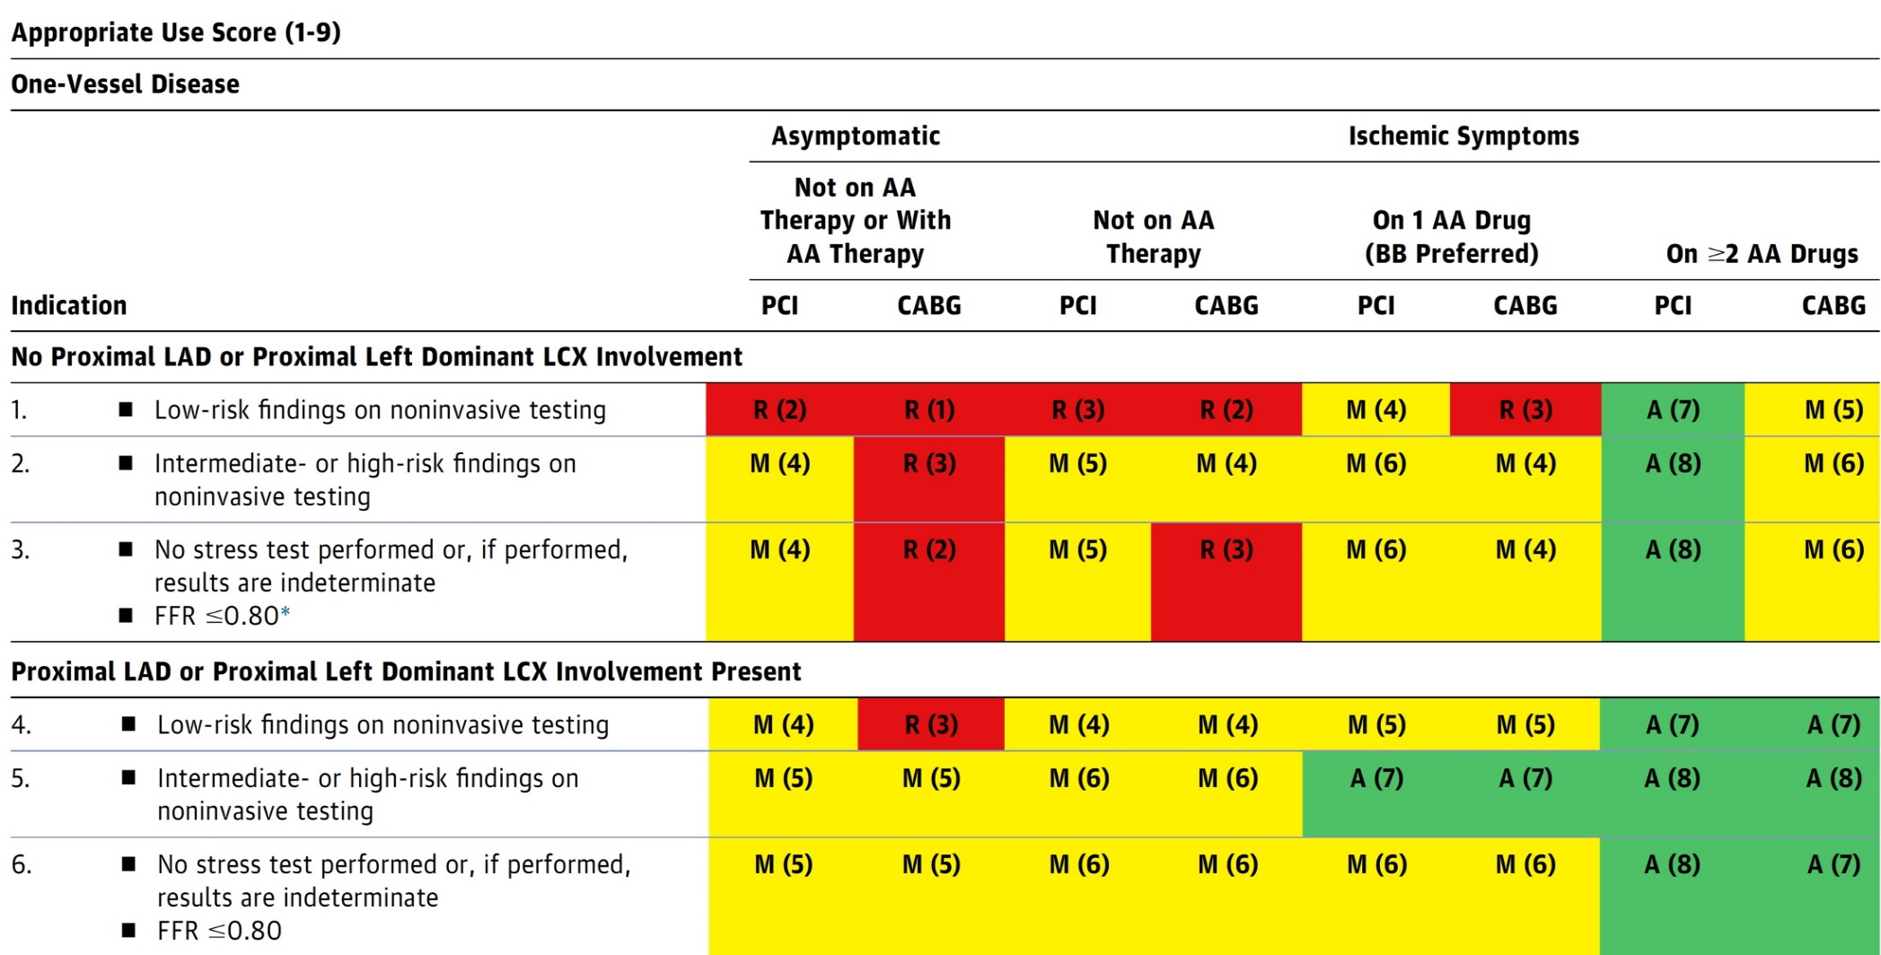
AUC 2017: One-Vessel Disease
Patel et al., J Am Coll Cardiol 2017;69:2212

Slide 11

Latest Issues in Coronary Intervention
Key Interventional Trials from TCT 2021;
FAME 3 Trial, MASTER DAPT- MI Substudy,
SCB vs PCB in DES ISR
Focused review of the month
New CA-AKI Risk Score:
A Contemporary simple risk score for prediction
of contrast associated acute kidney injury after PCI

Slide 12
Latest Issues in Coronary Intervention
Key Interventional Trials from TCT 2021;
FAME 3 Trial, MASTER DAPT- MI Substudy,
SCB vs PCB in DES ISR
Focused review of the month
New CA-AKI Risk Score:
A Contemporary simple risk score for prediction
of contrast associated acute kidney injury after PCI

Slide 13
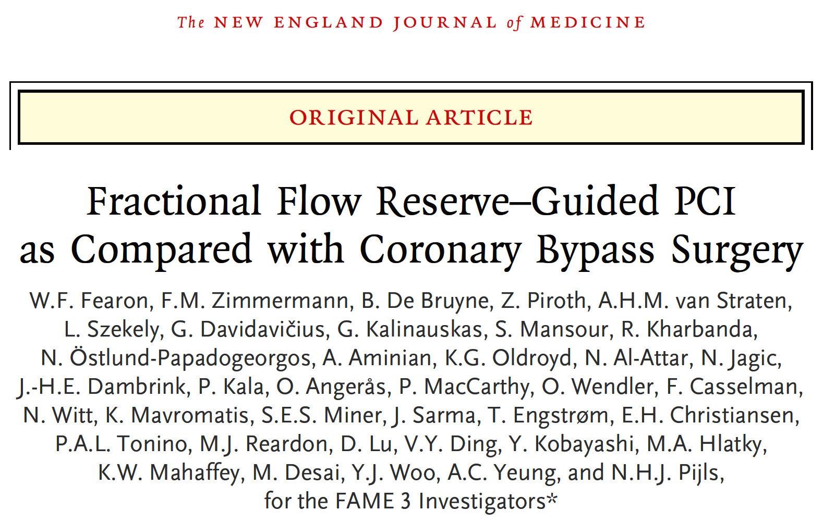

Slide 14
FAME 3 Trial: Background
Previous studies have demonstrated improved outcomes with CABG compared with PCI in patients with 3-vessel CAD.¹
However, most trials used BMS or 1st generation DES.²
In addition, none of these studies measured fractional flow reserve (FFR) to guide PCI.³
¹ Serruys et al., N Engl J Med 2009;360:961
² Stone et al., N Engl J Med 2010;362:1663
³ Tonino et al., N Engl J Med 2009;360:213
Fearon W, TCT 2021

Slide 15
FAME 3 Trial: Study Design
Investigator-initiated, multicenter, randomized, controlled study
All Comers with 3V-CAD (not involving Left Main)
Amenable to PCI or CABG by Heart Team
at 48 centers in Europe, North America, Australia and Asia
FFR-Guided PCI
Stent all lesions with FFR ≤0.80
(N=750)
CABG
Based on coronary angiogram
(N=750)
Primary Endpoint:
MACCE at 1 Year: all-cause death, MI, stroke or repeat revascularization
Key Secondary Endpoints:
3- and 5-year follow-up for Death/MI/Stroke
Fearon W, TCT 2021

Slide 16
FAME 3 Trial: Patient Eligibility
Key Inclusion Criteria | Key Exclusion Criteria
Three vessel CAD: ≥ 50% diameter stenosis in 3 major epicardial vessels (visual estimation, no Left Main Amenable to revascularization by both PCI and CABG (Heart Team) | Cardiogenic shock Recent STEMI (within 5 days) LV ejection fraction <30%
Fearon W, TCT 2021

Slide 17
FAME 3 Trial: Patient Flowchart
1,500 Patients Enrolled
N=757 Randomized to
FFR-Guided PCI
11 underwent CABG
4 Withdrew
N=743 Randomized to
CABG
37 underwent PCI
12 Withdrew
2 Lost to follow-up
2 Lost to follow-up
1 Year Follow-Up
n=757
Included in ITT Analysis
1 Year Follow-Up
n=743
Included in ITT Analysis
Fearon W, TCT 2021

Slide 18
FAME 3 Trial: Procedural Characteristics
Variable | PCI (n=757)
% Lesions FFR measured | 82%
FFR >0.80 | 24%
Staged procedure | 22%
Number of stents | 3.7 ± 1.9
Total stent length | 80 mm
Intravascular imaging | 12%
FFR measured after PCI | 60%
Variable | CABG (n=743)
FFR measured prior to CABG | 10%
Number of distal anastomoses | 3.4 ± 1.0
Multiple arterial grafts | 25%
LIMA | 97%
Off-Pump surgery | 24%
Fearon W, TCT 2021

Slide 19
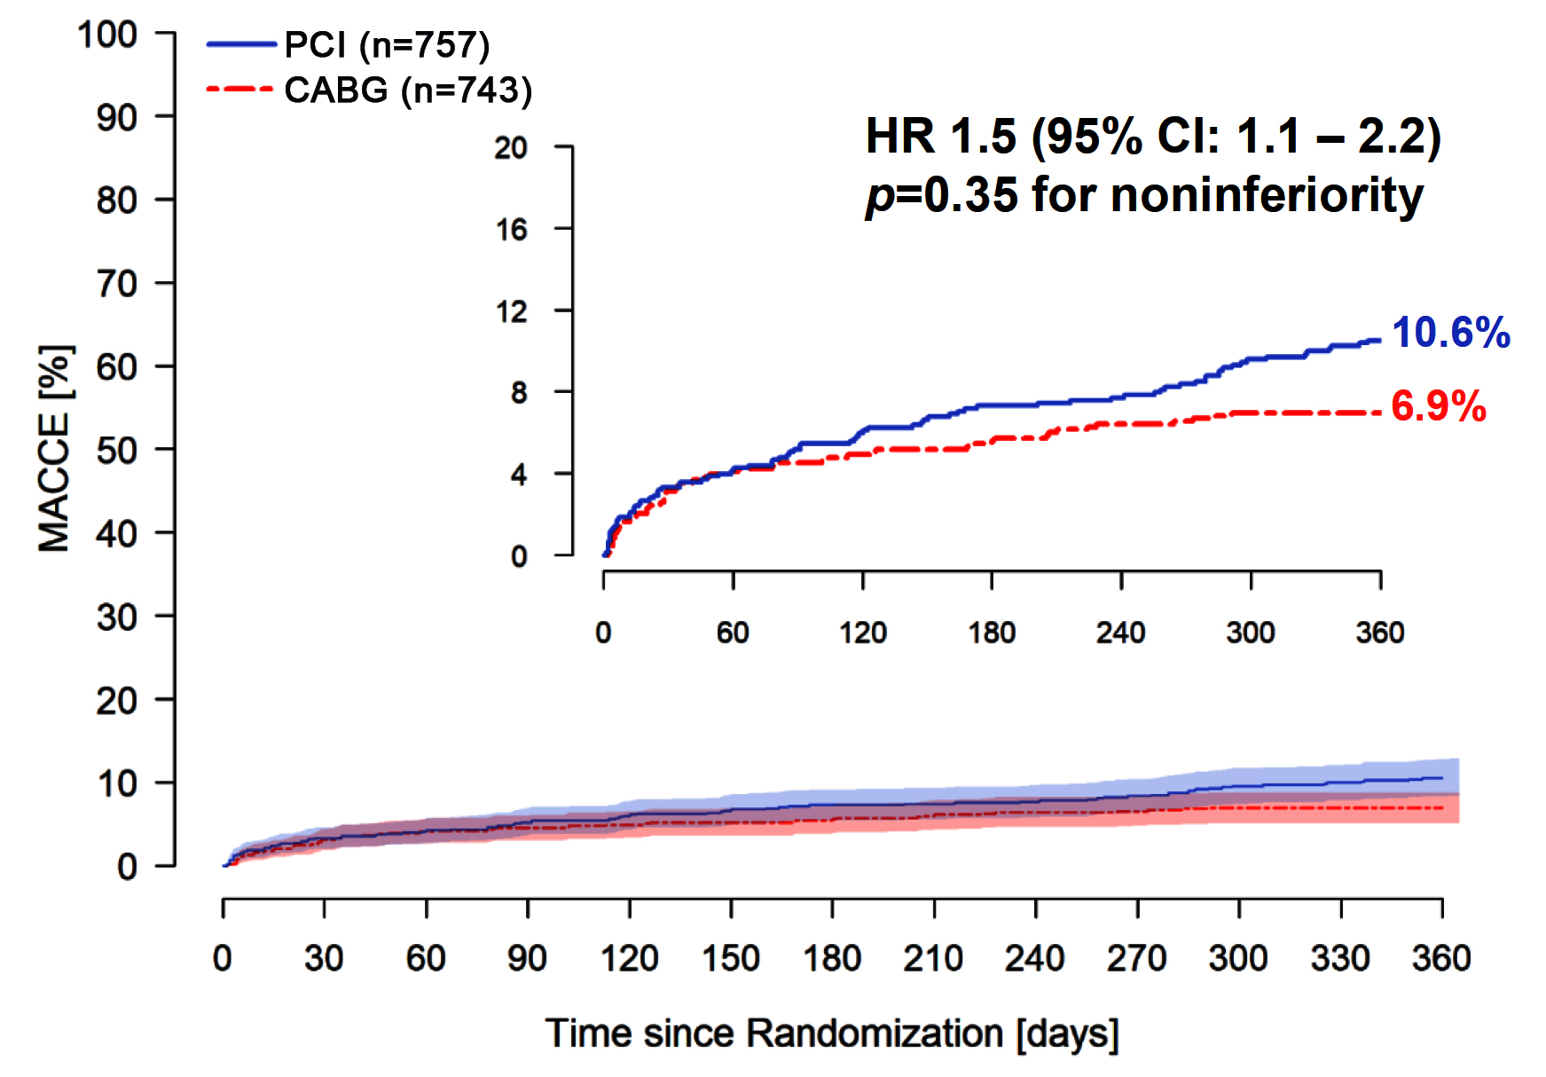
FAME 3 Trial: Primary Endpoint
MACCE (Death, MI, Stroke or Repeat Revasc) at 1 Year
Fearon W, TCT 2021

Slide 20
FAME 3 Trial: Clinical Outcomes at 1 Year
HR 1.5 (1.1-2.2)
Events (%)
HR 1.5 (0.9-2.5)
HR 1.4 (0.9-2.1)
Procedural MI
1.7% vs 1.2%
Spontaneous MI
3.3% vs 2.3%
HR 1.5 (0.9-2.3)
HR 1.7 (0.7-4.3)
HR 0.9 (0.3-2.4)
HR 1.7 (0.7-4.3)
Fearon W, TCT 2021

Slide 21
FAME 3 Trial: Safety Endpoints
Endpoint | PCI (n=757) | CABG (n=743) | P Value
BARC Type 3-5 Bleeding | 1.6% | 3.8% | <0.01
Acute Kidney Injury | 0.1% | 0.9% | <0.04
Atrial Fibrillation/Arrhythmia | 2.4% | 14.1% | <0.001
Definite Stent Thrombosis | 0.8% | N/A
Symptomatic Graft Occlusion | N/A | 1.3%
Rehospitalization within 30D | 5.5% | 10.2% | <0.001
Fearon W, TCT 2021

Slide 22
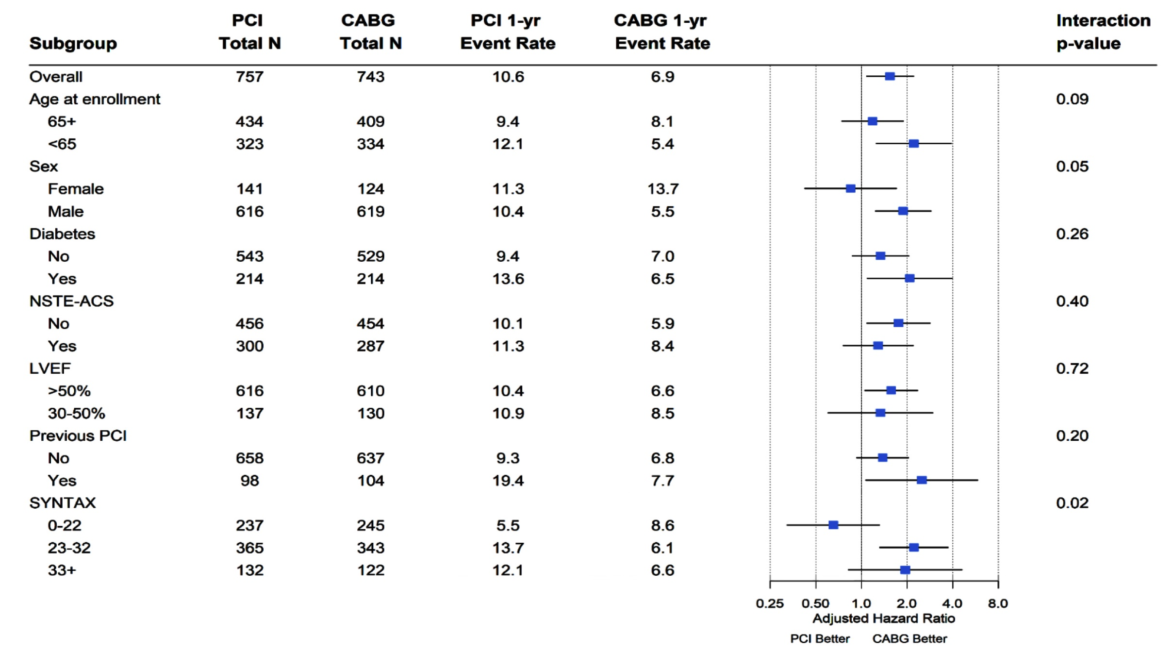
FAME 3 Trial: Subgroup Analysis
Fearon W, TCT 2021

Slide 23
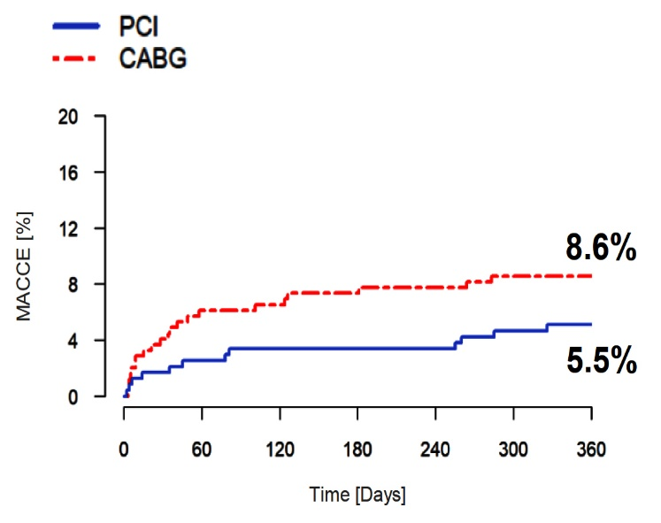
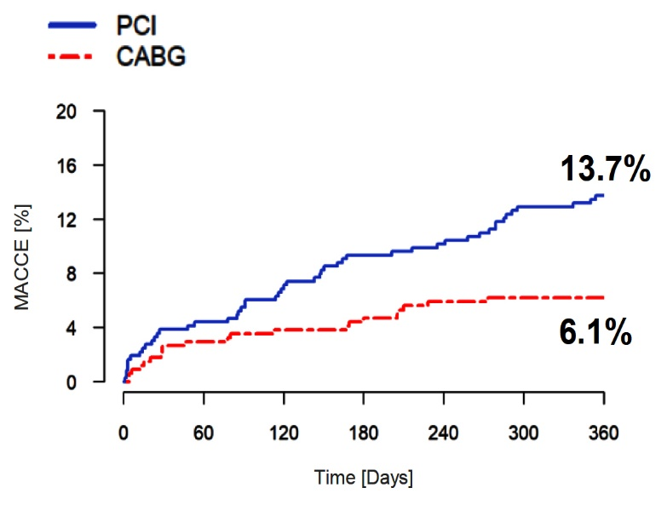
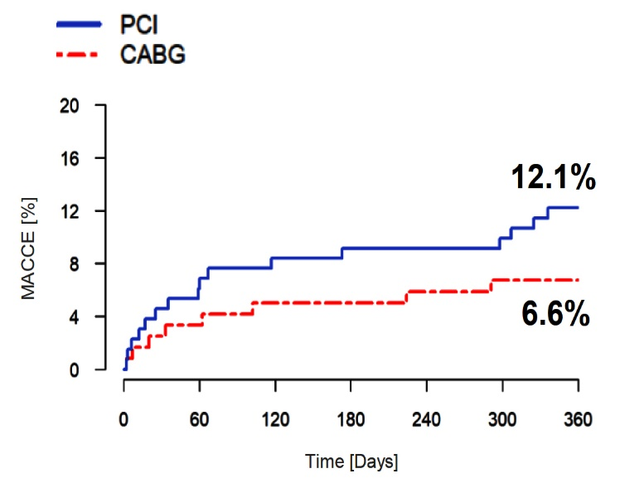
FAME 3 Trial: MACCE According to SYNTAX Score
Low (<23)
SYNTAX Score
Intermediate (23-32)
SYNTAX Score
High (>32)
SYNTAX Score
Fearon W, TCT 2021

Slide 24
Evolution of MACCE: FAME 3 and SYNTAX Trials
MACCE (Death, MI, Stroke, or Repeat Revasc) at 1 Year
MACCE (%)
2008 2020
Fearon W, TCT 2021

Slide 25
Conclusions
FAME 3 Trial
In patients with 3V-CAD, FFR-guided PCI with a current generation DES did not meet the criterion set for noninferiority in comparison with CABG in terms of death, MI, stroke or revascularization at one year.
One-year rate of death, MI or stroke was not significantly different between the two groups
In FAME 3, MACCE rates for both FFR-guided PCI (10.6%) and CABG (6.9%) were lower than with CABG in the SYNTAX trial (12.4%)
FFR-guided PCI with a current generation DES performed favorably in comparison with CABG in 3V-CAD patients with less complex disease according to the SYNTAX score
In patients with more complex 3V-CAD, CABG remains the treatment of choice

Slide 26
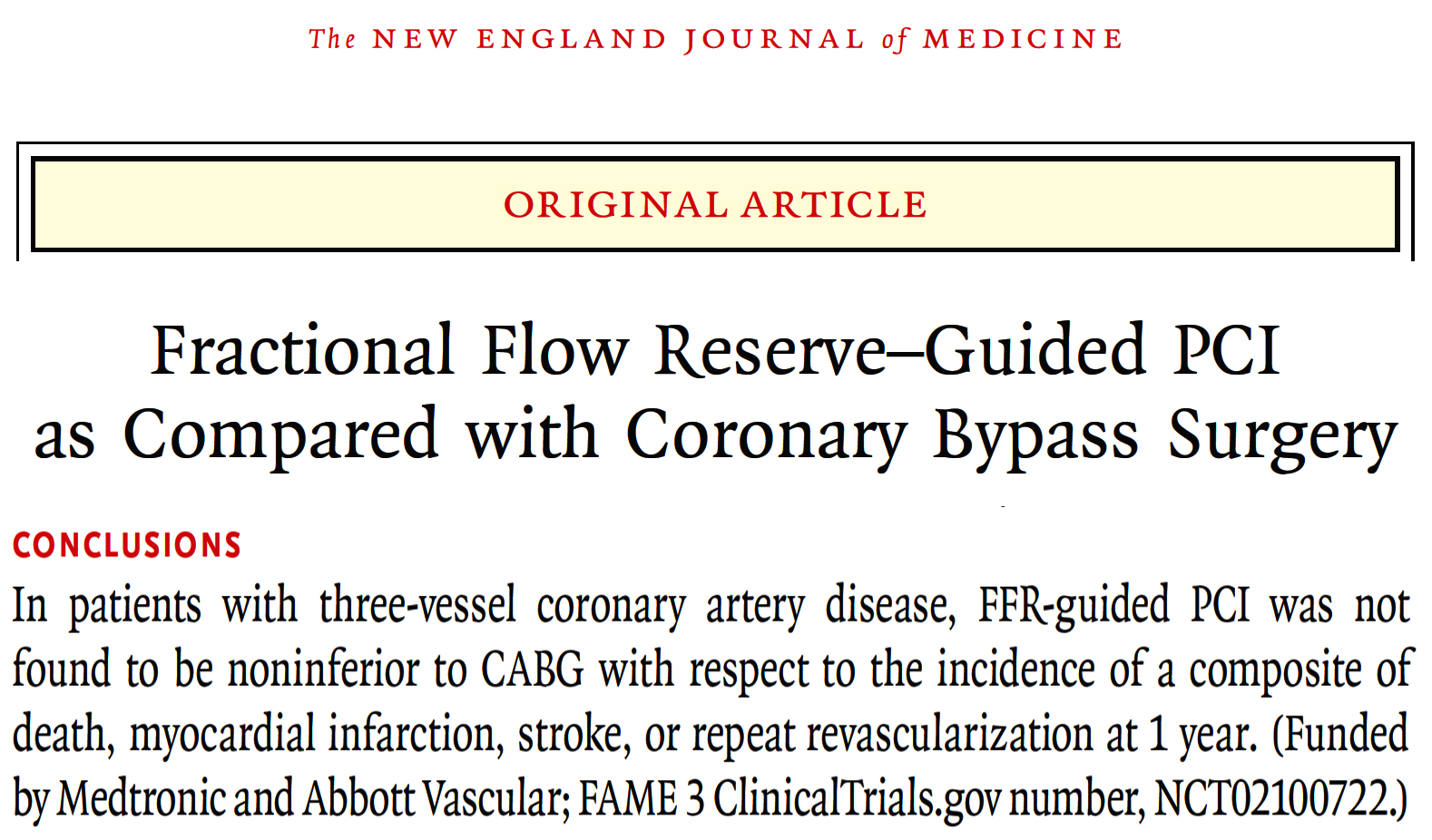

Slide 27
MASTER-DAPT MI Substudy
A Randomized Trial of Abbreviated Antiplatelet Therapy in HBR Patients
Substudy
Outcomes in High Thrombotic and Ischemic Risk
(Prior MI or No Prior MI)

Slide 28

MASTER-DAPT Trial Design
Screened Population: HBR pts, treated exclusively with Ultimaster stent, with no restriction based on clinical presentation or PCI complexity
30 (+14) Days after index PCI
Free from cardiac and cerebral ischemic events
and active bleeding
No further revascularization planned
3 co-primary endpoints
NACE
MACCE
BARC 2,3 or 5
Stratification for:
Site
Need for oral anticoagulation
Prior MI within 12 months
Abbreviated DAPT
Immediate DAPT discontinuation
followed by SAPT for 11 months
or 5 months if OAC is indicated
Non abbreviated DAPT
DAPT for ≥ 2 or 5 months in pts with
or without OAC indication, respectively
followed by SAPT up to 11 months
Smits P, TCT 2021

Slide 29
MASTER-DAPT MI Substudy: Flow Chart
Randomized at
30 days post index PCI
(n = 4579)
Allocated to abbreviated DAPT
n=2295
Allocated to non-abbreviated DAPT
n=2284
Prior MI last 12 months
(n=914)
No Prior MI last 12 months
(n=1381)
Prior MI last 12 months
(n=866)
No Prior MI last 12 months
(n=1418)
Patient lost to follow-up (n=1)
Patient withdrew consent (n=7)
Death (n=39)
Patient lost to follow-up (n=1)
Patient withdrew consent (n=6)
Death (n=36)
Patient lost to follow-up (n=6)
Patient withdrew consent (n=3)
Death (n=43)
Patient lost to follow-up (n=2)
Patient withdrew consent (n=6)
Death (n=38)
Intention-to-treat
n=914
Intention-to-treat
n=1381
Intention-to-treat
n=866
Intention-to-treat
n=1418
Smits P, TCT 2021

Slide 30
MASTER-DAPT MI: Baseline Characteristics
Mean (SD) or Number (%) | Prior MI (Acute or recent MI) |  | No prior MI (No acute or recent MI)
 | Abbrev DAPT (n=914) | Nonabbrev DAPT (n=866) | Abbrev DAPT (n=1381) | Nonabbrev DAPT (n=1418)
Age, years | 76.1 (9.9) | 76.1 (9.7) | 76.2 (7.9) | 75.9 (8.2)
Male sex | 613 (67.1%) | 577 (66.6%) | 977 (70.7%) | 1004 (70.8%)
Diabetes mellitus | 291 (31.8%) | 316 (36.5%) | 463 (33.5%) | 468 (33.0%)
Active smoker | 120 (13.1%) | 84 (9.7%) | 110 (8.0%) | 100 (7.1%)
Previous MI (before first PCI) | 219 (24.0%) | 195 (22.5%) | 215 (15.6%) | 235 (16.6%)
Previous PCI (before first PCI) | 185 (20.2%) | 172 (19.9%) | 409 (29.6%) | 422 (29.8%)
Previous CVA | 105 (11.5%) | 108 (12.5%) | 163 (11.8%) | 194 (13.7%)
Chronic renal failure* | 198 (21.7%) | 199 (23.0%) | 220 (15.9%) | 259 (18.3%)
Oral anticoagulant indication | 291 (31.8%) | 253 (29.2%) | 557 (40.3%) | 565 (39.8%)
Precise DAPT score | 29.0 (11.9) | 29.2 (12.1) | 25.4 (10.0) | 25.2 (10.1)
ACUTE MI at baseline PCI = 95%
History of MI (within 12 mo) = 5%
Smits P, TCT 2021

Slide 31
MASTER-DAPT MI: NACE
All-cause death, MI, Stroke and BARC 3 or 5 Bleeding
Smits P, TCT 2021

Slide 32
MASTER-DAPT MI: MACCE
All-cause death, MI, Stroke
Smits P, TCT 2021

Slide 33
MASTER-DAPT: Clinically Relevant Non-Major
or Major Bleeding (BARC 2, 3 or 5 Bleeding)
Smits P, TCT 2021

Slide 34
MASTER-DAPT MI Outcomes at 1 Year
Smits P, TCT 2021

Slide 35
Conclusions
In this pre-defined and stratified MASTER-DAPT subgroup analysis in high bleeding risk patients presenting with acute or recent myocardial infarction, we found that at 1 year follow-up:
  NACE and MACCE rates did not differ between an abbreviated (median 34 days) and a non-abbreviated (median 193 days) DAPT strategy
  There was NO signal towards increased ischemic risk in the abbreviated DAPT population presenting with MI
  An abbreviated APT strategy significantly reduced clinically relevant bleeding risk in these bi-risk patients
  The abbreviated APT effect was consistent between patients with or without (recent) acute myocardial infarction

Slide 36
One-year Outcomes of Two Parallel Randomized Trials of Sirolimus-Coated versus Paclitaxel-Coated Balloons in Coronary In-Stent Restenosis Lesions

Slide 37
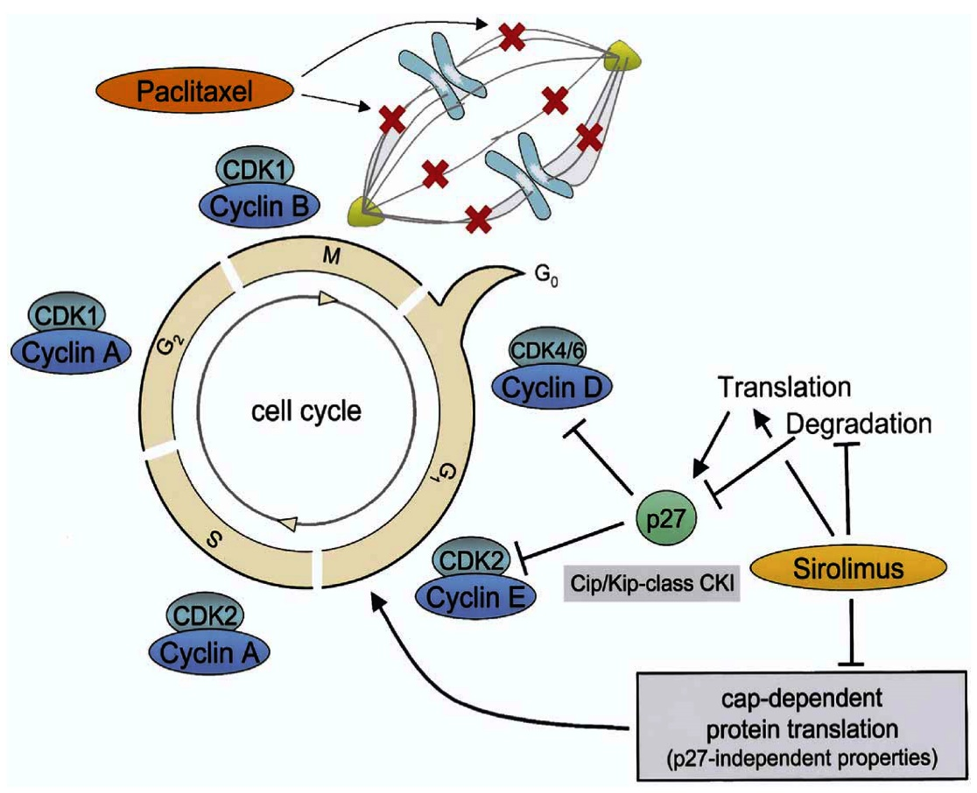
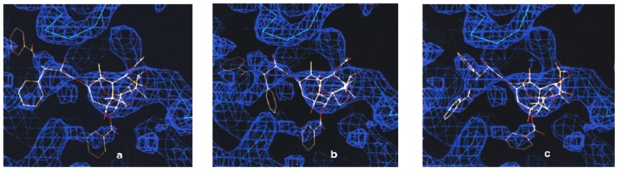
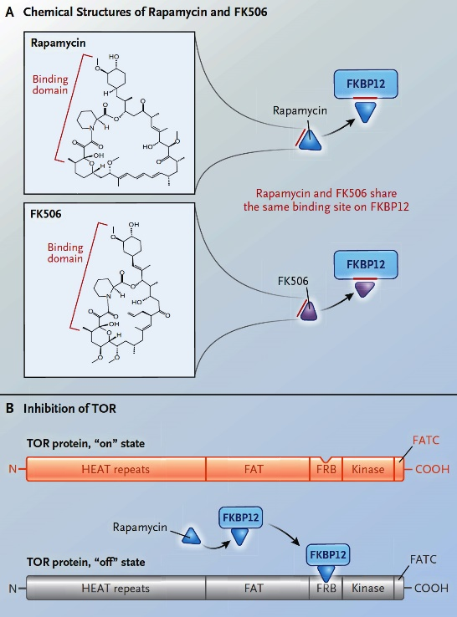
Sirolimus vs Paclitaxel
Randomized Trials of Sirolimus-Coated and Paclitaxel-Coated Balloons in Coronary ISR Lesions
Cell Cycle and Its Regulatory Mechanisms that are Relevant for the Inhibitory Effect Imposed by Sirolimus and Paclitaxel
Blockade of cell-cycle progression during mitosis by binding to and stabilizing microtubules
Game of TOR – The Target of Rapamycin Rules Four Kingdoms
Snyder et al., PNAS 2001;98:5312
Wellesby et al., J Am Coll Cardiol 2006;47:708
Manning B, N Engl J Med 2017;377:1297
Schelleer B, TCT 2021

Slide 38
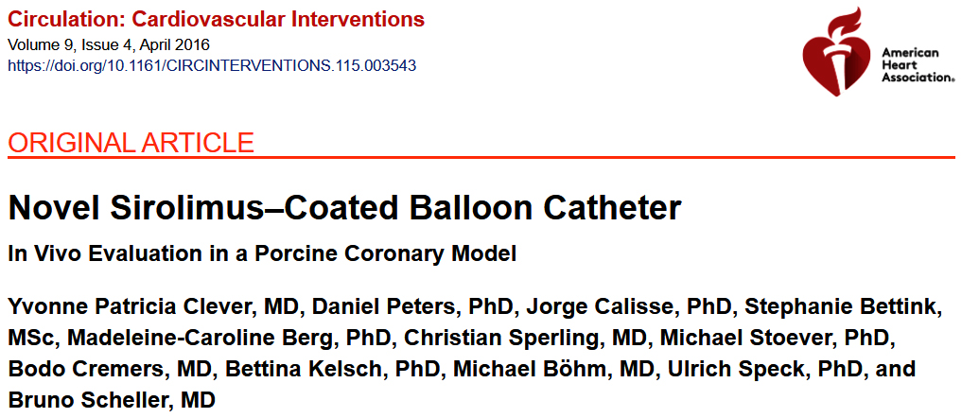
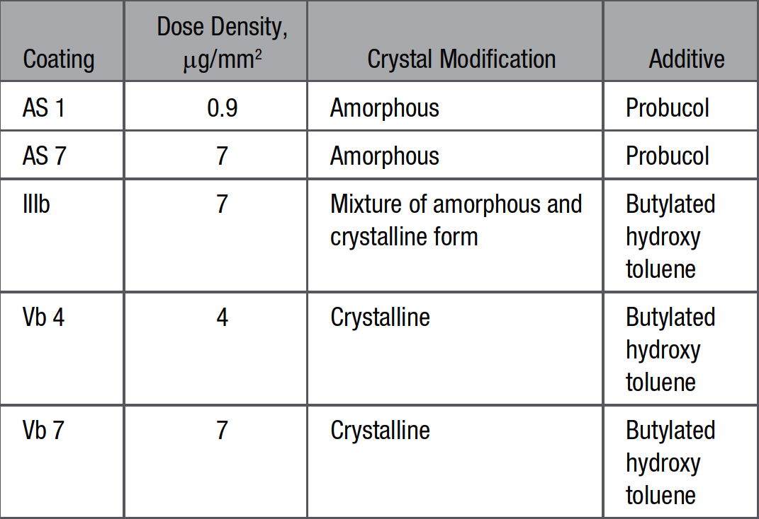
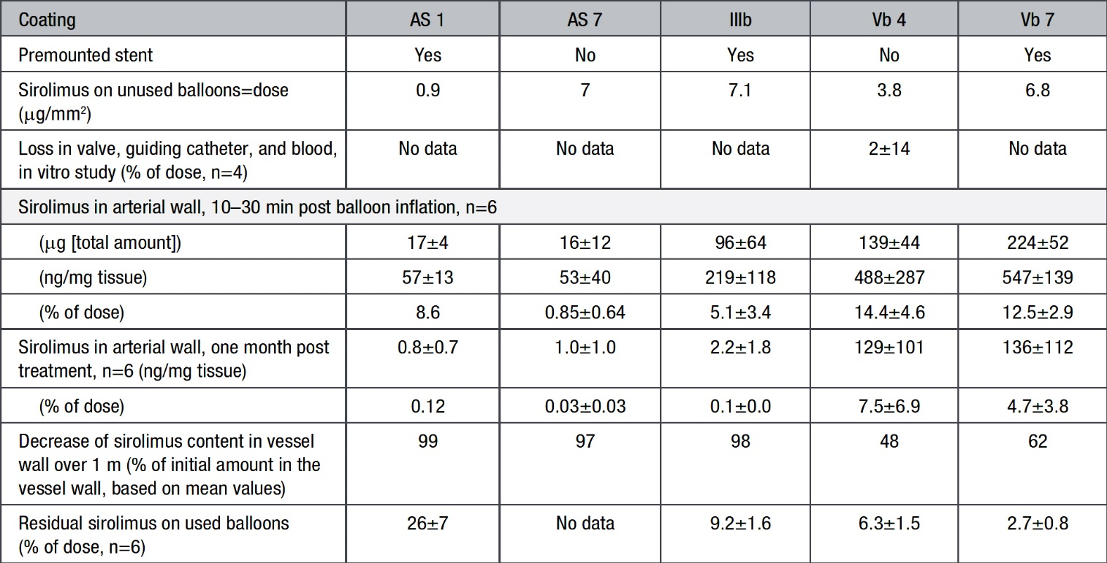

Circulation: Cardiovascular Interventions. 2016;9:e003543
Sirolimus Coatings Studied in the Different Experiments
Selection of Preferrred Coating: Sirolimus Content of 3.5x20 mm on Sirolimus-Coated Balloon Catheters Before and After Use in Pocine Coronary Arteries, Drug Content of Treated Vessel Segments 10 mins Post Balloon Infaltion and 1 Month Later

Slide 39
Study Design
Randomized Trials of Sirolimus-Coated and Paclitaxel-Coated Balloons in Coronary ISR Lesions
Multicenter, randomized prospective, controlled, non-inferiority trial
Five centers in Malaysia and 5 centers in Germany/Switzerland
Two in parallel conducted trials using an identical study protocol; combined analysis pre-specified
PCI in coronary DES-ISR
Comparison of SeQuent SCB (sirolimus 4 µg/mm²) with SeQuent Please Neo (paclitaxel 3 µm/mm²)
Primary Endpoint: angiographic late lumen loss at 6 months (blinded core lab)
Non-inferiority margin of δ = 0.35 mm to test the difference in SCB and PCB
Mixed model with repeated measures with study group (SCB vs PCB) as independent variable and country (Malaysia vs Germany/Switzerland)
Schelleer B, TCT 2021

Slide 40
Major Inclusion/Exclusion Criteria
Randomized Trials of Sirolimus-Coated and Paclitaxel-Coated Balloons in Coronary ISR Lesions
Inclusion Criteria
  >18 years of age
  Clinical evidence of stable or unstable angina or a positive functional study
  Up to two ISR lesions in a coronary artery treated before with drug eluting stents
  Exclusion Criteria
    STEMI within the past 72 hours
    Chronic renal insufficiency with serum creatinine >2.0 mg/DL
    Intolerance and/or allergy to sirolimus, paclitaxel matrix
    LVEF of <30%
    Lesion length >35 mm, reference vessel diameter <2.5 mm
Schelleer B, TCT 2021

Slide 41
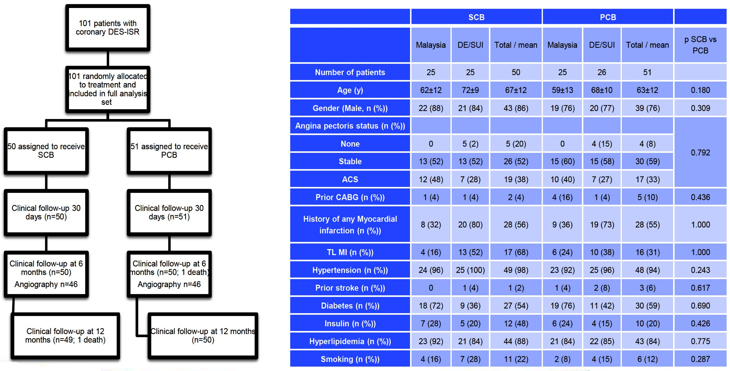
Study Flowchart and Baseline Data
Randomized Trials of Sirolimus-Coated and Paclitaxel-Coated Balloons in Coronary ISR Lesions
Schelleer B, TCT 2021

Slide 42
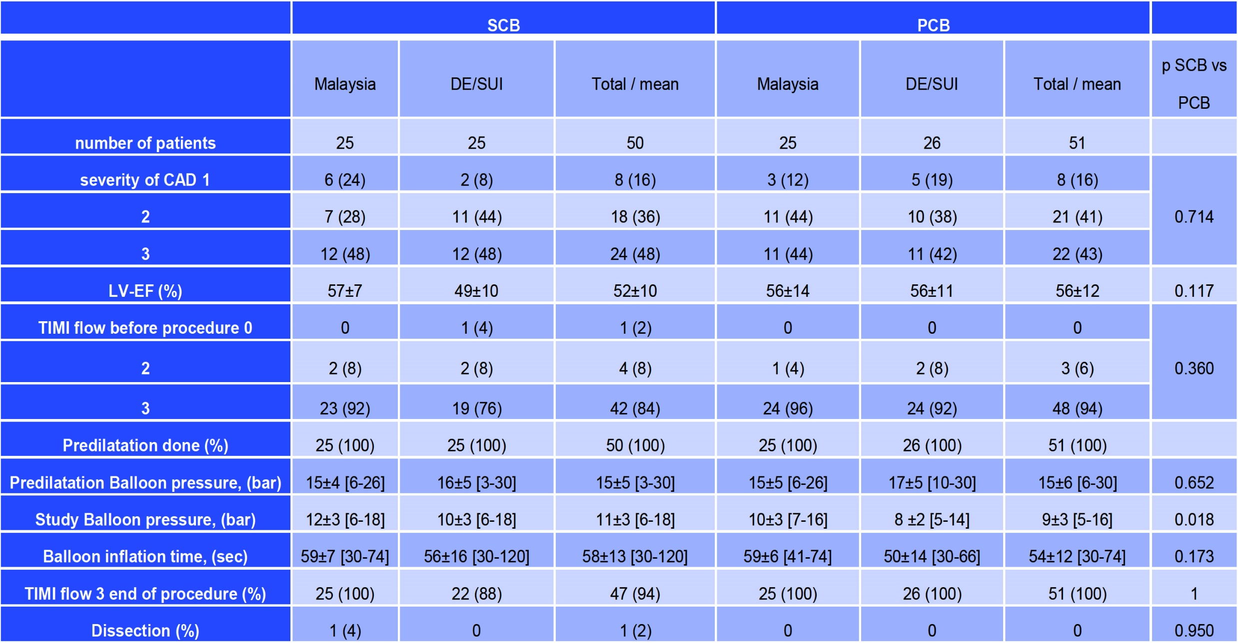
Procedural Data
Randomized Trials of Sirolimus-Coated and Paclitaxel-Coated Balloons in Coronary ISR Lesions
Schelleer B, TCT 2021

Slide 43
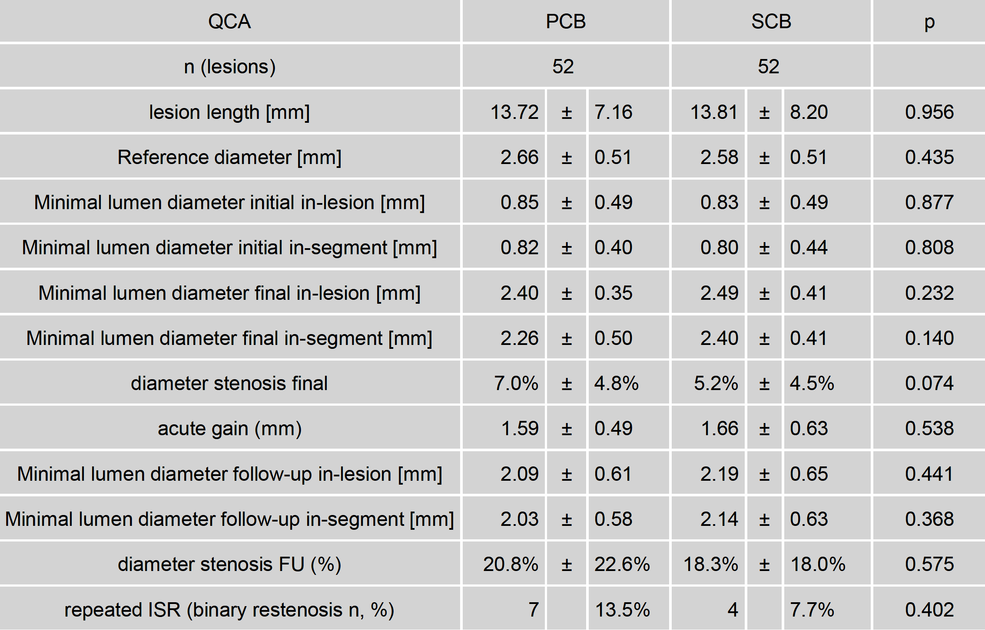
Quantitative Coronary Angiography
Randomized Trials of Sirolimus-Coated and Paclitaxel-Coated Balloons in Coronary ISR Lesions
Schelleer B, TCT 2021

Slide 44
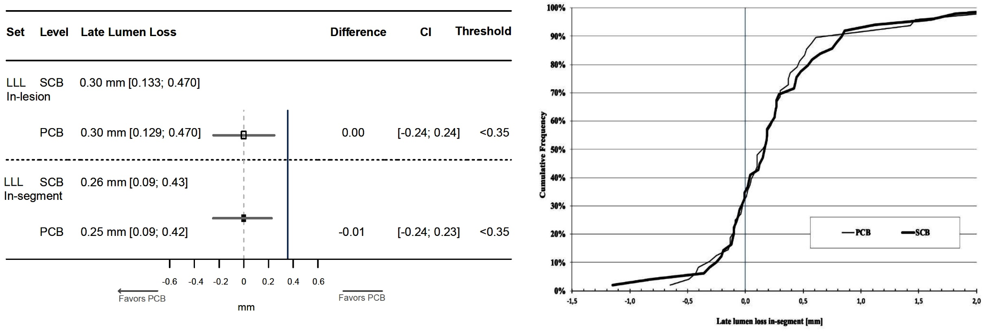
Primary Endpoint (Non-Inferiority Late Lumen
Loss at 6 Months)
Randomized Trials of Sirolimus-Coated and Paclitaxel-Coated Balloons in Coronary ISR Lesions
Schelleer B, TCT 2021

Slide 45
Clinical Outcomes
Randomized Trials of Sirolimus-Coated and Paclitaxel-Coated Balloons in Coronary ISR Lesions
 | SCB |  |  | PCB
 | Malaysia | DE/SUI | Total | Malaysia | DE/SUI | Total | P SCB vs PCB
Number of pts | 25 | 25 | 50 | 25 | 26 | 51
TLR (%) | 3 (12) | 5 (20) | 8 (16) | 4 (16) | 1 (4) | 5 (10) | 0.39
Stent thrombosis (%) | 0 | 0 | 0 | 1 (4) | 0 | 1 (2) | 1.00
Death (%) | 0 | 1 (4) | 1 (2) | 0 | 1 (4) | 1 (2) | 1.00
MI (%) | 0 | 0 | 0 | 0 | 1 (4) | 1 (2) | 1.00
MACE (%) | 3 (12) | 6 (24) | 9 (18) | 4 (16) | 3 (12) | 7 (14) | 0.60
Schelleer B, TCT 2021

Slide 46
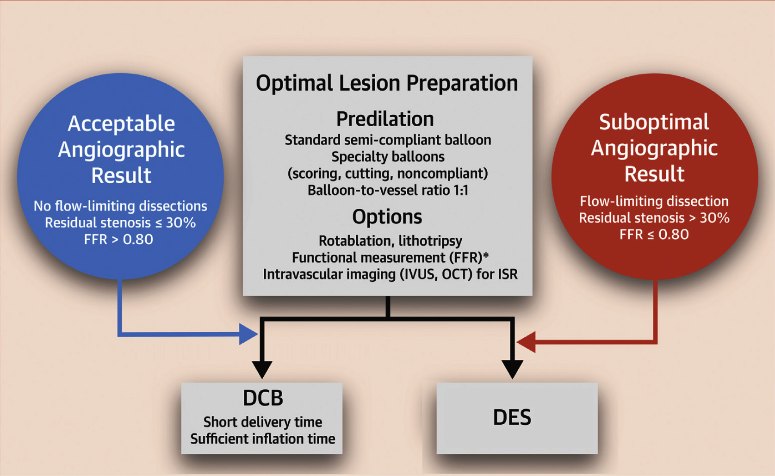
Drug-Coated Balloons for Coronary Artery Disease
Third Report of the International DCB Consensus Group
DCB-Only Strategy for PCI in Coronary Artery Disease
Jeger et al., J Am Coll Cardiol Intv 2020;13:1391

Slide 47
Latest Issues in Coronary Intervention
Key Interventional Trials from TCT 2021;
FAME 3 Trial, MASTER DAPT- MI Substudy,
SCB vs PCB in DES ISR
Focused review of the month
New CA-AKI Risk Score:
A Contemporary simple risk score for prediction
of contrast associated acute kidney injury after PCI

Slide 48

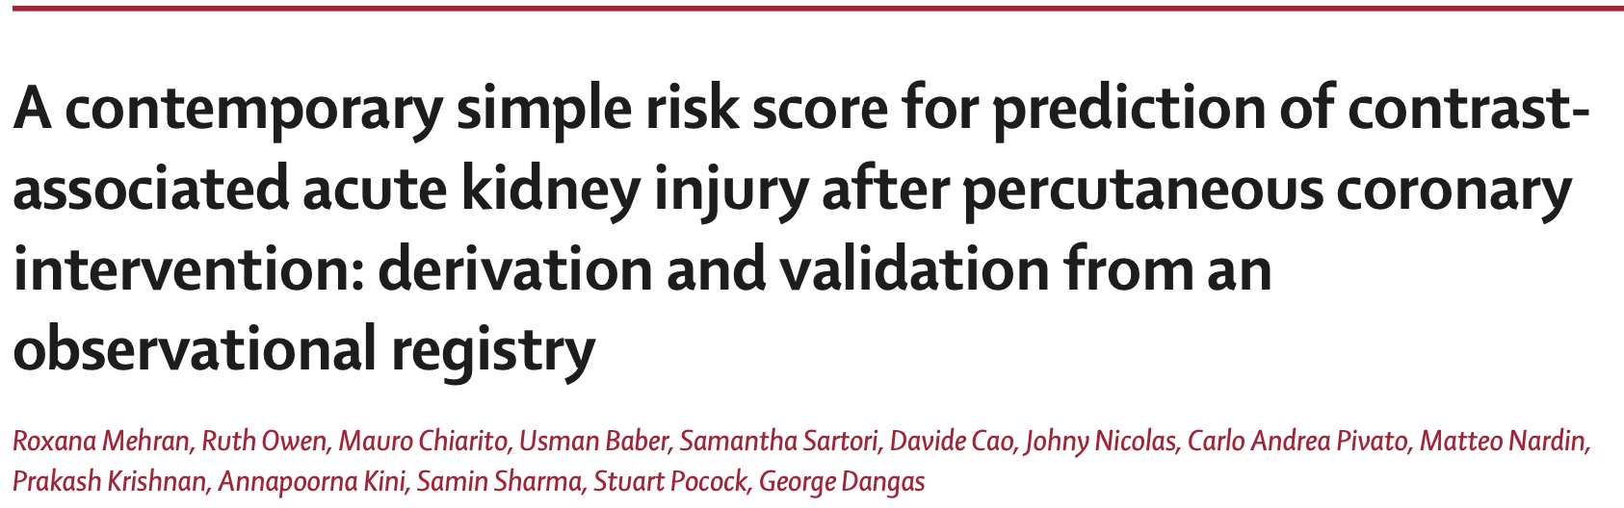
Lancet 2021; 398: 1974–83

Slide 49
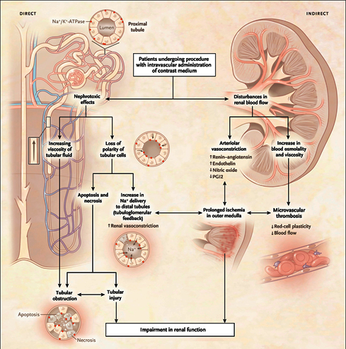
BACKGROUND
Mechanisms of CA-AKI
Ischemic injury: contrast agents induces intra-renal vasoconstriction, mediated by endothelin, nitric oxide, and prostaglandin and in turn to reduced glomerular blood flow and reduced oxygen delivery to the metabolically active parts of the nephron.
Increased blood viscosity: further reduction of the microcirculatory flow and changes in blood osmolality cause impairment of erythrocytes plasticity and increase the risk of microvascular thrombosis.
CA AKI is associated with:
With significant increase in mortality.¹
Prolonged hospitalizations and additional costs.²
¹Valle et al., Circ Cardiovasc Interv 2017;10:e004439
²Aubry et al., BMC Nephrol 2016;17:167
Mehran et al., N Engl J Med 2019:381:1296

Slide 50
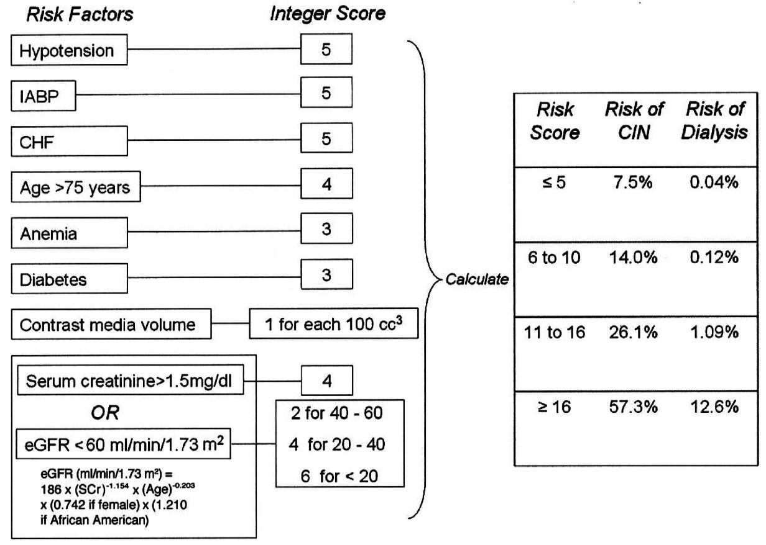
BACKGROUND
CA-AKI Risk Score
The Mehran CA-AKI risk score was developed in 2004,¹ and externally validated in different settings.^{2,3}
Remarkable advancements in proper recognition and preventive measures:⁴
  Updated and more specific definition⁵
  Low- or iso-osmolality contrast agents
  Intravascular volume expansion
  Interruption of nephrotoxic medications
  Judicious use of contrast volume
¹Mehran et al., J Am Coll Cardiol 2004;44:1393
²Zhou et al., Sci Rep 2018;8:9769
³Narula et. Al, Eur Heart J 2014;35:1533
⁴Seeliger et al., Eur Heart J 2012;33:2007
⁵Levin et al., Kidney Int Suppl 2013;3:1

Slide 51
Study Population
CA-AKI Risk Score
Inclusion Criteria
Exclusion Criteria
PCI between 2012 and 2020 at MSH.
Available serum creatinine both pre-procedure and within 48 hours after PCI.
Pre-PCI end-stage renal disease requiring dialysis.
Multiple procedures.
Mehran et al., Lancet 2021;398:1974

Slide 52
CA-AKI Definition and Study Endpoints
Modified KDIGO/AKIN definition: increase by ≥50% or ≥0.3mg/dl within 48 hours after PCI compared to pre-PCI serum creatinine
Primary Endpoint:
Contrast-associated kidney injury up to 48 hours post PCI.
Secondary Endpoint:
All-cause mortality in patients with and without CA-AKI at 1 year
Levin et al., Kidney Int Suppl 2013;3:1

Slide 53
Study Design
CA-AKI Risk Score
Derivation Cohort: patients undergoing PCI between 2012 and 2017 at a single tertiary care center (Mount Sinai Hospital).
Validation Cohort: patients undergoing PCI between 2018 and 2020 at a single tertiary care center (Mount Sinai Hospital).
  Model 1: only preprocedural variables
  Model 2: pre- and periprocedural variables
Mehran et al., Lancet 2021;398:1974

Slide 54
Statistical Analysis
CA-AKI Risk Score
Independent predictors of CA-AKI derived from multivariable logistic regression analysis.
Weighted integer risk score derived by summing the point values assigned to each variable based on its OR in the model:
  OR 1 to <1.5 = 1 point
  OR 1.5 to <2 = 2 points
  OR 2 to <4 = 4 points
  OR >6 = 8 points
Multivariable Cox regression and 30-day landmark analysis to evaluate the association of CA-AKI with 1-year mortality.
Mehran et al., Lancet 2021;398:1974

Slide 55
Study Flow Diagram
CA-AKI Risk Score
32,378 procedures performed between 2012 and 2020
12,156 procedures included
  2,604 lack of baseline or post procedure creatinine value
  1,328 on chronic dialysis or lack of data about chronic dialysis
  8,224 patients with multiple procedures
20,222 patients treated between 2012 and 2020:
14,616 patients included for CA-AKI risk score development (2012-2017)
5,606 patients included for CA-AKI risk score validation (2018-2020)
5,270 procedures excluded
  903 treated less than 1 year before data extraction
  4,342 with less than 2 days of follow-up
  11 died within 2 days after PCI
  14 with unknown date of death
14,952 patients included in the analysis to evaluate the association between CA-AKI occurrence and 1-year mortality
Mehran et al., Lancet 2021;398:1974

Slide 56
CA-AKI Study Population
Variable | Development Set n=14,616 | Validation Set n=5,606
Demographics
Age (years) | 66.2 (11.6%) | 67.0 (11.3%)
Female* | 4268 (29.2%) | 1481 (26.4%)
Non-white ethnicity | 8014 (54.9%) | 1261 (34.2%)
Clinical features
Diabetes mellitus
Overall | 6967 (47.7%) | 2573 (45.9%)
Non-insulin-treated diabetes | 4668 (31.9%) | 1631 (29.1%)
Insulin-treated diabetes | 2299 (15.7%) | 942 (16.8%)
Anemia | 5826 (40.1%) | 2300 (35.4%)
Hypertension | 13449 (92.0%) | 6229 (90.8%)
LVEF (%) | 53.9 (10.9%) | 55.0 (11.4%)
Chronic kidney disease* | 4123 (28.2%) | 1806 (32.2%)
CHF on presentation* | 1221 (8.4%) | 754 (13.4%)
STEMI | 466 (3.2%) | 209 (3.7%)
*p<0.001, no significant differences for the other variables. Chronic kidney disease defined as glomerular filtration rate <60 mL/min/1.73 m²; LVEF: left ventricular ejection fraction - assessed by echocardiography; CHF: congestive heart failure.
Mehran et al., Lancet 2021;398:1974

Slide 57
Incidence of CA-AKI
Year | n (total) | AKIN¹, n (%) | AKI², n (%) | RIFLE³, n (%) | KDIGO⁴, n (%)
2012 | 2943 | 128 (4.4) | 246 (8.4) | 46 (1.6) | 128 (4.4)
2013 | 3006 | 152 (5.1) | 266 (8.9) | 63 (2.1) | 152 (5.1)
2014 | 2405 | 118 (4.9) | 192 (8.0) | 31 (1.3) | 118 (4.9)
2015 | 2198 | 120 (5.5) | 198 (9.0) | 42 (1.9) | 120 (5.5)
2016 | 2110 | 107 (5.1) | 180 (8.5) | 46 (2.2) | 107 (5.1)
2017 | 1963 | 85 (4.3) | 147 (7.5) | 25 (1.3) | 85 (4.3)
2018 | 1974 | 68 (3.4) | 116 (5.9) | 22 (1.1) | 68 (3.4)
2019 | 2128 | 33 (1.6) | 46 (2.2) | 17 (0.8) | 33 (1.6)
2020 | 1504 | 49 (3.3) | 54 (3.6) | 20 (1.3) | 49 (3.3)
¹Mehta et al., Crit Care 2007; 11: R31; ²Mehran et al., J Am Coll Cardiol 2004;44:1393
³Narula et. al.; Eur Heart J 2014;35:1533; ⁴Levin et al., Kidney Int Suppl 2013;3:1

Slide 58
CA-AKI Risk Score Development – Model 1 (Periprocedural)
Variable | Integer Score | OR (95% CI) | χ² | P value
Presentation |  |  | 203.0 | <0.001
Asymptomatic or stable angina | 0 | Reference group
Unstable angina | 2 | 1.73 (1.43, 2.09)
NSTEMI | 4 | 2.98 (2.37, 3.75)
STEMI | 8 | 7.83 (5.89, 10.41)
eGFR (ml/min 1.73m²) |  |  | 43.7 | <0.001
≥60 | 0 | Reference group
30 to 60 | 1 | 1.21 (1.00, 1.46)
<30 | 4 | 2.96 (2.19, 4.00)
LVEF<40% | 2 | 1.68 (1.35, 2.08) | 22.6 | <0.001
Diabetes |  |  | 14.7 | <0.001
No diabetes | 0 | Reference group
Non-insulin-treated | 1 | 1.16 (0.95, 1.42)
Insulin-treated | 2 | 1.61 (1.27, 2.04)
Haemoglobin <11g/dL | 1 | 1.46 (1.19, 1.79) | 14.3 | <0.001
Basal glucose ≥150mg/dL | 1 | 1.33 (1.09, 1.61) | 11.1 | 0.005
CHF on presentation | 1 | 1.47 (1.16, 1.85) | 9.7 | 0.001
Age >75yr | 1 | 1.26 (1.05, 1.52) | 6.0 | 0.014
Mehran et al., Lancet 2021;398:1974

Slide 59
CA-AKI Risk Score Development – Model 2
(Pre- and Periprocedural)
 | Pre-procedural
Variable | Integer Score | OR (95% CI) | χ² | p-value
Presentation |  |  | 203.0 | <0.001
Asymptomatic or stable angina | 0 | Reference group
Unstable angina | 2 | 1.76 (1.45, 2.12)
NSTEMI | 4 | 3.04 (2.41, 3.83)
STEMI | 8 | 7.76 (5.79, 10.38)
eGFR (ml/min 1.73m²) |  |  | 43.7 | <0.001
≥60 | 0 | Reference group
30 to 60 | 1 | 1.24 (1.03, 1.51)
<30 | 4 | 3.45 (2.51, 4.73)
LVEF<40% | 2 | 1.59 (1.28, 1.98) | 22.6 | <0.001
Diabetes |  |  | 14.7 | <0.001
No diabetes | 0 | Reference group
Non-insulin-treated | 1 | 1.15 (0.94, 1.42)
Insulin-treated | 2 | 1.64 (1.29, 2.07)
Haemoglobin <11g/dL | 1 | 1.53 (1.25, 1.87) | 14.3 | <0.001
Basal glucose ≥150mg/dL | 1 | 1.31 (1.07, 1.60) | 11.1 | 0.008
CHF on presentation | 1 | 1.45 (1.15, 1.83) | 9.7 | 0.002
Age >75yr | 1 | 1.26 (1.04, 1.52) | 6.0 | 0.017
 | Periprocedural
Periprocedural variables | Integer Score | OR (95% CI) | χ² | p-value
Contrast volume (per 100 ml) |  |  | 28.3 | <0.001
<100 | 0 | Reference group
100-200 | 1 | 1.24 (0.99, 1.57)
200-300 | 2 | 1.78 (1.35, 2.36)
>300 | 4 | 2.61 (1.70, 4.01)
Periprocedural bleed☥ | 4 | 3.63 (2.31, 5.72) | 25.3 | <0.001
Slow flow-no flow/ TIMI <3 post procedure | 2 | 1.68 (1.22, 2.31) | 9.3 | 0.001
Complex anatomy℥ | 1 | 1.49 (1.05, 2.11) | 5.6 | 0.025
☥Drop in hemoglobin value of >3 g/dl compared to pre-procedure
℥Multivessel disease, no. of lesions >2, high coronary lesion complexity, chronic total occlusion, lesion length > 30 mm or bifurcation.
Mehran et al., Lancet 2021;398:1974

Slide 60
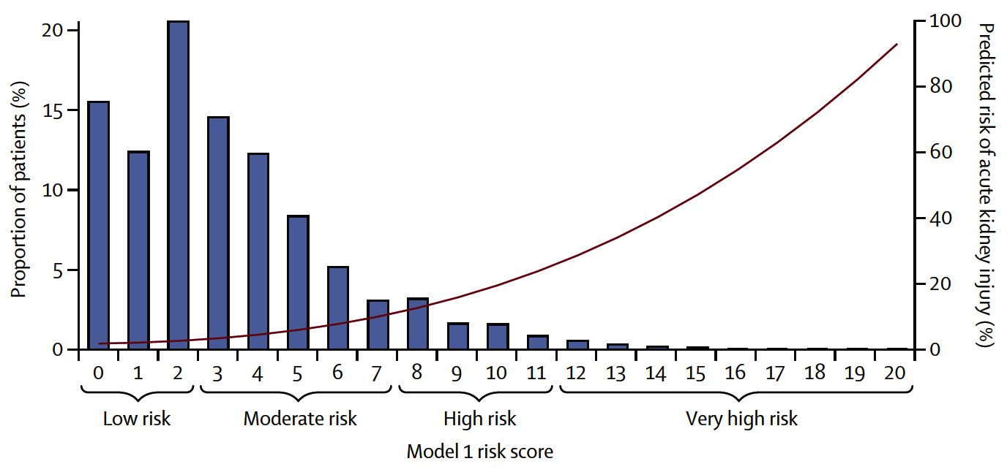
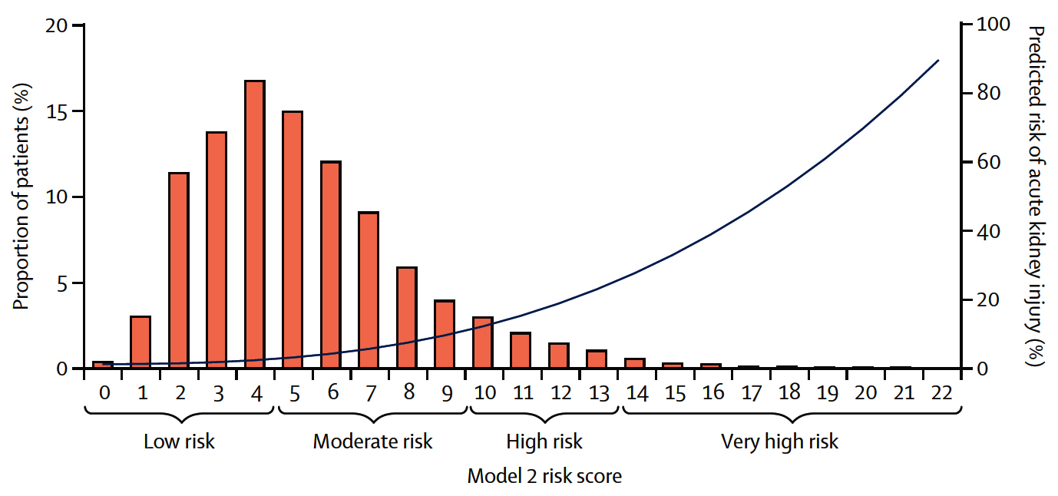
CA-AKI Risk Contrast-Associated AKI in the Derivation Cohort According to Risk Score Values
Model 1
Only pre-procedural variables
Model 2
Pre- and periprocedural variables
Mehran et al., Lancet 2021;398:1974

Slide 61
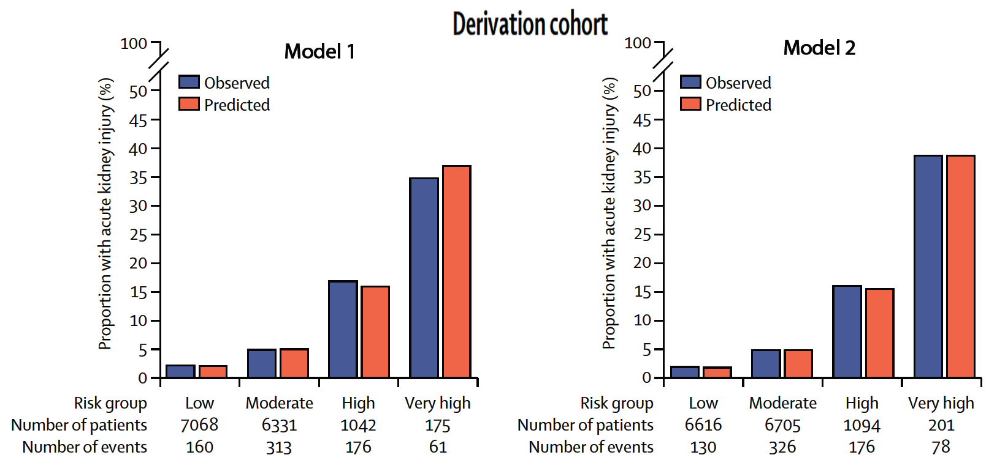
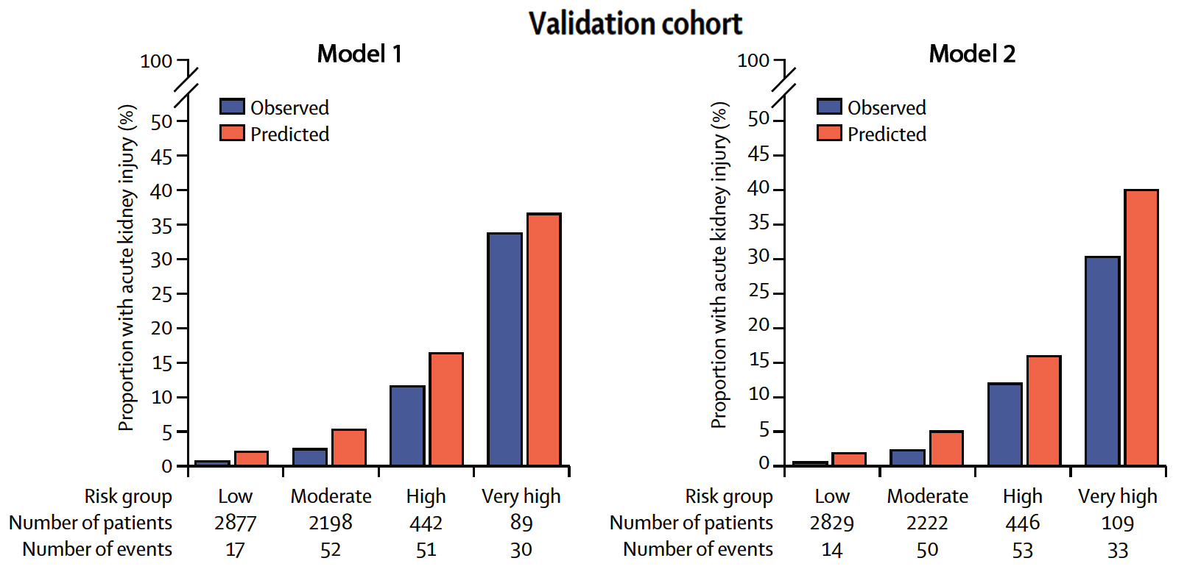
CA-AKI Risk Score Performance and Validation
Model 1
Only pre-procedural variables
Model 2
Pre- and periprocedural variables
c-statistic: 0.74
c-statistic: 0.74
c-statistic: 0.84
c-statistic: 0.86
Mehran, Kini, Sharma et al., Lancet 2021;398:1974

Slide 62
CA-AKI and Mortality
 | Unadjusted |  | Adjusted*
 | HR (95% CI) | p-value | HR (95% CI) | p-value
Death at 1 year | 5.11 (3.91-6.68) | <0.0001 | 1.76 (1.31-2.36) | 0.0002
Death at 0-30 days | 14.64 (10.04-21.34) | <0.0001 | 3.20 (2.07-4.94) | <0.0001
Death at 31-365 days | 2.06 (1.30-3.26) | 0.0019 | 0.94 (0.58-1.52) | 0.79
*Adjusted for congestive heart failure at presentation, hemoglobin, need for mechanical circulatory support, atrial fibrillation, age, neoplastic disease, peripheral artery disease, diabetes, previous myocardial infarction, previous cerebrovascular events, peak of creatinine kinase-myocardial band before percutaneous coronary intervention, in-hospital bleeding, procedural myocardial infarction, presentation, leukemia, SYNTAX score, and chronic obstructive pulmonary disease.
Mehran et al., Lancet 2021;398:1974

Slide 63
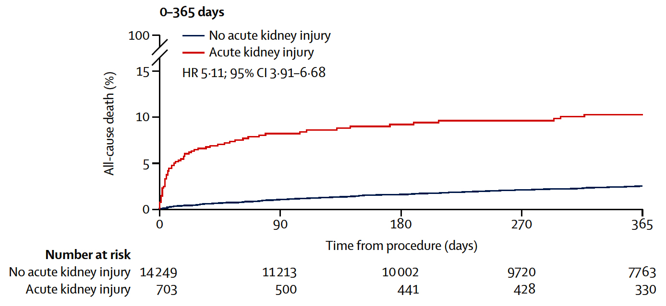
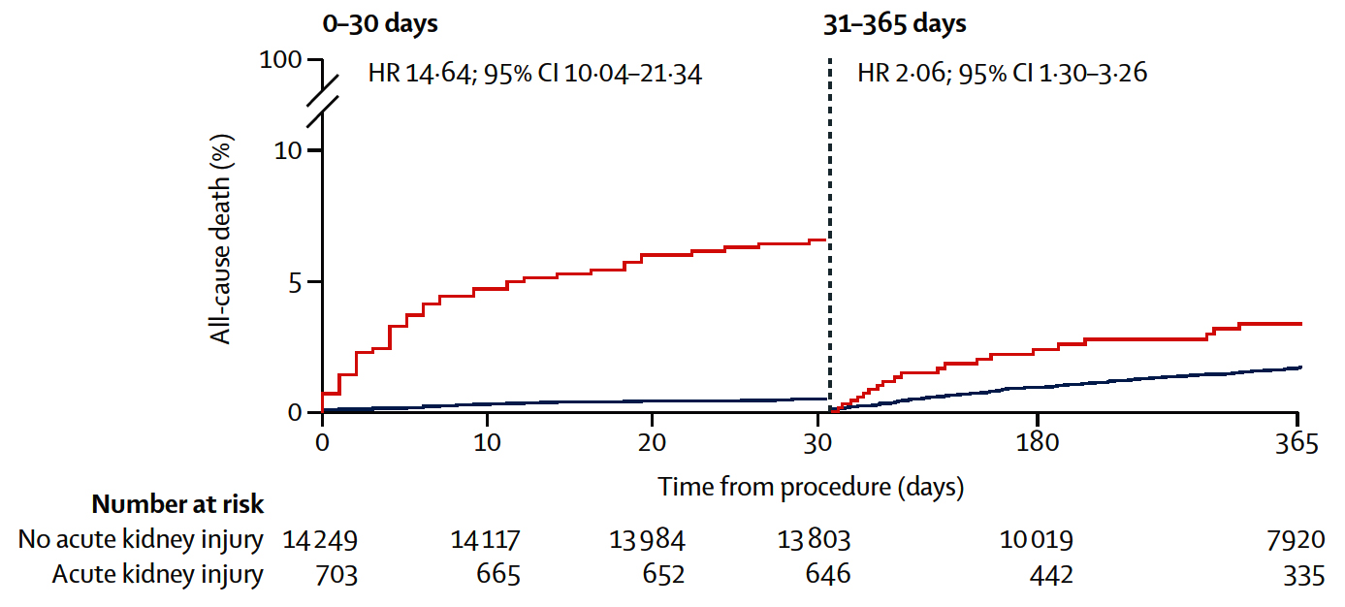
Cumulative Incidence of Death in the Overall
Cohort of Patients With and Without CA-AKI
1 Year Death with Landmark Analysis at 30 Days
Death at 1 Year
Mehran et al., Lancet 2021;398:1974

Slide 64
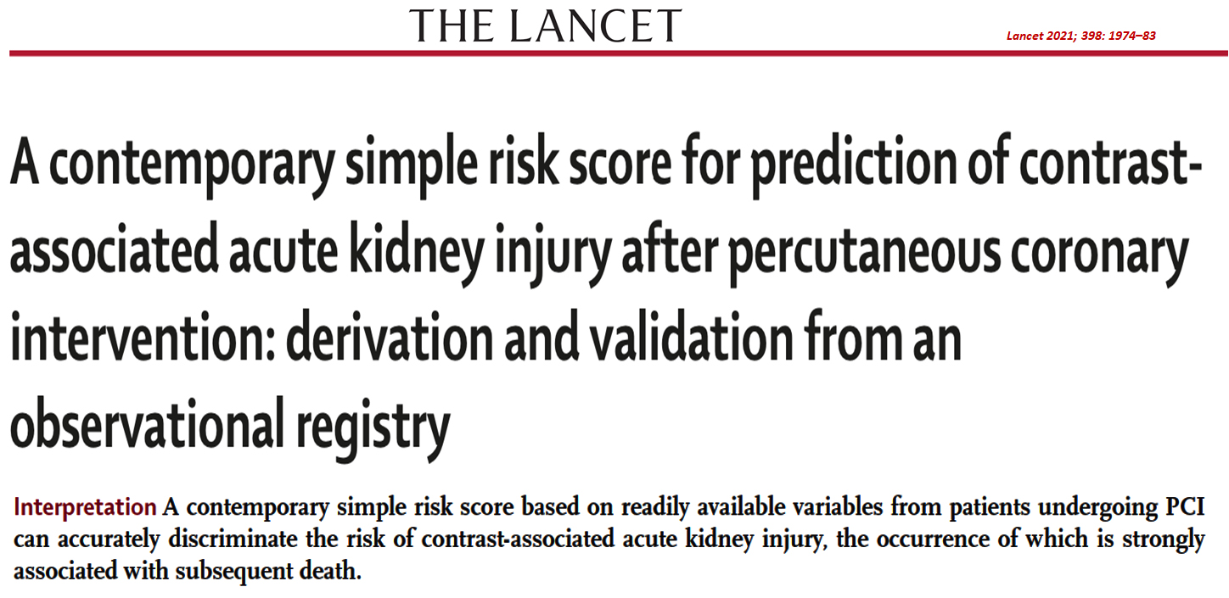

Slide 65
CONCLUSIONS
Contemporary CA-AKI Risk Score after PCI
Prevalence of CA-AKI appears to have decreased over the last decade; the rates of CA-AKI vary according to the definition used.
We derived and validated a practical risk score including 8 readily available clinical variables able to predict the risk of CA-AKI with high discrimination:
  The inclusion of periprocedural features slightly increased the score’s discriminatory power
  CA-AKI was associated with 1-year mortality after PCI, mainly due to excess 30-day mortality

Slide 66
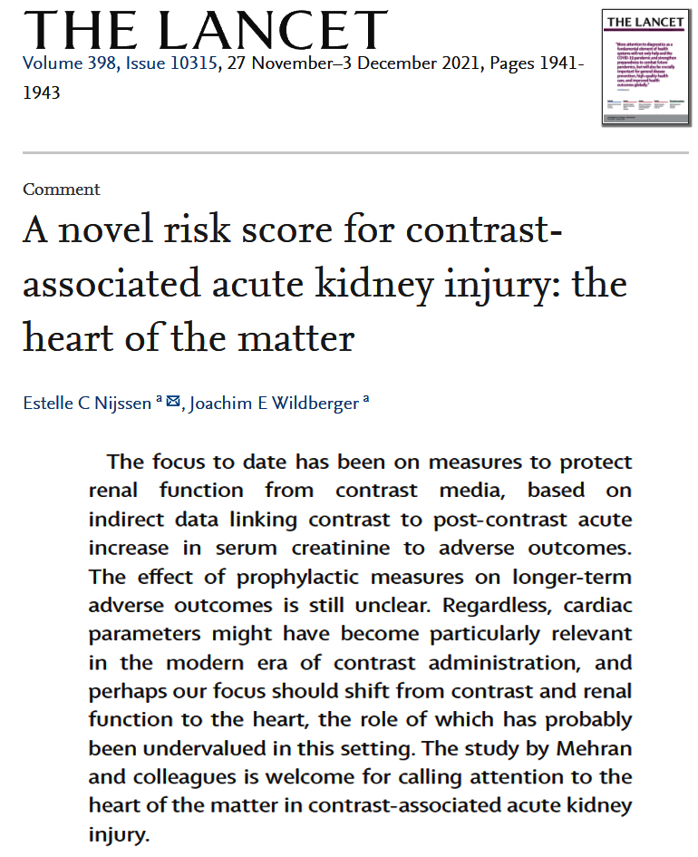

Slide 67


Take Home Message:
Interventional Trials TCT 2021 and New CA-AKI risk score post PCI
Abbreviated DAPT in HBR pts with or without MI:
FFR guided PCI vs CABG for MV CAD:
FFR guided PCI in low syntax score vs CABG in MV CAD:
Sirolimus vs Paclitaxel coated balloon for DES ISR:
Current updated Mehran’s CA-AKI risk score post PCI is simple to measure from the available pre and peri-procedural variables and can accurately discriminate the incremental risk of CIN, occurrence of which is strongly associated with subsequent short and long-term death. Hence, managing many of these risk factors related to heart, may attenuate the risk of CIN post PCI with resultant improved survival.
Notes:
HbA1c

Slide 68

Question # 1
Following statements are true regarding the results of the FAME 3 trial comparing PCI vs CABG except;
  Primary endpoints were higher in PCI gp vs CABG gp
  BARC 3-5 bleeding was higher in CABG gp vs PCI gp
  Lower AKI in PCI gp vs CABG gp
  Higher re-hospitalization within 30-days with PCI vs CABG gp
  E. Similar ST in PCI gp and graft occlusion in CABG gp
The correct answer is D

Slide 69

Question # 2
Following statements are true regarding the results of recently presented interventional trials of 2021 except;
  MASTER-DAPT MI substudy showed similar NACE and MACCE in
  both abbreviated and non-abbreviated arms with MI or no MI
  B. MATER-DAPT MI substudy showed lower bleeding with abbreviated DAPT in MI and no MI gp
  C. MASTER-DAPT MI substudy showed similar ischemic endpoints in abbreviated and non-abbreviated arms in pts with MI or no MI
  D. Sirolimus coated balloon had higher LLL vs Paclitaxel coated balloon in treatment of ISR
  E. MACE rates were similar after Sirolimus coated balloon vs Paclitaxel coated balloon in treatment of ISR
The correct answer is D

Slide 70
Question # 3
Following statements are the components of newly reported risk score for CA-AKI except:
  ACS presentation
  IABP use
  Higher contrast volume
  Peri-procedure bleed
  Insulin treated diabetes
The correct answer is B

