Slide 1
Live Case
11/2021

Slide 2
80 y.o. male w/ PMH of HTN, HLD, A-Fib, former smoker, COPD, CKD-stage 2, known CAD s/p CABG x 3 on 6/2018: LIMA->LAD, SVG->Diag, SVG->OM, s/p RCA PCI on 7/23/2021.
Patient continues to have chest pain on minimal exertion and intermittent dizziness.
MPI suggestive of extensive anterolateral ischemia .

Slide 3
Medications: Asa 81, Lipitor 40, Coreg 25 mg BID, Imdur 60 mg, Colchicine, Escitalopram
Labs: Hgb/Hct 10.2/28.3, Plts 166, Cr 1.3, INR 1.3

Slide 4
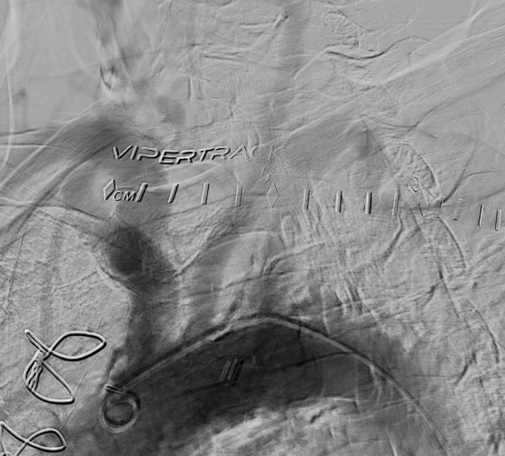
Proximal subclavian stenosis

Slide 5
Simultaneous subclavian and vertebral artery stenosis
The prevalence of subclavian artery (SA) stenosis is about 2%.
The real prevalence of extracranial vertebral artery (VA) estimates ranging from 7% to 40%
In cases of combination of vertebral and subclavian stenosis, typically symptoms occur mainly due to vertebro-basilar insufficiency (VBI).

Slide 6
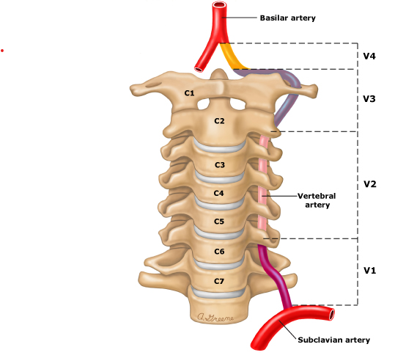
Simultaneous subclavian and vertebral artery stenosis
50% of patients with VA stenosis present initially with stroke, and 26% TIA.
Over course of next 5 years → VA stenosis portends a 20–30% risk of stroke
Current recommendations → intervene in cases of VA stenosis in patients with stroke or definite symptoms of VBI.
VBI symptoms → dizziness, vertigo, visual dysfunction, peri-oral paresthesia.

Slide 7
For asymptomatic patients vertebral intervention is considered in following scenarios:
→ Significant unilateral stenosis in a dominant VA
ipsilateral carotid occlusion
tight stenosis of contralateral VA
Along with subclavian artery stenting : Proximity of VA to SA lesion, diseased VA ostium, risk of compromising vertebral flow

Slide 8
Scarce literature on combined subclavian and vertebral artery disease.
15 patients with symptomatic subclavian and vertebral artery stenosis underwent simultaneous SA/VA intervention.
Follow up done at 1, 6 and 12 months
66.7% patients experienced relief of chronic ischemic symptoms.
Maciejewski DR et al, Postepy Kardiol Interwencyjnej 2017.

Slide 9
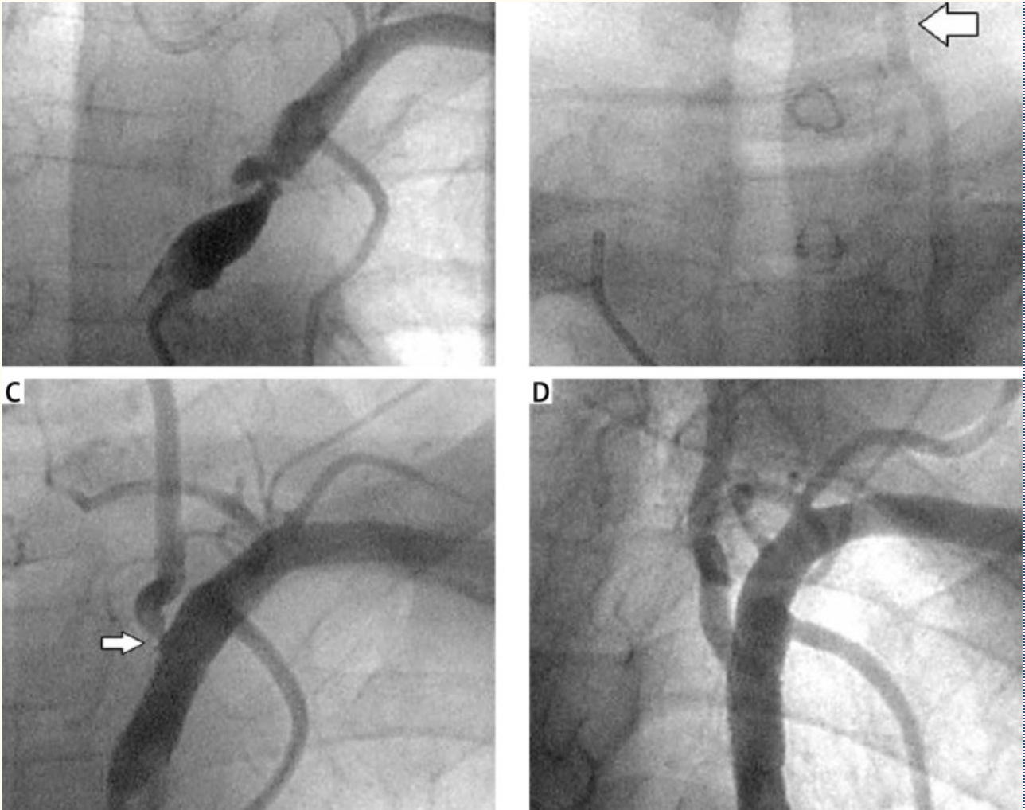
Vertebral artery stenting as a salvage/ad hoc procedure
VA stenosis after SA stenting --> VA stenting
Maciejewski DR et al, Postepy Kardiol Interwencyjnej 2017.

Slide 10
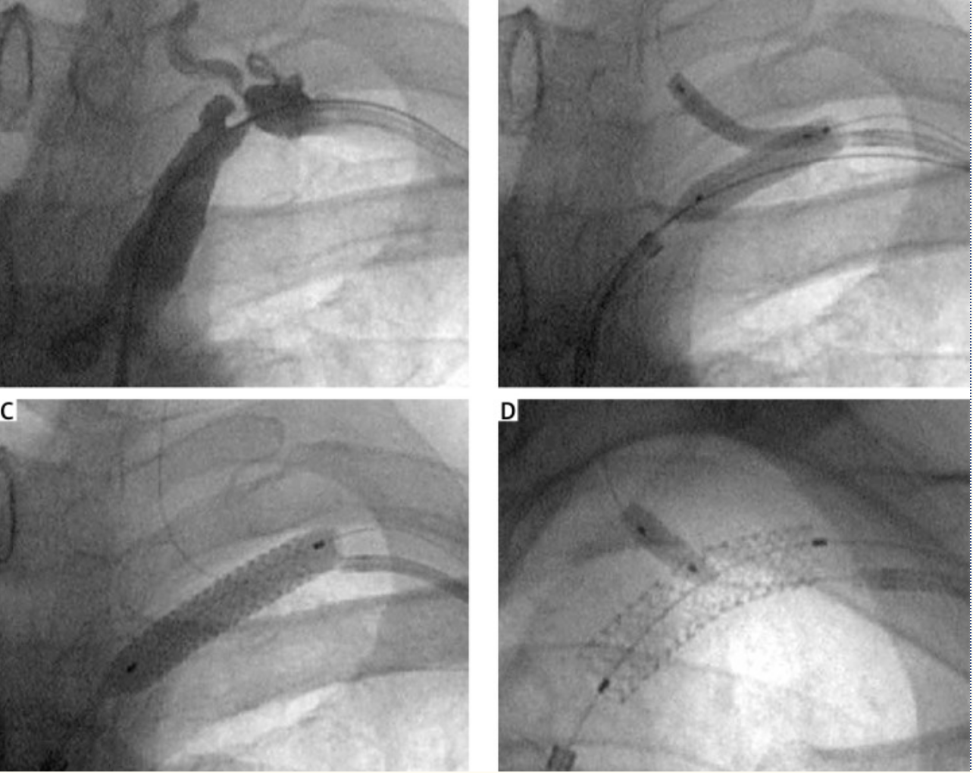
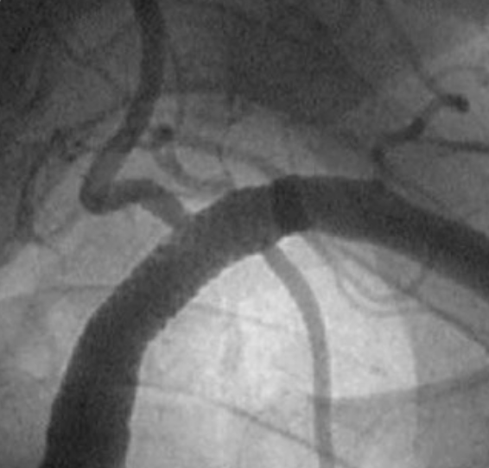
Simultaneous vertebral and subclavian artery stenting
Simultaneous pre-dilation
Serial stent placement
Maciejewski DR et al, Postepy Kardiol Interwencyjnej 2017.

Slide 11
Technical success defined as stent implantation with residual stenosis < 20%, no significant dissection and normal flow was achieved in all 15 (100%) cases of vertebral and in 13 (86.7%) cases of subclavian artery stenting.
No periprocedural death, stroke, myocardial infarction or transient ischemic attack occurred. (No neuroprotection filter was used)
There was 1 symptomatic vertebral and 1 subclavian in-stent restenosis, and 2 cases of asymptomatic VA in-stent occlusion occurred.
Simultaneous vertebral and subclavian stenting is a safe and effective procedure regarding the initial success rate and long-term patency.
Maciejewski DR et al, Postepy Kardiol Interwencyjnej 2017.

Slide 12
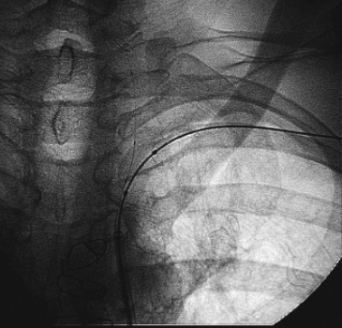
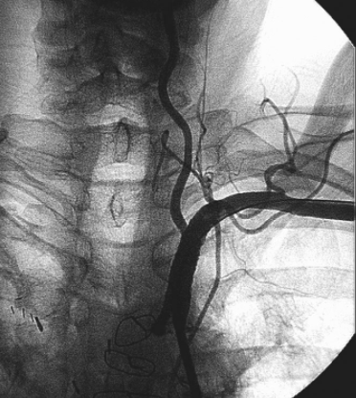
Mini- crush technique
A 0.014 EZ FilterWire™ (Boston Scientific) placed in the distal cervical segment of the VA.
KBI was then performed.
A Cypher 3.5 x 13.0 mm stent was positioned in the proximal portion of VA with some of the stent hanging in the subclavian
Genesis 8.0 x 24.0 mm stent was positioned across the subclavian stenosis, making sure that it remained proximal to the origin of the LIMA.
VA stent was deployed → Filter basket captured and retrieved.
SAS was then deployed crushing the VA stent
Re-crossed VA stent struts with 014 wire and sequentially dilated.
FKBI was performed using a Quantum 3.5 x 12.0 mm balloon in the Cypher, and an Optipro 8.0 x 2.0 mm balloon in the subclavian stent.
Biria M et al, JIC, 2007

Slide 13
Re-stenosis
Risk of restenosis in plain vertebral artery stenting reported 10% at 6 months to 25–43% at 1 year
Risk of restenosis for bifurcation stenting in the vertebral-subclavian area is not known → expected to be higher as seen in coronaries.

Slide 14
Re-stenosis
35 patients treated with non –DES and 15 treated with DES for management of VA origin stenosis.
Symptoms resolved in 30/31 (96.8%) patients treated with non-DES and 11/12 (91.7%) treated with DES.
ISR was documented in 11 patients; non DES 9/24 (38%), DES 2/12 (17%).
Ogilvy et al, JIC, 2010

Slide 15
Distal embolic protection devices
Paucity of data for embolic protection device use in vertebral artery.
Sawada et al studied 12 consecutive patients undergoing percutaneous intervention for SCA and VA stenosis. Several new signals on transcranial doppler were detected immediately after angioplasty in 6 of the 12 patients.
Canyigit et al studied 16 patients pre- and post-VA stenting. 6 of 16 patients had a total of 25 new lesions in the vertebrobasilar circulation area in the post-stent images.
Swada M et al et al, Neurosurgery, 1997
Canygit et al, Cardiovasc Intervent Radiol, 2007

Slide 16
Coronary bifurcation techniques are feasible for vertebral/subclavian artery bifurcation lesions.
Drug eluting stents preferred for VA stent due to high restenosis rates
Distal embolic protection device should be used frequently

Slide 17
Thank You!

