Slide 1
Complex Coronary Case
Supported by:
Sun Pharmaceutical Industries Ltd.

Slide 2
Disclosures
Samin K. Sharma, MD, MSCAI, FACC
Speaker’s Bureau – BSC, Abbott, CSI
Annapoorna S. Kini, MD, MRCP, FACC
Nothing to disclose
Prakash K Hazra, MD, DM, FACC (Guest Faculty)
Sumanta Chatterjee, MD, DM, FSCAI (Moderator)

Slide 3
Prakash Kumar Hazra, MD(Med), DM(Cardiology), DNB, FACC
HOD Cardiology and Director of Cardiac Cath Lab
AMRI Hospitals, Dhakuria, Kolkata
Sumanta Chatterjee, MD(Med), DM(Cardiology), FSCAI, AFESC
Consultant Interventional Cardiologist
AMRI Hospitals, Dhakuria, Kolkata
Dr. Prakash Kumar Hazra is HOD in Cardiology Department and Director of Cardiac Cath Lab at AMRI hospitals in Dhakuria, Kolkata. He has done more than 7000 procedures in Primary PCI/Angioplasty, MRI compatible subcutaneous ICD which is first in India, leadless pacemaker implanter and ASD/VSD ad PDA closure techniques. He is invited faculty in various International Conference like TCT Russia, BIT Bangladesh, TCTTAPS Korea and AICT Singapore.
Dr. Sumanta Chatterjee is a dedicated and hardworking young Interventional Cardiologist in Kolkata, currently attached to AMRI Hospitals, Dhakuria. He is performing radial route angiography and angioplasty with special interest in primary angioplasty round the clock. Dr. Chatterjee is well versed in FFR OCT and IVUS guided angioplasties, difficult coronary procedures, bifurcation lesions with newer sophisticated gadgets. Dr. Chatterjee is well versed in echocardiology (TTE and TEE) balloon mitral and pulmonary valvuloplasty, EP study, leadless pacemaker implantation, subcutaneous ICD, LAAA Closure and TAVR.

Slide 4
Live Case # 10
Patient Demographics
60 yrs, M with angina
Present Clinical Presentation
Presented new onset CCS class III angina and + SPECT MPI for MV ischemia
CAD Risk Factors
Un-controlled IDDM
Controlled Hyperlipidemia
Controlled Hypertension
COPD/Asthma
+F/H, SAQ-7: 57, Super Obese
Clinical Variables
High risk noninvasive testing, EF 60%

Slide 5
Weight and Body Mass Index Classification
Weight Categories | BMI (kg/m²)
Underweight | <18.5
Healthy Weight | 18.5 – 24.9
Overweight | 25 – 29.9
Obese (Class I) | 30 – 34.9
Severely Obese (Class II) | 35 -39.9
Morbidly Obese (Class III) | 40 – 49.9
Super Obese (Class IV) | >50

Slide 6
Live Case # 10
Patient Demographics
60 yrs, F with angina
Present Clinical Presentation
Presented new onset CCS class III angina and + SPECT MPI for MV ischemia
CAD Risk Factors
Un-controlled IDDM
Controlled Hyperlipidemia
Controlled Hypertension
COPD/Asthma
+F/H, SAQ-7: 57, Super Obese
Clinical Variables
High risk noninvasive testing, EF 60%
Medications
Aspirin, Rosuvastatin, Metoprolol XL, Losartan, HCTZ, Glucophage, Glimepiride, Inhalers
Cath: Cath on August 5th 2021 revealed 3 V+LM CAD: 70% eccentric LM bifurcation, 60% pLAD, 70% pLCx, 80% severely calcified pRCA, Syntax score 33 and LVEF 60%. Pt was referred for CABG, but declined by the CTS due to super-obesity.
Plan: Now planned for high-risk complex dLM bifurcation with Mini-Crush technique and IVUS/OCT for stent optimization.

Slide 7
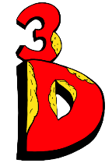
BifurcAID 3D – An animated bifurcation lesion treatment educational application and website. With two views, detailed descriptions, and more, BifurcAID 3D helps make clear the complex steps in techniques such as Minicrush, DK Crush and Culotte, as well as provisional approached and bailout techniques.

Slide 8
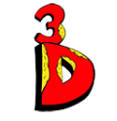
www.CardiologyApps.com/BifurcAID-3D
Key Features:
Left Main and Non-Left Main bifurcation lesions
Secondary view highlighting key points such as stent crush
Android, iOS and WebApp
Many techniques:
DK Crush
Mini Crush
Culotte
Provisional Stenting
Bailout Techniques
Available for free on Android Google Play Store and Apple App Store in addition to our WebApp version on www.cardiologyapps.com/BifurcAID-3D

Slide 9
Available for Free Download Now
Shown Below:
LM Minicrush

Slide 10
AUC 2017: Revascularization to Improve Survival
Compared with Medical Therapy
Syntax score 33; STS score 2.2
Patel et al., J Am Coll Cardiol 2017;69:2212

Slide 11
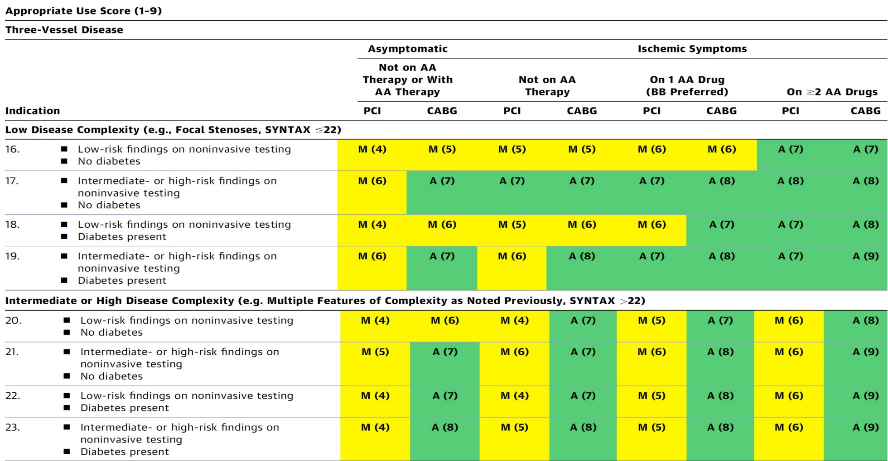
AUC 2017: Left Main + 3 V CAD
After Heart team discussion: A
Patel et al., J Am Coll Cardiol 2017;69:2212

Slide 12
Available for Free Download Now
Shown Below:
LM LAD Provisional
& Bailout if needed

Slide 13
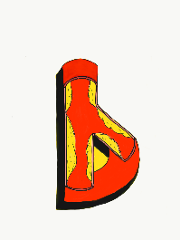
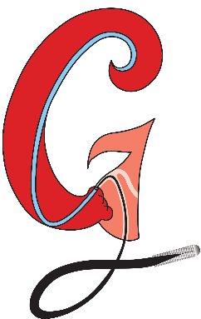
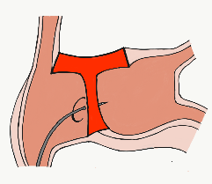
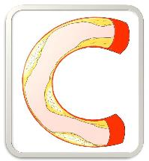
BifurcAID
TAVRcathAID
ComplicAID
Mobile App
Coming soon…
GuidewireAID
Cath Lab
Apps
BifurcAID 3D
CalcificAID
OCTAID
TranseptAID

Slide 14
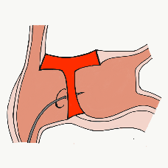
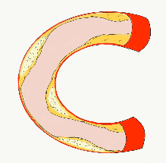
More than 35,800 unique downloads
Cath Lab Apps CardiologyApps.com
iOS 5/5 stars
9896 downloads
Android 4.4/5 stars
8245 downloads
Released sept 2017
iOS 5/5 stars
6068 downloads
Android 4.8/5 stars
3850 downloads
Released June 2018
iOS 5/5 stars
2073 downloads
Android N/A stars
549 downloads
Released March 2018
iOS 5/5 stars
1074 downloads
Android N/A stars
547 downloads
Released Sept 2018
iOS 5/5 stars
931 downloads
Android 5/5 stars
538 downloads
Released June 2019
WebApp Only*
2600 unique users
4800 sessions
Released August 2020
BifurcAID
OCTAID
TAVRcathAID
TranseptAID
CalcificAID
ComplicAID
*Also available
as WebApp
Download Apps
For Free on Both:
WebApps available free on
www.CardiologyApps.com
Apple ® and App Store® are registered trademarks of Apple Inc.
Notes:
These are the apps we have created which will provide digital algorithms for our future ambitious projects to make our cath labs smarter.

Slide 15
Apps Coming Soon…
STEMIcathAID – STEMI patient transfer platform designed to optimize communication between key members, record key performance metrics for AHA’s Mission: Lifeline program, and avoid costly false activations through direct CCL contact.
GuidewireAID – This application covers the design of coronary guidewires and the resulting properties they exhibit during use in the lab. Over two dozen teaching cases, a dense wire library with more than a hundred wires, and a robust search function provide a lot of tailored learning opportunities.
BifurcAID 3D – An animated bifurcation lesion treatment educational application and website. With two views, detailed descriptions, and more, BifurcAID 3D helps make clear the complex steps in techniques such as Minicrush, DK Crush and Culotte, as well as provisional approached and bailout techniques.

