Slide 1
Complex Coronary Cases Supported by:
Abbott Vascular Inc.
Boston Scientific Corp.
Terumo Vascular Corp.
Cardiovascular Systems Inc.
Abiomed Inc.
Chiesi Inc.
Shockwave Medical Inc.

Slide 2
Disclosures
Samin K. Sharma, MD, MSCAI, FACC
Speaker’s Bureau – BSC, Abbott, CSI
Annapoorna S. Kini, MD, MRCP, FACC
Nothing to disclose
Sameer Mehta, MD, FACC (Moderator)
Nothing to disclose

Slide 3
CCC Live Case # 147
Patient Demographics
75 yrs, F with CABG and AS
Present Clinical Presentation
Presented with progressive DOE and angina for 6 months.
CAD Risk Factors
Hyperlipidemia
Un-controlled Hypertension
Chronic HFpEF
SAQ-7: 59, + F/H
Clinical Variables
Known CAD s/p CABG x2 2007 and progressive AS. Pt underwent Evolut TF-TAVR on July 27, 2021 and cath revealed 3 V CAD, patent LIMA to LAD, patent SVG to OM and new 80-90% multiple calcified lesions in RCA
Medications
Aspirin, Clopidogrel, Rosuvastatin, Amlodipine, Metoprolol XL, Accupril, Albuterol
Cath: Cath done on 7/27/2021 revealed 3 V CAD: 100% mid LAD fills via LIMA, 100% OM1 fills via SVG, 80-90% heavily calcified multiple lesions in mid-distal RCA. Pt underwent successful Rt TF Evolut TAVR after IVL of RIC and did well. Pt continued to have moderate DOE symptoms NYHA class II
Plan: Now planned for complex PCI of calcified RCA lesions via Evolut TAVR valve struts using RA+IVL (RotaTripsy).

Slide 4
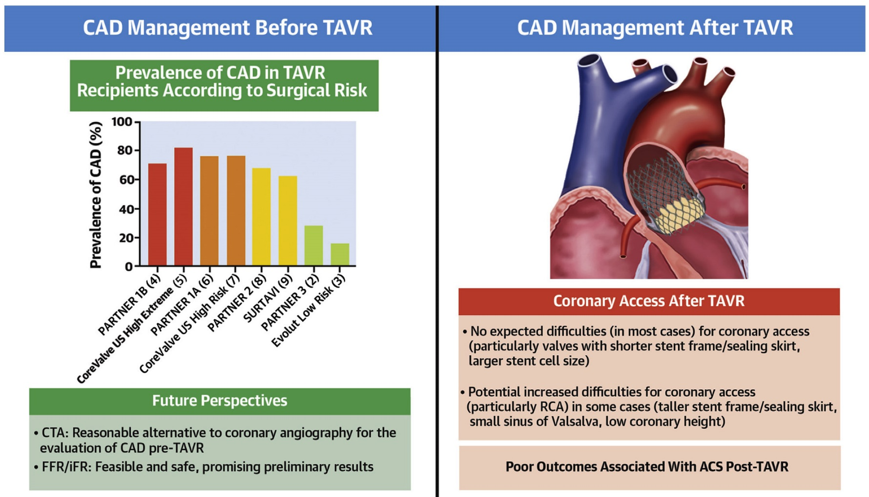
CAD Management Before and After TAVR
Faroux et al., J Am Coll Cardiol 2019;74:362

Slide 5
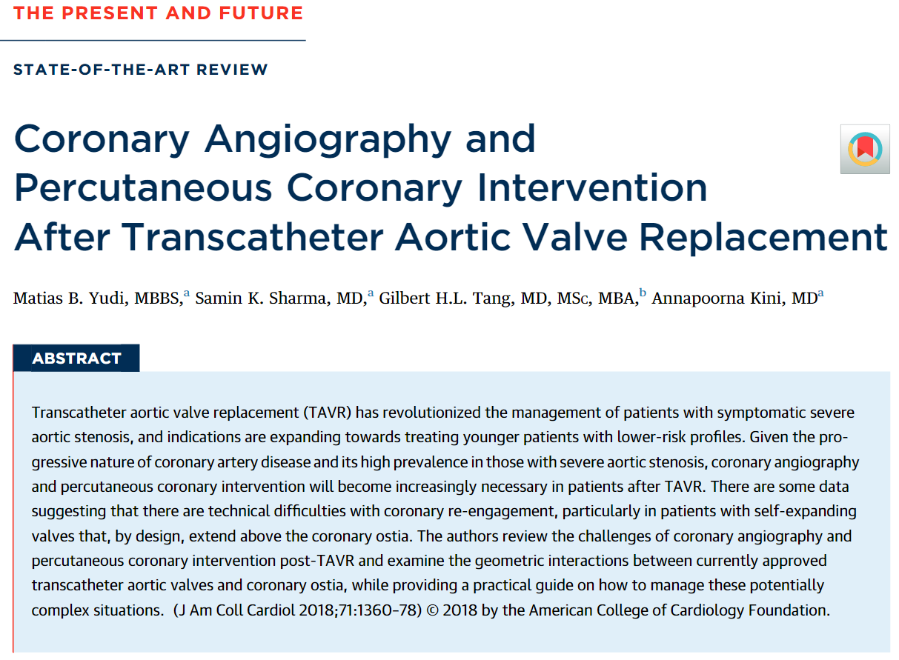
Coronary Angiography and PCI After TAVR
Yudi, Sharma, Kini et al. J Am Coll Cardiol.2018;71:1360

Slide 6
Coronary Angiography and PCI After TAVR
Yudi, Sharma, Kini et al. J Am Coll Cardiol.2018;71:1360

Slide 7
Algorithm on PCI Post-TAVR With a Self-Expanding Valve
6 French access from femoral or radial (left preferred) artery as per operator’s expertise
1. Use J-wire to enter diamond closest, and ideally in-front, of coronary ostia
2. Use Stiff Angled Glide wire if there is difficulty entering diamond or tracking the guide catheter
Commissural post in front of coronary ostia
(Assume if unable to enter diamond in front of ostia)
Commissural post away from coronary ostia
(Assume if able to enter diamond at level of coronary ostia)
LCA
1. Use FL3.0/3.5 guide
2. Second line guide: Ikari right 1.0/1.5
3. If difficulty with coronary
engagement, rail guide
towards the ostium using:
• Coronary guidewire ±
• Balloon support ±
• Guide extension catheter
RCA
1. Use FR4 guide
2. Second line guide: Ikari right 1.5
3. If difficulty with coronary
engagement, rail guide
towards the ostium using:
• Coronary guidewire ±
• Balloon support ±
• Guide extension catheter
LCA
1. Use FL 3.0/3.5 guide
2. Second line guide: Ikari right 1.0/1.5
3. If skirt is high, use Ikari Right guide to enter diamond from above ostia and rail guide towards ostium using:
• Coronary guidewire ±
• Balloon support ±
• Guide extension catheter
RCA
1. Use FR4 guide
2. Second line guide: Ikari Right 1.5, AR2 (wide sinuses), MP
3. If skirt is high, use Ikari Right or MP guide to enter diamond from above coronary ostia and rail guide towards ostium using:
• Coronary guidewire ±
• Balloon support ±
• Guide extension catheter
Yudi, Sharma, Kini et al. J Am Coll Cardiol.2018;71:1360

Slide 8
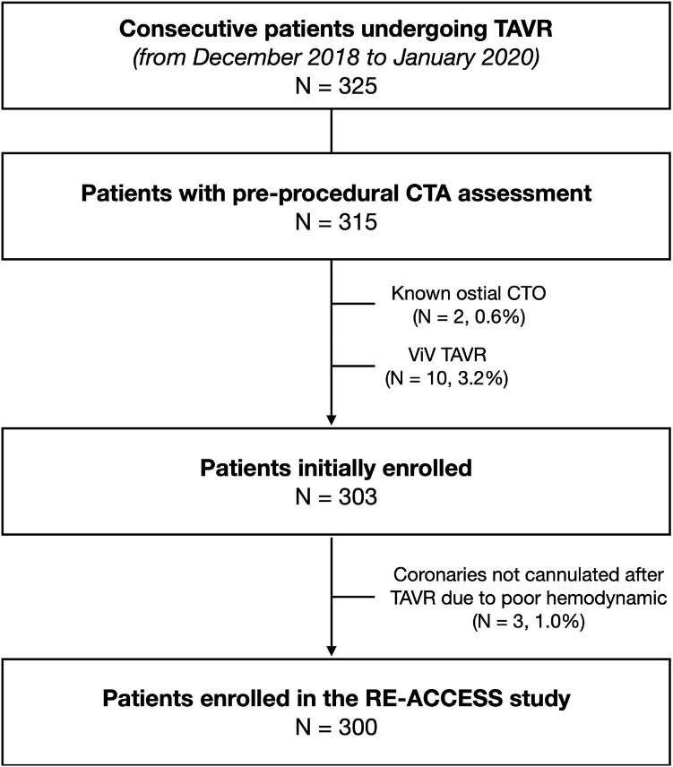
Coronary Cannulation After TAVR: The RE-ACCESS Study
300 patients – all available devices:
23 (7.7%) unsuccessful cannulations; 22/23 occurred with Evolut R/Pro TAV
Barbanti et al. J Am Coll Cardiol 2020;13:2542
Notes:
Coronary cannulations were defined as “selective” when the catheter completely engaged the coronary ostium; “semiselective” when the catheter was just in front of the coronary ostium without obtaining complete engagement, but resulting in an adequate opacification of the coronary; or “unsuccessful” when it was deemed impossible to obtain selective or semiselective coronary engagement, thus precluding proper opacification of the coronary artery with contrast media injection.
Difficulties in achieving selective cannulation after TAVR (particularly for the RCA) were also demonstrated by the higher rate of semiselective cannulation, the longer time, and the larger amount of contrast dye used to engage either coronary ostia.

Slide 9
Predictors of Unsuccessful Coronary Cannulation After TAVR
Barbanti et al. J Am Coll Cardiol 2020;13:2542
Notes:
Patients receiving the Evolut R and PRO TAVs were more prone to have more challenging coronary cannulation.
SAPIEN valves rarely interact with the coronary arteries, with only 1 case of unsuccessful coronary cannulation reported in a patient with a tubular aortic root; this observation could be explained by the fact that this prosthesis has a shorter frame, and it is usually deployed in the sub coronary position
The newer generation SAPIEN valves are taller and thus more likely to extend above the coronary ostia and potentially interfere with coronary access
The greater the oversizing of the SoV, the higher the risk for impairment of coronary ostia engagement
The depth of implantation seems to play an even more important role in predicting an impairment in coronary cannulation after TAVR
Interestingly, these 3 variables (use of an Evolut valve, high SoV oversizing, and high implantation) when considered together had excellent discrimination capability (AUC: 0.94) to predict unsuccessful coronary cannulation after TAVR.

Slide 10
TAVRcathAID
Free Download
March 2021: large content update for our application on coronary re-access post TAVR
Apple ® and App Store® are registered trademarks of Apple Inc.

Slide 11
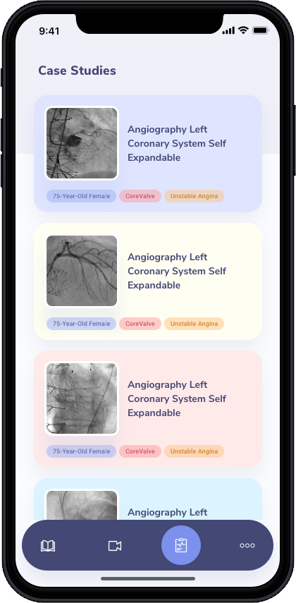
The New TAVRcathAID
Features
Added case reviews
Offline functionality
Updated user interface
Powerful search function
Detailed animations
Fully-featured WebApp
Eight detailed case reviews show how coronary access was achieved in patients after TAVR.
Guide catheter escalation if required, guide extension catheter use, as well as the proceeding diagnostic catheterization or intervention.

Slide 12
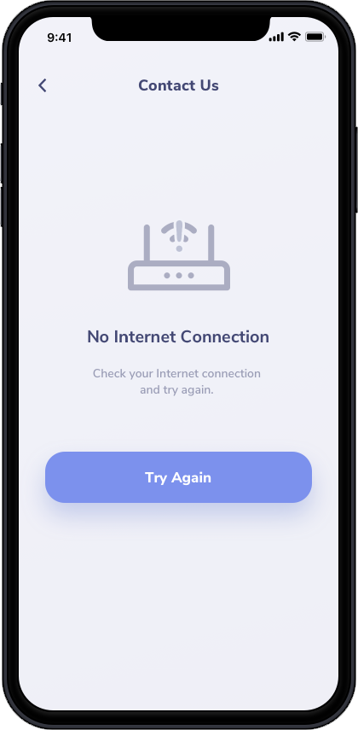
The New TAVRcathAID
Features
Added case reviews
Offline functionality
Updated user interface
Powerful search function
Detailed animations
Fully-featured WebApp
Whether you are in a shielded cath lab, airplane, or underwater tunnel, the application works without a hitch.
100% offline functionality, text, images, and videos.

Slide 13
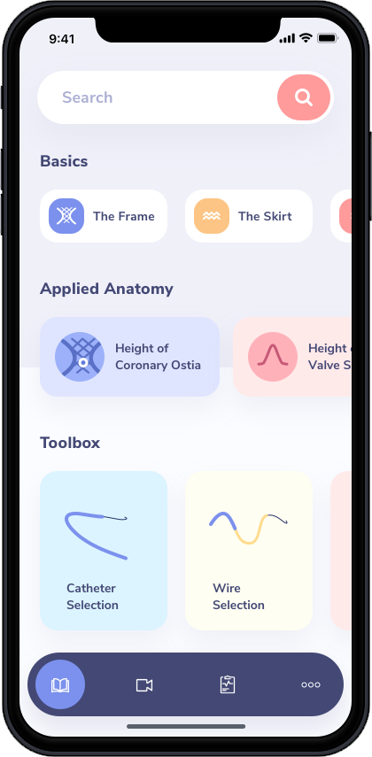
The New TAVRcathAID
Features
Added case reviews
Offline functionality
Updated user interface
Powerful search function
Detailed animations
Fully-featured WebApp
The user interface was re-designed from the ground up to bring all of the new and old features one or two presses away without getting lost in a maze of menus.

Slide 14
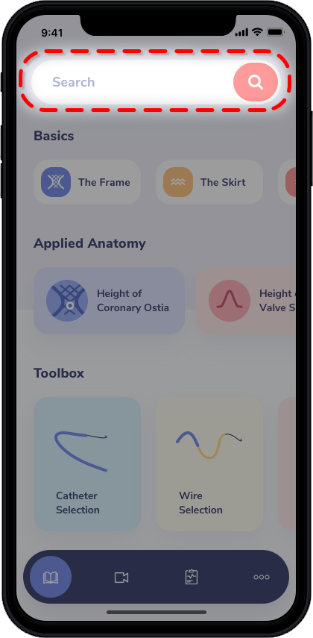
The New TAVRcathAID
Features
Added case reviews
Offline functionality
Updated user interface
Powerful search function
Detailed animations
Fully-featured WebApp
An application-wide search has been introduced that will find your term of interest inside of the educational sections or case reviews and take you right there without having to spend any time manually looking.

Slide 15
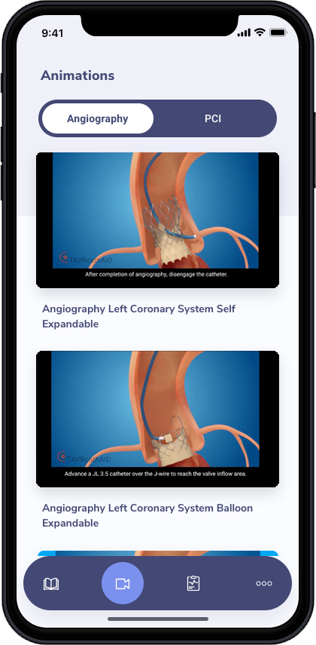
The New TAVRcathAID
Features
Added case reviews
Offline functionality
Updated user interface
Powerful search function
Detailed animations
Fully-featured WebApp
Take the high quality coronary reaccess animations anywhere.
Includes right and left cath, as well as PCI with commissural posts in front and away from the coronary ostium.

Slide 16
TAVRcathAID Animations

Slide 17
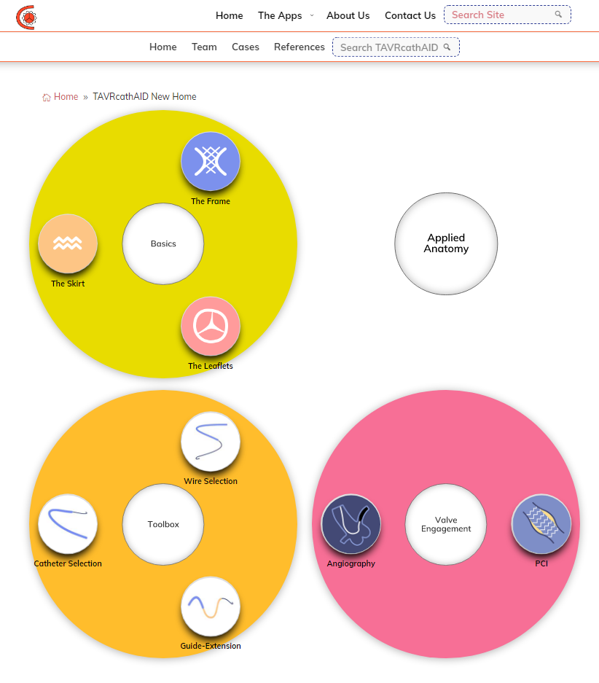
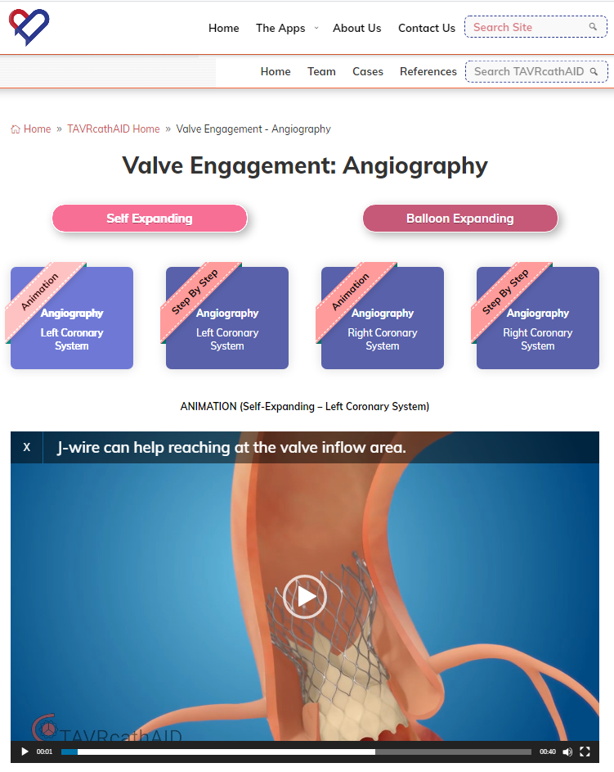
The New TAVRcathAID
Features
Added case reviews
Offline functionality
Updated user interface
Powerful search function
Detailed animations
Fully-featured WebApp
All features available within the app are also available on the WebApp www.CardiologyApps.com/TAVRcathAID

Slide 18
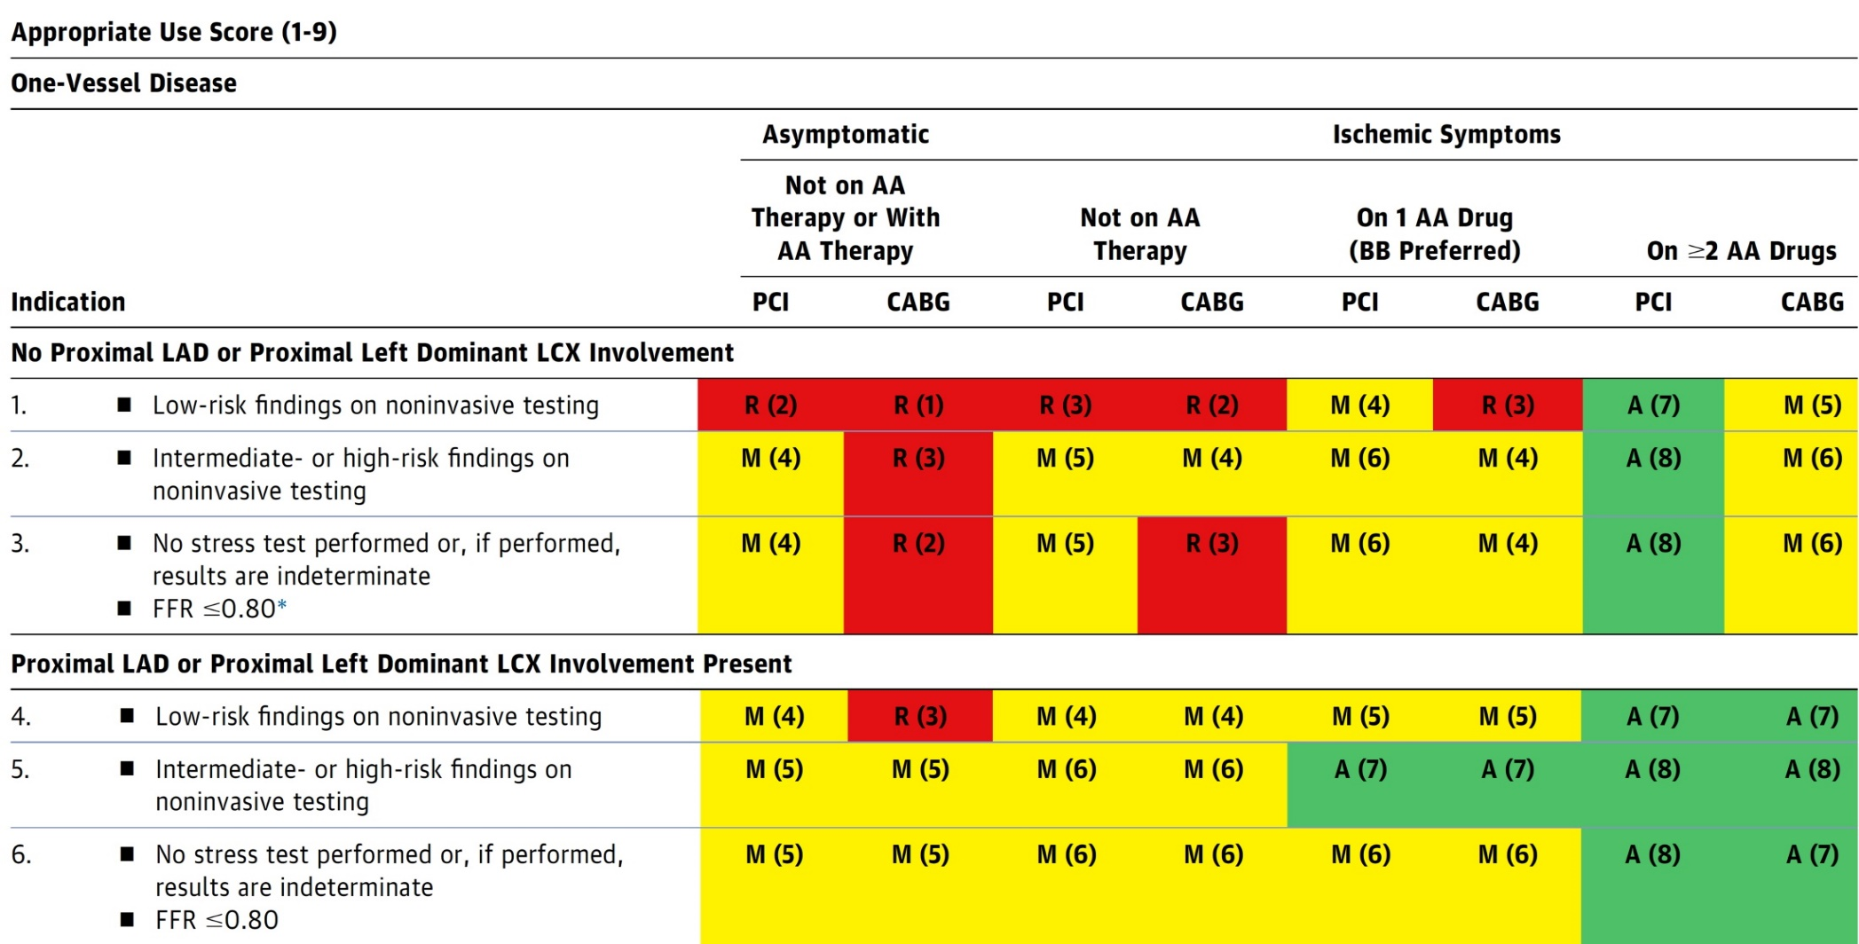
AUC 2017: One-Vessel Disease
Patel et al., J Am Coll Cardiol 2017;69:2212

Slide 19
Latest Issues in Coronary Intervention
Key Interventional Trials from ESC 2021;
MASTER-DAPT, STOPDAPT-2 ACS,
RIPCORD-2,
Focused review of the month
DAPT De-escalation in ACS pts:
Improving balance between efficacy and bleeding

Slide 20
Latest Issues in Coronary Intervention
Key Interventional Trials from ESC 2021;
MASTER-DAPT, STOPDAPT-2 ACS,
RIPCORD-2,
Focused review of the month
DAPT De-escalation in ACS pts:
Improving balance between efficacy and bleeding

Slide 21
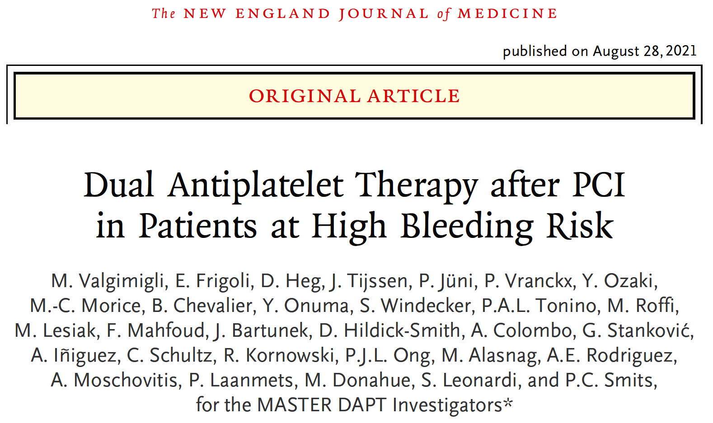

Slide 22
MASTER DAPT: Background and Objectives
Studies with 1 month DAPT after DES implantation suggested that this regimen may mitigate bleeding without compromising safety.
These studies were either nonrandomized, did not select high bleeding risk (HBR) pts or included pts at low ischemic risk.
To determine whether an abbreviated compared with a standard DAPT regimen preserves net and major clinical events, and, if so mitigates the bleeding risk in a broadly inclusive HBR population who underwent PCI.

Slide 23
MASTER DAPT: High Bleeding Risk Definition
Patients are at high bleeding risk if at least one of the following criteria applies:
Clinical indication to oral anticoagulants (OAC) for at least 12 months
Recent (<12 months) non-access site bleeding episode(s), which required medical attention
Previous bleeding episode(s) which required hospitalization if the underlying cause has not been definitively treated
Age ≥75 years
Systemic conditions associated with an increased bleeding risk
Documented anemia (Hb<11 g/dL) or transfusion within 4 weeks before randomization
Need for chronic treatment with steroids or NSAID
Diagnosed malignancy (other than skin) considered at high bleeding risk
Stroke at any time or transient ischemic attack (TIA) in the previous 6 months
PRECISE DAPT score ≥25
Valgimigli et al., N Engl J Med Aug 28, 2021 Epub ahead of print

Slide 24
MASTER DAPT: Patient Disposition
5204 consented patients
From February, 2017, to December, 2019
4520 Consented at Index PCI*
267 Excluded
5 not eligible
27 died
33 did not attend M1
202 withdrew consent
4937 Assessed for Eligibility at M1*
684 Consented at M1*
358 Excluded
304 not eligible
54 Medical reasons
4579 Randomized
2295 Abbreviated DAPT
2204 (96%) per-protocol pop †
2284 Standard DAPT
2230 (98%) per-protocol pop †
2 LTFUP
13 withdrew consent
8 LTFUP
9 withdrew consent
Outcome data at 1 year
2280 (99%) Intention-to-treat
2194 (99%) Per-protocol †
Outcome data at 1 year
2267 (99%) Intention-to-treat
2214 (99%) Per-protocol †
*: From February 28, 2017 through December 5, 2019
† : Per-protocol population: met eligibility criteria and implemented study Tx within 14 days after Rx
Valgimigli et al., N Engl J Med Aug 28, 2021 Epub ahead of print

Slide 25
MASTER DAPT: Study Endpoints
The study has 3 primary endpoints to be tested in an hierarchical order:
Net adverse clinical events (NACE): the composite of all-cause death, MI, stroke, and major bleeding defined as BARC type 3 or 5
Major adverse cardiac and cerebral events (MACCE): the composite of
all-cause death, MI, and stroke
Major or clinically relevant non-major bleeding (MCB): the composite of BARC type 2, 3 and 5 bleeding
The first two primary endpoints were to be tested on a non-inferiority basis in the per protocol population. If non-inferiority was met for both, the third primary endpoint was to be tested on superiority basis in the Intention to treat population. The main analyses evaluate the occurrence of the primary endpoints between randomization and 335 after index PCI

Slide 26
MASTER DAPT: NARC Adherence Rates* and Regimens
*: Perfect adherence rate, defined as 100% intake of protocol mandated regimen, counted on a daily basis
The median DAPT duration from the
index coronary intervention was
34 days (IQR, 31-39) in the abbreviated-
and 193 days (IQR, 102-366) in the
standard-treatment groups.
Type of SAPT in the abbreviated DAPT
%
71.2%
53.9
28.8%
13.6
1.2
*:NARC definition and Framework, Eur Heart J. 2019;40:2070
Valgimigli et al., N Engl J Med Aug 28, 2021 Epub ahead of print

Slide 27
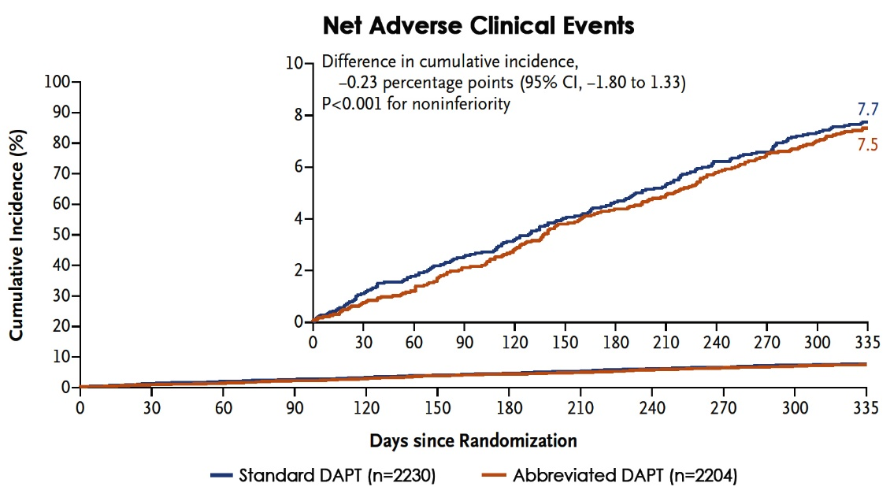
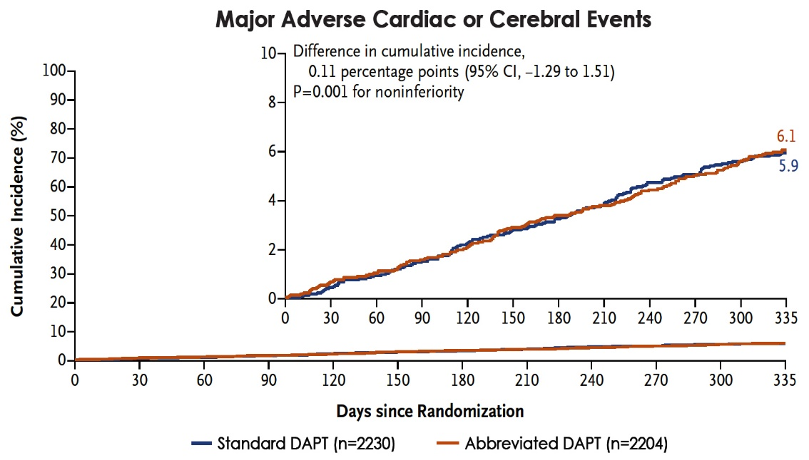
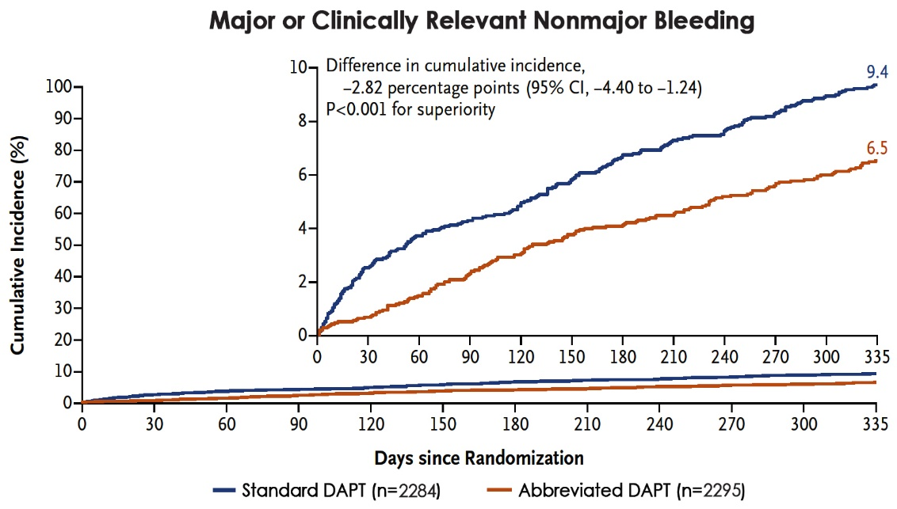
MASTER DAPT: Three Primary Composite Outcomes at 335 Days
Valgimigli et al., J AM Coll Cardiol Aug 28, 2021 Epub ahead of print

Slide 28
MASTER DAPT: Composite Primary and Secondary Outcomes in the Pre-Protocol Populations
0.66
(0.51-0.84)
%
0.52
(0.28-0.95)
NACE MACCE Major/ Death Stroke/TIA MI Def/prob ST Bleeding
Clinical Relevant BARC 3-5
bleeding
Valgimigli et al., N Engl J Med Aug 28, 2021 Epub ahead of print

Slide 29
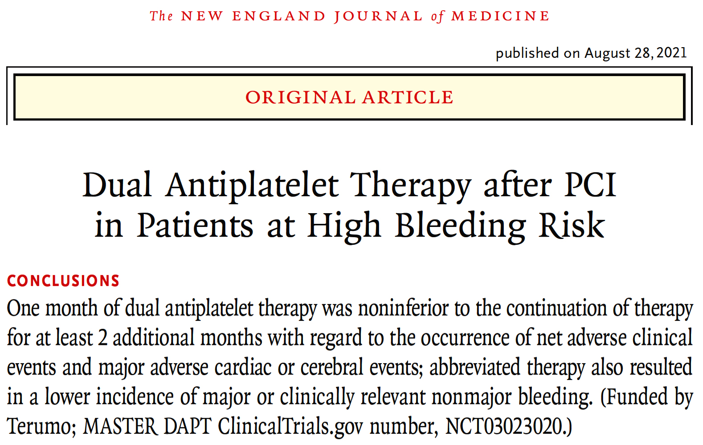

Slide 30
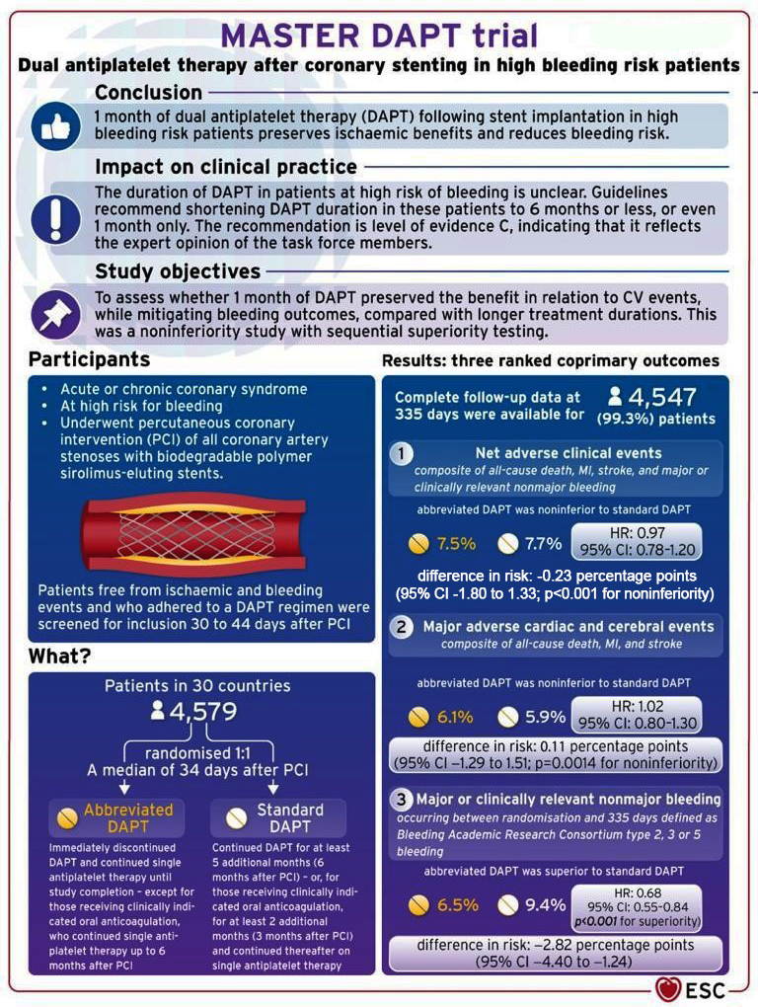

Slide 31
One-month Dual Antiplatelet Therapy Followed by Clopidogrel Monotherapy in Acute Coronary Syndrome:

Slide 32
STOPDAPT-2 ACS: Background
Standard DAPT duration in patients with ACS is 12 months with class I recommendation.
Recent trials and some meta-analysis demonstrated the benefit of very short DAPT (1-3M) and subsequent P2Y12i monotherapy in reducing bleeding without increase in cardiovascular events even after ACS-PCI.
Death, MI and Stroke (1-year)
 | P2Y12i mono |  | DAPT |  | HR (95%CI) | HR (95%CI)
P2Y12i type
Newer P2Y12i | 158/5845 | (3.0%) | 187/5884 | (3.7%) |  | 0.85 (0.69-1.06)
Clopidogrel | 028/1103 | (2.9%) | 033/1134 | (3.2%) |  | 0.88 (0.53-1.46)
Overall | 186/6948 | (3.0%) | 220/7018 | (3.7%) |  | 0.86 (0.71-1.04)
SIDNEY-2, BMJ 2021; 373: n1332
However, monotherapy with newer P2Y12i was the dominant strategy in ACS patients in these very short DAPT studies. The benefit of very short DAPT and subsequent clopidogrel monotherapy is not fully addressed in ACS patients.
Watanabe H, ESC 2021

Slide 33
STOPDAPT-2 ACS
Prospective multicenter open-label randomized trial comparing
1-month vs 12-month DAPT after CoCr-EES implantation for patients with ACS
1M
(30-59d)
1Y
(335-394d)
5Y
1-month DAPT group
ASA
ACS-PCI
P2Y12i
Clopidogrel 75mg/d
R
Clopidogrel 75mg/day or
Prasugrel 3.75 mg/day
Primary analysis
P2Y12i
Clopidogrel 75mg/d
ASA
ASA
ASA
12-month DAPT group
Key exclusion criteria
Oral anticoagulants
Prior intracranial hemorrhage
In-hospital serious complication (re-infarction, stroke, major bleeding)
Watanabe H, ESC 2021

Slide 34
STOPDAPT-2 ACS: Endpoints
Primary endpoint:
A composite of cardiovascular (cardiovascular death, myocardial infarction, definite stent thrombosis, any stroke) and bleeding (TIMI major/minor bleeding) events
Major secondary endpoints:
Cardiovascular (CV) composite endpoint
A composite of cardiovascular death, myocardial infarction, definite stent thrombosis, any stroke
Bleeding endpoint
TIMI major/minor bleeding
Watanabe H, ESC 2021

Slide 35
STOPDAPT-2 ACS: Study Flow
STOPDAPT-2 ACS (NCT03462498)
Mar. 2018- Jun.2020
Eligible ACS patients
N=4056
STOPDAPT-2 (NCT02619760)
Dec. 2015- Dec.2017
Eligible ACS patients
N=2437
No Participation
N=1048 (26%)
No Participation
N=1276 (52%)
STOPDAPT-2 ACS
N=3008
ACS in STOPDAPT-2
N=1161
Randomized ACS patients
N=4169
1-month DAPT arm
N=2078
Stratified
by Center
12-month DAPT arm
N=2091
20 withdrew consent
N=4136
13 withdrew consent
1-month DAPT, ITT
N=2058
12-month DAPT, ITT
N=2078
1-year FU 99.3%
1-year FU 99.3%
Watanabe H, ESC 2021

Slide 36
STOPDAPT-2 ACS: Procedural Characteristics
and Medications
 | 1-month DAPT N=2058 | 12-month DAPT N=2078
Staged Procedure | 14% | 15%
Radial approach only | 85% | 86%
N of target lesions | 1.27±0.60 | 1.28±0.59
Minimal stent diameter, mm | 3.01±0.51 | 3.02±0.50
Total stent length, mm | 34.3±22.6 | 34.6±23.5
Target of LMCA | 3% | 3%
Two or more target vessels | 17% | 19%
IVUS or OCT | 97% | 98%
ASA; 100mg/d | 99.9%; 98.6% | 99.9%; 98.4%
Clopidogrel | 52% | 53%
Prasugrel (3.75mg/day) | 48% | 47%
Statin; High-intensity statin | 96%; 35% | 97%; 34%
PPI | 91% | 93%
Watanabe H, ESC 2021

Slide 37
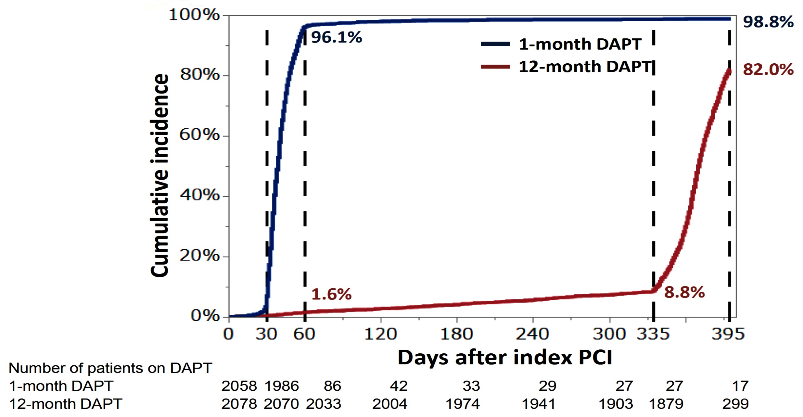
STOPDAPT-2 ACS: Persistent DAPT Discontinuation Rate
Watanabe H, ESC 2021

Slide 38
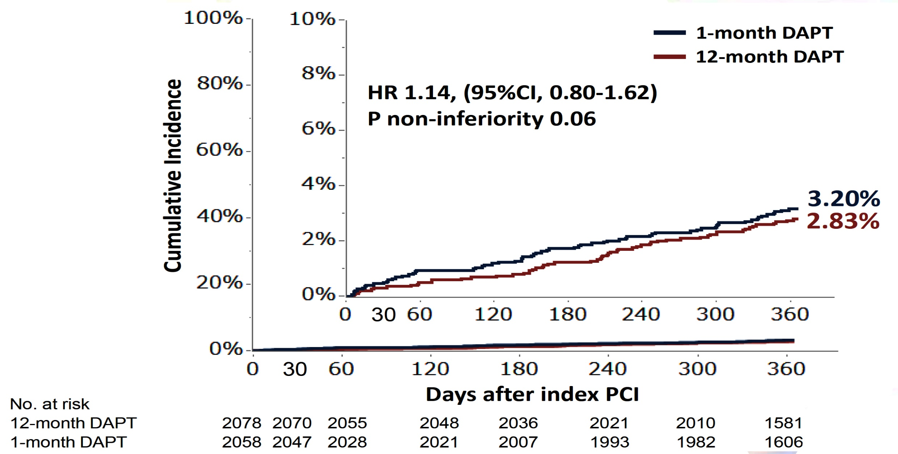
STOPDAPT-2 ACS: Primary Endpoint
CV death, MI, Stroke, TIMI major/minor bleeding
Watanabe H, ESC 2021

Slide 39
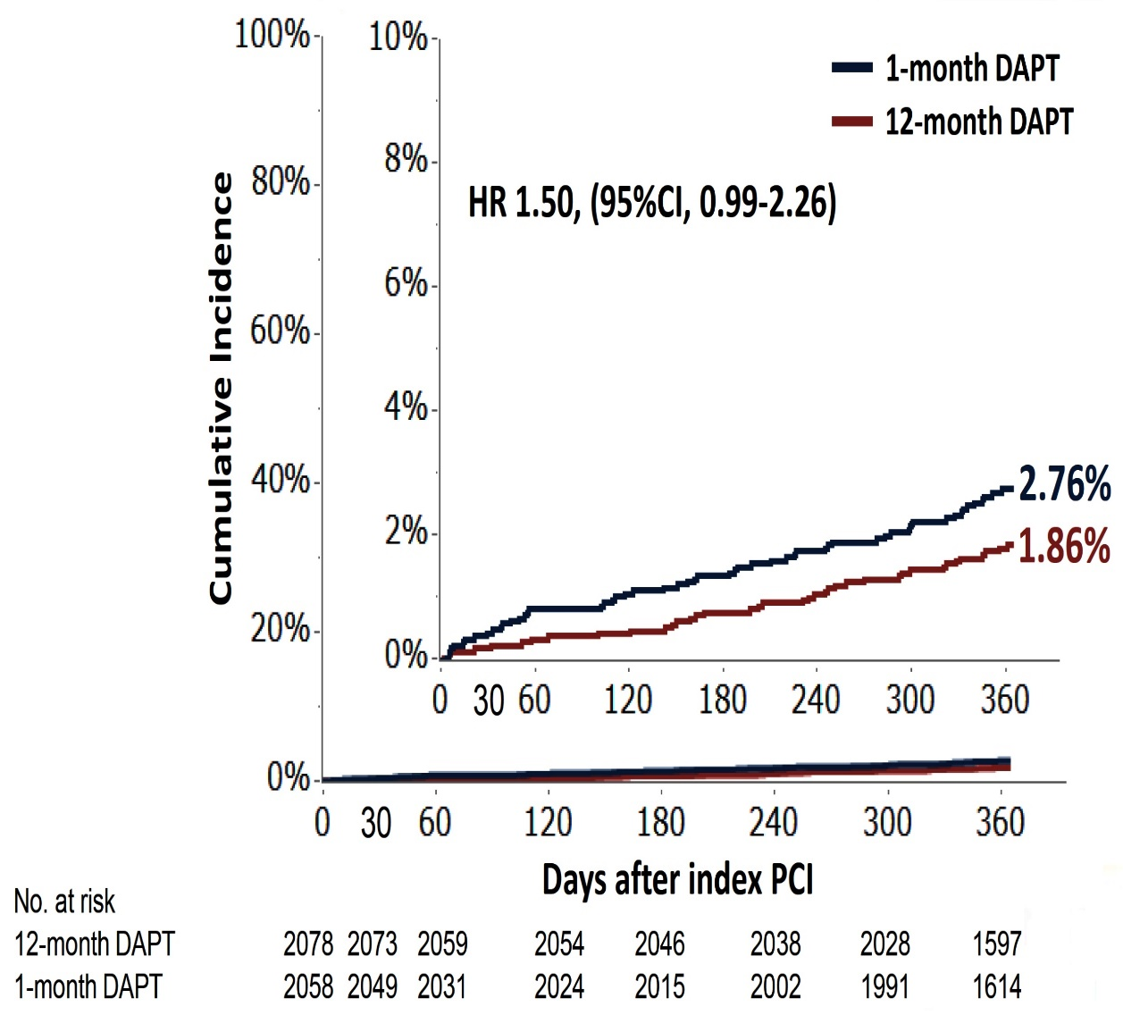
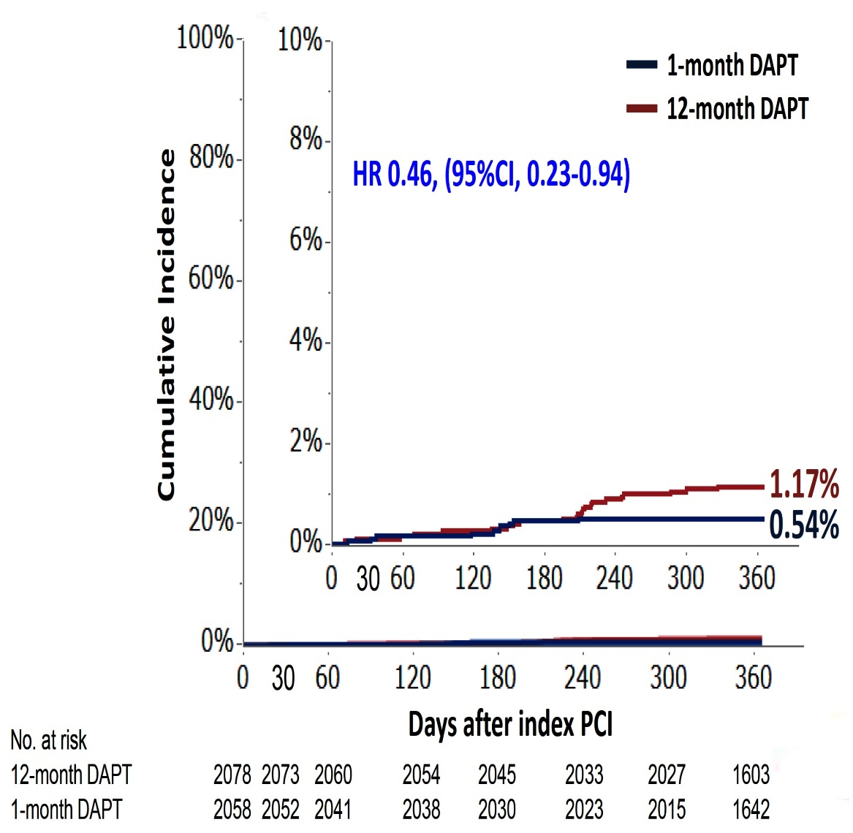
STOPDAPT-2 ACS: Major Secondary Endpoints
CV death, MI, ST, Stroke
TIMI major/minor bleeding
Watanabe H, ESC 2021

Slide 40
STOPDAPT-2 ACS: Clinical Outcomes at
1 Year
Hazard ratio (95%CI)
1.49
(0.83-2.67)
1.01
(0.42-2.43)
1.91
(1.06-3.44)
1.53 (0.43-5.43)
2.29
(0.70-7.42)
1.38
(0.63-3.00)
0.41
(0.20-0.83)
Cumulative Incidence
(CKMB >=10*ULN)
Watanabe H, ESC 2021

Slide 41
Conclusions
In ACS patients who underwent successful PCI using CoCr-EES, clopidogrel monotherapy after 1-month DAPT failed to attest the noninferiority to 12-month DAPT with aspirin and clopidogrel for the net clinical benefit with a trend toward increase in cardiovascular events despite reduction in major bleeding events.
Further investigations are needed to establish the optimal antiplatelet therapy after PCI in patients with ACS

Slide 42
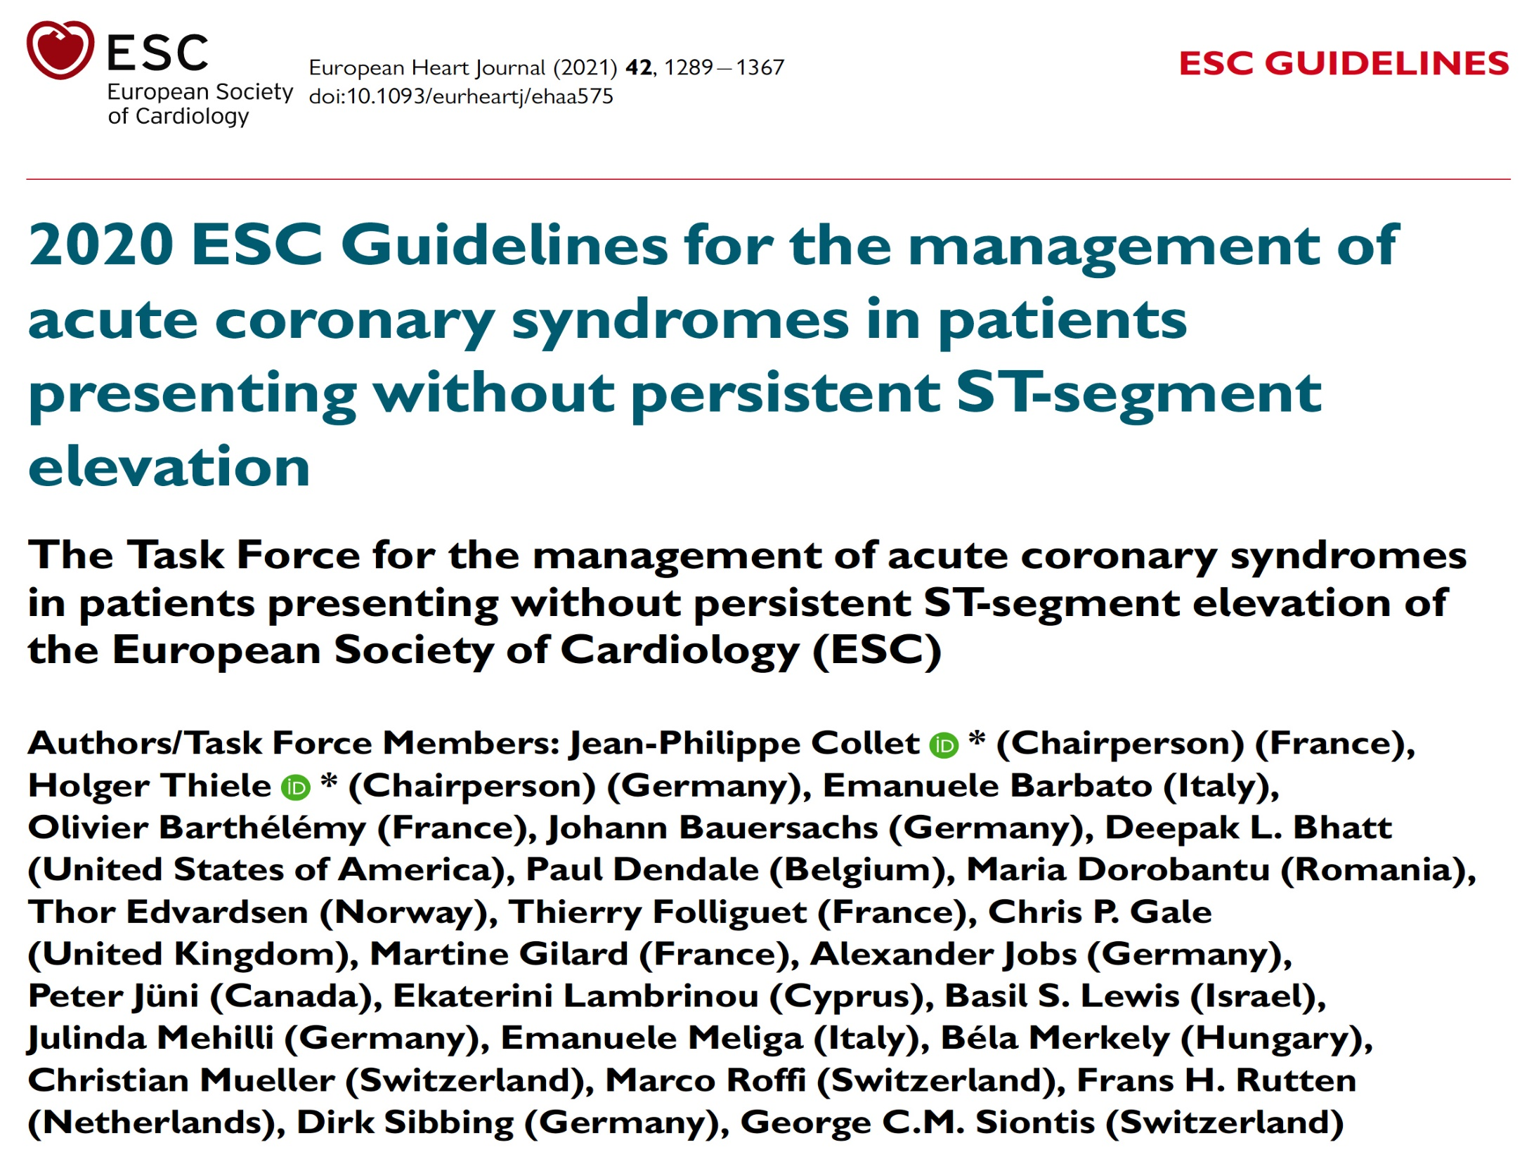

Slide 43
Algorithm for Antithrombotic Therapy in Non-ST-Segment Elevation ACS Patients Without A-Fib Undergoing PCI
Collet et al., Eur Heart J 2021;42:1289

Slide 44
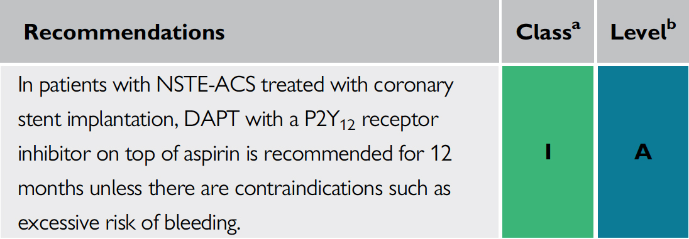
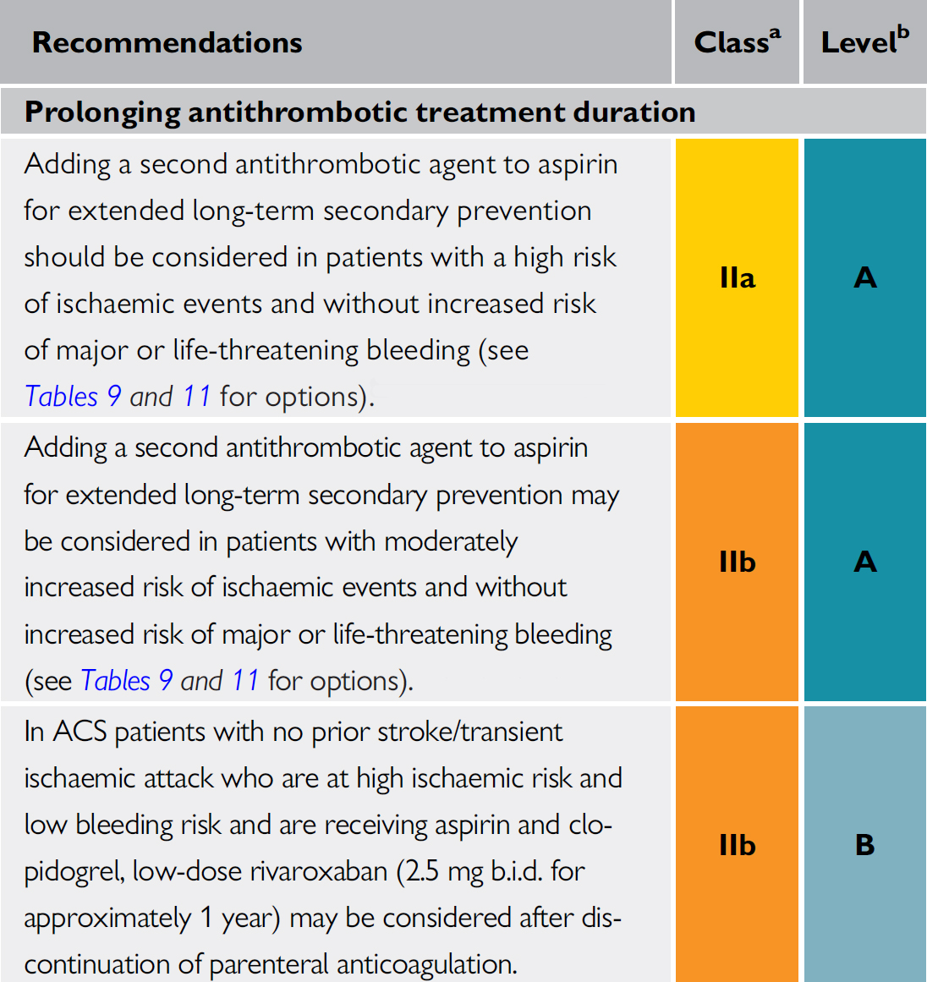
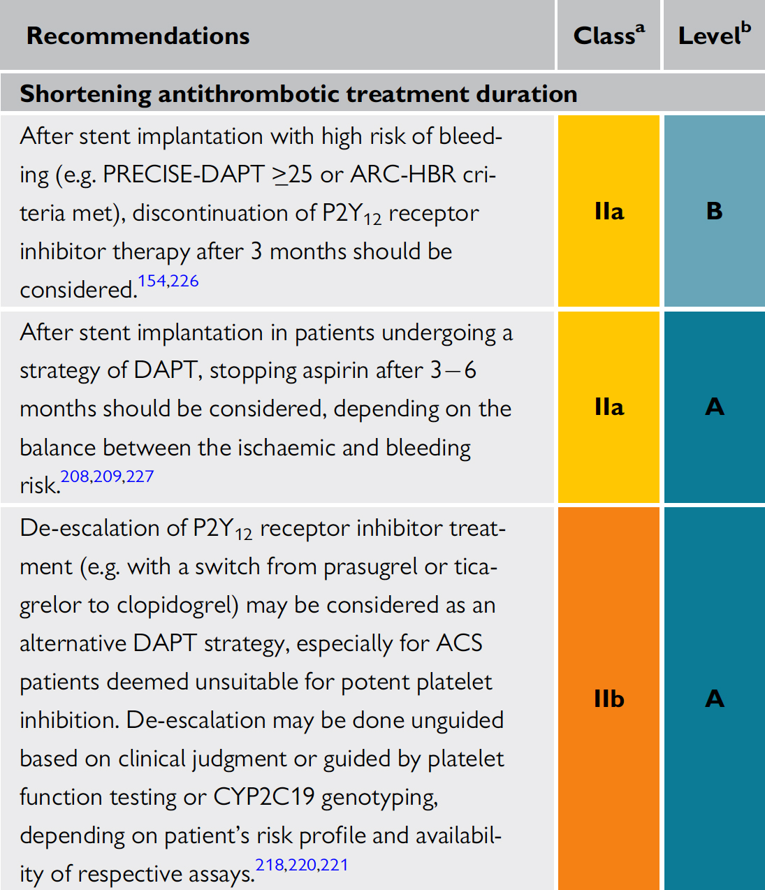
Recommendations for Post-Interventional and Maintenance Treatment in Pts with Non-ST-Segment Elevation ACS
Collet et al., Eur Heart J 2021;42:1289

Slide 45
Routine Pressure Wire Assessment Versus Conventional Angiography in the Management of Patients With Coronary Artery Disease:
The RIPCORD 2 Trial

Slide 46
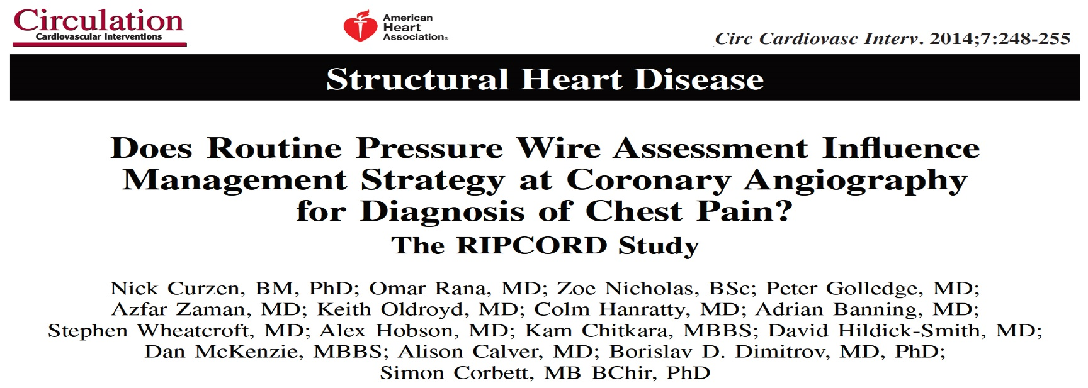
RIPCORD 2: Background
RIPCORD 2: Background
What we know about the clinical value of FFR?
Cruzen N, ESC 2021
Cruzen N, ESC 2021

Slide 47
RIPCORD 2: Hypothesis
That systematic, FFR-guided assessment of coronary artery disease would be superior,
in terms of resource utilisation & quality of life, to assessment by angiography alone
at the stage of diagnostic invasive coronary angiography (ICA).
Design
Open label, randomized, controlled, multicenter trial
Co-Primary Endpoints
-Primary Economic Endpoint: Total hospital costs at 12 months
-Primary Quality of Life: Quality of Life at 12 months
Power Calculations
Total Cost
We assumed an average baseline cost of £4615 & expected a wide standard deviation (£1850)
Sample size of 1030 subjects would provide 80% power at an alpha of 0.05, to detect an absolute change of 7%.
Because of expected non-parametric data, we increased the sample size to 1100.
QoL
In terms of the EQ-5D-5L data, we assumed a baseline mean (SD) score of 74.3 (16.7).
Evaluable data on 1040 patients would afford 80% power to detect an absolute difference of 3 points or 4% of the
observed value.
Cruzen N, ESC 2021

Slide 48
RIPCORD 2: Methods
1100 patients randomized in 17 UK centers
Scheduled to undergo diagnostic coronary angiography for either stable angina or non-ST elevation MI
Key Angiographic Inclusion Criterion
Presence of potentially hemodynamically significant coronary disease defined as:
any stenosis >30% reduction in luminal diameter, by visual estimate, in at least one vessel (main or branch) of sufficient caliber to permit the potential performance of PCI /CABG- approximately 2.25 mm diameter.
Randomization
After angiography and in cath lab
Web-based
Randomization to either:
angiographic guidance alone [ANGIO ONLY] or
FFR assessment of all epicardial vessels of a caliber that would be sufficient for stent or graft. [ANGIO+FFR]
FFR not required for: CTOs – allocated FFR=0.5; vessels with < TIMI 3 flow
I.C. or I.V. adenosine at operator discretion
Cruzen N, ESC 2021

Slide 49
RIPCORD 2: Methods
Management Plan
4 options: (1) OMT alone; (2) PCI; (3) CABG; (4) more information/further test required
12 month Follow Up
Co-Primary Endpoints
Total Hospital Costs: All hospital events (inpatient and outpatient attendances)
including ED
Not including GP attendances or medication
Primary QoL Endpoint QoL using EuroQol EQ-5D-5L questionnaire (visual analogue
scale)
Angina using CCS classification
Prespecified Secondary Endpoints
Clinical events at 12 months including:
all-cause mortality, stroke, myocardial infarction (MI) & unplanned revascularisation.
Cruzen N, ESC 2021

Slide 50
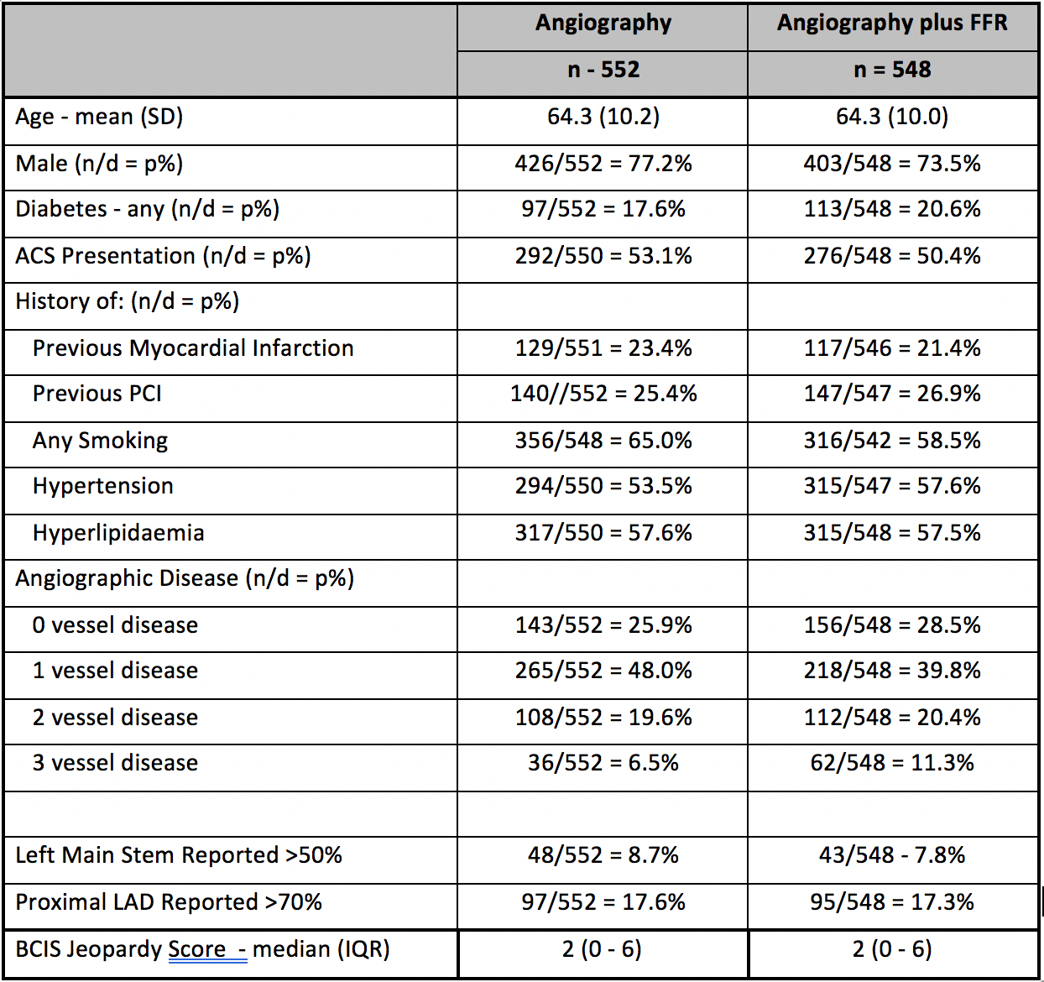
RIPCORD 2: Results
Patients undergoing diagnostic coronary angiography for stable angina or NSTEMI (n=1100)
ANGIOGRAPHY ALONE Group (n=552) Assessment & management decided
according to angiographic appearances only
ANGIOGRAPHY plus FFR Group (n=584) Assessment & management according to angiographic appearances + FFR of all arteries of revascularisable calibre
Randomization
Cruzen N, ESC 2021

Slide 51
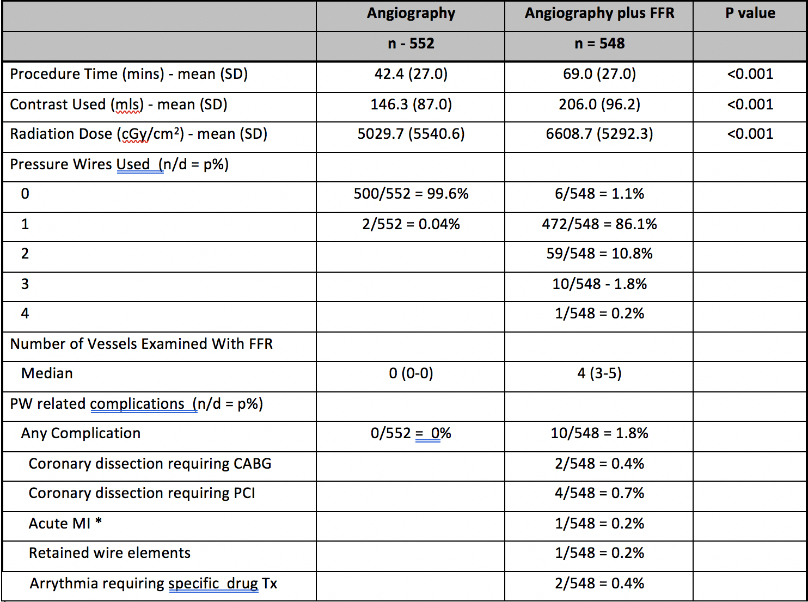
RIPCORD 2: Procedure Results
Cruzen N, ESC 2021

Slide 52
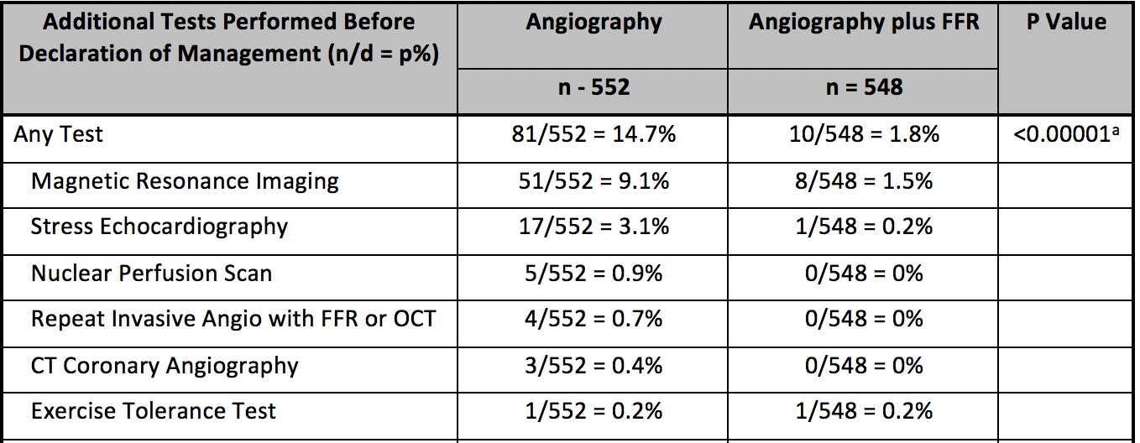
RIPCORD 2: Management Results
Cruzen N, ESC 2021

Slide 53
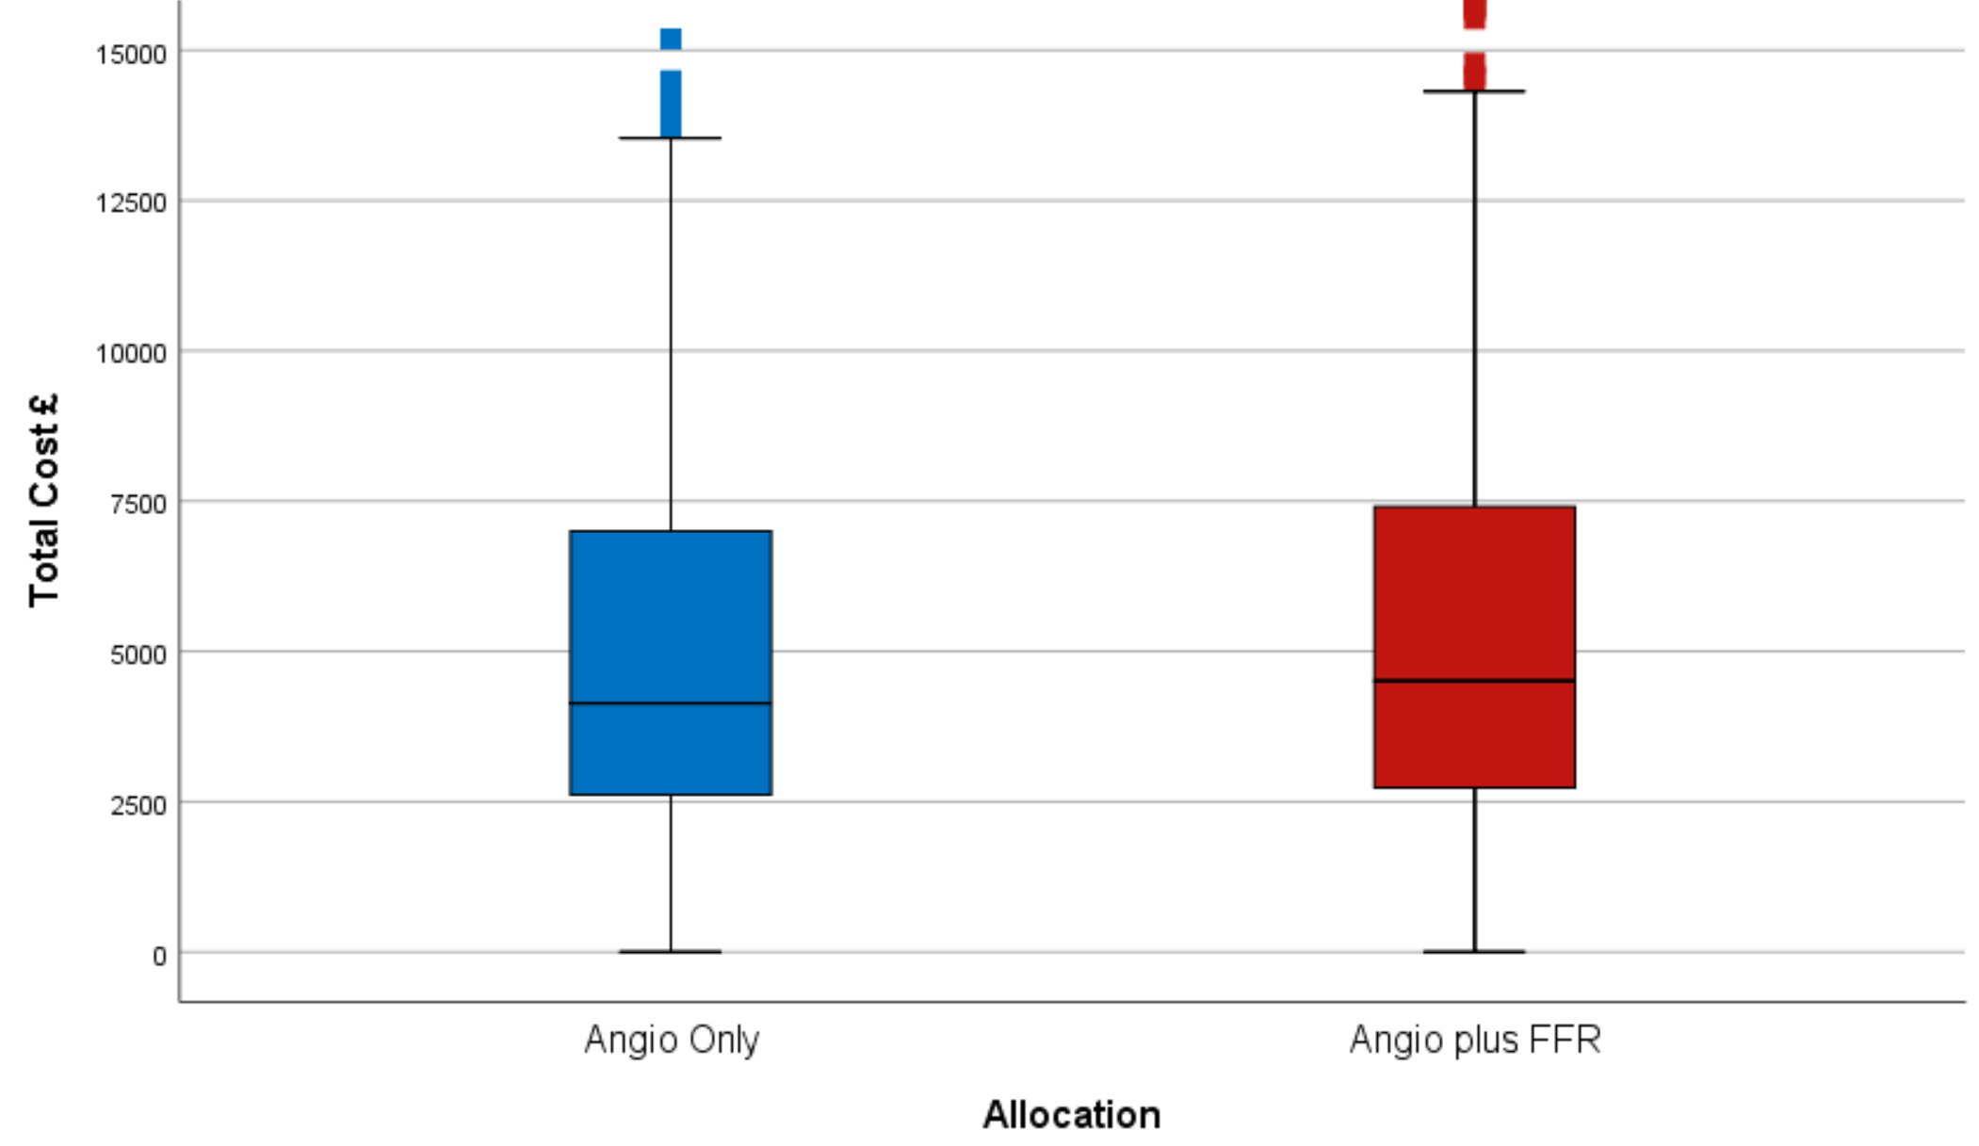
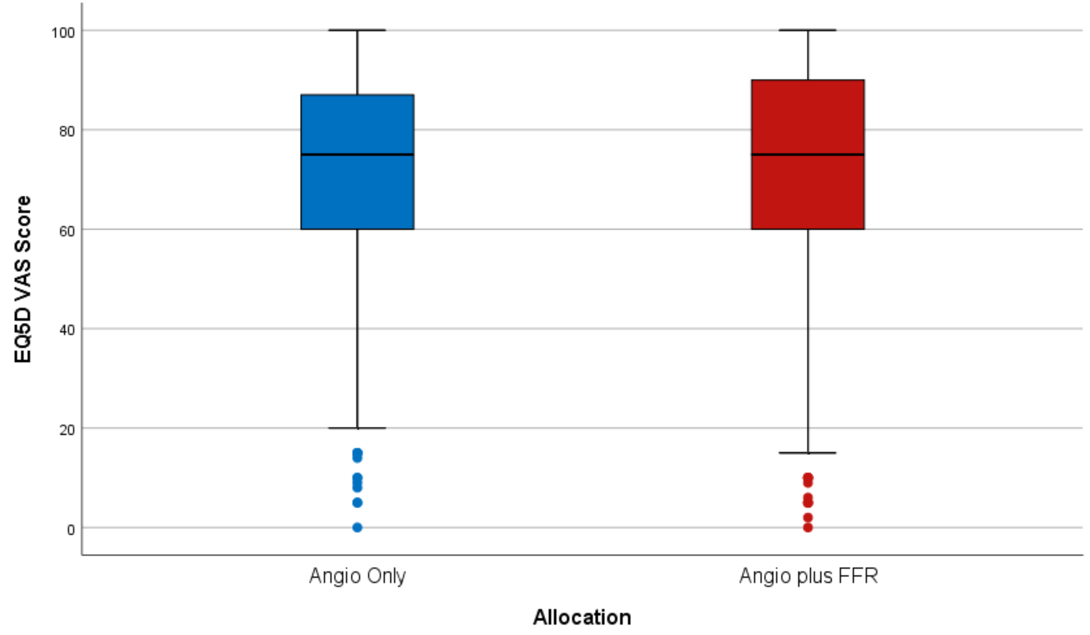
RIPCORD 2: Primary Endpoints Results
Co-Primary Endpoint
Total Hospital Costs at
12 months (£)
Co-Primary Endpoint
Quality of Life
(EQ5d VAS)
p=0.137
p=0.88
Total Cost £
EQ5D VAS
ANGIO ONLY
ANGIO+FFR
ANGIO ONLY
ANGIO+FFR
£4136 (2613-7015)
£4510 (2721-7415)
75 (60-87)
75 (60-90)
Cruzen N, ESC 2021

Slide 54
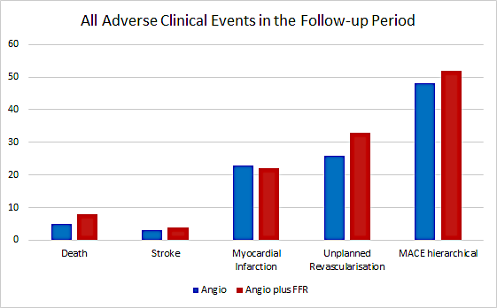
RIPCORD 2: Secondary Endpoints Results
Clinical Events
p=0.64
TOTAL MACCE EVENTS
ANGIO ALONE 8.7% (48/552)
ANGIO+FFR. 9.5% (52/548)
N
Cruzen N, ESC 2021

Slide 55
Conclusions
Routine, systematic FFR assessment at the time of diagnostic angiography is cost neutral compared with angiographic guidance alone and is not associated with significant differences in QoL or angina status at 1 year
Nor did systematic FFR of all epicardial coronary vessels significantly alter the clinical event rate, or the distribution of management (OMT/PCI/CABG).
Systematic FFR was associated with longer procedure, more radiation + contrast, & more complications compared to angiography alone.
This strategy therefore has no overall advantage compared to angiography alone.

Slide 56
Latest Issues in Coronary Intervention
Key Interventional Trials from ESC 2021;
MASTER-DAPT, STOPDAPT-2 ACS,
RIPCORD-2
Focused review of the month
DAPT De-escalation in ACS pts:
Improving balance between efficacy and bleeding

Slide 57
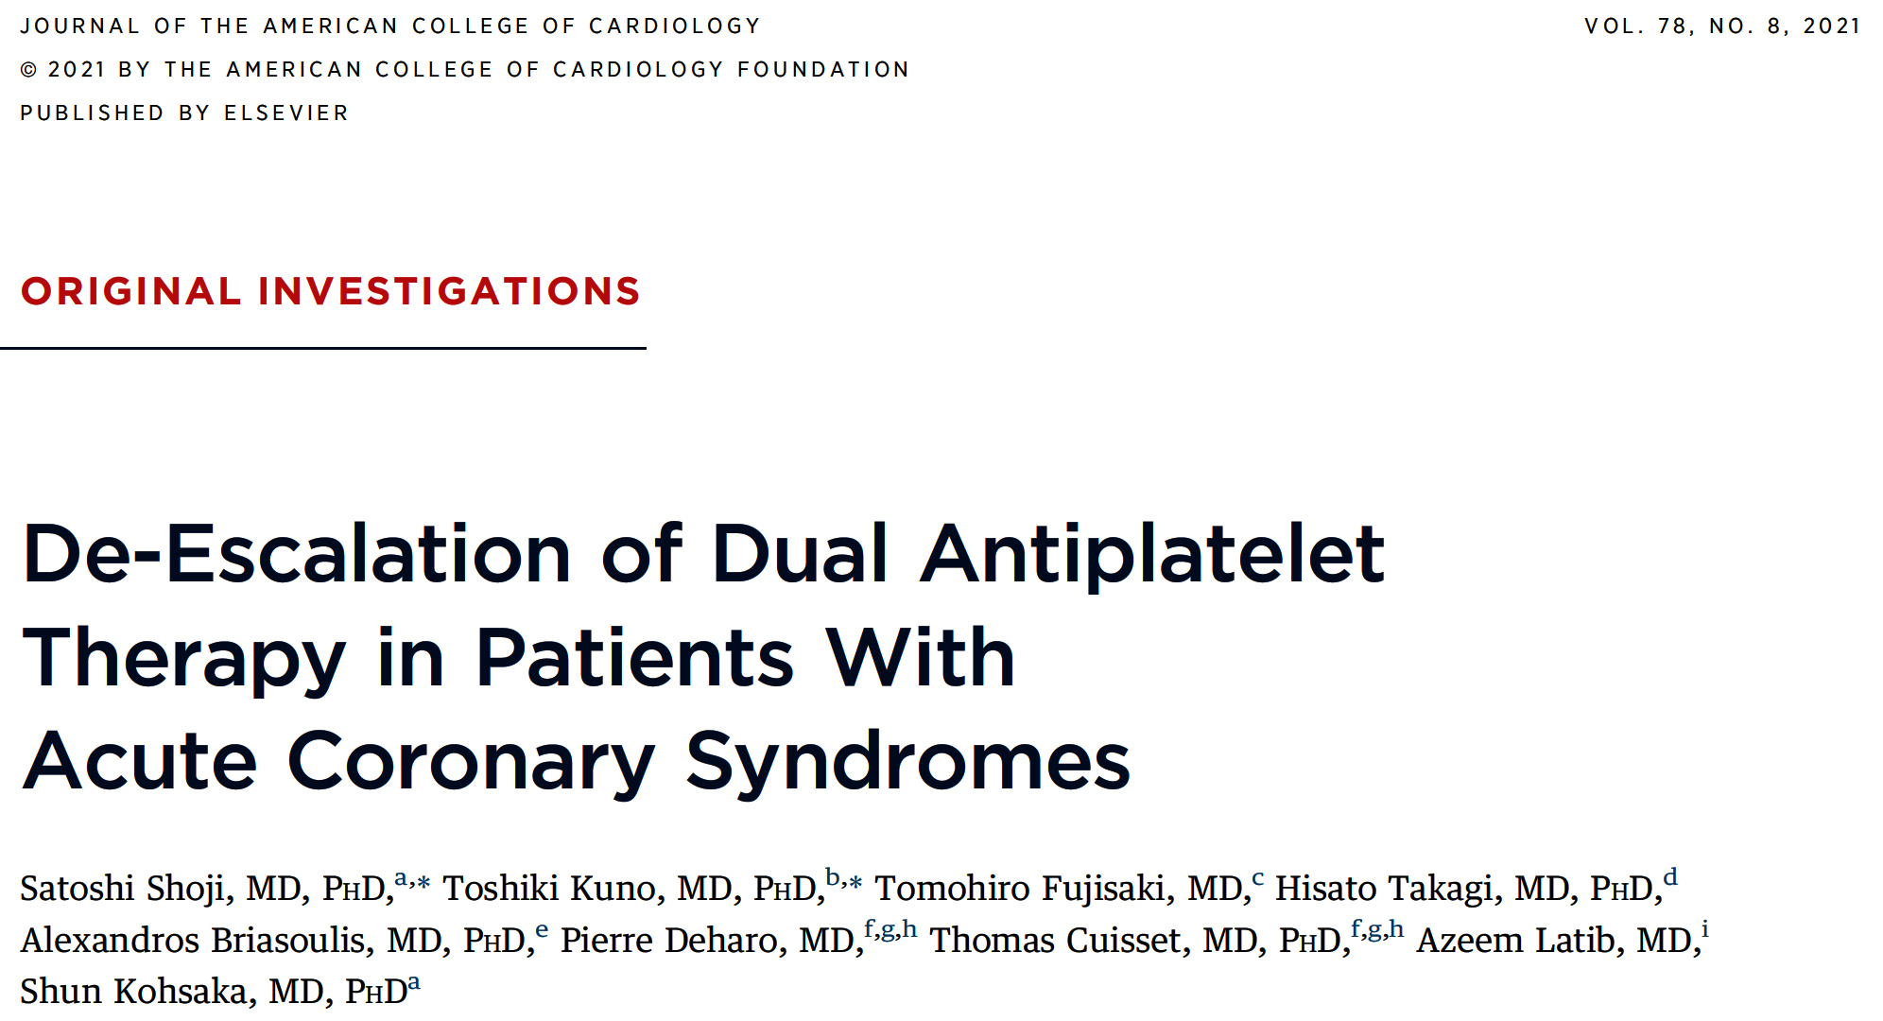

Slide 59
Network of DAPT Strategies
Clopidogrel
De-escalation
1
6
3
2
Ticagrelor
2
2
Low-Dose Prasugrel
Prasugrel
Shoji et al., J Am Coll Cardiol 2021;78:763

Slide 60
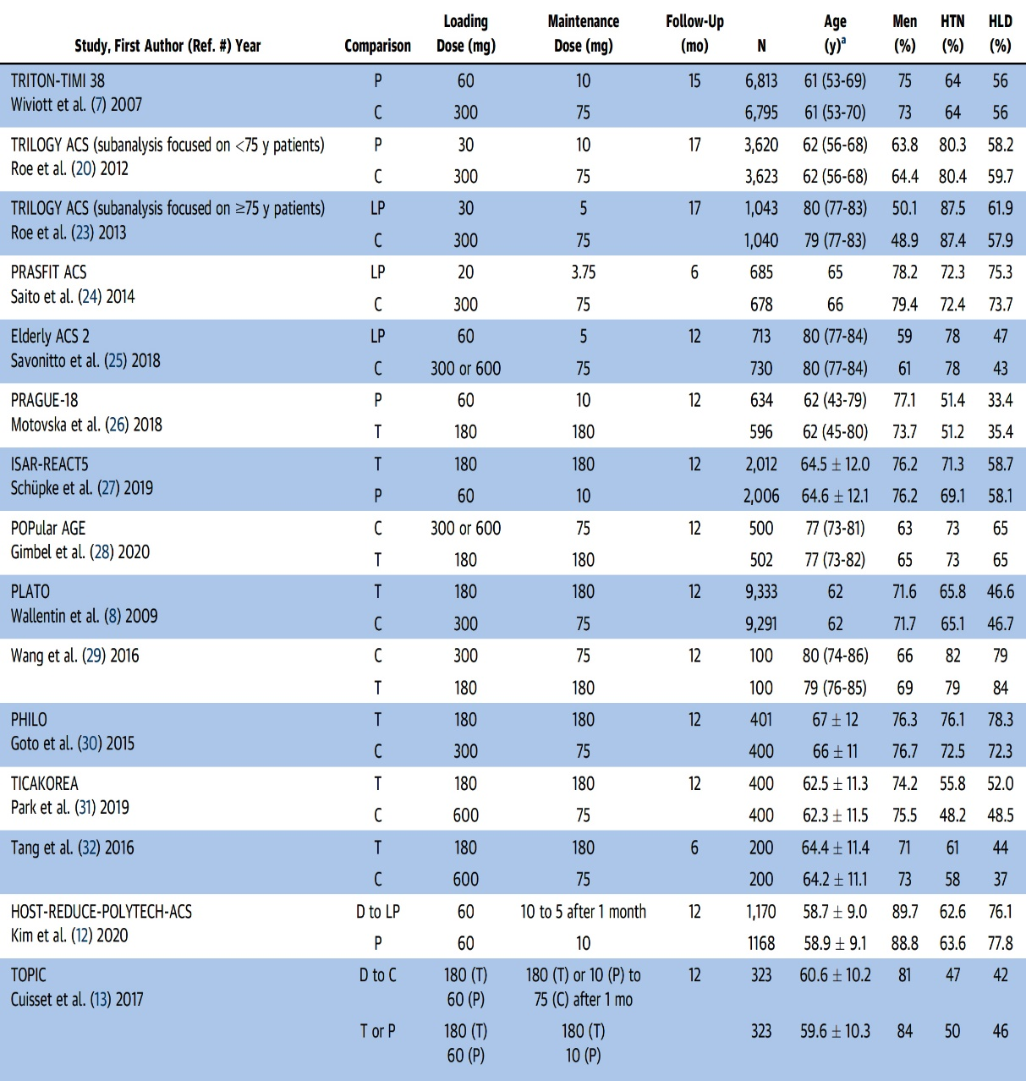
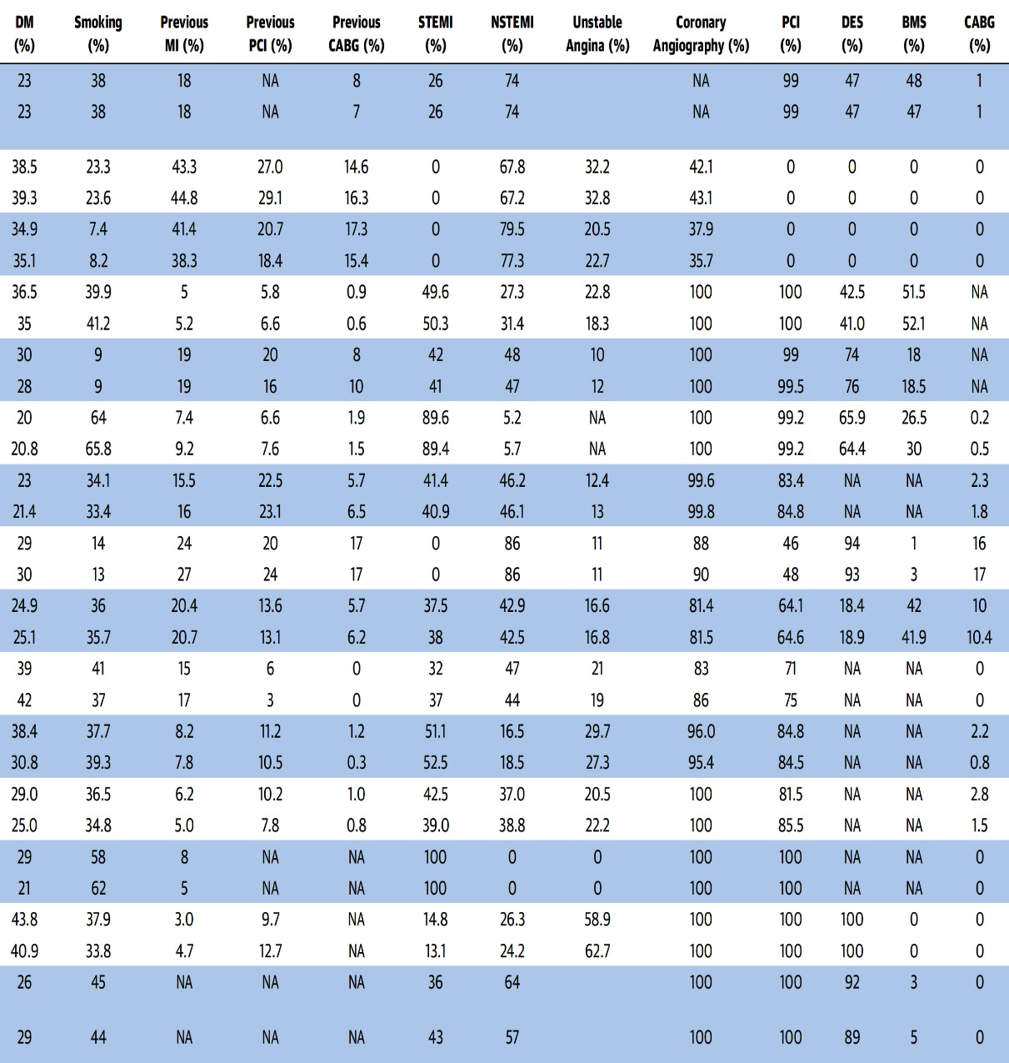
Characteristics of the Included Studies
Shoji et al., J Am Coll Cardiol 2021;78:763

Slide 61
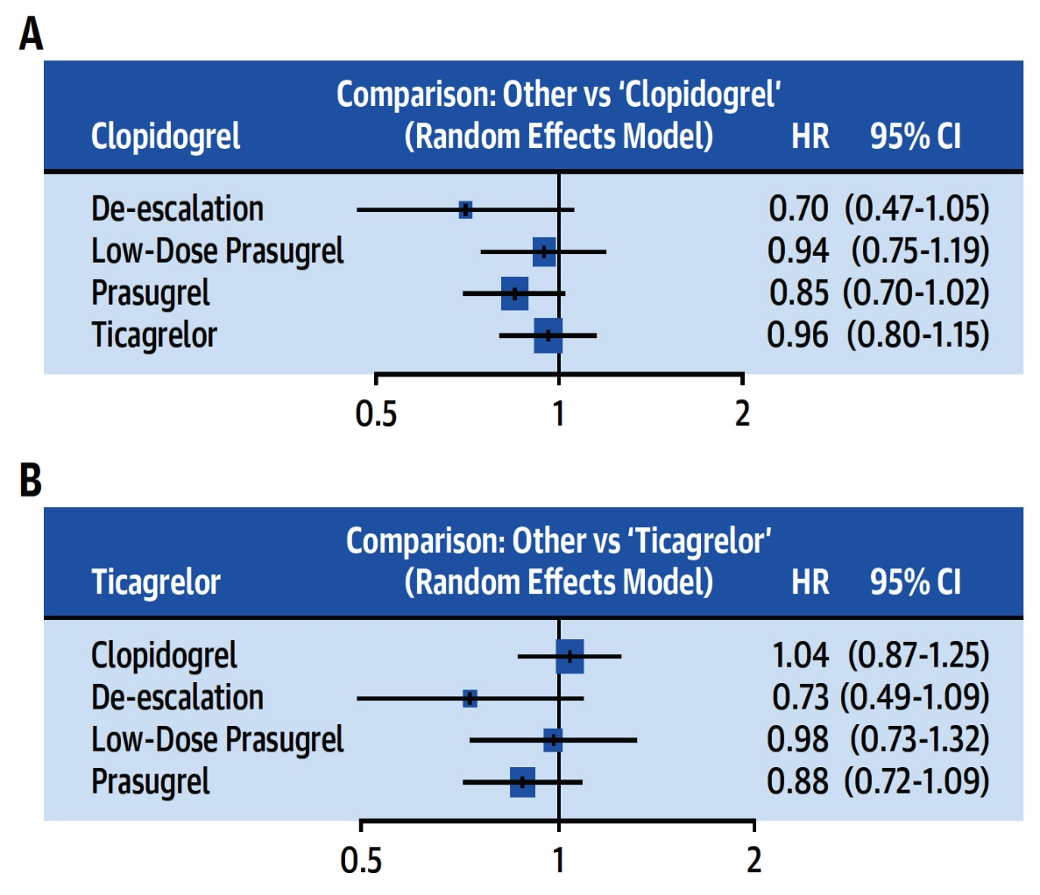
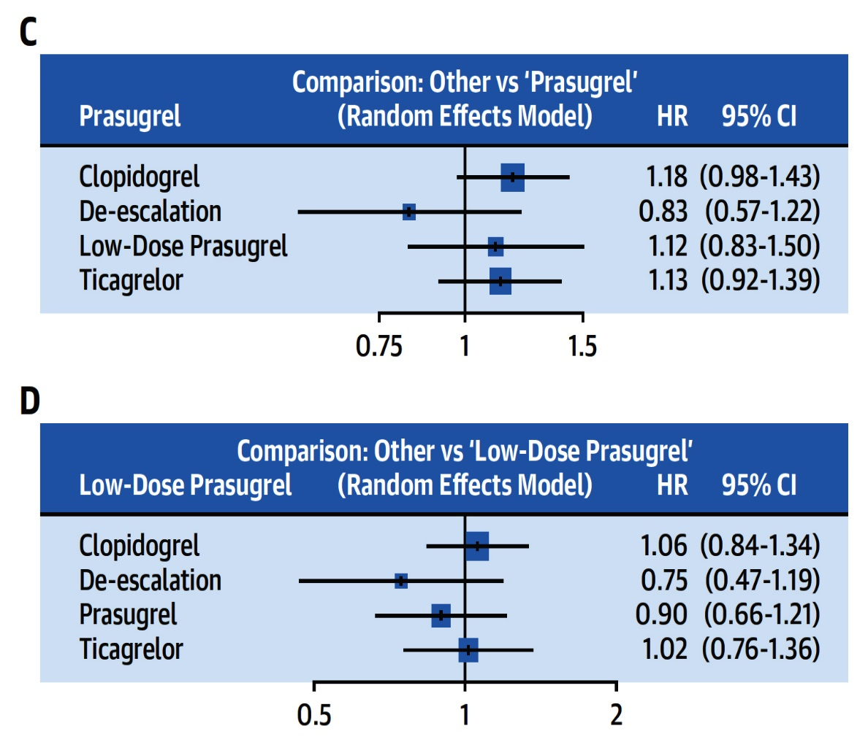
Network Meta-Analysis of the Primary Efficacy Outcome (Random Effects Model)
HRs and CIs for each treatment arm
Shoji et al., J Am Coll Cardiol 2021;78:763

Slide 62
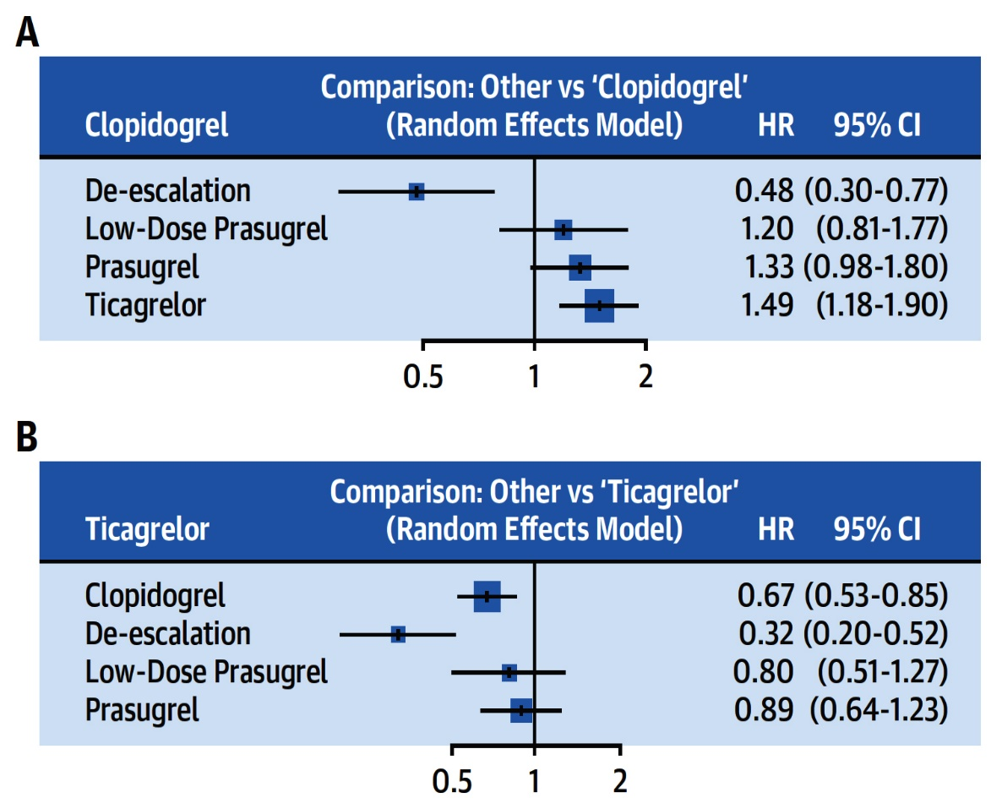
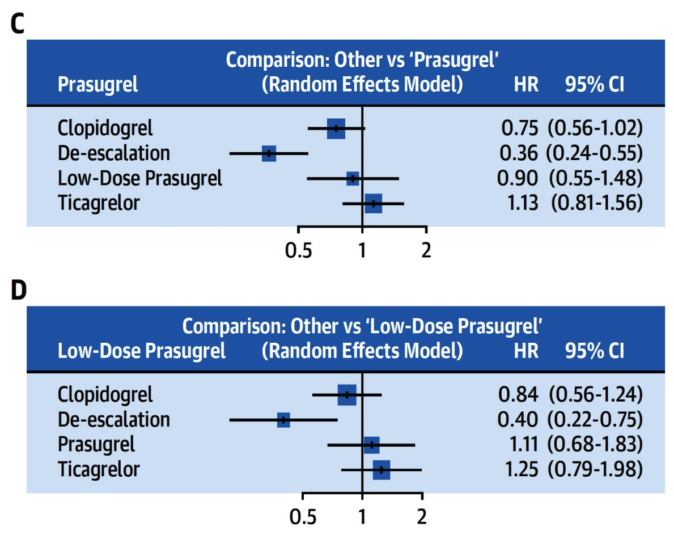
Network Meta-Analysis of the Primary Bleeding Outcome (Random Effects Model)
HRs and CIs for each treatment arm
Shoji et al., J Am Coll Cardiol 2021;78:763

Slide 63
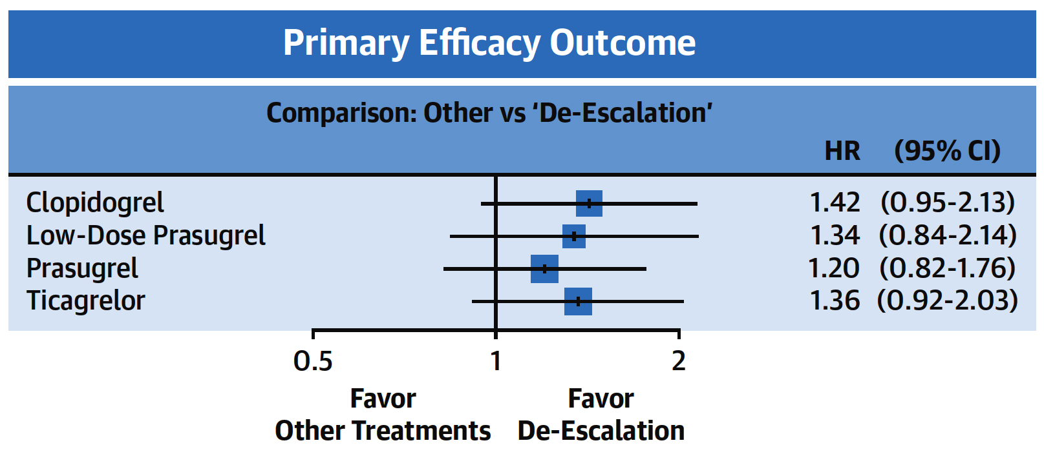
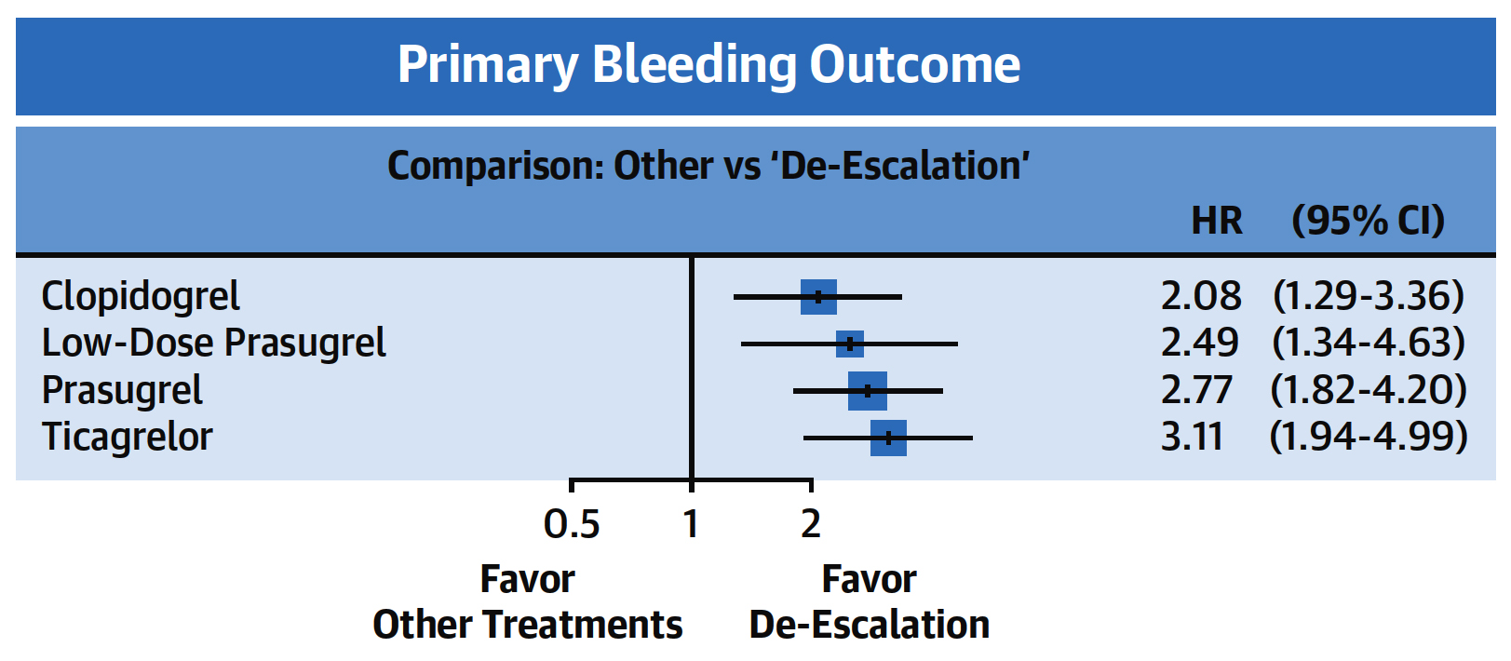
Primary Efficacy and Bleeding Outcomes Compared to De-Escalation Therapy
De-escalation was the most effective strategy for ACS treatment, resulting in fewer bleeding events without increasing the incidence of ischemic events
DAPT de-escalation: Reduced CV death and no difference in ST & stroke
Shoji et al., J Am Coll Cardiol 2021;78:763

Slide 66
Take Home Message: Interventional Trials from ESC 2021 and DAPT De-escalation in ACS/PCI
DAPT abbreviation to 1month in HBR pts:
DAPT abbreviation to 3months in ACS PCI:
FFR guidance for management of stable CAD:
DAPT de-escalation to clopidogrel or 5 mg dose of Prasugrel is associated with lower bleeding but no difference in the ischemic endpoints. Therefore, except in pts with high ischemic risk, DAPT de-escalation post PCI should be routinely practiced. In many cases especially in HBR pts, SAPT will suffice after 1-3months of initial DAPT.
Notes:
HbA1c

Slide 67
Question # 1
Following statements are true regarding the abbreviated duration of DAPT after PCI except;
MASTER DAPT trial showed similar efficacy in 1M DAPT arm
MASTER DAPT trial showed lower bleeding in 1M DAPT arm
MASTER DAPT trial had very good compliance of the assigned treatment strategy
MASTER DAPT trial showed higher ST in 1M DAPT arm
E. MASTER DAPT trial showed similar stroke in 2 arms
The correct answer is D

Slide 68
Question # 2
Following statements are true regarding the results of STOPDAPT-2 ACS trial except;
A. Open label comparison of 1M vs 12M DAPT
B. Majority of cases were done by Radial approach
C. 1M DAPT had similar MI compared to 12M DAPT
D. 1M DAPT had lower bleeding compared to 12M DAPT
E. 1M DAPT had similar death compared to 12M DAPT
The correct answer is C

Slide 69
Question # 3
Following statements are true regarding the results of DAPT de-escalation in pts with ACS except:
DAPT de-escalation is safe as shown by few RCTs
DAPT de-escalation is associated with higher ST
DAPT de-escalation is associated with lower bleeding
DAPT de-escalation is not associated with higher ischemic endpoints
DAPT de-escalation is associated with lower CV death
The correct answer is B

