Slide 1
www.CardiologyApps.com/BifurcAID-3D
Key Features:
Left Main and Non-Left Main bifurcation lesions
Secondary view highlighting key points such as stent crush
Android, iOS and WebApp
Many techniques:
DK Crush
Mini Crush
Culotte
Provisional Stenting
Bailout Techniques
Available for free on Android Google Play Store and Apple App Store in addition to our WebApp version on www.cardiologyapps.com/BifurcAID-3D

Slide 2
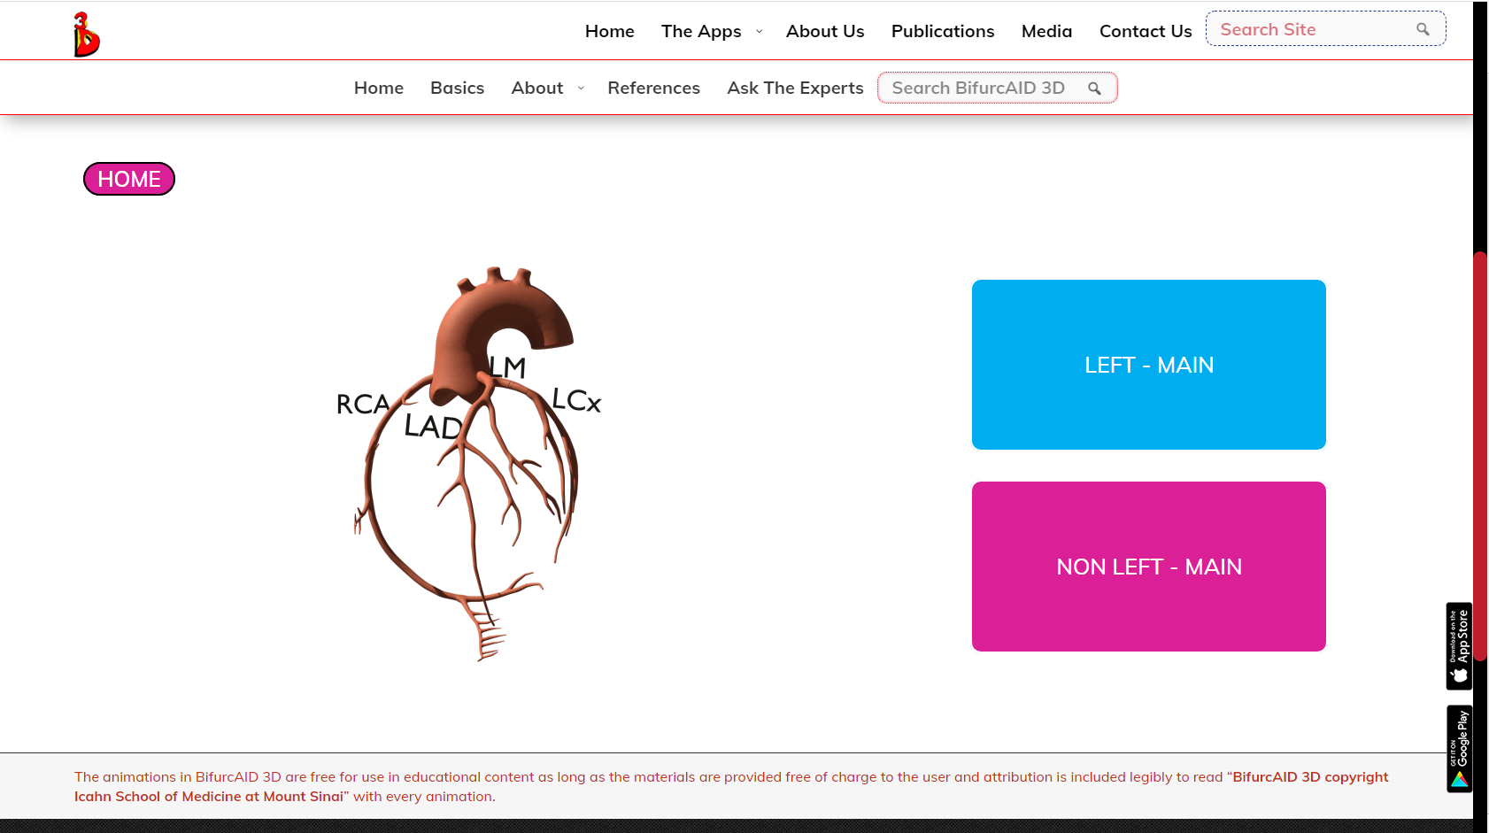
www.CardiologyApps.com/BifurcAID-3D

Slide 3
Available for Free Download Now

Slide 4
Complex Coronary Cases Supported by:
Abbott Vascular Inc.
Boston Scientific Corp.
Terumo Vascular Corp.
Cardiovascular Systems Inc.
Abiomed Inc.
Chiesi Inc.
Best Medical Inc.

Slide 5
Disclosures
Samin K. Sharma, MD, MSCAI, FACC
Speaker’s Bureau – BSC, Abbott, CSI
Annapoorna S. Kini, MD, MRCP, FACC
Nothing to disclose
Sameer Mehta, MD, FACC (Moderator)
Nothing to disclose

Slide 6
CCC Live Case # 144
Patient Demographics
70 yrs, M
Present Clinical Presentation
Presented with new onset CCS class II angina and high risk stress echo for anterior and infero-septal ischemia
CAD Risk Factors
Controlled NIDDM
Controlled Hyperlipidemia
Clinical Variables
No known CAD or cardiac issues before present symptoms.
Very active otherwise. Current SAQ 65
Medications
Aspirin, Simvastatin, Glucophage, Glipizide
Cath: Cath done on 5/20/2021 revealed 2 V CAD: Two 95% lesions in RCA, 50% dLM, 80% pLAD/D1 bifurcation (1,1,1), LVEF 60% and Syntax score 22. Pt underwent RA+DES (2 Promus Elite) RCA and did well. Clopidogrel added.
Plan: Now planned for imaging guided (for LM) staged PCI of proximal LAD/D1 bifurcation using RA and dedicated 2-stent mini-crush technique.

Slide 7
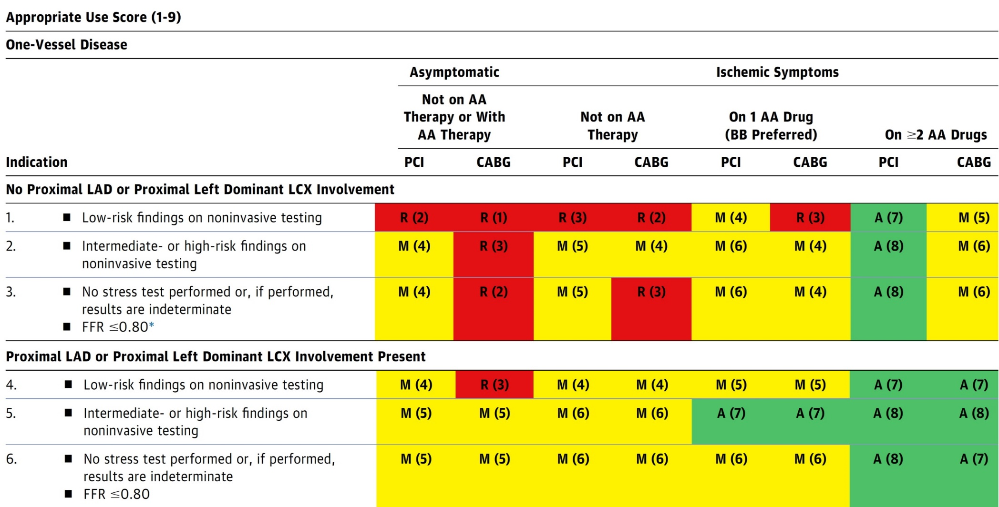
AUC 2017: One-Vessel Disease
Patel et al., J Am Coll Cardiol 2017;69:2212

Slide 8
Latest Issues in Coronary Intervention
ACC 2021 Interventional Trials:
RADIANCE-HTN Trio Trial, FLOWER MI Trial,
TWILIGHT Sex Difference Trial
Focused review of the month
Coronary micro-vascular function
abnormalities in non-obstructive CAD

Slide 9
Latest Issues in Coronary Intervention
ACC 2021 Interventional Trials:
RADIANCE-HTN Trio Trial, FLOWER MI Trial,
TWILIGHT Sex Difference Trial
Focused review of the month
Coronary micro-vascular function
abnormalities in non-obstructive CAD

Slide 10
Ultrasound Renal Denervation for Hypertension Resistant to a Triple Medication Pill:
The Randomized Sham Controlled
RADIANCE-HTN TRIO Trial

Slide 11
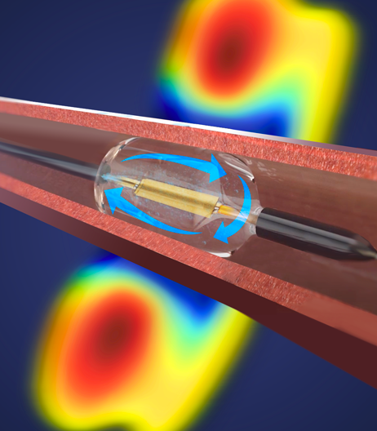
RADIANCE-HTN TRIO: Paradise Ultrasound Renal Denervation System
Thermal Profile
Ultrasonic Heating + Water Cooling
Ring of ablative energy (depth of 1-6 mm) to interrupt renal nerve traffic
Arterial wall protected by water circulating through balloon
2-3 sonications lasting 7 seconds each are delivered to each main renal artery
Kirtane A, ACC 2021

Slide 12
RADIANCE-HTN TRIO: Blinded, Sham-Controlled,
Powered to Demonstrate BP Lowering Effectiveness at 2M
Office BP Screening
Fixed Dose, 3-Drug Combination Pill Stabilization
(4 weeks)
Baseline Daytime ABP ≥135/85
Key Entry Criteria:
Office BP ≥140/90 on 3+ anti-HTN meds
Daytime ABP ≥135/85 on a fixed-dose, 3-drug combination pill
Age 18-75 years
No secondary hypertension aside from OSA
No CV or cerebrovascular events within the prior 3M
No Type I or uncontrolled Type II diabetes
eGFR ≥40 mL/min/m²
Eligible renal artery anatomy
No Med Changes Unless Escape BP Criteria Exceeded Patients Blinded at Randomization Outpatient Assessors Blinded
CTA / MRA, Renal Duplex, Renal Angiography
R
Renal Denervation
Sham Procedure
Primary Efficacy Endpoint @ 2 Months
∆ Daytime Ambulatory Systolic BP
Blinded Medication Titration Protocol
6-Month Follow-up
(ABP, home BP, office BP, Duplex Driven CTA/MRA)
12-Month Follow-up
(ABP, home BP, office BP, CTA/MRA)
Unblinded “Standard of Care” Meds
24, 36, 48, & 60 Month Follow-up (Office BP)
Kirtane A, ACC 2021

Slide 13
RADIANCE-HTN TRIO: Patient Flow Chart
989 Patients Enrolled
839 Excluded prior to renal angiography
Did not meet ambulatory BP criteria (354 too low, 7 other)
Did not meet office BP criteria
108 Did not meet renal anatomic criteria on CTA/MRA
78 Withdrawn
60 Did not subsequently meet clinical inclusion criteria
25 Adverse events not related to BP
18 BP related event (9 Hypertension, 9 Hypotension)
8 Lost to follow-up
7 Study complete before patient could be randomised
3 Home BP met high BP action
1 Death (pancreatic cancer)
150 Underwent Renal Angiography
14 Did not meet angiographic criteria
136 Underwent Randomization
69 Assigned to RDN
67 Assigned to Sham Procedure
69 Included in the ITT analysis at 2M
67 Included in the ITT analysis at 2M
6 missing clinical follow-up and/or ABPM at 2M*
2 Patients did not complete the ABPM
1 Non-procedure related death
1 Lost to follow-up
1 Missed visit due to COVID-19
1 Remote visit due to COVID-19 (no ABPM)
4 subjects met protocol-defined escape criteria for severe
hypertension*
*These subjects had a protocol-specified “0” value imputed for 2M change in ABPM for the Intent-to-Treat analysis
Kirtane A, ACC 2021

Slide 14
RADIANCE-HTN TRIO: Primary Efficacy Endpoint
Change in Daytime Ambulatory SBP at 2 Months
Intent-To-Treat Population
Complete ABPM Population
mmHg
mmHg
Median Between Group
Difference
-4.5 mmHg
(95% CI, -8.5 to -0.3)
P=0.022*
Median Between Group
Difference
-5.8 mmHg
(95% CI, -9.7 to -1.6)
P=0.005*
IQR:
-16.4 to 0.0
IQR:
-10.3 to 1.8
IQR:
-17.1 to 1.4
IQR:
-10.3 to 1.8
N=6 RDN w/missing data set to 0
N=4 Sham that met escape set to 0
N=4 Sham that met escape set to 0
*Baseline-adjusted ANCOVA on the ranks due to non-normality of distribution
Kirtane A, ACC 2021

Slide 15
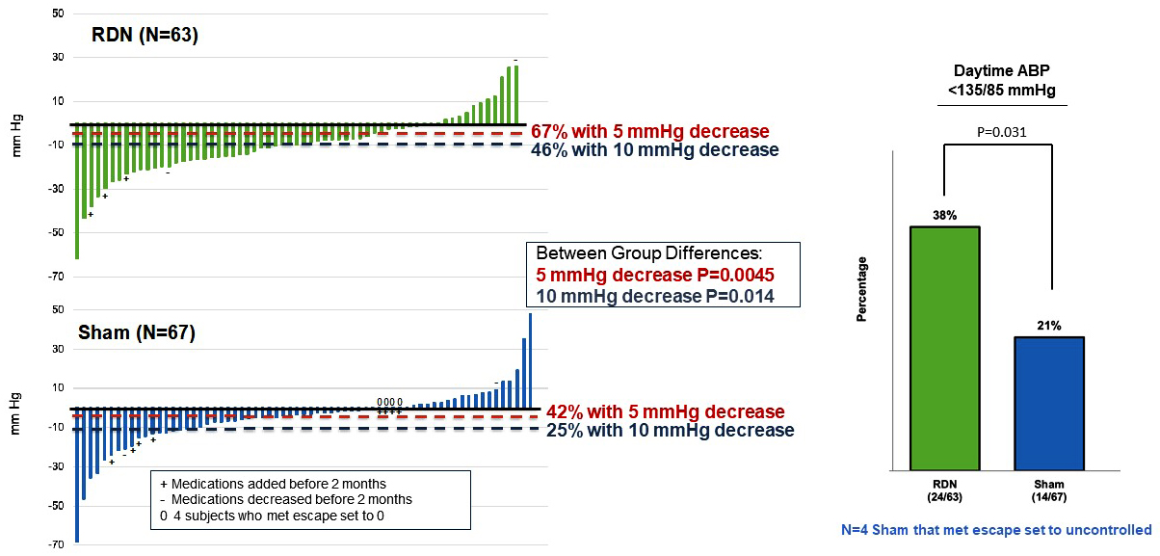
RADIANCE-HTN TRIO: Individual Pt Response and % Pts with Controlled BP
Change in Daytime Ambulatory SBP at 2 Months (Complete ABPM Population)
Kirtane A, ACC 2021

Slide 16
RADIANCE-HTN TRIO: Antihypertensive Medication Changes (ITT Population)
Medication Changes | RDN (N=69) | Sham (N=67) | P-value
Additional meds at 2M * | 3/69 (4%) | 8/67 (12%) | 0.10
Protocol defined criteria | 0/69 (0%) | 4/67 (6%) | 0.056
Physician decision/patient preference | 3/69 (4%) | 4/67 (6%) | 0.72
Reduction in meds at 2M | 2/69 (3%) | 2/67 (3%) | 1.0
*2 pts of the RDN group were on 25mg spironolactone; 7 pts of the sham group were on spironolactone (2 on 12.5mg, 4 on 25mg and 1 on 50mg)
Kirtane A, ACC 2021

Slide 17
RADIANCE-HTN TRIO: Major Adverse Events
Major Adverse Events | RDN (N=69) | Sham (N=67)
30-Day Major Adverse Events
Death | 1%¹ | 0%
End stage renal disease, the need for permanent renal replacement therapy | 0% | 0%
Doubling of plasma creatinine | 1%² | 0%
Embolic event resulting in end organ damage | 0% | 0%
Renal artery complication requiring intervention | 0% | 0%
Major access site complications requiring intervention | 1%³ | 0%
Hypertensive emergency resulting in hospitalization | 0% | 0%
Other Major Adverse Events Measured Through 2 Months
New onset renal artery stenosis of greater than 70% | 0% | 0%
¹ Sudden death unrelated to device or procedure 21 days post-procedure
² Transient acute renal injury 25 days post-procedure associated with spironolactone use & resolved upon d/c of spironolactone
³ Femoral access site pseudoaneurysm post-procedure resolved with thrombin injection
Kirtane A, ACC 2021

Slide 18
Conclusions
In patients with hypertension resistant to guideline-recommended triple combination therapy in a single pill, ultrasound based RDN was associated with a reduction of 8.0 mmHg in daytime ambulatory SBP (a 4.5 mmHg greater decrease than a sham procedure)
The greater BP lowering effect of RDN vs. sham was consistent for 24h, nighttime, and office SBP
These results are concordant with those of RADIANCE-HTN SOLO (patients with mild-to-moderate hypertension), confirming that ultrasound RDN can lower BP across a spectrum of hypertension
Longer-term assessments for efficacy & safety are ongoing

Slide 19
The FLOWER MI Trial
FFR- versus Angiography-Guided Multivessel Revascularization in ST-Elevation Myocardial Infarction Patients

Slide 20
FLOWER-MI: Background
In patients with chronic coronary syndromes, fractional flow reserve (FFR)-guided percutaneous coronary intervention (PCI) is superior to angiography-guided PCI
In ST-elevation myocardial infarction (STEMI) patients with multivessel disease (MVD), both angiography-guided and FFR-guided PCI for non-culprit lesions are superior to culprit lesion treatment-only therapy
In such STEMI patients with MVD, however, FFR-guided PCI has not been compared with angio-guided PCI
Puymirat E, ACC 2021

Slide 21
FLOWER-MI: Study Design
STEMI patients with successful culprit lesion PCI (primary, rescue or pharmaco-invasive)
and ≥ 50% stenosis in at least one additional non-culprit lesion
Randomization*
1:1
* stratified by center and
timing of procedure (immediate or staged)
Complete revascularisation
Angio-guided PCI
(during the index hospital admission†)
+
Optimal Medical Therapy
Complete revascularisation
FFR-guided PCI
(during the index hospital admission†)
+
Optimal Medical Therapy
Follow-up : Discharge, 1, 6, 12 and 36 months
Primary Endpoint
Composite of all-cause mortality, non-fatal MI or unplanned hospitalization with urgent revascularization at 1 year
Puymirat E, ACC 2021

Slide 22
FLOWER-MI: Patient Selection
INCLUSION CRITERIA
STEMI patients
Age ≥ 18 y
Successful culprit lesion PCI (primary, rescue or pharmaco-invasive) and ≥50% stenosis jusdged amendable to PCI in at least one additional non-culprit lesion
Willing and able to provide informed, written consent
EXCLUSION CRITERIA
Cardiogenic shock
Previous coronary bypass surgery
Extremely tortuous, calcified coronary vessels or CTO
Patients with single-VD
MVD patients referred to surgery
Hypersensitivity to adenosine
Life expectancy <2 years
Pregnancy
Participation in another study
Participant not affiliated to the French social society
Puymirat E, ACC 2021

Slide 23
FLOWER-MI: Flowchart
Period of inclusion :
Between Dec 18, 2016 and Dec 6, 2018
1183 patients with acute STEMI and MVD with successful culprit lesion PCI included
Excluded (n=12)
6 protocol deviation
3 physician refusal
2 technical problems
1 patient withdrawal
Randomized
N=1171 patients
41 centers in France
Angio-guided PCI
N=581
FFR-guided PCI
N=590
Excluded (n=4)
1 invalid consent form
3 no health insurance*
Excluded (n=4)
2 consent withdrawal
2 no health insurance*
Angio-guided PCI
ITT population
N=577
FFR-guided PCI
ITT population
N=586
* Patient with no event at 1-year
Population analyzed
N=577
Death (n=10)
Lost to follow-up (n=2)
Study withdrawal (n=2)
Population analyzed
N=586
Death (n=9)
Lost to follow-up (n=3)
Study withdrawal (n=1)
Puymirat E, ACC 2021

Slide 24
FLOWER-MI: Procedural Data
Characteristics of lesions | FFR-Guided PCI (n=586) | Angio-Guided PCI (n=577)
Location of CL ‡ LMCA LAD LCX RCA | 3/718 (0.4) 222/718 (30.9) 135/718 (18.8) 358/718 (49.9) | 4/706 (0.6) 241/706 (34.1) 144/706 (20.4) 317/706 (44.9)
Location of non-CL ‡ LMCA LAD LCX RCA | 7/980 (0.7) 458/980 (46.7) 303/980 (30.9) 212/980 (21.6) | 9/891 (1.0) 402/891 (45.1) 262/891 (29.4) 218/891 (24.5)
Diameter of non-CL (mm) | 2.86 ± 0.48 | 2.97 ± 0.53
Non-CL stenosis 50–69% 70–90% > 90% | 42.2 47.6 5.3 | 29.7 62.7 4.5
PCI of non-culprit lesion | FFR-Guided PCI (n=586) | Angio-Guided PCI (n=577)
Staged procedure of non-CL | 96.6 | 95.8
FFR procedure attempted† | 95.7 | NA
Mean FFR value FFR before PCI FFR post PCI | 0.79 ± 0.11 0.90 ± 0.06 | NA NA
Lesions with FFR ≤0.80 | 55.7 | NA
PCI (≥1) per patient | 66.2 | 97.1*
Mean no. of stents used† | 1.01 ± 0.99 | 1.50 ± 0.86*
Type of stent used Zotarolimus eluting Sirolimus eluting Everolimus eluting Others drug-eluting Bare-metal stent | 16.1 17.9 51.9 13.2 0.8 | 13.5 20.0 52.8 12.9 0.7
‡ no./total no. of lesions (%); † per patient
* < 0,01
Puymirat E, ACC 2021

Slide 25
FLOWER-MI: Primary Outcome
*
95.8%
94.5%
* Major Adverse Cardiac Events (MACE) denotes the composite of all-cause mortality, nonfatal MI, and unplanned hospitalization leading to urgent revascularization, at one year
Puymirat E, ACC 2021

Slide 26
FLOWER-MI: Primary Outcome at 1 Year
Non-culprit lesions treated – 53.3.%
Non-culprit lesions treated – 27.3.%
p=0.31
%
Puymirat E, ACC 2021

Slide 27
FLOWER-MI: Prespecified Clinical Outcomes at 1 Year
Secondary outcome at 1 year | FFR-Guided PCI (n=586) | Angio-Guided PCI (n=577) | HR (95% CI)
Stent thrombosis | 0.7 | 1.0 | 0.65 (0.19-2.32)
Any revascularization | 6.5 | 4.5 | 1.45 (0.88-2.38)
Hospitalization for heart failure | 1.5 | 1.9 | 0.82 (0.34-1.98)
Hospitalization for recurrent ischemia | 5.5 | 3.3 | 1.68 (0.95-2.97)
Any hospitalization in Cardiology | 11.6 | 8.0 | 1.49 (1.03-2.17)
Functional status at 1 year | FFR-Guided PCI (n=586) | Angio-Guided PCI (n=577) | HR (95% CI)
Number of anti-anginal medications used | 1.0 ± 0.5 | 1.0 ± 0.5 | 1.01 (0.90-1.14)
QALY based on EQ-5D score | 0.86 ± 0.19 | 0.87 ± 0.18 | 0.01 (0.004-0.01)
Recurrent ischemia CCS class ≥2 | 5.5 64.5 | 3.3 68.4 | 0.82 (0.21-3.24)
Puymirat E, ACC 2021

Slide 28
FLOWER-MI: Secondary Clinical Outcomes
at 1 Year
%
Puymirat E, ACC 2021

Slide 29
Conclusions
In patients presenting with STEMI and MVD treated with MV revascularization during the index hospitalization :
The event rates of MACE at one-year is low
For non-culprit lesion revascularization, investigators’ preference is staged procedure
FFR-guided PCI of non-infarct-related lesions does not reduce the risk of a composite outcome of death, reinfarction or urgent revascularization at one year, as compared with an angiography-guided strategy
Cost effectiveness and cost utility favor angiography-guided PCI

Slide 30
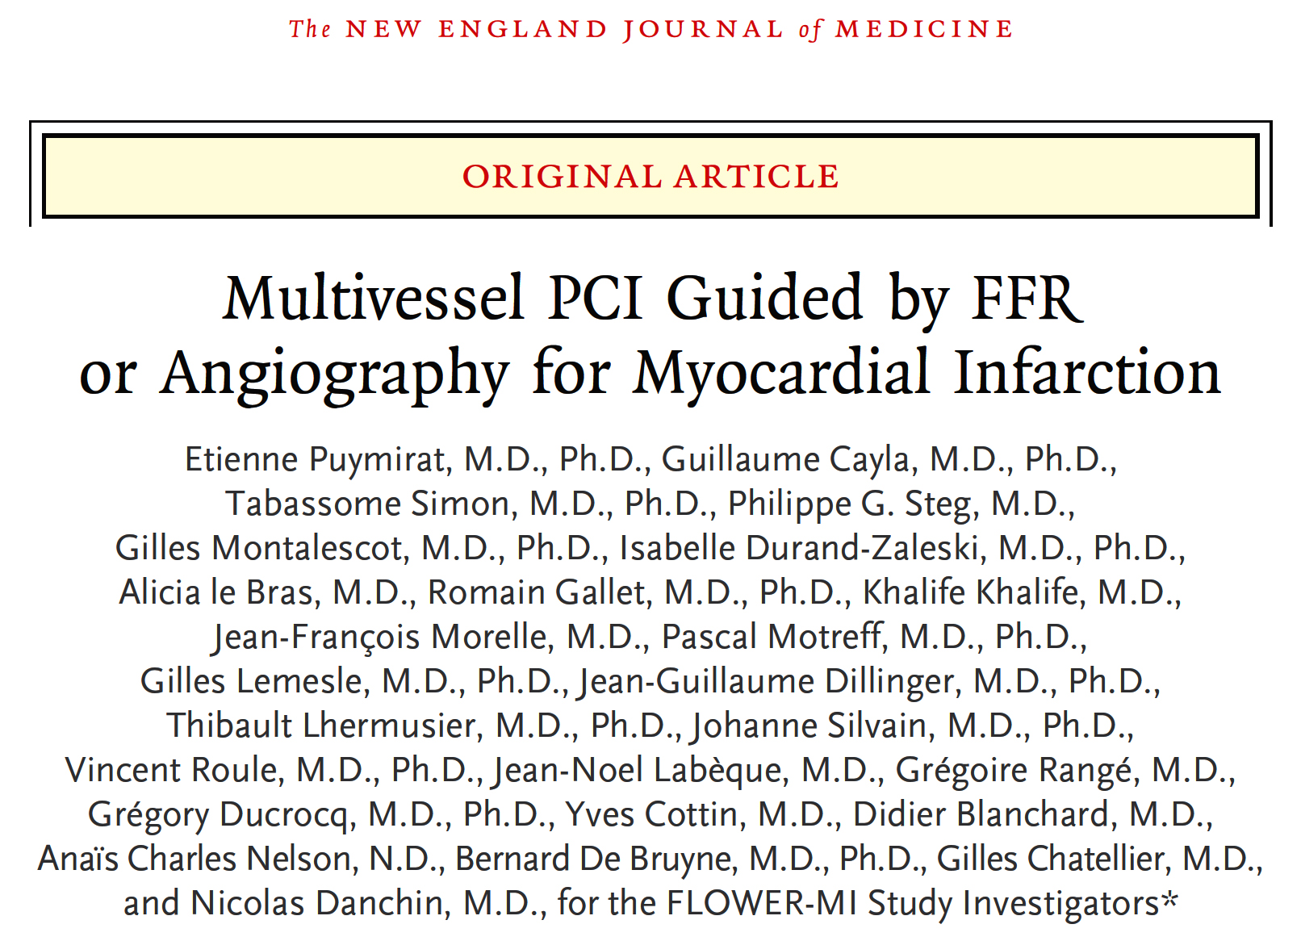
Article published on May 16, 2021 at NEJM.org DOI: 10.1056/NEJMoa2104650

Slide 31
Sex-Specific Outcomes in High-Risk Patients Receiving Ticagrelor With or Without Aspirin After PCI: Results from the TWILIGHT Trial

Slide 32
TWILIGHT – Sex Analysis: Study Design
Randomized, double-blind placebo controlled trial in 187 sites and 11 countries
High-risk patients underwent PCI and were treated with ticagrelor plus aspirin for 3 months
Event-free and adherent patients were randomized to aspirin vs placebo and continued ticagrelor for and additional year
9006 pts enrolled (28.5% women)
Ticagrelor + Aspirin
852 women
2712 men
Standard of Care
7119 pts randomized (23.9% women)
Ticagrelor + Placebo
846 women
2709 men
Standard of Care
Enrollment period 3 Months
Observation period 3 Months
3 M
Randomization period
12 Months
15 M
18 M
Vogel B, ACC 2021

Slide 33
TWILIGHT – Sex Analysis: BARC 2, 3 or 5 Bleeding by Sex at 1 Year
Women vs Men
HR 1.32 (95% CI 1.06 – 1.64)
P = .013
6.8%
5.2%
Cumulative incidence (%)
Women (n=1698)
Men (n=5421)
Days after randomization
Vogel B, ACC 2021

Slide 34
TWILIGHT – Sex Analysis: Pre-Specified Bleeding Endpoints by Sex
p=0.06
p=0.03
p=0.06
1-year event rate (%)
p=0.79
Vogel B, ACC 2021

Slide 35
TWILIGHT – Sex Analysis: Death, MI or Stroke by Sex at 1 Year
Women vs Men
HR 0.86 (95% CI 0.65 – 1.15)
P = 0.32
Women (n=1676)
Men (n=5363)
Cumulative incidence (%)
4.0%
3.5%
Days after randomization
Vogel B, ACC 2021

Slide 36
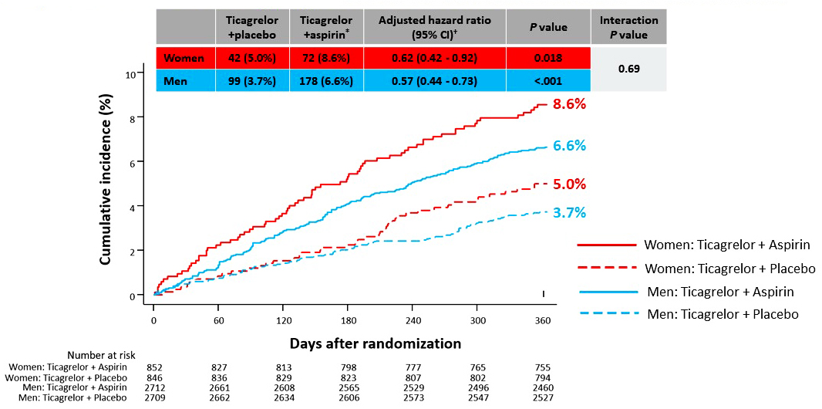
TWILIGHT – Sex Analysis: BARC 2,3 or 5 Bleeding by Sex and Randomized Treatment
Vogel B, ACC 2021

Slide 37
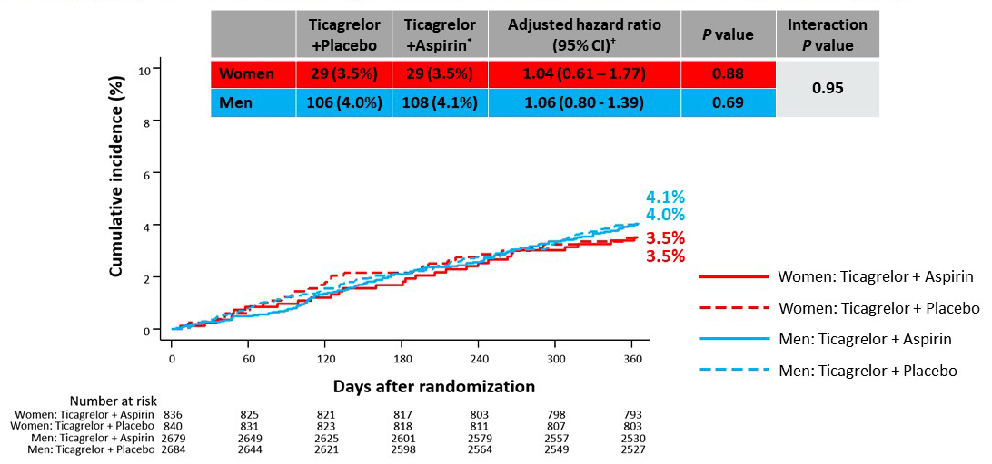
TWILIGHT – Sex Analysis: Death, MI, or Stroke by Sex and Randomized Treatment
Vogel B, ACC 2021

Slide 38
Latest Issues in Coronary Intervention
ACC 2021 Interventional Trials:
RADIANCE-HTN Trio Trial, FLOWER MI Trial,
TWILIGHT Sex Difference Trial
Focused review of the month
Coronary micro-vascular function
abnormalities in non-obstructive CAD

Slide 39
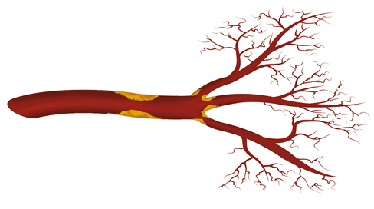
Providing Hemodynamic Data for Entire Coronary Vasculature
Epicardial Assessment
FFR (fractional flow reserve)
RFR (resting full-cycle ratio) a non-hyperemic index that does not require adenosine infusion
Pd/Pa
Pullback measurements
Microvascular Assessment
CFR (coronary flow reserve)
IMR (index of microvascular resistance)
FFR, RFR, Pd/Pa
Assess only epicardial disease
CFR
Flow at rest vs at Hyperemia: affected by both microvascular and epicardial disease
IMR
Assesses microvascular disease

Slide 40
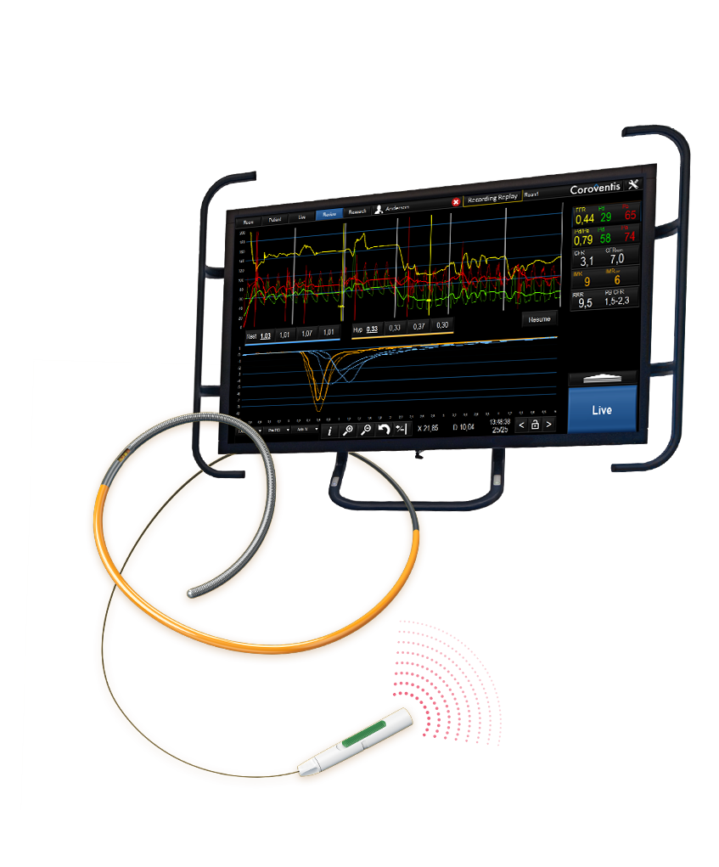
Coroventis^{ⱡ} CoroFlow^{ⱡ} Cardiovascular System

Slide 41
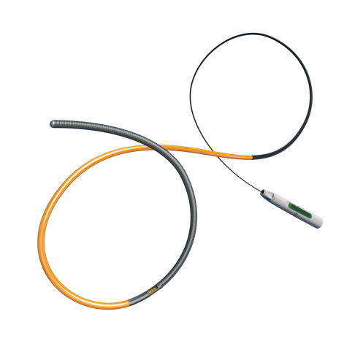
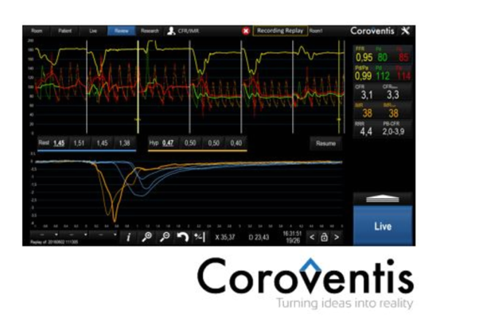
Coroventis CoroFlow Cardiovascular System
The Coroventis CoroFlow Cardiovascular System is an advanced platform for assessment of both epicardial and microvascular physiology.
The CoroFlow software allows Abbott’s PressureWire™ X Guidewire to diagnose coronary microvascular dysfunction caused by abnormalities in the heart’s smallest arteries.
CoroFlow is easy to use for daily clinical practice while also providing powerful tools for advanced physiology.
The temperature sensor enables the IMR (Index of Microvascular Resistance) and CFR (Coronary Flow Reserve) measurements, which are physiological indices used to diagnose CMD
Pressure and temperature sensors

Slide 42
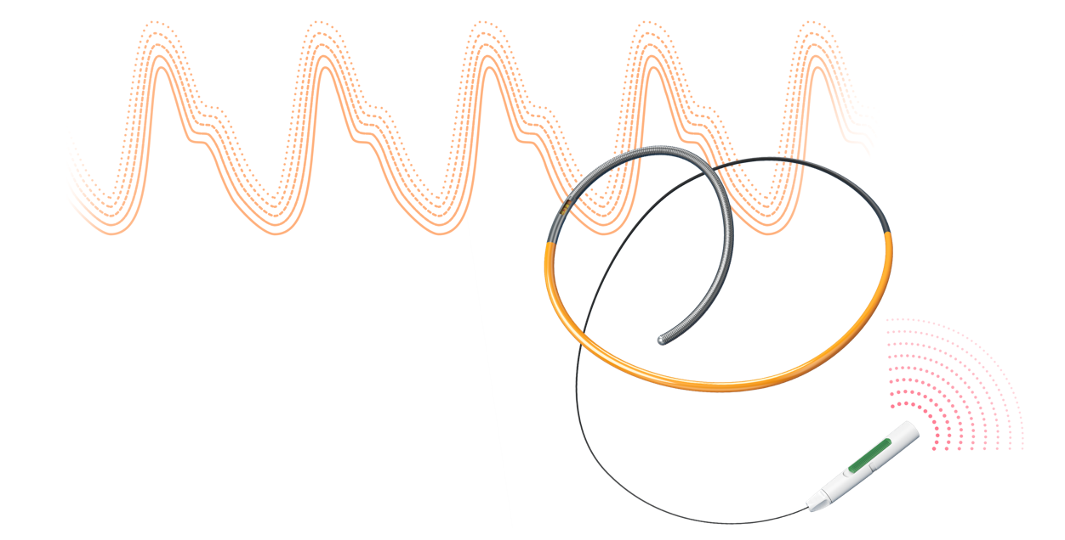
CoroFlow: Appropriate Cut-Off Point Index
Physiological Index Guide
Abbott’s PressureWire™ X Guidewire and Coroventis‡ CoroFlow‡ Cardiovascular System COMPREHENSIVE PHYSIOLOGY DIAGNOSIS
 | RFR Resting Full Cycle Ratio | FFR Fractional Flow Reserve | CFR Coronary Flow Reserve | IMR Index of Microcirculatory Resistance
Cut-off (defer) | >0.89 | >0.80 | ≥2.0 | <25
1. Svanerud et al., EuroIntervention 2018;14:806
2. Tonino et al., J Am Coll Cardiol 2010;55:2816 3. Ford et al., J Am Coll Cardiol 2020;13:33

Slide 43
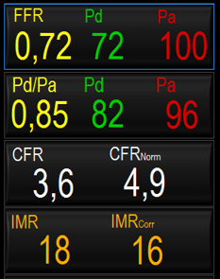
CoroFlow: About IMR
Normal IMR: < 25 (INOCA patients²)
IMR indicates the level of microcirculatory resistance in the target artery territory¹:
IMR = distal pressure (Pd) at hyperemia x T_{mn}
High IMR values (≥ 25) indicate CMD² Normal IMR values (< 25) indicate no CMD
To obtain an IMR value, use a PressureWire™ X Guidewire to:
Measure Pd during maximal hyperemia
Measure T_{mn} and flow at hyperemia using thermodilution
1. Fearon et al., Circulation 2003;107:3129
2. Ford et al., J Am Coll Cardiol 2020;13:33

Slide 44
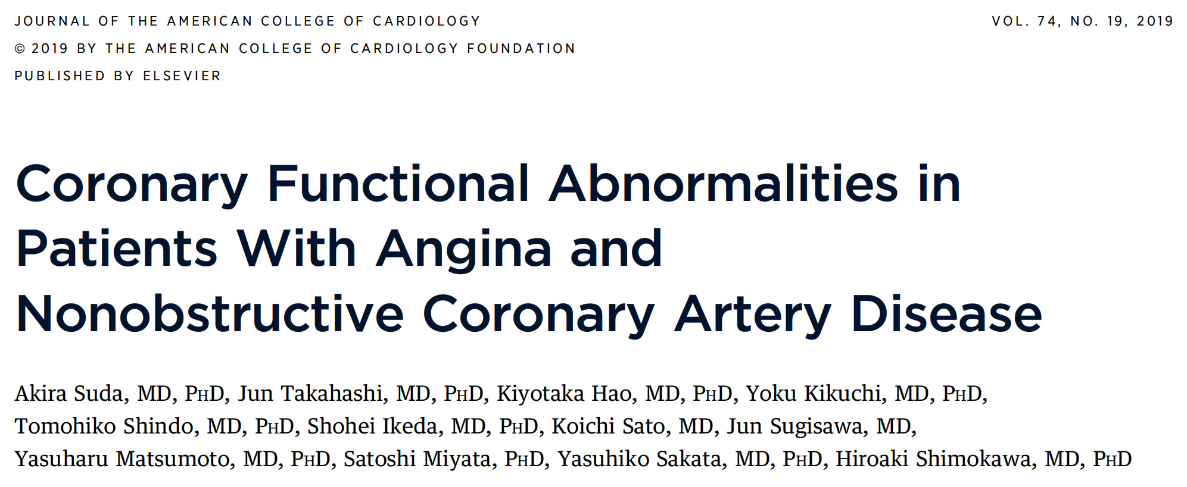

Slide 45
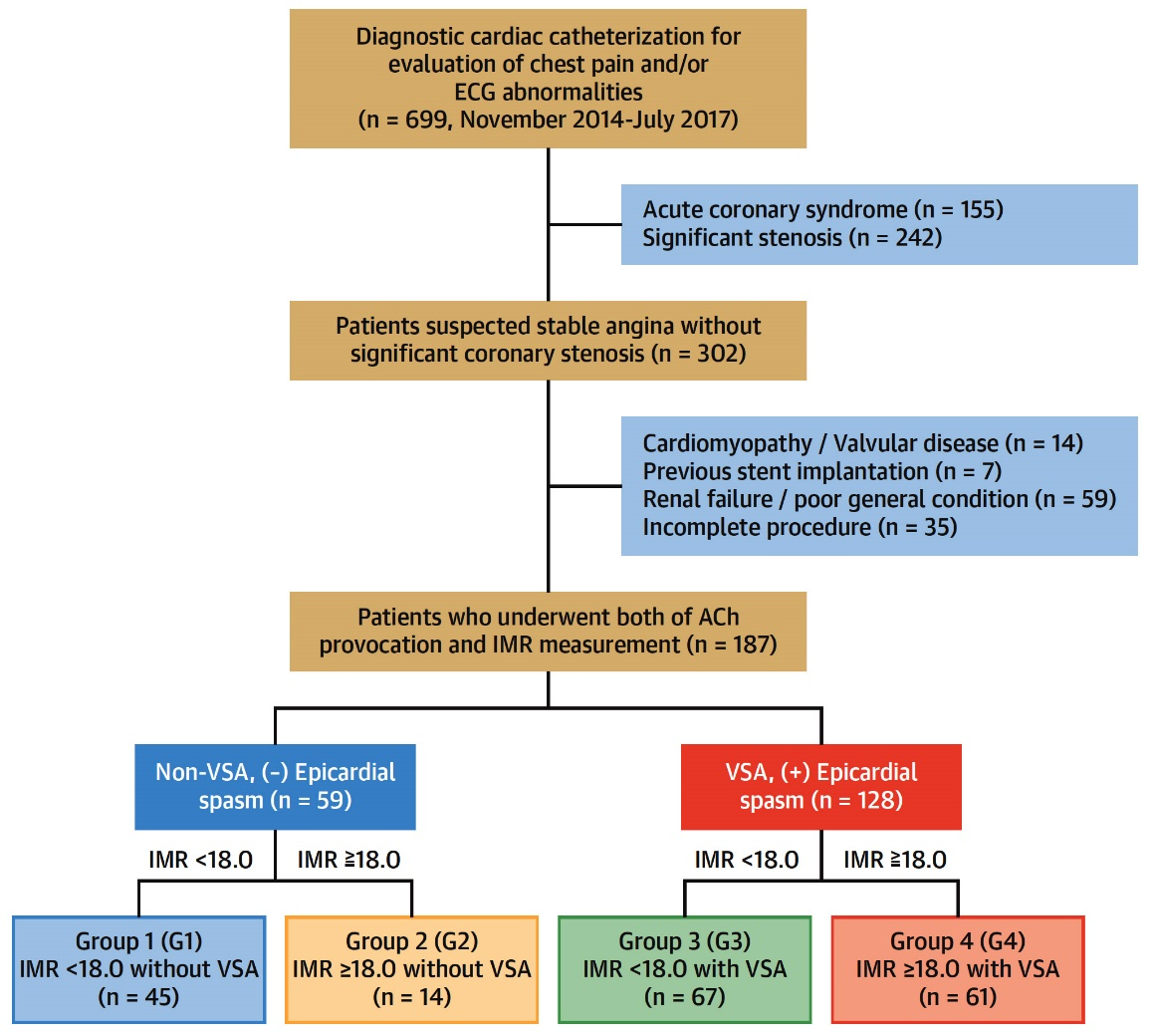
Study Flow Chart
Suda et al., J Am Coll Cardiol 2019;74:2350

Slide 46
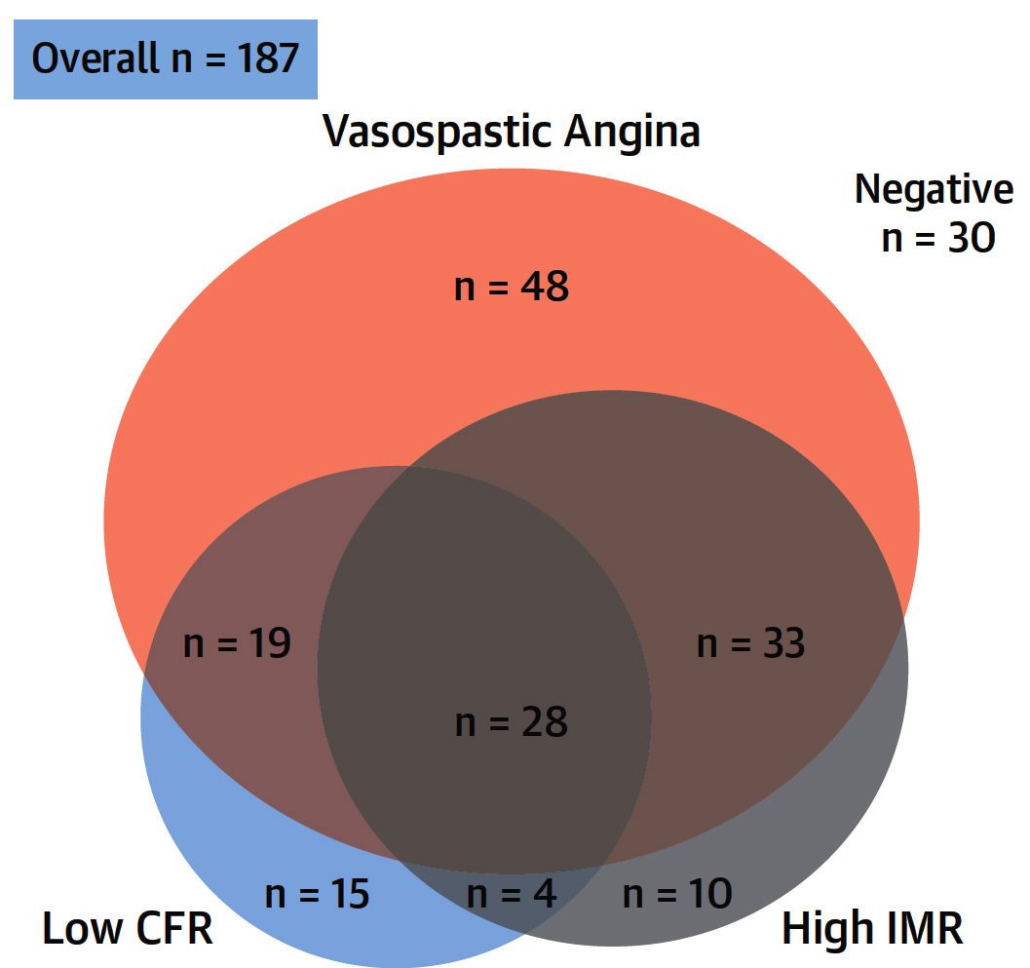
Coexistence of Coronary Functional Abnormalities
Suda et al., J Am Coll Cardiol 2019;74:2350

Slide 47
Comparison of Coronary Physiological Parameters Between Non-VSA and VSA Groups
IMR Values at Hyperemic State Were Significantly Higher in VSA Group
CFR Values at Hyperemic State Were Comparable Between 2 Groups
Non-VSA (n=59) VSA (n=128)
Non-VSA (n=59) VSA (n=128)
Suda et al., J Am Coll Cardiol 2019;74:2350

Slide 48
Correlation Between CFR and IMR Values in the Non-VSA and VSA Groups
Non-VSA (n=59)
VSA (n=128)
Suda et al., J Am Coll Cardiol 2019;74:2350

Slide 49
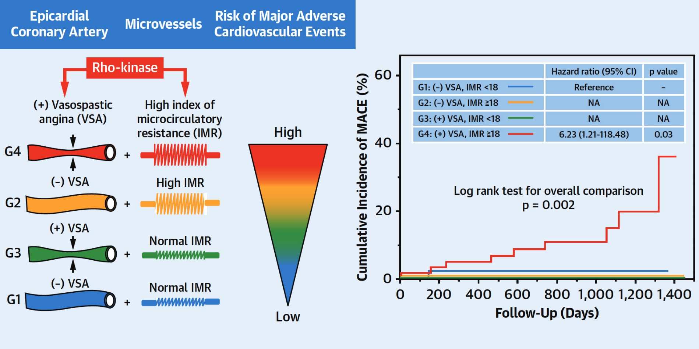
Vasopastic Angina and High Index of Microcirculatory Resistance(IMR): Prognostic Impact of Coexistence
Suda et al., J Am Coll Cardiol 2019;74:2350

Slide 50
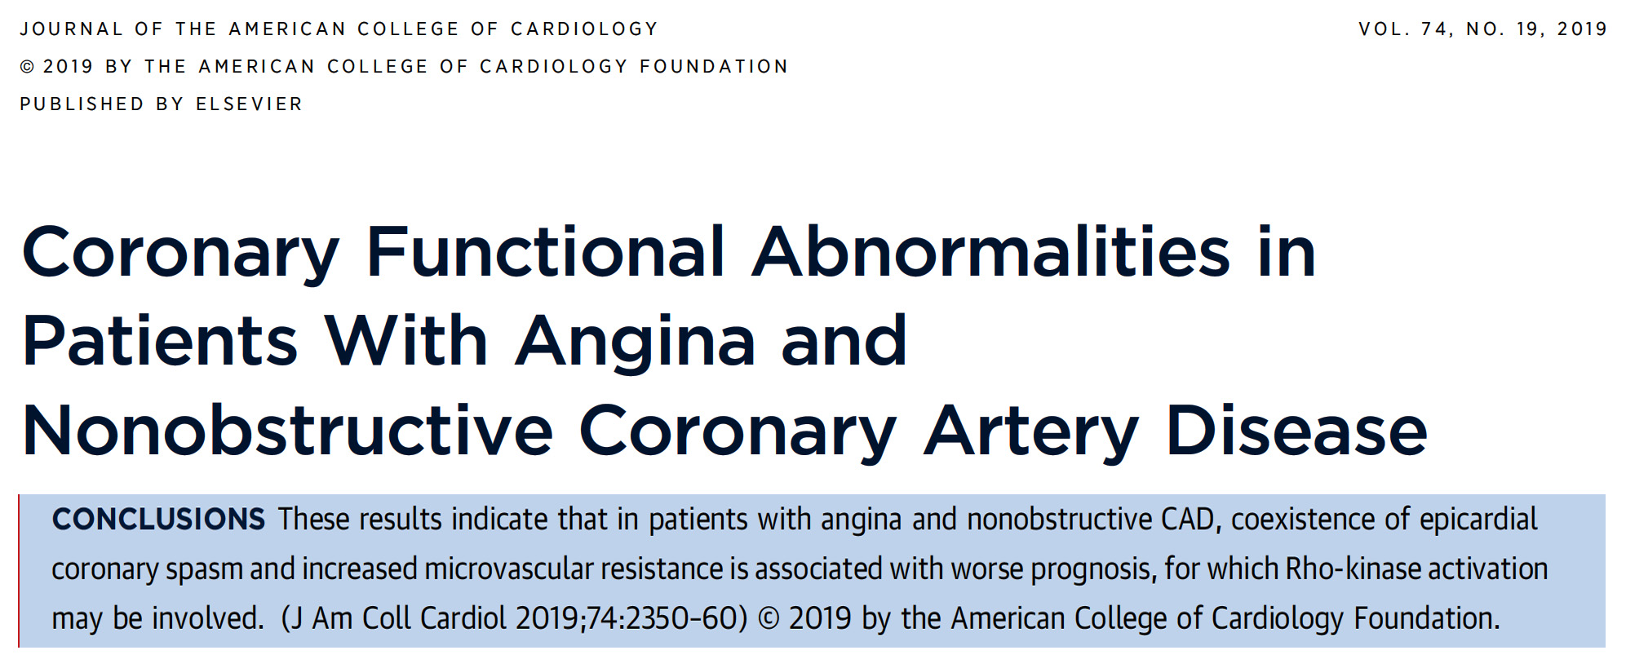

Slide 51
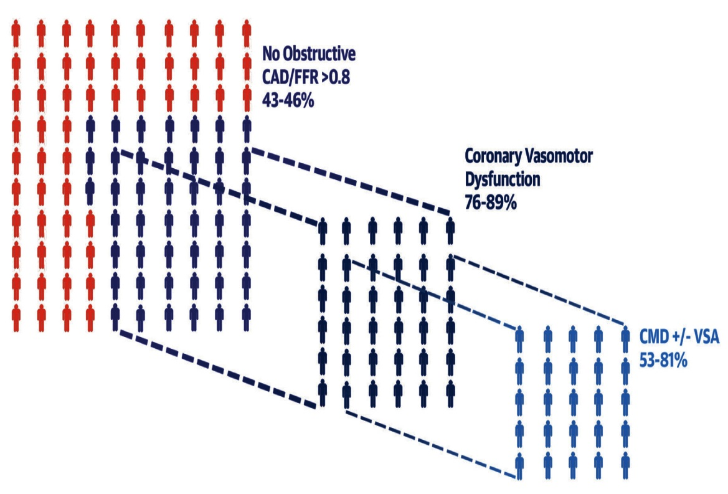
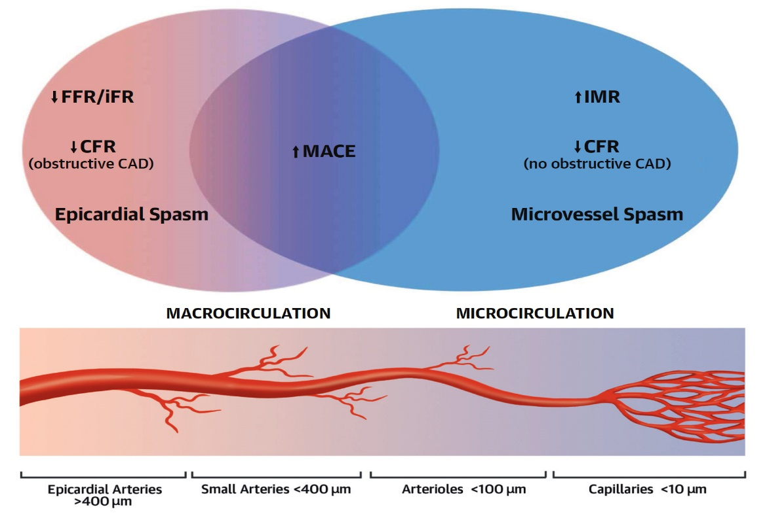
The Coronary Microcirculation in Macrovessel Disease Prognosis
Angina and/or Signs of Ischemia in Pts Referred for Coronary Evaluation
Abnormalities of the Coronary Macrocirculation & Microcirculation
Subphenotypes of patients with angina and/or ischemia
Abnormalities of the coronary macrocirc and microcirc may coexist in the same patient to increase risk of MACE
Taqueti V, J Am Coll Cardiol 2019;74:2361

Slide 52
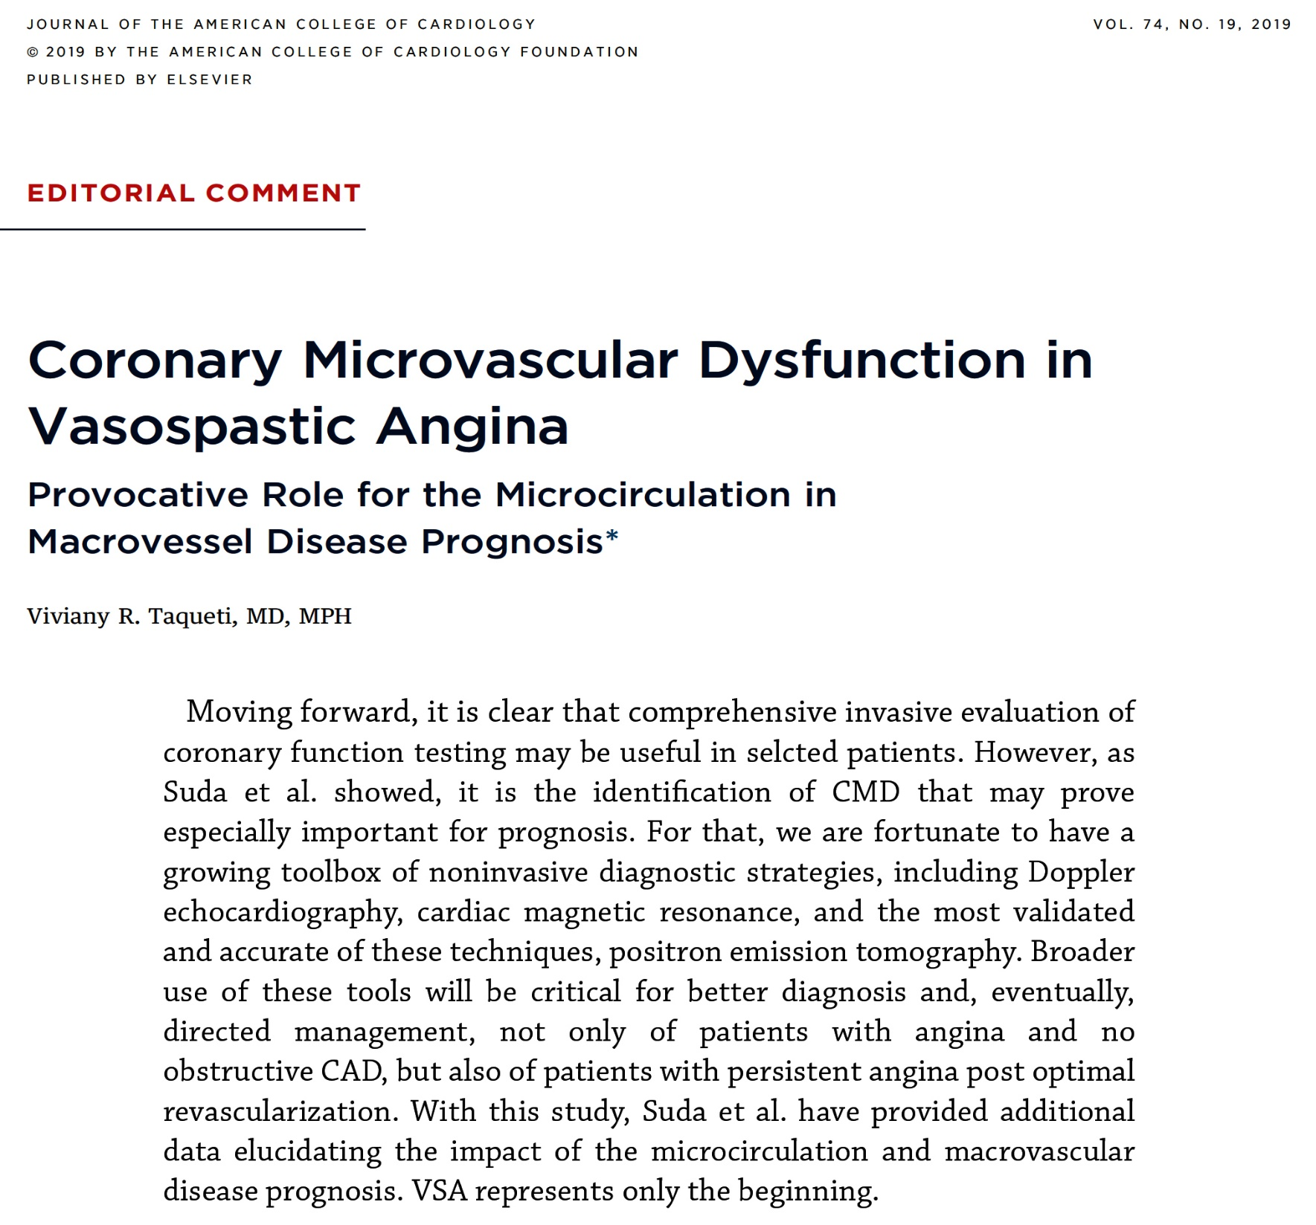

Slide 53
Take Home Message: Key Trials from ACC 2021 and Assessment of Microvascular Obstruction in Non-obstructive CAD
Ultrasound renal denervation in severe HTn:
Ticagrelor post-PCI alone in females for low bleeding:
FFR vs angio guided PCI in MV STEMI:
Pts with angina and non-obstructive CAD, presence of epicardial vasospasm and increased microvascular resistance (IMR) is associated with worse prognosis. Hence IMR measurement should be routinely incorporated in the invasive assessment of pts with normal FFR. High IMR should lead to aggressive measurement to improve microcirculation (nitrates, statin, DM control, vasodilators, ACEI, aggressive risk factor modification).
Notes:
HbA1c

Slide 54
Question # 1
Following statements are true regarding the FLOWER-MI trial comparing FFR vs angio guided PCI revealed the following except;
Similar MACE in both groups
Similar uRevasc in both groups
Similar MI in both groups
Similar total hospitalization in both groups
E. Lower non-culprit PCI in the FFR group
The correct answer is D

Slide 55
Question # 2
Following statements are true regarding the TWILIGHT Sex Difference outcomes trial except;
A. Overall higher bleeding in women vs men
B. No difference between MACE in women vs men
C. Lowest bleeding in women in Ticagrelor+placebo group
D. Highest bleeding in women in Ticagrelor+aspirin group
E. Lowest bleeding in men in Ticagrelor+placebo group
The correct answer is C

Slide 56
Question # 3
Following statements are true regarding the assessment of coronary functional abnormalities in pts with non-obstructive CAD except:
Coexistence of epicardial coronary spasm (VSA) is common
Increased microvascular resistance (IMR) is rare
Increased microvascular resistance is associated with higher MACE
Pts with both VSA and high IMR has worst prognosis
Both VSA and IMR can be modulated by vasodilator medications
The correct answer is B

