Slide 1
Calcified iliofemoral pad in a patient with ckd
ENDOVASCULAR LIVE CASE
JUNE 23, 2021

Slide 2
Clinical presentation
58 year old male with history of PAD with prior EVIs presenting with non-healing arterial ulcers involving his left great toe and third toe (Rutherford category 5) associated with severe ischemic rest pain and dependent rubor (W2 I3 fI 1) over past two months. He was being followed at outside hospital – referred for second opinion
Exam notable for dry gangrene/eschar over the medial aspect of hallux and dorsal 3rd toe with mild surrounding cellulitis. Exam limited due to severe pain on palpation
Pulses LLE– nonpalpable femoral/popliteal pulses – present on doppler ; with monophasic DP/PT signal
Other Medical History: Type 2 diabetes, HTN, HLD, CKD stage 3 (baseline Creat 1.6-1.8), CAD s/p PCI of LAD and LCx (3/15/2016)
Medications: Amlodipine, Insulin, Aldactone, Aspirin, Lipitor

Slide 3
Non-invasive Studies
Pertinent labs
WBC 9.7, H/H 9.6/29.3, Plt 186, BUN/Creat 45/1.75, K 5.0
ABIs from 04/2021
Right: ABI 1.42, TBI 0.31
Left: 0.34, flat PVRs
Arterial Duplex 04/2021
Possible R CIA occlusion, >75% stenosis of distal CIA and proximal EIA >75% stenosis of L proximal CIA. 50-74% stenosis of the distal CIA.
L CFA >75% stenosis. 50-74% stenosis prox SFA, mid-distal SFA occlusion. PTA occluded. Distal ATA occluded.

Slide 4
Peripheral angiogram
LLE Runoff
RLE Femoral angiogram
Iliac Angiogram

Slide 5
Calcific pad
Rocha-Singh KJ et al. Catheter Cardiovasc Interv. 2014;83(6):E212-E220.
Highly prevalent in Elderly, and associated with CKD, Diabetes or inflammatory states. Prevalence increases with age (about 2/3 patients over age 70) and is associated with mortality.
Accumulation of calcium and phosphate within arteries and mineral deposits within the intimal and medial layers of the arteries
Intimal calcium→ 2/2 atherosclerosis/lipid plaque and inflammation inducing osteogenic cell differentiation
Medial Calcium→ no luminal narrowing; however decreased elasticity of vessel wall leading to atherosclerosis and decreased perfusion
Monckeberg/calciphylaxis→ dystropic calcification of the tunica media due to osteoblastic transformation of VSMCs leading to calcium hydroxyapatite crystal deposition --> increased CV mortality in young people without other RFs
Mowafy et al; 2019 Vascular and Endovascular Review; 2 (1)

Slide 6
Challenges to evi in calcific pad
Currently, most on-going U.S. Investigational Device Exemption (IDE) endovascular device protocols specifically exclude patients with “severe” calcification.
Associated with suboptimal balloon dilation and stent expansion - circumferential calcium; ?recoil
In CTOs limit ability of guidewire and device passage, ability to cross proximal/distal cap, efficacy of re-entry devices
Reduced biologic drug effect with the use of paclitaxel therapies longitudinal calcium
Fanelli et al: 50% reduction in 1º patency and increase in LLL at 12 months in vessels with 270-360º arc of Ca treated with DCB
Associated with worse outcomes – increase in late lumen loss, reduced primary patency
Increased risk of complications (dissections/perforations/distal embolization)
Fanelli et al.

Slide 7
Calcium grading – compliance 360, PARC
Angiographic classification based on length , circumference of involvement and uni/bilateral involvement
Dattilo R et al. J Invasive Cardiol. 2014 Aug;26(8):355-60. PMID: 25091093.
Patel MR, et al. Am Coll Cardiol. 2015 Mar 10;65(9):931-41.

Slide 8
Calcium grading – PACSS, FANELLI
Rocha-Singh KJ et al. Catheter Cardiovasc Interv. 2014 May 1;83(6)
Fanelli, F et al. Cardiovasc Intervent Radiol 37, 898–907 (2014).

Slide 9
Calcium grading
Fanelli F. Vascular Calcium: detection, classification and implications in DCB treatment LINC 2018

Slide 10
Debulking devices in pad
Modification or debulking of plaque facilitating passage of devices
Reducing bail-out stenting
Improving clinical outcome
Niveditta Ramkumar.et al, Volume: 8, Issue: 12, DOI: (10.1161/JAHA.119.012081)

Slide 11
Atherectomy Devices
Excisional Atherectomy (SilverHawk/TurboHawk; Covidien-Medtronic)
Side-cutting rotating blade to excise plaque which is collected in the nose cone.
DEFINITIVE LE trial
Characteristics | CLI (RCC 4-6)
Number of Patients | 201
Number of Lesions | 279
Mean Length (cm) | 7.2
Baseline Stenosis (%) | 76
Occlusions (%) | 30
SFA | 48% (135)
Popliteal | 17% (48)
Infrapopliteal | 34% (96)
800 Patients | 47 Centers
Claudication 598 Patients* |  | Critical Limb Ischemia 201 Patients
Primary Patency by Duplex US at 12 months |  | Freedom From Major Unplanned Amputation at 12 months
MC Kinsey JM et al. JACC CardioVasc Int, 2014 Aug;7(8):923-33.

Slide 12
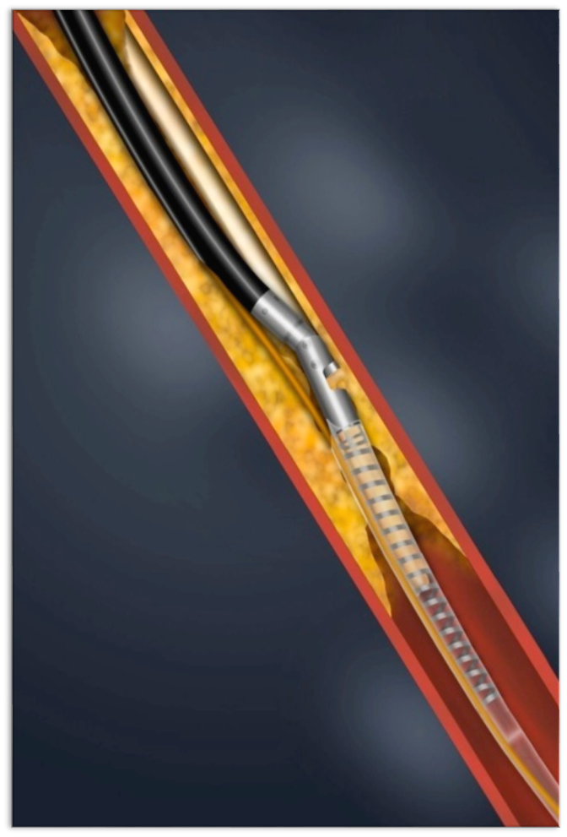
Atherectomy Devices
Excisional Atherectomy (SilverHawk/TurboHawk ; Covidien-Medtronic)
Diamond coated burr that orbits inside the vessel to macerate plaque
DEFINITIVE LE trial
Primary patency (PSVR < 2.4) : 71%
Wound healing % @ 3-6-12 m : 52%-61%-72%
Limb Salvage @12m : 95%
Especially in diabetics promising results
MC Kinsey JM et al. JACC CardioVasc Int, 2014 Aug;7(8):923-33.

Slide 13
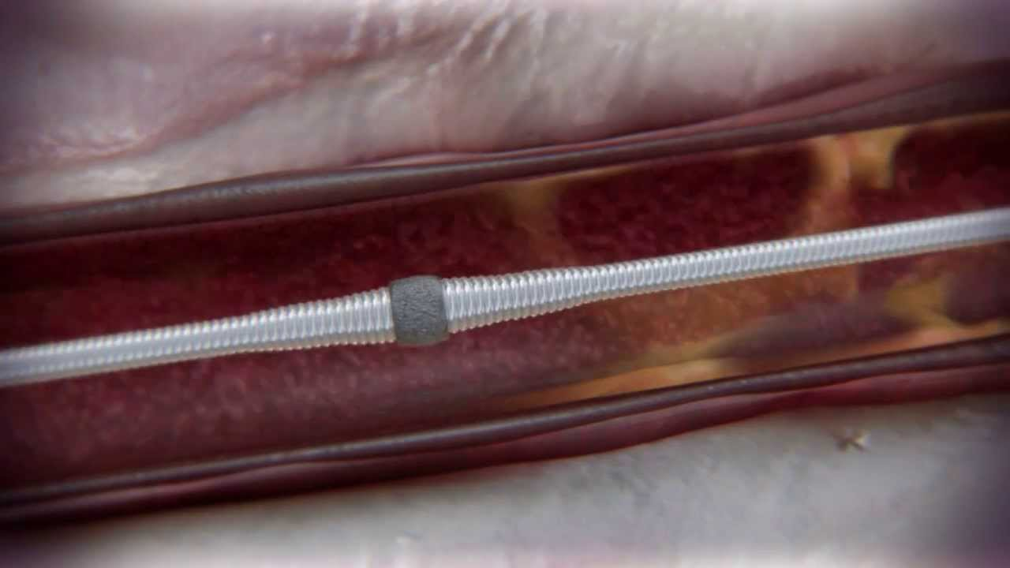
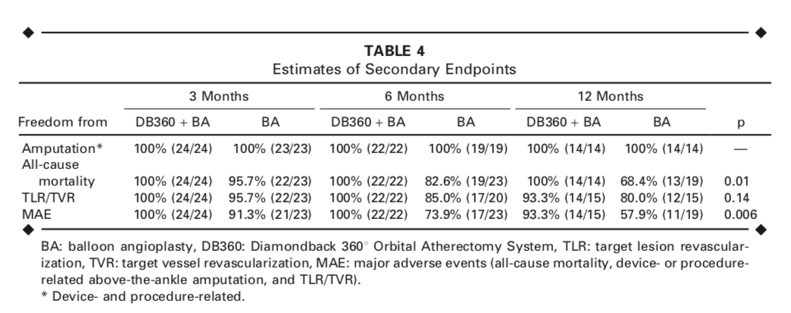
Atherectomy Devices BTK
Orbital atherectomy (Diamondback 360° ; Cardiovascular Systems)
Calcium 360 randomized pilot trial
Multicenter, randomized (BA vs. OA+BA), prospective trial
50 patients, popliteal + BTK lesions
RB classification 4-6
Orbital atherectomy + POBA vs POBA
Shammas NW et al. J Endovasc Ther 2012, Aug;19(4):480-8

Slide 14
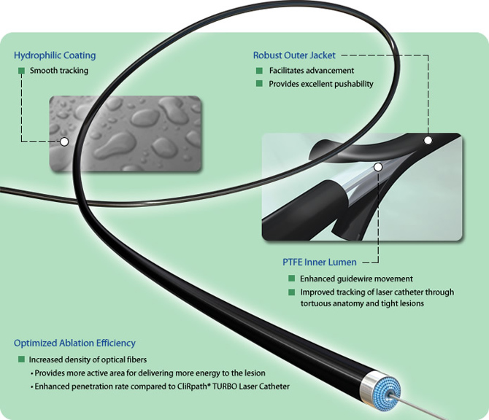
Atherectomy Devices BTK
CVX-300 Excimer laser (Spectranetics)
Uses ultraviolet radiation to disintegrate atheroma from the arterial lumen without heating,
Denovo and ISR fem-pop lesions
1 year patency rate in a small retrospective study (n=112), de novo lesions in comparison with atherectomy in combination with plain balloon angioplasty (86.7% vs 56.9%)
Kokkinidis DG et al. Journal of Endovascular Therapy. 2018;25(1):81-88.

Slide 15
Atherotomy
Serranator balloon: The Serranator balloon (Cagent Vascular, Wayne, PA, USA) is a semicompliant balloon with four serrated embedded strips along the longitudinal axis (see inset) which penetrate the intima which may improve delivery of drug to the vessel wall

Slide 16
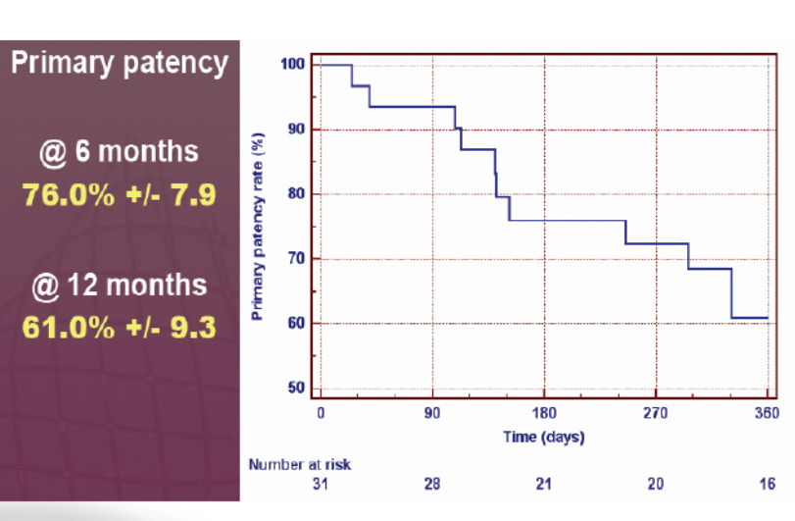
Atherotomy: Angiosculpt

Slide 17
NEWER Calcium debulking devices
Rotarex Device (Bard)
JetStream Atherectomy
Rotational cutter with aspiration, 7Fr
Luminal gain depends on burr size
Improvement in ABI/Rutherford class, but patency 33% and 25% at 1 and 2 yr f/u
High speed diamond-chip coated rotational cutter with aspiration

Slide 18
Shockwave lithotripsy – disrupt PAD III
Sonic pulse waves to fracture calcium
RCT 306 patients, 45 sites; 30 day and up to 2 year f/u
IVL (n=153) or PTA (n=153) Rutherford 2-4
IVL or PTA prior to DCB +/- stent
Primary effectiveness endpoint of procedural success was significantly greater in the IVL group (65.8% vs. 50.4%, p=0.007).
Residual diameter stenosis (27.3±11.5% vs. 30.5±13.9%, p=0.04), freedom from any dissection (81.5% vs.67.7%, p=0.009), flow-limiting dissection (1.4% vs. 6.8%, p=0.03), and provisional stent placement (4.6% vs. 18.3%, p<0.001) were also significantly lower in the IVL group.
Secondary outcomes, including rates of MAE and CD-TLR at 30 days, were comparable between groups.
Gray et al. DISRUPPT PAD III VIVA Nov 7, 2020

Slide 19
IVL in mod-sev calcified lesions

