Slide 1
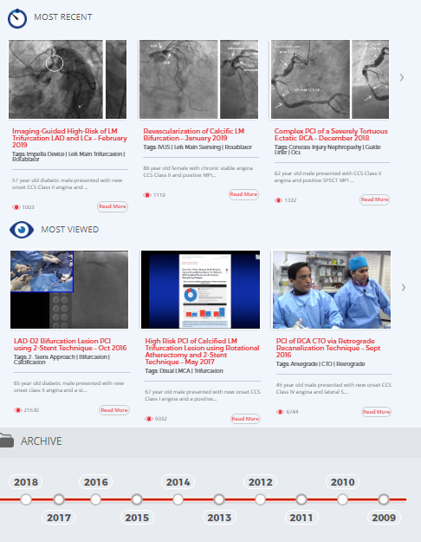
www.ccclivecases.org
Coronary Moderation by:
Dr. Sameer Mehta
www.ccclivecases.org

Slide 2
Total Pageviews per Month
(Past 2 Years)
Date | CCC Live Website | YouTube | Total Page Views
Jan-19 | 11,087 | 10,885 | 21,972
Feb-19 | 11,524 | 11,144 | 22,668
Mar-19 | 18,036 | 12,095 | 30,131
Apr-19 | 10,465 | 12,059 | 22,524
May-19 | 8,698 | 13,617 | 22,315
Jun-19 | 7,802 | 9,832 | 17,634
Jul-19 | 9,870 | 9,814 | 19,684
Aug-19 | 11,706 | 9,176 | 20,882
Sep-19 | 10,547 | 10,460 | 21,007
Oct-19 | 12,732 | 14,985 | 27,717
Nov-19 | 11,336 | 13,443 | 24,779
Dec-19 | 10,861 | 13,054 | 23,915
Jan-20 | 9,193 | 13,523 | 22,716
Feb-20 | 9,769 | 14,162 | 23,931
Mar-20 | 13,090 | 13,050 | 26,140
Apr-20 | 17,511 | 13,041 | 30,552
May-20 | 16,277 | 16,677 | 32,954
Jun-20 | 10,451 | 12,339 | 22,790
Jul-20 | 11,287 | 12,379 | 23,666
Aug-20 | 9,329 | 11,071 | 20,400
Sep-20 | 12,210 | 13,581 | 25,791
Oct-20 | 10,866 | 14,648 | 25,514
Nov-20 | 9,542 | 13,341 | 22,883
Dec-20 | 9,319 | 12,286 | 21,605
Jan-21 | 10,372 | 12,271 | 22,643
Feb-21 | 10,019 | 11,963 | 21,982
Mar-21 | 12,769 | 15,480 | 28,249
Apr-21 | 9,700 | 12,739 | 22,439

Slide 3
Complex Coronary Cases Supported by:
Abbott Vascular Inc.
Boston Scientific Corp.
Terumo Vascular Corp.
Cardiovascular Systems Inc.
Abiomed Inc.
Chiesi Inc.
Best Medical Inc.

Slide 4
Disclosures
Samin K. Sharma, MD, MSCAI, FACC
Speaker’s Bureau – BSC, Abbott, CSI
Annapoorna S. Kini, MD, MRCP, FACC
Nothing to disclose
Sameer Mehta, MD, FACC (Moderator)
Nothing to disclose
Gerald Werner, MD, FACC (Guest Faculty)

Slide 5
CCC Live Case # 143
Patient Demographics
66 yrs, M
Present Clinical Presentation
Presented with new onset CCS class IV angina and high risk SPECT MPI for multivessel ischemia
CAD Risk Factors
Controlled Hyperlipidemia
Controlled NIDDM
Controlled Hyperlipidemia
PAD s/p PTA, Ex-Smoker, HIV
Clinical Variables
No known CAD or cardiac issues before present symptoms.
Very active otherwise. Current SAQ 85
Medications
Aspirin, Metoprolol XL, Atorvastatin, Losartan, Nifedipine, Glucophage, HIV antivirals
Cath: Cath done on 4/15/2021 revealed 2 V CAD: 80% mid LAD, 50% OM2, totally occluded extremely tortuous dRCA with another 90% lesion in pRCA, LVEF 60% and Syntax score 22. Pt underwent atherotomy+DES (Xience Sierra) of mLAD and did well. Clopidogrel added.
Plan: Now planned for staged PCI of totally occluded extremely tortuous dRCA and pRCA lesions.

Slide 6
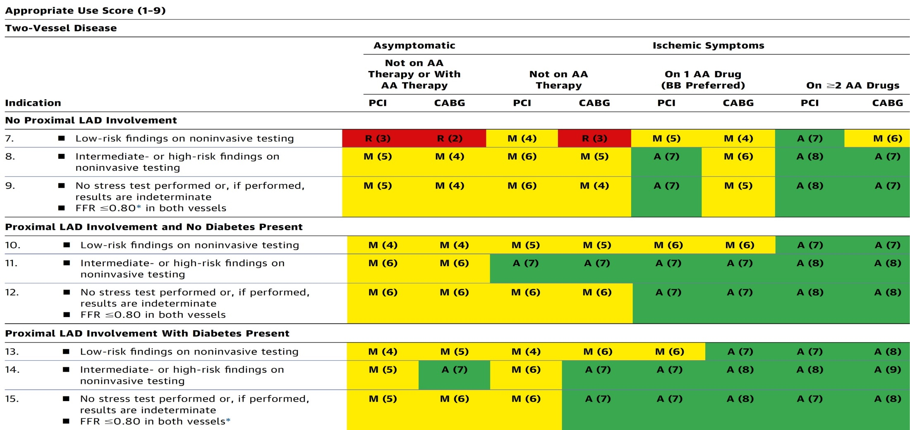
AUC 2017: Two-Vessel Disease
Patel et al., J Am Coll Cardiol 2017;69:2212

Slide 7
Latest Issues in Coronary Intervention
ACC 2021 Interventional Trials: APT Trials
ADAPTABLE-Aspirin doses, HOST-EXAM,
TALOS-AMI
Focused review of the month
Eruptive calcific nodule as the cause of ACS

Slide 8
Latest Issues in Coronary Intervention
ACC 2021 Interventional Trials: APT Trials
ADAPTABLE-Aspirin doses, HOST-EXAM,
TALOS-AMI
Focused review of the month
Eruptive calcific nodule as the cause of ACS

Slide 9
A Patient-Centric Trial Assessing Benefits and Long-Term Effectiveness

Slide 10
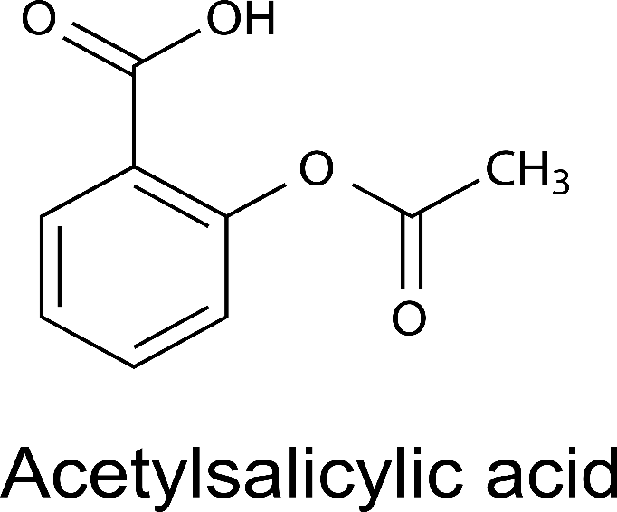
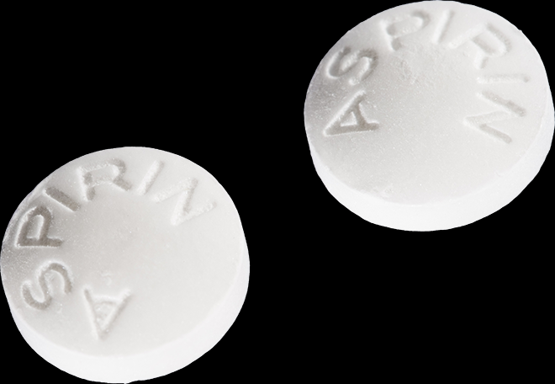
ADAPTABLE: Background
2014 AHA/ACC NSTE-ACS Guidelines
I
IIa
IIb
III
x
For patients who experience NSTE-ACS, a maintenance dose of aspirin (81 mg/d to 325 mg/d) should be continued indefinitely.
Jones S, ACC 2021

Slide 11
ADAPTABLE: Research Question
In patients with established or pre-existing cardiovascular disease, is a strategy of 81 mg or 325 mg of aspirin better?
Everyday decision for patients (OTC medication)
The correct dose of aspirin may PREVENT:
Thousands of deaths / heart attacks
or
Thousands of bleeds
Annually in the United States
Jones S, ACC 2021

Slide 12
ADAPTABLE: Main Objectives
To compare the effectiveness and safety of two doses of aspirin (81 mg and 325 mg) in high-risk patients with coronary artery disease.
Primary Effectiveness Endpoint: Composite of all-cause mortality, hospitalization for MI, or hospitalization for stroke
Primary Safety Endpoint: Hospitalization for major bleeding that was associated with a blood product transfusion
Jones S, ACC 2021

Slide 13
ADAPTABLE: Study Design
15,000 patients with known ASCVD + ≥ 1 “enrichment factor”
Eligible patients identified via inclusion/exclusion criteria (applied to EHRs)
Electronic consent and self randomization on participant portal
ASA 81 mg QD
RANDOMIZATION
ASA 325 mg QD
Electronic patient follow-up
Data from EHR, health plans, Medicare
Primary Endpoint: Composite of all-cause mortality, hospitalization for MI, or hospitalization for stroke
Primary Safety Endpoint: Hospitalization for major bleeding
ClinicalTrials.gov: NCT02697916
Jones S, ACC 2021

Slide 14
Known CV Disease
≥ 1 Enrichment Risk Factor
Prior myocardial infarction
Prior revascularization (PCI or CABG)
Prior angiogram showing significant CAD
History of chronic ischemic heart disease, CAD, or ASCVD
Age ≥ 65 years
Creatinine ≥ 1.5 mg/dL
Diabetes mellitus
Known 3-vessel CAD
Cerebrovascular disease
Peripheral artery disease
Current smoker
Known LVEF < 50%
Chronic systolic or diastolic heart failure
SBP ≥ 140 (within past 12 mos)
LDL ≥ 130 (within past 12 mos)
ADAPTABLE Inclusion Criteria
History of significant allergy to aspirin
History of GI bleeding within 12 months
Bleeding disorder that precludes the use of aspirin
Current or planned used of an oral anticoagulant or ticagrelor
Female patients who were pregnant or nursing
ADAPTABLE Exclusion Criteria
Jones S, ACC 2021

Slide 15
ADAPTABLE: Study Flow
Approximately 450,000 people were approached for the study
32,164 individuals visited the patient portal
15,076 participants enrolled and underwent randomization
Withdrawal of consent (overall 4.1%)
81 mg (2.9%)
325 mg (5.2%)
Limited participation (overall 2.3%)
81 mg (1.8%)
325 mg (3.4%)
7540 randomized to 81 mg group
7536 randomized to 325 mg group
Jones S, ACC 2021

Slide 16
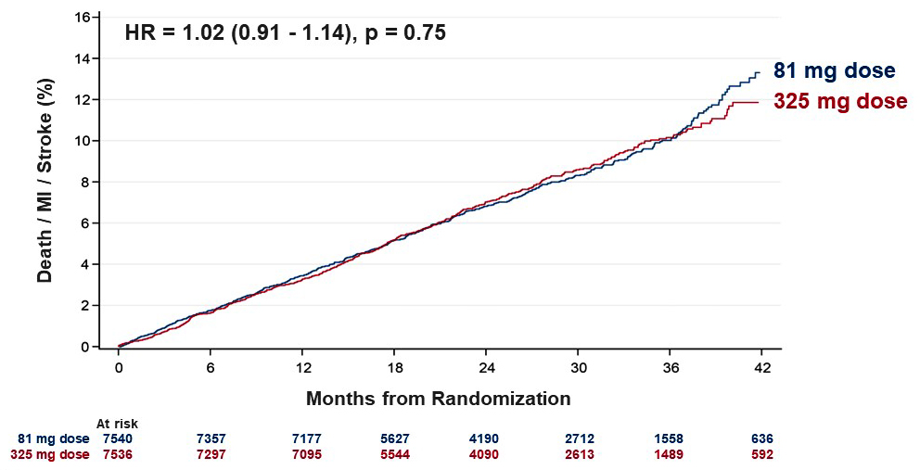
ADAPTABLE: Primary Effectiveness Endpoint
(All-cause death, hospitalization for MI, or hospitalization for stroke)
Jones S, ACC 2021

Slide 17
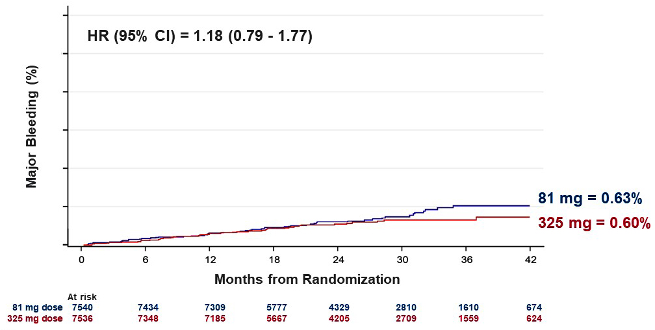
ADAPTABLE: Primary Effectiveness Endpoint
(Hospitalization for major bleeding with associated blood product transfusion)
Jones S, ACC 2021

Slide 18
ADAPTABLE: Effectiveness and Safety Outcomes
 | 81 mg group N=7434 | 325 mg group N=7330 | HR (95% CI)
Primary endpoint | 590 (7.28%) | 569 (7.51%) | 1.02 (0.91 - 1.14)
Major bleeding | 53 (0.63%) | 44 (0.60%) | 1.18 (0.79 - 1.77)
All-cause death | 315 (3.80%) | 357 (4.43%) | 0.87 (0.75 - 1.01)
Non-fatal MI | 228 (2.99%) | 213 (2.87%) | 1.06 (0.88 - 1.27)
Non-fatal stroke | 102 (1.23%) | 92 (1.27%) | 1.09 (0.82 - 1.45)
PCI or CABG | 471 (6.05%) | 446 (5.96%) | 1.04 (0.92 - 1.19)
Jones S, ACC 2021

Slide 19
ADAPTABLE: Study Medication
 | Overall | 81 mg | 325 mg
Dose switching, % * | 24.2% | 7.1% | 41.6%
Aspirin discontinuation, % ** | 9.1% | 7.0% | 11.1%
Median days of exposure, assigned aspirin dose | 551 days (139 - 737) | 650 days (415 – 922) | 434 days (139 – 737)
Median days of exposure, any aspirin dose | 658 days (426 - 932) | 670 days (439 – 944) | 646 days (412 – 922)
* Defined as at least one dose change
** Reasons for aspirin discontinuation: 25% participant did not want to continue 75% doctor’s decision or medical condition (e.g., atrial fibrillation, dyspepsia)
Jones S, ACC 2021

Slide 20
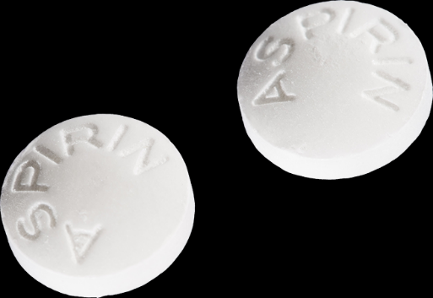
Messages to Patients
If you are on 81 mg now, staying (rather than switching) is probably right given the similar study results for the primary endpoint
If you are resuming aspirin, starting a lower dose (81 mg) is probably right due to better tolerability and we did not find conclusive evidence that higher dose is better
If you are tolerating 325 mg now, staying on this dose may be okay and not harmful

Slide 21
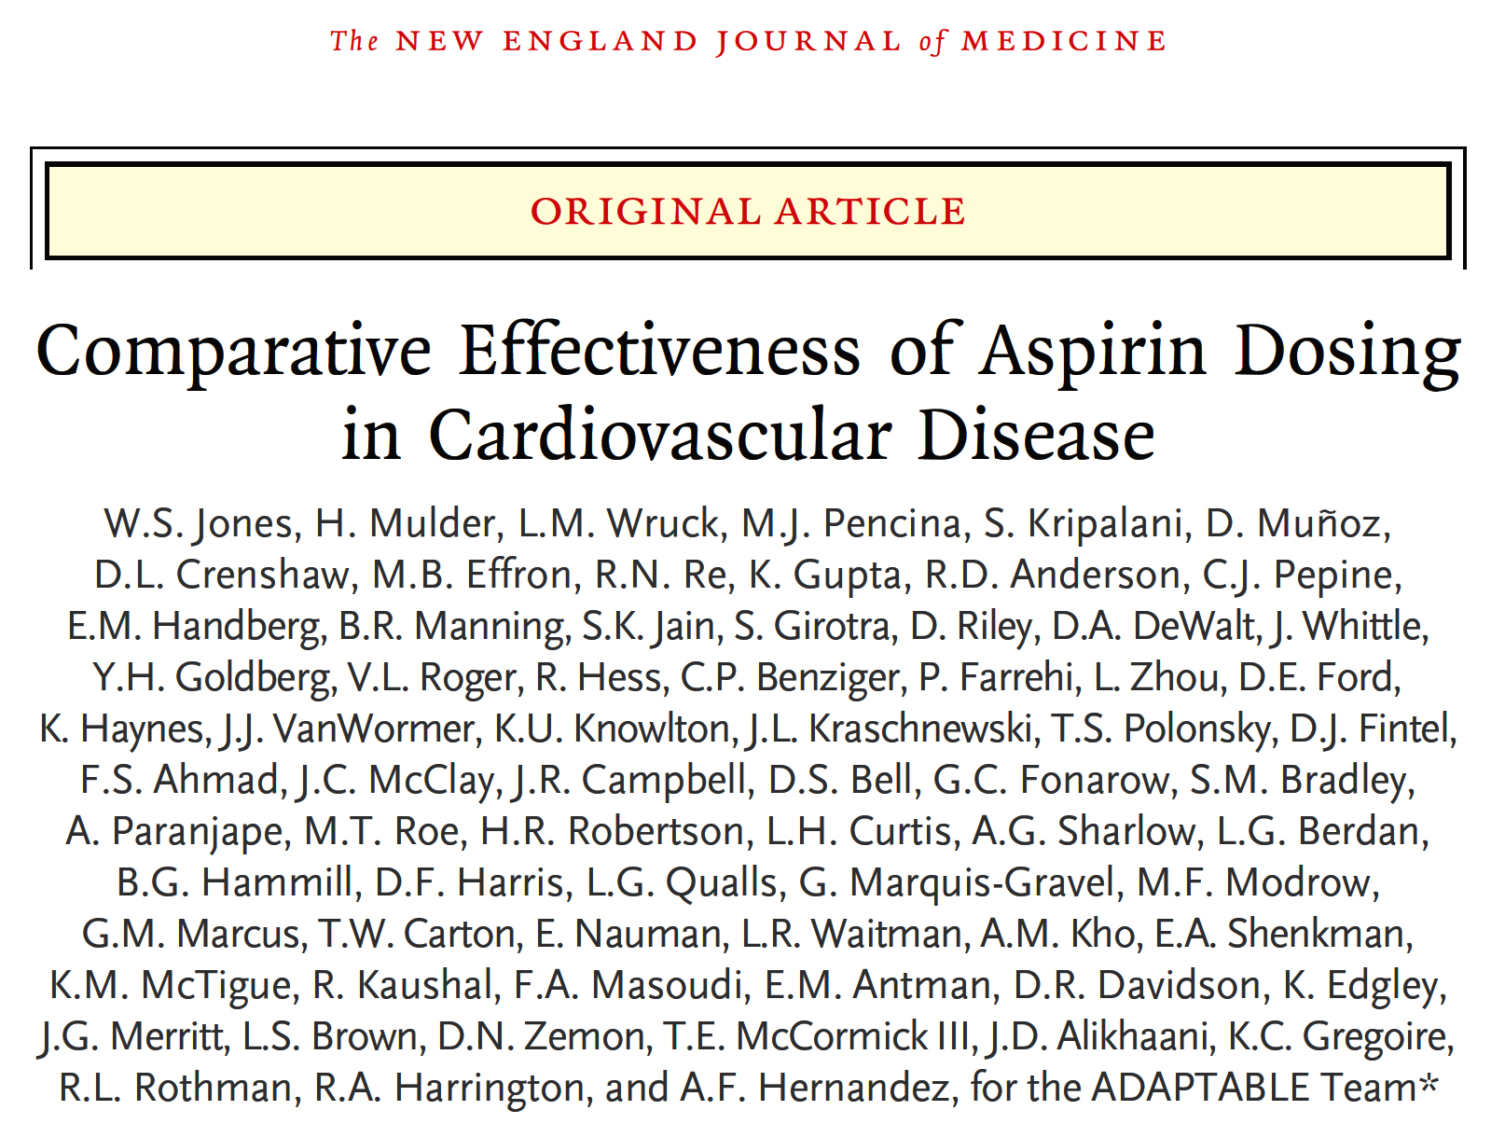
Article published on May 15, 2021, at NEJM.org DOI: 10.1056/NEJMoa2102137

Slide 22
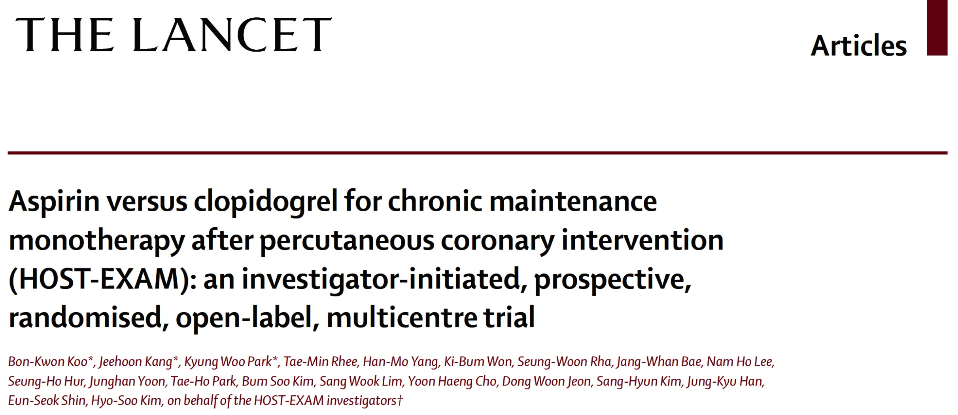
Article published in Lancet on May 16, 2021
https://doi.org/10.1016/S0140-6736 (21)01063-1

Slide 23
HOST-EXAM: Study Design and Patient Population
5,530 eligible patients screened, from 37 centers in Korea
Post-random 24 months
Event-free under DAPT
for 6 ~ 18 months
Aspirin for 24 months
Clopidogrel for 24 months
Index PCI
Randomization
Primary outcome
Inclusion Criteria
a) Subject must be ≥ 20 years b) Maintenance of DAPT for at least 12 ± 6 months after PCI with DES c) No history of clinical event after PCI with DES before enrollment d) Agreement to give written informed consent
Exclusion Criteria
a) Known hypersensitivity or contraindication to key medications b) Patients with active pathologic bleeding c) Female of childbearing potential, unless a pregnancy test is negative d) History of bleeding diathesis, known coagulopathy e) Non-cardiac co-morbid conditions with life expectancy <1 year
Key criterias
Patients who recieved PCI with a drug-eluting stent (DES) and maintained DAPT without any clinical event during 12 ± 6 months after PCI.
No exclusion criteria of the clinical risk factors / clinical diagnosis / complexity of the PCI
Kim H, ACC 2021

Slide 24
HOST-EXAM: Trial Flow
Event-free under DAPT
for 6 ~ 18 months
Aspirin for 24 months
Clopidogrel for 24 months
Index PCI
Randomization
Primary outcome
All-cause death, nonfatal MI, stroke,
readmission due to ACS,
major bleeding (BARC type ≥3)
5530 patients enrolled
92 patients excluded from randomization
50 did not meet the eligibility criteria
28 declined participation
14 randomization error
5438 patients successfully randomized
2,710 patients enrolled in the
Clopidogrel monotherapy group
2,728 patients enrolled in the
Aspirin monotherapy group
62 patients excluded for Per protocol analysis
8 withdrew consent
41 were lost to follow up
13 did not receive allocated antiplatelet agent
73 patients excluded for Per protocol analysis
1 withdrew consent
50 were lost to follow up
22 did not receive allocated antiplatelet agent
2,661 (98.2%) patients completed
24-month follow-up
2,677 (98.1%) patients completed
24-month follow-up
Kim H, ACC 2021

Slide 25
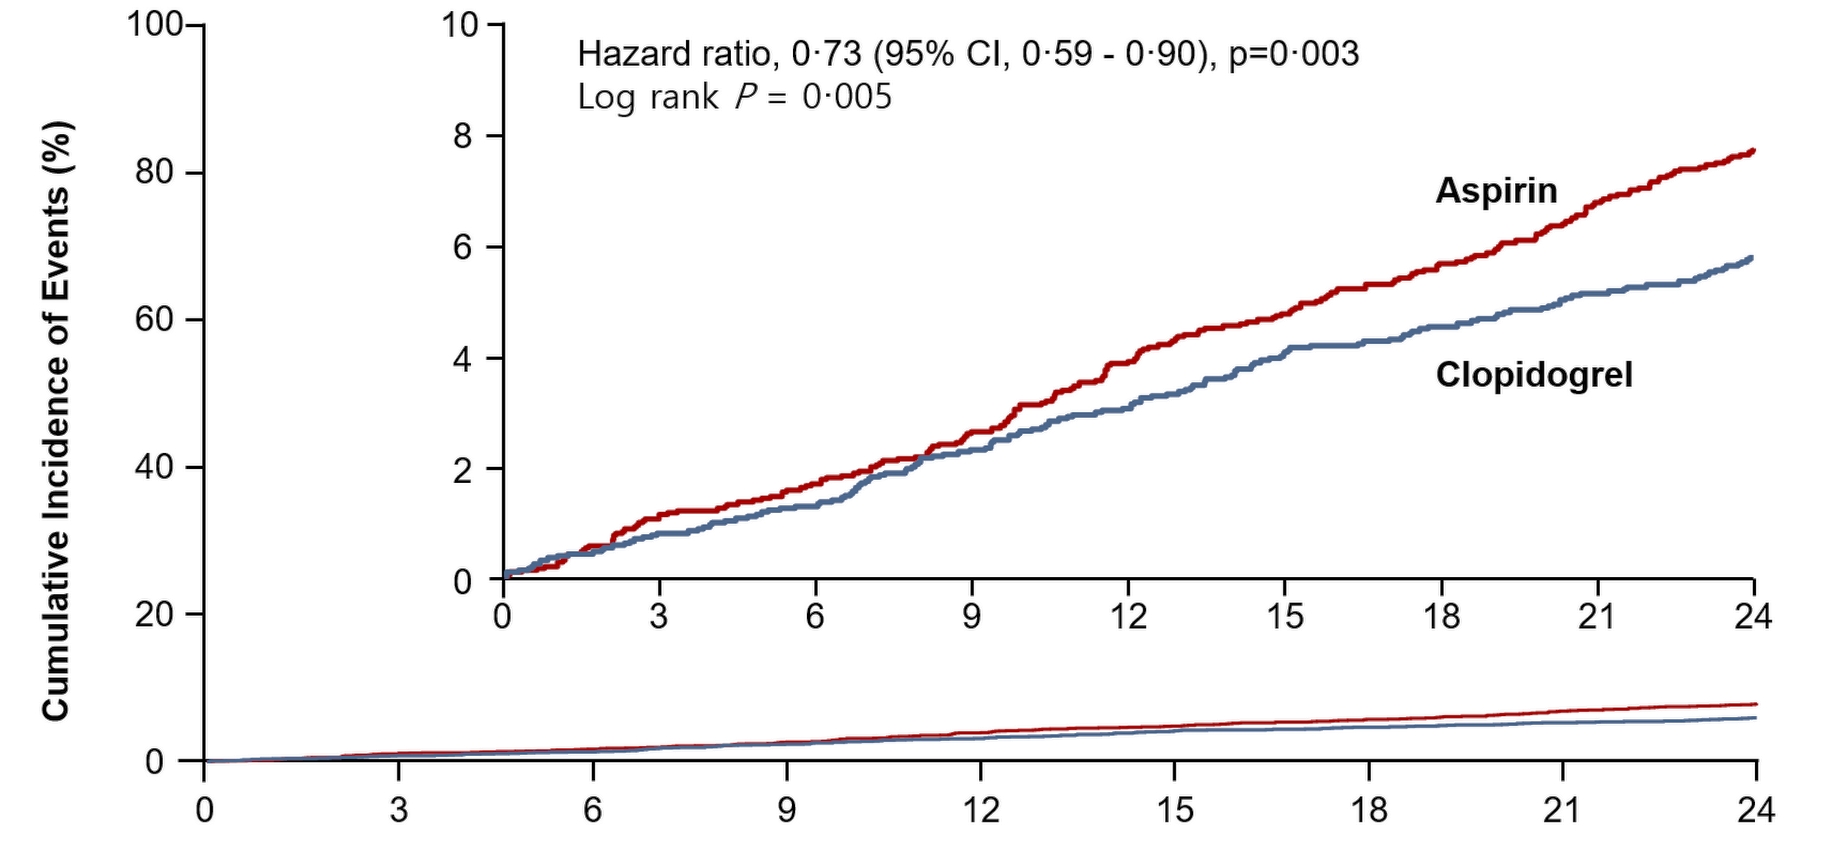
HOST-EXAM: Primary Outcome
Event-free under DAPT
for 6 ~ 18 months
Aspirin for 24 months
Clopidogrel for 24 months
Index PCI
Randomization
Primary outcome
All-cause death, nonfatal MI, stroke,
readmission due to ACS,
major bleeding (BARC type ≥3)
7.7%
Risk difference : -2.0% (-3.3% - 0.6%)
NNT : 50.6 (30.0 – 161.9)
5.7%
Months after randomization
Clopidogrel (n=2710)
Aspirin (n=2728)
Kim H, ACC 2021

Slide 26
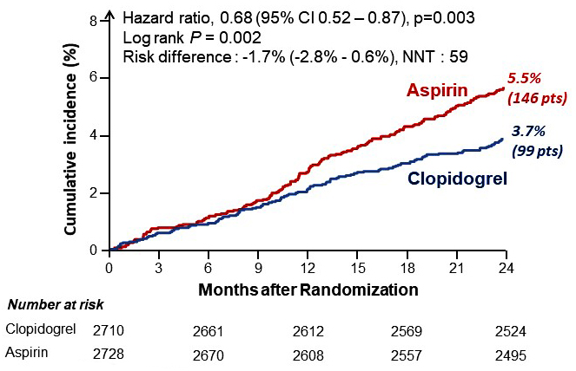
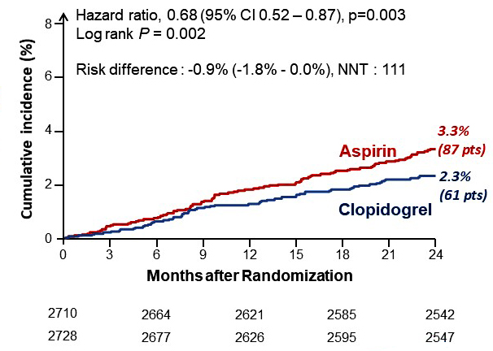
HOST-EXAM: Secondary Outcomes
Thrombotic Composite Outcome
(death, MI, stroke, readmission due to ACS, and def/prob ST)
Any Bleeding
(BARC Type ≥2 bleeding))
Kim H, ACC 2021

Slide 27
HOST-EXAM: Component of Outcomes for 2 Years
p=0.001
p=0.04
%
p=0.06
p=0.15
p=0.25
p=0.37
Kim H, ACC 2021

Slide 28
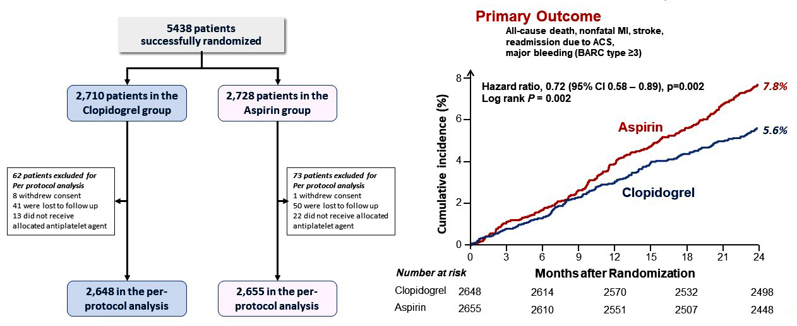
HOST-EXAM: Per-Protocol Analysis
Kim H, ACC 2021

Slide 29
Conclusion
In patients who were event-free under DAPT for 6~18 months after PCI with DES,
Clopidogrel monotherapy, as compared with Aspirin monotherapy, significantly reduced the risk of the composite of all-cause death, nonfatal MI, stroke, readmission due to ACS, and BARC type ≥3 bleeding.
The beneficial effect of clopidogrel was observed in thrombotic composite endpoints as well as any bleeding endpoint.
Long-term follow-up of this cohort will give us the concrete conclusion on the optimal single agent during the chronic maintenance period after PCI with DES.
Kim H, ACC 2021

Slide 30
TALOS-AMI Trial
Ticagrelor vs. Clopidogrel in Stabilized Patients with AMI

Slide 31
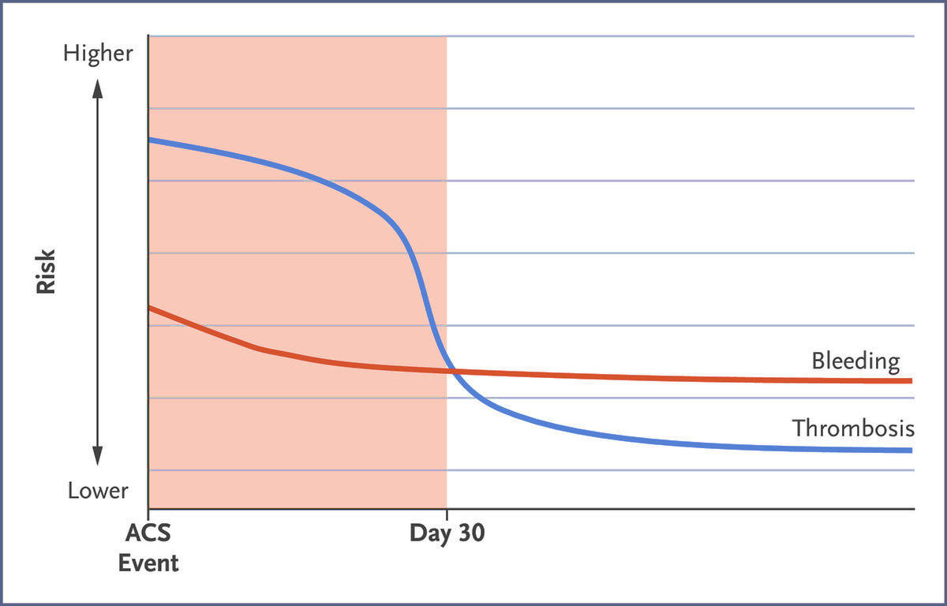
TALOS-AMI: Background
Risks of Thrombosis and Bleeding After AMI
Rodriguez F and Harrington RA, N Engl J Med 2021;384:452
Chang K, ACC 2021

Slide 32
TALOS-AMI: Background
Large-Scale Data are Lacking on Unguided Stepwise
De-Escalation of DAPT Strategy
Potent P2Y12 inhibitor
in the acute phase
(<30 days after AMI)
Less potent clopidogrel
during the maintenance phase
Chang K, ACC 2021

Slide 33
TALOS-AMI: Hypothesis
De-escalating DAPT with clopidogrel may be non-inferior to ticagrelor in terms of net clinical benefit in stabilized patients with AMI who did not experience major adverse events during the first month after an index PCI.
Chang K, ACC 2021

Slide 34
TALOS-AMI: Study Design
A Multicenter, Randomized, and Open-Label Study
AMI patients with successful PCI
Aspirin
+Ticagrelor
Patients
Without
Adverse
events
Treatment group : Aspirin + Clopidogrel
R
30±7days
Control group : Aspirin +Ticagrelor
Index PCI
Visit 1
Visit 2
Visit 3
Final visit
Day 1
PCI 1M
(Randomization)
PCI 3M
(Random. 2M)
PCI 6M
(Random. 5M)
PCI 12M
(Random. 11M)
Screening period
Treatment period
Chang K, ACC 2021

Slide 35
TALOS-AMI: Enrollment, Randomization, and Follow-up
2,697 patients randomized
2,901 Patients screened
De-escalation group(ASA + CLOPD)
(N=1349)
Active control group(ASA + TICA)
(N=1348)
Screening failure 204*
1,208 Received allocated treatment
31 Stopped medication
62 Received ASA+TICA(crossover)
48 Used different regimen
1,172 Received allocated treatment
30 Stopped medication
24 Received ASA+CLOPD(crossover)
122 Used different regimen
2,697 patients enrolled
22 withdrew consent
21 Lost to FU
16 withdrew consent
33 Lost to FU
1306(96.8%) completed follow up
at 12 months
1299(96.3%) completed follow up
at 12 months
1312(97.2%) vital status available
at 12 months
1315(97.5%) vital status available
at 12 months
1349 included in ITT analysis
1348 included in ITT analysis
Chang K, ACC 2021

Slide 36
TALOS-AMI: Adherence of Antiplatelet Therapy
Adherence (%)
Chang K, ACC 2021

Slide 37
TALOS-AMI: Primary Endpoint
Composite of cardiovascular death, MI, stroke and BARC bleeding (type 2,3, or 5)
15
Active control (n=1348)
De-escalation (n=1349)
Absolute difference -3.6%
10
HR 0.55 (95% CI, 0.40-0.76)
p_{noninferiority}<0.001
8.2%
Cumulative incidence rate(%)
p_{superiority} <0.001
Primary endpoints
5
4.6%
0
1
3
6
12
Months from PCI
Chang K, ACC 2021

Slide 38
TALOS-AMI: Main Secondary Endpoint
Composite of cardiovascular death, MI, and stroke
Composite of BARC bleeding (type 2,3, or 5)
15
Active control (n=1348)
15
Active control (n=1348)
De-escalation (n=1349)
De-escalation (n=1349)
HR 0.69 (95% CI, 0.42-1.14)
HR 0.52 (95% CI, 0.35-0.77)
10
p=0.148
10
p=0.001
Cumulative incidence rate(%)
Cumulative incidence rate(%)
Composite of BARC (2,3, or 5)
5.6%
Composite of CV death, MI or stroke
5
5
3.1%
3.0%
2.1%
0
0
1
3
6
12
1
3
6
12
Months from PCI
Months from PCI
Chang K, ACC 2021

Slide 39
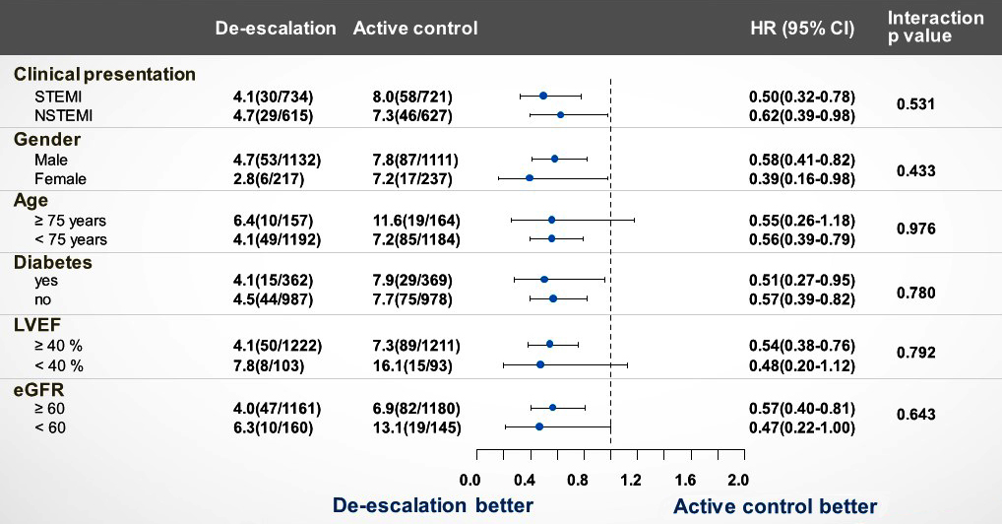
TALOS-AMI: Subgroup Analysis
Chang K, ACC 2021

Slide 40
TALOS-AMI: Event Rates Comparison of Major
De-Escalation Trials
 | TALOS-AMI | TICO | Twilight-ACS | TROPICAL-ACS | POPular Genetics | HOST-REDUCE- POLYTECH-ACS
De-escalation method | A+clopidogrel from 1 month | Ticagrelor mono from 3 months | Ticagrelor mono from 3 months | PFT-guided from 2 weeks | Genotype-guided from 48 h | A+Prasugrel 5mg from 1 month
Primary Ischemic Outcome | 1-12 mo incidence of CV death, MI or stroke | 1-Yr incidence of CV death, MI,ST or TVR | 1-Yr incidence of All-cause mortality, MI, stroke | 1-Yr incidence of CV death, MI or stroke | I-Yr incidence of Vascular death, MI, ST or stroke | 1-Yr incidence of CV death, MI, ST or stroke
de-escalation | 2.1% | 1.2% | 4.3% | 3.0% | 2.7% | 1.4%
standard | 3.1% | 2.0% | 4.4% | 3.0% | 3.3% | 1.8%
Primary Bleeding Outcome | BARC 2, 3, or 5 | TIMI Major + Minor | BARC 2, 3 or 5 | BARC 2, 3, or 5 | PLATO major + minor | BARC 2, 3, or 5
de-escalation | 3.0% | 3.6% | 4.0% | 5.0% | 10.1% | 2.9%
standard | 5.6% | 5.5% | 7.1% | 6.0% | 13.1% | 5.9%
Chang K, ACC 2021

Slide 41
Latest Issues in Coronary Intervention
ACC 2021 Interventional Trials: APT Trials
ADAPTABLE-Aspirin doses, HOST-EXAM,
TALOS-AMI
Focused review of the month
Eruptive calcific nodule as the cause of ACS

Slide 42
Notes:
Updated 4.4.2017

Slide 43
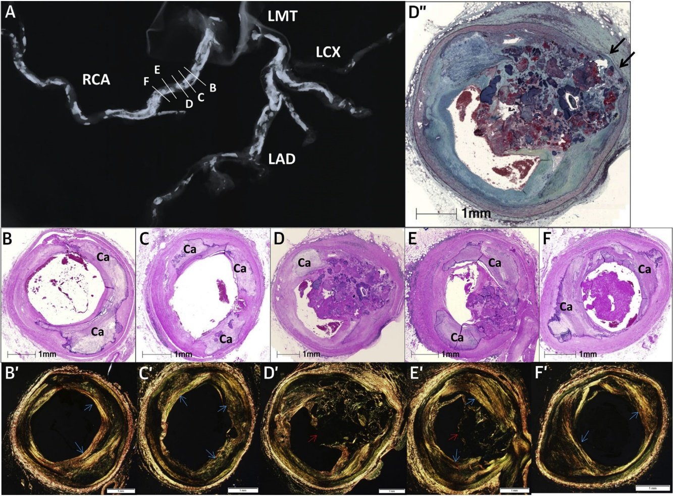
Consecutive Sections of the Vessels with CN Located in the RCA
Image from a 79-year-old female with h/o htn, diabetes, CAD and HF
A – severe calcification from prox to mid RCA and LAD and left diagonal branches
B-F – histologic sections show consecutive severely calcified coronary sections of the RCA
B, C (prox), F (distal), flanking regions adjacent to the culprit lesion (D,E)
B, C, and F show sheet calcification
D” (enlarged image of D) – shows medial disruption
E – shows culprit lesion of calcified node
B’ – F’ – areas with calcified nodule
D’, E’ – do not demonstrate presence of collagen (red arrows)
B’, C’, E’ and F’ – areas of sheet calcification show collagen (blue arrows)
Torii et al., J Am Coll Cardiol 2021;77:1599

Slide 44
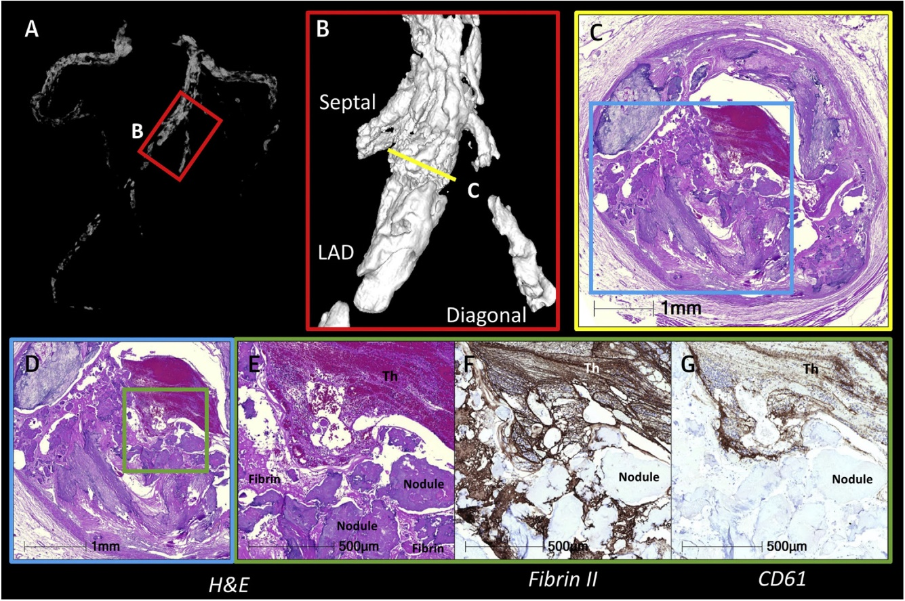
Co-Registration Between Radiograph, MicroCT with
Histology of CN
Co-registration between radiograph, microCT with histology for histologic characterization of CN
Torii et al., J Am Coll Cardiol 2021;77:1599

Slide 45
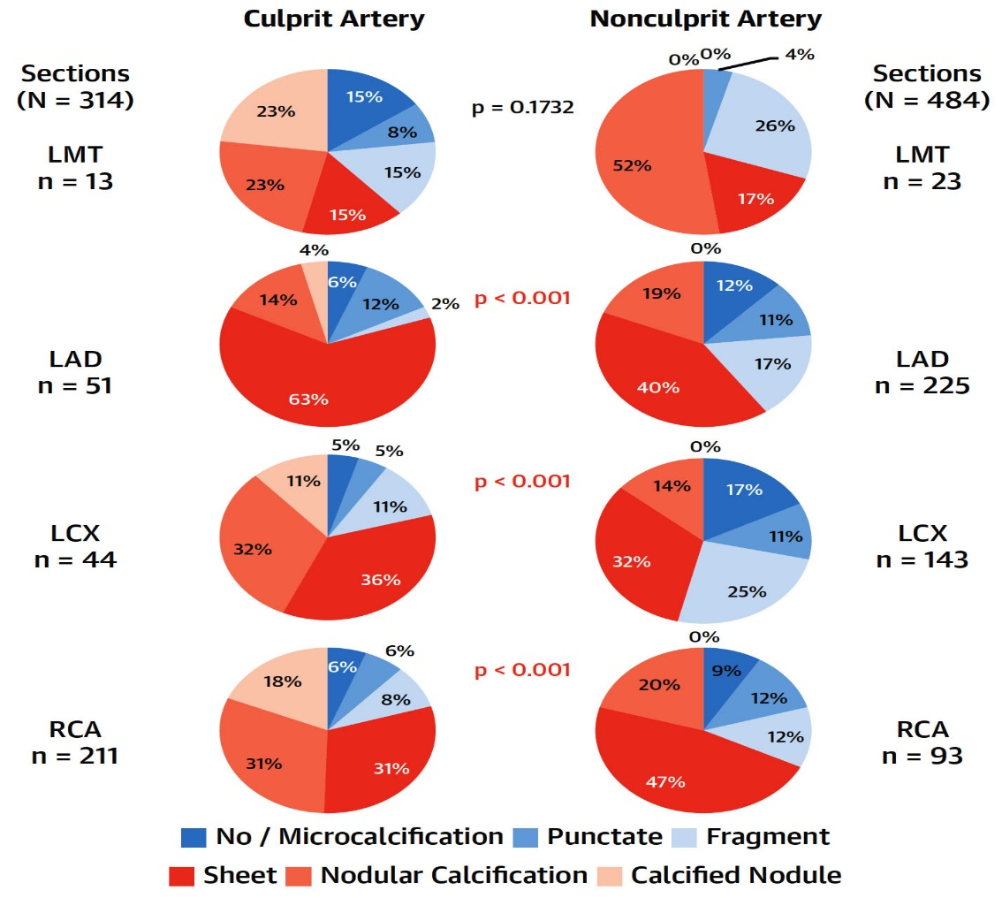
Prevalence of Various Types of Calcification Morphologies and
Nonculprit Arteries in the LMT, LAD, LCx, and RCA in Pts with CN
Torii et al., J Am Coll Cardiol 2021;77:1599

Slide 46
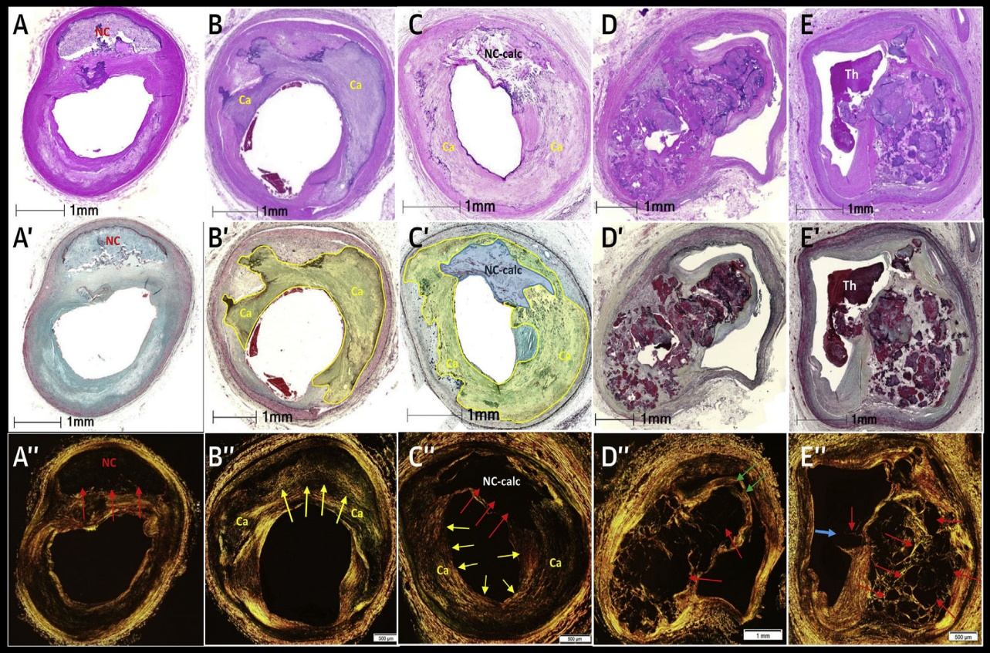
Histologic Appearance of Sheet Calcium in Necrotic Core
and Collagen Calcification in Various Atherosclerotic Lesions, Including CN
A, A’ - necrotic core in a fibroatheroma; A” – absence of any staining within the necrotic core (red arrows)
B, B’ Collagen calcification in a fibrocalcific plaque. (purple and yellow-green area) show sheet ca+
B” – underlying plaque is composed of collagen (yellow arrows)
C, C’, C” – necrotic core is observed and outer rim of necrotic core is surrounded by smooth muscle cells and collagen with calcification of both regions.
C” – absence of staining within the necrotic region (red arrows), but collagen seen in the surrounding calcific area (yellow arrows)
D, D’ – nodular calcification (healed CN)
E, E’ – calcified nodule
D”, E” – absence of collagen staining in regions of the nodules (red arrows)
D” – nodular calcification has a healed fibrous cap (green arrows)
E” – CN has a luminal thrombus with an absence pf fibrous cap (blue arrow)
Torii et al., J Am Coll Cardiol 2021;77:1599

Slide 47
Prevalence of NC Calcification and C Calcification of Sections from Culprit (With CN) and Nonculprit (Proximal
and Distal) Arteries Without CN
p<0.0001
%
184 Sections 230 Sections
Torii et al., J Am Coll Cardiol 2021;77:1599

Slide 48
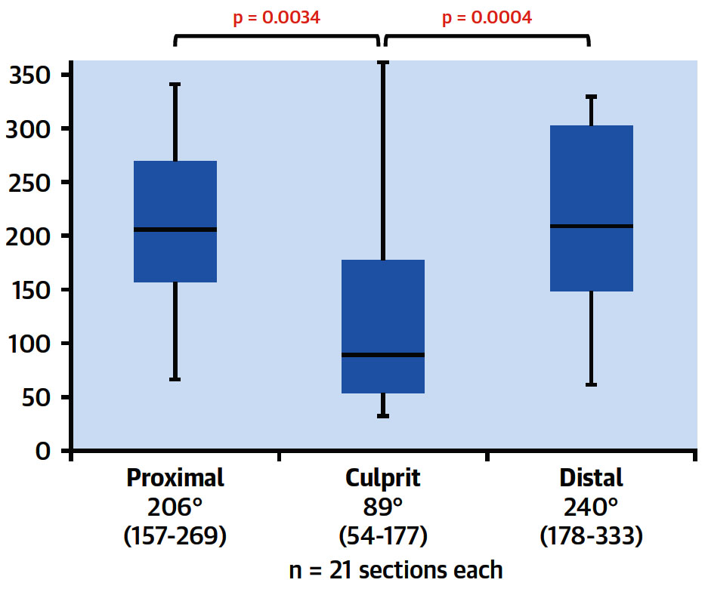
Box-and-Whisker Plots Showing Degree of Circumferential Sheet Calcification in the Proximal, Culprit, and Distal Sections of CN
Torii et al., J Am Coll Cardiol 2021;77:1599

Slide 49
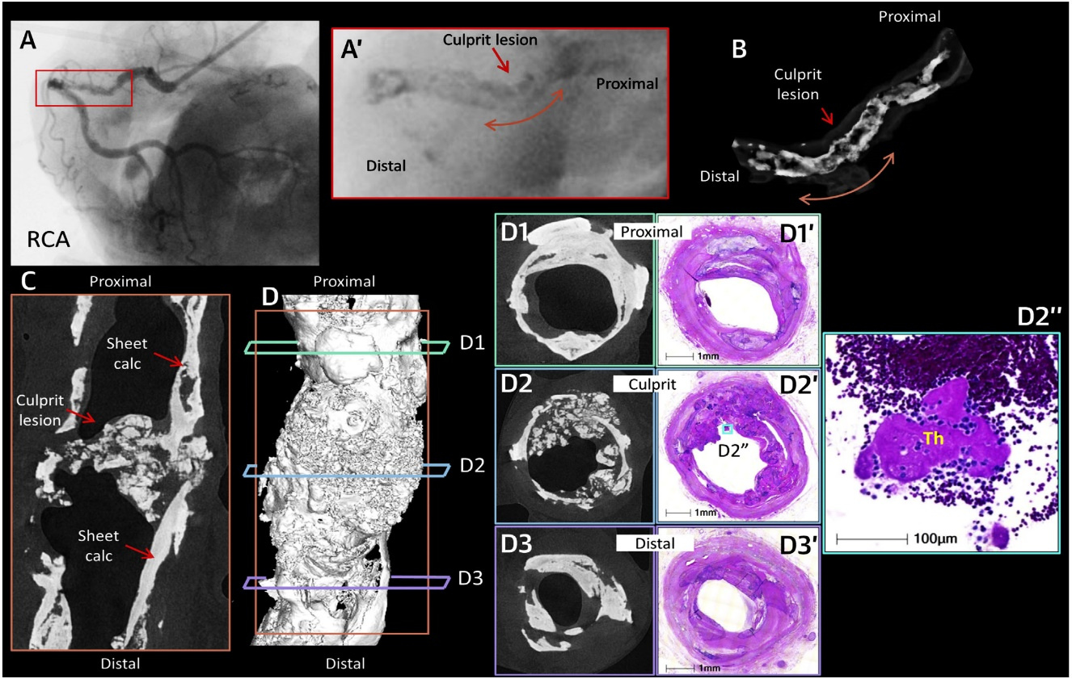
Angiogram, Fluoroscopy, Radiograph, MicroCT Images of
CN With Adjacent Flanking Sections and Corresponding Histological Sections
A 62-year-old woman with past medical h/o of htn, dialysis-dependent RF, and h/o smoking
A – tortuous proximal RCA with severe stenosis and calcification
B – region of the culprit site showing severe calcification of RCA
C – MicroCT showing calcification
D – histological section from culprit sites and proximal, distal and flanking sections showing fibrin-platelet thrombus attachment at culprit lesion of CN
Torii et al., J Am Coll Cardiol 2021;77:1599

Slide 50
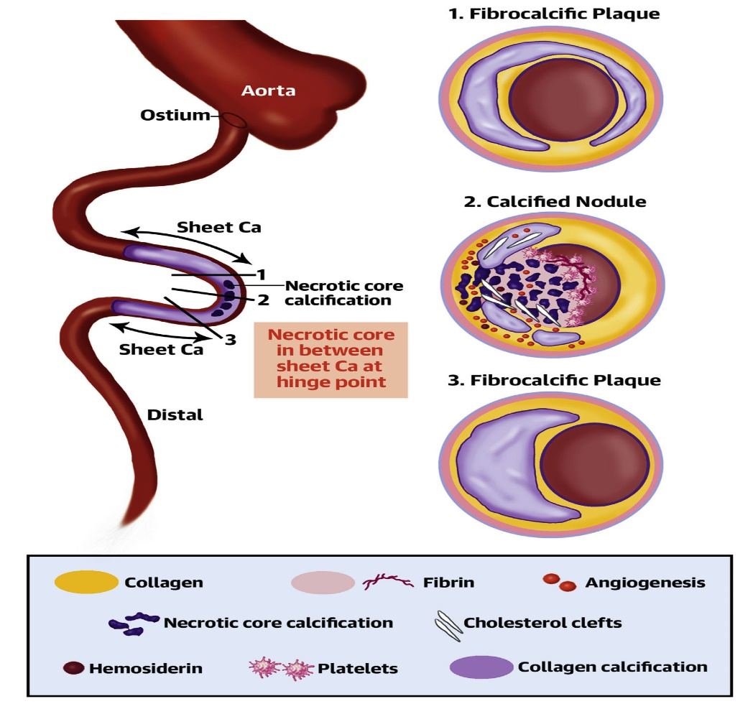
Proposed Mechanism of the Occurrence of Calcified Nodule
Torii et al., J Am Coll Cardiol 2021;77:1599

Slide 52
Take Home Message: Antiplatelet trials from ACC 2021 and Role of eruptive calcific nodule in ACS
Clopidogrel over aspirin in maintenance phase:
Clopidogrel causes less bleeding then aspirins:
Ticagrelor over Clopidogrel after 1M in PCI pts:
Aspirin 81mg vs 325mg longterm benefit in CAD:
Calcific nodule (CN) is responsible for acute coronary thrombosis and sudden death in some elderly pts. Recent histo-pathological analysis suggested fibrous cap disruption in CN is initiated by the fragmentation of necrotic core calcification with proximal and distal hard collagen-rich calcification in coronary arteries. It will serve as an additional therapeutic target to prevent acute coronary events in future.
Notes:
HbA1c

Slide 53
Question # 1
Following statements are true regarding the recent trial comparing low dose vs regular dose aspirin except;
Both doses are equally effective to prevent MACE
Both doses have similar bleeding incidence
Both doses have similar death rates
Both doses are similar in dose switching
E. Low dose aspirin causes lower discontinuation vs high dose
The correct answer is D

Slide 54
Question # 2
Following statements are true regarding the de-escalation in the TALOS-AMI trial except;
A. Lower primary endpoints in de-escalation group
B. Lower BARC bleeding in de-escalation group
C. Lower death rates in de-escalation group
D. Similar CV death/MI and stroke in de-escalation group
E. De-escalation is worse in pts with DM
The correct answer is C

Slide 55
Question # 3
Following statements are true regarding the mechanism of CN causing ACS except:
CN can cause coronary thrombosis
CN can have plaque disruption and thrombosis
CN is a common cause of ACS and sudden death
Overlying thrombosis in CN occurs due to fragmentation on NC ca
CN are most common in RCA and LM
The correct answer is C

