Slide 1
ARCH 2021
Greetings from the Mount Sinai Hospital
Cardiac Cath Lab, New York, NY.

Slide 2
Disclosures
ARCH 2021
Samin K. Sharma, MD, MSCAI, FACC
Speaker’s Bureau – BSC, Abbott, CSI
Annapoorna S. Kini, MD, MRCP, FACC
Nothing to disclose

Slide 3
Live Case # 7
ARCH 2021
Patient Demographics
67 yrs, M with progressive DOE
Present Clinical Presentation
Presented with progressive DOE, NYHA class IV
Clinical Variables
Frequent brief hospital admissions for systolic heart failure and non compliant with treatment and meds. Recent admission via MSH ER in HFrEF (12%) with torrential TR and MR. Pt was optimized and then cath on 4/8/21. cMR in the past has shown dICM with patchy areas of viability in inferior and anterior areas
CAD Risk Factors
Hyperlipidemia
+ F/H
Medications
Aspirin, Clopidogrel, Carvedilol, Furosemide, Entresto, Aldactone, Atorvastatin
Cath: Cath on April 8th 2021 revealed extensive 3V CAD with multiple lesions in all 4 vessels, Syntax score 33 & STS 6.8. Heart team discussion (CTS, HF attending, Cardiologist) recommended trial of PCI before listing for heart transplantation. Pt underwent DES x2 of RCA. F/U echo EF 18%.
Plan: Now planned for complex PCI of LAD/Diagonal lesions with Impella assist and final imaging for stent optimization.

Slide 4
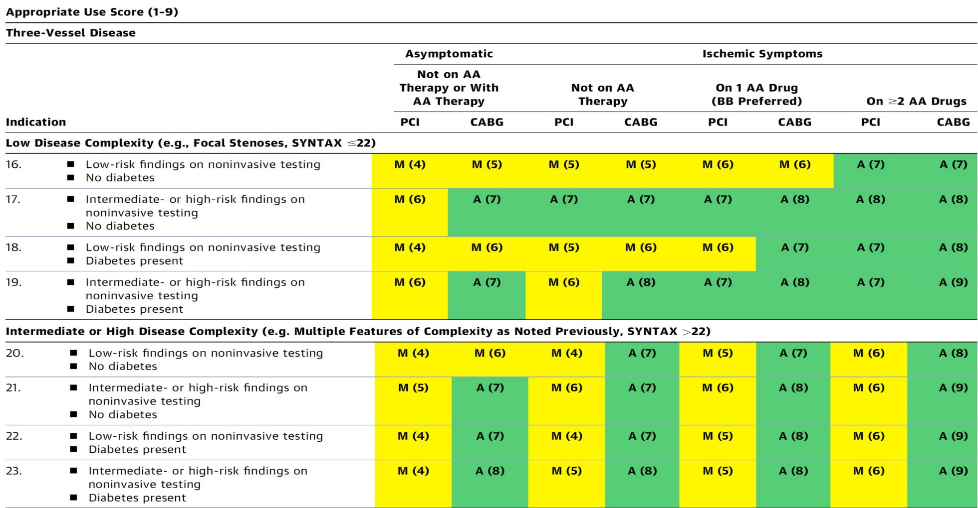
AUC 2017: Three-Vessel Disease
After Heart team discussion: A
Patel et al., J Am Coll Cardiol 2017;69:2212

Slide 5
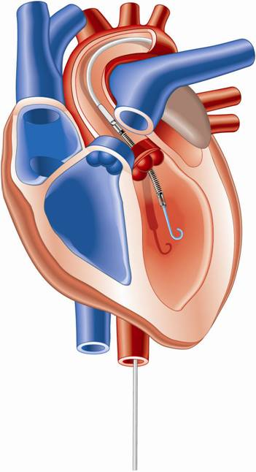
Percutaneous LV Assist Devices
PTVA:
TandemHeart
IMPELLA:
Recovers 2.5/CP
IABP

Slide 6
LV Support during High-risk PCI:
LVEF + Lesion Complexity
LVEF >35%
LVEF 20-35%
LVEF <20%
Simple PCI
Complex PCI
Simple PCI
Complex PCI: High Syntax score >32/ STS>5 Extensive revascularization
Simple or Complex: Inoperable cases
None/ IABP
Impella
None or IABP
No support
Impella
/IABP (if Impella is CI)
Impella/ PTVA
Notes:
6

Slide 7
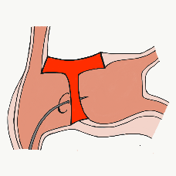
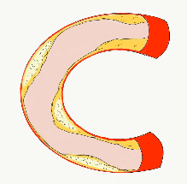
More than 35,800 unique downloads
Cath Lab Apps CardiologyApps.com
iOS 5/5 stars
9896 downloads
Android 4.4/5 stars
8245 downloads
Released sept 2017
iOS 5/5 stars
6068 downloads
Android 4.8/5 stars
3850 downloads
Released June 2018
iOS 5/5 stars
2073 downloads
Android N/A stars
549 downloads
Released March 2018
iOS 5/5 stars
1074 downloads
Android N/A stars
547 downloads
Released Sept 2018
iOS 5/5 stars
931 downloads
Android 5/5 stars
538 downloads
Released June 2019
WebApp Only*
2600 unique users
4800 sessions
Released August 2020
BifurcAID
OCTAID
TAVRcathAID
TranseptAID
CalcificAID
ComplicAID
*Also available
as WebApp
Download Apps
For Free on Both:
WebApps available free on
www.CardiologyApps.com
Apple ® and App Store® are registered trademarks of Apple Inc.
Notes:
These are the apps we have created which will provide digital algorithms for our future ambitious projects to make our cath labs smarter.

Slide 8
Apps Coming Soon…
STEMIcathAID – STEMI patient transfer platform designed to optimize communication between key members, record key performance metrics for AHA’s Mission: Lifeline program, and avoid costly false activations through direct CCL contact.
GuidewireAID – This application covers the design of coronary guidewires and the resulting properties they exhibit during use in the lab. Over two dozen teaching cases, a dense wire library with more than a hundred wires, and a robust search function provide a lot of tailored learning opportunities.
BifurcAID 3D – An animated bifurcation lesion treatment educational application and website. With two views, detailed descriptions, and more, BifurcAID 3D helps make clear the complex steps in techniques such as Minicrush, DK Crush and Culotte, as well as provisional approached and bailout techniques.

Slide 9
www.CardiologyApps.com/BifurcAID-3D

Slide 10
www.CardiologyApps.com/BifurcAID-3D
Key Features:
Left Main and Non-Left Main bifurcation lesions
Secondary view highlighting key points such as stent crush →
Android, iOS and WebApp
Many techniques:
DK Crush
Mini Crush
Culotte
Provisional Stenting
Bailout Techniques

Slide 12
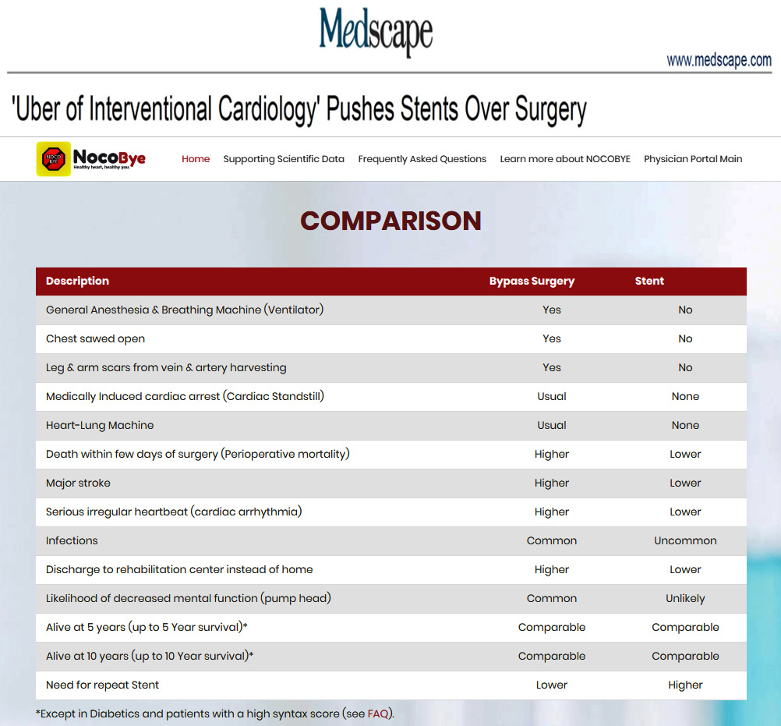

Slide 13
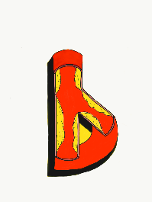
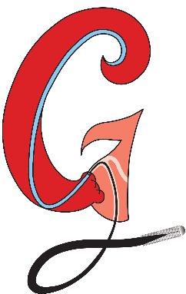
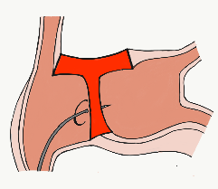
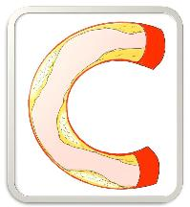
BifurcAID
TAVRcathAID
ComplicAID
GuidewireAID
Cath Lab
Apps
BifurcAID 3D
CalcificAID
OCTAID
TranseptAID

