Slide 1
Complex Coronary Cases Supported by:
Abbott Vascular Inc.
Boston Scientific Corp.
Terumo Vascular Corp.
Cardiovascular Systems Inc.
Abiomed Inc.
Chiesi Inc.
Best Medical Inc.

Slide 2
Disclosures
Samin K. Sharma, MD, MSCAI, FACC
Speaker’s Bureau – BSC, Abbott, CSI
Annapoorna S. Kini, MD, MRCP, FACC
Nothing to disclose
Sameer Mehta, MD, FACC (Moderator)
Nothing to disclose
Jasvinder Singh, MD, FACC (Guest Faculty)

Slide 3
CCC Live Case # 142
Patient Demographics
43 yrs, M with ESRD on HD
Present Clinical Presentation
Presented with new onset CCS class IV angina and NSTEMI (pTnI 2.1U) on 2/26/21
CAD Risk Factors
Controlled Hyperlipidemia
Controlled IRDM
H/o CVA without deficit
+Lupus anticoagulant
Clinical Variables
No known CAD or cardiac issues before present symptoms.
Very active otherwise. Current SAQ 78
Medications
Aspirin, Metoprolol XL, ISMN, Atorvastatin, Losartan, Nifedipine, Insulin, Warfarin
Cath: Cath done on 2/26/2021 revealed severely calcified 2 V CAD: 90% mid LAD, multiple calcified 80-99% lesions in extremely tortuous RCA, LVEF 55% and Syntax score 27. Pt underwent atherotomy+DES (Xience Sierra) of LAD and did well. Aspirin changed to Clopidogrel
Plan: Now planned for staged PCI of severely calcified and tortuous RCA using rotational atherectomy with guide extension catheter and final OCT imaging for stent optimization.

Slide 4
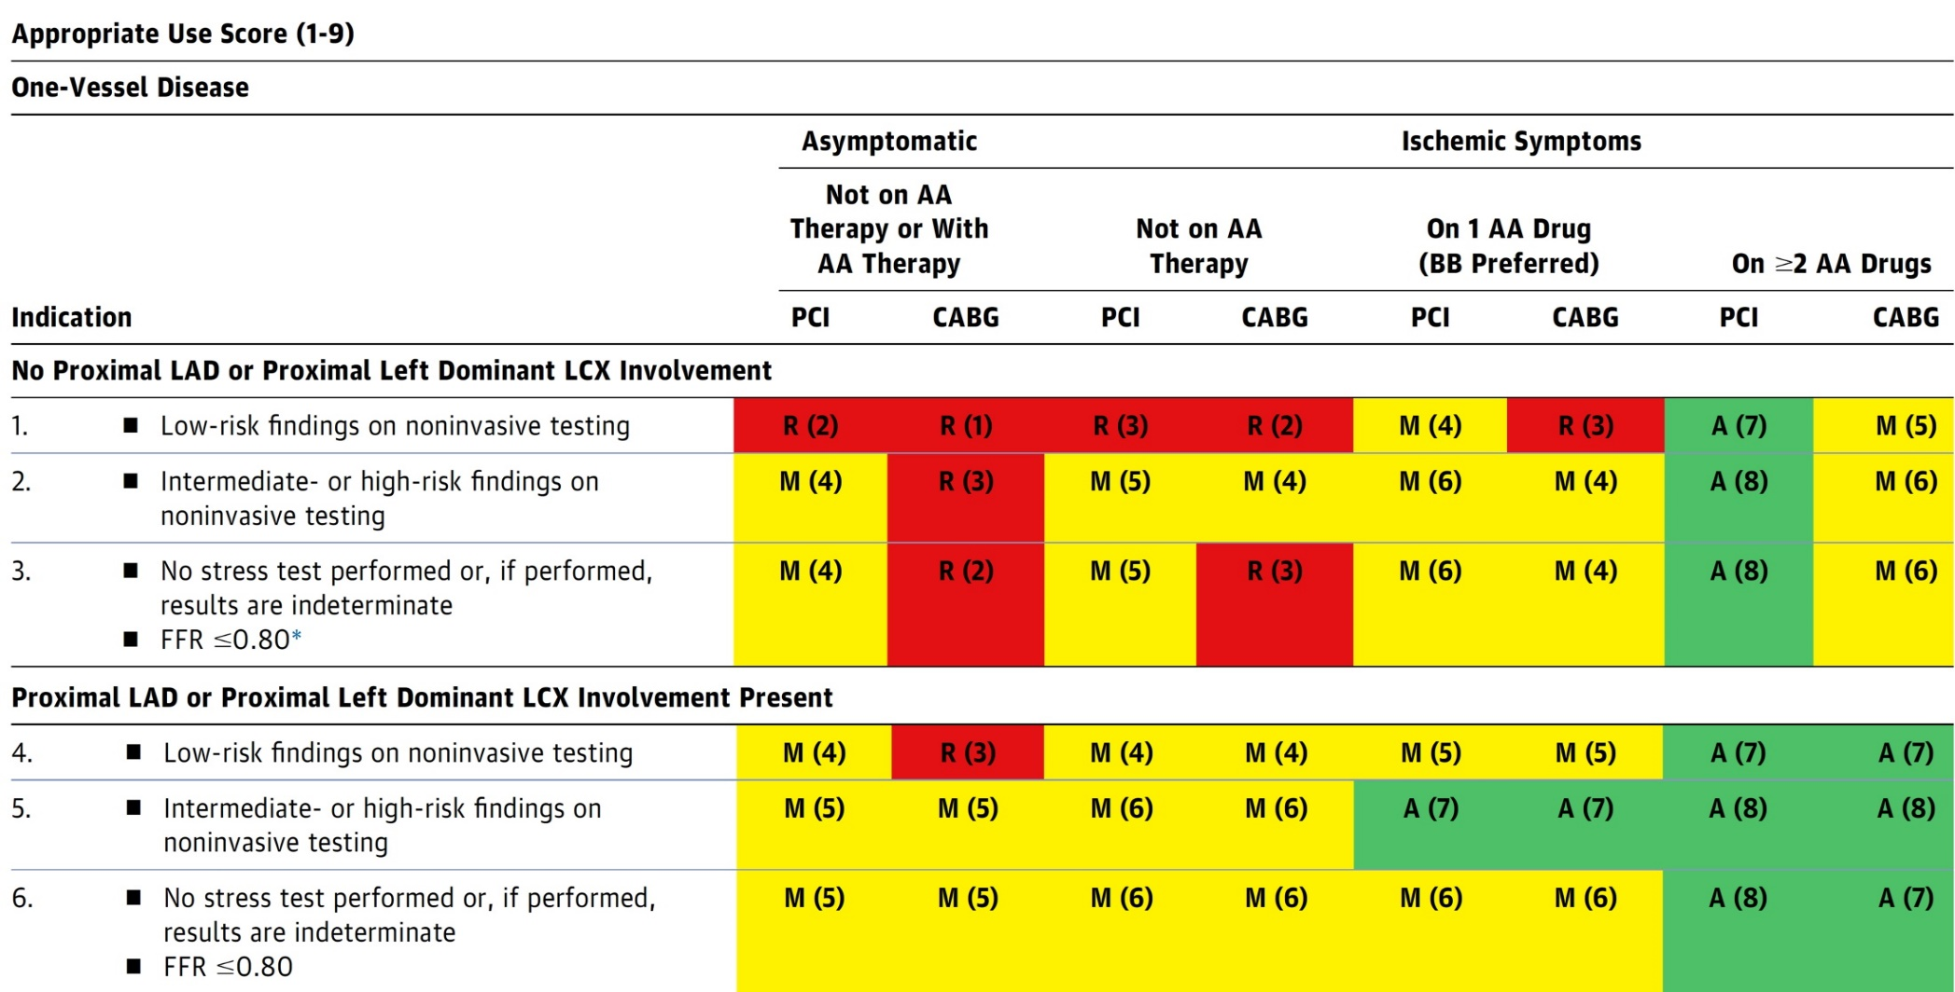
AUC 2017: One-Vessel Disease
Patel et al., J Am Coll Cardiol 2017;69:2212

Slide 5
Latest Issues in Coronary Intervention
Recent data on role of Colchicine in CAD
Focused review of the month
Impact of Hemoglobin A1c on CV outcomes post PCI

Slide 6
Latest Issues in Coronary Intervention
Recent data on role of Colchicine in CAD
Focused review of the month
Impact of Hemoglobin A1c on CV outcomes post PCI

Slide 7
Targeting Inflammatory Pathways for the Treatment of Cardiovascular Disease
Ridker PM, Eur Heart J 2014;35:540

Slide 8
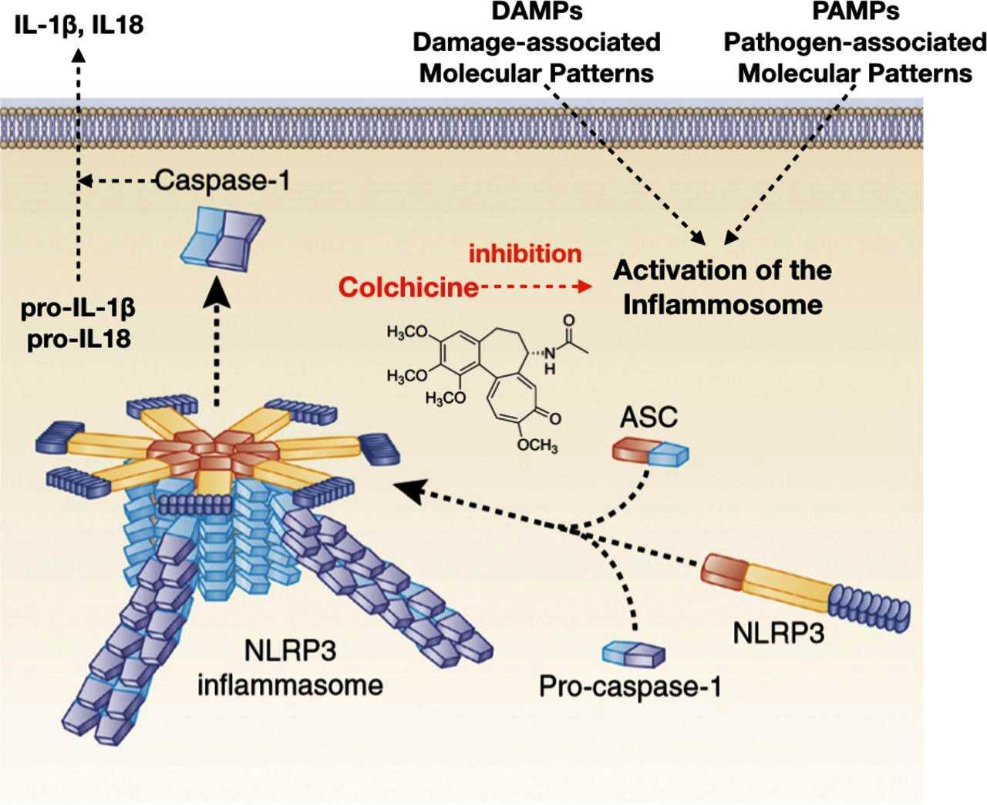
Therapeutic Mechanism of Action of Colchicine
Imazio et al., Heart 2020;106:1555
Notes:
Updated 4.4.2017

Slide 9
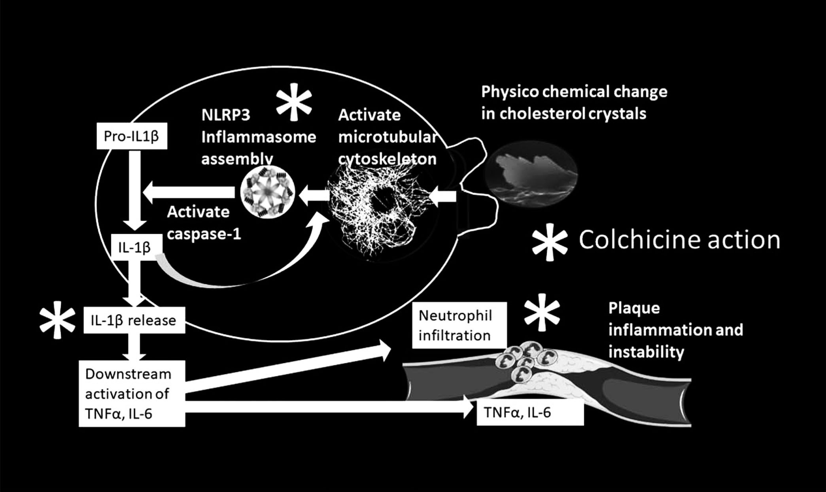
Multiple Sites of Action of Colchicine Relevant to Atherosclerosis
Thompson and Nidorf, Cur Opin Lipidol 2018;29:467
Notes:
Updated 4.4.2017

Slide 11
LoDoCo Trial: CONSORT Flow Diagram
Assessed for eligibility (n=901)
Enrollment
Excluded (n=369)
Not meeting inclusion criteria (n=237)
Declined to participate (n=72)
Randomized (n=532)
Allocation
Allocated to colchicine 0.5 mg/d (n=282)
Received colchicine script (n=282)
Early cessation due to side effects (n=32)
Allocated to
Control group (n=250)
Follow-Up
Lost to follow-up (n=0)
Did not start colchicine (n=7)
Ceased colchicine late (n=30)
Lost to
Follow-up (n=0)
Included in
Primary Analysis (n=282)
Included in
Primary Analysis (n=250)
Nodorf et al., J Am Coll Cardiol 2013;61:404)

Slide 12
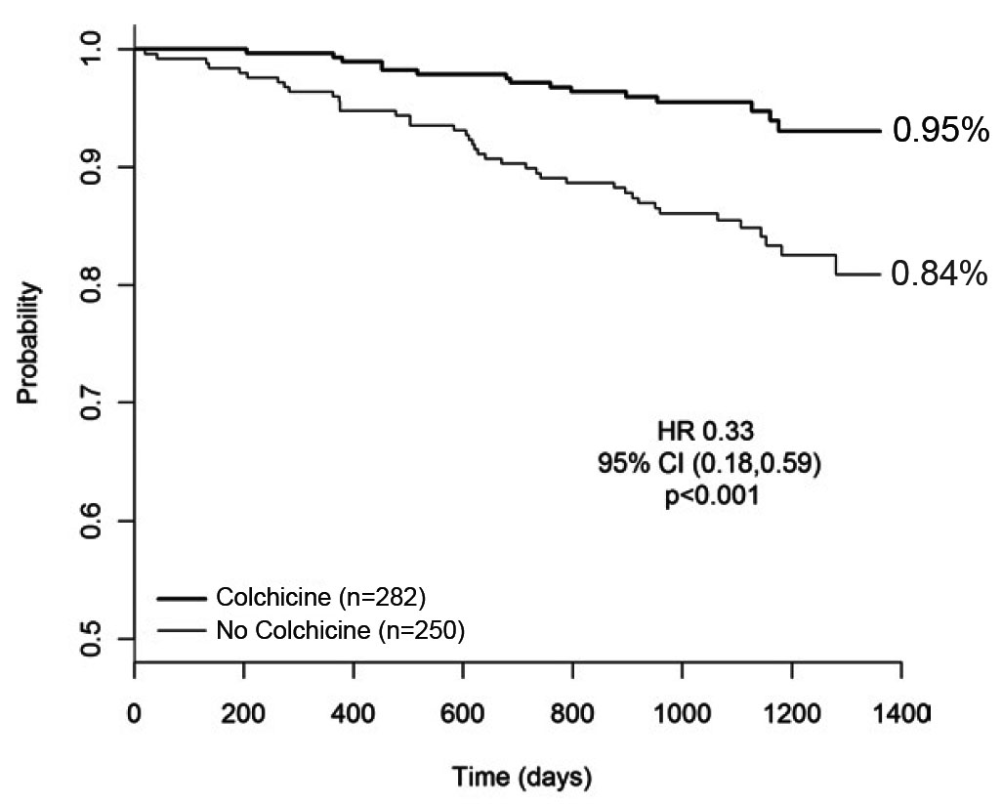
LoDoCo Trial: Freedom from the Primary Outcome
Nodorf et al., J Am Coll Cardiol 2013;61:404)

Slide 13
LoDoCo Trial: Primary Outcome and Its Components
 | Control (n=250) | Treatment (n=282) | HR (95% CI) | p Value
Primary outcome | 16% | 5.3% | 0.33 (0.18-0.59) | <0.001
Components of primary outcome ACS OOH cardia arrest Noncardioembolic stroke | 13.6% 0.8% 1.6% | 4.6% 0.35%* 0.35% | 0.33 (0.18-0.63) 0.47 (0.04-5.15) 0.23 (0.03-2.03) | <0.001 0.534 0.184
Component of ACS Stent-related Nonstent-related Nonstent-related AMI Nonstent-related UA | 1.6% 12% 5.6% 12% | 1.4% 3.2% 1.6% 2.4% | 0.26 (0.12-0.55) 0.25 (0.08-0.76) 0.27 (0.10-0.75) | NS <0.001 0.014 0.011
*Nonfatal
Nodorf et al., J Am Coll Cardiol 2013;61:404)

Slide 14
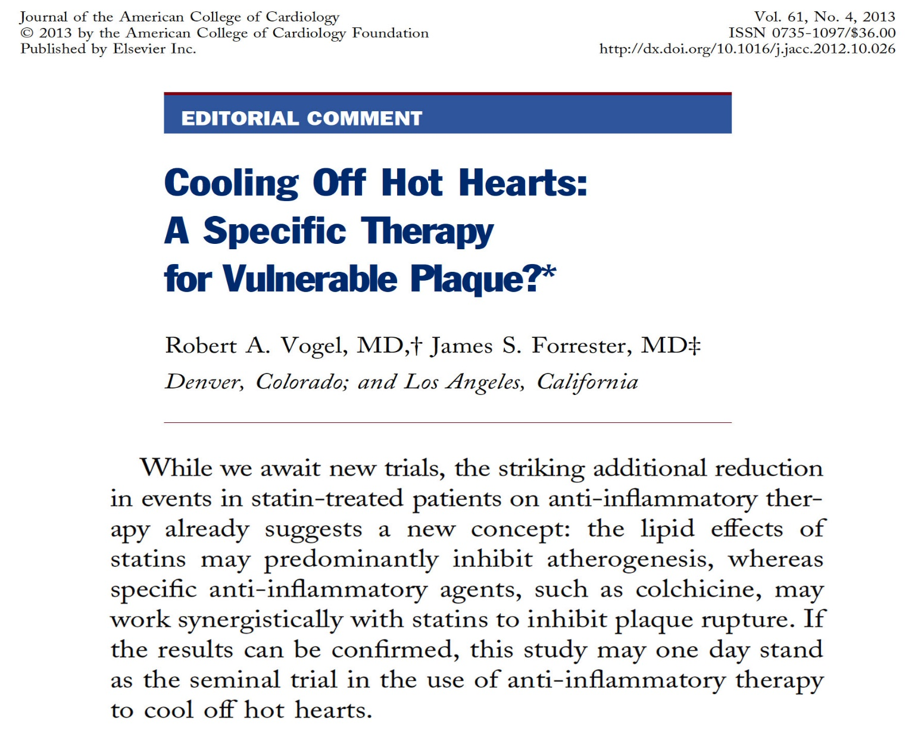
Notes:
Updated 4.4.2017

Slide 15
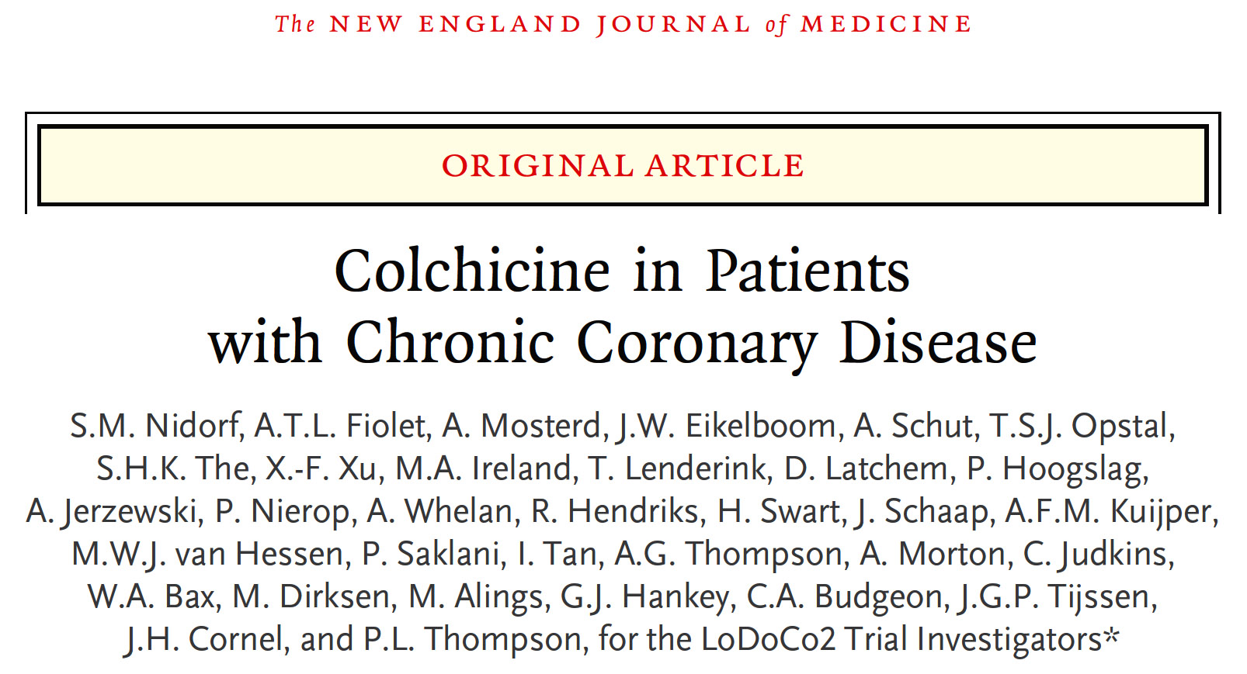

Slide 16
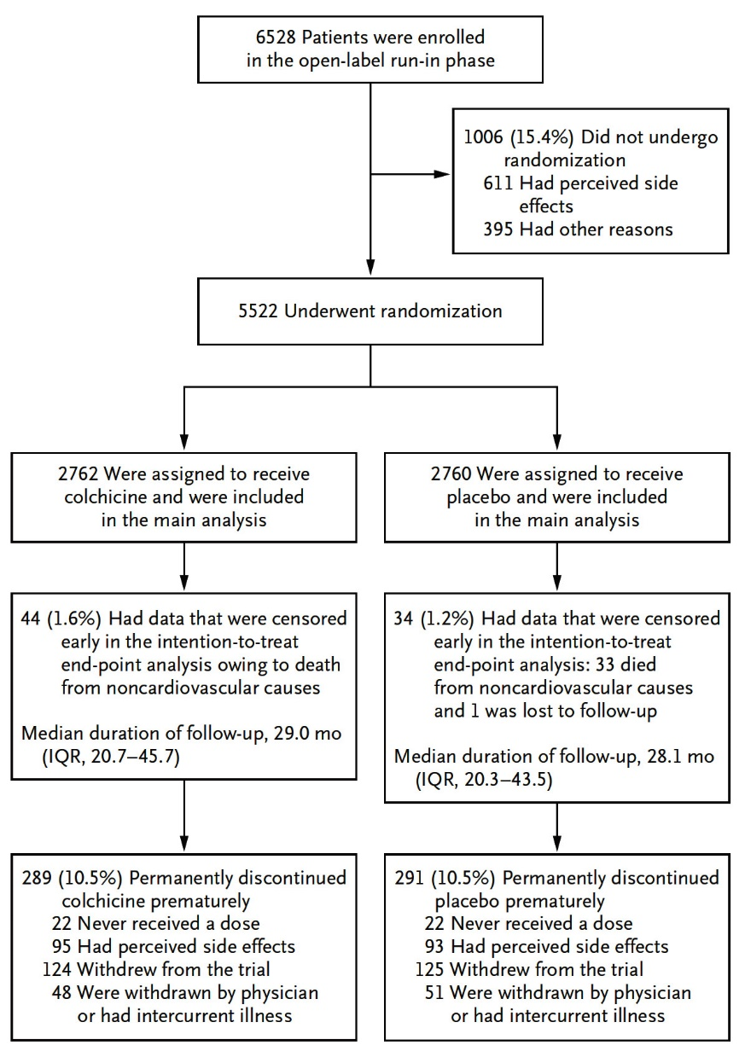
LoDoCo2 Trial: Enrollment, Randomization and Follow-Up
Nidorf et al., N Engl J Med 2020;383:1838

Slide 17
LoDoCo2 Trial: Key Points and Their Components
p<0.001
p=0.01
p=0.007
p=0.01
%
p=0.20
(Death, MI, Stroke, ID-coronary disease)
(Death, MI, or Stroke)
Nidorf et al., N Engl J Med 2020;383:1838

Slide 18
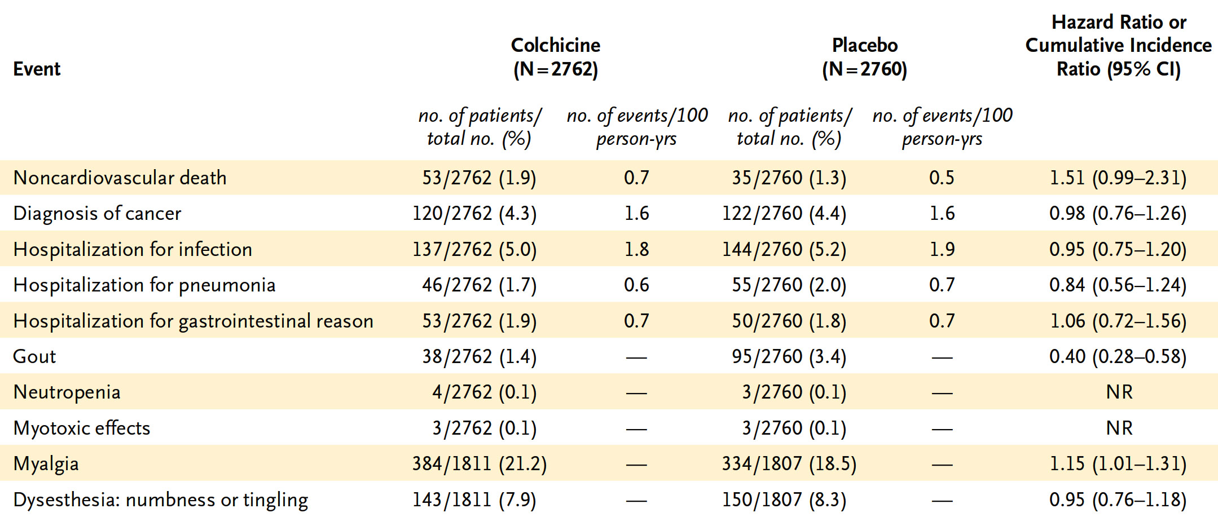
LoDoCo2 Trial: Adverse Events in the ITT Population
Nidorf et al., N Engl J Med 2020;383:1838

Slide 19
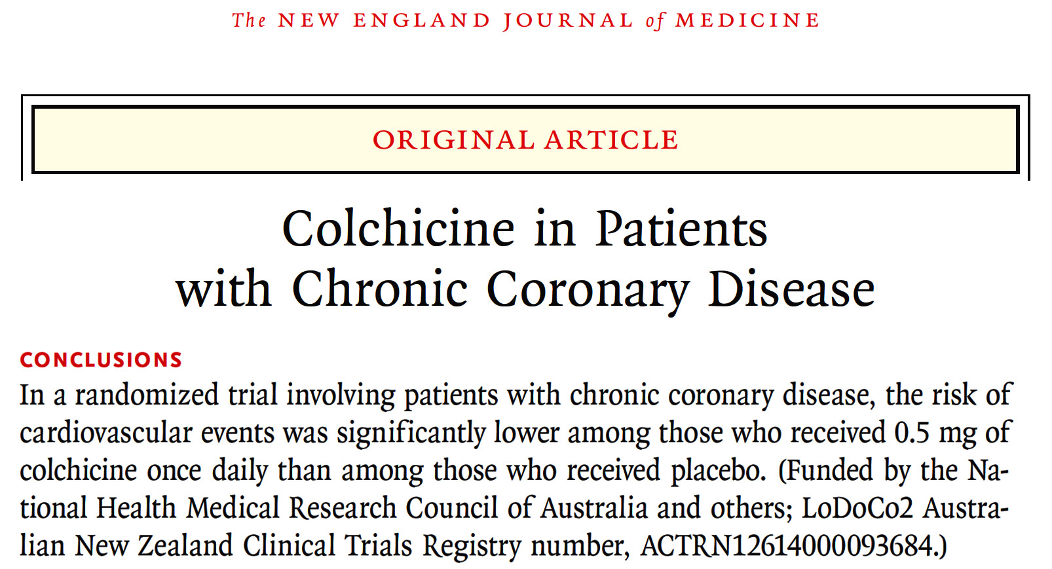

Slide 20
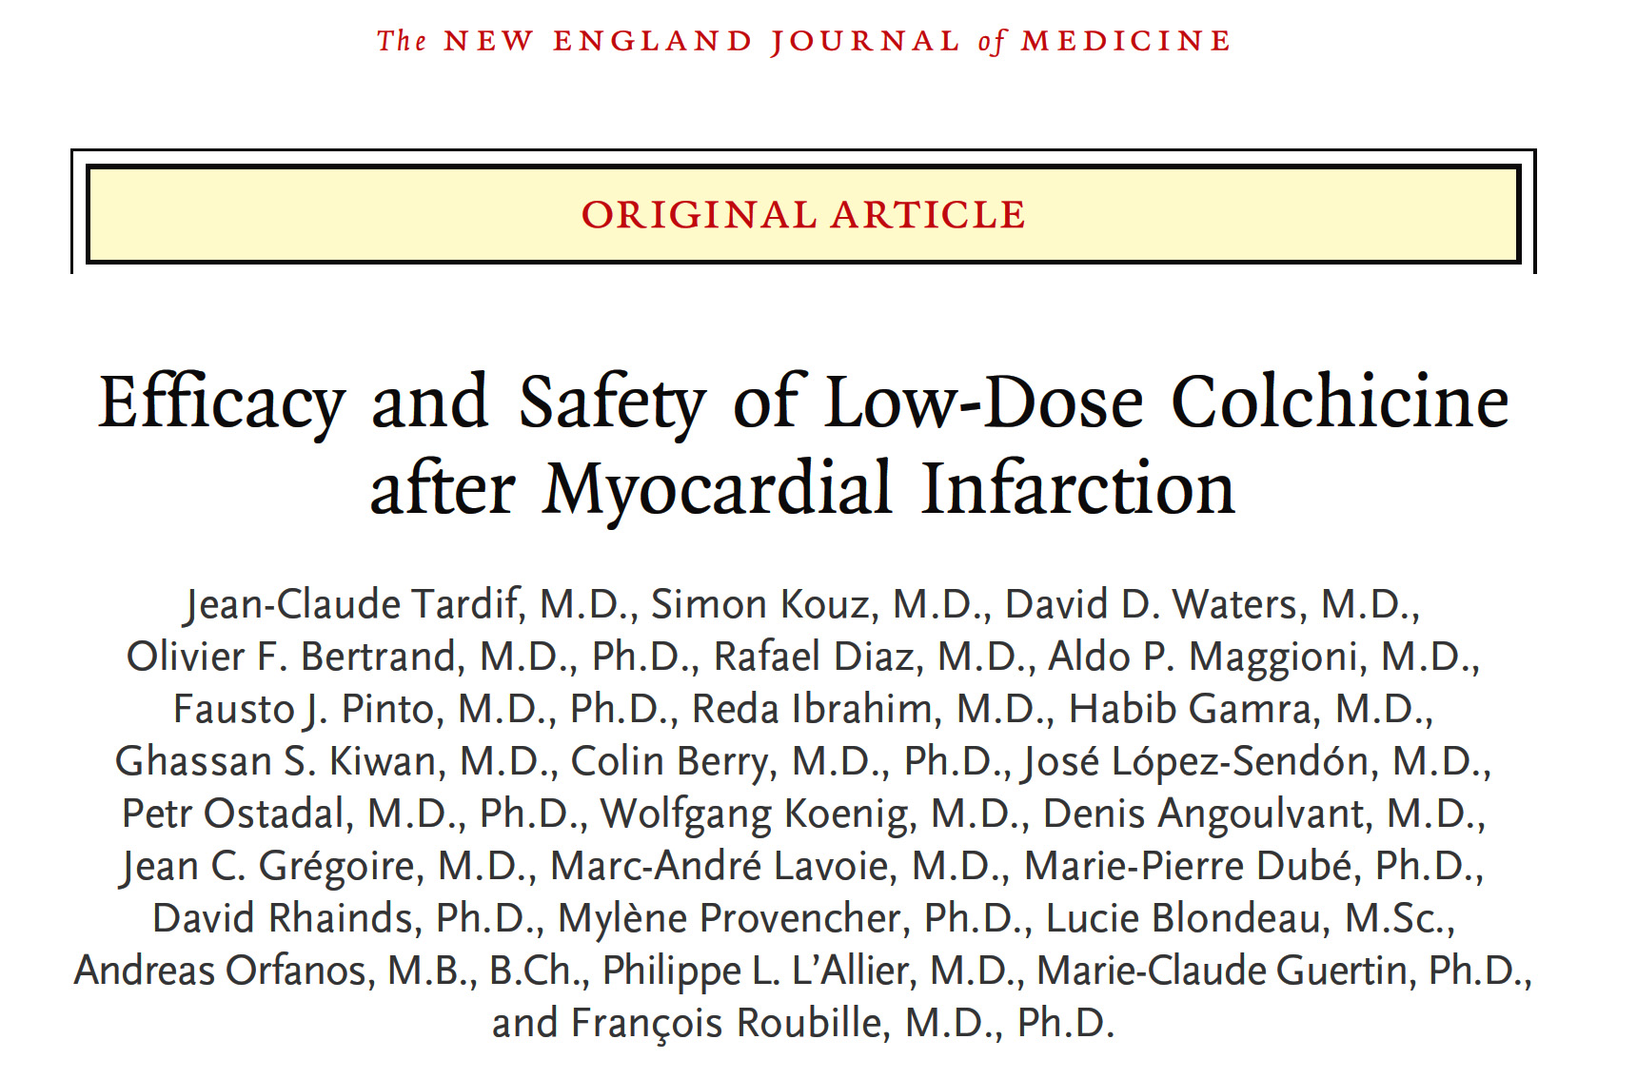

Slide 21
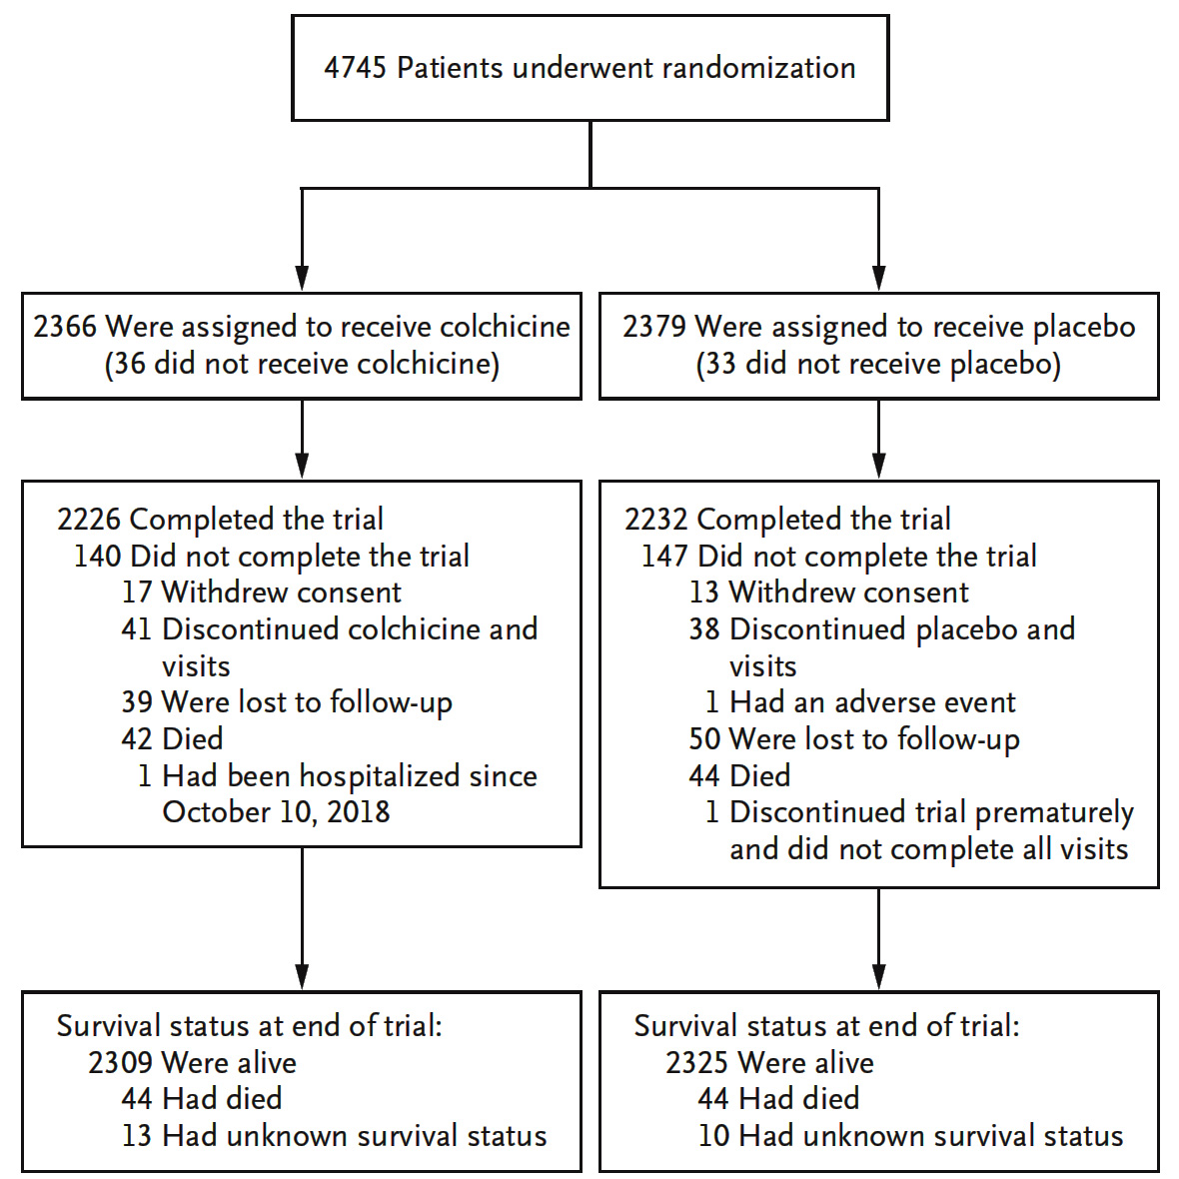
COLCOT Trial: Randomization and Follow-Up of the Patients
Tardif et al., N Engl J Med 2019;381:2497

Slide 22
COLCOT Trial: Major Clinical Endpoints
(ITT Population)
Tardif et al., N Engl J Med 2019;381:2497

Slide 23
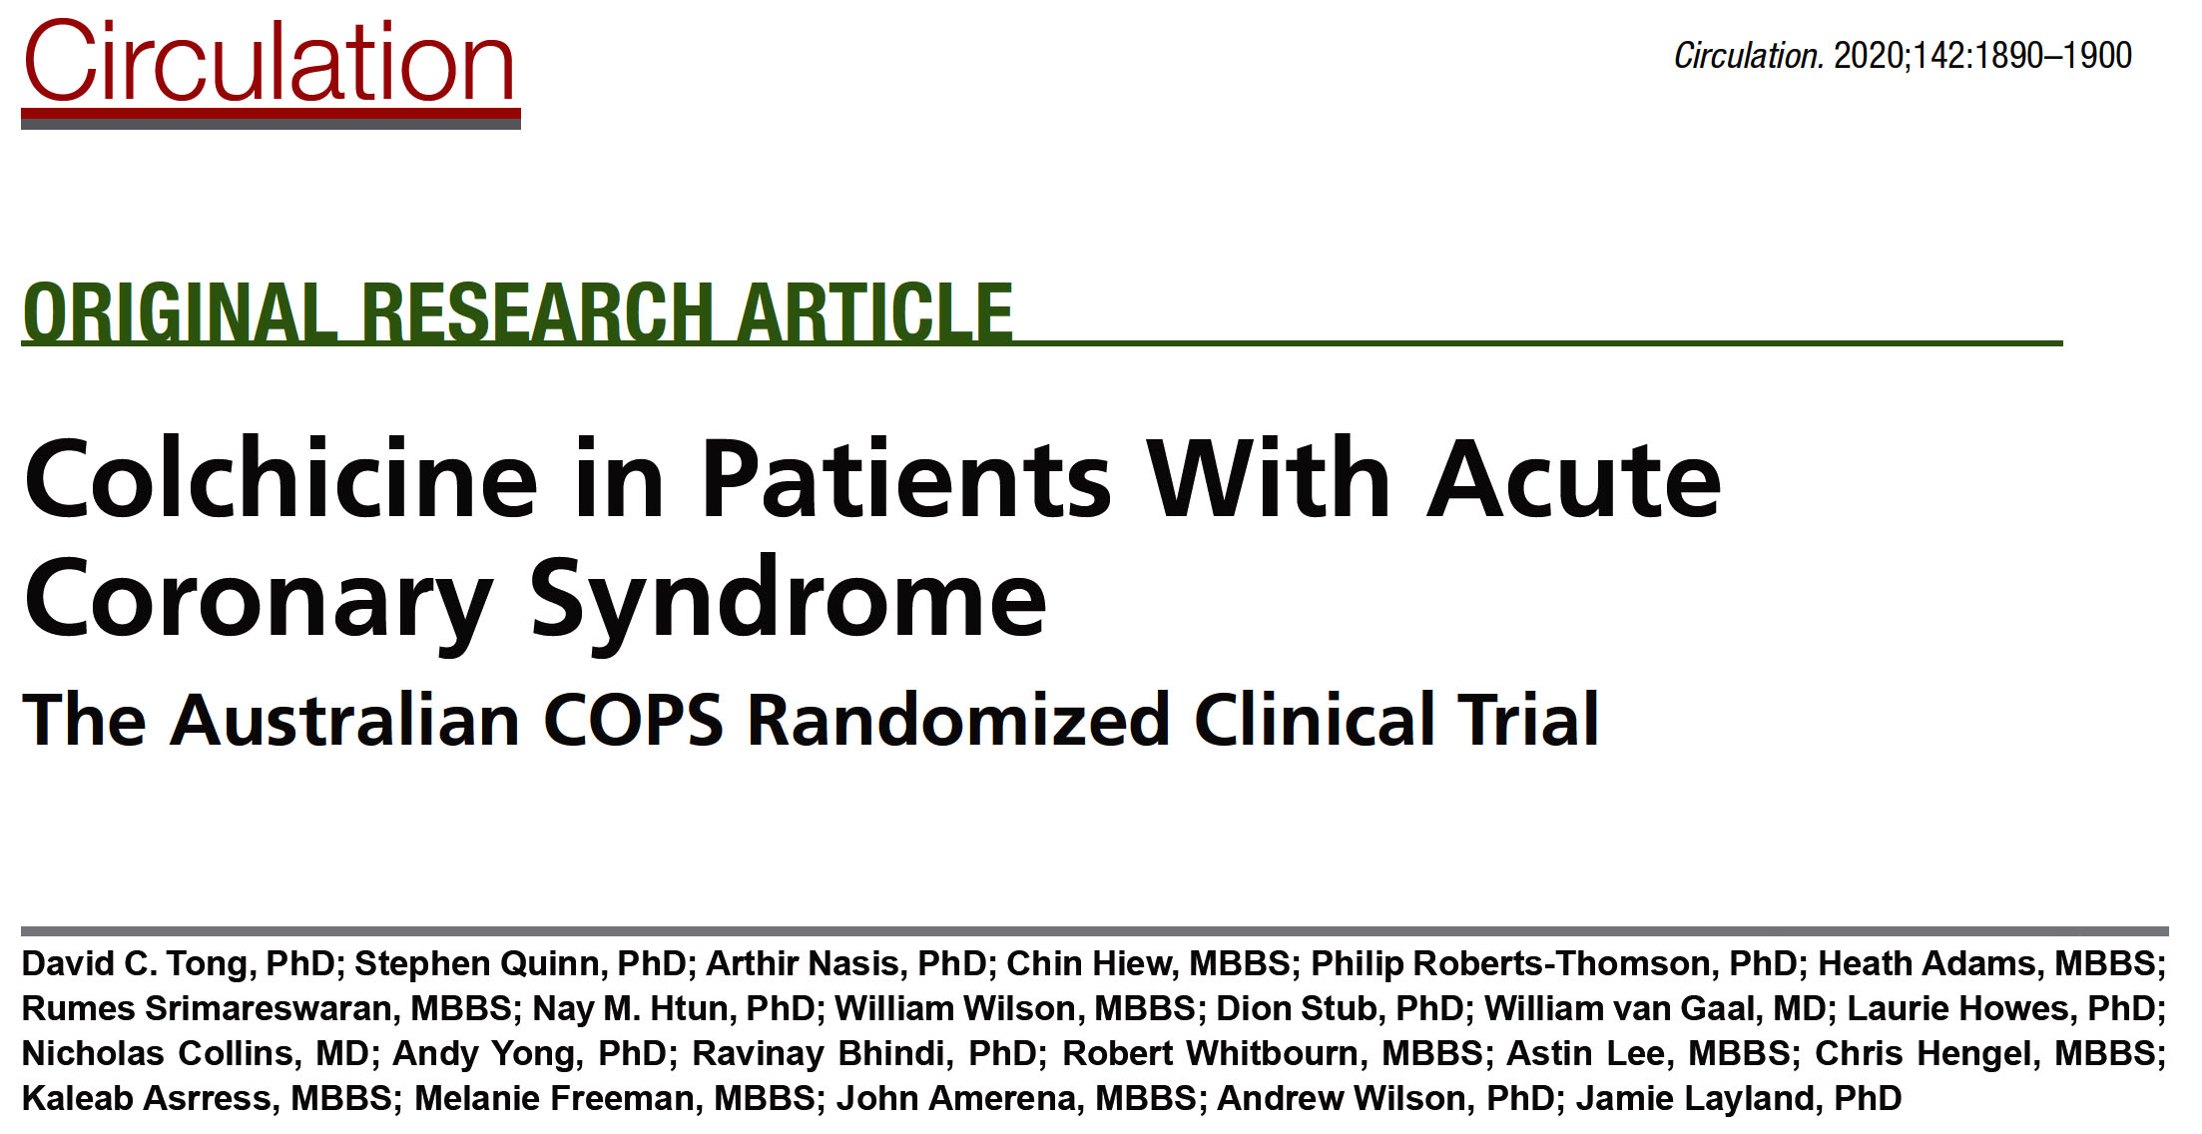
Notes:
Updated 4.4.2017

Slide 24
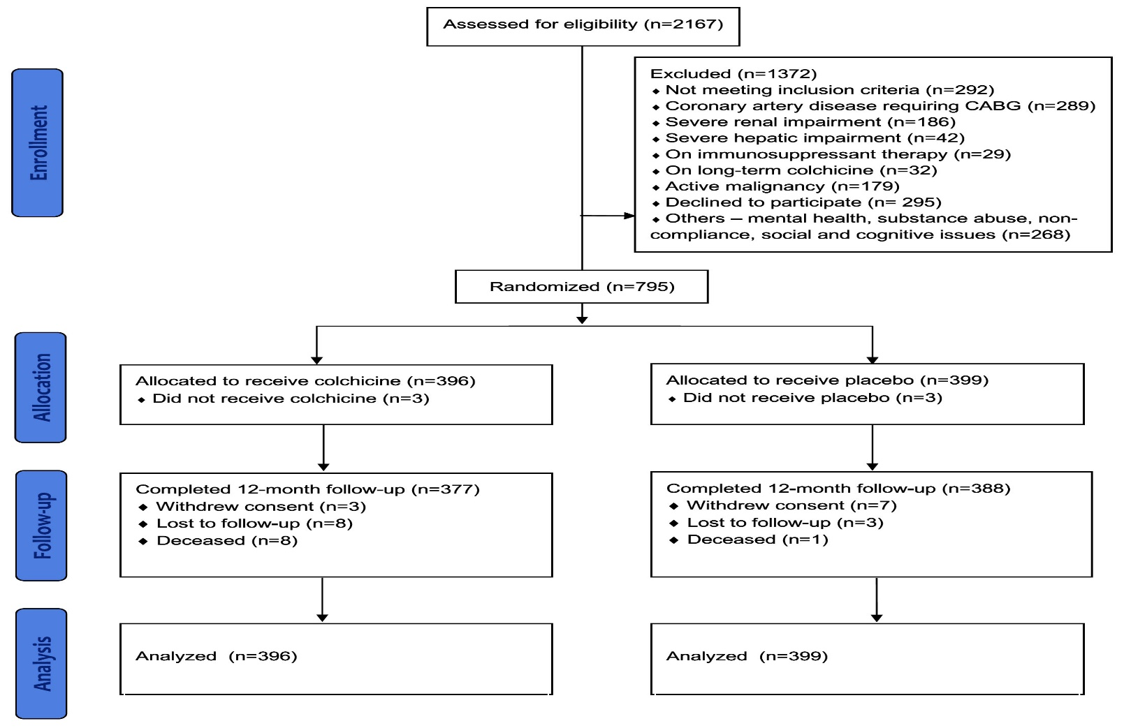
Australian COPS Trial: CONSORT Study Flowchart
Colchicine dose
0.5mg twice daily for 1M
and then
0.5mg once daily for 11M
Tong et al., Circulation 2020;142:1890
Notes:
Updated 4.4.2017

Slide 25
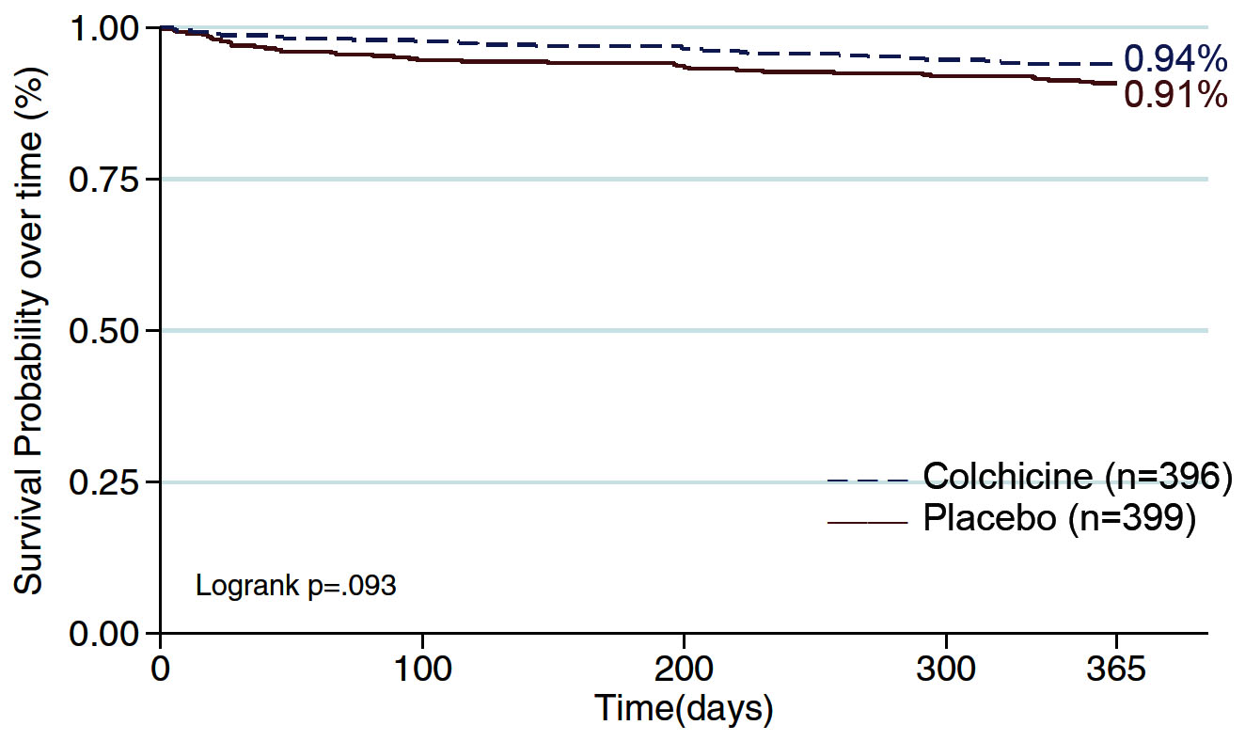
Australian COPS Trial: K-M Survival for Primary Endpoint in the ITT Population at 365 Days
Tong et al., Circulation 2020;142:1890
Notes:
Updated 4.4.2017

Slide 26
Australian COPS Trial: Clinical Endpoints at
400 Days (ITT Population)
p=0.05
p=0.08
%
p=0.04
p=0.05
Tong et al., Circulation 2020;142:1890
Notes:
Updated 4.4.2017

Slide 27
Notes:
Updated 4.4.2017

Slide 28
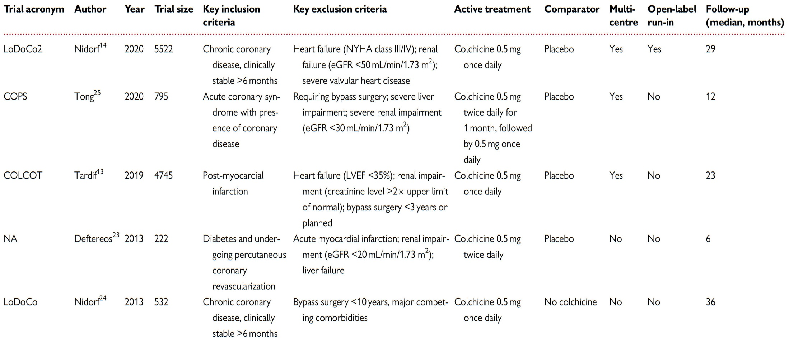
Key Features of Colchicine Trials
Fiolet et al., Eur Heart J 2021 Mar 26 Epub ahead of print
Notes:
Updated 4.4.2017

Slide 29
Baseline Characteristics of Included Trials
Fiolet et al., Eur Heart J 2021 Mar 26 Epub ahead of print
Notes:
Updated 4.4.2017

Slide 30
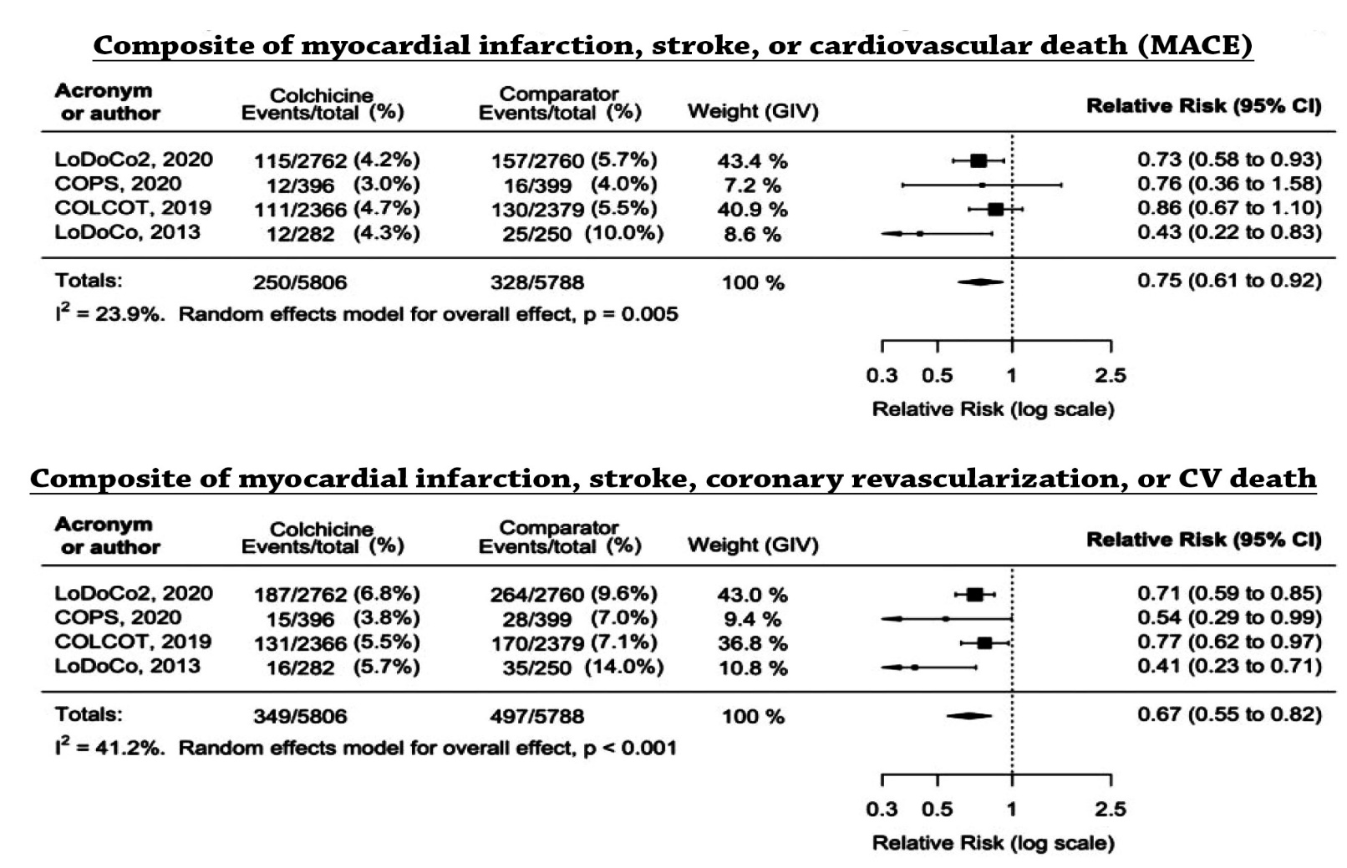
Primary and Secondary Endpoint
Fiolet et al., Eur Heart J 2021 Mar 26 Epub ahead of print
Notes:
Updated 4.4.2017

Slide 31
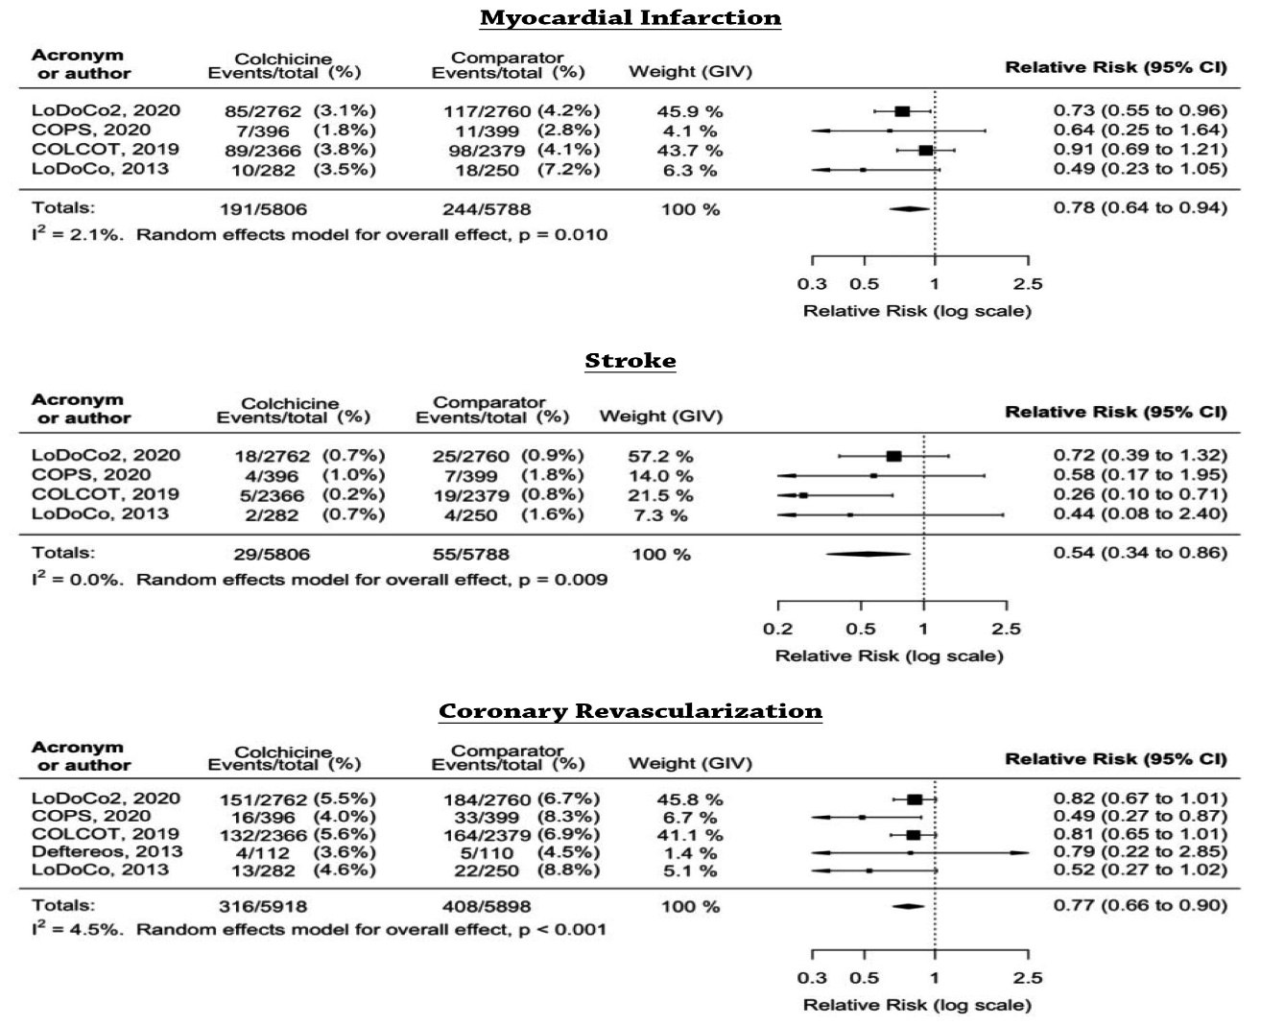
MI, Stroke, and Coronary Revascularization
Fiolet et al., Eur Heart J 2021 Mar 26 Epub ahead of print
Notes:
Updated 4.4.2017

Slide 32
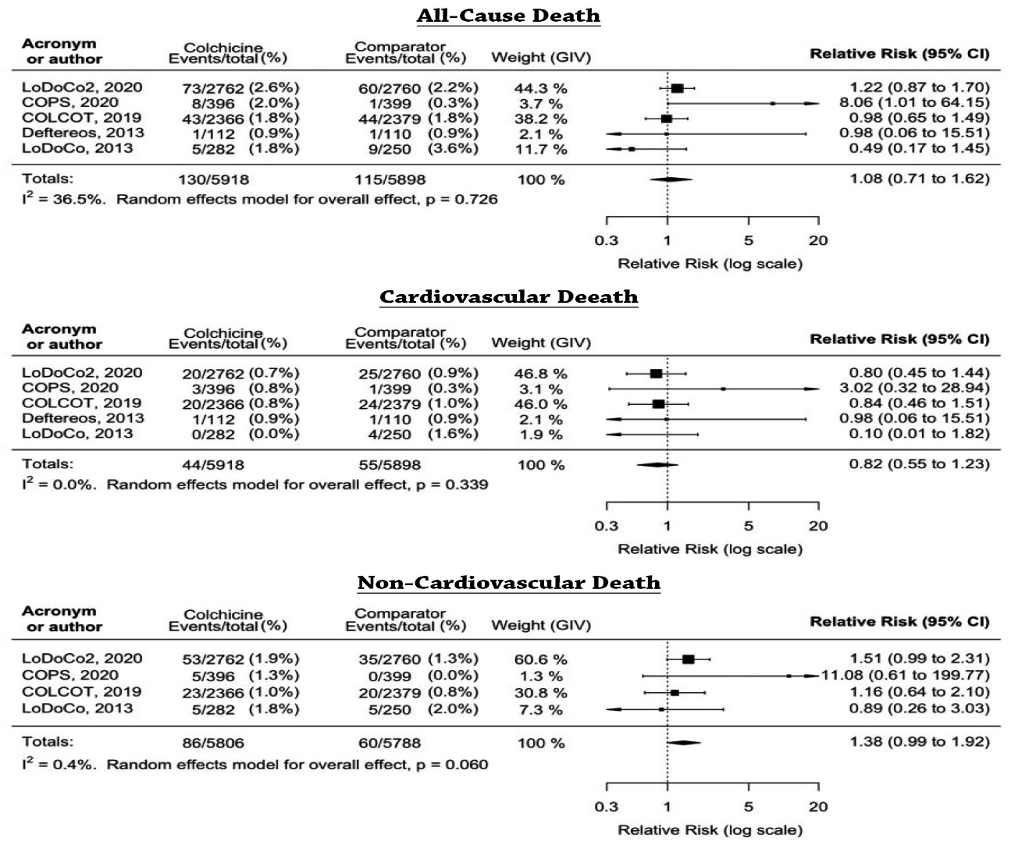
Death
Fiolet et al., Eur Heart J 2021 Mar 26 Epub ahead of print
Notes:
Updated 4.4.2017

Slide 33
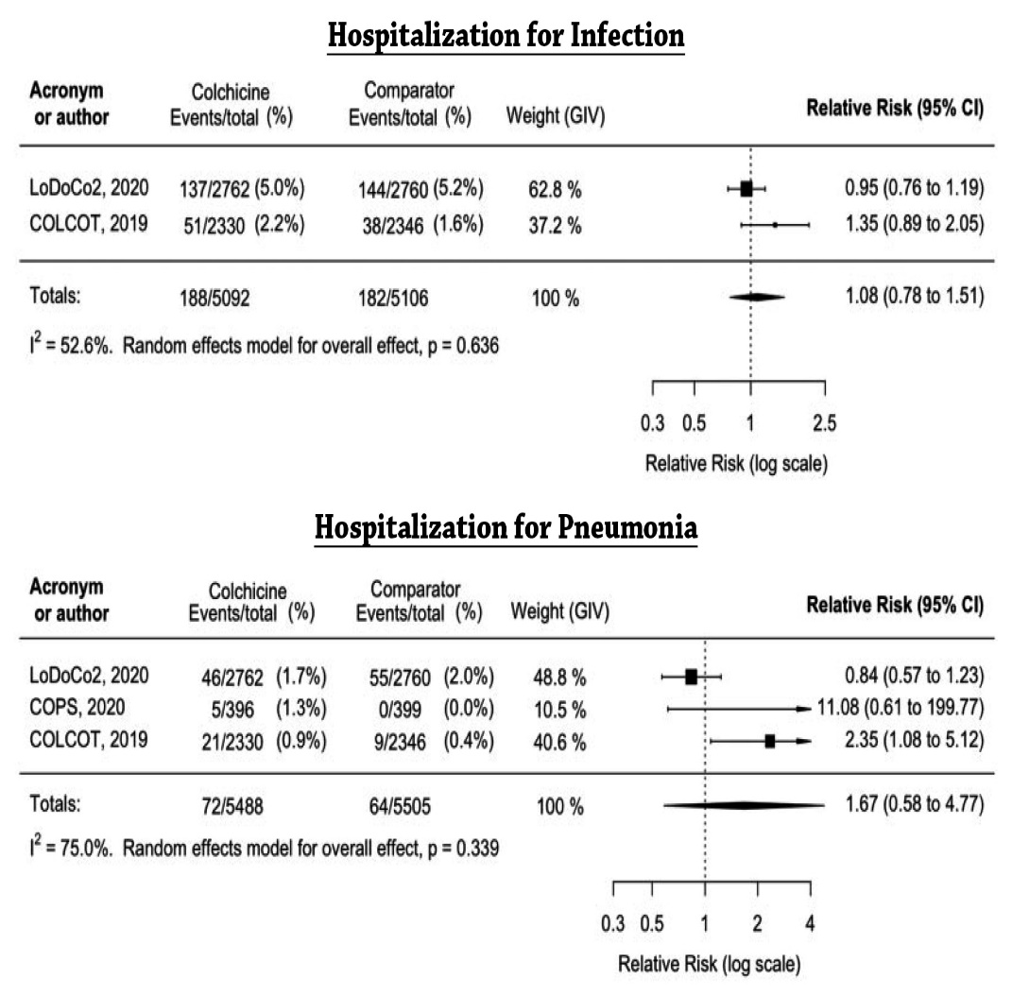
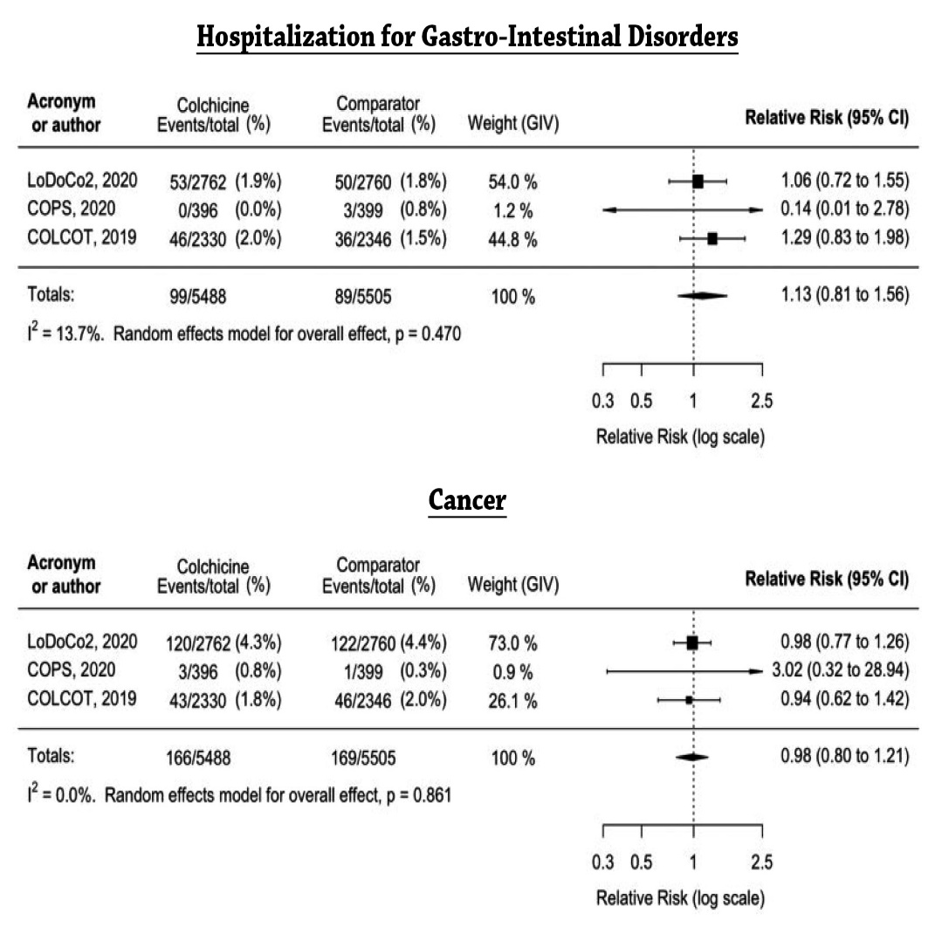
Adverse Events
Fiolet et al., Eur Heart J 2021 Mar 26 Epub ahead of print
Notes:
Updated 4.4.2017

Slide 34
Notes:
Updated 4.4.2017

Slide 35
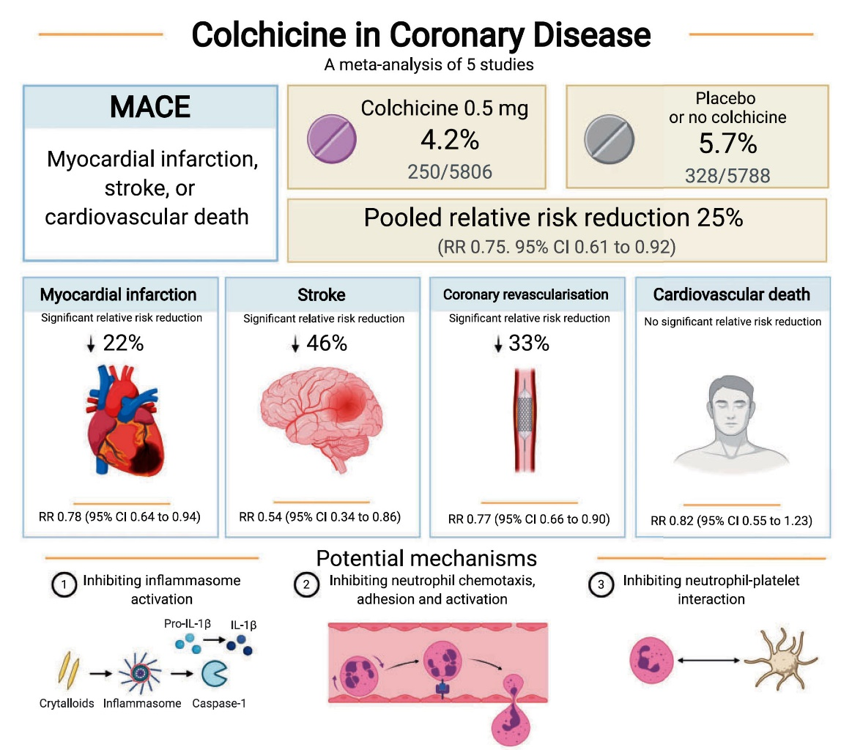
Colchicine in Coronary Artery Disease
Fiolet et al., Eur Heart J 2021 Mar 26 Epub ahead of print
Notes:
Updated 4.4.2017

Slide 36
Notes:
Updated 4.4.2017

Slide 37
Colchicine Randomized Controlled Trials
Registered in Clinical Trials.gov
Pradhan A, Eur Heart J 6 April 2021 Epub ahead of print
Notes:
Updated 4.4.2017

Slide 38
Latest Issues in Coronary Intervention
Recent data on role of Colchicine in CAD
Focused review of the month
Impact of Hemoglobin A1c on CV outcomes post PCI

Slide 39
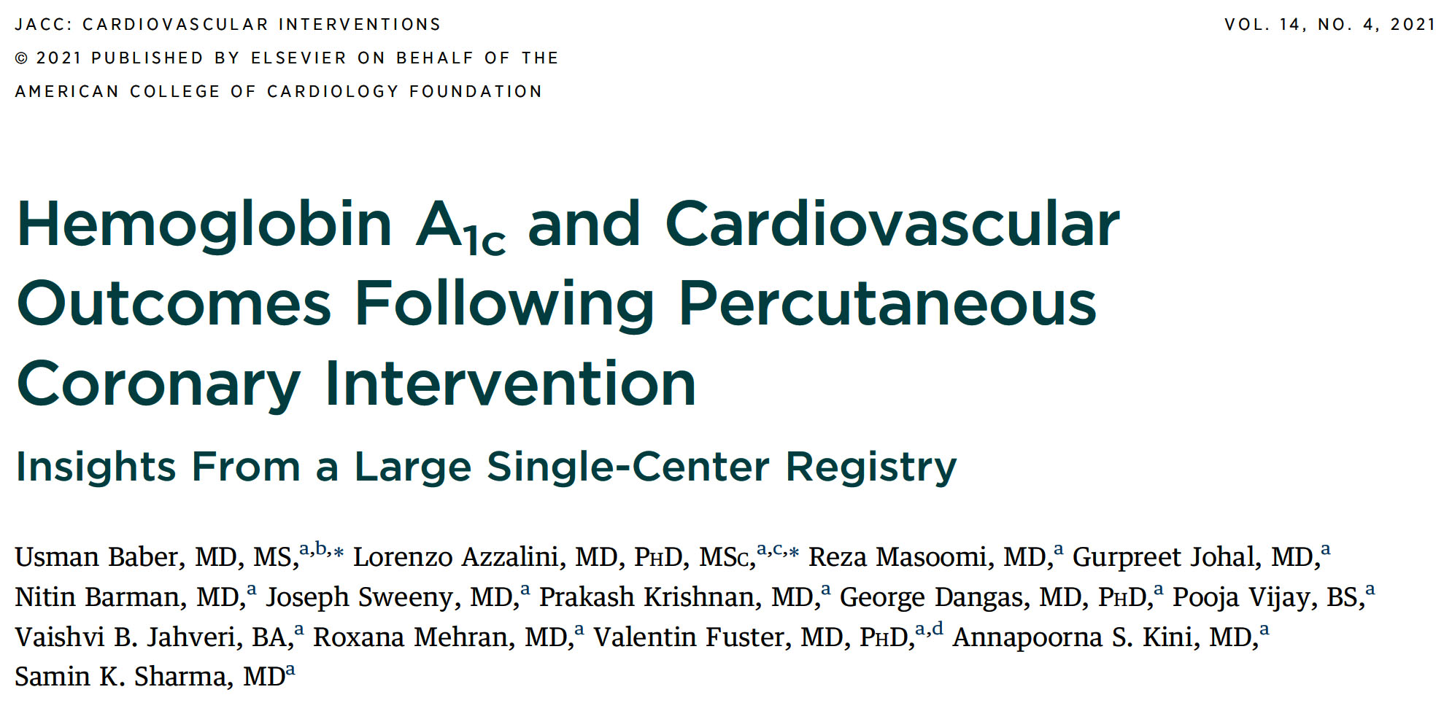
Notes:
Updated 4.4.2017

Slide 40
Study Flowchart
Unique patients undergoing PCI
(n=24,590)
Between January 2009 and December 2017
Missing HbA_{1c}
(n=9,875)
With HbA_{1c} data
(n=14,715)
Did not receive a stent
(n=1,120)
Received at least one stent
(n=13,595)
Died in hospital
(n=52)
Study population
(n=13,543)
HbA_{1c}
≤5.5%
(n=1,214)
HbA_{1c}
5.6-6.0%
(n=2,202)
HbA_{1c}
6.1-7.0%
(n=4,130)
HbA_{1c}
7.1-8.0%
(n=2,609)
HbA_{1c}
>80%
(n=3,388)
Baber, Kini, Sharma et al., J Am Coll Cardiol Intv 2021;14:388

Slide 41
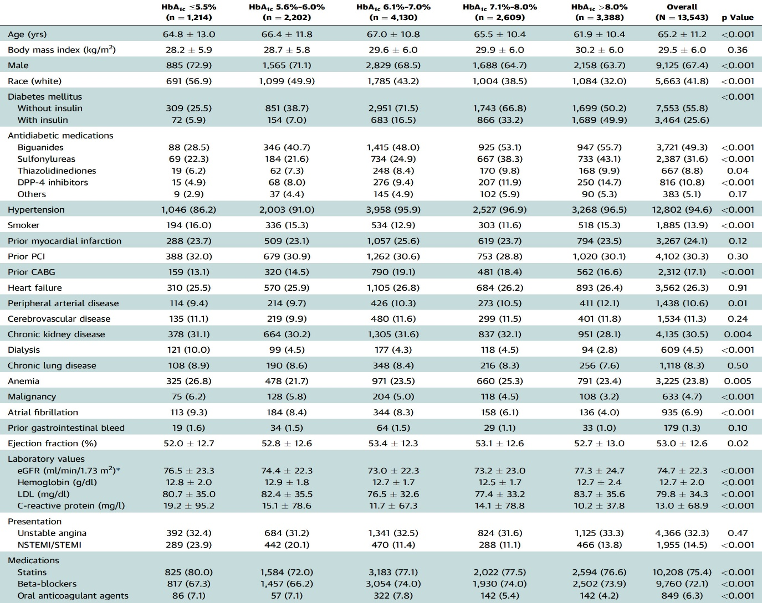
Baseline Clinical Characteristics
Baber, Kini, Sharma et al., J Am Coll Cardiol Intv 2021;14:388

Slide 42
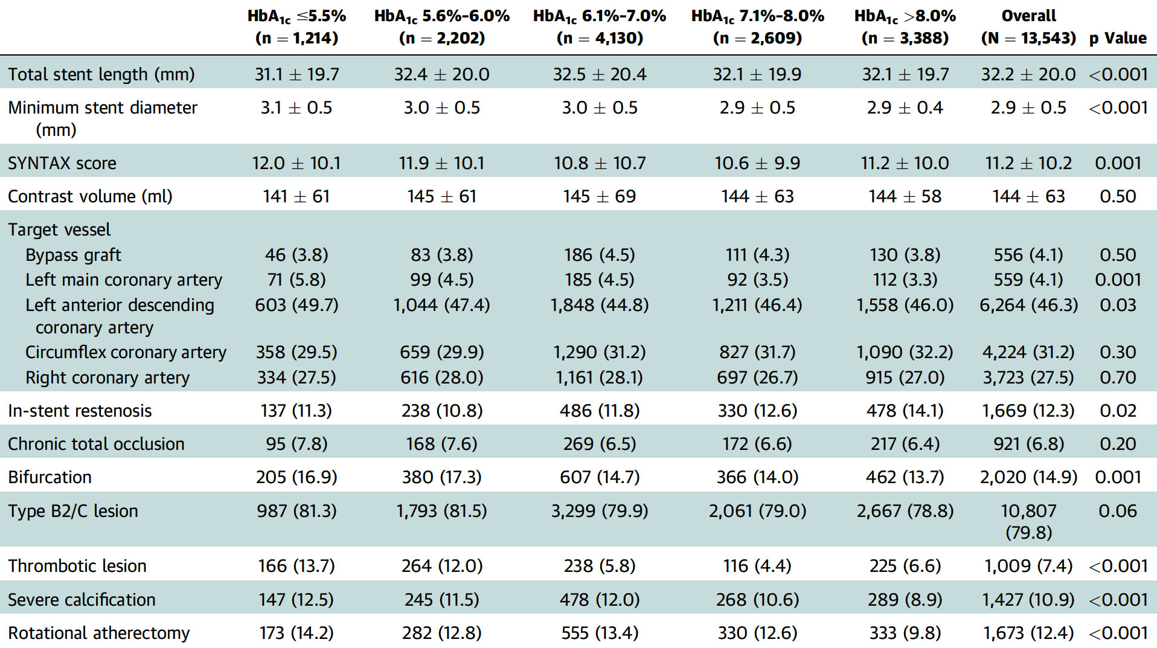
Procedural Characteristics
Baber, Kini, Sharma et al., J Am Coll Cardiol Intv 2021;14:388

Slide 43
Rates of 1-Year Outcomes Stratified by HbA_{1c}
Baber, Kini, Sharma et al., J Am Coll Cardiol Intv 2021;14:388

Slide 44
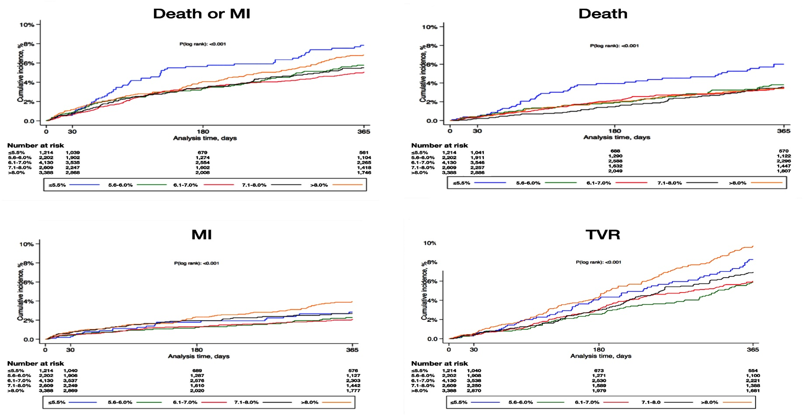
Cumulative Incidence of 1-Yr Study Outcomes According to Glycated Hemoglobin Levels
7.3%
6.3%
5.2%
5.6%
5.2%
4.8%
3.4%
3.3%
3.3%
3.2%
8.8%
7.3%
6.4%
5.4%
5.2%
3.7%
2.6%
2.6%
2.1%
2.1%
1.9%
Baber, Kini, Sharma et al., J Am Coll Cardiol Intv 2021;14:388

Slide 45
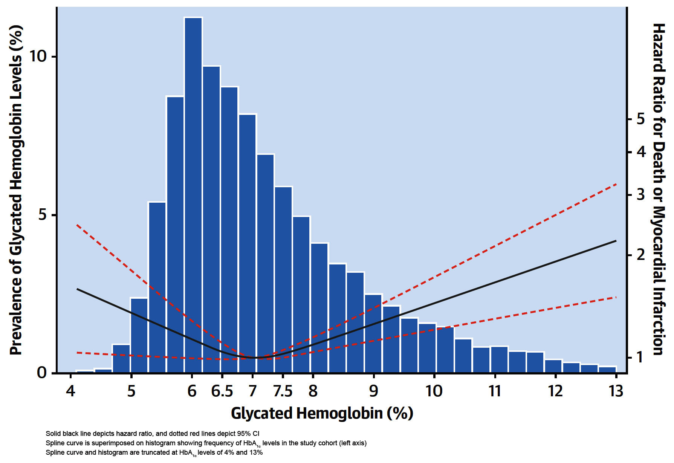
Age- and Sex-Adjusted HR and 95%CI for All-Cause Death
or MI by Glycated Hb Level According to Restricted Cubic Spline Regression Models Using 3 Knots at 6%, 7% and 8%
Baber, Kini, Sharma et al., J Am Coll Cardiol Intv 2021;14:388

Slide 46
Adjusted Risk for Clinical Outcomes at 1 Year Stratified by HbA_{1c}
Reference
Reference
Reference
%
Baber, Kini, Sharma et al., J Am Coll Cardiol Intv 2021;14:388

Slide 48
Notes:
Updated 4.4.2017

Slide 49
Take Home Message: Role of Colchicine in CAD and HbA1c on CV events post PCI
Colchicine reducing cardiac events in CAD pts:
Colchicine reducing MI in CAD pts:
Colchicine reducing non-cardiac deaths in CAD pts:
Colchicine serious side effects causing d/c:
A recent single center registry report of pts undergoing PCI, pre-procedure HbA1c levels displayed a U shaped relationship with CV outcomes with levels <5.5% associated with higher death and levels >8% is associated with higher MI and trend towards higher revascularization. Hence optimal HbA1c level seems to be 6-7%.
Notes:
HbA1c

Slide 50
Question # 1
Following statements are true regarding the outcomes of colchicine vs placebo in the RCT except;
Colchicine use was associated with lower MACE
Colchicine use was associated with lower MI
Colchicine use was associated lower stroke
Colchicine use was associated with lower non-cardiac deaths
E. Colchicine use was associated with lower revascularization
The correct answer is D

Slide 51
Question # 2
Following statements are true regarding the potential mechanism of actions of colchicine causing improved CV outcomes except;
A. Colchicine inhibits inflammasome
B. Colchicine activates IL-1B
C. Colchicine inhibits IL-1B
D. Colchicine inhibits neutrophil chemotaxis
E. Colchicine inhibits neutrophil-platelet interaction
The correct answer is B

Slide 52
Question # 3
Following statements are true regarding the impact of HbA1c levels on CV outcomes except:
Levels showed U shaped curve in outcomes
Levels showed higher MI with higher levels
Levels showed higher mortality with higher levels
Levels showed higher mortality with levels <5.5%
Levels of 6.1-7% were associated with best outcomes
The correct answer is C

