Slide 1

Live Analytics Lifetime Pageviews
N
Notes:
1

Slide 2
Live Analytics Pageviews
N
Notes:
2

Slide 3

Total Webcast Pageviews
N

Slide 4

Complex Coronary Cases Supported by:
Abbott Vascular Inc.
Boston Scientific Corp.
Terumo Vascular Corp.
Cardiovascular Systems Inc.
Abiomed Inc.
Chiesi Inc.
Best Medical Inc.

Slide 5
Disclosures
Samin K. Sharma, MD, MSCAI, FACC
Speaker’s Bureau – BSC, Abbott, CSI
Annapoorna S. Kini, MD, MRCP, FACC
Nothing to disclose
Sameer Mehta, MD, FACC (Moderator)
Nothing to disclose
William J Nicholson, MD, FACC (Guest Faculty)

Slide 6

CCC Live Case # 141
Patient Demographics
47 yrs, F with ESRD on HD
Present Clinical Presentation
Presented with new onset CCS class I angina for few months and markedly + stress MPI for severe anterior/lateral wall ischemia
CAD Risk Factors
Controlled Hypertension
Controlled Hyperlipidemia
Anemia
Clinical Variables
No known CAD or cardiac issues before present symptoms.
Very active otherwise. SAQ 78.
Medications
Aspirin, Metoprolol XL, ISMN, Atorvastatin, Losartan, Clonidine, Renal drugs
Cath: Cath done on 2/23/2021 revealed severely calcified 1 V CAD: 90% prox LAD and Diagonal bifurcation (Medina 1,1,1), 80% mid LAD, non-obstructive LCx and RCA, LVEF 50-60% and Syntax score 23.
Plan: Now planned for IVUS guided PCI of severely calcified LAD-D1 bifurcation using rotational atherectomy (step burrs 2 & 2.25mm) and dedicated two-stent mini-crush technique.

Slide 7

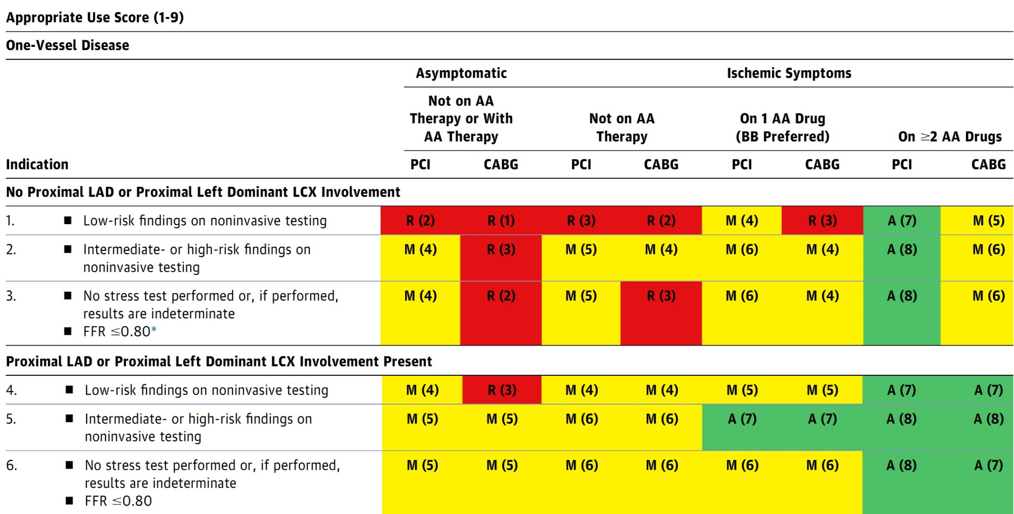
AUC 2017: One-Vessel Disease
Patel et al., J Am Coll Cardiol 2017;69:2212

Slide 8

Latest Issues in Coronary Intervention
Recent publications in use of FFR and outcomes
Focused review of the month
Characteristics and outcomes of type 1 vs 2 MI

Slide 9
Latest Issues in Coronary Intervention
Recent publications in use of FFR and outcomes
Focused review of the month
Characteristics and outcomes of type 1 vs 2 MI

Slide 10
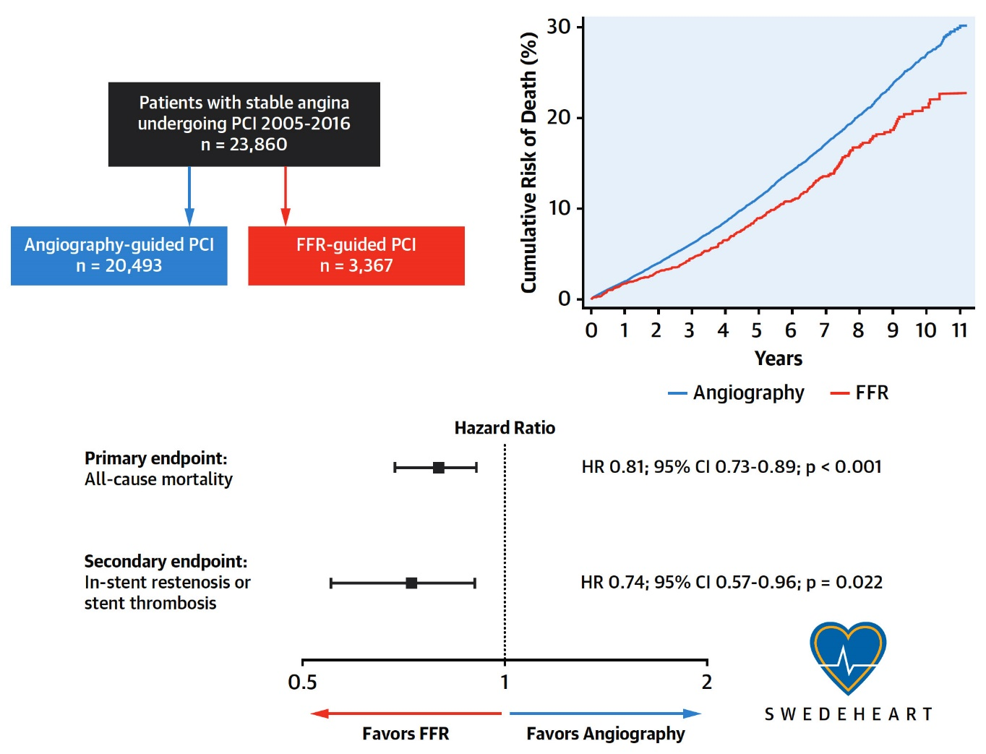
Angio vs FFR Guided PCI Outcomes: SCAAR Registry
30.2%
22.7%
Possible Explanations:
- Identifying vulnerable plaque even <70%
- Reduce overall ischemia
- Decrease stent use
Völz et al., J Am Coll Cardiol 2020;75:2785

Slide 11

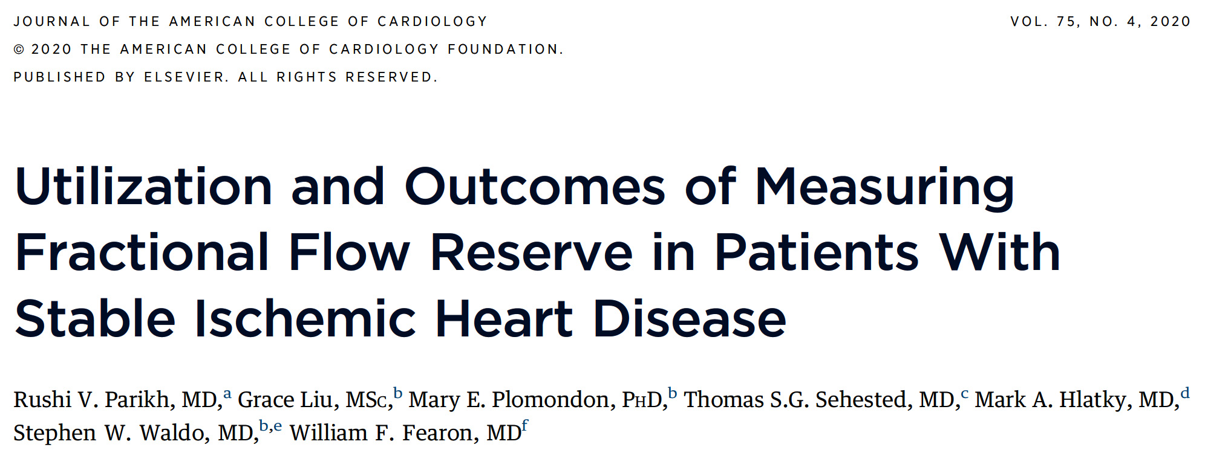

Slide 12
Study Design
Total number of patients undergoing coronary angiography at 66 FFR/PCI capable VA cardiac catheterization laboratories from January 1, 2009 to September 20, 2017 with at least 1 angiographically-intermediate stenosis
(n=104,708)
Concomitant severe stenosis
(n=81,947)
ACS
(n=2,552)
History of CABG
(n=2,220)
Final SIHD cohort for analysis
(n=17,989)
FFR-guided revasc
(n=2,967)
Angiography only revasc
(n=15,022)
Parikh et al., J Am Coll Cardiol 2020;75:409

Slide 13
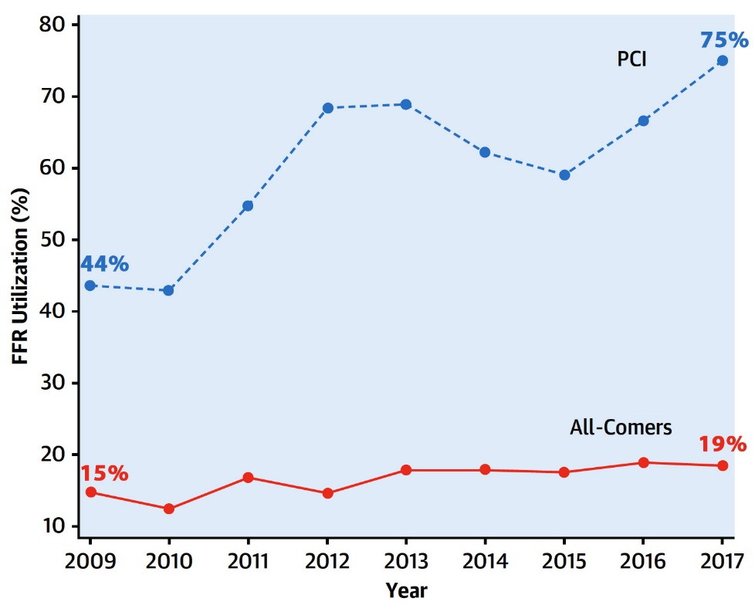
FFR-Guided Revasc of Angiographically Intermediate Coronary Stenoses in SIHD
FFR Utilization
FFR gp:
-revasc in 18% (90% PCI, 10% CABG)
Angio gp:
-revasc in 4% (52% PCI, 48% CABG)
Parikh et al., J Am Coll Cardiol 2020;75:409

Slide 14
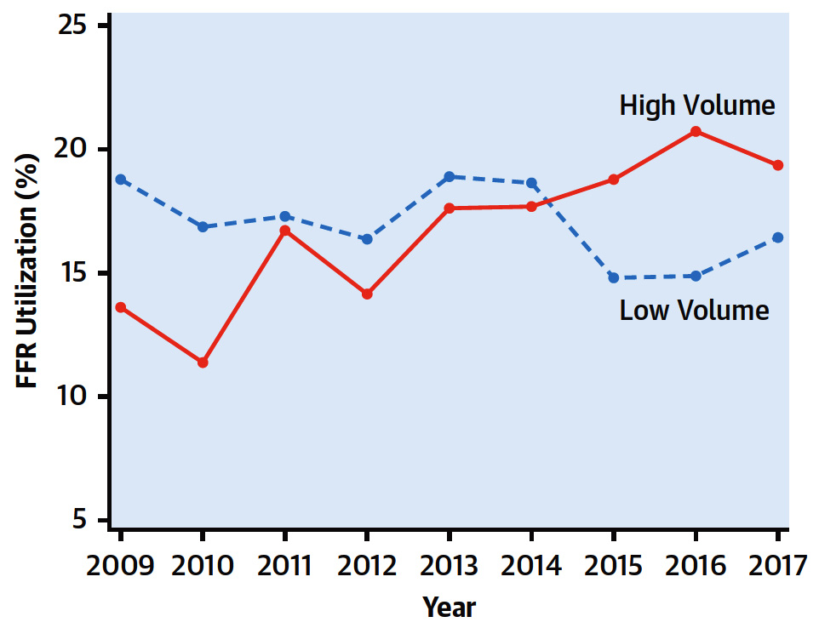
Temporal Patterns of FFR Utilization Stratified by Hospital Volume
Parikh et al., J Am Coll Cardiol 2020;75:409

Slide 15
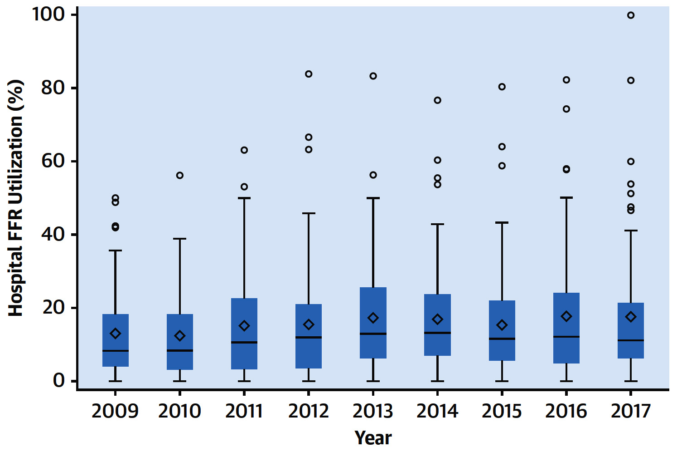
Site-Level Variation in Use of FFR
There was significant site-level variation in the use of FFR (median OR: 3.56; 95% CI: 2.7 to 4.4) after adjustment for all of the patient, site-level, and procedural factors.
Parikh et al., J Am Coll Cardiol 2020;75:409

Slide 16
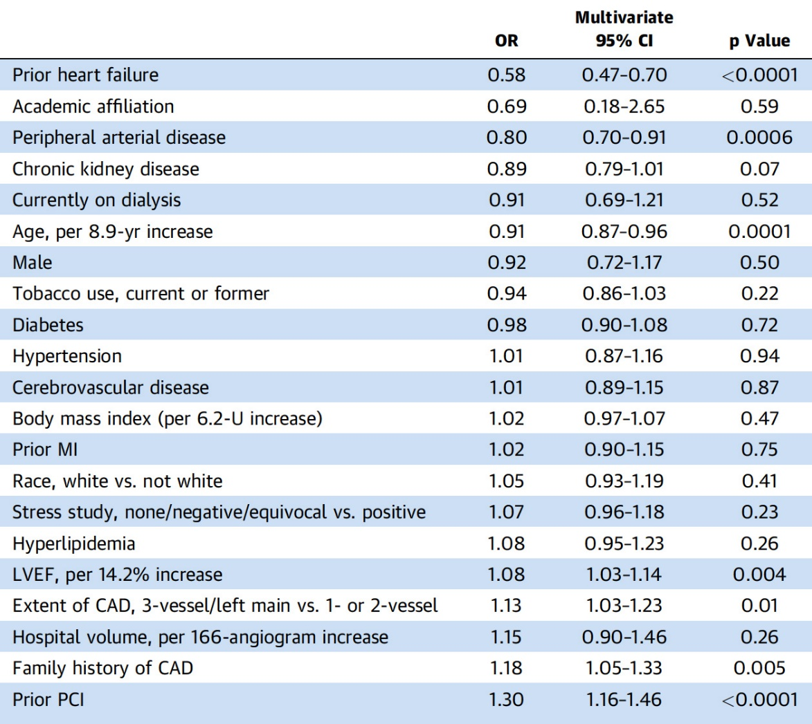
Predictors of FFR Utilization
Parikh et al., J Am Coll Cardiol 2020;75:409

Slide 17
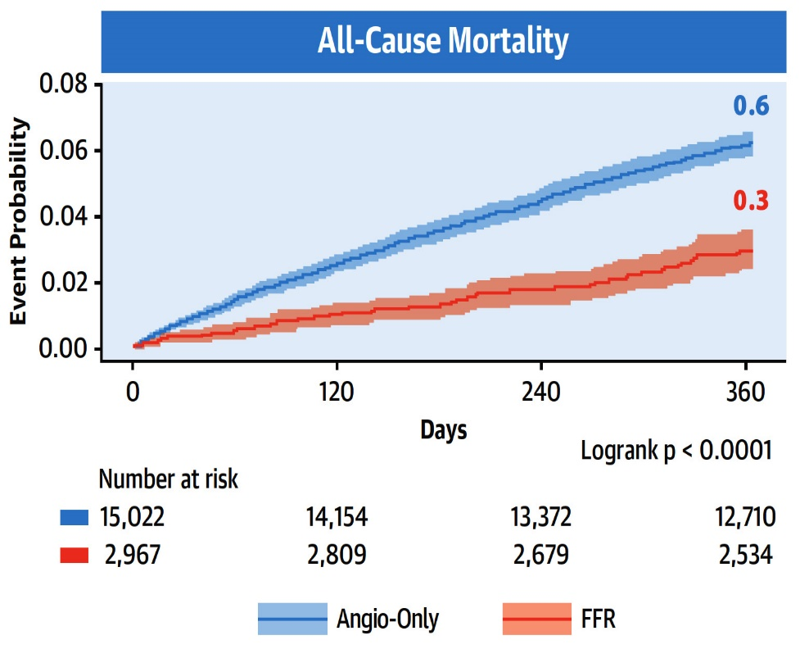
FFR-Guided Revasc of Angiographically Intermediate Coronary Stenoses in SIHD
All-Cause Mortality at 1 Year
Parikh et al., J Am Coll Cardiol 2020;75:409

Slide 18
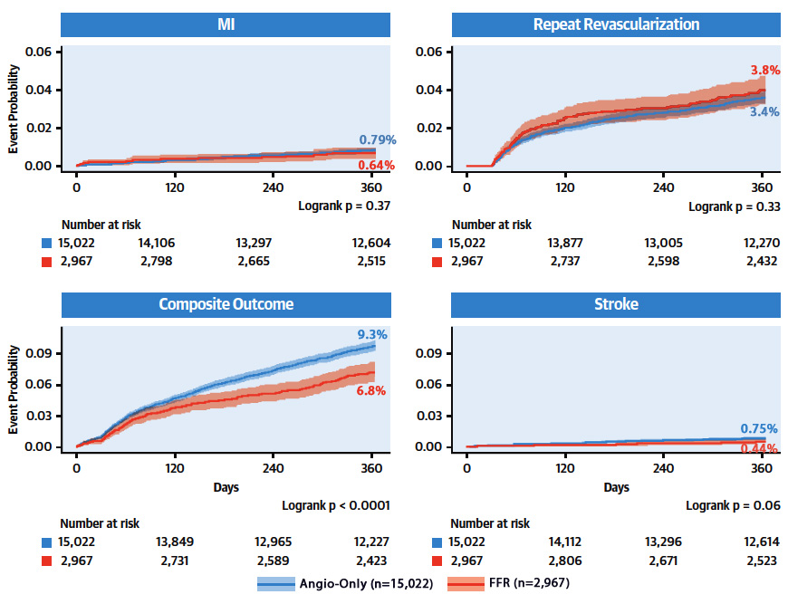
Association of FFR-Guided Revascularization
with Secondary Clinical Endpoints at 1 Year
Parikh et al., J Am Coll Cardiol 2020;75:409

Slide 19
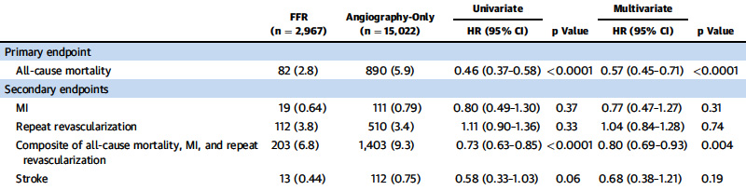
Association of FFR-Guided Revascularization
with Secondary Clinical Endpoints at 1 Year
Parikh et al., J Am Coll Cardiol 2020;75:409

Slide 20
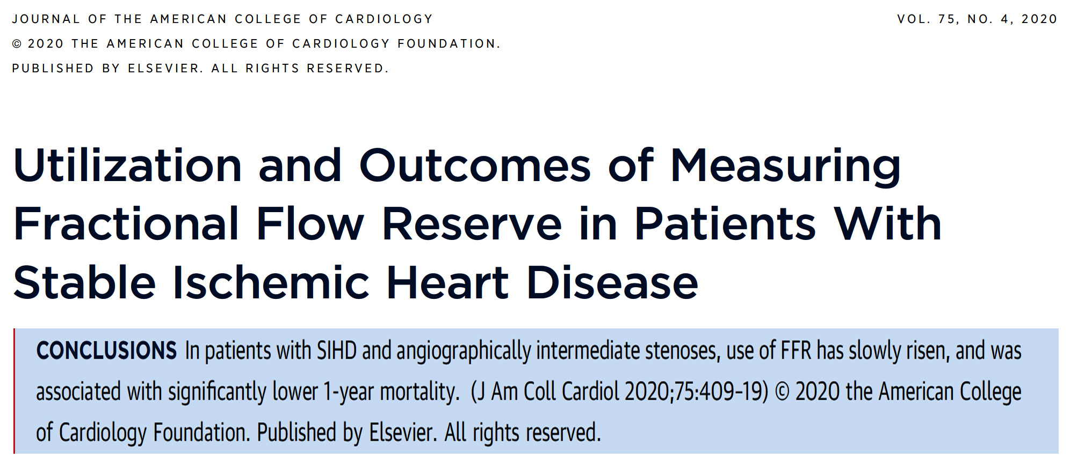

Slide 21
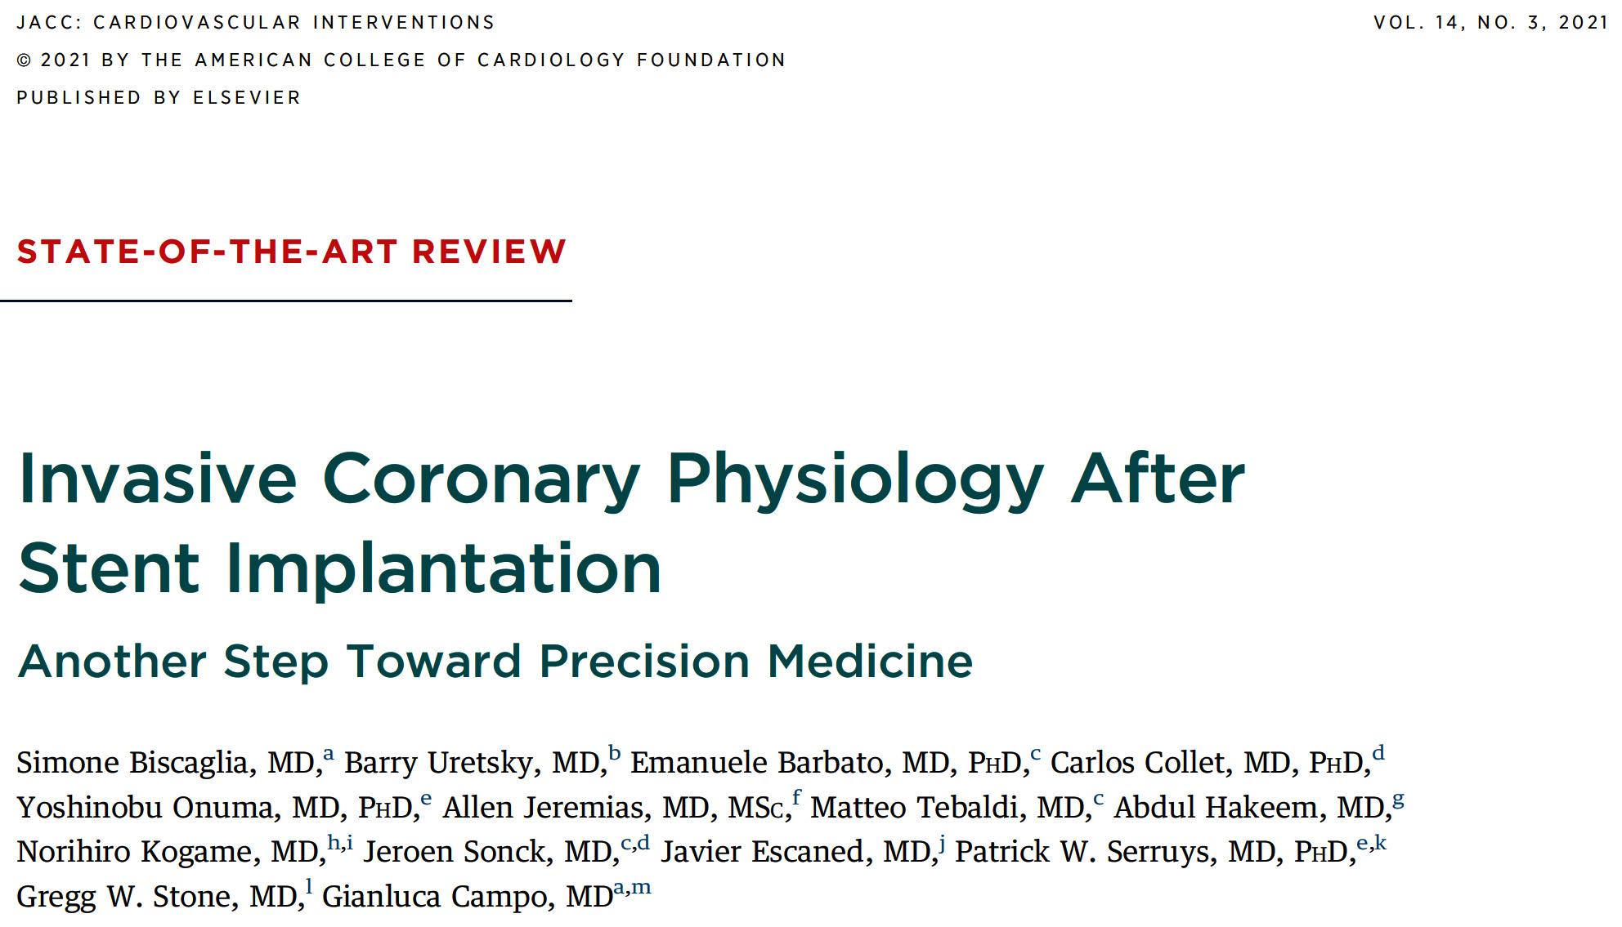
Notes:
21

Slide 22
Background
Recurrent Angina at 1 Year After PCI
Remains Between 20-30%; MACE rate approx. 4-5%
NEJM
2007;365:1503
NEJM
2011;364:1016
JAMA
2013;310:1581
Lancet
2009;373:1190
Circulation
2009;119:653
NEJM
2009;360:213

Slide 23
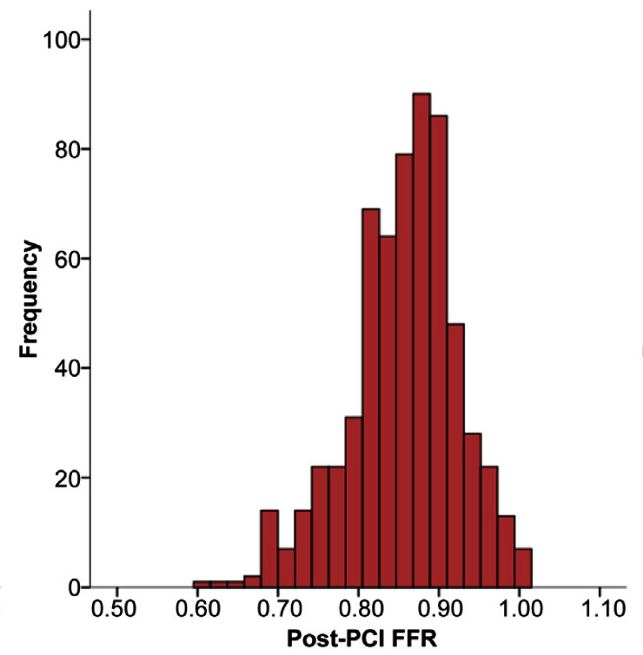
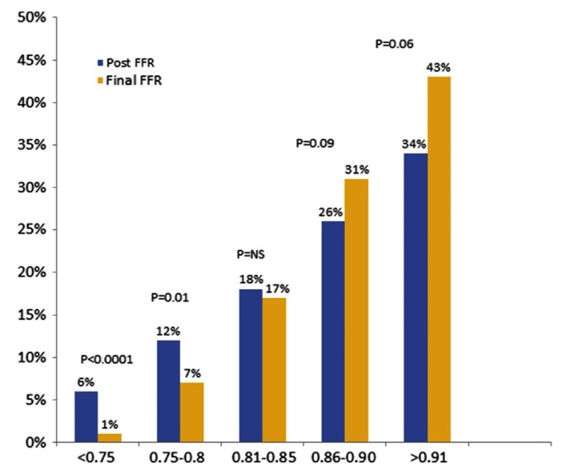


Background
Post PCI Ischemia Based on FFR ≤0.80 Occurs in 10-20% of Cases
Impact of Post-PCI on “Achieving Optimization”
Distribution of Post-PCI FFR
Lee et al., J Am Coll Cardiol Intv 2018;11:2099
Agarwal et al., J Am Coll Cardiol Intv 2016;9:1022

Slide 24
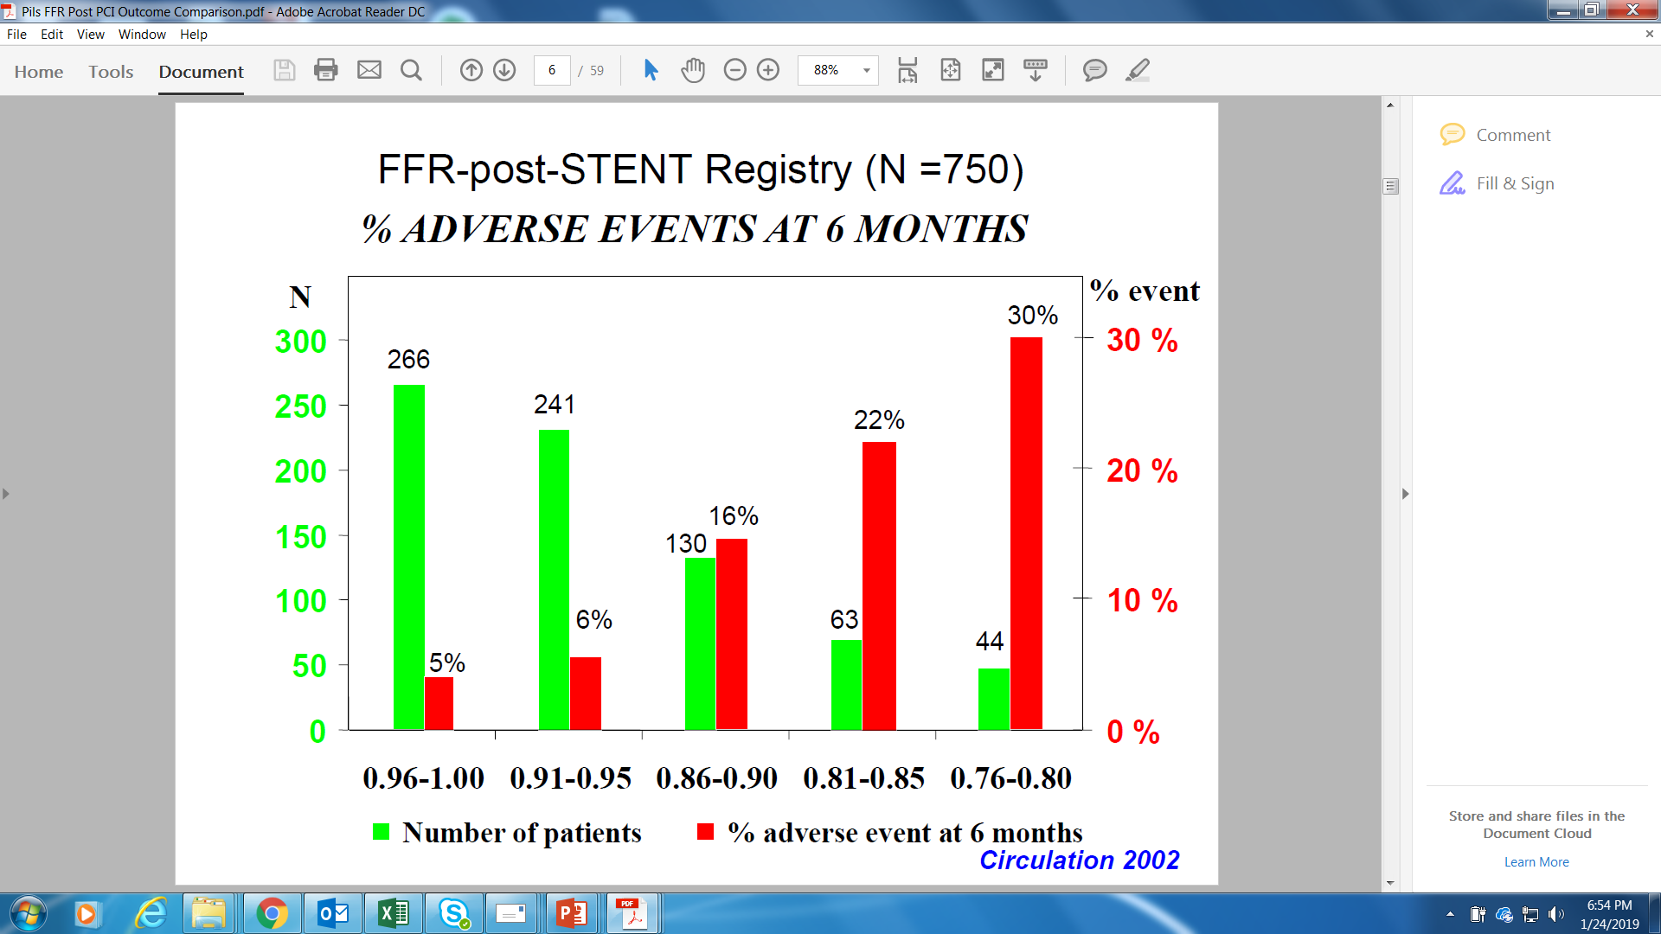
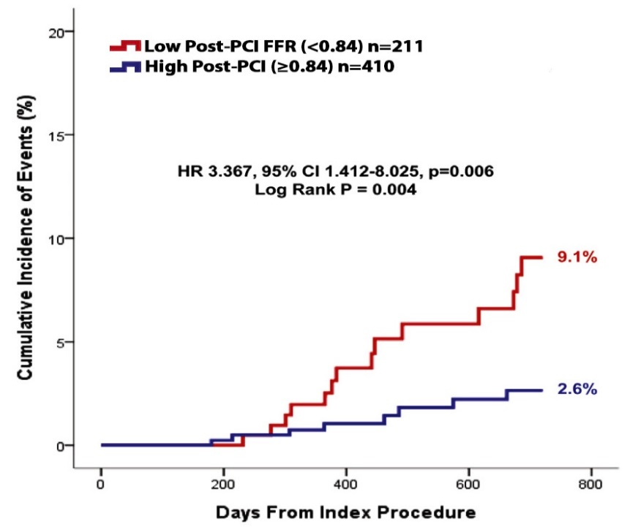
Background
Low Post-PCI FFR is Related to Adverse Events
TVF at 2-Yr FU Post-PCI FFR
Pijls et al., Circulation 2002;105:2950
Lee et al., J Am Coll Cardiol Intv. 2018;11:2099

Slide 25
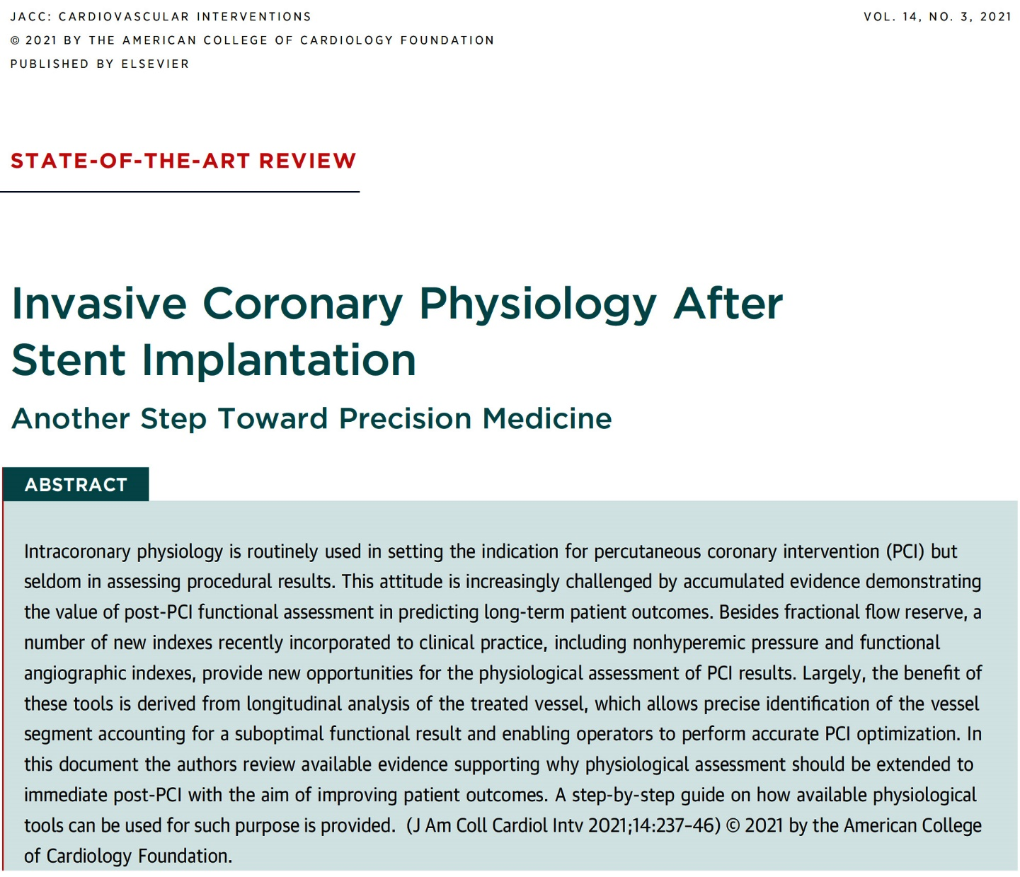
Notes:
25

Slide 26
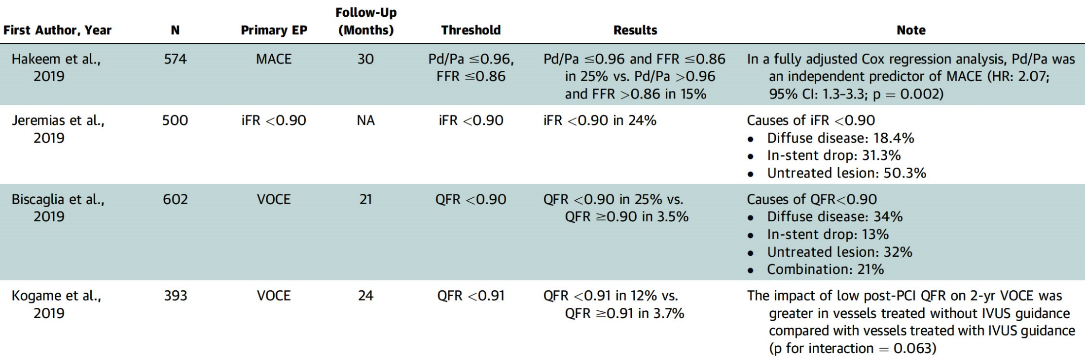
Recent Clinical Studies Evaluating the Role of
Post-PCI Registry
Biscaglia et al., J Am Coll Cardiol Intv 2021;14:237

Slide 27
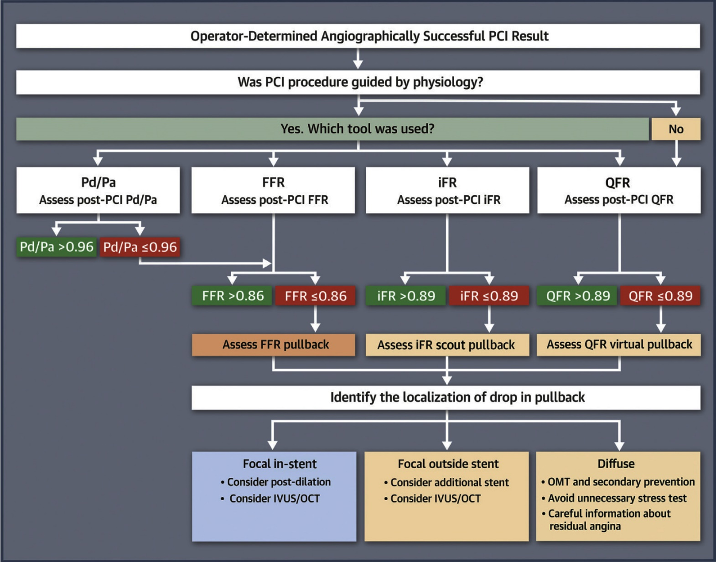
Flowchart for Guide Physiology-Guided PCI Optimization Considering Current Methods
Biscaglia et al., J Am Coll Cardiol Intv 2021;14:237

Slide 28
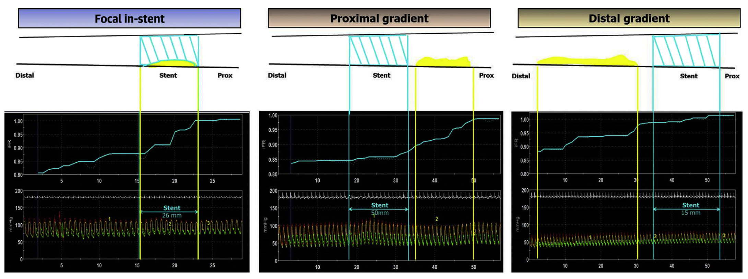
Examples of Different Post-PCI iFR Traces According to Underlying CAD Mechanisms
(In-Stent Drop, Proximal Gradient, Distal Gradient)
Biscaglia et al., J Am Coll Cardiol Intv 2021;14:237

Slide 29
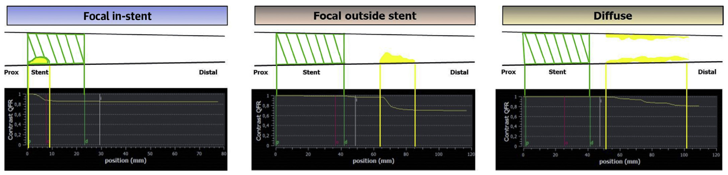
Examples of Different Post-PCI QFR Traces According to Underlying CAD Mechanisms
(In-Stent Drop, Proximal Gradient, Distal Gradient)
Biscaglia et al., J Am Coll Cardiol Intv 2021;14:237

Slide 30
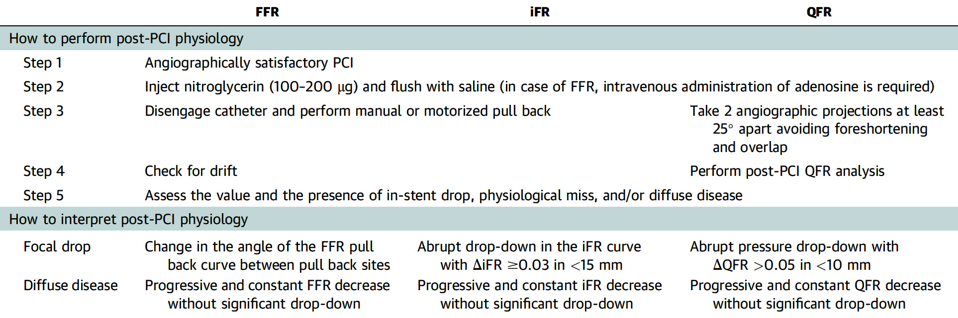
How to Perform and Interpret Physiology Post-PCI
Biscaglia et al., J Am Coll Cardiol Intv 2021;14:237

Slide 31
Physiology-Guided Optimization of PCI
A Randomized Controlled Trial

Slide 32
Study Flow
PIOS* Group
Patients complete angina & quality of life questionnaires prior to PCI
Control Group
Post-PCI coronary physiology measurements
Post-PCI coronary physiology measurements
If target FFR (≥0.90) achieved – procedure complete
If FFR <0.90 – further optimization of stent and/or additional stenting performed
Result not disclosed to operator – procedure complete
Physiology-guided
Incremental
Optimization
Strategy
Post-PCI FFR ≥0.90
– procedure complete
FFR <0.90 and no further
optimization possible
– procedure complete
Randomized patients repeat questionnaires at 3 months
Collison D, TCT Connect 2020

Slide 33
Physiology-guided Incremental Optimization Strategy (PIOS)
FFR <0.90 and hyperemic pullback shows diffuse atherosclerosis with no focal step-ups: Result accepted, no optimization attempted
Hyperemic trans-stent gradient (HTG) ≥0.05: Post-dilation with larger NC balloon to 18atm. Intracoronary imaging at operator discretion. Repeat hyperemic pullback
Focal FFR increase ≥0.05 within an unstented segment <20mm: Deploy additional stent. Repeat hyperemic pullback
FFR still <0.90: Repeat hyperemic pullback. If either of the above criteria remain, option of further post-dilation or one more additional stent
Final hyperemic pullback
Collison D, TCT Connect 2020

Slide 34
Angiographically-Guided Post-PCI FFR
(Pre-Randomization)
* 238/260 (92%) with Core Lab-adjudicated
Post-PCI FFR values for analysis
Collison D, TCT Connect 2020
Notes:
34

Slide 35
Additional Procedural Details
 | PIOS (n=40) | No PIOS (n=220) | P value
Procedure Duration (mins) | 94±23 | 67±24 | <.001
Contrast Dose (ml) | 225±53 | 185±51 | <.001
Fluoroscopy Time (mins) | 23±8 | 16±8 | <.001
Dose Area Product (cGy.cm²) | 5236±2783 | 3780±2391 | <.001
Radiation Dose (mGy) | 921±551 | 686±462 | .004
Adenosine Duration (sec) | 439±87 | 290±73 | <.001
Adenosine Dose (mg) | 93±25 | 62±32 | <.001
Collison D, TCT Connect 2020

Slide 36
DEFINE GPS Trial: Trial Flowchart
DEFINE GPS (Guided Physiologic Stenting)
N=2000
iFR Guided Therapy
Standard of Care
iFR Pullback with SyncVision
Angiographically Guided PCI
PCI based on SyncVision Plan
Baseline Physiology & Intravasc Imaging Optional

Slide 37
Latest Issues in Coronary Intervention
Recent publications in use of FFR and outcomes
Focused review of the month
Characteristics and outcomes of type 1 vs 2 MI

Slide 38
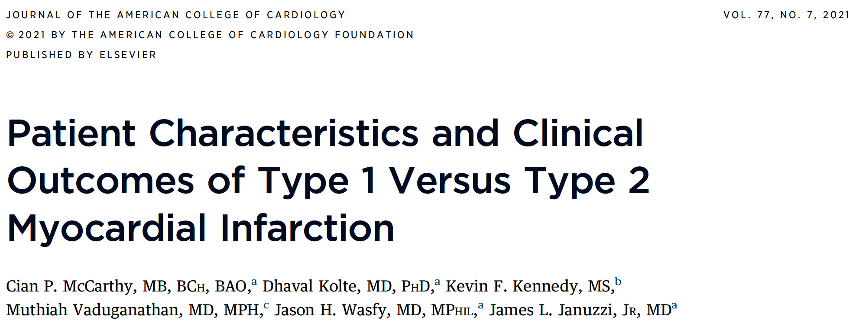
Notes:
38

Slide 39
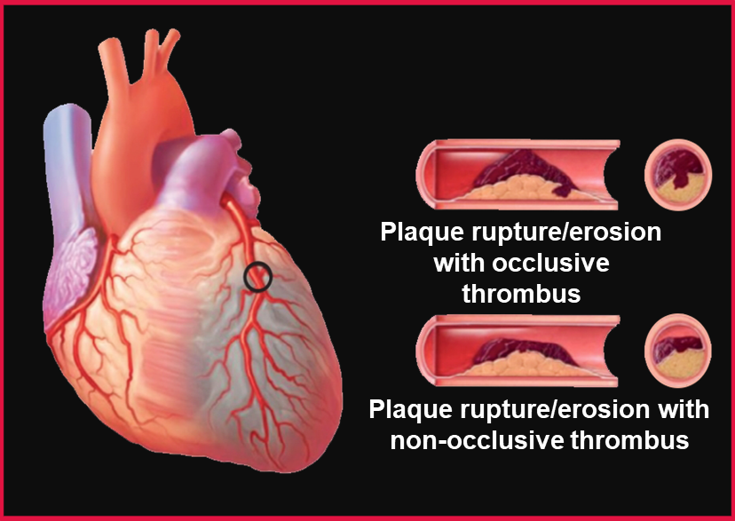
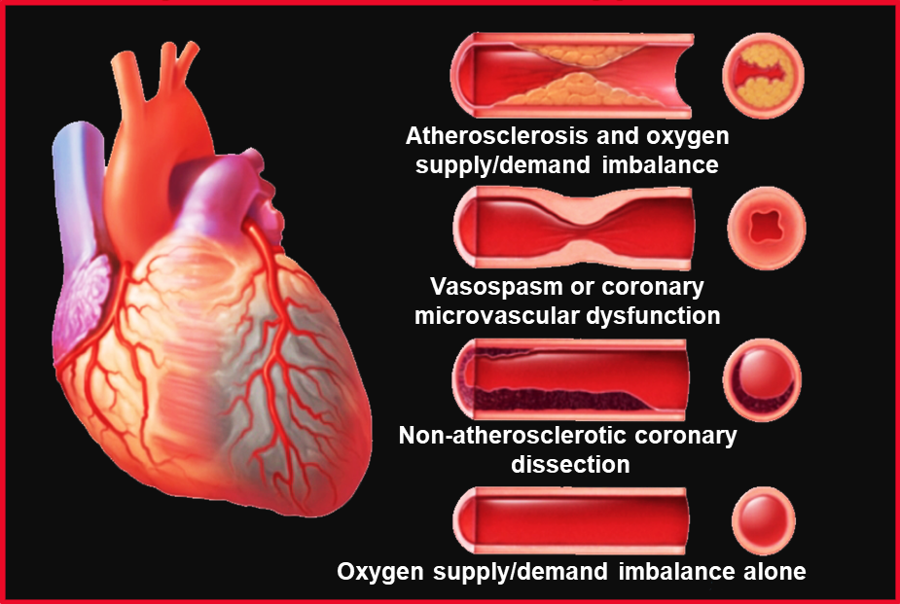
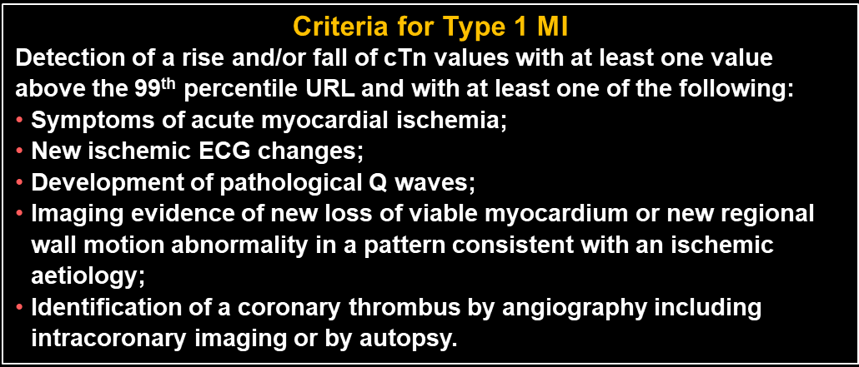
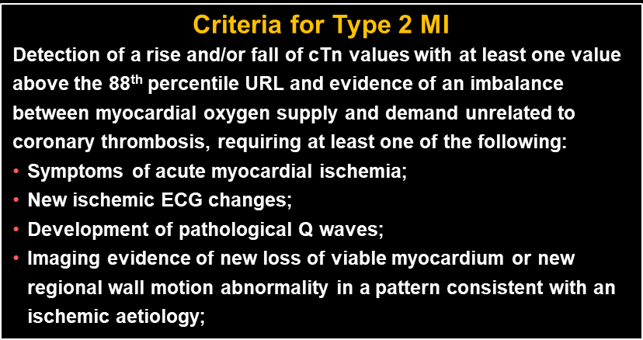
Type 1 MI
Type 2 MI
Thygesen et al., Circulation 2018;138:e618
Notes:
39

Slide 40
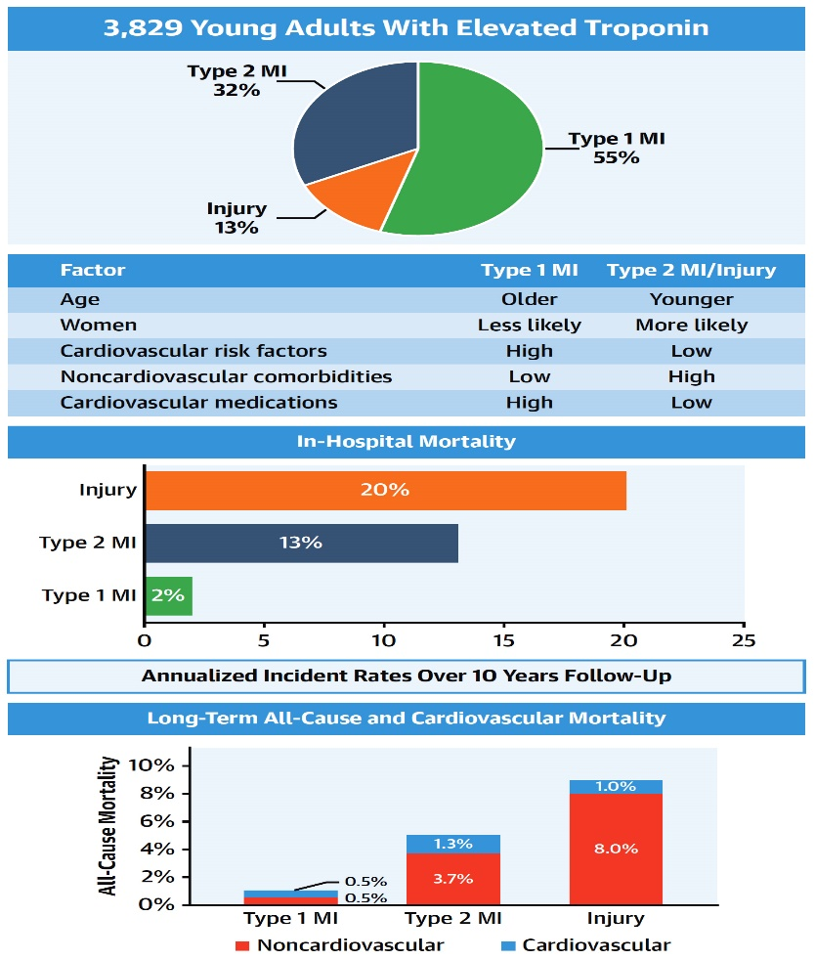
Clinical Features and Outcomes of Young Adults with
First-Time Type 1 MI, Type 2 MI, or MyocardiaI Injury
Singh et al., J Am Coll Cardiol 2020;75:1003

Slide 41
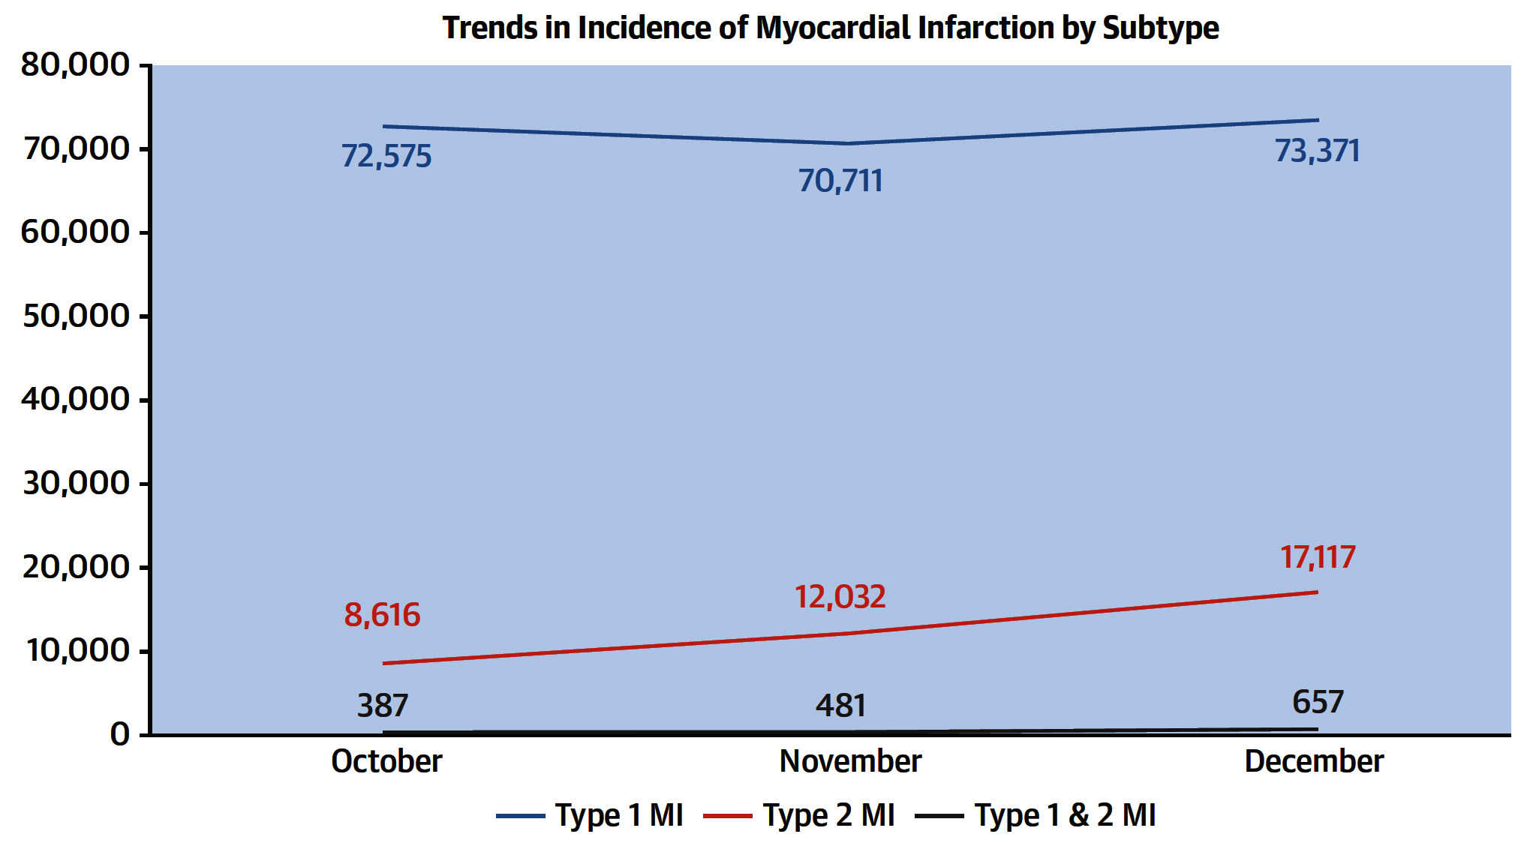
Trends in Incidence of Subtype of MI Over
3-Month Study Period in 2017
McCarthy et al., J Am Coll Cardiol 2021;77:848

Slide 42
10 Most Common Primary Hospital Diagnoses Among Patients with Type 2 MI as a Secondary Hospital Diagnosis
Sepsis | 8,452 (24.5%)
Hypertension | 5,826 (16.9%)
Cardiac arrhythmia | 2,089 (6.1%)
Respiratory failure | 1,487 (4.3%)
Pneumonia | 970 (2.8%)
Cerebrovascular accident | 925 (2.7%)
GI bleed | 887 (2.6%)
COPD | 802 (2.3%)
Complication of device implant or graft | 710 (2.1%)
Pulmonary heart disease | 710 (2.1%)
McCarthy et al., J Am Coll Cardiol 2021;77:848

Slide 43
10 Most Common Causes of Readmission Among Isolated Type 1 and 2 MI Patients
Type 1 MI |  |  | Type 2 MI
Cause of Readmission | Readmissions |  | Cause of Readmission | Readmissions
Hypertension | 3,013 (16.5%) |  | Hypertension | 651 (17.9%)
Acute MI | 2,141 (11.7%) |  | Sepsis | 430 (11.9%)
Sepsis | 1,658 (9.1%) |  | Acute renal failure | 166 (4.6%)
CAD or other heart disease | 818 (4.15%) |  | Respiratory failure | 143 (3.9%)
Cardiac arrhythmia | 728 (4.0%) |  | Acute MI | 137 (3.8%)
Acute renal failure | 588 (3.2%) |  | Cardiac arrhythmia | 131 (3.6%)
Device complication | 559 (3.1% |  | GI bleed | 123 (3.4%)
Complications of surg procedures or medical care | 547 (3.0%) |  | Device complication | 117 (3.2%)
GI bleed | 507 (2.8%) |  | Pneumonia | 112 (3.1%)
Respiratory failure | 490 (2.74%) |  | Complications of surg procedures or medical care | 107 (3.0)
McCarthy et al., J Am Coll Cardiol 2021;77:848

Slide 44
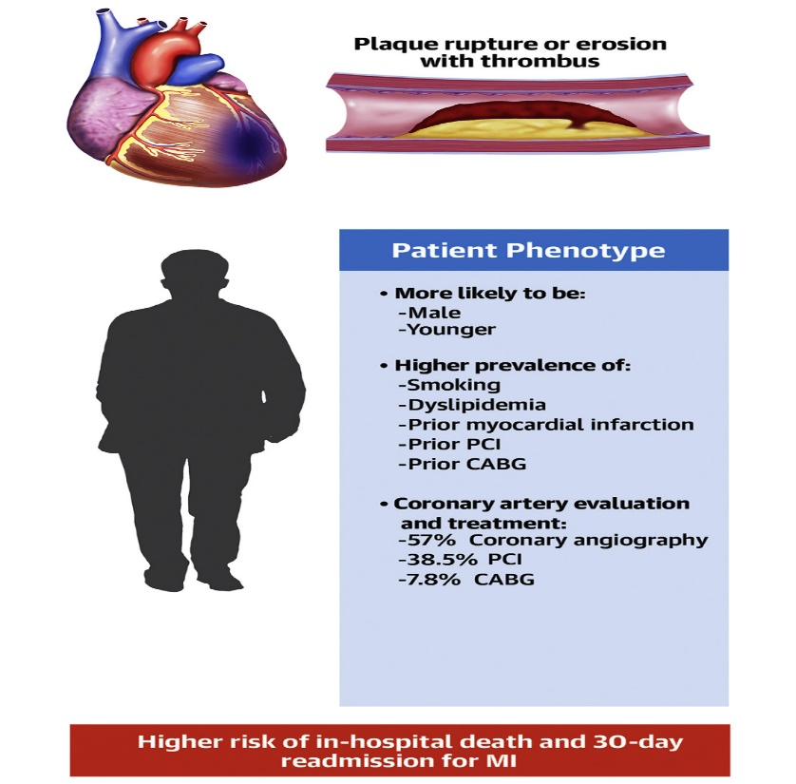
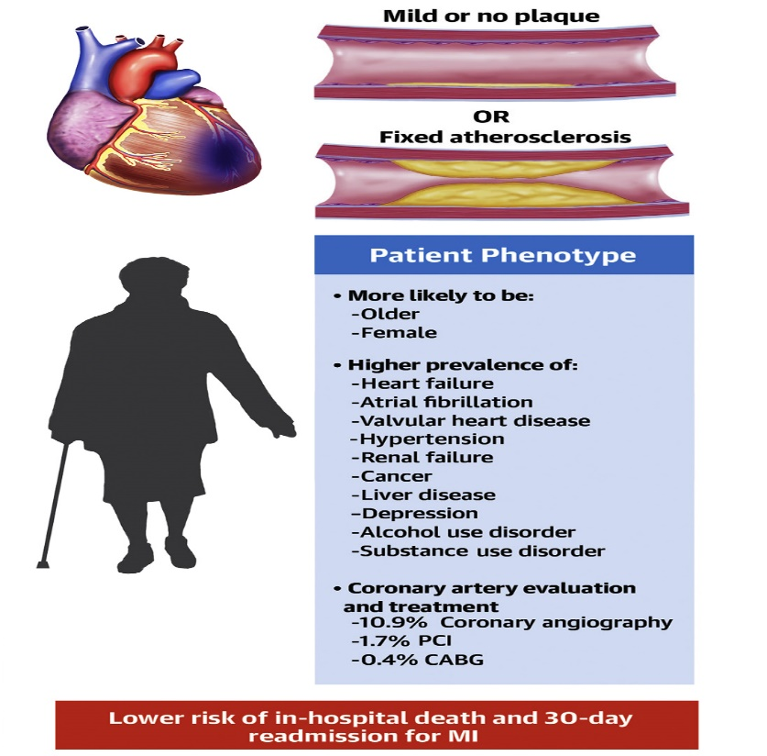
Differences in Clinical Characteristics Between Patients with Type 1 and Type 2 MI
Type 1 Myocardial Infarction
Type 2 Myocardial Infarction
McCarthy et al., J Am Coll Cardiol 2021;77:848

Slide 45
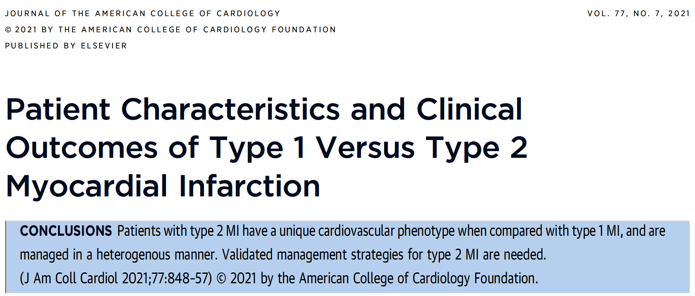
Notes:
45

Slide 46
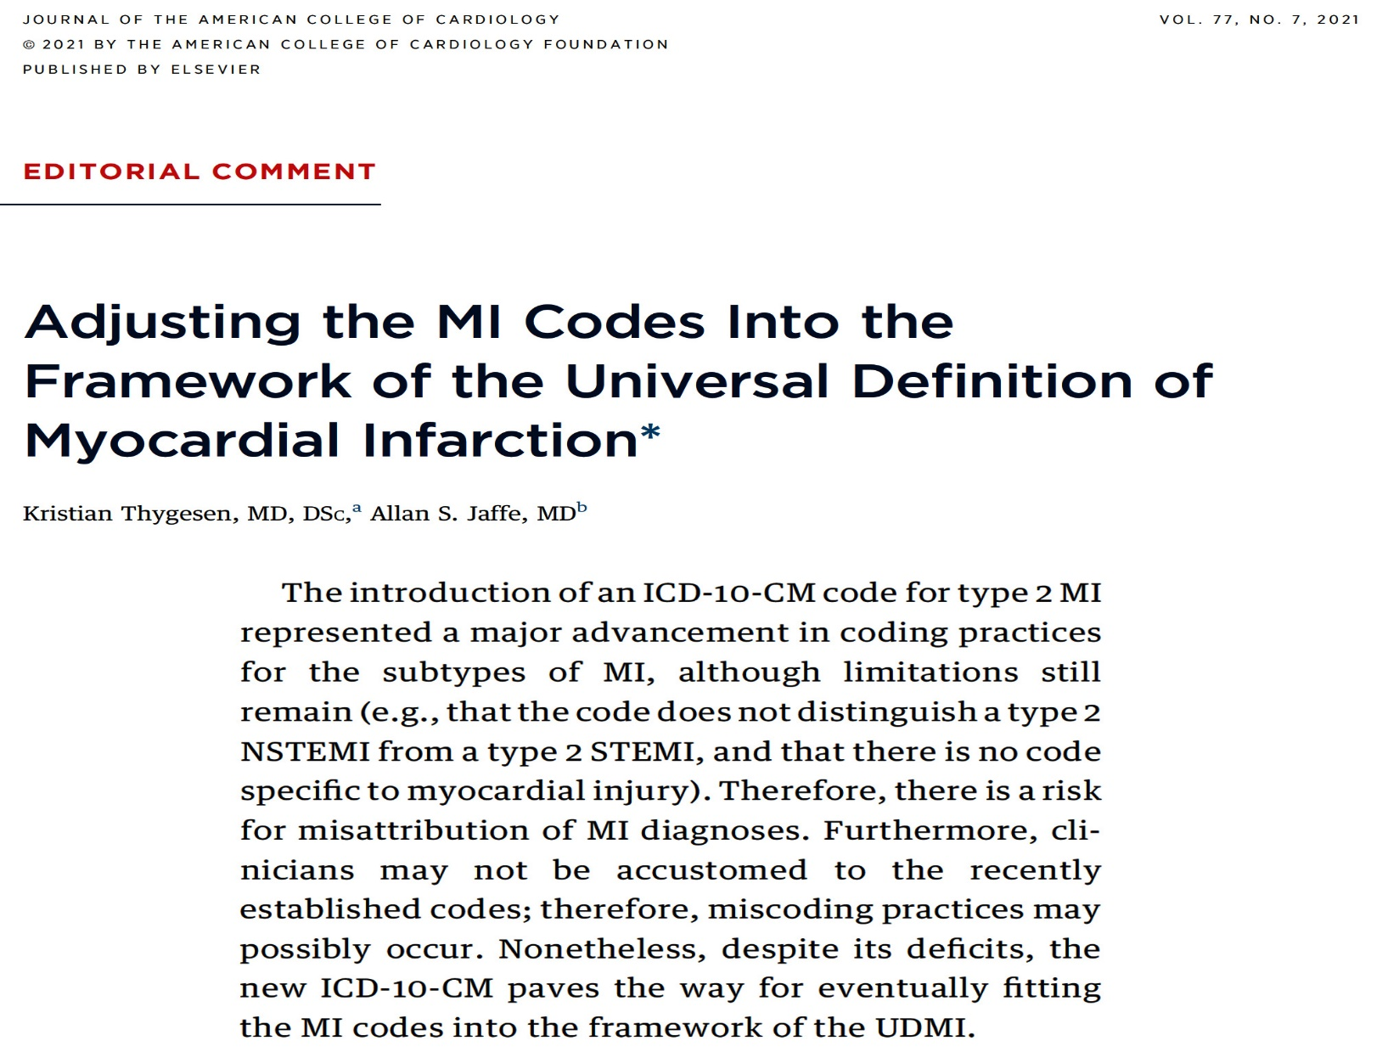
Notes:
46

Slide 47


Take Home Message:
Update FFR guided revascularization and Outcomes of type 1 vs type 2 MI
FFR guided PCI in intermediate coronary lesions:
Post-PCI FFR and outcomes:
Post-PCI FFR optimization to improve FFR >0.9:
Contribution of diffuse disease in low pot-PCI FFR:
Pt characteristics of type 1 vs type 2 MI are significantly different and with widely different with type 2 MI pts are very diverse with multiple comorbid conditions. Treatment of type 2 is also not streamlined and they are less likely to undergo invasive procedures. Despite that type 2 MI is associated with lower in-hospital death and 30-day readmission for MI.

Slide 48

Question # 1
Following statements are true regarding the outcomes of FFR vs angio guided PCI for intermediate lesions in the recent VA CART report except;
  FFR guided PCI has lower mortality
  FFR guidance resulted in higher revascularization
  FFR guided PCI was associated with lower overall MACE
  FFR guidance was associated with lower TLR and MI
  E. FFR utilization has increased overtime
The correct answer is D

Slide 49

Question # 2
Following statements are correct regarding post-procedure FFR except;
  A. Post-procedure FFR of >0.9 is uncommon
  B. Post-procedure FFR of >0.8 occurs in 20-30% of cases
  C. Post-procedure FFR value correlates with subsequent outcomes
  D. Post-procedure FFR cannot be normalized by optimization in majority
  E. Lower Post-procedure FFR occurs due to both focal or diffuse disese
The correct answer is B

Slide 50
Question # 3
Following statements are true regarding the type 2 vs type 1 MI except:
  Type 2 MI represent heterogeneous group
  Type 2 MI has lower in-hospital mortality
  Type 2 MI has higher 30-day readmission
  Type 2 MI pts are older and more female
  Type 2 MI pts undergo less invasive proceures
The correct answer is C

