Slide 1
Complex Coronary Case
Supported by:
Sun Pharmaceutical Industries Ltd.

Slide 2
Disclosures
Samin K. Sharma, MD, MSCAI, FACC
Speaker’s Bureau – BSC, Abbott, CSI
Annapoorna S. Kini, MD, MRCP, FACC
Nothing to disclose
Praveen Chandra, DM, FACC, FESC, FSCAI (Guest Faculty)
Nagendra Chouhan, MD, DNB, FACC, FSCAI (Moderator)

Slide 4
Live Case # 4
Patient Demographics
47 yrs, M with new onset angina
Present Clinical Presentation
Presented with CCS class II angina and stress MPI revealed moderate inferior, infero-lateral and antero-apical ischemia. Preop for renal transplant.
CAD Risk Factors
Hypertension
Hyperlipidemia
Uncontrolled NIDDM
CKD on HD
Clinical Variables
Cardiac cath on Dec 10,2020 revealed 3 V CAD, Syntax score 33 and mild LV dysfunction. CABG recommended but after Heart team discussion, pt decided for multivessel PCI.
Medications
Aspirin, Carvedilol, ISMN, Atorvastatin, Metformin+Sitaglaptin, Nicardipine
Cath: Cath on Dec 10th 2020 revealed 3 V CAD: 95% distal RCA with 95% angulated RPDA, 80% mid LAD/D2 bifurcation, 80% distal LAD, 90% distal LCx/OM2 bifurcation, LVEF 50% and Syntax score 33.
Plan: Now planned for multivessel PCI starting with angulated RCA/RPDA lesions and LCx and FFR of LAD/D1 lesions.

Slide 5
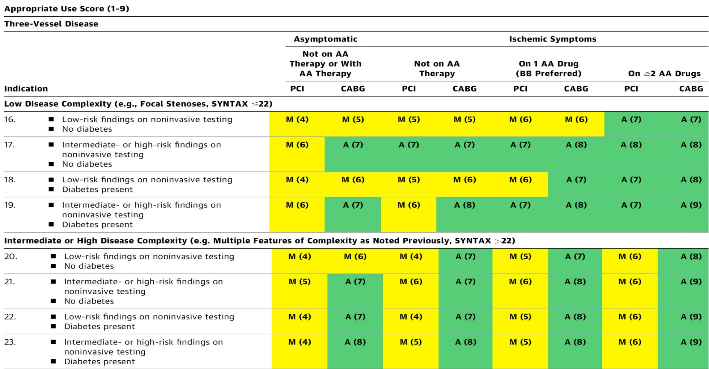
AUC 2017: Three-Vessel Disease
After Heart team discussion: A
Patel et al., J Am Coll Cardiol 2017;69:2212

Slide 6
SUPERCROSS
Angulated Catheters
VENTURE
Manufacturer: Teleflex
Tip O.D: 1.6F (tip can be deflected up to 90° to precisely direct guidewires)
Crossing Profile: 1.8F
Proximal shaft profile: 3.7F
Distal I.D (inch): 0.015
Proximal I.D (inch): 0.018
Coating: Hydrophilic
Available lengths: 140/145cm
Recommended Guidewire: 0.014”
Preferred use: Tortuous vessels, Angulated side branch rewiring
SWIFTNINJA

Slide 7
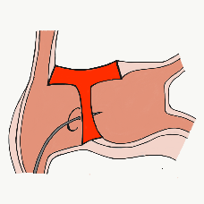
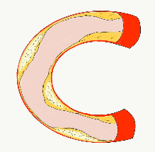
More than 35,800 unique downloads
Cath Lab Apps CardiologyApps.com
iOS 5/5 stars
9896 downloads
Android 4.4/5 stars
8245 downloads
Released sept 2017
iOS 5/5 stars
6068 downloads
Android 4.8/5 stars
3850 downloads
Released June 2018
iOS 5/5 stars
2073 downloads
Android N/A stars
549 downloads
Released March 2018
iOS 5/5 stars
1074 downloads
Android N/A stars
547 downloads
Released Sept 2018
iOS 5/5 stars
931 downloads
Android 5/5 stars
538 downloads
Released June 2019
WebApp Only*
2600 unique users
4800 sessions
Released August 2020
BifurcAID
OCTAID
TAVRcathAID
TranseptAID
CalcificAID
ComplicAID
*Also available
as WebApp
Download Apps
For Free on Both:
WebApps available free on
www.CardiologyApps.com
Apple ® and App Store® are registered trademarks of Apple Inc.
Notes:
These are the apps we have created which will provide digital algorithms for our future ambitious projects to make our cath labs smarter.

Slide 8
Apps Coming Soon…
STEMIcathAID – STEMI patient transfer platform designed to optimize communication between key members, record key performance metrics for AHA’s Mission: Lifeline program, and avoid costly false activations through direct CCL contact.
GuidewireAID – This application covers the design of coronary guidewires and the resulting properties they exhibit during use in the lab. Over two dozen teaching cases, a dense wire library with more than a hundred wires, and a robust search function provide a lot of tailored learning opportunities.
BifurcAID 3D – An animated bifurcation lesion treatment educational application and website. With two views, detailed descriptions, and more, BifurcAID 3D helps make clear the complex steps in techniques such as Minicrush, DK Crush and Culotte, as well as provisional approached and bailout techniques.

Slide 9
Issues Involving The Case
Long-term Outcomes after CABG vs PCIs for MV and LM CAD

Slide 10
Outcomes of PCI vs CABG up to 5 yrs
What we know so far?
CABG++
Lower repeat revascularization
Durable angina relief
Lower mortality in subgroups of high syntax score & MV DM
Better QOL parameters
PCI++
Rapid recovery and lower LOS
Better short term results
Lower CVA
Improvement in LVEF
Similar outcomes in LM & low syntax score (<32) pts
What happens in 5-10+ yrs?

Slide 11
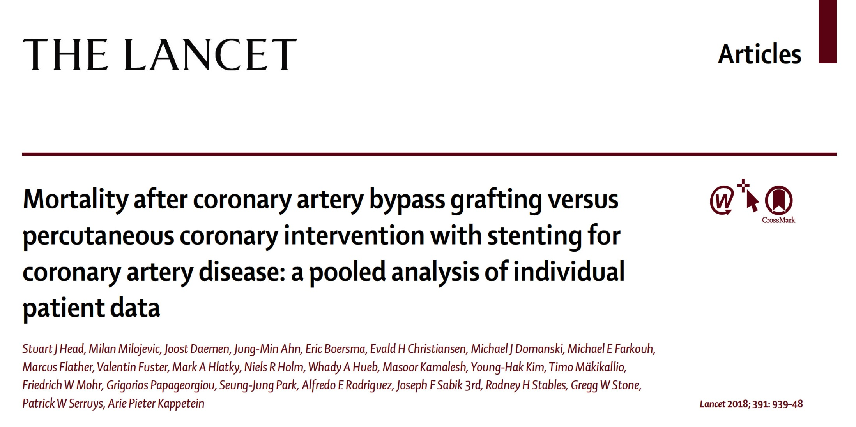

Slide 13
Mortality After CABG vs PCI During
5 Years’ Follow-Up
Overall Pooled Patient Population
Head et al., Lancet 2018;391:939

Slide 14
Mortality After CABG vs PCI During 5 Years’ Follow-Up by SYNTAX Score
Head et al., Lancet 2018;391:939

Slide 15
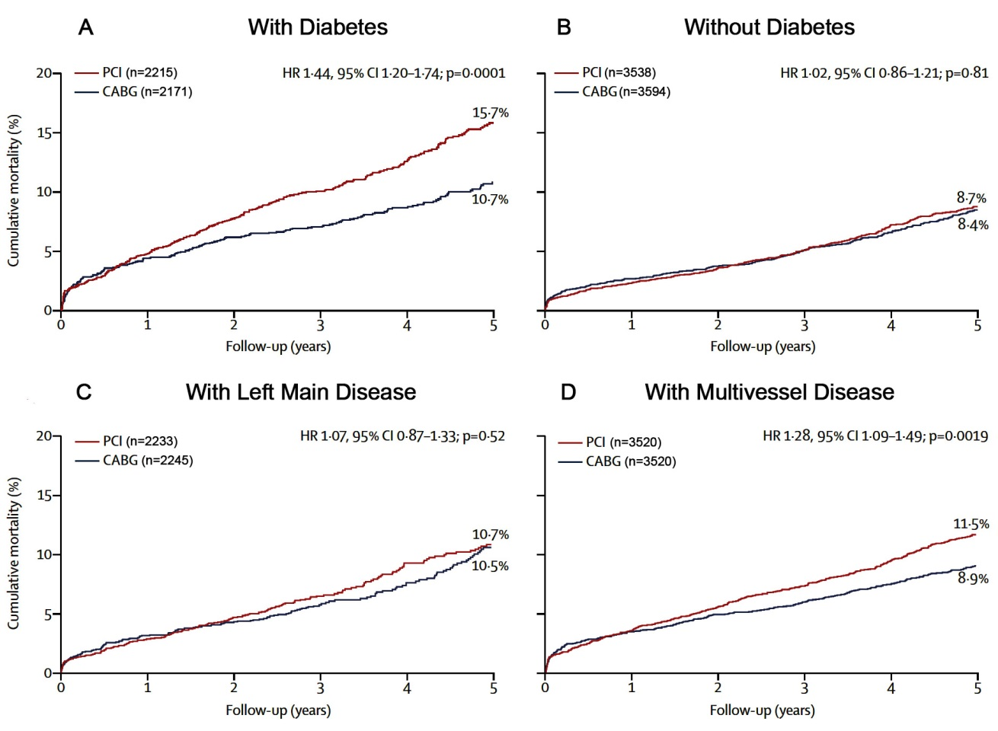
Mortality After CABG vs PCI During 5 Years’
Follow-Up in Subgroup Analysis
Head et al., Lancet 2018;391:939

Slide 17
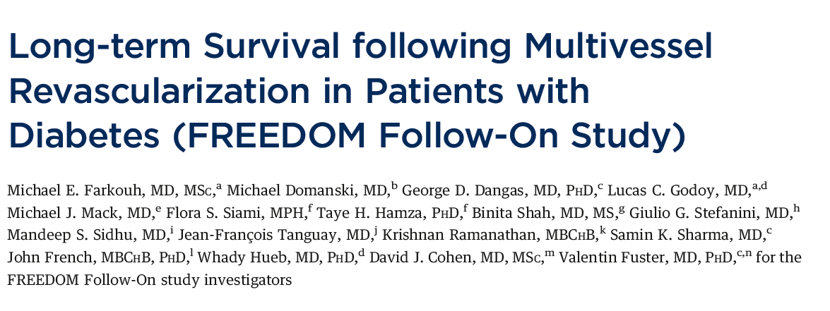
J Am Coll Cardiol Nov. 2018 Accepted Manuscript

Slide 18
FREEDOM Trial and FREEDOM
Follow-on Study
1900 patients consented to participate in the FREEDOM trial
953 were randomized to PCI
947 were randomized to CABG
After Initial MFU 3.8 years
Mortality 16.3%
P=0.049
After Initial MFU 3.8 years
Mortality 10.9%
FU rate 89%
478 subjects, MFU 7.5 Yrs
25 sites, Mortality 23.7%
465 subjects, MFU 7.5 Yrs
25 sites, Mortality 18.7%
Fuster V, AHA 2018

Slide 19
FREEDOM Trial and FREEDOM Follow-on Study
All-Cause Mortality – Extended Follow-Up Cohort (n=943)
Fuster V, AHA 2018

Slide 20
FREEDOM Trial and FREEDOM Follow-on Study
All-Cause Mortality – Whole FREEDOM Cohort (n=1900)
Fuster V, AHA 2018

Slide 21
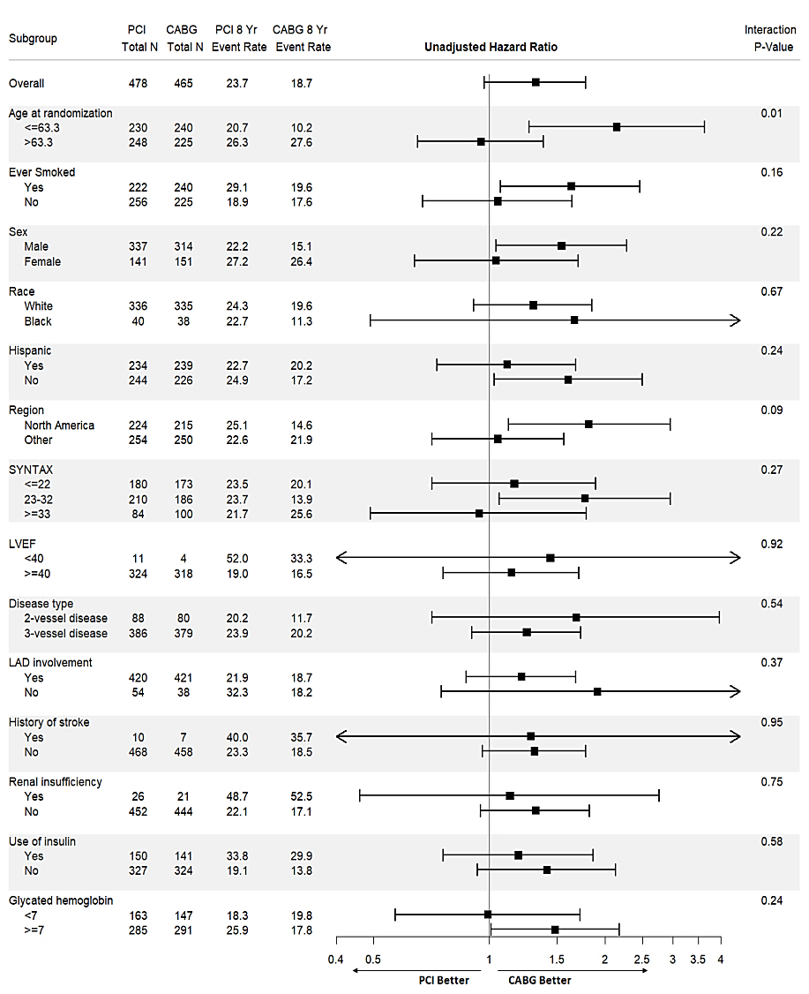
FREEDOM Trial and FREEDOM Follow-on Study
Subgroup Analyses – Extended Follow-Up Cohort
Fuster V, AHA 2018

Slide 23
