Slide 1
SFA In-Stent Restenosis Intervention
Endovascular Live Case
February 2021
Mount Sinai Hospital, N.Y.

Slide 2
Presentation
62 y.o. female with history of PAD s/p prior peripheral interventions presenting with severe right calf pain with minimal ambulation (<1 block), now progressing to pain at rest over the past 2 weeks. Diminished but palpable DP pulse on the left and present on doppler on the right. No skin ulcers/wounds. Rutherford Class II, category 4
PAD History –
Multiple prior interventions –01/14/2019 – PTA and DES to the proximal and mid right SFA (Zilver PTX 6.0 x 120mm), LSFA interventions in 2016-18
Most recently 09/28/2020 – Right CIA PTA and BMS (Absolute Pro 10.0x40mm)
Other Medical History: insulin dependent diabetes, HTN, HLD, Former smoker (quit in 1993)

Slide 3
Labs and Medications
CBC: 6.8/12.8/41.3/213
CMP: 139/4.7/107/23.4/19/0.72<96
HbA1C: 8.1%
Lipid Panel: T.chol 141, LDL 86, HDL 42, TG 64
Medications: Plavix 75mg daily, Rivaroxaban 2.5mg BID, Metformin 1000mg BID, Lantus insulin, omeprazole, Lisinopril 2.5mg daily, Atorvastatin 80mg daily

Slide 4
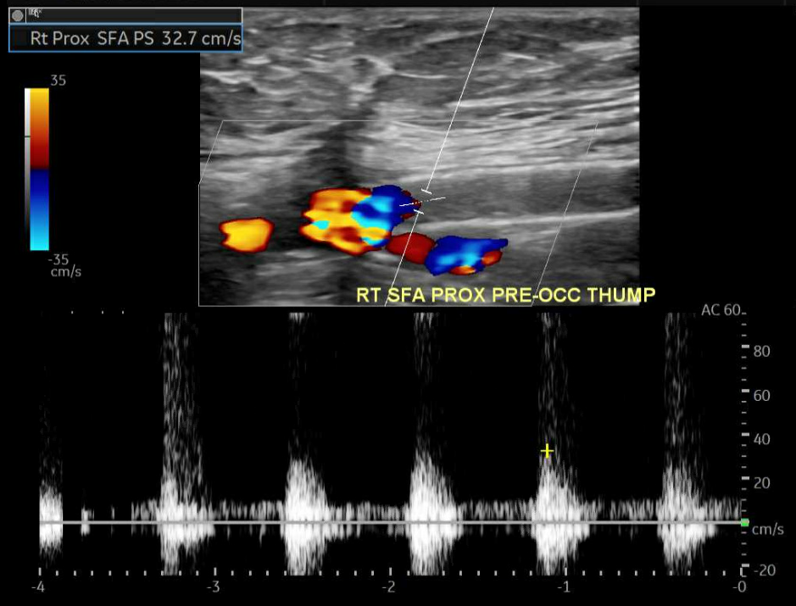
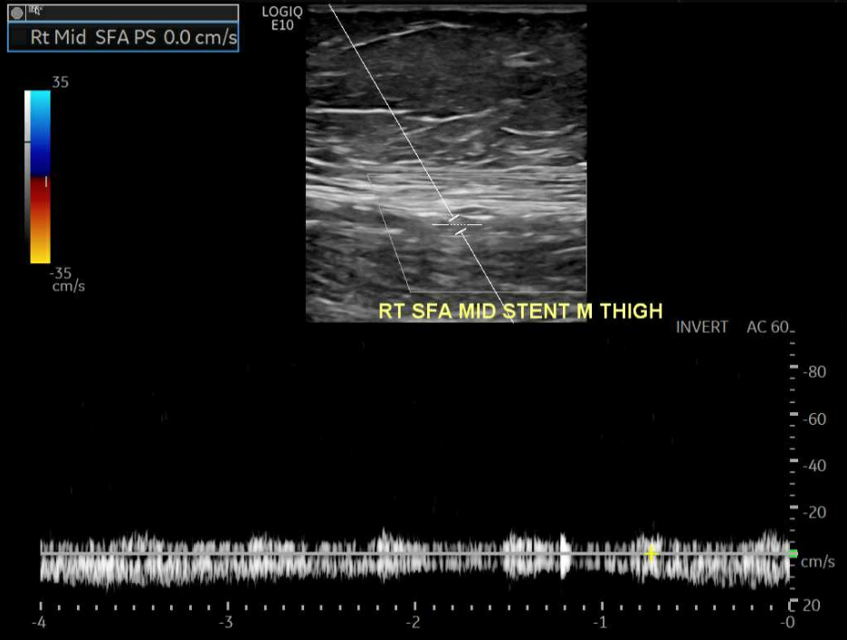
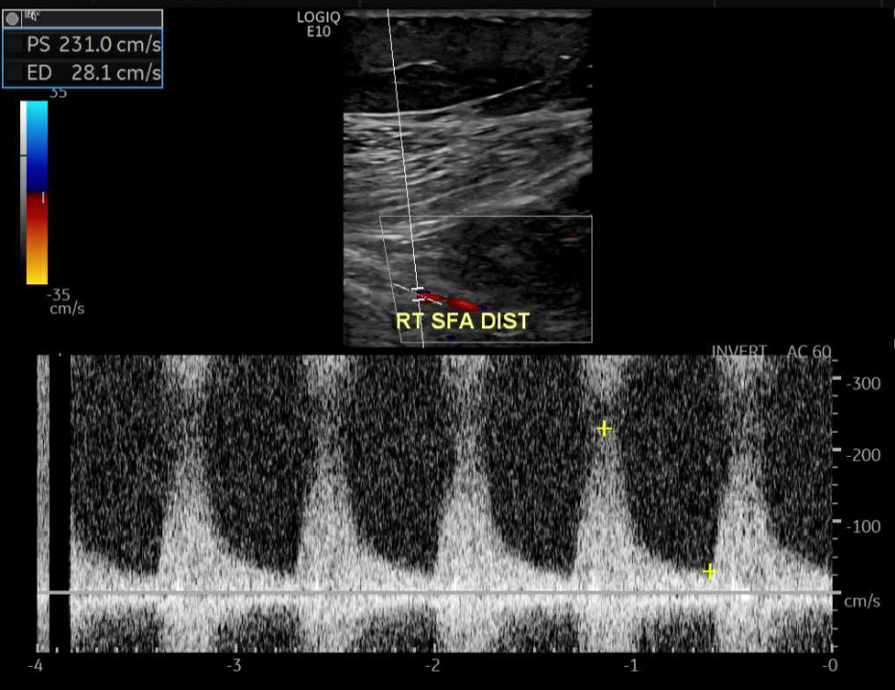
Vascular Ultrasound

Slide 5
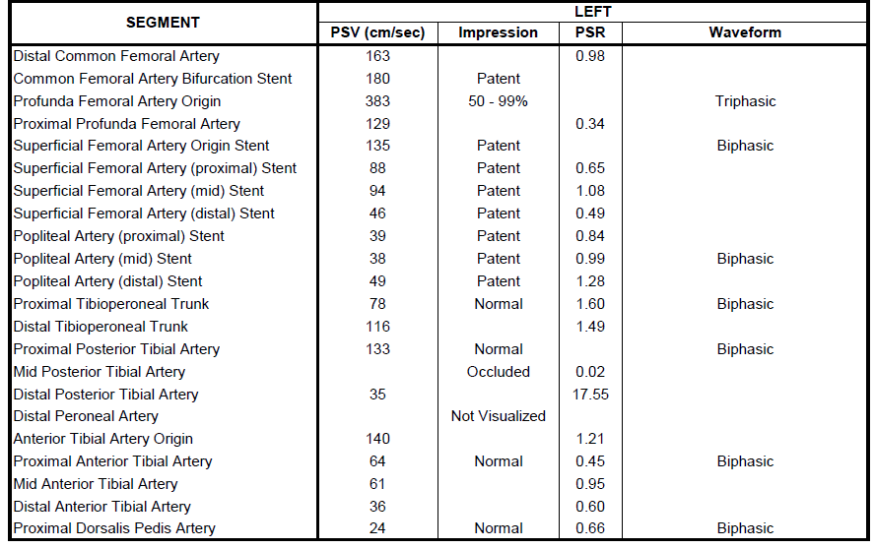
Vascular Ultrasound

Slide 6
Peripheral Angiogram – LLE Access run-off

Slide 7
Iliac Angiogram

Slide 8
Peripheral Angiogram - RLE

Slide 9
Post Iliac intervention Angiogram

Slide 10
Tosaka Classification – In stent restenotic lesions
In a multi-center, retrospective analysis of 738 patients, Tosaka et al. described patterns of ISR in femoro-popliteal lesions
Type I (focal, ≤50 mm long) – 29%
Type II (diffuse, >50 mm long) - 38%
Type III (totally occluded) – 33%
All lesions were treated by conventional BA for at least 60 seconds, and followed up for 24±17 months.
In a multi-center, retrospective analysis of 738 patients, Tosaka et al. described patterns of ISR in femoro-popliteal lesions
Type I (focal, ≤50 mm long) – 29%
Type II (diffuse, >50 mm long) - 38%
Type III (totally occluded) – 33%
All lesions were treated by conventional BA for at least 60 seconds, and followed up for 24±17 months.
Tosaka A et al. J Am Coll Cardiol. 2012 Jan 3;59(1):16-23.

Slide 11
Tosaka Classification – predictors of ISR
Tosaka A et al. J Am Coll Cardiol. 2012 Jan 3;59(1):16-23.

Slide 12
Tosaka Classification – In stent restenosis predictors
Recurrent ISR rate at 2 years was 84.8% for type III compared with 49.9% (P<.0001) in type I and 53.3% (P=.0003) in type II lesions
Recurrent occlusion rate at 2 years was 64.6% vs 15.9% and 18.9% (P<.0001 for both).
Pattern of restenosis after FP nitinol stenting therefore is an important predictor of recurrent ISR and occlusion

Slide 13
Therapies for Femoropopliteal ISR
PTA – up to 73% restenosis at 6 mo.
Cutting Balloons – 65% 6 mo. restenosis
VIABAHN Endoprosthesis
Drug Coated Balloons
Drug Eluting Stents
Laser Atherectomy +/- DCB
Directional Atherectomy
Rotational Thrombectomy (JetStream and Rotarex)

Slide 14
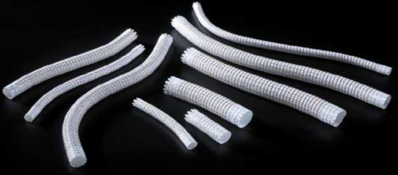
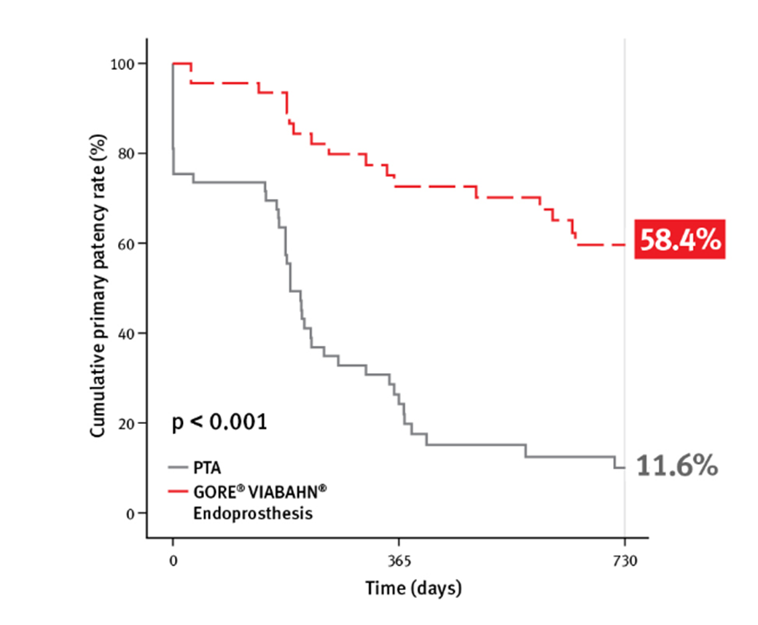
RELINE Trial Use of VIABAHN Stent Graft in FP ISR Lesions
VIABAHN Stent Graft vs Angioplasty in Long FP ISR Lesions
Prospective, multicenter, 1:1 randomized trial. Key inclusion criteria: Rutherford II-V and ABI ≤.8.
N=88 patients, randomized to VIABAHN endoprosthesis (N=39) and PTA (N=44)
Average lesion length VIABAHN: 173 mm [30 - 330 mm] vs angioplasty: 190 mm [30 - 270 mm]
Primary patency (by duplex without TLR) 79.9% in the VIABAHN group vs 28.0% in the angioplasty group (P<.001).
Freedom from TLR was also higher in the VIABAHN group than angioplasty group (79.9% vs 54.4%, P<.001), with cases in the VIABAHN arm being approximately three times less likely than those in the angioplasty arm to require a TLR at 12 months.
Bosiers M et al. Journal of Endovascular Therapy 2015;22(1):1-10.

Slide 15
DCB Use in Femoropopliteal ISR
 | Trial | Treatment arms | Avg. Length | Endpoints | Outcomes
DEBATE-ISR 2014 | RCT N=44 Diabetics + fem-pop ISR | IN.PACT Admiral (N=44) (3.5μg/mm2) DCB vs PTA (N=42) | 137cm | Recurrent ISR, TLE rate, up to 3 yrs | Recurrent ISR 19.5% vs 71.8% DCB vs POBA TLR 13.6% vs 31% At 3 yrs: TLR 40% vs 43% in DCB vs. PTA
FAIR 2016 | Prospective single center RCT 1:1 N=119 SFA ISR | IN.PACT Admiral (3.5μg/mm2) DCB vs PTA (Admiral Xtreme) | 82.2mm 29% CTO | Restenosis at 6 mo. and 1 yr. Freedom from CD-TLR All cause mortality at 12 mo. Thrombosis at 12 mo. | Restenosis at 1 yr 29.5% vs 62.5% DCB vs. POBA (p=0.004) Freedom from CD-TLR 90.8% vs 52.6% DCB vs. POBA at 1 yr (p=0.0001) All cause mortality 4.3% vs 6.8% (p=0.59) at 12 mo.
PACUBA 2016 | Prospective, dual-center RCT N=74 ISR of fem-pop lesions | Freeway balloon with shellac (3.0 μg/mm2) DCB (N=35) vs PTA (N=39) | 173mm | 1º patency at 12 mo. (<50% stenosis by duplex or CTA without TLR) Complication rate at 1 mo. Clinical Success (change in Rutherford/ABI, CD-TLR) at 30 d. | 40.7% vs 13.4% DCB vs. PTA patency rate at 12 mo. p=0.02 Freedom from CD-TLR 49% vs. 22% DCB vs. PTA, p=0.11 Change in Rutherford 69% vs. 54.5% DCB vs. PTA
ISAR-PEBIS 2017 | Dual Center RCT 1:1 N=70 SFA ISR | IN.PACT Admiral (3.5μg/mm2) DCB N=36 vs PTA N=34 | 139 mm 36% CTO | % diameter stenosis at 6-8mo. Binary restenosis, TLR, amputation/bypass surgery and all cause mortality at 24 mo. | % diameter stenosis 44% vs 65% at 6-8 mo. Binary restenosis 30% vs. 59% p=0.03 TLE 19% vs 50% p=0.007 at 24 mo.

Slide 16
DCB Meta-analyses in ISR
4 RCTs of 367 patients
DCB angioplasty vs. PTA for femoropopliteal ISR over 12 mo.
The DCB group had a lower risk for TLR (odds ratio 0.20, p=0.002) and recurrent ISR (OR 0.24, p=0.003), and a sustained RC improvement (OR 2.57, p=0.002) compared to PTA
(Cassese S et al. EuroIntervention. 2017 Jul 20;13(4):483-489).

Slide 17
Available DCBs
DCB | Company | Dose (μg/mm²) | RCT | Dose Range in RCT (mg) | Excipient | Length (mm) | Diameter (mm)
IN.PACT | Medtronic | 3.5 | IN.PACT SFA I, II | 1.9-21.7 | Urea, THF, pyrogen-free water | 40-220 | 4-7
Stellarex | Phillips | 2 | ILLUMEN- ATE | 1.3 – 9.4 | PEG 8000 and Iodine | 40-120 | 4-6
Lutonix | Bard | 2 | LEVANT 1/2 | 1.0-11.3 | Polysorbate and Sorbitol | 40-220 | 4-7
Ranger | Boston Scientific | 2 | RANGER-SFA | 6.97 (Avg dose) | Acetyl-tributyl citrate | 30-200 | 2-7

Slide 18
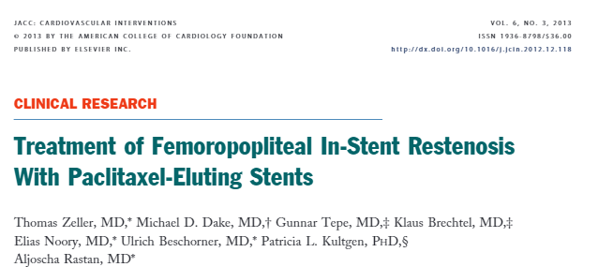
108 Patients with 119 ISR lesions enrolled in ZILVER-PTX single-arm, prospective, multicenter trial of 787 patients.
All patients treated with paclitaxel-eluting nitinol stents
Mean lesion length of 133.0 mm ±91.7 mm,
33.6% of lesions longer than 150 mm, and 31.1% of lesions with total occlusion
Primary patency at 6 months and 12 months was 95.7% and 78.7% respectively
Freedom from TLR at 6 months and 1 and 2 years was 96.2%, 81.0%, and 60.8% respectively
Rutherford class improvement 81.1% >/=3 before treatment → 60.9% had </=1 at 2 years
Significant improvement with WIQ and ABIs
1 year fracture rate 1.2%

Slide 19
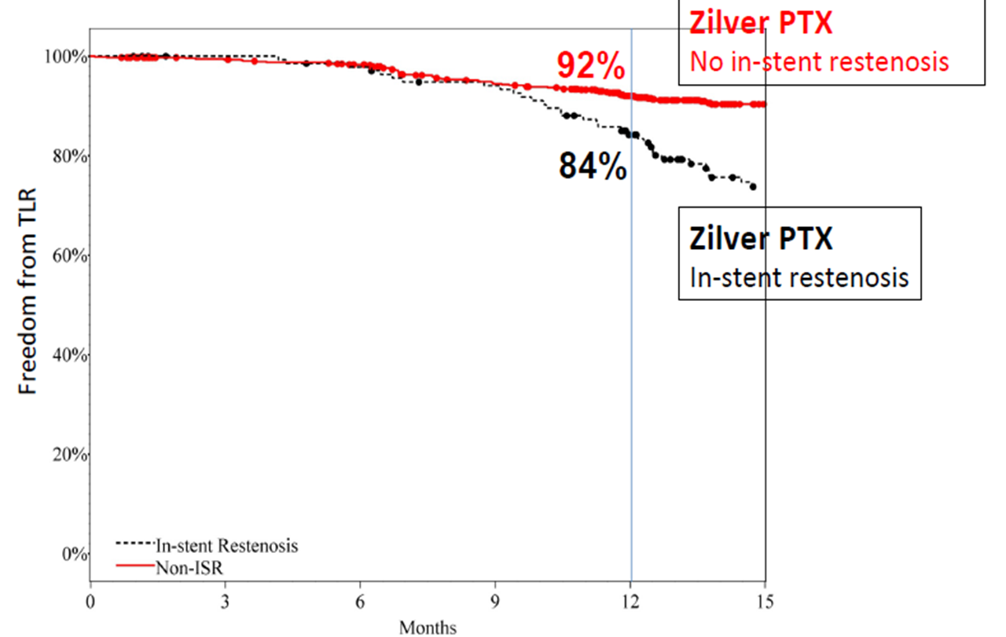

Slide 20
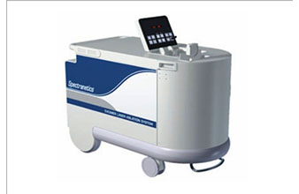
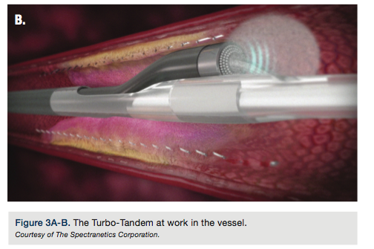
Laser Atherectomy for ISR
Uses UV light to break up chemical bonds in intra-vascular material to generate a vapor bubble and vaporize tissue
Fragments released are less than 10mcm
Minimal effect on calcium – ablates pliable lesions within calcific lesions, ISR lesions (soft plaque) and material behind stent struts
Fluence – energy required for penetration of UV light into tissue (up to 60)
PRF – number of pulses per second (maximum 80Hz)
Turbo-Elite
Turbo-Power
Turbo-Tandem

Slide 21
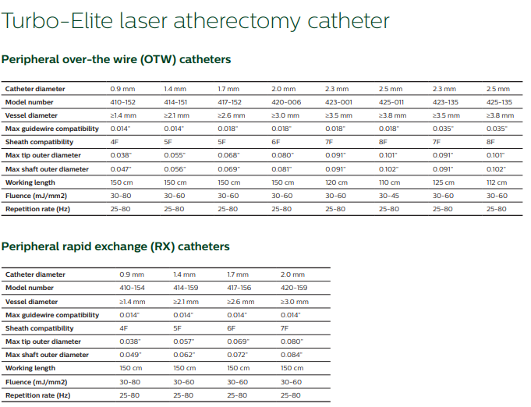
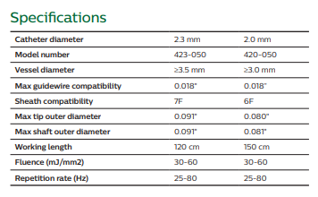
Laser Atherectomy
Turbo-Power (For Fem-pop ISR)

Slide 22
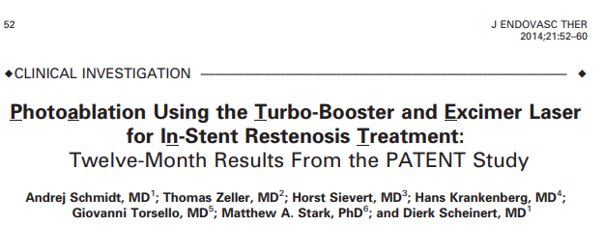
Prospective, multicenter registry of 99 patients
90% claudicants; target lesion length was 123 mm ± 96 mm;
ISR classification was well balanced (ISR class I: 26.7%, II: 38.9%, III: 34.4%)
A pilot channel was created with the Turbo-Elite laser catheter (Spectranetics) in 96.7% using a mean of 1.5 passes, while a mean 5.7 passes were performed with the Turbo-Booster (Spectranetics). Adjunctive balloon angioplasty in 87.8% cases
Primary patency (by duplex US) was 64.1% and 37.8% at 6 and 12 months, respectively.
Freedom from TLR rate was 87.8% and 64.4% at 6 and 12 months, respectively.
Distal embolization in 10%
Twelve-month primary patency stratified by ISR classification was 54.5% in class I, 27.6% in class II and 24.0% in class III, demonstrating no statistical difference (class I vs II, P=.07, class I vs III, P=.07). The authors therefore concluded that removing hyper-proliferative tissue alone does not solve the problem of ISR.

Slide 23
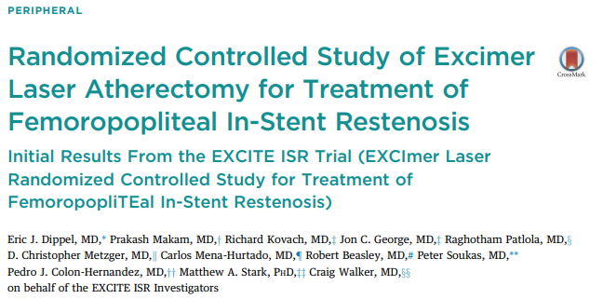
Multicenter, randomized trial of 250 patients
Excimer laser atherectomy (ELA) plus PTA (N=169) to PTA alone (N=81) for the treatment of ISR
Treatment strategy using ELA included (1) Turbo-Elite for pilot channel creation, and (2) Turbo-Tandem (Spectranetics) for biased laser catheter for large lumen ablation.
Average lesion length in both groups was 19 cm, and in 20% of patients lesion length exceeded 30 cm
Primary efficacy endpoint (freedom from TLR at 6 mo.) in the ELA plus PTA group was higher than that in the PTA alone group (94.2% vs 79.2%, P<.001, respectively)
Primary safety endpoint (freedom from MAE at 30 days) (73.5% vs 54.2%, P<.005).

Slide 25
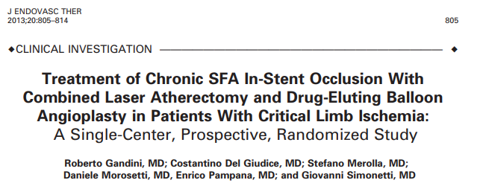
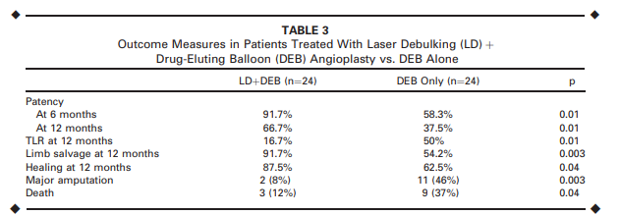
Single-center randomized controlled trial from Italy
48 patients with CLI secondary to type III ISR assigned to treatment using laser atherectomy plus DEB or DEB alone (N=24 each).
Primary patency rates at 6 months and 12 months in laser atherectomy plus DEB were statistically higher than those in the DEB alone group (91.7% and 66.7% vs 58.3% and 37.5%, P=.01), while the 12-month rate of major amputation was lower (8% and 46%, respectively).

Slide 26
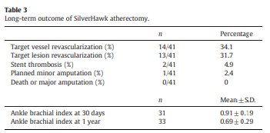
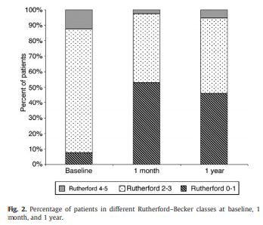
Cardiovascular Revascularization Medicine 13 (2012) 224-27
Single center, retrospective study
Outcomes of FP ISR lesions treated with SA and PTA
N=41 patients, followed for 331.63 days
Lesion length 126.2 +/- 79mm)
Embolic Protection devices used in 56.1%
Macroemboli 36.4% vs microemboli 45.5%
TLR 31.7%
TVR 24.1%

Slide 27
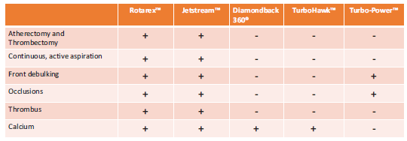

Slide 28
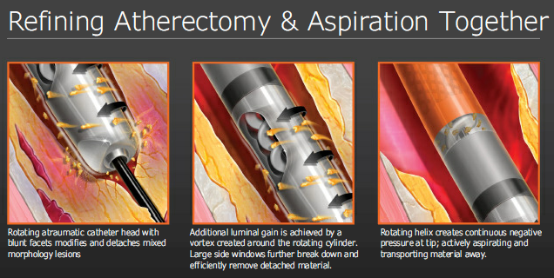
Rotarex (Straub Medical)

Slide 29
Rotarex (Straub Medical)

Slide 30
Feasibility study of 32 patients with iliac and femoropopliteal ISR treated with Rotarex followed by PTA
Subacute to chronic ISR lesions, followed for 13.1 months
Primary patency rates at 30 days was 96.8%. 6 months were 75%, and at 12 months were 58.1%,
Complications included SFA dissection, SFA and external iliac perforations and a groin hematoma. No distal embolization
One patient required reintervention (3.1%); an attempted surgical bypass and amputation. Secondary reinterventions were required in 17 patients (53.1%).
Limb salvage rate at 12 months was 90.6%.
Late mortality was 18.75% at an average follow-up of 13.1 months (3-45) due to the severe disease state of these patients.

Slide 31
Efficacy and safety of Rotarex thrombectomy plus DCB in FP-ISR lesions
Observational, prospective registry data of 32 patients (29 completed 12 mo. follow-up)
Outcomes
Primary patency (by duplex without CD-TLR) at 12 months was 86.2%
Freedom from CD-TLR rate at 12 months was 89.7% (26/29)
Mean ABI: 0.45 ± 0.14 (baseline)-→0.84 ± 0.12 at 12 months ( P < 0.05).
WIQ score was 30.45 ± 21.14 (baseline)-→ 52.68 ± 29.75 (12 months) (P < 0.05)

Slide 32
JetStream Atherectomy (Bos Sci)
Rotational atherectomy catheter with active aspiration to minimize distal embolization
For treatment of infrainguinal disease
Compatible with any 0.014” wire, Barewire and Nav6 filter
Size of device used depends on amount of plaque excision – blades up (max tip) vs. blades down (min tip)
SC (Single cutter) – only front end cutting with no BU option
Plaque consisting of calcium, thrombus, soft/fibrous plaque or total occlusions
Early data from JET registry – rate of distal embolization 3.6% with no adverse events

Slide 33
Prospective cohort of 29 patients with femoropopliteal ISR in 32 limbs (follow-up 27 patients at 6 and 12 mo.)
Lesion length was 17.4±13.1 cm
Acute success (<30% residual stenosis) in 29/32 (91%) limbs.
Acute device success (<50% residual narrowing after atherectomy alone): 76% (22/29).
Adjunctive balloon angioplasty performed in all cases
Embolic filter protection used in 16 (50%) of 32 limbs.
Macrodebris was noted in 2 (12%) of 16 filters.
Distal embolization requiring treatment occurred in 3/32 (9.4%) limbs (2 with no filter). Other non-procedure-related adverse events were 1 (3%) death (nonvascular) and 1 (3%) case of major bleeding.
No new stent fractures
TLR: 4/29 (14%) at 6 mo. and 12/29 (41%) at 12 mo.
Patency (duplex-derived peak systolic velocity ratio <2.4) was 72% at 6 months.

Slide 34
Zeller T et al. JACC: CVI, Vol 6, No 3, 2013 (274-81)

Slide 35
Thank you

