Slide 1
Complex Coronary Cases
Supported by:
Sun Pharmaceutical Industries Ltd.

Slide 2
Disclosures
Samin K. Sharma, MD, MSCAI, FACC
Speaker’s Bureau – BSC, Abbott, CSI
Annapoorna S. Kini, MD, MRCP, FACC
Nothing to disclose
A.Srinivas Kumar, MD, DM, FACC (Faculty)
Director Cardiology & Clinical Research, Apollo Hospital, Hyderabad
M.Gokul Reddy, MD, DM, FACC (Moderator)
Senior Consultant Cardiologist, Apollo Hospital, Hyderabad

Slide 6
Complex Live Case #2: Mount Sinai Cath Lab
Patient Demographics
71 yrs, male with long standing
History of CAD and ischemic CM
Present Clinical Presentation
Recently presented with CCS class III angina and HFrEF. Cardiac cath revealed 3 V CAD and severe LV dysfunction.
CAD Risk Factors
Controlled Hypertension
Controlled Hyperlipidemia
Chronic A Fib
Clinical Variables
Known 3 V CAD for 15 yrs and has been managed on GDMT due to extensive calcification and frailty. Pt had 2 MIs in the past. CABG declined. Recent thallium redistribution scan revealed viable myocardium in lateral & anterior walls
Medications
Apixiban, Clopidogrel, Atorvastatin, Carvedilol, Lisinopril, ISMN, HCTZ
Cath: Cath done on 12/1/2020 revealed 3 V CAD: 60% prox RCA, 80-90% segmental calcified prox-mid LAD and 80% D1 bifurcation, 95% calcified prox LCx, LVEF 30% and Syntax score 33. Pt underwent RotaDES PCI of prox LCx and did well. Pt still has CCS class II angina on MMT. rSS =28.
Plan: Now planned for staged Impella assisted (Protected) PCI of LAD/D1 bifurcation using rotational atherectomy and IVUS imaging for final stent optimization.

Slide 7
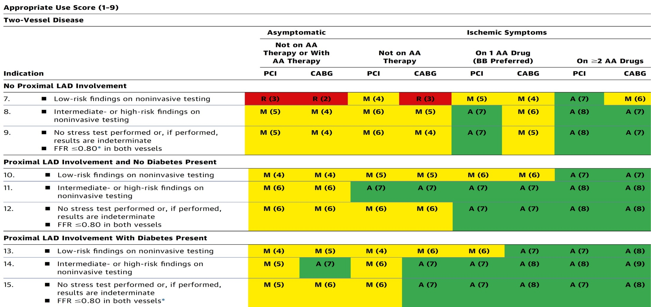
AUC 2017: Two-Vessel Disease
Patel et al., J Am Coll Cardiol 2017;69:2212

Slide 8
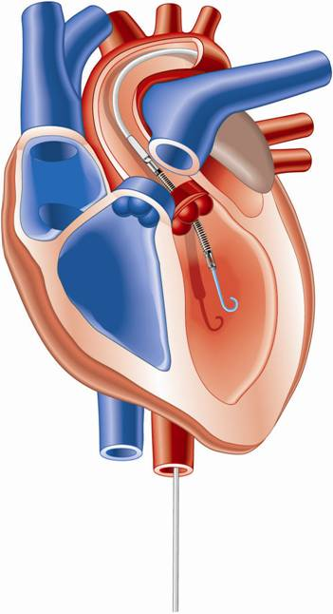
Percutaneous LV Assist Devices
PTVA:
TandemHeart
IMPELLA:
Recovers 2.5/CP
IABP

Slide 9
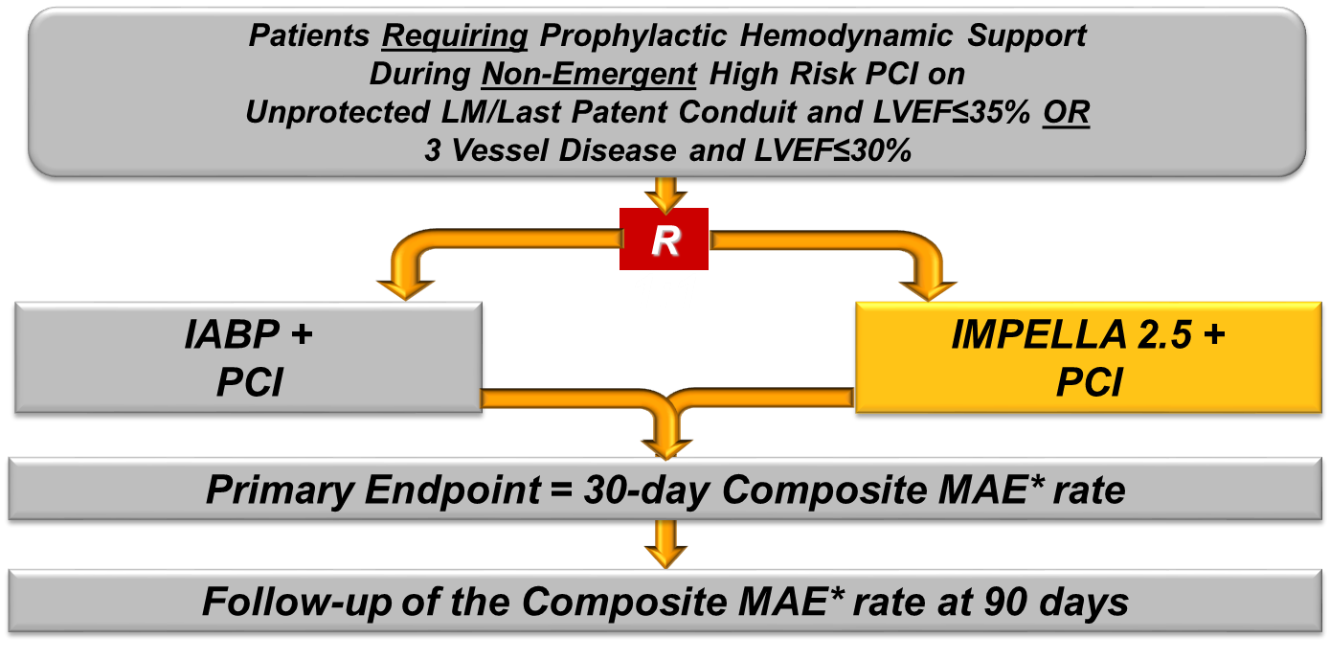
Protect II Trial Design
*Major Adverse Events (MAE) :
Death, MI (>3xULN CK-MB or Troponin) , Stroke/TIA, Repeat Revasc, Cardiac or Vascular Operation or Vasc. Operation for limb ischemia, Acute Renal Dysfunction, Increase in Aortic insufficiency, Severe Hypotension, CPR/VT, Angio Failure
O’Neill et al., Circulation 2012;126:1717

Slide 10
Impella Reduces Major Adverse Events
Per Protocol
(N=427)
30 Day
MAE
90 Day
MAE
50
IABP
22%
reduction
22% reduction
In MACCE
45
p=0.023
40
p=0.092
Major Adverse Events Rate (%)
Impella
35
30
25
Log rank test, p=0.048
N=211
N=216
N=210
N=215
20
IABP
Impella
IABP
Impella
0
10
20
30
40
50
60
70
80
90
Time post index procedure (days)
O’Neill et al., Circulation 2012;126:1717

Slide 11
Composite Death, Stroke, MI, Repeat Revasc (MACCE)
N=427
MACCE (%)
30
29% reduction
In MACCE
25
IABP
N=211
20
Impella
15
N=216
10
p=0.042
0
10
20
30
40
50
60
70
80
90
Time Post Procedure (day)
Dangas et al., Am J Cardiol 2014;113:222

Slide 12
LV Support during High-risk PCI:
LVEF + Lesion Complexity
LVEF >35%
LVEF 20-35%
LVEF <20%
Simple PCI
Complex PCI
Simple PCI
Complex PCI: High Syntax score >32/ STS>5 Extensive revascularization
Simple or Complex: Inoperable cases
IABP/?Impella
None or IABP
No support
Impella
/IABP (if Impella is CI)
Impella/PTVA
Notes:
12

Slide 13
PROTECT III: PROTECT Study Enrollment
Only FDA RCT Ever Conducted for Hemodynamically Supported High-Risk PCI
898
448
FDA Pilot
FDA Pivotal RCT
FDA Post-Approval Study
2006-2007
2007-2010
2017-2019
(Ongoing Enrollment)
Popma J, TCT 2019

Slide 14
Baseline Characteristics
PROTECT III vs. PROTECT II
 | PROTECT III |  |  | PROTECT II
 | All N=898 | Impella CP N=571 | Impella 2.5 N=327 | Impella 2.5 N=216 | p-value PROTECT III All vs P II
Age | 70.9±11.0 | 71.0±11.0 | 70.6±11.1 | 67.5±11.0 | <0.001
Sex - Female | 26.3% | 25.6% | 27.5% | 19.4% | 0.044
Race - Caucasian | 67.5% | 70.3% | 62.6% | 83.8% | <0.001
Hypertension | 91.0% | 89.9% | 92.9% | 88.0% | 0.197
Diabetes | 55.6% | 56.4% | 54.3% | 53.2% | 0.542
Prior Stroke | 16.1% | 16.4% | 15.5% | 12.0% | 0.170
Renal Insufficiency | 26.2% | 29.0% | 21.3% | 22.7% | 0.338
COPD | 21.3% | 22.9% | 18.4% | 26.1% | 0.143
NYHA Class III/IV | 71.8% | 70.5% | 74.4% | 67.4% | 0.311
MAP | 88.5±15.5 | 88.1±15.4 | 89.3±15.7 | 88.4±14.6 | 0.874
LVEF% | 32.3±15.2 | 31.6±15.1 | 33.6±15.3 | 23.4±6.3 | <0.001
Popma J, TCT 2019

Slide 15
Procedural Characteristics
PROTECT III vs. PROTECT II
 | PROTECT III |  |  | PROTECT II
 | All N=898 | Impella CP N=571 | Impella 2.5 N=327 | Impella 2.5 N=216 | p-value PROTECT III All vs P II
# Vessels Treated | 2.00±0.77 | 2.00±0.75 | 2.02±0.80 | 1.81±0.67 | <0.001
3 Vessels Treated | 29.9% | 28.2% | 32.7% | 14.4% | <0.001
LAD | 37.7% | 37.6% | 37.9% | 34.2% | 0.123
Left Main | 15.7% | 16.8% | 13.5% | 11.5% | 0.011
LCx | 27.7% | 27.1% | 28.9% | 28.5% | 0.716
RCA | 15.7% | 15.3% | 16.4% | 19.0% | 0.058
Pre-PCI TIMI 0/1 | 14.7% | 15.7% | 12.5% | 7.0% | <0.001
Atherectomy Use | 43.3% | 45.2% | 40.0% | 14.2% | <0.001
# Vessels w/ Atherectomy | 2.01±0.75 | 2.03±0.74 | 1.96±0.77 | 1.44±0.62 | <0.001
Contrast Volume (mL) | 204.2±105.6 | 206.9±105.4 | 199.4±106.0 | 267.5±141.7 | <0.001
Length of Support (hrs) | 6.79±21.1 | 7.78±22.3 | 4.83±18.2 | 1.9±2.7 | <0.001
Popma J, TCT 2019

Slide 16
PROTECT III Outcomes Compared to Protect II
Composite Major Adverse Cardiac and Cerebrovascular Events (MACCE) at 90 Days
p<0.0001
p= 0.033
N = 210
N = 215
N = 469
PROTECT II RCT
PROTECT III
MACCE = Death, Stroke, MI, Repeat Revascularization
N = number of patients with 90-day follow-up
Popma J, TCT 2019

Slide 17
PROTECT III Sub-Study of AKI Reduction
PROTECT III Subgroup¹:
Patients with recorded baseline creatinine, and at least 1 follow-up creatinine measurement within 48-72 hours of PCI were included
Patients on dialysis at the time of PCI were excluded
223 patients were identified
AKI Rate (PM)
P=0.0002
Control Group²:
Elective or urgent HRPCI patients treated without Impella support in the University of Louisville AKI study
108 patients were identified
Propensity Score (PS) Matching³:
Patients were matched 1:1 based on propensity scores by Age, Gender, Diabetes, Contrast volume, GFR
106 patients were matched in each arm
N=106
N=106
Control
(No Support)
PROTECT III
(Propensity Matched)
Flaherty et al., Catheter Cardiovasc Interv. 2019
Flaherty et al., Circ Res. 2017;20:692
Abiomed internal data submitted to FDA, 2019

Slide 18
Trends and Outcomes of ISR

Slide 19
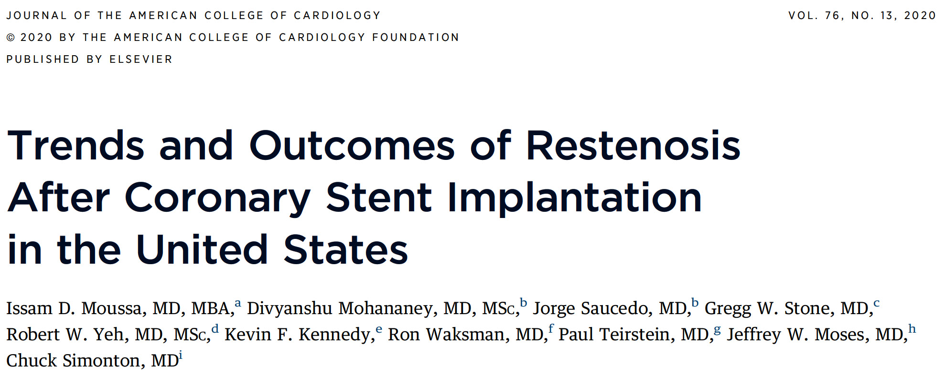

Slide 20
Flowchart of the Study Cohort
CathPCI Index Procedures: 2009Q3-2017Q2
N=5,322,898
Exclusions
Shock: n=161,022
Arrest: n=59,073
Salvage: n=2,409
Analytic Cohort
n=5,100,394 PCIs
ISR PCI
n=542,112 (10.6%)
Non-ISR PCI
n=4,558,282 (89.4%)
BMS ISR PCI
n=86,111
(16%)
DES ISR PCI
n=295,489
(55%)
Undefined PCI
n=160,512
(29%)
Moussa et al., J Am Coll Cardiol 2020;76:1521

Slide 21
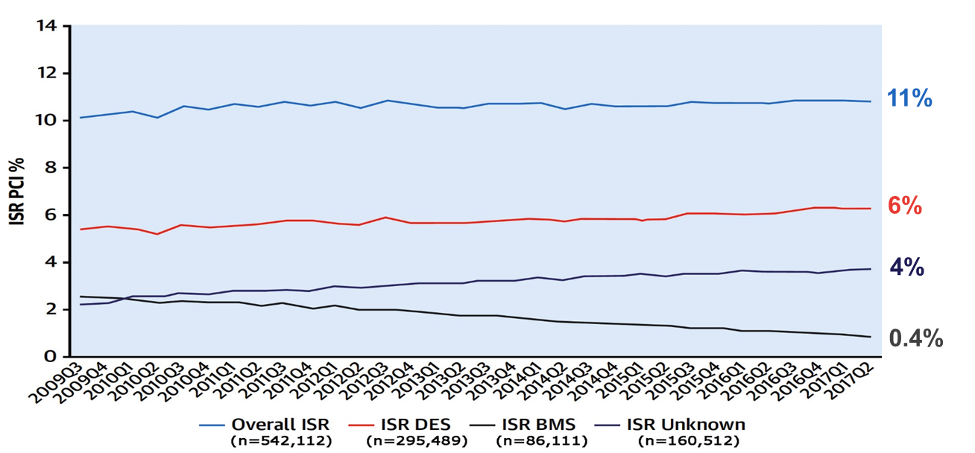
Temporal Trends of Incidence of PCI for ISR
Incidence of PCI for ISR in pts enrolled in the CathPCI NCDR Registry between 2009 as 2017 based on stent type
Moussa et al., J Am Coll Cardiol 2020;76:1521

Slide 22
CAD Clinical Presentation: ISR PCI vs Non-ISR PCI
 | Total (N = 5,100,394) | ISR PCI (N = 542,112) | Non-ISR PCI (N = 4,558,282) | p Value
No angina | 5.9 | 4.2 | 6.1 | ns
Symptoms unlikely to be ischemic | 2.3 | 1.7 | 2.4 | ns
Stable angina | 14.8 | 15.1 | 14.8 | ns
Unstable angina | 40.0 | 51.8 | 38.6 | <0.001
NSTEMI | 22.1 | 18.7 | 22.5 | <0.001
STEMI | 15.0 | 8.5 | 15.7 | <0.001
Moussa et al., J Am Coll Cardiol 2020;76:1521

Slide 23
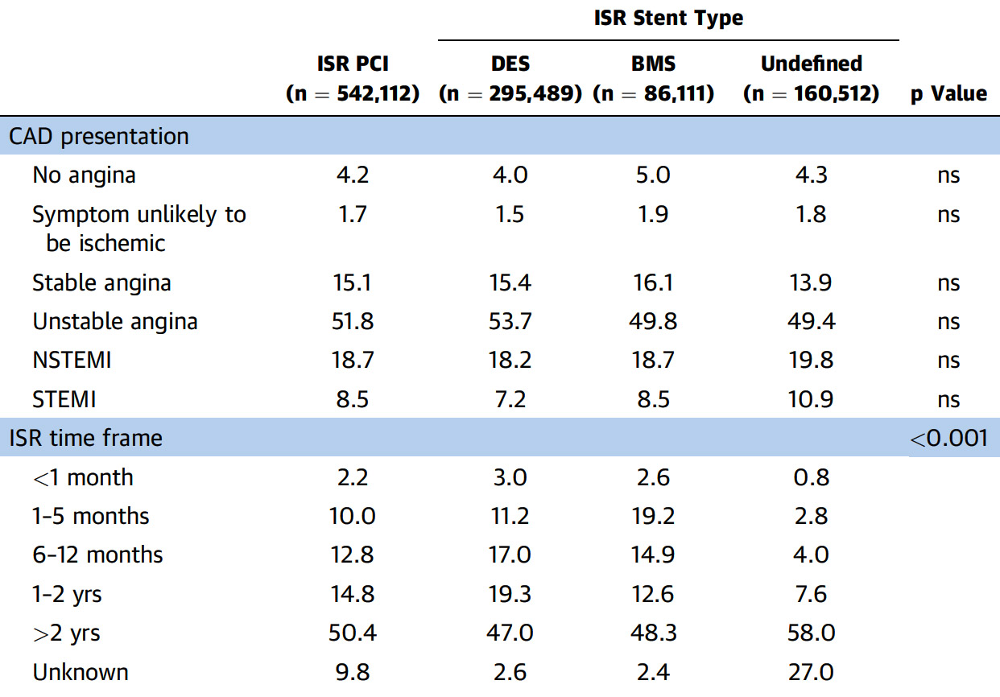
Clinical Presentation Based on ISR Type
Moussa et al., J Am Coll Cardiol 2020;76:1521

Slide 24
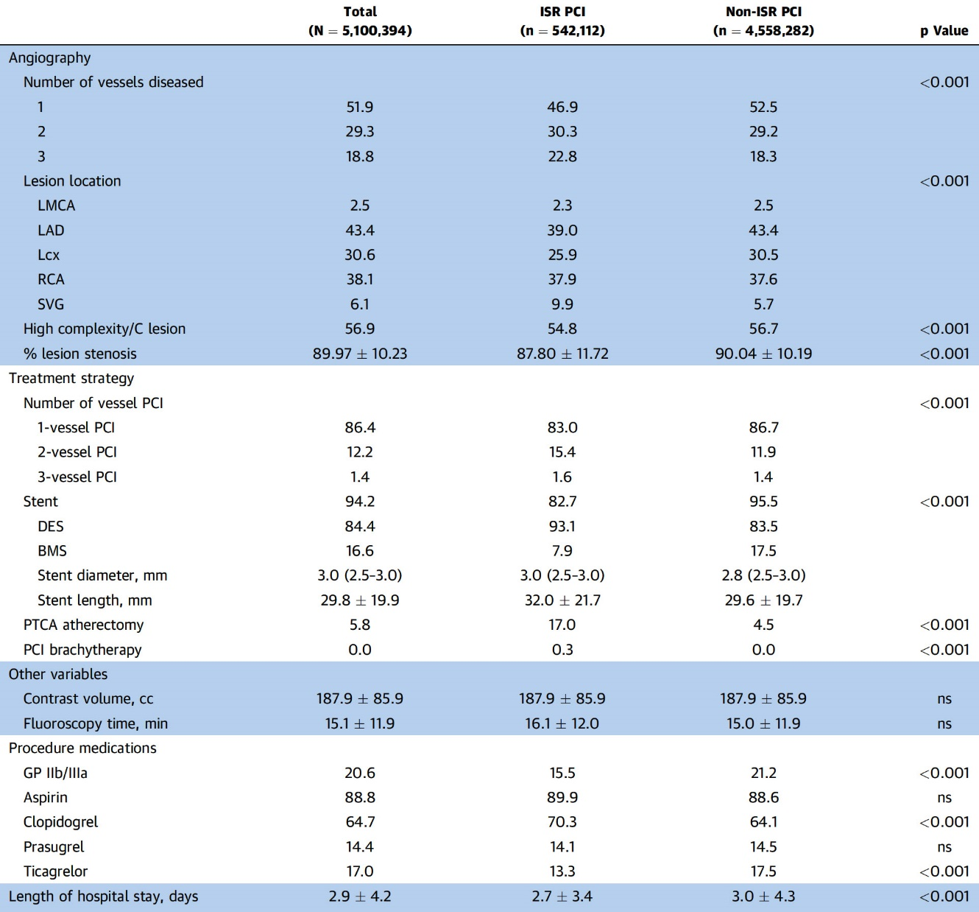
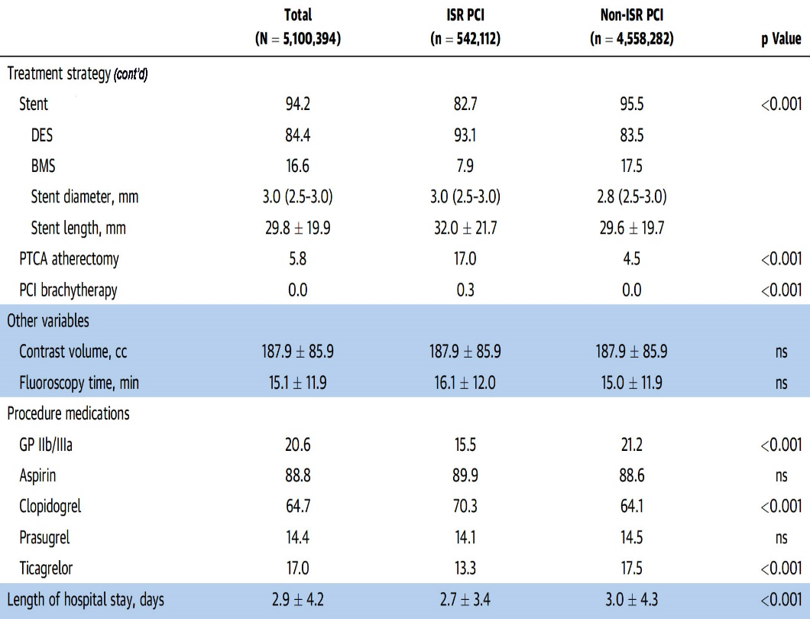
Baseline Angiographic Characteristics and Treatment Strategy: ISR PCI vs Non-ISR PCI Pts
Moussa et al., J Am Coll Cardiol 2020;76:1521

Slide 25
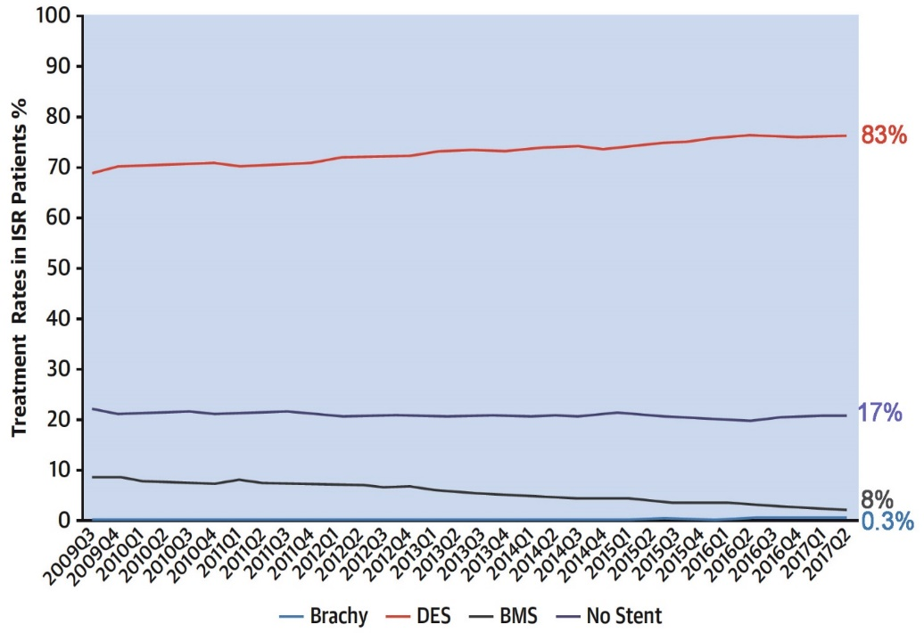
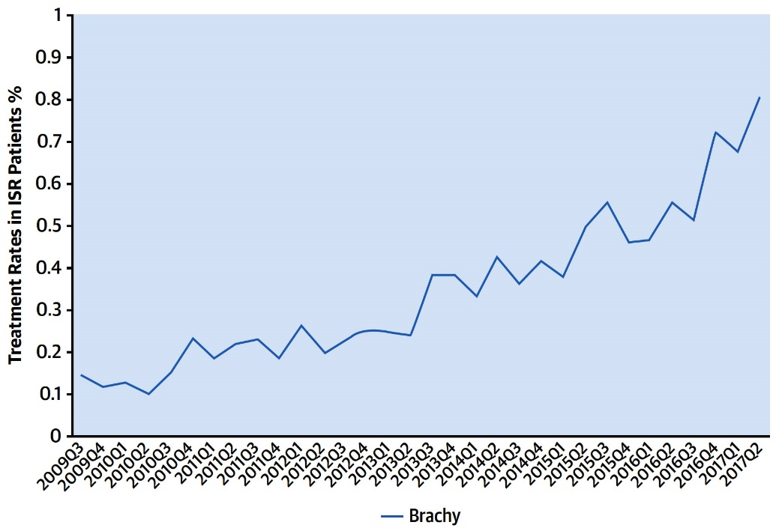
ISR PCI Treatment Strategies in USA
Temporal Trends of Treatment Modalities of ISR in the US (N=542,112)
Temporal Trend of Brachytherapy Use for Treatment of ISR in the US
Moussa et al., J Am Coll Cardiol 2020;76:1521

Slide 26
In-Hospital Outcome: ISR PCI vs Non-ISR PCI Pts (Matched Population)
%
Moussa et al., J Am Coll Cardiol 2020;76:1521

Slide 28
Drug Coated Balloon?
IVBT?
Imaging guided PCI
Need of Reintervention After First and Recurrent ISR
%
For ISR
Kastrati and Cassese, J Am Coll Cardiol 2020;76:1532

Slide 29
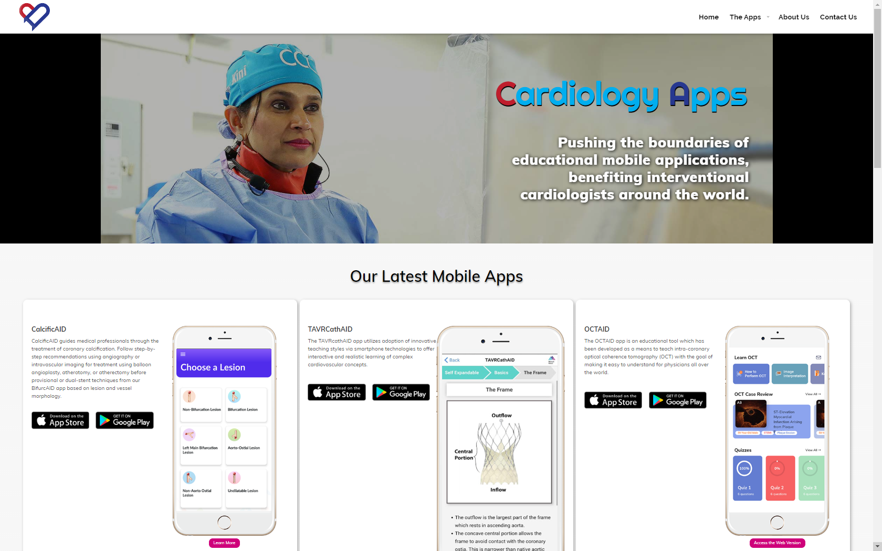
CardiologyApps.com
CardiologyApps.com
Notes:
You can learn about BIfurcAID and other apps from Mount Sinai Cath Lab on our new “Cath Lab Apps” website, which should be available soon

Slide 30
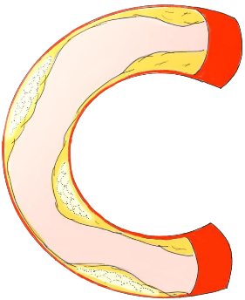
CalcificAID
Free Download

Slide 31
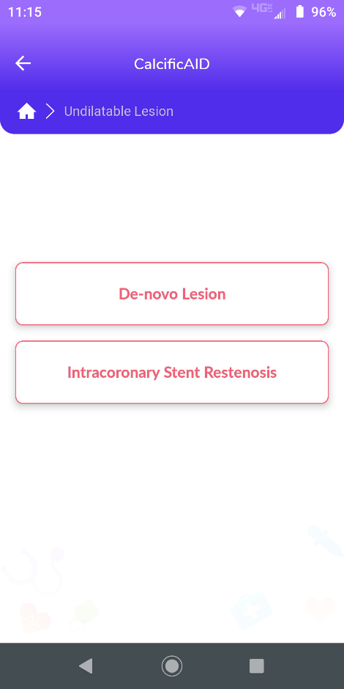
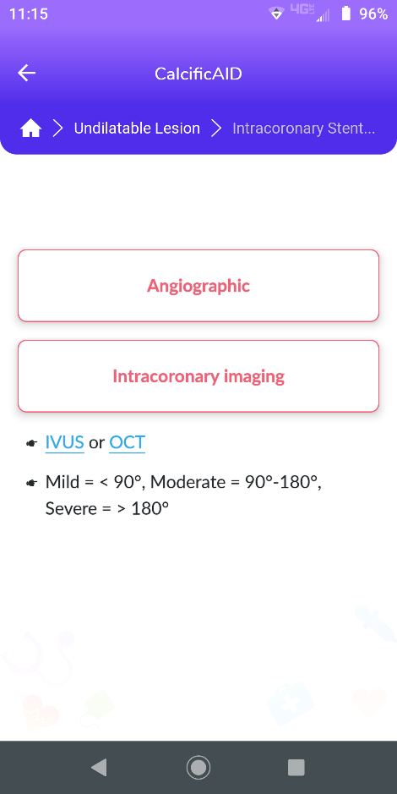
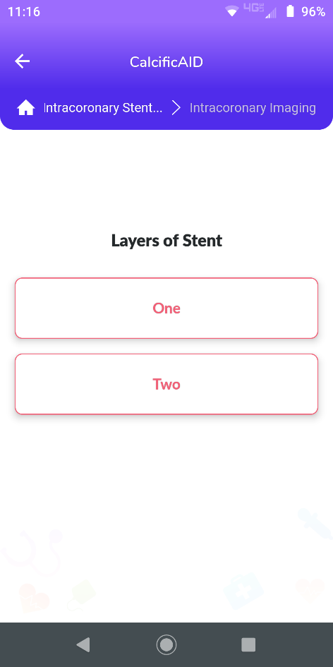
CalcificAID

Slide 32
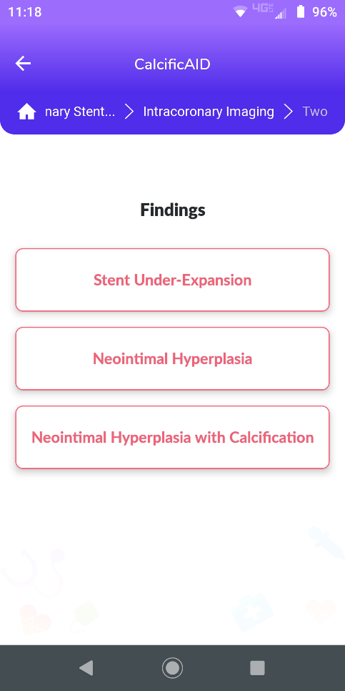
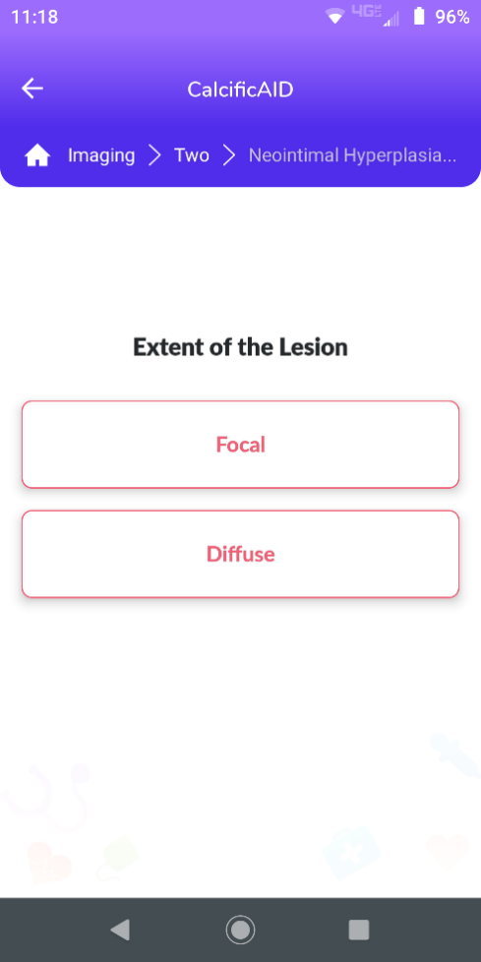
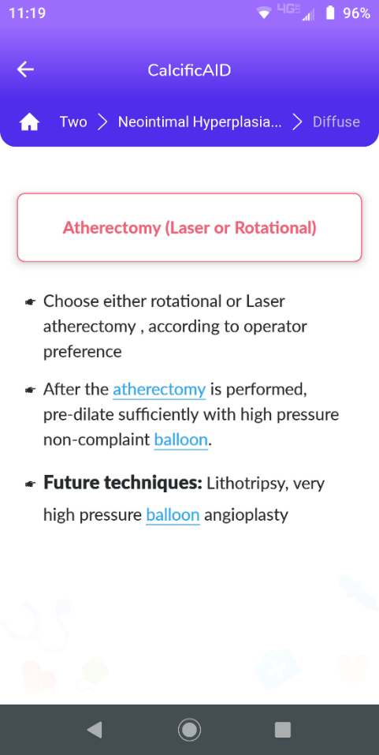
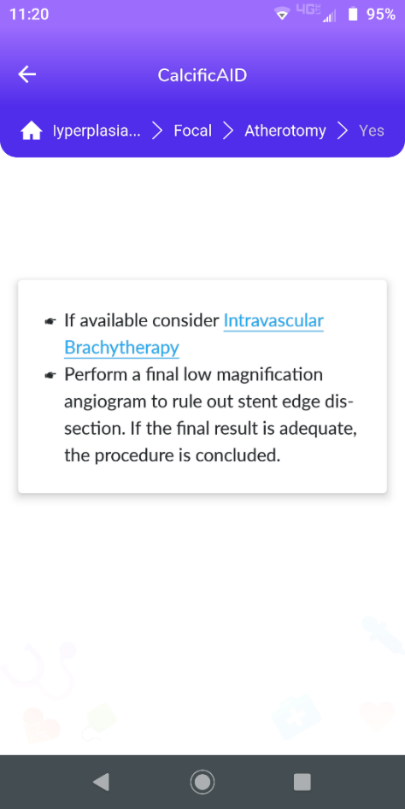
CalcificAID

Slide 33
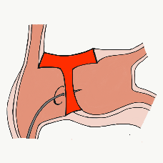
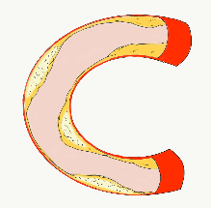
More than 28,000 unique downloads
Cath Lab Apps CardiologyApps.com
iOS 5/5 stars
8596 downloads
Android 4.4/5 stars
6145 downloads
Released sept 2017
iOS 5/5 stars
5068 downloads
Android 4.8/5 stars
2850 downloads
Released June 2018
iOS 5/5 stars
2073 downloads
Android N/A stars
549 downloads
Released March 2018
iOS 5/5 stars
1074 downloads
Android N/A stars
547 downloads
Released Sept 2018
iOS 5/5 stars
931 downloads
Android 5/5 stars
538 downloads
Released June 2019
Coming Soon
BifurcAID
OCTAID
TAVRcathAID
TranseptAID
CalcificAID
STEMIcathAID
Download for
Free on Both::
Apple ® and App Store® are registered trademarks of Apple Inc.
Notes:
These are the apps we have created which will provide digital algorithms for our future ambitious projects to make our cath labs smarter.

