Slide 1
Complex Coronary Case
Supported by:
Abbott Vascular Incorp.
AIM 2020

Slide 2
Disclosures
Samin K. Sharma, MD, MSCAI, FACC
Speaker’s Bureau – BSC, Abbott, CSI
Annapoorna S. Kini, MD, MRCP, FACC
Nothing to disclose

Slide 3
Live Case # 1
Patient Demographics
72 yrs, F, No prior cardiac history
Present Clinical Presentation
Presented to OSH with CCS class III angina and stress MPI revealed moderate antero-apical and inferior ischemia
CAD Risk Factors
Hyperlipidemia
GERD
Anemia
Clinical Variables
Cardiac cath on Nov 10,2020 revealed oLM + 2 V CAD
Echo revelaed EF 60%, no valvular disease
Medications
Aspirin, Clopidogrel, Metoprolol XL, Atorvastatin
Cath: Cath on Nov 12th 2020 revealed LM+ 2 V CAD: 60% ostial LM, long 80% calcified prox LAD, 80% pRCA, LVEF 58% and Syntax score 22. After Heart team discussion PCI was considered best option due to SS. Pt underwent PCI of pRCA using Xience Sierra (3/23) DES
Plan: Now planned for OCT guided PCI of ostial LM and prox LAD using Rotational atherectomy and Xience DES.

Slide 4
AUC 2017: Revascularization to Improve Survival
Compared with Medical Therapy
Syntax score 22; STS score 1.2
Patel et al., J Am Coll Cardiol 2017;69:2212

Slide 5
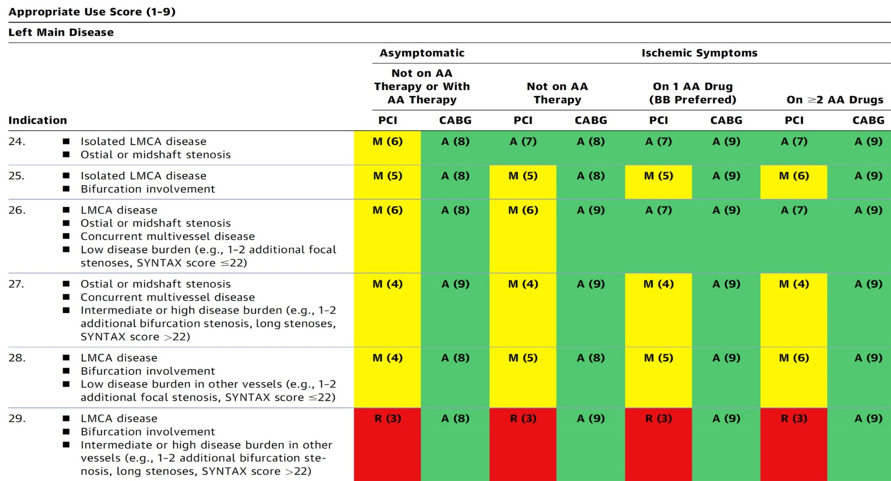
AUC 2017: Left Main Coronary Artery Stenosis
Patel et al., J Am Coll Cardiol 2017;69:2212

Slide 6
LV Support during High-Risk PCI:
LVEF + Lesion Complexity
LVEF >35%
LVEF 20-35%
LVEF <20%
Simple PCI
Complex PCI
Simple PCI: 1-2 V
Complex MV PCI: High Syntax >32/ STS >5 Extensive revascularization
Simple or Complex: Inoperable cases
IABP
No support
None or Impella or IABP
Impella
/IABP (if Impella is CI)
Impella/PTVA
In 2020 @MSH of ≈ 320 PCIs/M: 5-6 IABP & 12-14 Impella per month are used for high risk PCI
Notes:
6

Slide 7
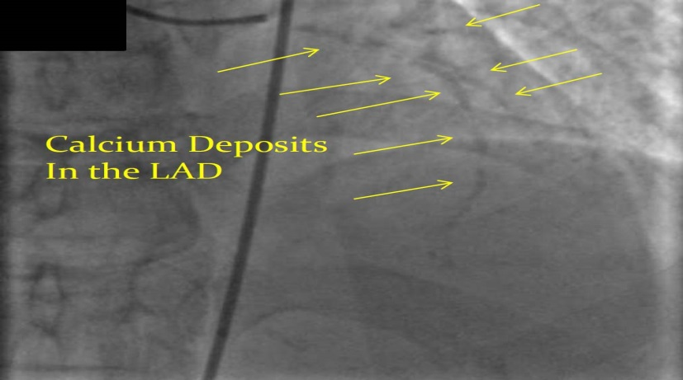
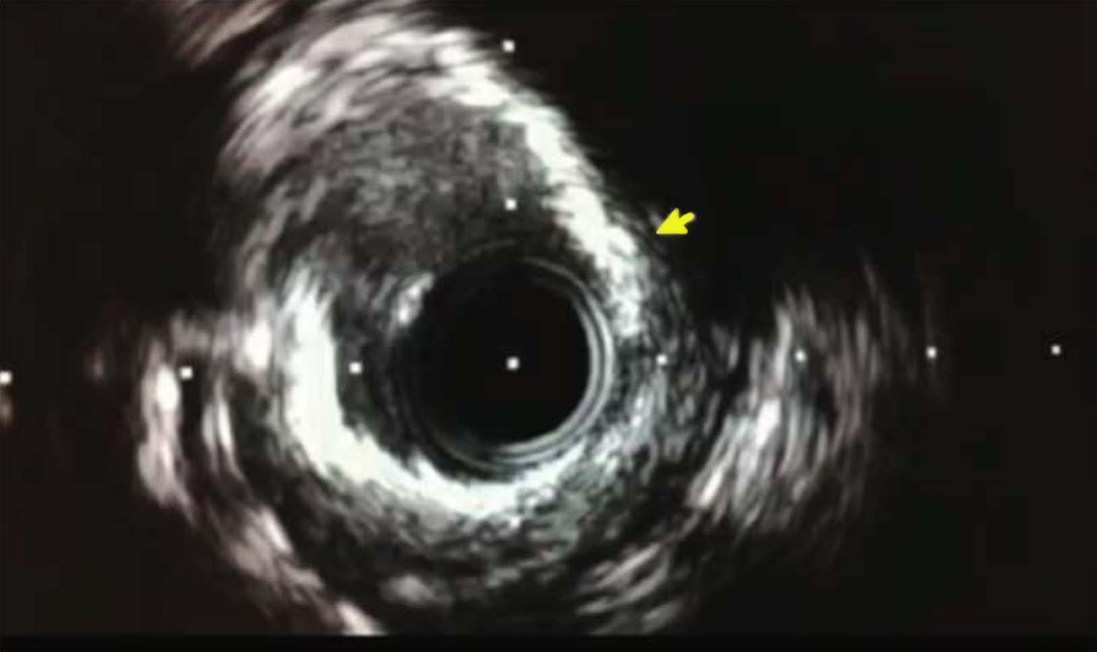
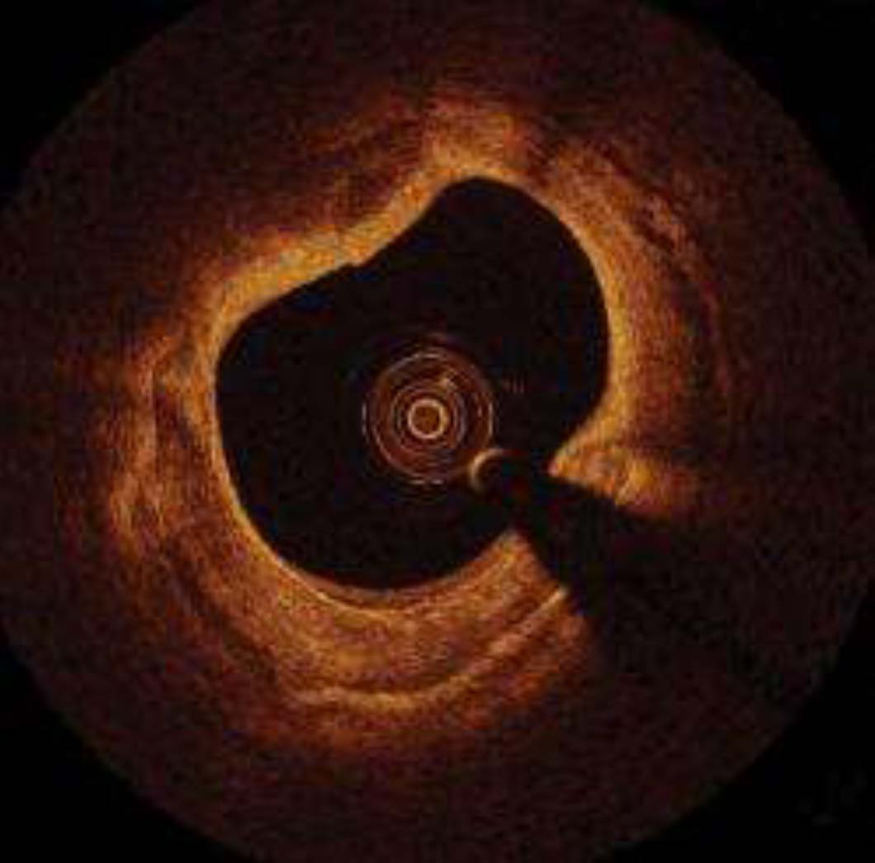
Angio, IVUS and OCT of Severe Calcium
“Tram-track” sign
on Angio X-ray
IVUS showing a highly
calcified lesion (>2Q)
OCT showing a highly
calcified lesion

Slide 8
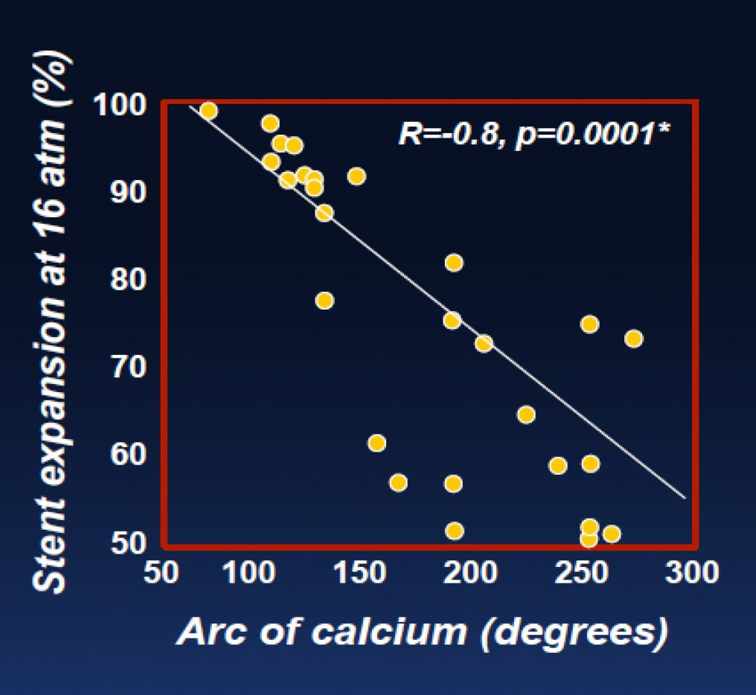
Stent Expansion in Calcified Lesions
Arc of Ca
Stent Expansion
OSTI Trial
 | 12 atm | 18 atm | 22 atm
Ca⁺⁺ (n=15) | 66% | 69% | 71%
Non Ca⁺⁺ (n=25) | 82% | 93% | 100%
Vavarunakis et al., Catheter Cardiovasc Interv 2001;52:164
Stone et al. AJC 1999;83:1397

Slide 9
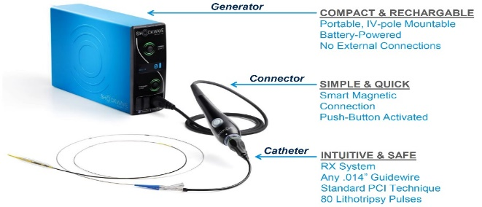
Treatment of Calcified Lesions: Options
IVL
OPEN NC Balloon

Slide 10
De Novo Calcified Lesion
no
Functionally significant
Diameter stenosis > 70-80% or FFR <0.8
Ischemia on noninvasive test
yes
Surgical candidate?
high
Disease complexity?
Left main disease, MV Diabetics
3 V CAD with SYNTAX score > 22-32
yes
no
low
PCI
Medical Therapy
CABG
Impella for
LVEF <35%
Angiographic calcification
Mild
Moderate
Severe
IVUS/OCT
Calcification
Tomey, Kini, Sharma.
JACC Intervention, 2014;7:345.
mild
severe
Rotational or Orbital Atherectomy strategy
Non-Atherectomy strategy
strategic failure
IVUS/OCT post DES

Slide 11
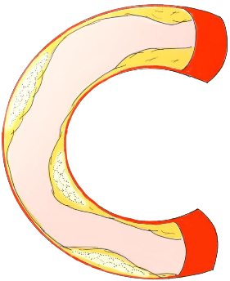
CalcificAID
Free Download

Slide 12
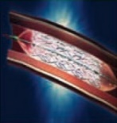
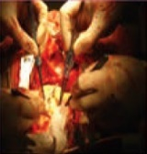
Revascularization Strategy for LMCA Disease
PCI:
Less invasive & early recovery
Early safety advantage
(less MI, less stroke)
Similar mortality
CABG:
Long-term durability
Less revascularization
Less spontaneous MI
Similar mortality
Heart
Team
Approach
Favor for PCI
Recommendation
Favor for CABG
Urgent revascularization
Serious comorbidity and high surgical risk (i.e. COPD, advanced age, stroke, prior CABG, or frailty)
Clinical equipoise
Low ejection fraction
Longstanding diabetes
Need for concomitant valve surgery
High-bleeding risk unable to comply with DAPT
Clinical Factors
Ostial or trunk LM disease
Isolate LM disease
LM plus additional 1 vessel disease
LM plus additional 2-vessel disease
LM plus additional 3-vessel disease
Combined complex anatomy not suitable for PCI (i.e. severe calcification or tortuosity, CTO, multiple/diffuse long lesions, or ISR)
Anatomical Factors
Each patient’s individual circumstances and preferences

Slide 13
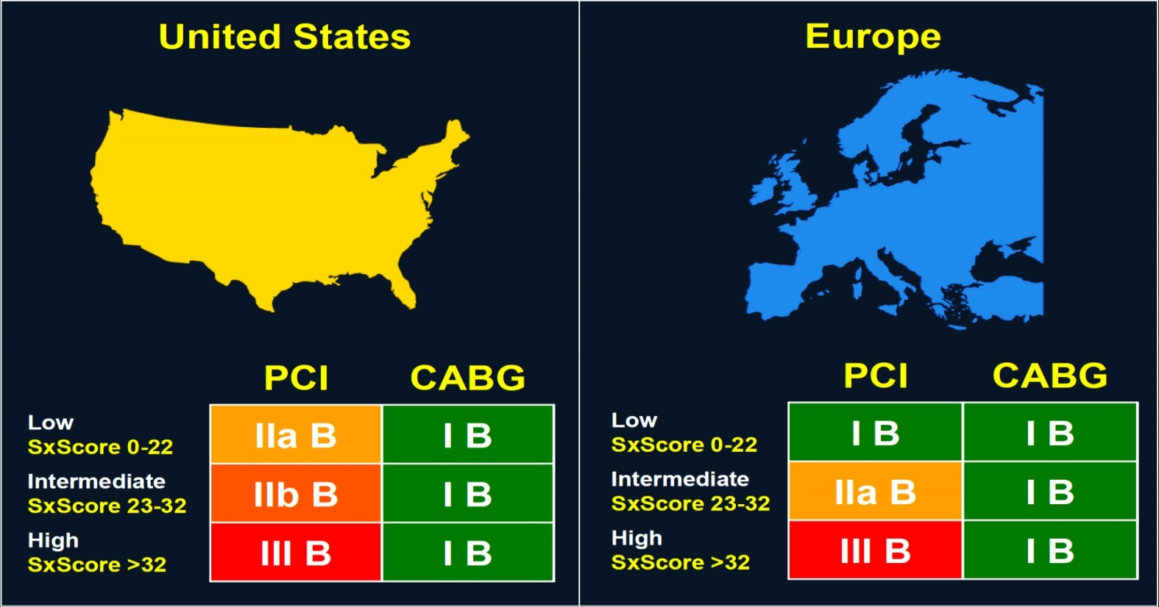
Recommendations for LM Revascularization
Heart Team Discussion; Class I
Levine et al., J Am Coll Cardiol 2011;58:44
Windecker et al., Eur Heart J 2014;35:2541

Slide 14
EXCEL Trial: Primary Endpoint
All-cause death, Stroke or MI at 5 Years
CABG (n=957)
PCI (n=948)
22.0%
19.2%
Death, stroke or MI (%)
OR [95% CI] =
1.19 [0.95, 1.50]
p=0.13
Months
Stone et al., N Engl J Med 2019;381:1820

Slide 15
EXCEL Trial: Piecewise Hazards
All-cause death, Stroke or MI at 5 Years
Three distinct periods of varying relative risk
CABG (n=957)
Treatment-time interaction: p<0.001
PCI (n=948)
0-day to 30-day HR: 0.61 [95% CI: 0.42, 0.88]; p-value = 0.008
30-day to 1-year HR: 1.07 [95% CI: 0.68, 1.70]; p-value = 0.76
15.1%
Death, stroke or MI (%)
1-year to 5-year HR: 1.61 [95% CI: 1.23, 2.12]; p-value <0.001
9.7%
8.0%
4.9%
4.1%
3.8%
Months
Stone et al., N Engl J Med 2019;381:1820

Slide 16
EXCEL Trial: Primary and Secondary
Endpoints at 5 Years
OR [95% CI]
1.19 [0.95-1.50]
OR [95% CI]
1.84 [1.39-2.44]
OR [95% CI]
1.38 [1.03-1.85]
%
OR [95% CI]
1.14 [0.84-1.55]
OR [95% CI]
0.78 [0.46-1.31]
OR [95% CI]
0.16 [0.08-0.32]
Stone et al., N Engl J Med 2019;381:1820

Slide 17
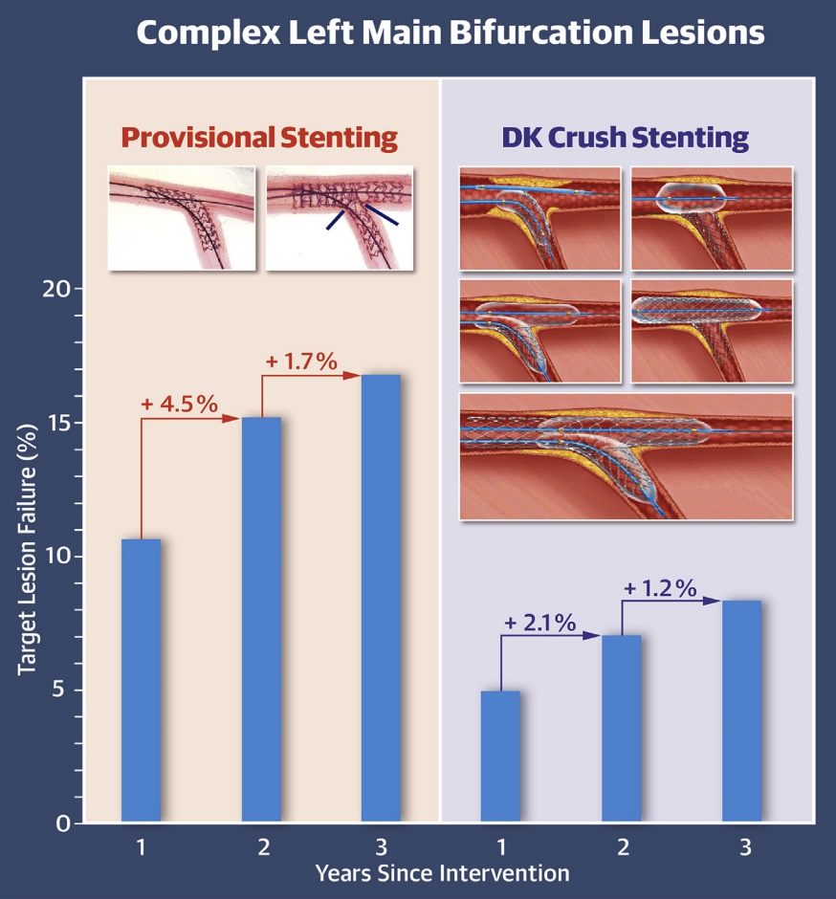
DKCRUSH-V Trial: Chronological Increase in
TLF After Provisional and DK Crush Stenting
In complex distal LM bifurcation lesions, suboptimal stent expansion (blue lines) after provisional side branch rescue stenting is common, resulting in higher TLF rate during the 3-year follow-up compared with DK crush stenting.
Chen et al., J Am Coll Cardiol Intv 2019;12:1927

Slide 18
DKCRUSH-V Trial: Clinical Outcomes at 3 Years
p=0.005
p=0.03
p=0.02
%
p=0.07
p=0.37
p=0.006
Chen et al., J Am Coll Cardiol Intv 2019;12:1927

Slide 19
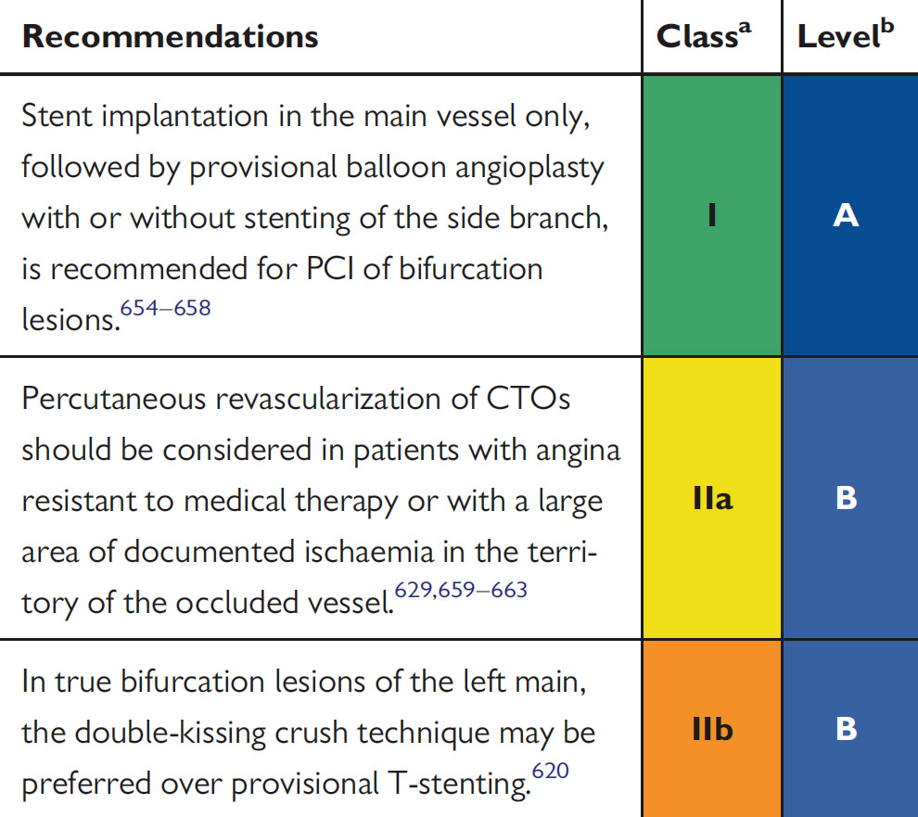
Recommendations on Specific Lesion Subsets: ESC 2019

Slide 20
Proportion of Patients Who Experienced
Cardiac Death after uLM PCI
Patients grouped into tertiles according to operator experience who performed the procedure
%
Mean: 5.8 (2.7, 9.4) 24.4 (19.2, 29.1) 38.3 (33.1, 43.4)
Operator experience defined as the mean number of LM PCI procedures performed by the operator per year.
Xu et al., J Am Coll Cardiol Intv 2016;9:2086

Slide 21
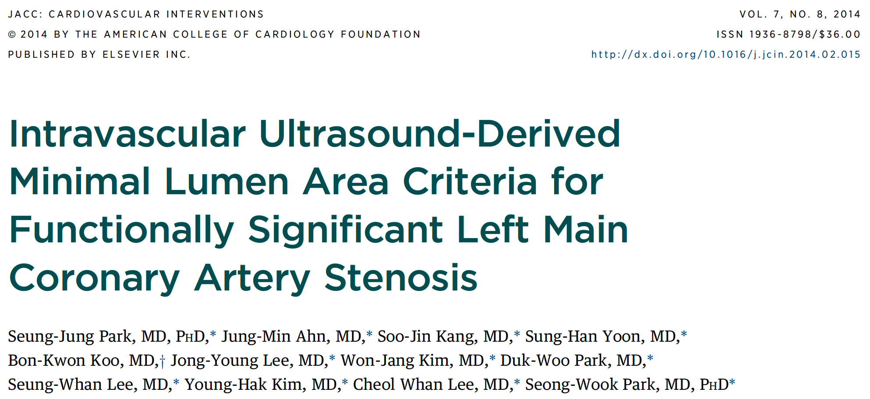
Significant stenosis: <6mm2

Slide 22
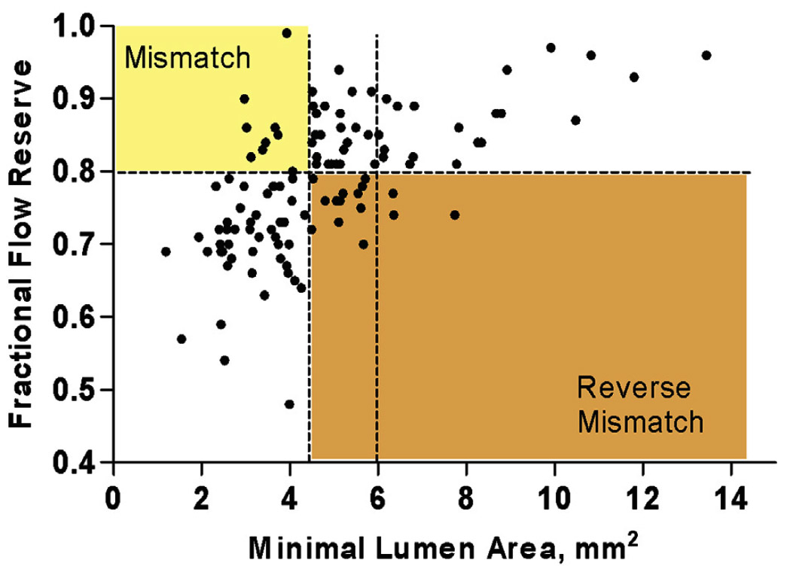
Cutoff Values of Parameter of IVUS MLA vs FFR
4.5
Park et al., J Am Coll Cardiol Intv 2014;7:868

Slide 23
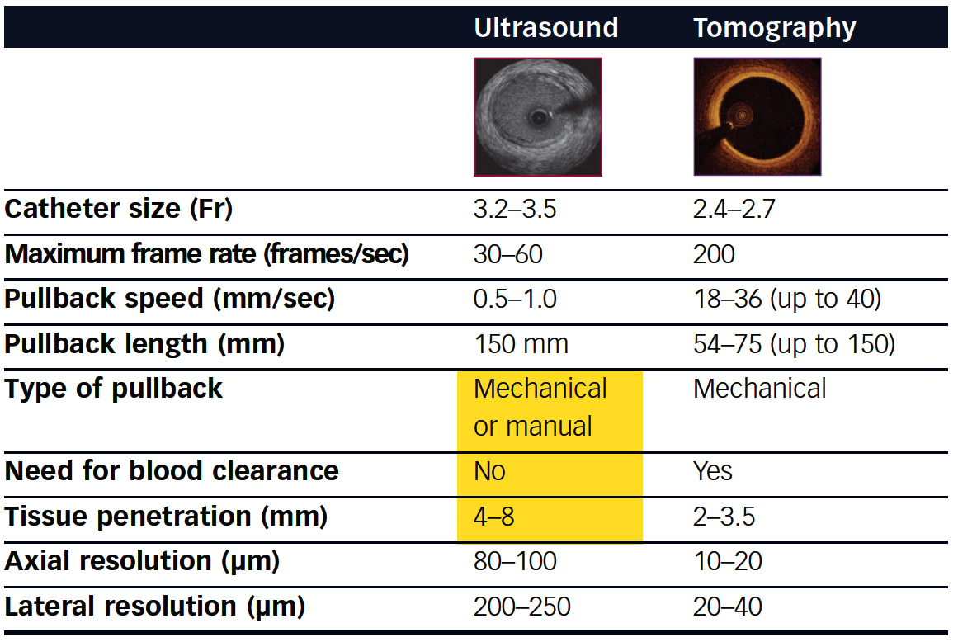
Technical Characteristics of IVUS and OCT
De Maria and Banning, Interv Cardiol 2017;13:8

Slide 24
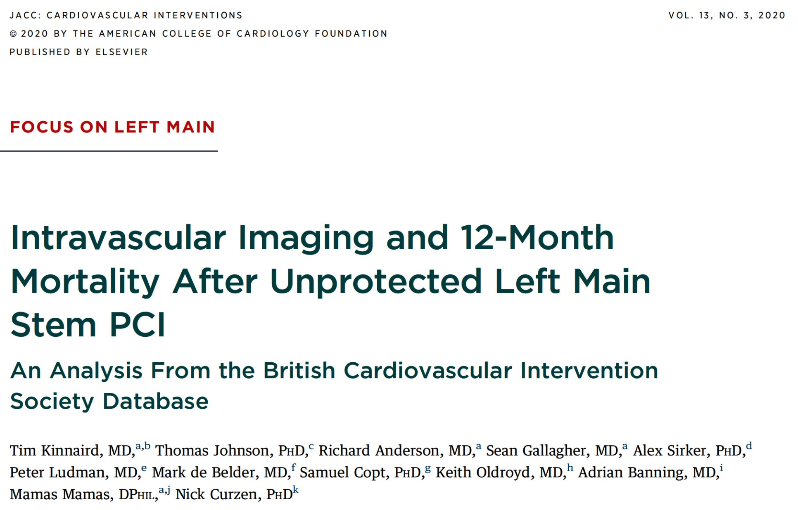

Slide 25
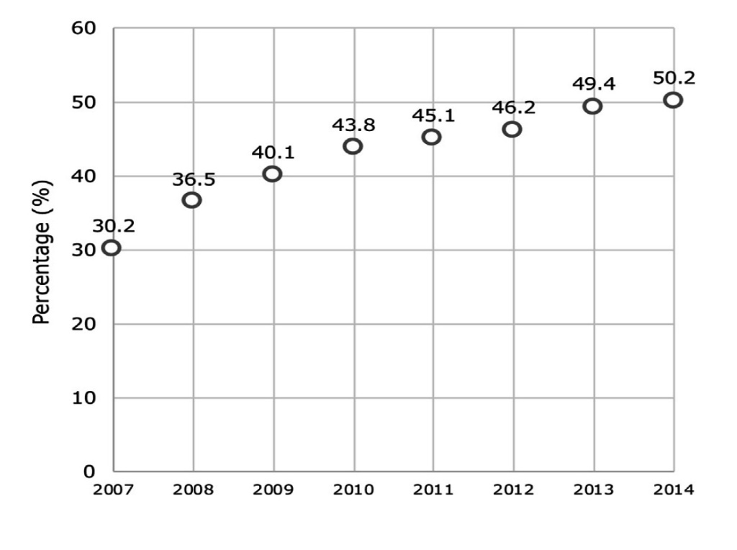
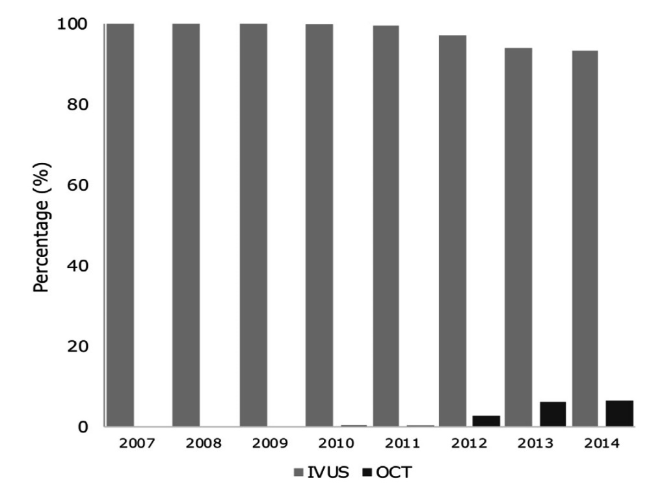
Trends in Imaging for ULMS PCI in England and Wales from 2007 to 2014
Percentage of Intravascular Imaging Use During uLMS PCI
Temporal change in IVUS vs OCT Use During uLMS PCI
p<0.001
Kinnaird et al., J Am Coll Cardiol Intv 2020;13:346

Slide 26
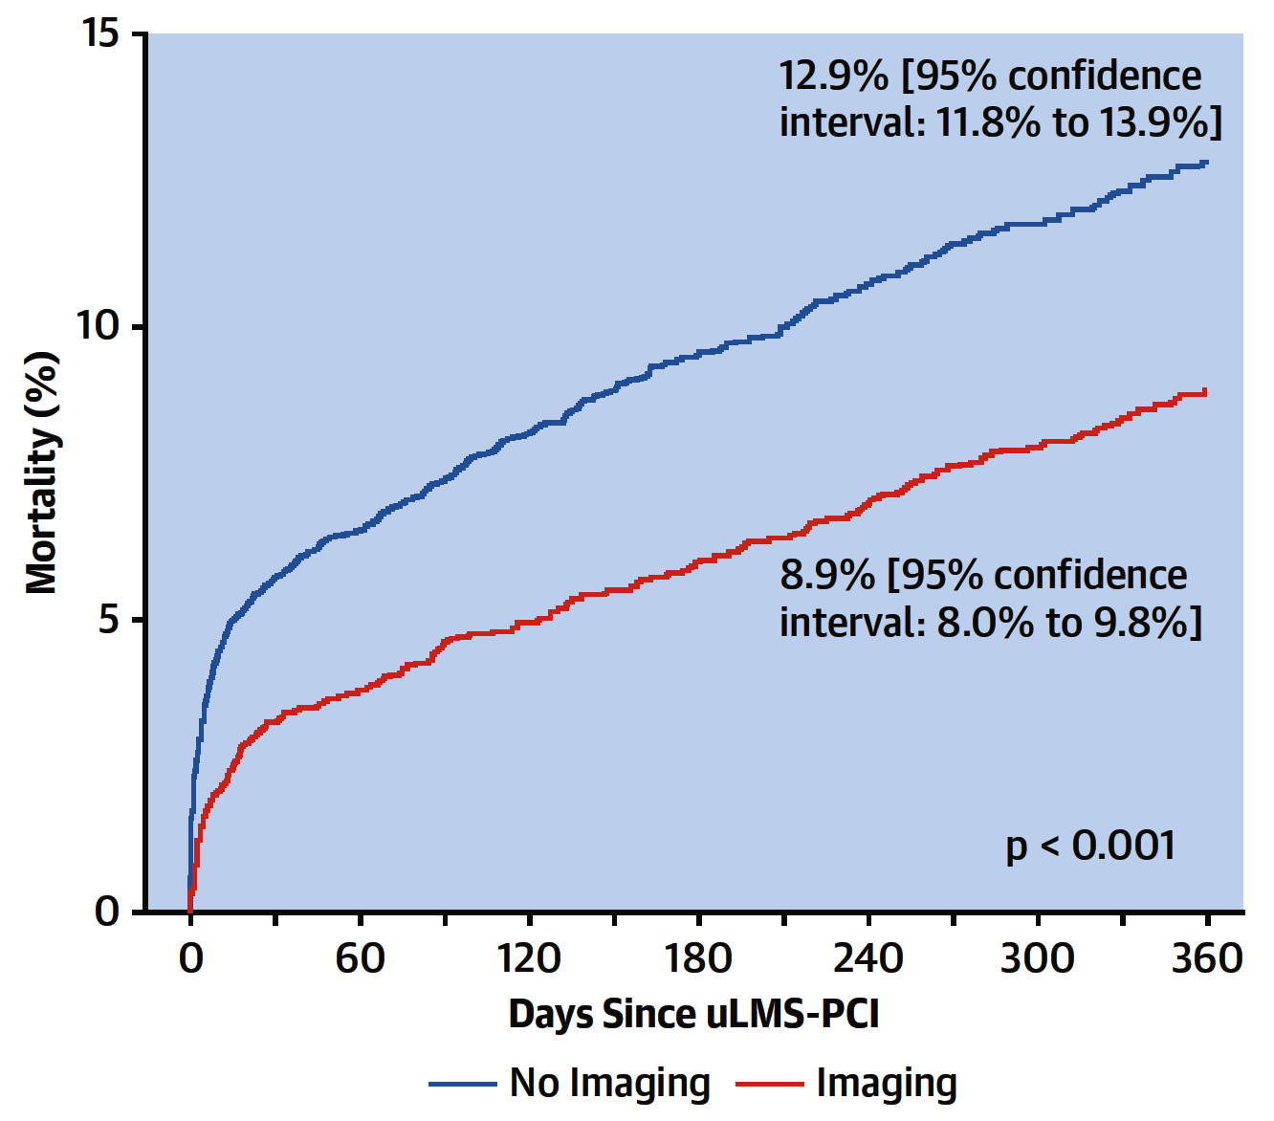
Survival by Intravascular Imaging Use After uLMS PCI
in England and Wales from 2007 to 2014
Kinnaird et al., J Am Coll Cardiol Intv 2020;13:346

Slide 27
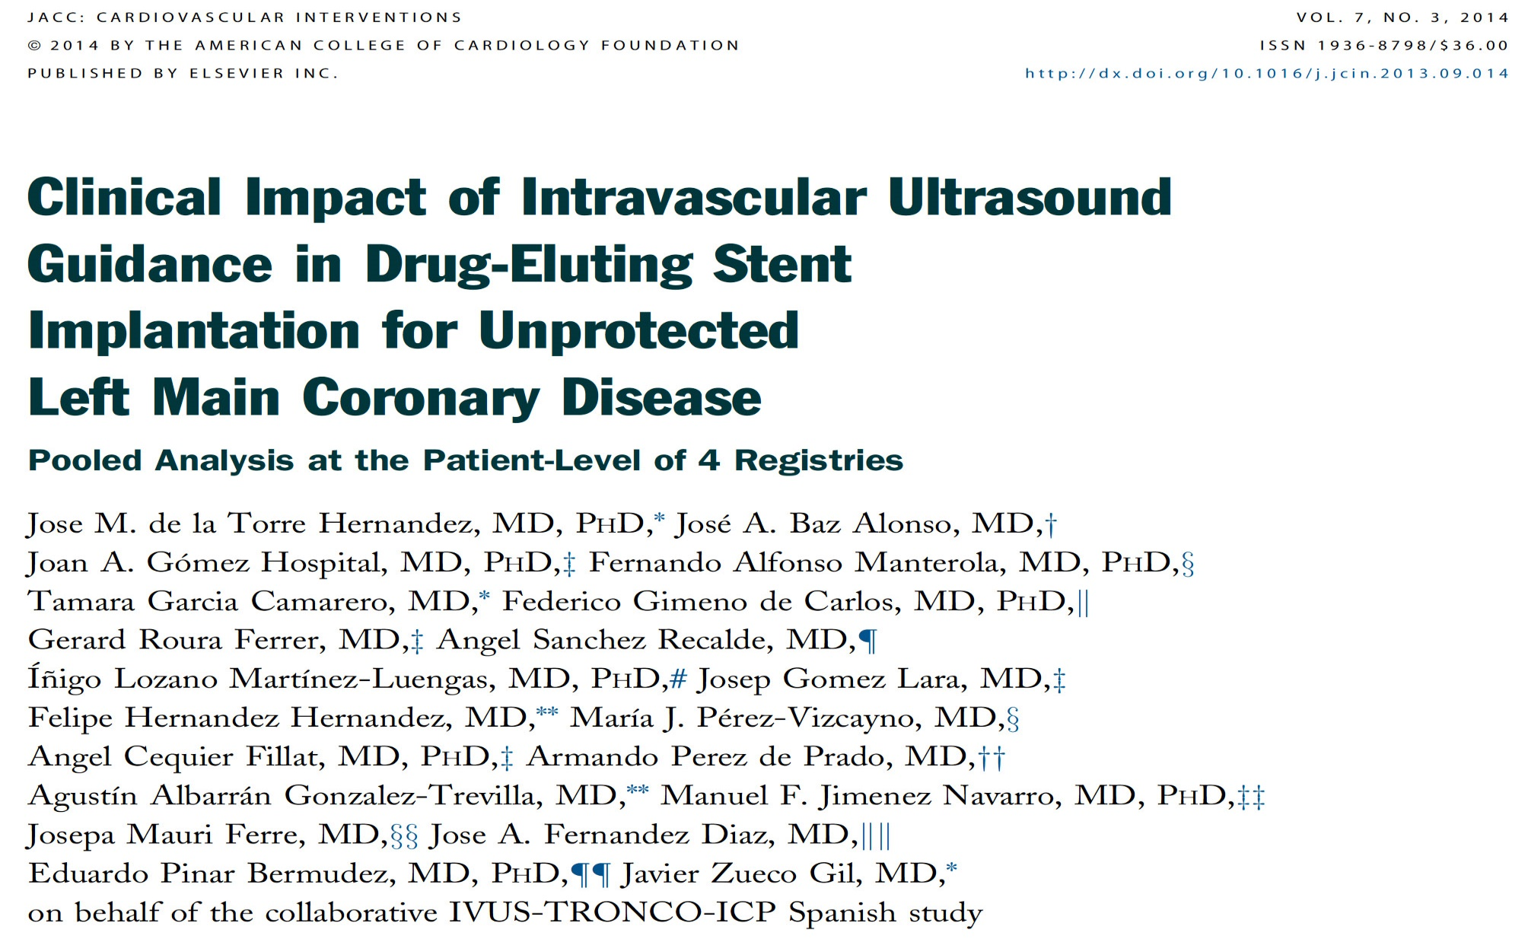

Slide 28
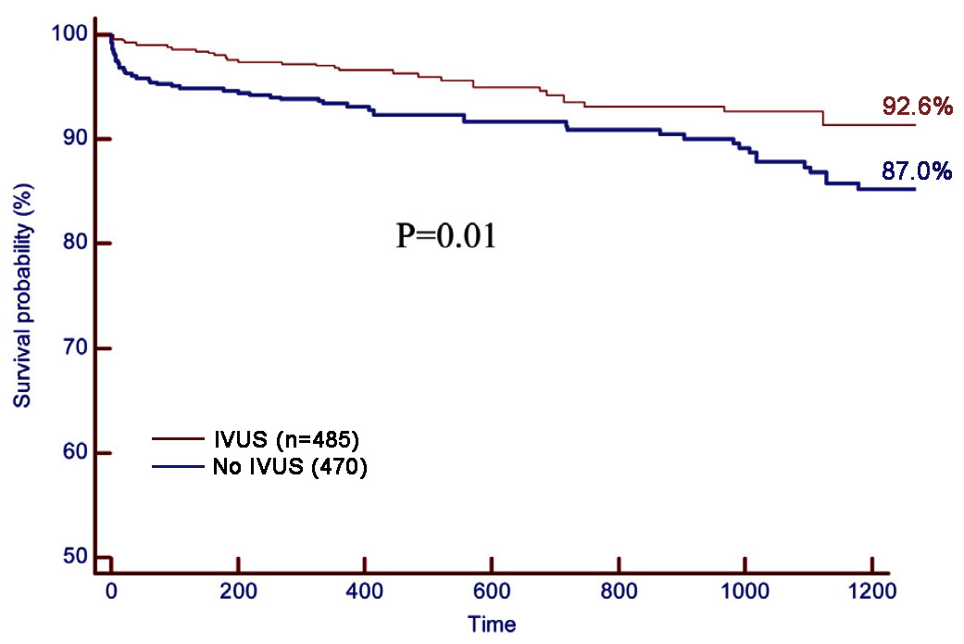
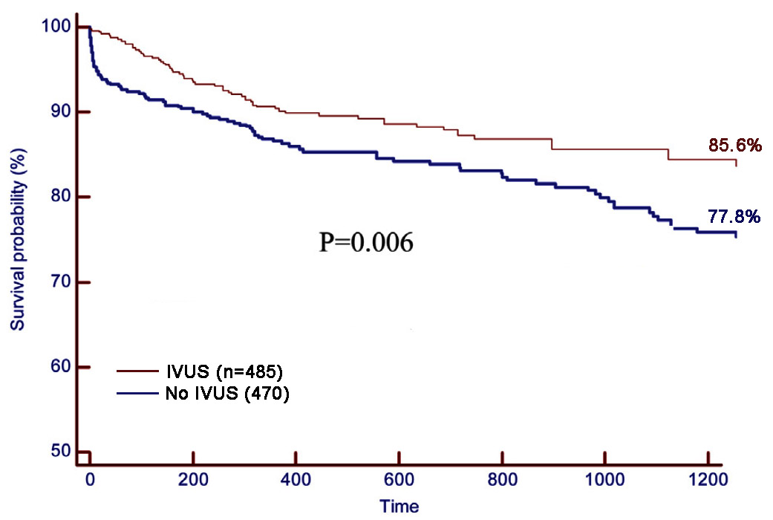
Outcomes for All Groups
All-Cause Death
All-Cause Death, MI, TLR
de la Torre Hernandez et al., J Am Coll Cardiol Intv 2014;7:244

Slide 29
Incidence of MACE
p=0.02
p=0.03
%
p=0.01
p=0.70
p=0.40
p=0.04
Distal lesion:
IVUS (n=221)
No IVUS (n=226)
Distal lesion 2 stents:
IVUS (n=63)
No IVUS (n=62)
de la Torre Hernandez et al., J Am Coll Cardiol Intv 2014;7:244

Slide 31
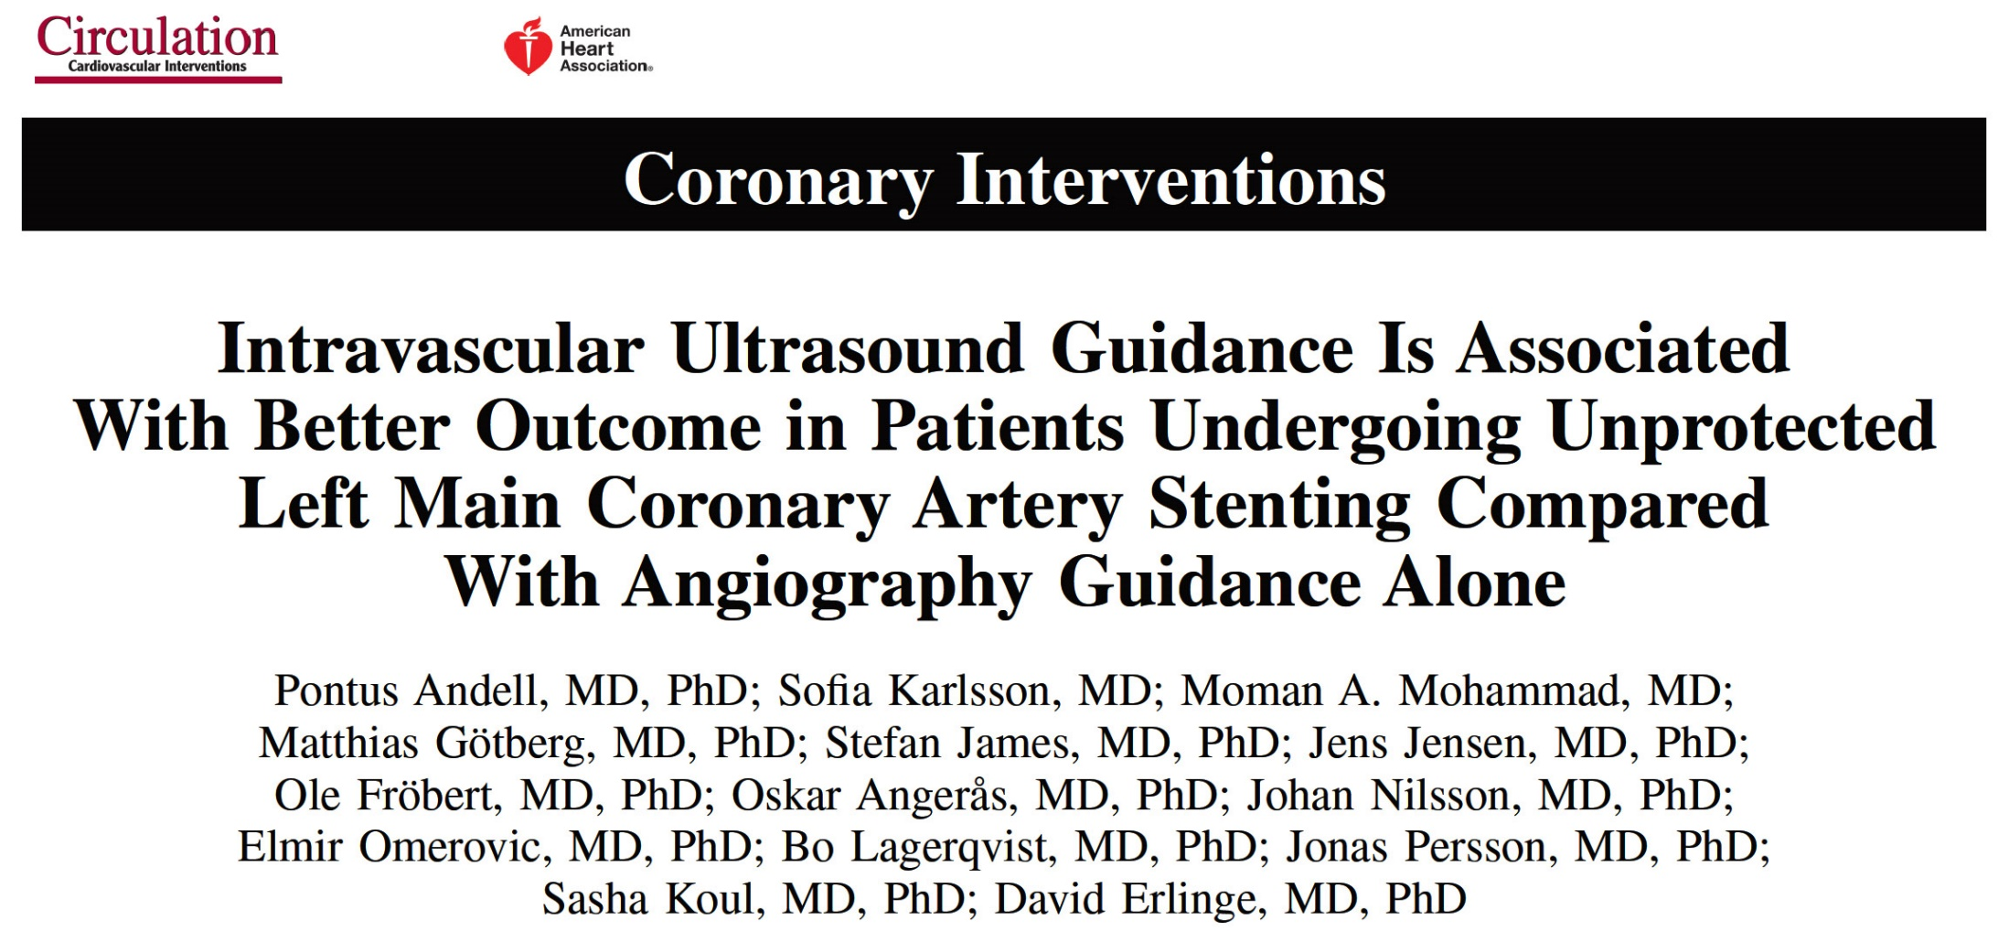
SCAAR registry

Slide 32
Study Flowchart
Patients who underwent PCI of LMCA because of stable CAD or ACS in 2005-2014
(n=5067)
Excluded (n=2599)
Previous CABG (n=1747)
Killip Class III-IV (n=271)
Periprocedural compl or deaths (n=195)
Final stent diameter below 3.00 mm (n=120)
Latter readmissions (n=266)
Study population
(n=2468)
No IVUS
(n=1847)
IVUS
(n=621)
Andell et al., Circ Cardiovasc Interv 2017;10:e004813

Slide 33
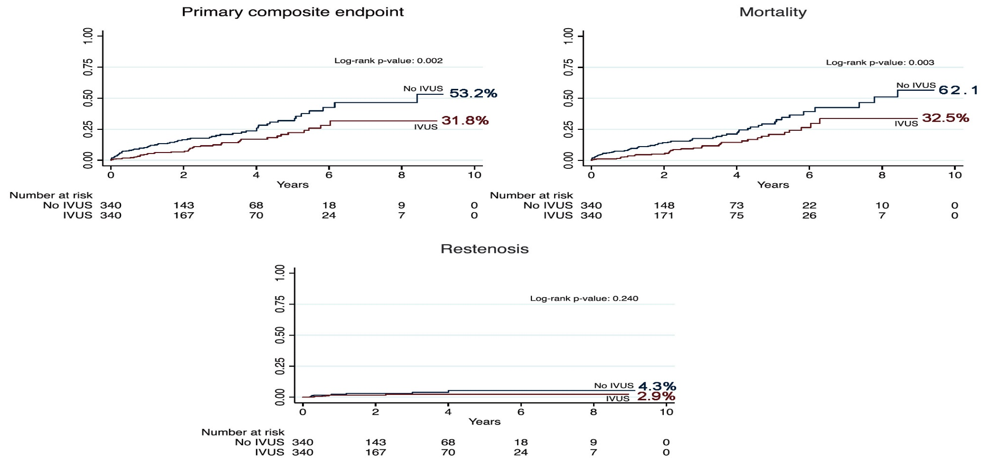
Endpoints in the Propensity Score-Matched Population
Andell et al., Circ Cardiovasc Interv 2017;10:e004813

Slide 34
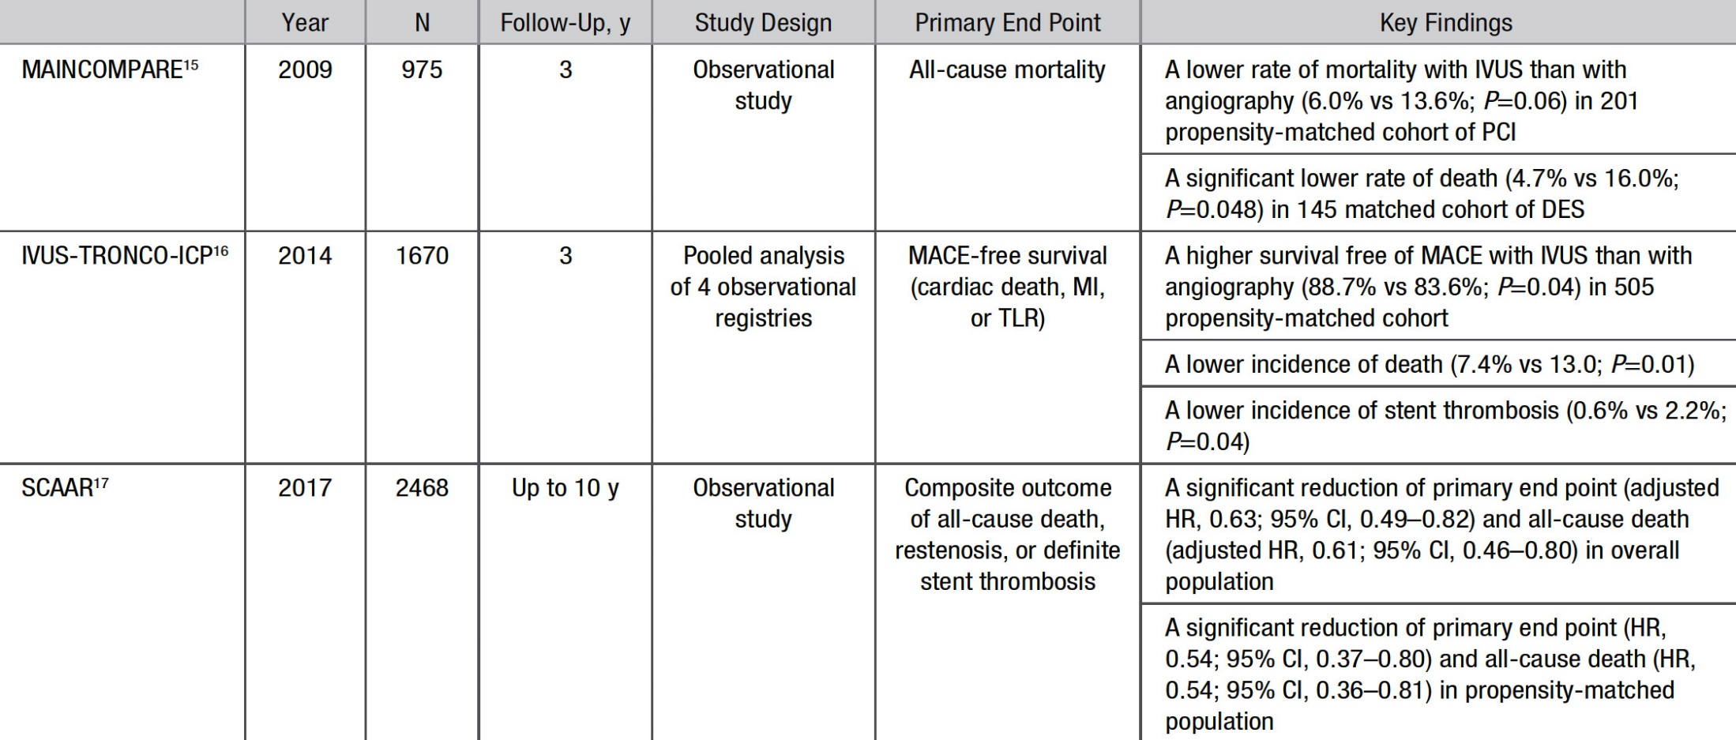
Studies Evaluating Clinical Impact of IVUS-Guided Left Main Intervention
Park et al., Circ Cardiovasc Interv 2017;10:e005293

Slide 35
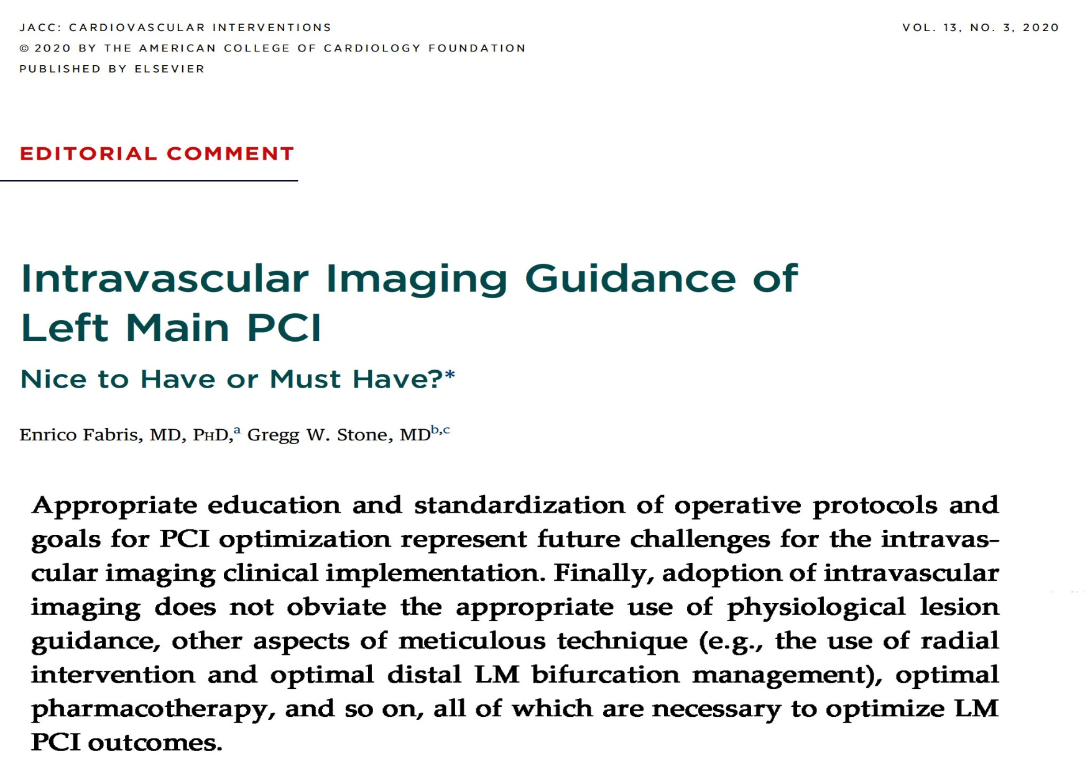

Slide 36
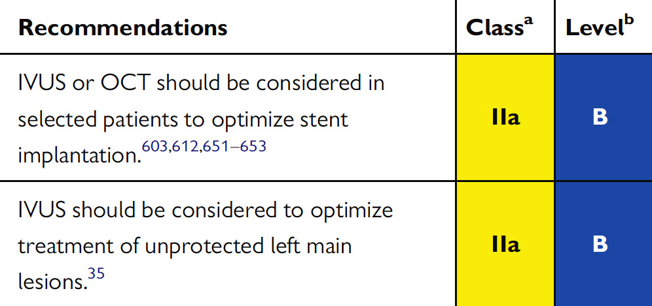
Recommendations on IVUS Imaging for Procedural Optimization
Kinnaird et al., J Am Coll Cardiol Intv 2020;13:346

Slide 37
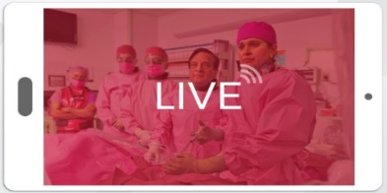
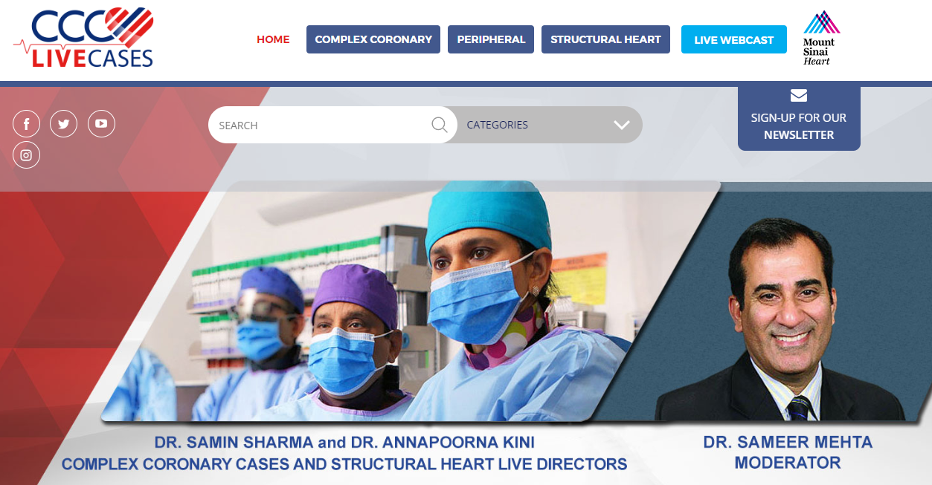
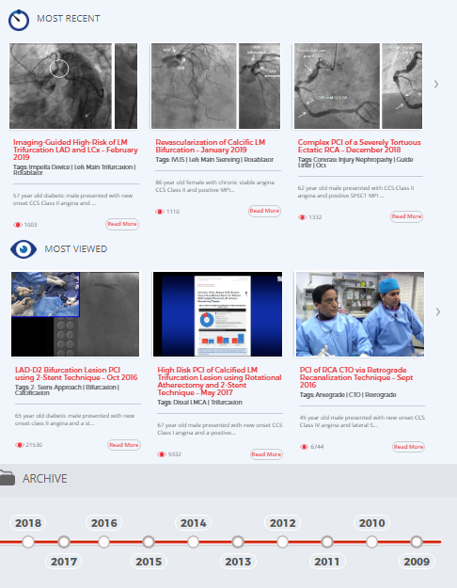
www.ccclivecases.org
www.ccclivecases.org

Slide 38
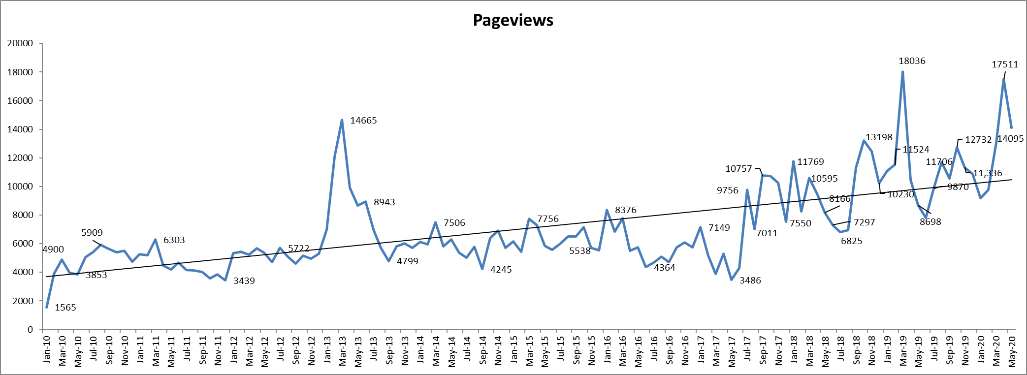
CCCLivecases Pageviews (132 countries)
USA: 71%
India: 13%
UK: 7%
Germany: 3%
Brazil: 2%
N

Slide 39
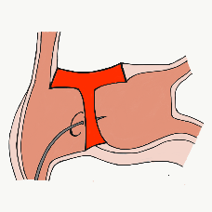
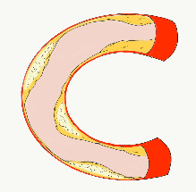
More than 35,800 unique downloads
Cath Lab Apps CardiologyApps.com
iOS 5/5 stars
9896 downloads
Android 4.4/5 stars
8245 downloads
Released sept 2017
iOS 5/5 stars
6068 downloads
Android 4.8/5 stars
3850 downloads
Released June 2018
iOS 5/5 stars
2073 downloads
Android N/A stars
549 downloads
Released March 2018
iOS 5/5 stars
1074 downloads
Android N/A stars
547 downloads
Released Sept 2018
iOS 5/5 stars
931 downloads
Android 5/5 stars
538 downloads
Released June 2019
WebApp Only*
2600 unique users
4800 sessions
Released August 2020
BifurcAID
OCTAID
TAVRcathAID
TranseptAID
CalcificAID
ComplicAID
*Also available
as WebApp
Download Apps
For Free on Both:
WebApps available free on
www.CardiologyApps.com
Apple ® and App Store® are registered trademarks of Apple Inc.
Notes:
These are the apps we have created which will provide digital algorithms for our future ambitious projects to make our cath labs smarter.

Slide 40
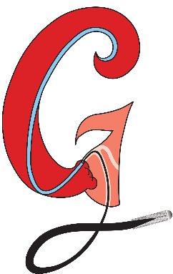
Apps Coming Soon…
STEMIcathAID – STEMI patient transfer platform designed to optimize communication between key members, record key performance metrics for AHA’s Mission: Lifeline program, and avoid costly false activations through direct CCL contact.
GuidewireAID – This application covers the design of coronary guidewires and the resulting properties they exhibit during use in the lab. Over two dozen teaching cases, a dense wire library with more than a hundred wires, and a robust search function provide a lot of tailored learning opportunities.
BifurcAID 3D – An animated bifurcation lesion treatment educational application and website. With two views, detailed descriptions, and more, BifurcAID 3D helps make clear the complex steps in techniques such as Minicrush, DK Crush and Culotte, as well as provisional approached and bailout techniques.

Slide 41
Therapeutic Tactics/Rationale for Complex Calcified Native Coronary Lesions in the DES Era
What if balloon high pressure PTCA
Failed to open the Ca+ lesion?

Slide 42
Severe Calcified Proximal LAD
90% severely calcified in pLAD

Slide 43
1V Vessel CAD (90% Ca+ pLAD and 50% LM Disease

Slide 44
Balloon Deployment
2.5/12 NC Balloon at 10-22 atm

Slide 45
Post PTCA Angiogram
Lesion did not yield

Slide 46
Wolverine Advancement
2.5/10 mm Wolverine;
did not cross the lesion

Slide 47
Post Failed POBA/CB of pLAD
Unsuccessful PCI to pLAD
Significant intimal dissection

Slide 48
Planned RA of undilatable Ca+ pLAD lesion with type B dissection

Slide 49
Re-crossing LAD: Re-crossing the Lesion
Fielder wire with Fine Cross and exchanged with the Rota Floppy wire

Slide 50
RA of pLAD
Burr Size: 1.5 mm total 3 runs of 20 sec (60 sec)

Slide 51
Post RA to pLAD

Slide 52
Balloon Expansion pLAD
LAD: Post Balloon Expansion
NC Emerge 3.5/20 mm 14 atm

Slide 53
Stent Deployment to pLAD
Xience Sierra 3.5/23 mm at 16 atm
Xience Sierra 3.5/24 mm at 16 atm

Slide 54
Stent Deployment to Ostial LM
Xience Sierra 4/12 mm at 16 atm
Xience Sierra 4/12 mm at 16 atm

Slide 55
LM Stent Deployment: Final Results post LM/LAD Stenting

Slide 56
Rotational Atherectomy for Coronary In-Stent Restenosis With Single or Multiple Layers of Underexpanded Stents
Keisuke Yasumura MD, Hiroki Ueyama MD, Selan Jeffrey MD, Yuliya Vengrenyuk PhD, Nitin Barman MD, Javed Suleman MD, Annapoorna S. Kini MD, Samin K. Sharma MD

Slide 57
Under-expanded Multilayer DES in LCx
Notes:
Run 4 and 5

Slide 58
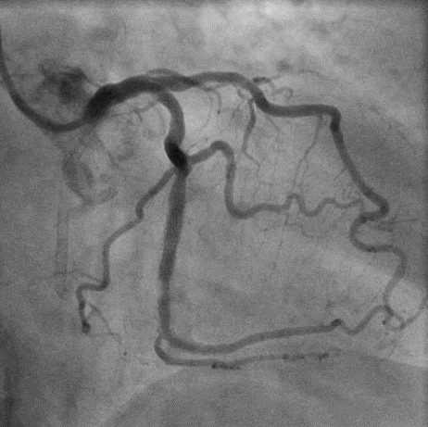
LCx-LPL ISR due to double layers of underexpanded stents
: 1st layer of old DES Cypher
: 2nd layer of new DES Promus
Underexpanded stent
Notes:
Run 2

Slide 59
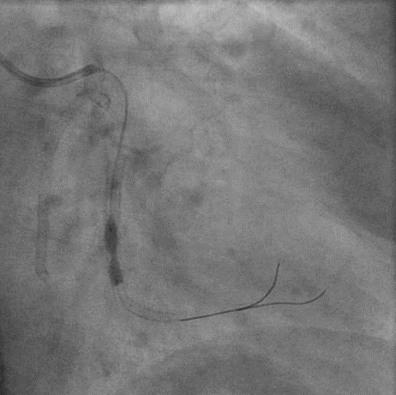
Failure of balloon dilation
TREK NC 3.0/12mm
@ 24atm
Notes:
Run 4 and 5

Slide 60
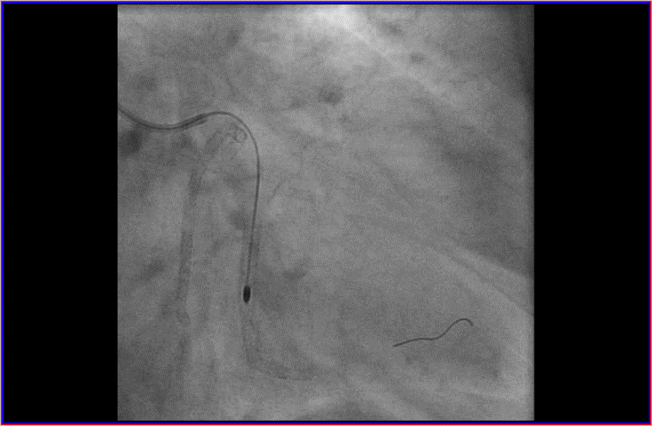
RA for ISR
Step-up of Rota burr
Rota burr 1.50mm with 150,000 rpm
Rota burr 1.75mm with 150,000 rpm
Notes:
Run 4 and 5

Slide 61
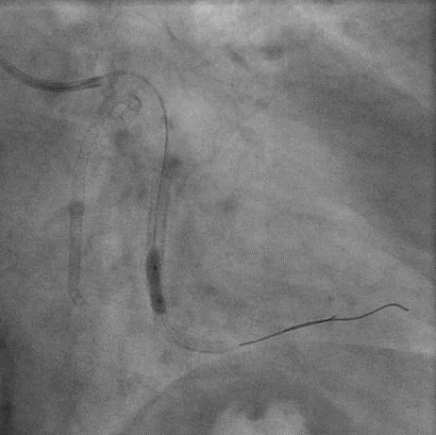
Successful balloon dilation
TREK NC 3.012mm
@20atm
Notes:
Run 4 and 5

Slide 62
After RA and balloon angioplasty
Ablated old stents
MSA 5.3mm²
Notes:
Run 4 and 5

Slide 63
Final Results post RA+PTCA
Notes:
Run 4 and 5

Slide 64
Case: 75yrs F
Presentation:
Presented with new onset CCS class III angina. Patient had history of PCI of proximal to mid LAD with 2 DES at OSH 5 months earlier. Now presents with concern for underexpanded LAD stent. LVEF 65%.
Prior History:
Hypertension, Hyperlipidemia, Diabetes mellitus, s/p PCI to LAD (Xience 2.75x18mm, Xience 2.5x38mm)
Medications:
Aspirin 81mg, Clopidogrel 75mg, Atorvastatin 80mg,
Lisinopril 2.5mg, Metoprolol, Nifedipine, Insulin
Notes:
64

Slide 65
Initial angiography
Notes:
Run 4 and 5

Slide 66
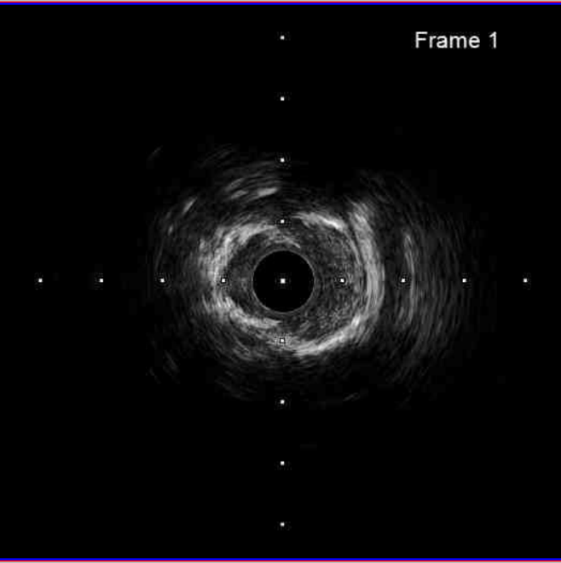
ISR due to severely underexpanded stent
Underexpanded stent due to
outer calcium
Underexpanded stent
*IVUS catheter did not cross the tightest lesion
Notes:
Run 2

Slide 67
ISR due to severely underexpanded stent
*
*
*
*
*
*
*
*
Underexpanded stent due to
outer calcium
Underexpanded stent
*IVUS catheter did not cross the tightest lesion
Notes:
Run 2

Slide 68
Balloon angioplasty
NC Emerge 2.0x 8mm
Notes:
Run 4 and 5

Slide 69
ELCA without contrast medium
Maximum fluency/rate 70/70
Notes:
Run 4 and 5

Slide 70
ELCA with contrast medium
Maximum fluency/rate 70/70
Notes:
Run 4 and 5

Slide 71
Stepwise balloon angioplasty
NC Emerge 2.0x 15mm
NC Emerge 2.5x 8mm
Notes:
Run 4 and 5

Slide 72
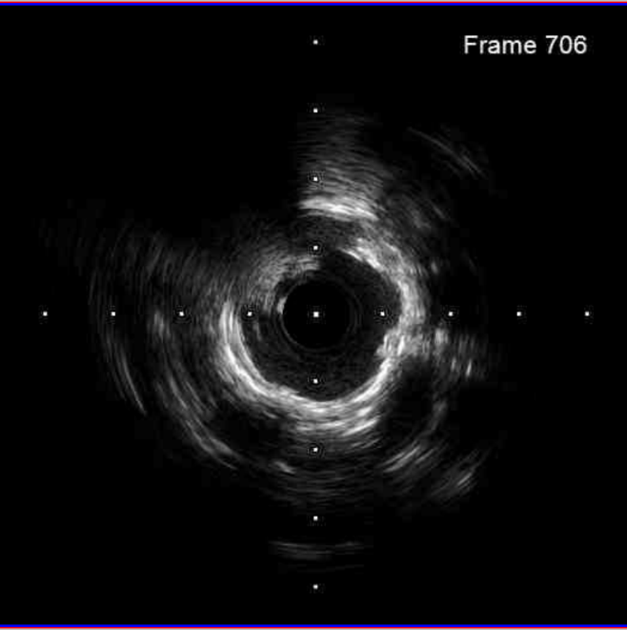
After ELCA and balloon angioplasty
crack
Notes:
Run 4 and 5

Slide 73
Post dilation with high-pressure balloon
NC Emerge 3.5x 12mm, 16atm
NC Emerge 3.5x 12mm, 24atm
Notes:
Run 4 and 5

Slide 74
Final
Notes:
Run 4 and 5

Slide 75
Provisional Approach Requiring a Second Stent
in the Side Branch
TAP
Reverse Crush
Cullote
Advantages: Easy to perform Complete coverage of Complete coverage of
No recrossing ostium, any anatomy ostium
Disadvantages: Struts protruding into Recrossing into SB More laborious
MB 3 layers of struts Rewiring both branches
Double stent layer

Slide 76
T-stenting And Protrusion

Slide 77
TAP
Dilate SB with compliant balloon
Mini TREK 2x12mm
NC TREK 2.5x12mm

Slide 78
TAP
Advance stent to SB (protrude into MV by 1mm).
Advance balloon to MV (NC balloon).
Xience Alpine 2.75x12mm
NC Quantum Apex 3.0x15mm to MV

Slide 79
TAP
KBI with
NC Quantum Apex 3.0x15mm to MV
Stent balloon 2.75x12mm to SB
Perform KBI.

Slide 80
TAP
Final angiogram to rule out distal edge dissection.

Slide 81
Final coronary angiography
AP, CRANIAL
LAO, CRANIAL

Slide 82
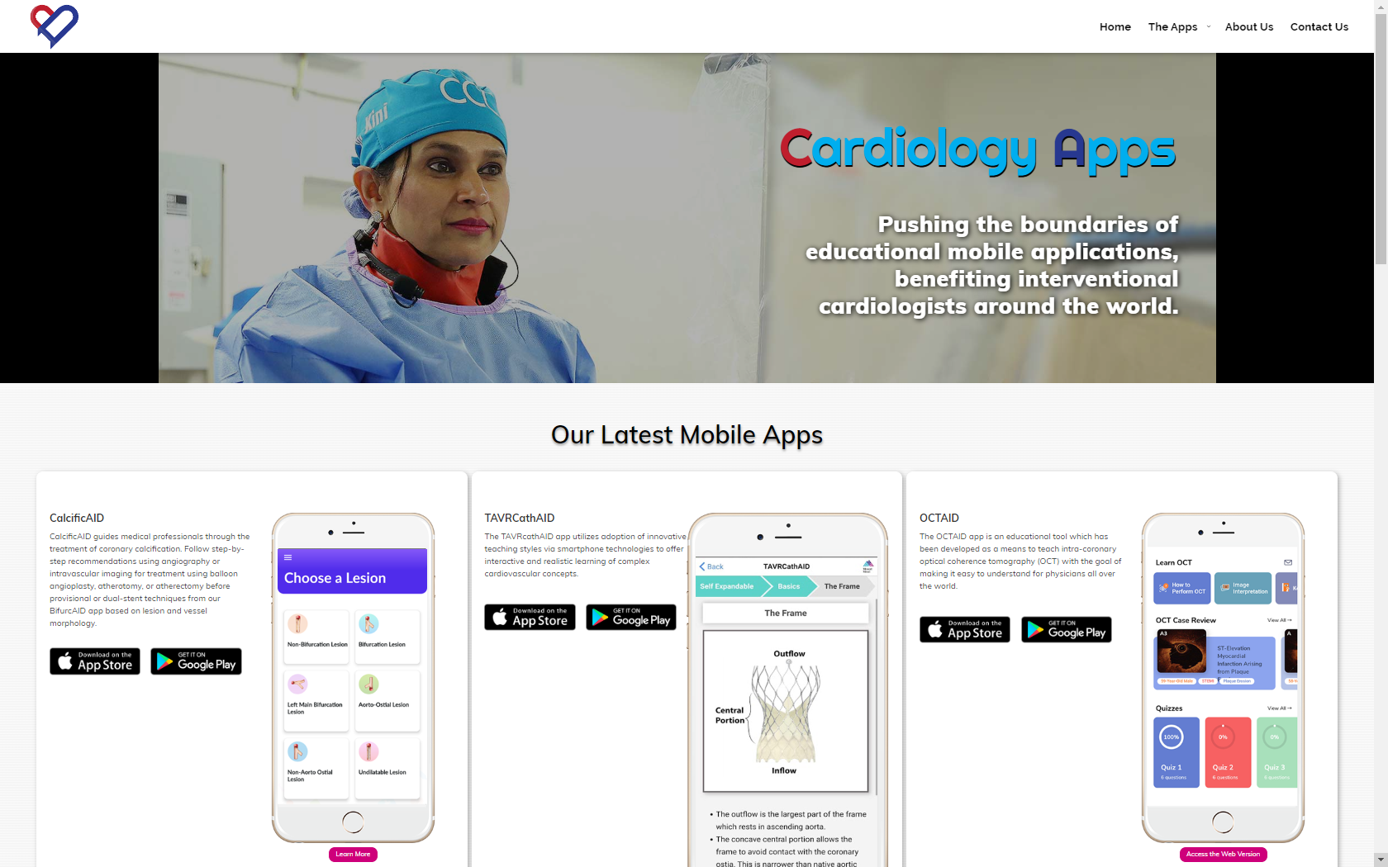
CardiologyApps.com
CardiologyApps.com
Notes:
You can learn about BIfurcAID and other apps from Mount Sinai Cath Lab on our new “Cath Lab Apps” website, which should be available soon

Slide 83
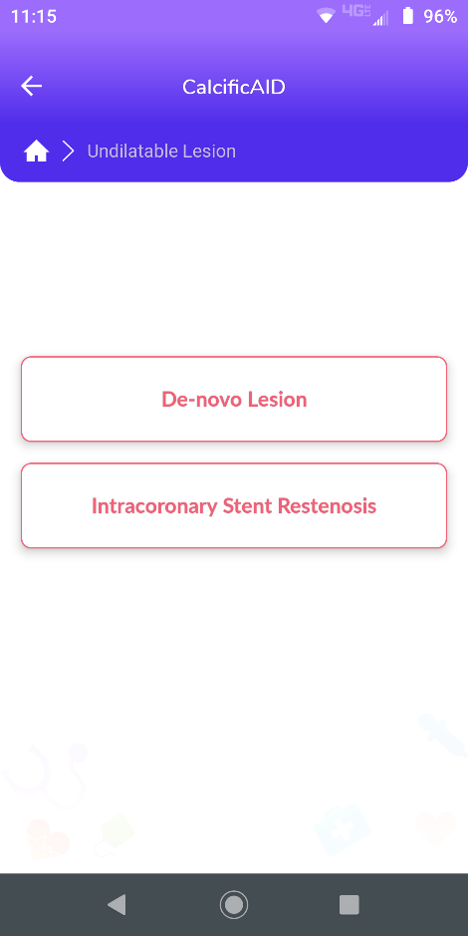
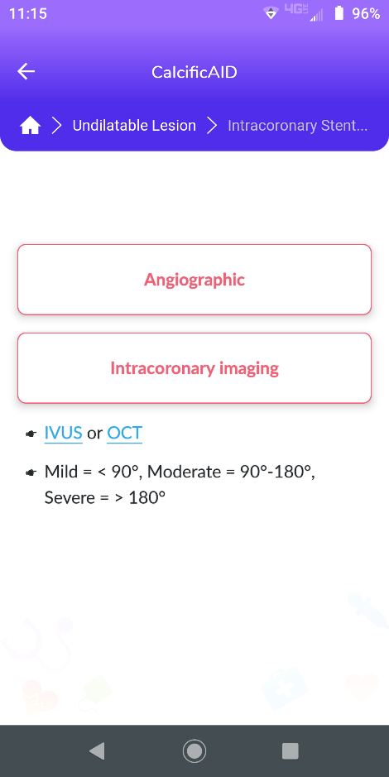
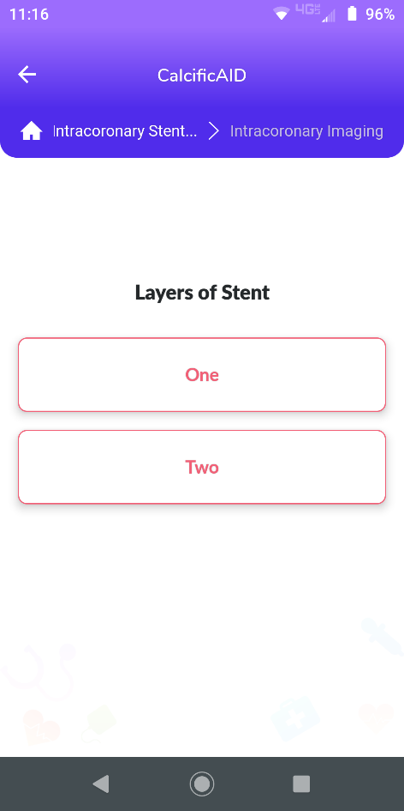
CalcificAID

Slide 84
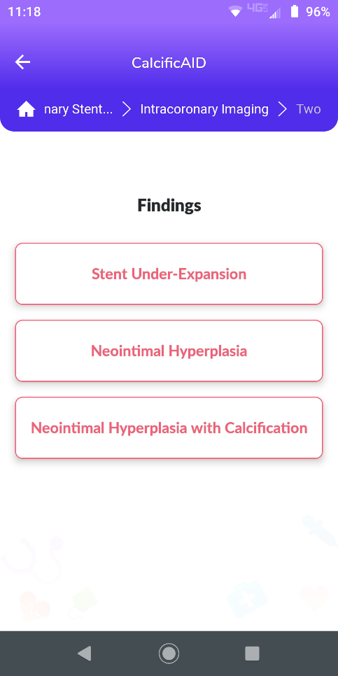
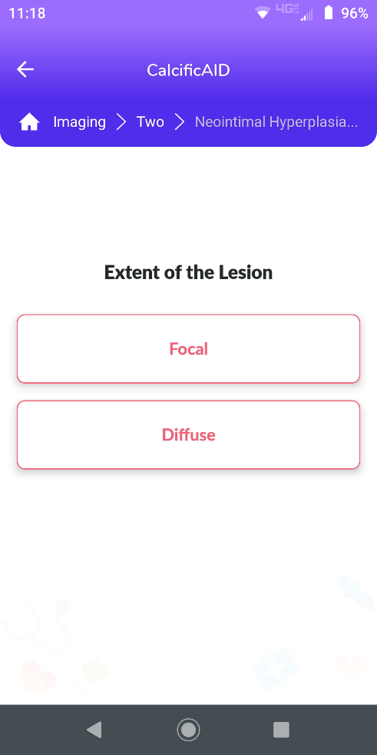
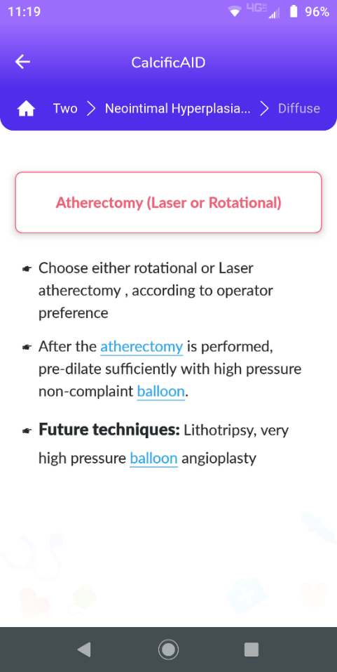
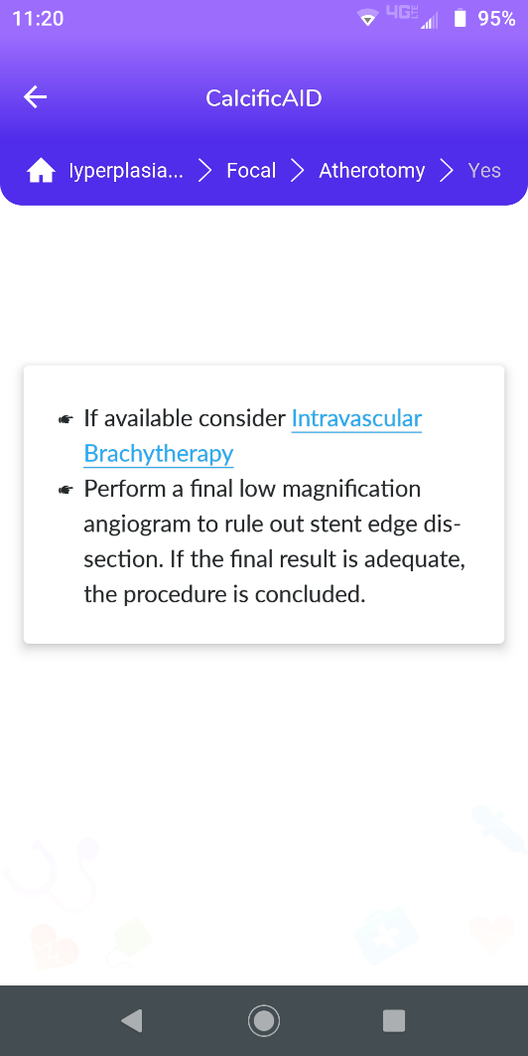
CalcificAID

Slide 85
More than 28,000 unique downloads
Cath Lab Apps CardiologyApps.com
iOS 5/5 stars
8596 downloads
Android 4.4/5 stars
6145 downloads
Released sept 2017
iOS 5/5 stars
5068 downloads
Android 4.8/5 stars
2850 downloads
Released June 2018
iOS 5/5 stars
2073 downloads
Android N/A stars
549 downloads
Released March 2018
iOS 5/5 stars
1074 downloads
Android N/A stars
547 downloads
Released Sept 2018
iOS 5/5 stars
931 downloads
Android 5/5 stars
538 downloads
Released June 2019
Coming Soon
BifurcAID
OCTAID
TAVRcathAID
TranseptAID
CalcificAID
STEMIcathAID
Download for
Free on Both::
Apple ® and App Store® are registered trademarks of Apple Inc.
Notes:
These are the apps we have created which will provide digital algorithms for our future ambitious projects to make our cath labs smarter.

