Slide 1

Antithrombotic Therapy Update:
2 vs. 1 Post-PCI, and 3 vs. 2 Post-PCI & Afib
Roxana Mehran, MD, FACC, FAHA, MSCAI, FESC
Mount Sinai Professor Of Cardiovascular Clinical Research and Outcomes
Professor of Medicine (Cardiology), and Population Health Science and Policy
Director of Interventional Cardiovascular Research and Clinical Trials,
Icahn School of Medicine at Mount Sinai,
New York, NY, USA
@Drroxmehran
Roxana.Mehran@mountsinai.org

Slide 2
Disclosures
Affiliation/Financial Relationship | Company
Consultant/Advisory/Speaking Engagements | Boston Scientific, Medscape, Siemens Medical Solutions, Roivant Sciences Inc, Sanofi, Janssen, Abbott Laboratories, Medtelligence (Janssen Scientific Affairs), Idorsia Pharmaceuticals Ltd. (no fee), Regeneron Pharmaceuticals (no fee), Abiomed (spouse), The Medicines Company (spouse), Abbott Laboratories (to institution), Spectranetics/Philips/Volcano Corp (to institution)
Research Funding to Institution | Abbott Laboratories, Astra Zeneca, Bayer, Beth Israel Deaconess, BMS, CERC, Chiesi, Concept Medical, CSL Behring, DSI, Medtronic, Novartis, OrbusNeich
Scientific Advisory Board | Medtelligence (Janssen Scientific Affairs), Bristol-Myers Squibb (to institute),
Equity, <1% | Claret Medical, Elixir Medical
DSMB membership paid to the institution | Watermark Research Partners
Associate Editor | ACC, AMA

Slide 3
DAPT Vs SAPT After PCI
Triple Vs Dual Therapy Following PCI in patients with AFib
1
2

Slide 4
DAPT Vs SAPT After PCI
Triple Vs Dual Therapy Following PCI in patients with Afib
1
2

Slide 5
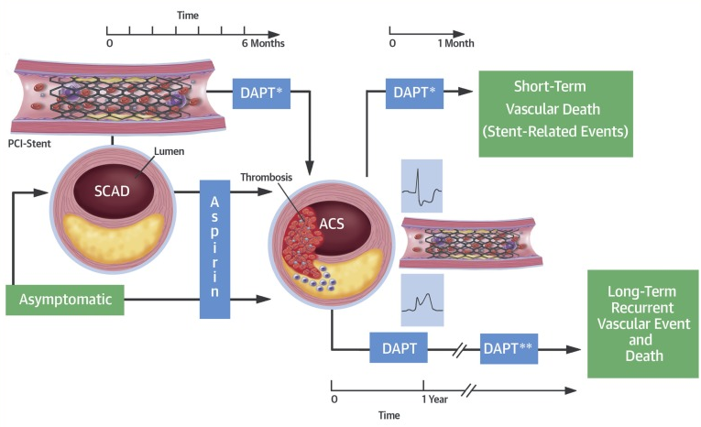
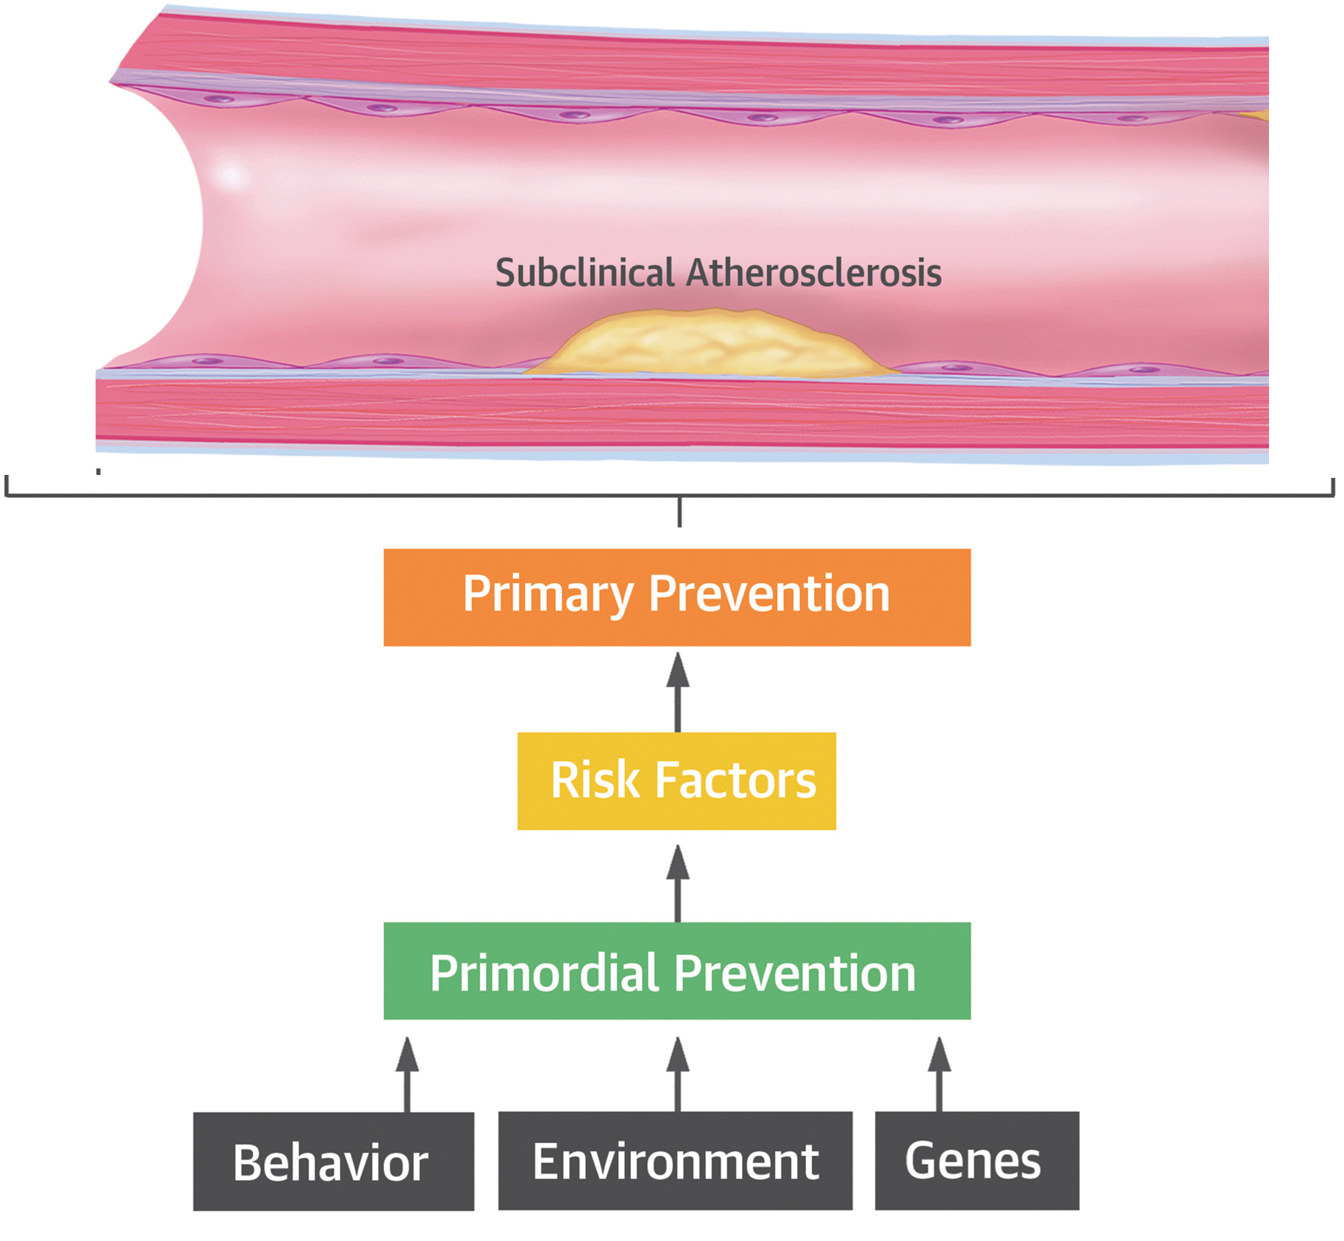
When Antiplatelet Agents are Needed?
Primary Prevention
Secondary Prevention
Nambi V. et al. J Am Coll Cardiol. 2017;70:2992-2994
Patrono, C. et al. J Am Coll Cardiol. 2017;70(14):1760-76

Slide 6
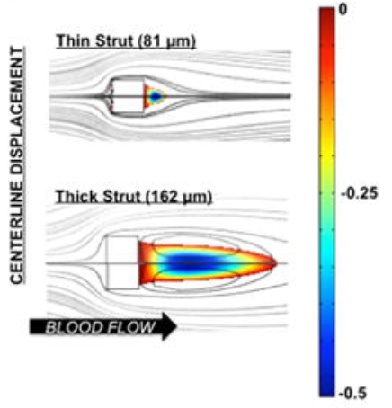
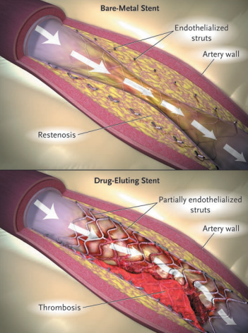
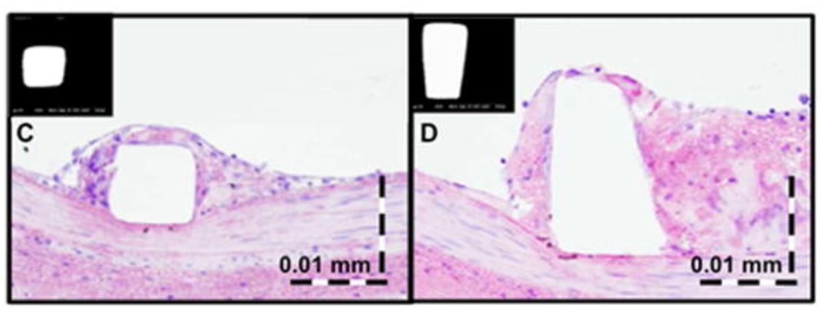
Dual antiplatelet agents after Stenting?
Restenosis vs. Thrombosis
Blood Flow Reduction in correspondence of Stent Scaffolds
Smooth Muscular Cell Proliferation
Neointimal Hyperplasia
Thick structure: More Thrombus..
Platelet and Coagulation Pathways Activation
..after 3 days!
Kolandaivelu K et al Circulation, 2011; 123:1400-1409

Slide 7

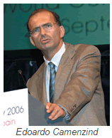

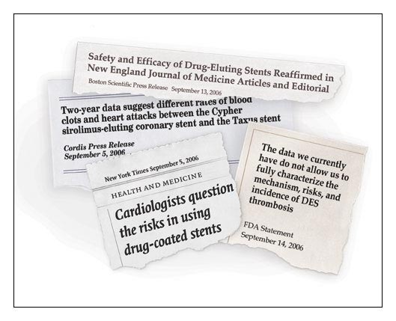
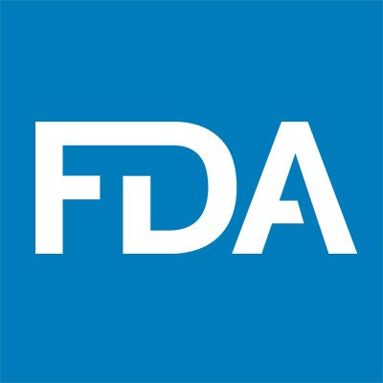
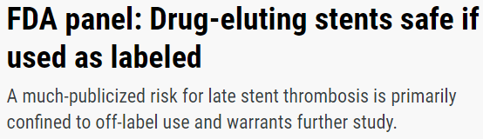
First Generation DES, ST and Need for Prolonged DAPT Duration
Congress 2006
Camenzind et al. meta-analysis showing that 1st Gen DES were associated with a significantly higher risk of late stent thrombosis than BMS
Calls for more long-term data and extended DAPT duration

Slide 8
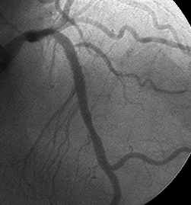
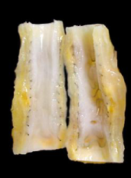
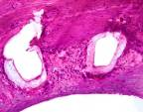
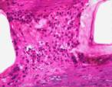
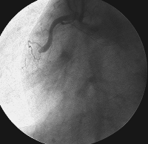
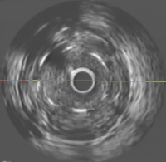


Drug Eluting Stents: The Bitter Sweet Reality!
Late loss = 0
Delayed Healing!
BMS
DES
Inflammation
Giant cells
Eosinophils
48 months
Incomplete Apposition
Angioscopy
BMS
DES
40 Months
Late stent
thrombosis
IVUS
#AHA19
Presented by A. Kirtane, @TCT 2019.

Slide 9
Much Has Changed Since the Introduction of 1st Gen DES . . .
1
Intravascular Imaging
2
Advanced Stent Technology
3
Potent Antiplatelet Agents
4
Improved Secondary Prevention Strategies

Slide 10
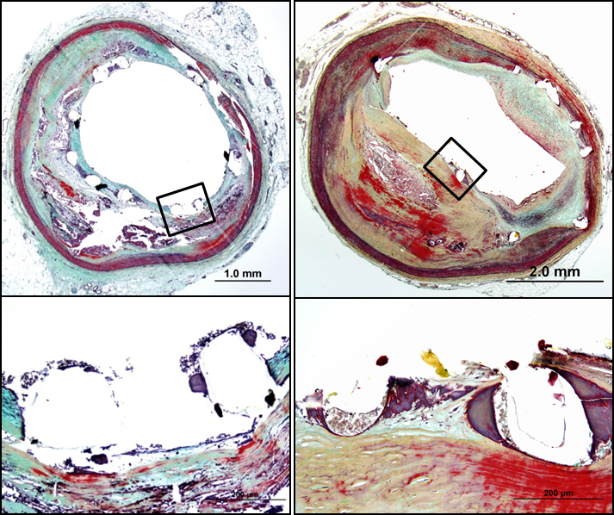
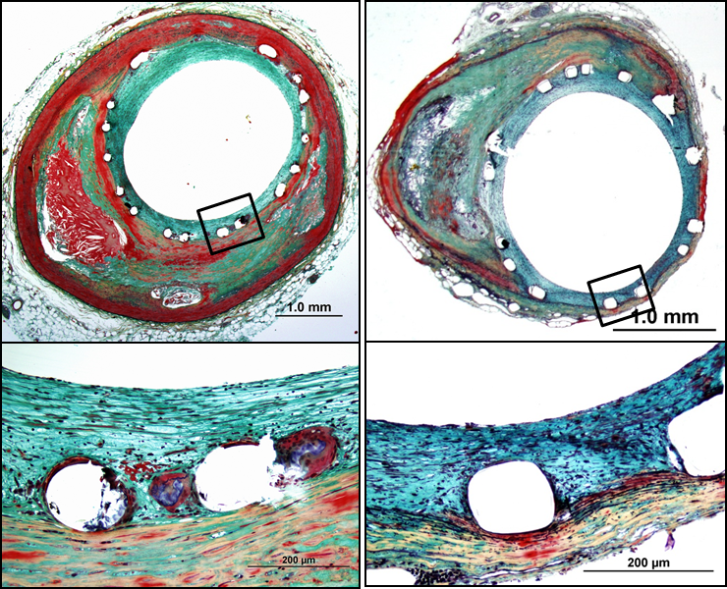
Early versus Next-Generation DES and Risk for Stent Thrombosis...Where is the difference?
1st generation DES
2nd generation DES
SES 13 months
PES 11 months
ZES 3 months
EES 6 months
Representative Images of 1st generation vs. 2nd DES in Human Coronary Arteries

Slide 11
Current Guideline Recomedations
2017 ESC focused update on DAPT
Recommendations | Class | Level
Irrespective of the intended DAPT duration, DES is the preferred treatment option | I | A
...yet, the optimal DAPT duration in HBR patients remains unknown and current guideline recommendations of an abbreviated DAPT regimen are based on a low level of evidence

Slide 12
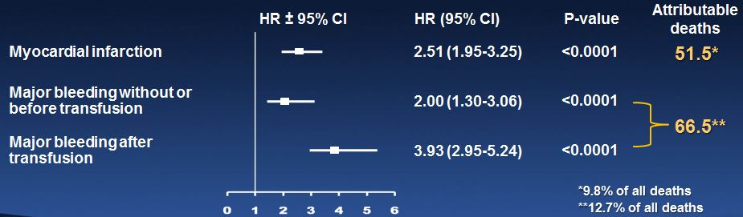
Comparative Impact of Bleeding and Myocardial Infarction on Mortality: From The Acuity Trial
Influence of Major Bleeding and MI in the First 30 Days on Risk of Death Over 1 Year
Of 13,819 enrolled patients, 524 (3.8%) died within 1 year
Cox model adjusted for 36 baseline predictors, with MI and major bleeding (non-CABG) as time-updated covariates
Note: Attributable deaths = N deaths among pts with
the time-updated event (attribute) X (adj. HR – 1)/adj. HR
Mehran RM et al. EHJ 2009;30:1457-66

Slide 13
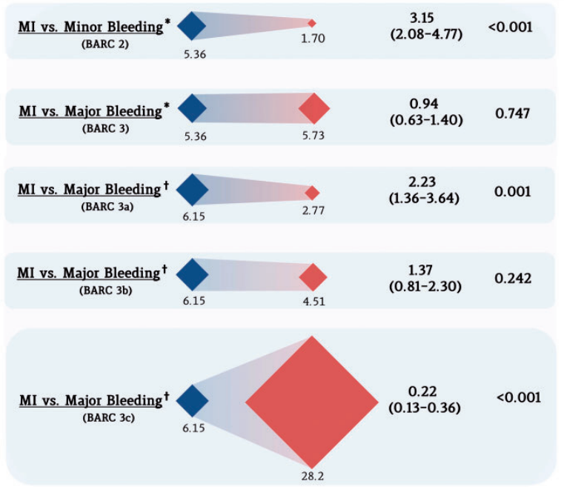
Comparative Impact of Bleeding and Myocardial Infarction on Mortality: From The TRACER Trial
MI or BARC Bleeding >30 days post-ACS
Trade-off of myocardial infarction vs. bleeding types on mortality after ACS
A total of 12,944 patients with NSTEMI
from the TRACER study
Valgimigli, Eur Heart J. 2017 Mar 14;38(11):804-810

Slide 14
CONSEQUENCES OF BLEEDING
Bleeding
DAPT
Discontinuation
Blood Extravasation
Transfusion
Rebound Platelet reactivity
+
Incomplete stent endothelialization
Hb Drop /
Hypovolemia / Hypotension
Inflammatory Activation
Vasoconstriction
Platelet Aggregation
Decreased O2 Delivery
Stent Thrombosis, MI
Cardiac or cerebrovascular event
DEATH
Généreux P. et al. J Am Coll Cardiol. 2015 Sep 1;66(9):1036-45

Slide 15
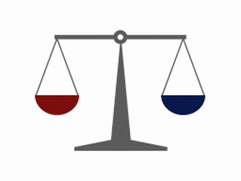
More Potent means more Efficacy.
Are we Sure?
BLEEDING RISK
ISCHEMIC RISK
How balance?

Slide 16
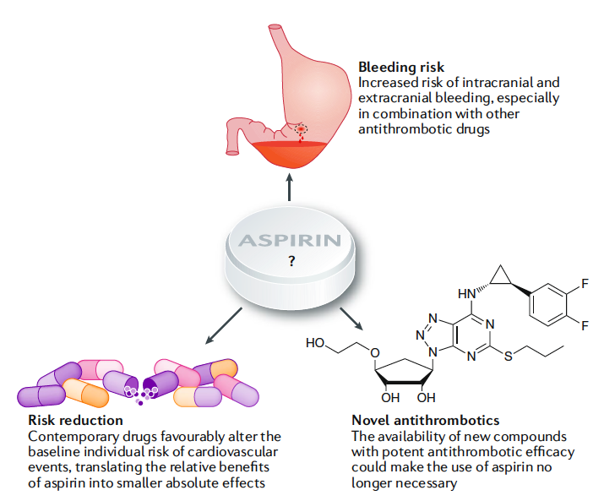
THE ROLE OF ASPIRIN
Uncertainties surrounding the use of acetylsalicylic acid for secondary prevention
Three major arguments challenge the use of acetylsalicylic acid for secondary prevention in combination therapy with other antithrombotic drugs.
Capodanno D & Angiolillo DJ. Nat Rev Cardiol. 2018; 15:480-496

Slide 17
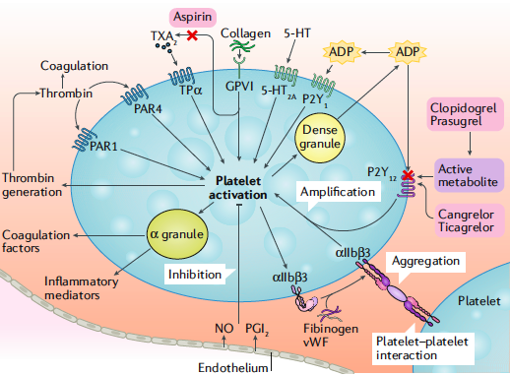
ALTERNATIVE: P2Y₁₂ INHIBITORS
Pivotal role of P2Y₁₂-mediated signaling on thrombotic & inflammatory processes
established clinical efficacy of P2Y₁₂ inhibitors to reduce stent thrombosis
Platelet activation mechanisms:
P2Y₁₂ has a major role in the amplification of platelet activation via interplay with other signaling pathways, including the GP IIb/IIIa receptor
Capodanno D & Angiolillo DJ. Nat Rev Cardiol. 2018; 15:480-496
Angiolillo DJ et al. Circ Cardiovasc Interv. 2016;9(11).2016
Storey RF et al. Curr Pharm Des 2006; 12:1255 -59

Slide 18
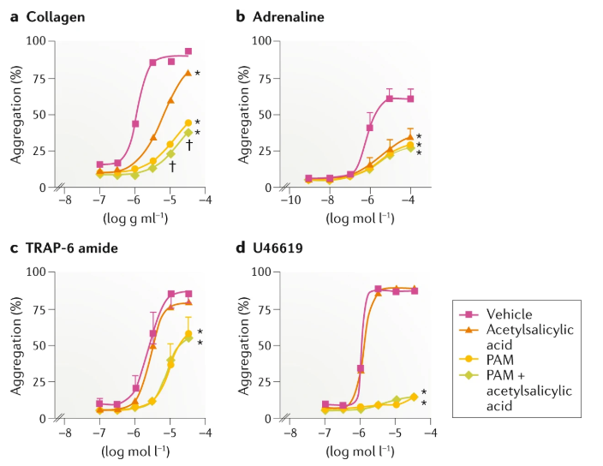
RATIONALE FOR P2Y₁₂ INHIBITOR MONOTHERAPY
Aspirin might abolish or decrease the proposed anti-thrombotic effect of P2Y12 receptor blockers in vivo that is mediated by the amplification of anti-platelet effect of inhibitory prostaglandins such as PGI2
In the presence of P2Y₁₂ receptor inhibitors, aspirin provides little additional inhibition of platelet aggregation
Capodanno D et.al., Nature Reviews, 2018.

Slide 19
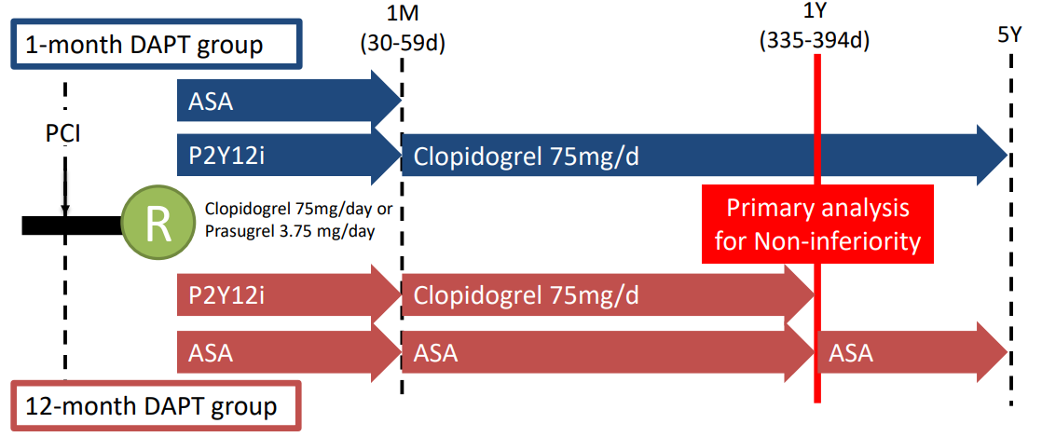
1 VS. 12-MONTH DAPT WITH CLOPIDOGREL
AFTER DES: STOPDAPT-2 Trial
Watanabe et al., JAMA 2019

Slide 20
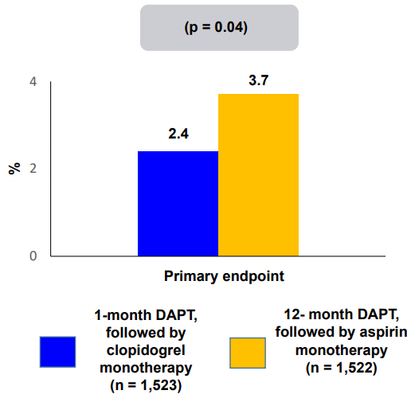
STOP DAPT-2 Trial: Conclusions
Death, MI, ST, Stroke,
TIMI major/minor bleeding at 1 year
1-month DAPT followed by clopidogrel monotherapy was superior to 12-month DAPT followed by aspirin monotherapy at preventing net adverse clinical events.
1-month DAPT was non-inferior to 12-month DAPT at preventing major adverse ischemic events.
Watanabe et al., JAMA 2019

Slide 21
P2Y₁₂ INHIBITOR MONOTHERAPY AFTER PCI:
SMART-CHOICE Trial
A prospective, multicenter, randomized, open-label, noninferiority trial
Key exclusion criteria
- Active bleeding
- DES implantation within 12 months
- Contraindication to study medication
Patients undergoing PCI with DES
CoCr-EES
PtCr-EES
BP-SES
Randomization stratified by
centers, clinical presentation,
and type of P2Y12 inhibitors
CoCr-EES: cobalt-chromium everolimus eluting stent (Xience series)
PtCr-EES: platinum-chromium everolimus-eluting stent (Promus series and Synergy)
BP-SES: bioresorbable polymer- sirolimus-eluting stent (Orsiro)
P2Y12 inhibitor group
P2Y12 inhibitor monotherapy after 3-month DAPT
DAPT group
DAPT for 12 months
Hahn et al., JAMA 2019

Slide 22
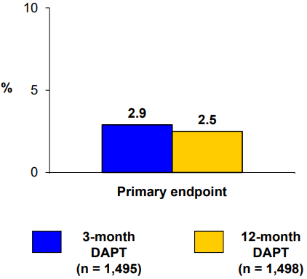
SMART-CHOICE Trial: Conclusions
MACCE (death, MI, stroke) at 12 months
3-month DAPT followed by P2Y₁₂ inhibitor monotherapy is non-inferior to 12-month DAPT in terms of MACCE.
Bleeding (BARC 2-5) was lower with short DAPT: 2.0% vs. 3.4%, p = 0.02
Pnoninferiority = 0.007
Psuperiority = 0.46
Hahn et al., 2019

Slide 23
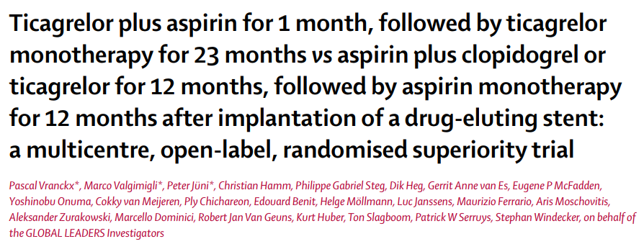
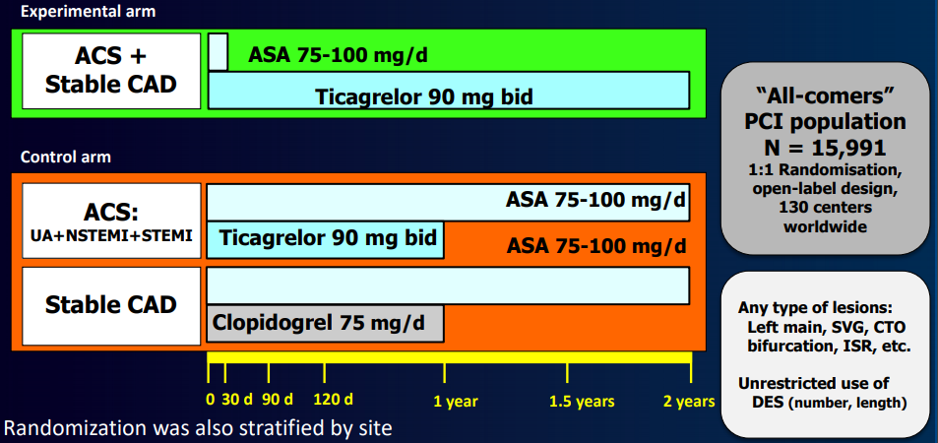
GLOBAL LEADERS Trial
Primary endpoint:
Composite of all-cause mortality or non-fatal new Q-wave MI up to 2 years post randomization
Safety endpoint:
Investigator-reported BARC 3 or 5 bleeding up to 2 years
Vranckx P et al. Lancet 2018

Slide 24
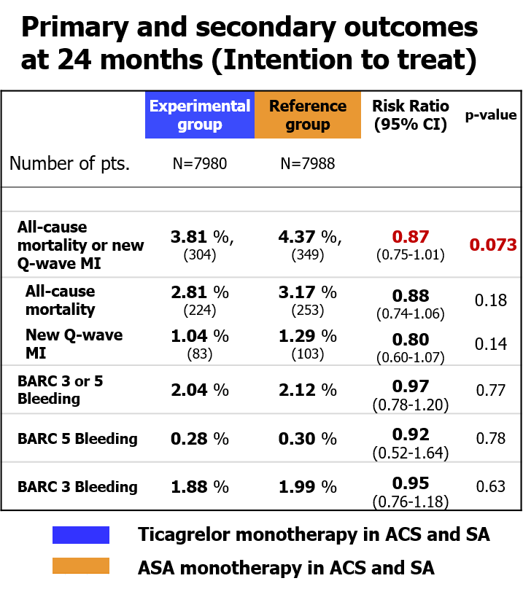
GLOBAL LEADERS Trial: A Missed Opportunity?
Limitations
Linked to a single stent platform
No US data; primarily in Europe
Lack of centralized adjudication; investigator-reported events
Comparator arm has multiple embedded comparisons
Vranckx P et al. Lancet 2018

Slide 25
TWILIGHT -Trial Schema
Enrollment Period
Randomization Period
Observational Period
Ticagrelor + Aspirin
Standard of Care
High-Risk PCI Patients (n=9000)
N = 8200
Ticagrelor + Placebo
Standard of Care
3 months
Short course DAPT
12 months
Monotherapy with potent platelet inhibitor provides ischemic protection while reducing ASA related bleeding
3 months
Standard therapy at physician’s discretion
TIME
0 M
3 M
15 M
18 M

Slide 26
Primary Endpoint: BARC 2, 3 or 5 Bleeding
ITT Cohort
10
Ticagrelor + Aspirin
Ticagrelor + Placebo
8
7.1%
Placebo vs Aspirin
HR (95%CI): 0.56 (0.45 to 0.68)
P <0.001
6
Cumulative incidence (%)
4.0%
4
ARD = -3.08% (-4.15% to -2.01%)
NNT = 33
2
0
0
3
6
9
12
Months since randomization
No. at risk
Ticagrelor + Aspirin
3564
3454
3357
3277
3213
Ticagrelor + Placebo
3555
3474
3424
3366
3321
Mehran R al. NEJM 2019; 381:2032-2042

Slide 27
Key Secondary Endpoint: Death, MI or Stroke
PP Cohort
10
Ticagrelor + ASA
8
Ticagrelor + Placebo
6
Placebo vs Aspirin
HR (95%CI): 0.99 (0.78 to 1.25)
P_{non-inferiority} <0.001
Cumulative incidence (%)
3.9%
4
3.9%
2
ARD = -0.06% (-0.97% to 0.84%)
0
0
3
6
9
12
Months since randomization
No. at risk
Ticagrelor + Aspirin
3515
3466
3415
3361
3320
Ticagrelor + Placebo
3524
3457
3412
3365
3330
Mehran R al. NEJM 2019; 381:2032-2042

Slide 28
TWILIGHT - Conclusions
In high-risk patients who underwent PCI and were treated with ticagrelor and aspirin for 3 months without any major adverse (bleeding or ischemic) events, an antiplatelet strategy of continuing ticagrelor monotherapy resulted in:
substantially less bleeding than ticagrelor plus aspirin
without increasing ischemic events over a period of 1 year
Mehran R al. NEJM 2019; 381:2032-2042

Slide 29
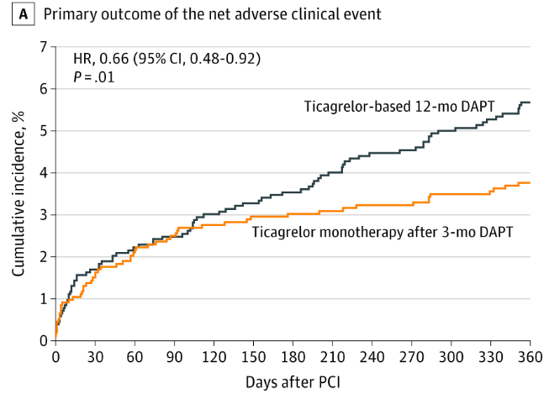

TICO Trial
Mainly driven by a reduction in bleeding!
Among patients with ACS treated with DES, ticagrelor monotherapy after 3 months of DAPT, compared with ticagrelor-based 12-month DAPT, resulted in a modest but statistically significant reduction in a composite outcome of major bleeding and CV events at 1 year.
Kim BK et al., JAMA, 2020

Slide 30
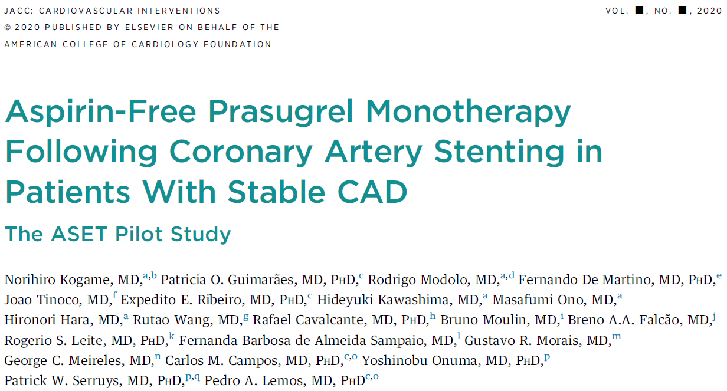
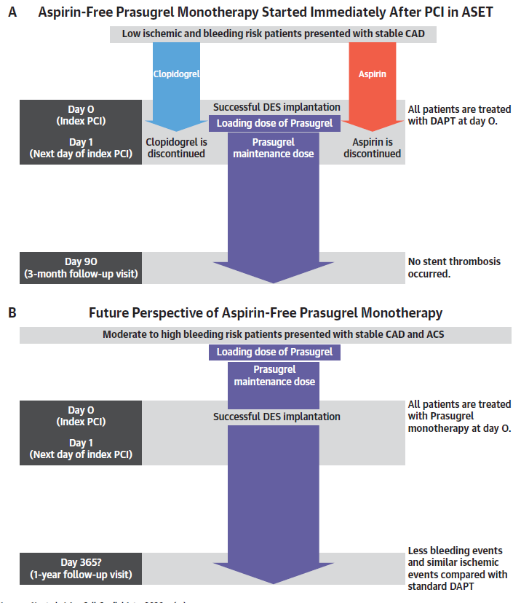
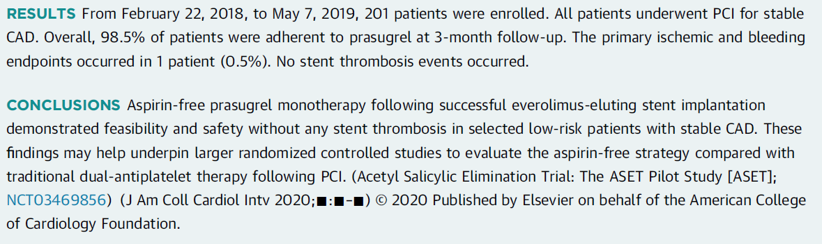
PRASUGREL MONOTHERAPY

Slide 31
It’s all About Balance!
Therefore, an individualized approach based on ischemic vs. bleeding risk assessment
is needed
Ischemia
Bleeding

Slide 32



THE RIGHT THERAPY FOR THE RIGHT PATIENT:
One Size Doesn’t Fit All
High-Ischemic Risk
Low-Bleeding Risk
Prolonged DAPT Duration
Low-Ischemic Risk
High-Bleeding Risk
Short DAPT Duration
Short DAPT Duration
(need for more data)
Low-Ischemic Risk
Low-Bleeding Risk
High-Ischemic Risk
High-Bleeding Risk
Short DAPT/Ticagrelor Monotherapy
Tailored Approach

Slide 33
DAPT Vs SAPT After PCI
Triple Vs Dual Therapy Following PCI in patients with Afib
1
2

Slide 34
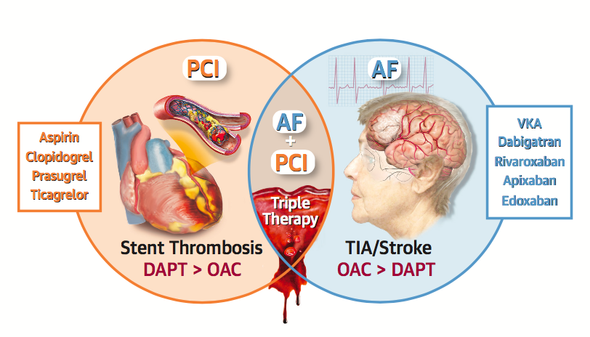
A-FIB + PCI STENT
Stent thrombosis and coronary events
⬇
High shear stress
platelet-rich thrombi
⬇
Antiplatelet therapy
Stroke, TIA and systemic embolism
⬇
Low shear stress, less platelet-dependent thrombi
⬇
Anticoagulation therapy
Capodanno D, Angiolillo DJ. JACC Cardiovasc Interv. 2017;10:1086-1088
Capodanno D, Angiolillo DJ. JACC Cardiovasc Interv. 2017;10:1086-1088

Slide 35
PREEXISTING AF
Atrial Fibrillation
(AFib)
Percutaneous Coronary Intervention
(PCI)
5-10% of patients undergoing PCI have AFib
Angiolillo et al. Circ Cardiovasc Interv. 2016;9:e004395

Slide 36
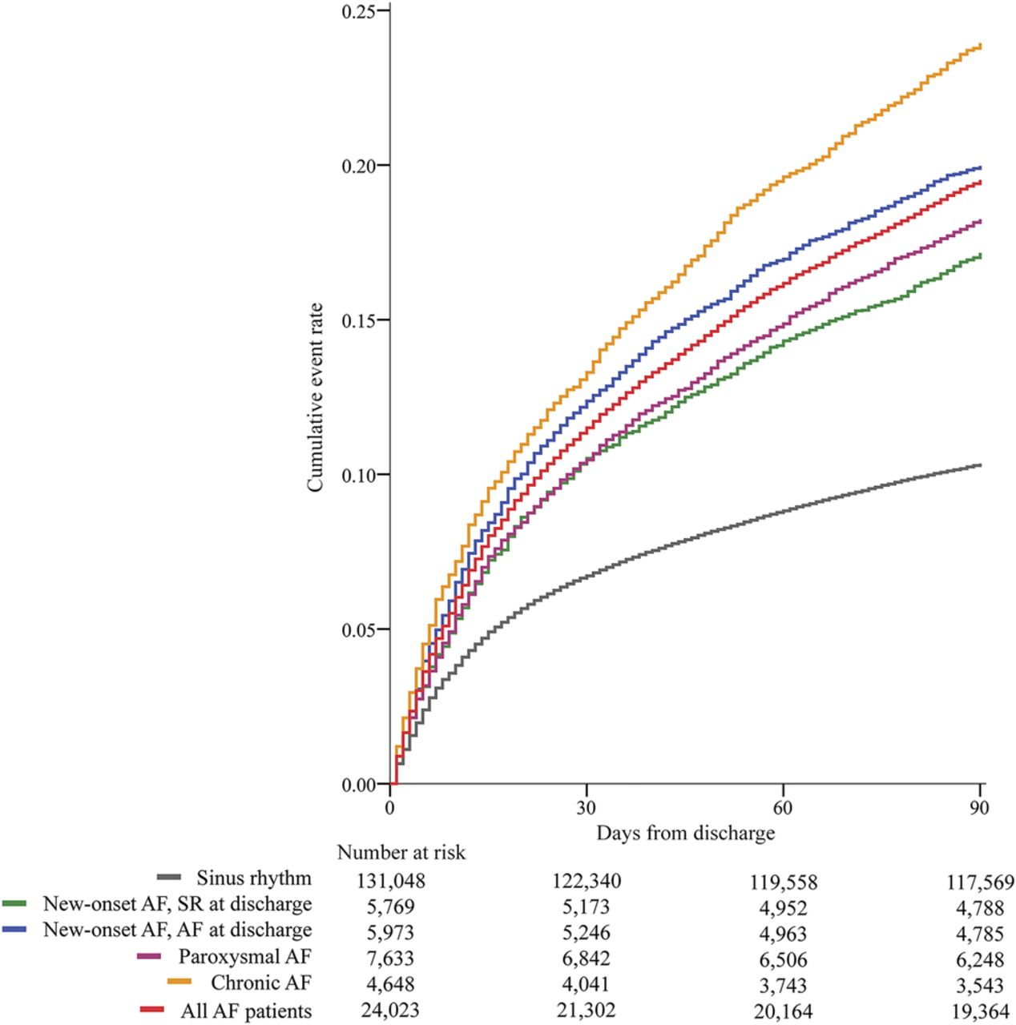
NEW ONSET AF AFTER PCI
6-11% of PCI patients (ACS + no ACS) patients develop new onset AF
  Half of these patients are in SR at discharge
Development at a mean of 2.7 days after PCI
  DAPT might already be initiated
  “All types of AF after PCI are associated with worse outcomes“
  Adjusted HR for Mortality 1.72
Mazzone et al. Int J Clin Pract. 2018;72:e13087; Batra et al. Heart 2016;102:926-933

Slide 37

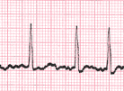

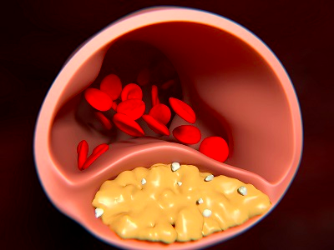
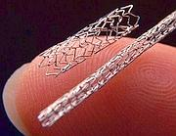
EPIDEMIOLOGY
People in EU and US
With A-Fib
OAT indicated
Revasc. indicated
With CAD
4.8 million
20 million
16 million
1-2 million
1 billion
Capodanno D, Angiolillo DJ. Circ Cardiovasc Interv. 2014;7:113-124

Slide 38
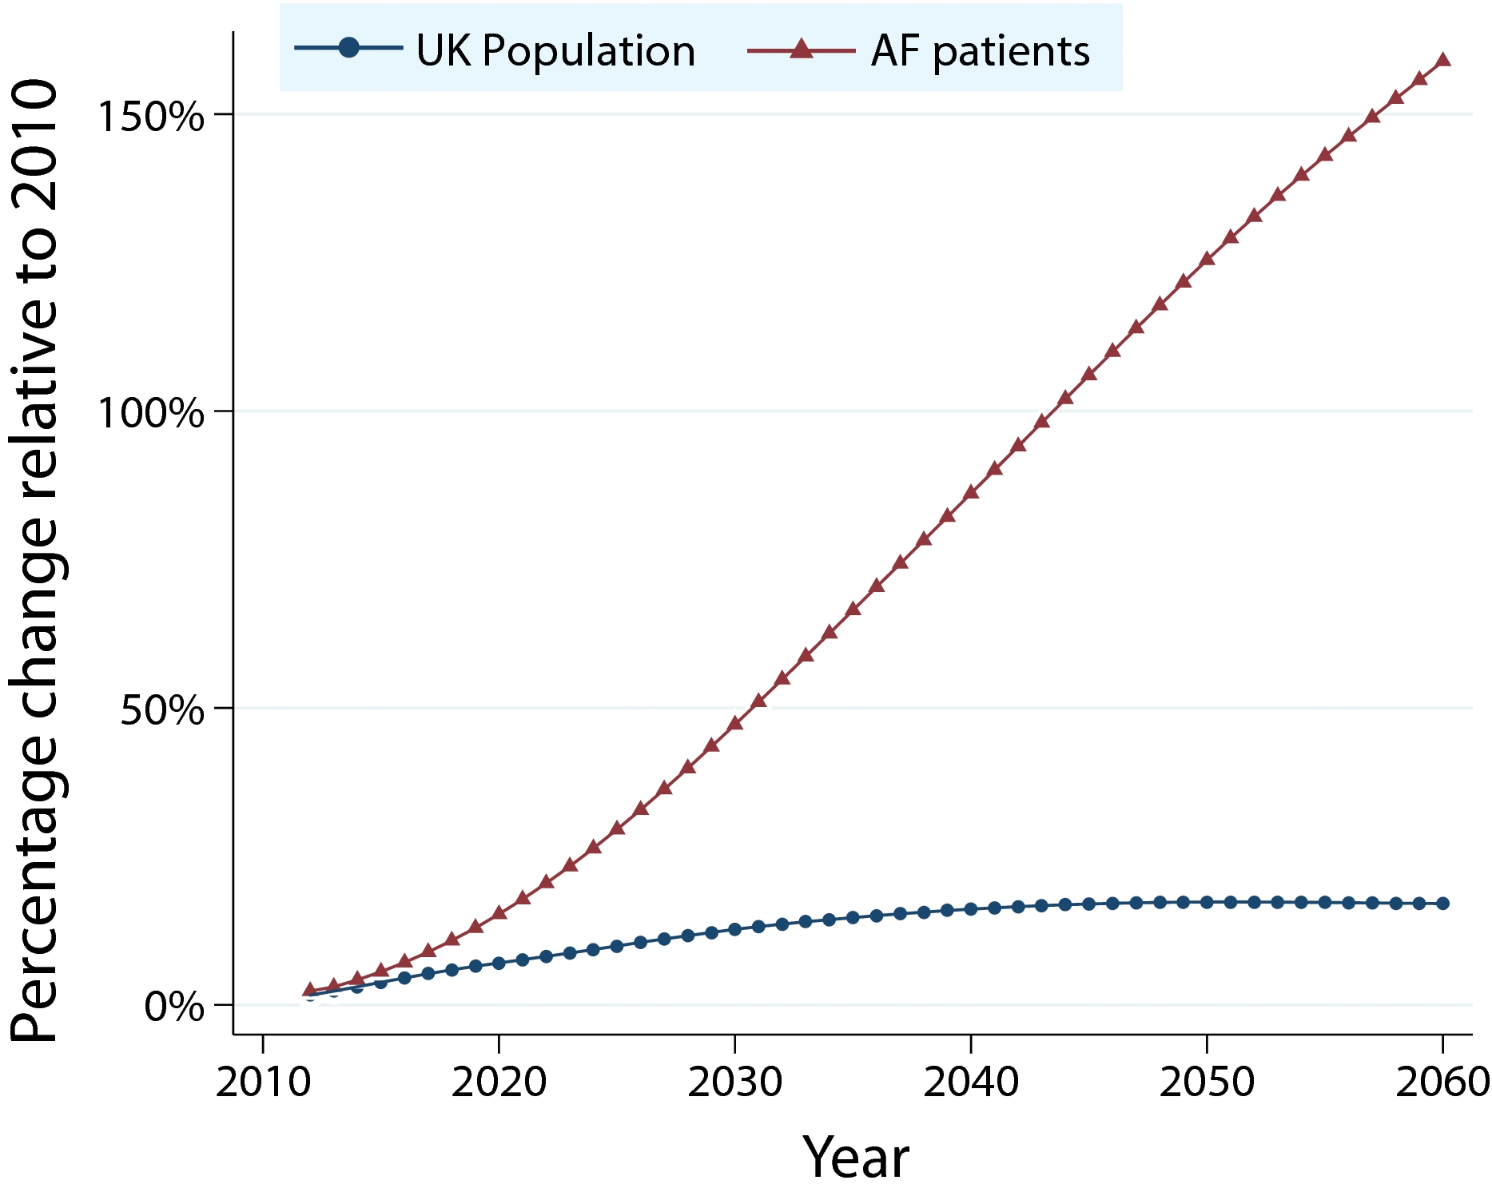
PROJECTED PREVALENCE OF AF
“The large projected increase in AF prevalence suggests the need for comprehensive implementation of AF prevention and management strategies”
Lane et al. JAHA 2017; 10.1161/JAHA.116.005155.

Slide 39
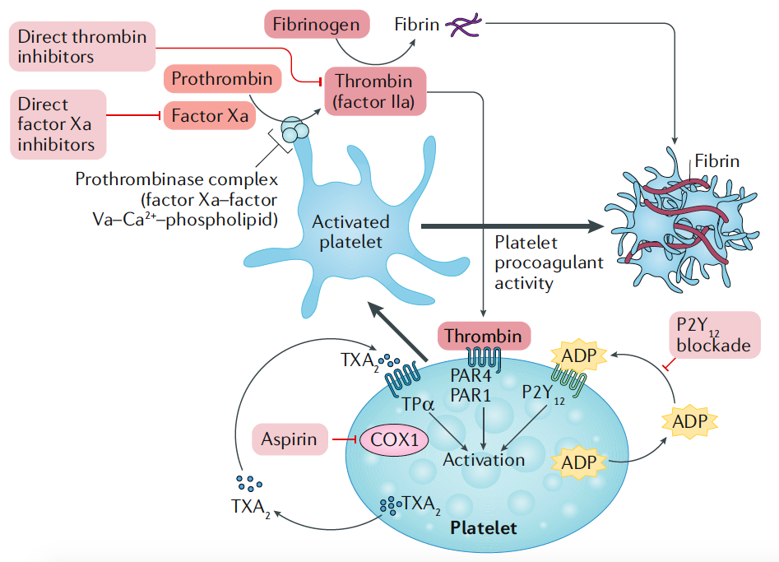
DUAL PATHWAY INHIBITION
Synergy of oral anticoagulant and antiplatelet therapy
Oral anticoagulant therapy, including direct inhibitors of factor IIa and Xa, and antiplatelet agents, such as acetylsalicylic acid and P2Y₁₂ inhibitors, synergistically target two essential components of thrombosis: coagulation and platelet activation.
Capodanno D & Angiolillo DJ. Nat Rev Cardiol. 2018; 15:480-496

Slide 40
NOACS VS. VKA IN AF TRIALS
Risk Ratio (95% CI)
Ischemic Stroke
0.92 (0.83 - 1.02)
Hemorrhagic Stroke
0.49 (0.38 - 0.64)
Myocardial Infarction
0.97 (0.78 - 1.20)
p=0.77
All-Cause Mortality
0.90 (0.85 - 0.95)
0.2
0.5
1
2
Favors NOAC
Favors Warfarin
Heterogeneity p=NS for all outcomes
Ruff CT, et al. Lancet 2014;383:955-962

Slide 41
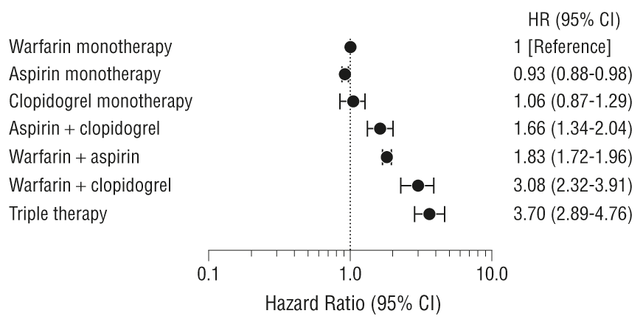
PRE-WOEST REGIMENS
Bleeding Risk with NOAC + Clopidogrel instead of Warfarin could be even lower
Hansen et al. Arch Intern Med 2010; 170:1433–1441.

Slide 42
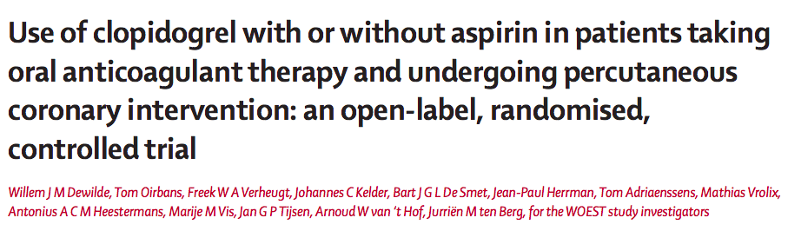
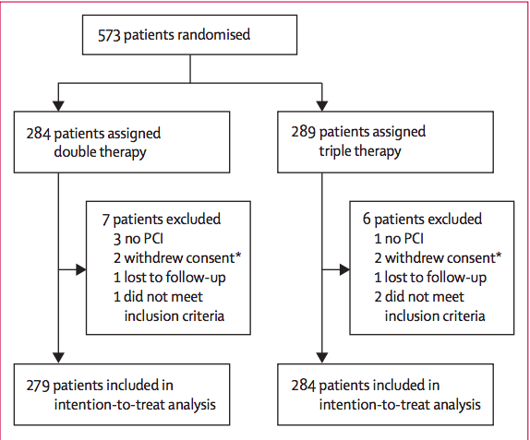
WOEST TRIAL 2013
Dewilde W et al . Lancet 2013; 381:1107

Slide 43
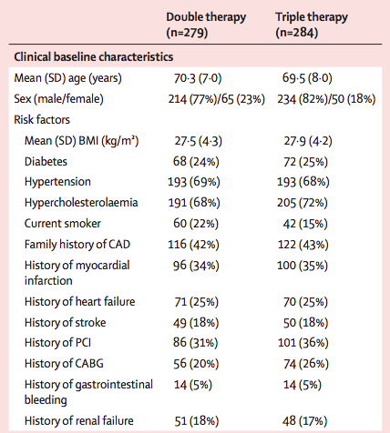
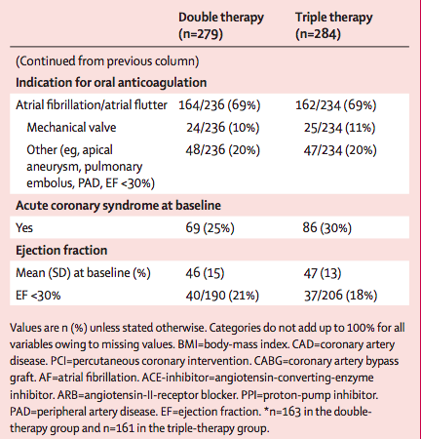
WOEST TRIAL 2013
Dewilde W et al . Lancet 2013; 381:1107

Slide 44
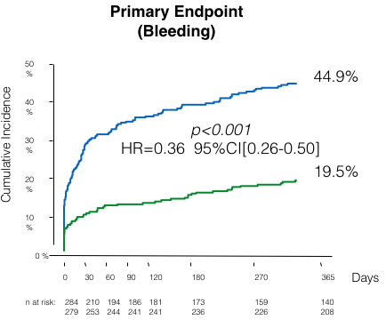
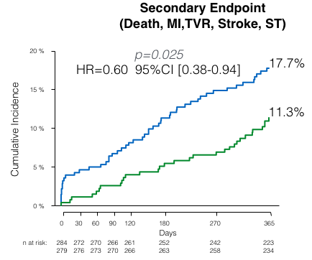
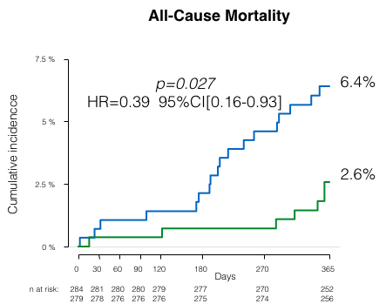

WOEST TRIAL 2013
Dewilde W et al . Lancet 2013; 381:1107

Slide 45
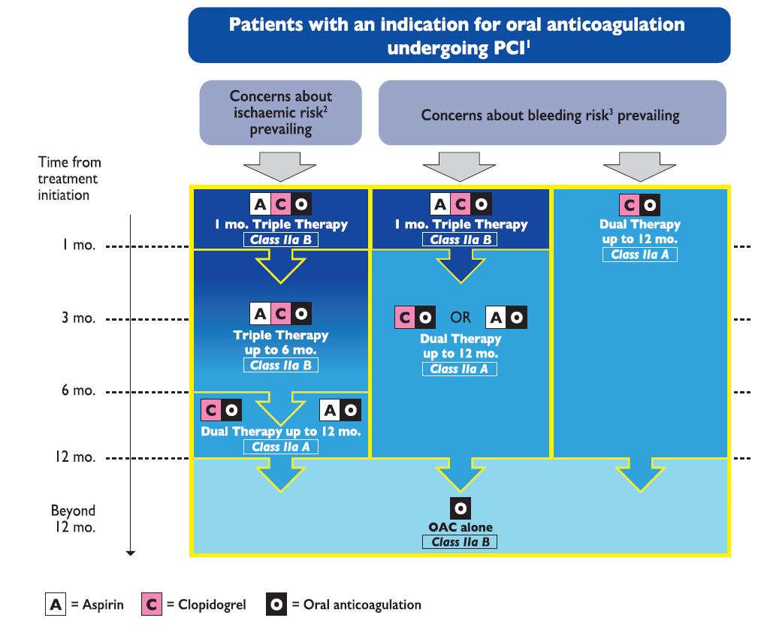

EUROPEAN PERSPECTIVE
2017 ESC DAPT focused update:
Pat. with OAC + PCI:
no default strategy
consider bleeding vs. ischemic risk
Angiolillo et al Circ Cardiovasc Interv. 2016;9:e004395.

Slide 46
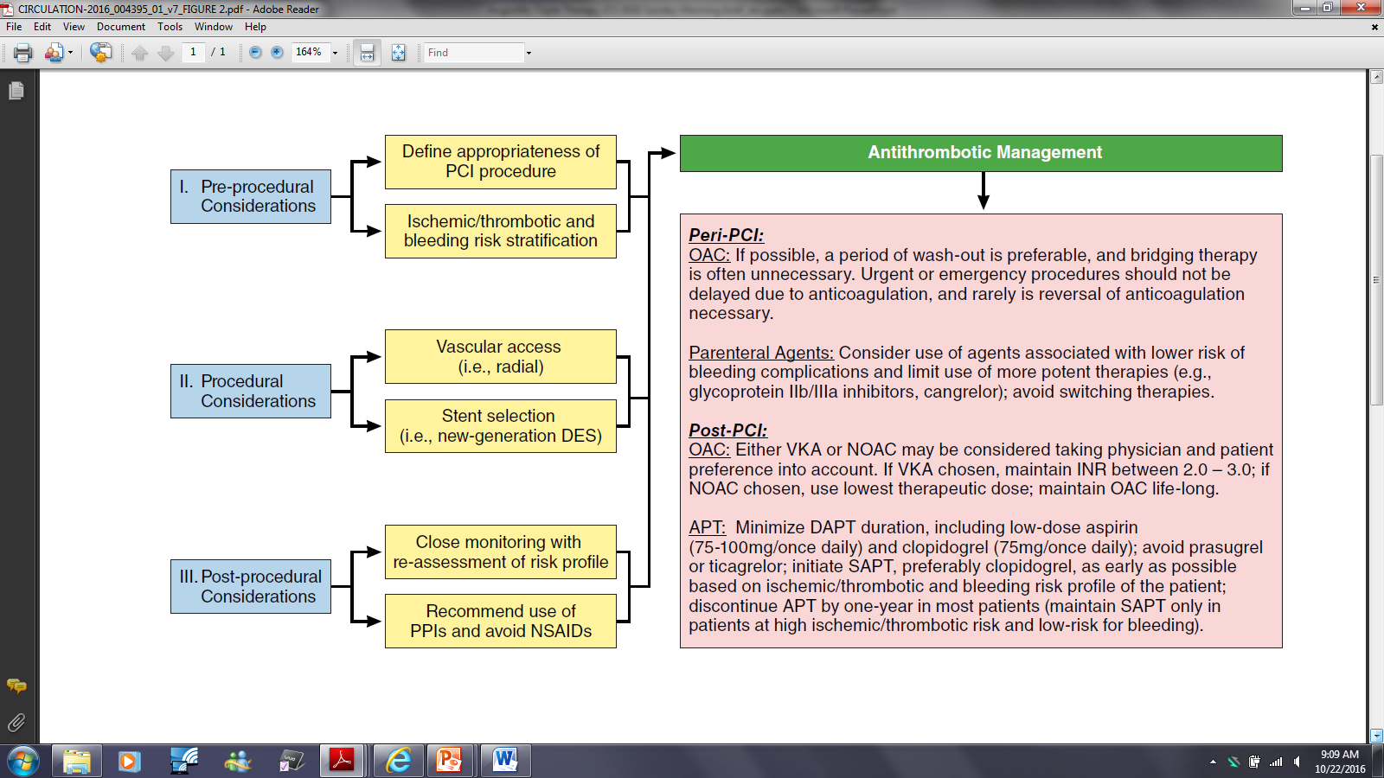

AF + PCI: A North American Perspective – 2016 Update
Pragmatic algorithm for the management of AF patients requiring OAC undergoing PCI
Discontinuation of one antiplatelet agent should be considered 1-3 months after PCI, this may occur sooner (including immediately after PCI) or later (but not beyond 6 months) according to the ischemic/thrombotic and bleeding risk profiles of the patient.
Angiolillo DJ et al. Circ Cardiovasc Interv. 2016

Slide 47

AMERICAN PERSPECTIVE
2018 Update on Patients with OAC + PCI
Default strategy:
Dual therapy
Patients with high ischemic risk:
consider triple therapy
Angiolillo DJ et al. Circulation 2018; 138:527–536.

Slide 48

The AUGUSTUS Trial
Prior studies were designed to identify strategies to reduce the bleeding associated with triple antithrombotic therapy
  - WOEST (n=573): less bleeding AND fewer ischemic events without aspirin compared with
  VKA + DAPT
  - PIONEER AF-PCI (n=2124): less bleeding with two reduced-dose rivaroxaban regimens
  compared with VKA + DAPT
  - RE-DUAL PCI (n=2725): less bleeding with two standard-dose dabigatran regimens, without aspirin, compared with VKA + DAPT
Data on the independent effects of aspirin in this population are needed
Dewilde WJ, et al. Lancet 2013;381:1107-15. - Gibson CM, et al. N Engl J Med 2016;375:2423-34. - Cannon CP, et al. N Engl J Med 2017;377:1513-24.

Slide 49
TWO INDEPENDENT HYPOTHESES
In patients with AF and ACS or PCI on a P2Y₁₂ inhibitor
Apixaban is non-inferior to VKA for International Society on Thrombosis and Hemostasis (ISTH) major or clinically relevant non-major (CRNM) bleeding
Triple therapy is inferior to Dual Therapy for ISTH major or CRNM bleeding

Slide 50

TRIAL DESIGN
TT
DT
TT
DT
Lopes RD, et al. Am Heart J. 2018;200:17-23.

Slide 51

MAJOR/CLINICALLY RELEVANT NON-MAJOR BLEEDING
TT
TT
DT
DT
Lopes RD, et al. (2019), NEJM

Slide 52

DEATH/HOSPITALIZATION
DT
TT
DT
Lopes RD, et al. (2019), NEJM

Slide 53






UPDATED META-ANALYSIS OF
AF-PCI RANDOMIZED TRIALS
PubMed (MEDLINE)
Scopus
Web of Science
PIONEER AF-PCI
2016
10,969 AF-PCI patients
RE-DUAL PCI
2017
NOAC+SAPT
vs.
VKA+DAPT
AUGUSTUS
2019
ENTRUST-AF PCI
2019
Capodanno D, Angiolillo DJ, et al. Journal of American Heart Association, 2020, 9:e017212

Slide 54

TRIAL-DEFINED MACES
Reconstructed Kaplan-Meier curves
NOAC + SAPT
VKA + DAPT
HR: 1.02 [0.86, 1.22]
p = 0.790
NOAC + SAPT
VKA + DAPT
Capodanno D, Angiolillo DJ, et al. Journal of American Heart Association, 2020, 9:e017212

Slide 55
TRIAL-DEFINED CLINICALLY SIGNIFICANT BLEEDING
Reconstructed Kaplan-Meier curves
NOAC + SAPT
VKA + DAPT
NOAC + SAPT
VKA + DAPT
HR: 0.57 [0.52, 0.64]
p < 0.001
HR: 0.52 [0.46, 0.58]
p < 0.001
HR: 0.83 [0.66, 1.04]
p = 0.103
NOAC + SAPT
NOAC + SAPT
VKA + DAPT
VKA + DAPT
Capodanno D, Angiolillo DJ, et al. Journal of American Heart Association, 2020, 9:e017212

Slide 56


RESULTS OVERVIEW
Relative risks
NNT (Number Needed to Treat)
NNH (Number Needed to Harm)
Stent thrombosis
Stroke
Myocardial infarction
Death
MACEs
Intracranial hemorrhage
Clinically relevant non-major bleeding
Major bleedings
Clinically significant bleedings
Capodanno D, Angiolillo DJ, et al. Journal of American Heart Association, 2020, 9:e017212

Slide 57

STENT THROMBOSIS
Stent thrombosis
Capodanno D, Angiolillo DJ, et al. Journal of American Heart Association, 2020, 9:e017212

Slide 58


CONCLUSION
In patients with AF undergoing PCI, no significant differences were found between NOAC + SAPT and VKA + DAPT strategies in terms of MACE and single ischemic endpoints
In patients with AF undergoing PCI, a strategy of NOAC + SAPT is associated with a significantly lower incidence of both clinically relevant bleedings and major bleedings compared with a VKA + DAPT strategy

Slide 59


Thank You
@Drroxmehran

