Slide 1
Noninvasive Imaging of Stable CAD post ESC Guidelines
ESC Guidelines on Chronic Coronary Syndromes, 2019
S. Achenbach
No Disclosures

Slide 2
Three very basic considerations

Slide 3
Three very basic considerations
What do we want to know in patients with suspected CAD?

Slide 4
Three very basic considerations
What do we want to know in patients with suspected CAD?
A) Symptoms caused by ischemia? => can they be relieved by revascularization?
B) At risk for MI and death? => revascularization, Statins, Aspirin?

Slide 5
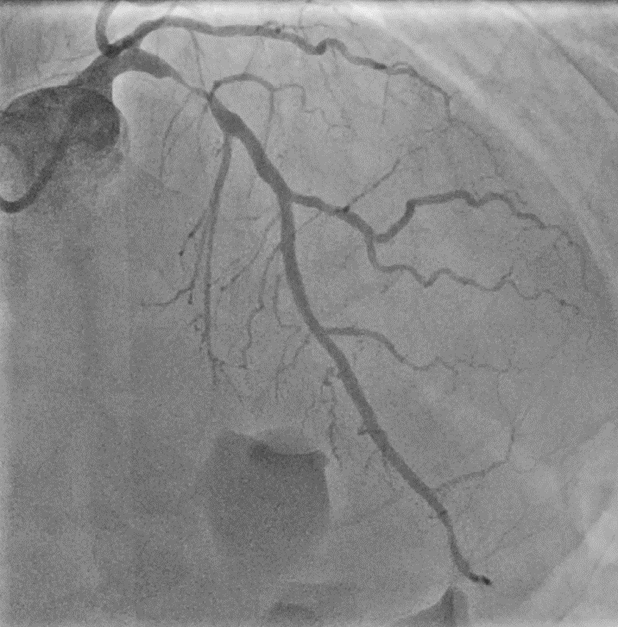
Three very basic considerations
What do we want to know in patients with suspected CAD?
Symptoms (revascularization)
Might not be enough

Slide 6
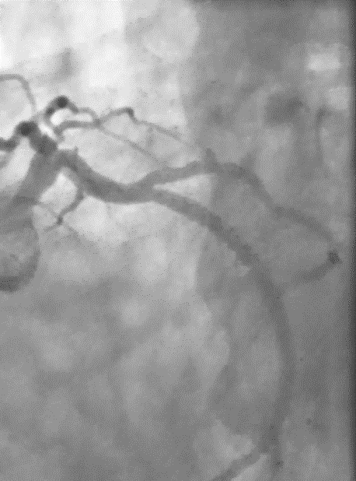
Three very basic considerations
What do we want to know in patients with suspected CAD?
Symptoms (revascularization) Events
Might not be enough
Might not be enough

Slide 7
Three very basic considerations
What do we want to know in patients with suspected CAD?
Symptoms (revascularization) Events
Might not be enough
4 days later

Slide 8
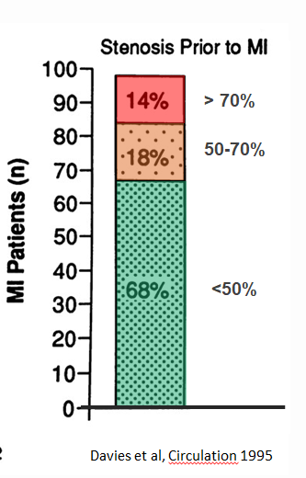
Three very basic considerations
What do we want to know in patients with suspected CAD?
Symptoms (revascularization) Events
Might not be enough
Davies et al, Circulation 1995

Slide 9
Three very basic considerations
What do we want to know in patients with suspected CAD?
Symptoms Events
Might be useful
Might not be enough

Slide 10
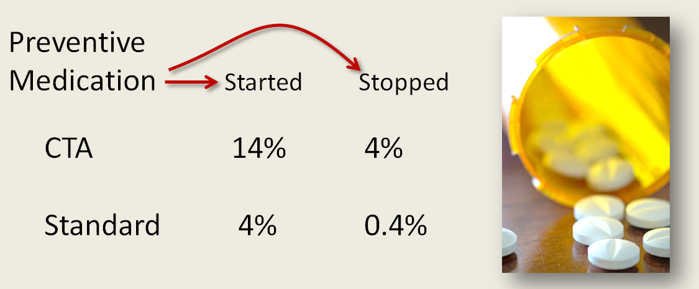
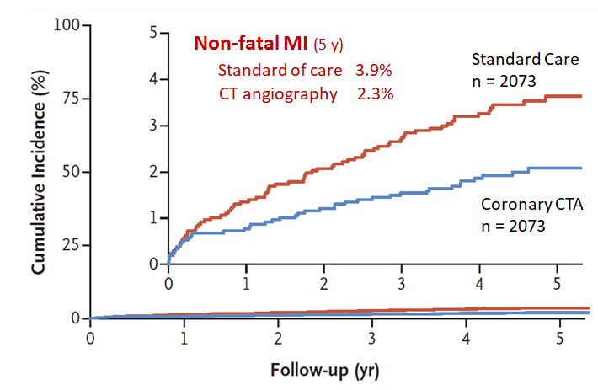
Three very basic considerations
What do we want to know in patients with suspected CAD?
Events
Might be useful
SCOT Heart: 4179 patients, suspected CAD
Randomized to CT vs. standard of care

Slide 11
Three very basic considerations
What do we want to know in patients with suspected CAD?
How accurate are our tests to find patients with CAD?

Slide 12
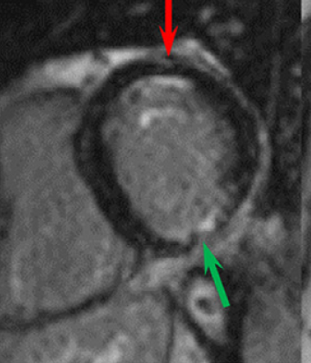
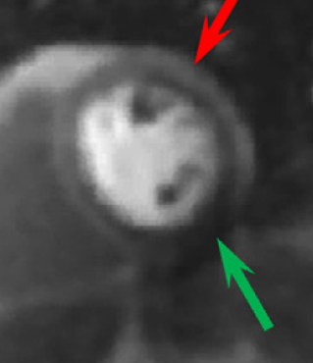
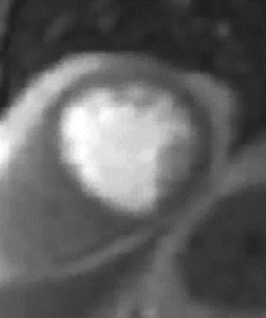
Three very basic considerations
What do we want to know in patients with suspected CAD?
How accurate are our tests to find patients with CAD?
What do we want to know in patients with suspected CAD?
Late Enhancement
Stress Perfusion
Rest Perfusion
n = 764
Sensitivity: 79%
Specificity: 87%
To identify 70% stenosis
Arad et al, J Am Coll Cardiol 2020

Slide 13
Three very basic considerations
What do we want to know in patients with suspected CAD?
How accurate are our tests to find patients with CAD?
Sensitivity Specificity
Exercise ECG 50% 85%
PET 90% 85%
SPECT 73-87% 70-83%
Stress Echo 85% 82%
Stress cMR 90% 80%
Coronary CTA 96% 82%

Slide 14
Three very basic considerations
What do we want to know in patients with suspected CAD?
How accurate are our tests to find patients with CAD?
Performed by Experts
Sensitivity Specificity
Exercise ECG 50% 85%
PET 90% 85%
SPECT 73-87% 70-83%
Stress Echo 85% 82%
Stress cMR 90% 80%
Coronary CTA 96% 82%

Slide 15
Three very basic considerations
What do we want to know in patients with suspected CAD?
How accurate are our tests to find patients with CAD?
Performed by Experts
Sensitivity Specificity
Exercise ECG 50% 85%
PET 90% 85%
SPECT 73-87% 70-83%
Stress Echo 85% 82%
Stress cMR 90% 80%
Coronary CTA 96% 82%
85%

Slide 16
Three very basic considerations
What do we want to know in patients with suspected CAD?
How accurate are our tests to find patients with CAD?
Is testing always useful?

Slide 17
Three very basic considerations
What do we want to know in patients with suspected CAD?
How accurate are our tests to find patients with CAD?
Is testing always useful?
After the test, do we know more about the patient´s condition than before the test?

Slide 18
Pre-test Likelihood
Definitely… Probably…
Don´t think so…

Slide 19
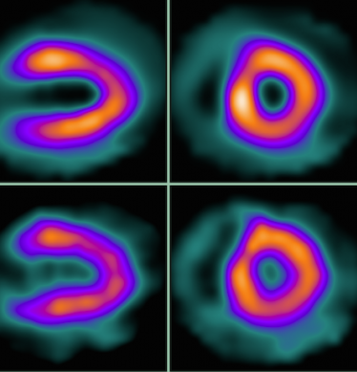
Pre-test Likelihood
“If I perfom a test, I will know more about the patient after the test than I did before.
It will give me a clearer picture“
Definitely… Probably…
Don´t think so…

Slide 20
Pre-test Likelihood
Conventional thinking:
“After a test, the likelihood of disease assigned to a given patient is closer to reality than it was before the test.“

Slide 21
Pre-test Likelihood
Conventional thinking:
“After a test, the likelihood of disease assined to a given patient is closer to reality than it was before the test.“
=> “Testing is helpful“

Slide 22
Pre-test Likelihood
No test is 100% accurate
(but we typically assume: even if accuracy is not 100%, there is still some value of the test)

Slide 23
Pre-Test Likelihood
Noninvasive tests for “obstructive“ CAD: Sensitivity and specificity ~ 85%
=> 15% of all results will be incorrect
No test is 100% accurate
(but we typically assume: even if accuracy is not 100%, there is still some value of the test)

Slide 24
Pre-Test Likelihood
Noninvasive tests for “obstructive“ CAD: Sensitivity and specificity ~ 85%
=> 15% of all results will be incorrect
1100 patients, 100 have disease

Slide 25
Pre-Test Likelihood
Noninvasive tests for “obstructive“ CAD: Sensitivity and specificity ~ 85%
=> 15% of all results will be incorrect
1100 patients, 100 have disease
100 with disease => 85 correct 15 incorrect

Slide 26
Pre-Test Likelihood
Noninvasive tests for “obstructive“ CAD: Sensitivity and specificity ~ 85%
=> 15% of all results will be incorrect
1100 patients, 100 have disease
100 with disease => 85 correct 15 incorrect
1000 without disease => 850 correct 150 incorrect

Slide 27
Pre-Test Likelihood
Noninvasive tests for “obstructive“ CAD: Sensitivity and specificity ~ 85%
=> 15% of all results will be incorrect
1100 patients, 100 have disease
100 with disease => 85 correct 15 incorrect
1000 without disease => 850 correct 150 incorrect
TOTAL 935 correct 165 incorrect

Slide 28
Pre-Test Likelihood
Noninvasive tests for “obstructive“ CAD: Sensitivity and specificity ~ 85%
=> 15% of all results will be incorrect
1100 patients, 100 have disease
100 with disease => 85 correct 15 incorrect
1000 without disease => 850 correct 150 incorrect
TOTAL 935 correct 165 incorrect
“ALL ARE HEALTHY“ 1000 correct 100 incorrect

Slide 29
Pre-Test Likelihood
Sometimes, as a result of performing a test, the assessment of the patient after the test is worse than it was before
True in particular for very high and very low pre-test likelihoods.

Slide 30
Pre-Test Likelihood
The value of a diagnostic test depends on
1) pre-test likelihood (sometimes it may be better to not use any test)
2) how the test performs in patient cohorts with low, intermediate, and high prevalence of disease
.

Slide 31
Three very basic considerations
1. What do we want to know in patients with suspected CAD?
A) Symptoms
B) Prognosis
2. How accurate are our tests to find patients with CAD?
About 85%
3. Is testing always useful?
Not necessarily

Slide 32
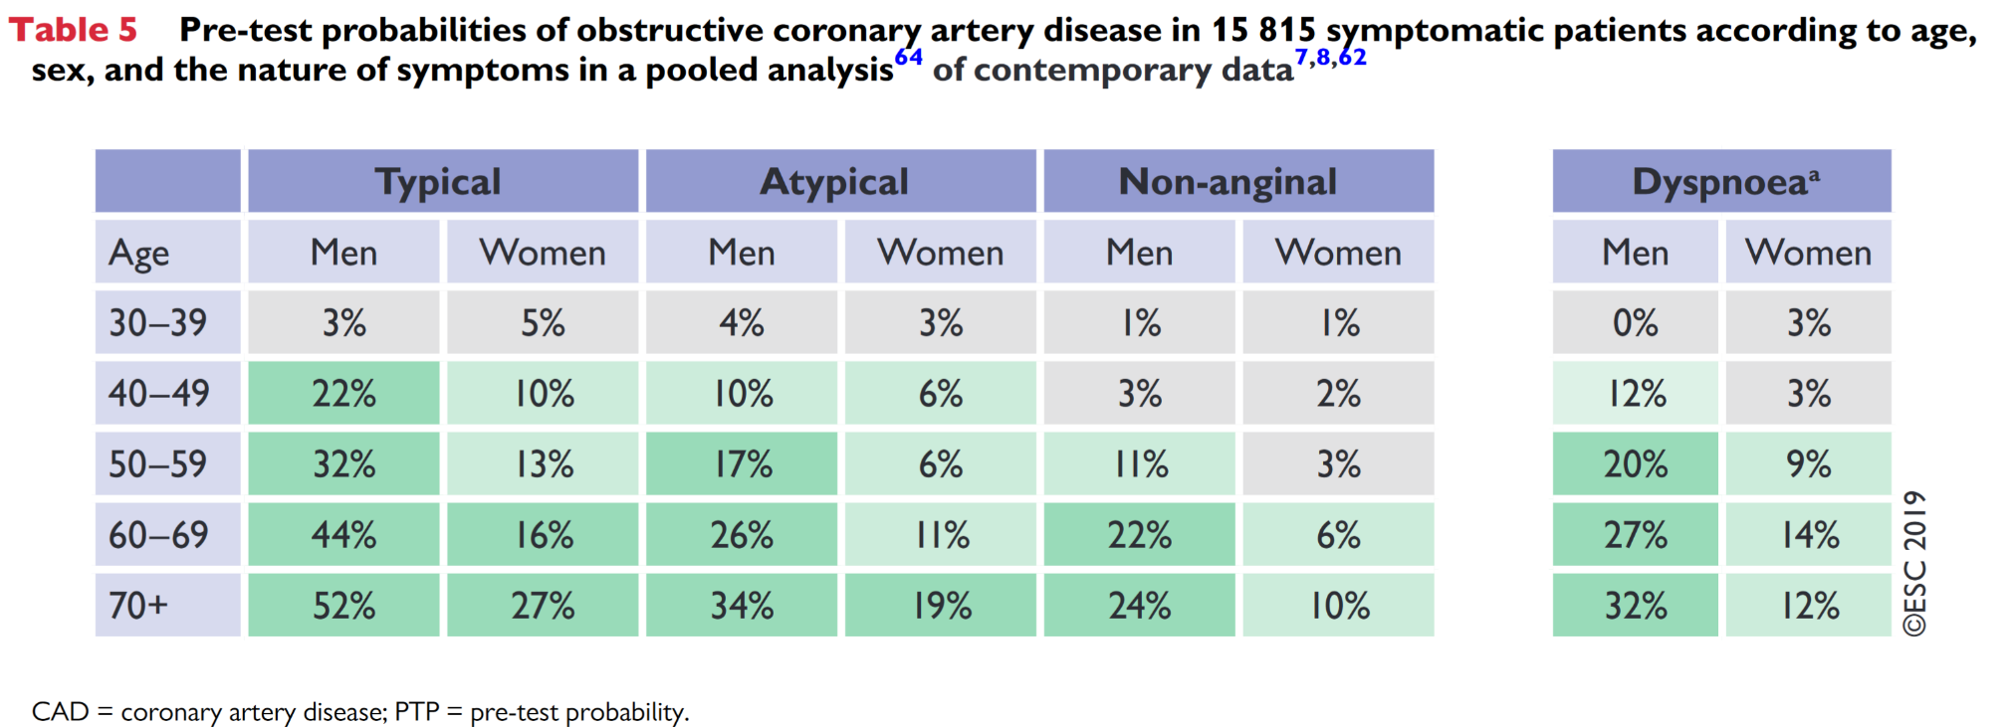
Symptoms and pre-test Likelihood

Slide 33
Symptoms and pre-test Likelihood
Likelihood of CAD is modified substantially if
- multiple risk factors - abnormal ECG
- Wall motion abnormality in echocardiography

Slide 34
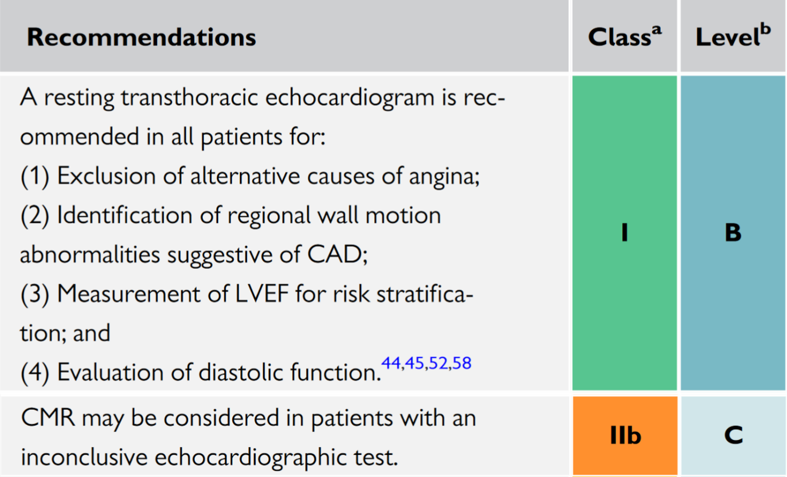
Symptoms and pre-test Likelihood

Slide 35
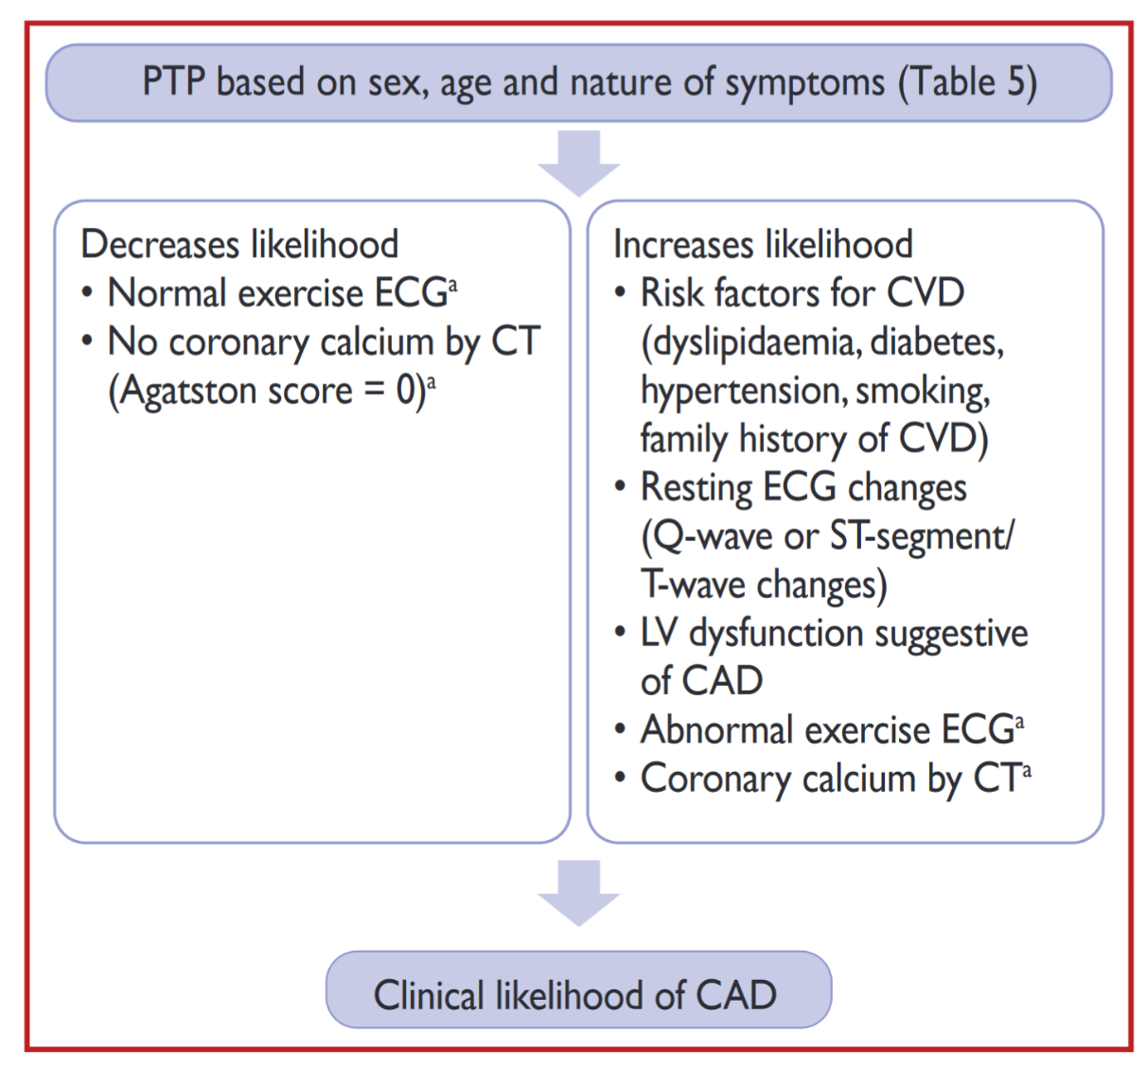
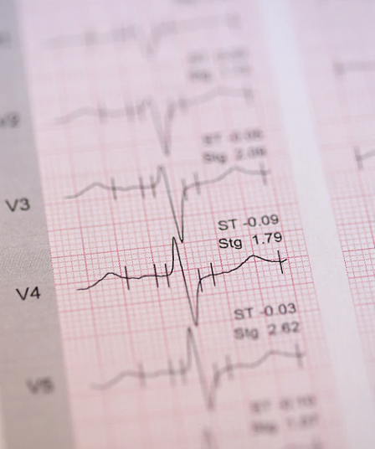
Testing for CAD
Stress ECG
Sensitivity: 50-70% Specificity: 60-80%

Slide 36
Testing for CAD
+ FFR
Stress ECG
Imaging Stress Test SPECT Stress-Echo Stress-cMR
CT Angiography
Coronary Angiography
Sensitivity: 50-70% Specificity: 60-80%
80-85%

Slide 37
Testing for CAD
+ Coronary Angiography
(potentially also FFR/iFR)
+ Stress Test or FFR/iFR
(unless > 90%)
+ FFR/iFR
(unless > 90%)
Stress ECG
Imaging Stress Test SPECT Stress-Echo Stress-cMR
CT Angiography
Coronary Angiography
Sensitivity: 50-70% Specificity: 60-80%
80-85%

Slide 38
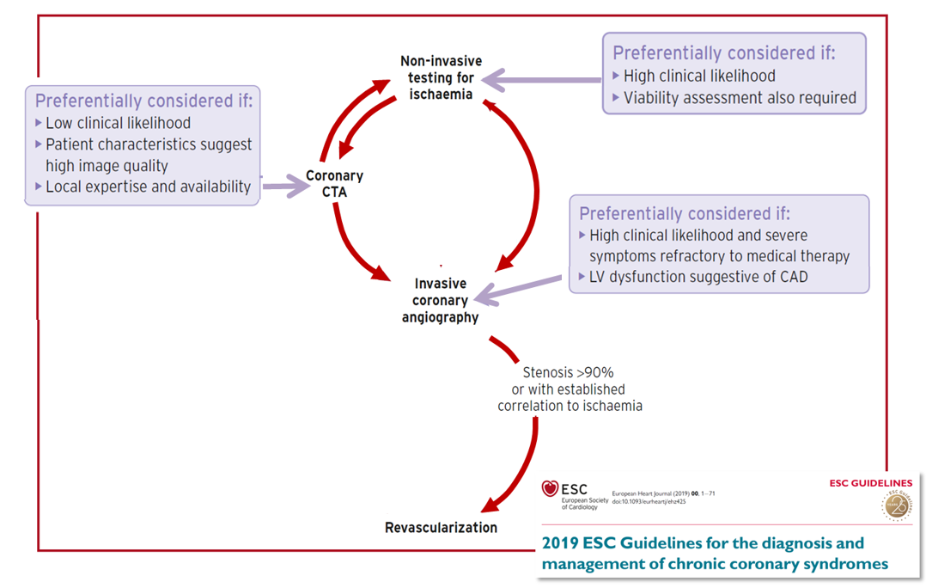
Testing for CAD
This graph as been slightly modified from the published version (for clarification)

Slide 39
Testing for CAD
NEW!

Slide 40
Testing for CAD
The Guidelines emphasize that a test should only be selected if
- patient characteristics allow to expect high image quality
- local expertise
Coronary CTA: 1) Regular, low heart rate
2) Absence of substantial obesity

Slide 41
Follow-up Testing

Slide 42
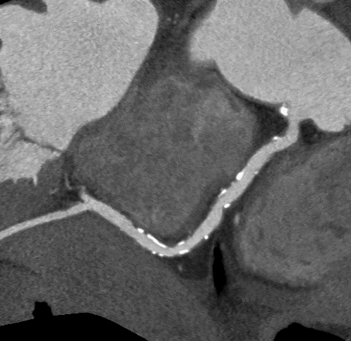
Summary:
With current technology and knowledge about test performance:
High degree of freedom in choosing the initial test
The ability of CT to visualize plaque may allow improved identification of at-risk individuals
Sequence of tests may be appropriate
Invasive angiography is a test, not an automatic route to PCI

