Slide 1
Left AT CTO Intervention
Division of endovascular interventions
October 28, 2020

Slide 2
Case presentation
80 year old female with a PMHx of HTN, HLD, DM, former smoker, PAD s/p previous SFA interventions who originally presented 5/2020 with ischemic rest pain (Rutherford 4) who underwent successful L SFA intervention with PTA and DES, with residual L AT CTO lesion.
Now presents with non-healing ulcer located on the dorsal aspect of the hallux, in the setting of trauma to the area. Reports erythema and pain around the area WIfI: wound 1, ischemia 1, infection 0
Medications: Aspirin 81mg, Plavix 75mg, Enalapril 5mg, Nifedipine 30mg, Metformin 500mg, Lipitor 40mg

Slide 3
Angiogram 5/2020

Slide 4
Angiogram 5/2020

Slide 5
Case presentation
ABI: R 0.74 L 0.71
Arterial Duplex: Significant tibial atherosclerosis

Slide 6
Critical limb ischemia – ACC/AHA revascularization guidelines

Slide 7
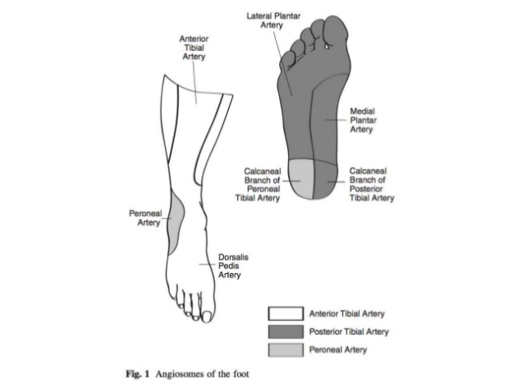
ACC/AHA guideline recommendation for treatment of PAD
Circulation. 2017;135:e726–e779

Slide 8
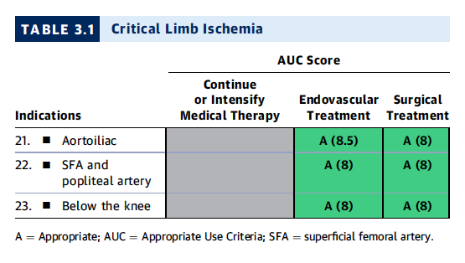
ACC/AHA/SCAI/SIR/SVM 2018 Appropriate Use Criteria for Peripheral Artery Intervention
JACC. 2019 Jan 22;73(2):214-237

Slide 9
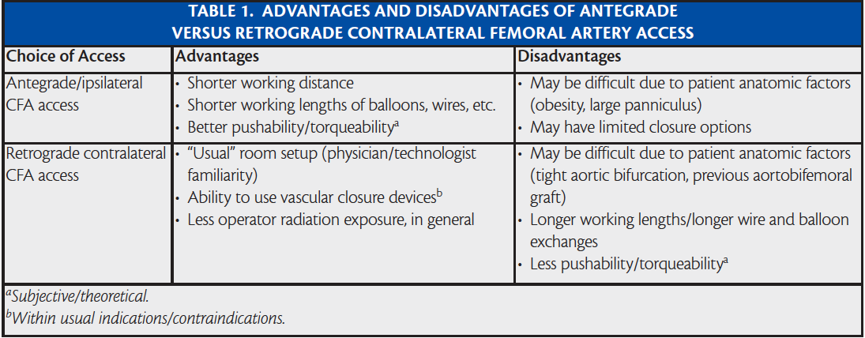
Access: CFA ante- vs. retro-grade

Slide 10
Tibiopedal access

Slide 11
Patient selection for tibiopedal access
Advanced PAD or CLI
Inability to lie flat for prolonged periods of time (severe osteoarthritis, lower back pain, CHF, COPD)
Hostile groins: morbid obesity, infected groins, severely scarred/ fibrotic groins.
Flush occlusion of the ostium of the SFA
The proximal CTO cap has an antegrade convex morphology.
Long suprapopliteal CTO

Slide 12
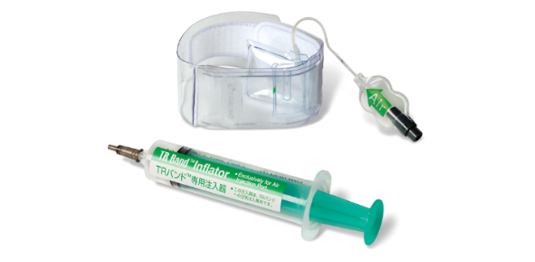
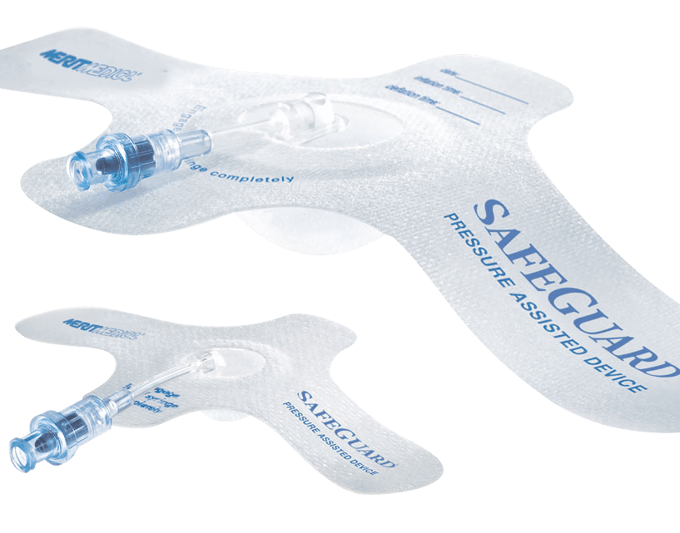
Important steps to consider for tibiopedal access
Puncture site selection (US or Flouroscopy guidance)
Vasodilators (NTG and verapamil)
Puncture needle (21-gauge perhaps echogenic needle)
Sheath (3-Fr micropuncture sheath)
Catheter microcatheter
OTW balloons are also recommended since they give the abilty to dilate the corssed lesion (single-marker 1.5/20mm)
Wires: 0.018 (recommended) or 0.014
Rendezvous: pedal access wire externalization either manipulate into guide-cathter or snare
Access site hemostasis: manual compression, TR-band or safegurad
Semin Intervent Radiol. 2014 Dec; 31(4): 313–319.

Slide 13
Treatment options for infrapopliteal disease
Plain Balloon Angioplasty
Drug Coated Balloon Angioplasty
Bare Metal Stent
Drug Eluting Stent
Atherotomy/Atherectomy
Shock-wave lithotripsy/IVL?

Slide 14
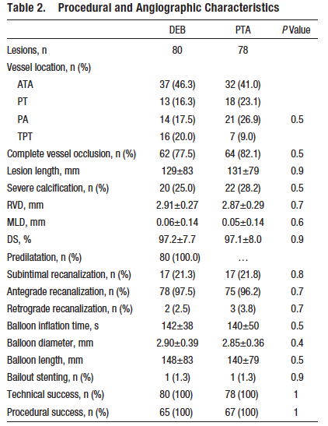
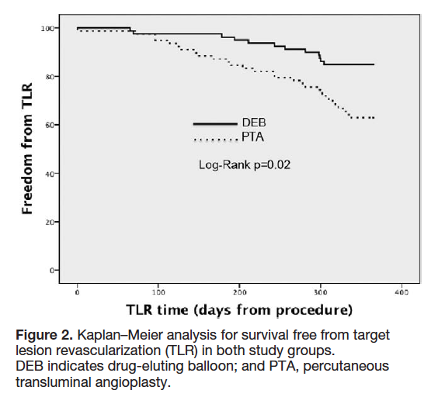

Slide 15
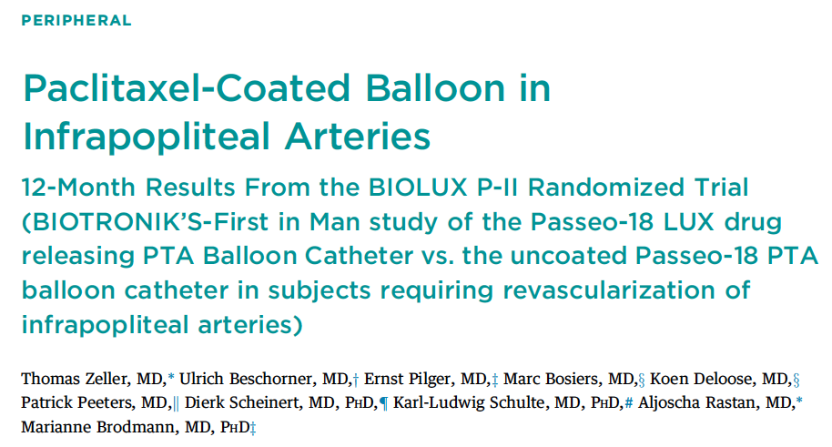
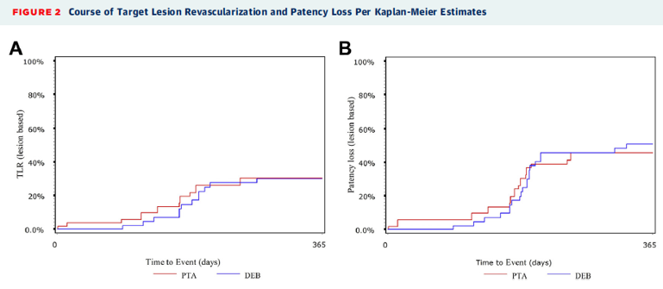
The primary safety endpoint (a composite of all-cause mortality, amputation, target lesion thrombosis, and TVR at 30 days) was 0% in the DEB group versus 8.3% in the PTA group (p = 0.239).
The primary performance endpoint (patency loss at 6 months) was 17.1% in the DEB group versus 26.1% in the PTA group (p = 0.298), and major amputations of the target extremity occurred in 3.3% versus 5.6% of the patients at 12 months, respectively.
JACC interv. 2015 Oct;8 (12):1614-22

Slide 16
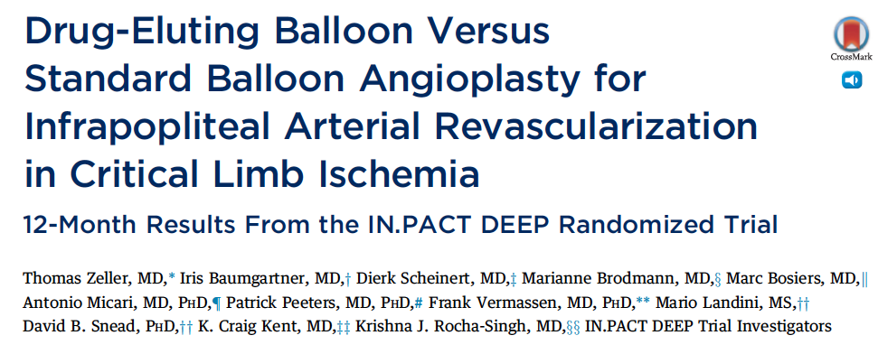
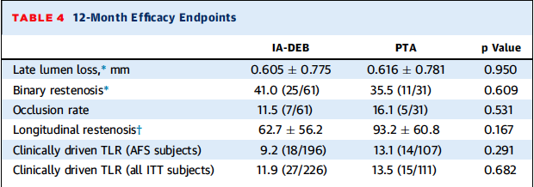
Prospective Randomized Independently adjudicated and Monitored trial of infrapopliteal therapy for critical limb ischemia
JACC 2014 Oct 14;64(15):1568-76

Slide 17
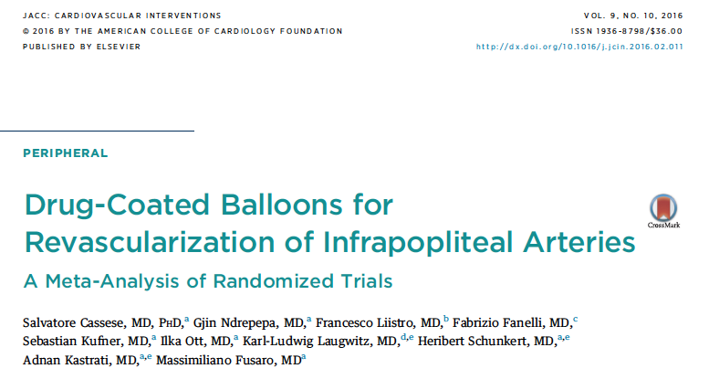
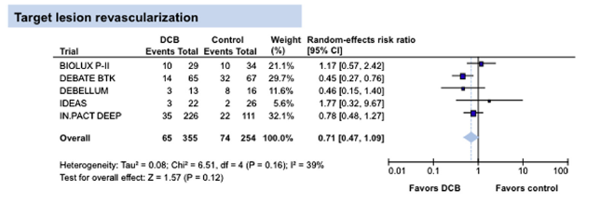
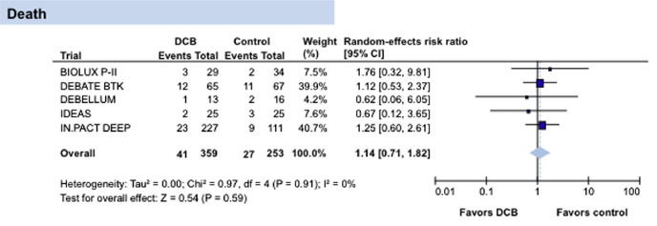
N=641 patients from 5 trials
Follow up of 12 months
DCB vs PTA or DES
DCB – similar outcomes compared to control with TLR, amputation and death
DCBs associated with lower late lumen loss compared to PTA or DES

Slide 18
INPACT BTK – TCT 2020 –
9 month outcomes
Prospective multicenter feasibility study
50 CLI patients across 9 sites enrolled – Randomized to IN.PACT DCB (3.5mcg/mm2) vs PTA
Angiographic f/u 9 months and follow up through 36 months
Inclusion – Rutherford 4-5, single or multiple total occlusions $≥40mm$, Infection grade 0-2, ischemia 2-3, vessels 2-4mm, evidence of adequate distal runoff
Exclusion – Planned amputation, inflow disease, prior stent/surgery or DCB within 6 mo, infection grade 3/osteomyelitis and ischemia 0-1
Endpoints
Primary – Effectiveness – Late Lumen Loss at 9 months
Safety Endpoint – 30 day freedome from device and procedure related major amputation and freedom from TLR at 9 months

Slide 19
Randomized trials for DES-BTK
Achilles
Sirolimus eluting (Cypher) stent vs. POBA
Yukon
Sirolimus eluting (Yukon/no polymer) stent vs. BMS
Destiny
Everolimus eluting stent (Xience) vs. BMS (Multilink Vision)
JACC 2012, 60: 2290-2295
JACC 2012, 60: 587-91
JVS 2012, 55: 390

Slide 20
Summary of DES-BTK randomized trials 12 month Patency
Trial DES PTA/BMS Lesion length
Achilles 80.6% 58.1% 25-27mm
Yukon 80.6% 55.6% 31mm
Destiny 85.2% 54.4% 16-19mm
JACC 2012, 60: 2290-2295
JACC 2012, 60: 587-91
JVS 2012, 55: 390

Slide 21
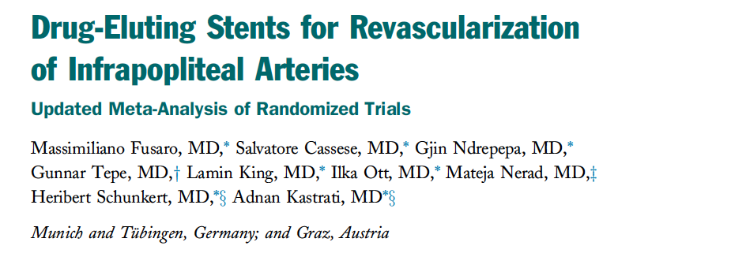
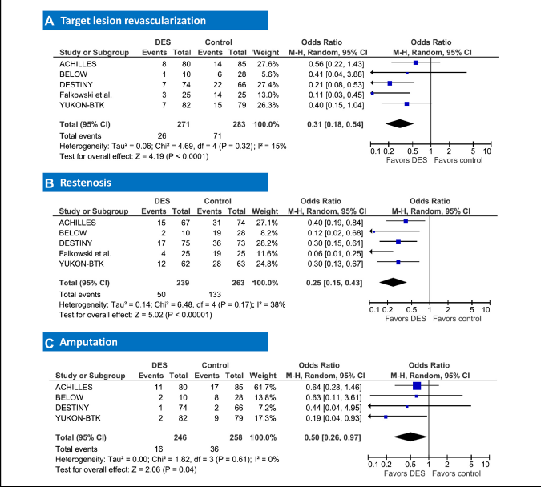
DES Reduces risk of restenosis and amputation compared with BMS or balloon angioplasty without impact on mortality or Rutherford class
JACC interv. 2013;6(12):1284-93.

Slide 22
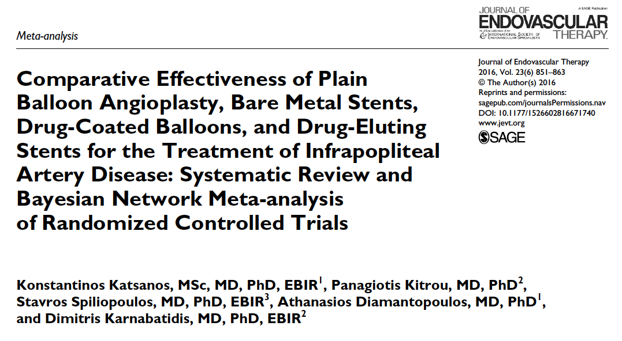
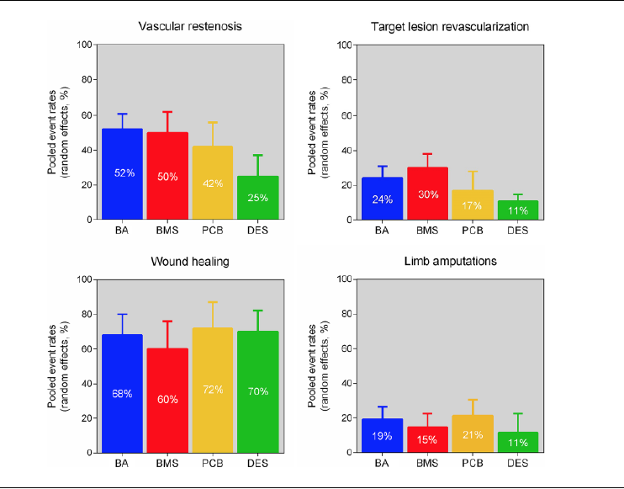
Meta-analysis of 16 RCTS
N=1805
Follow up over 1 year
Lower restenosis, amputations and TLR of DES c/w BMS or PTA
DCBs – lower TLR compared with BMS and PTA alone

Slide 23
Role of vessel Preparation
Role of vessel Preparation
Modification or debulking of plaque facilitating passage of devices
Reducing bail-out stenting
Improving clinical outcome

Slide 24
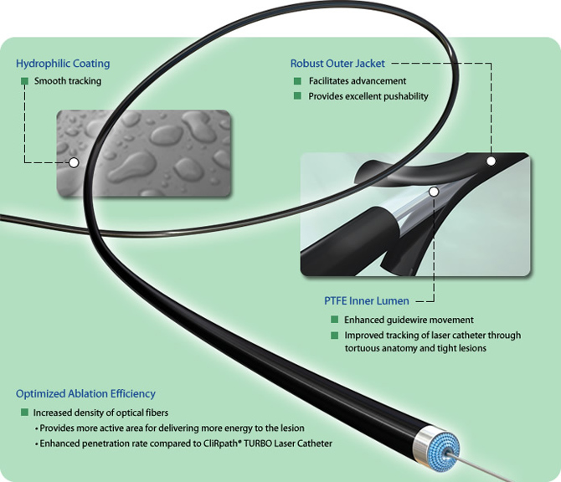
Atherectomy Devices BTK
CVX-300 Excimer laser (Spectranetics)
LACI trial
Multicenter, prospective trial
145 patients, 155 CLI-limbs
Laser + POBA
41% in BTK
45% bailout stenting in toto, 16% BTK
Procedural success rate 86%
LSR @6m : 93%
Laird JR et al, J Endovasc Ther 2006 Feb;13(1):1-11.

Slide 25
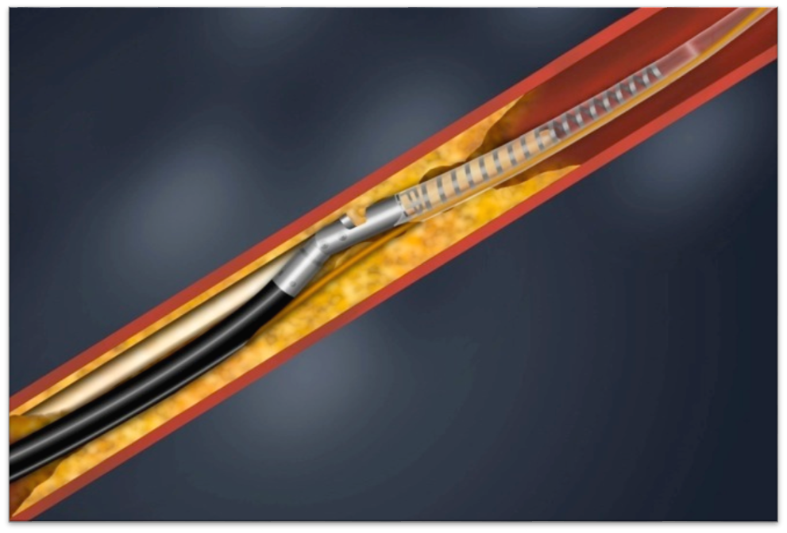
Atherectomy Devices BTK
Excisional Atherectomy (SilverHawk/TurboHawk; Covidien-Medtronic)
DEFINITIVE LE trial
800 Patients | 47 Centers
Characteristics | CLI (RCC 4-6)
Number of Patients | 201
Number of Lesions | 279
Mean Length (cm) | 7.2
Baseline Stenosis (%) | 76
Occlusions (%) | 30
SFA | 48% (135)
Popliteal | 17% (48)
Infrapopliteal | 34% (96)
Claudication 598 Patients* |  | Critical Limb Ischemia 201 Patients
Primary Patency by Duplex US at 12 months |  | Freedom From Major Unplanned Amputation at 12 months
33% post-atherectomy POBA
MC Kinsey JM et al. JACC CardioVasc Int, 2014 Aug;7(8):923-33.

Slide 26
Atherectomy Devices BTK
Excisional Atherectomy (SilverHawk/TurboHawk ; Covidien-Medtronic)
DEFINITIVE LE trial
Primary patency (PSVR < 2.4) : 71%
Wound healing % @ 3-6-12 m : 52%-61%-72%
Limb Salvage @12m : 95%
Especially in diabetics promising results
MC Kinsey JM et al. JACC CardioVasc Int, 2014 Aug;7(8):923-33.

Slide 27
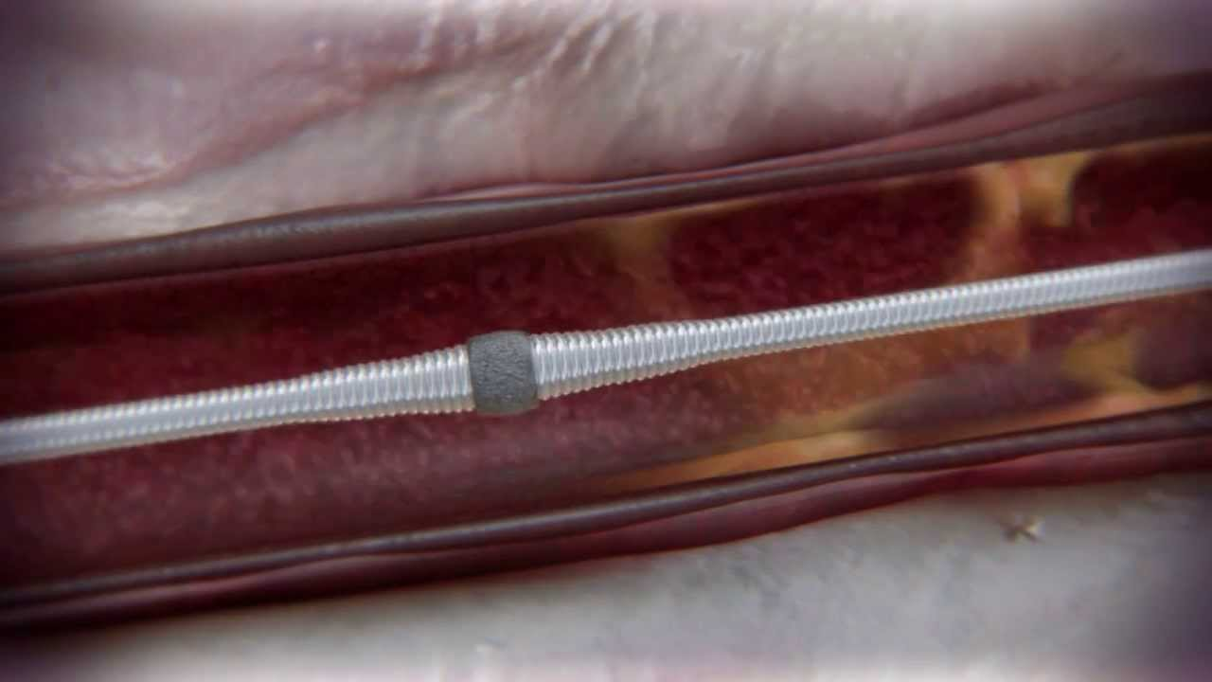
Atherectomy Devices BTK
Orbital atherectomy (Diamondback 360° ; Cardiovascular Systems)
Calcium 360 randomized pilot trial
Multicenter, randomized, prospective trial
50 patients, PA + BTK lesions
RB classification 4-6
Orbital atherectomy + POBA vs POBA
Shammas NW et al. J Endovasc Ther 2012, Aug;19(4):480-8

Slide 28
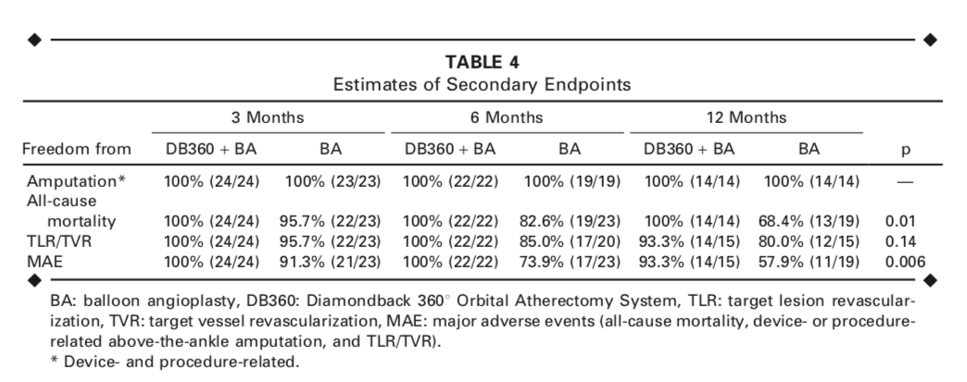
Atherectomy Devices BTK
Orbital atherectomy (Diamondback 360°; Cardiovascular Systems)
Calcium 360 randomized pilot trial
Shammas NW et al. J Endovasc Ther 2012, Aug;19(4):480-8

Slide 29
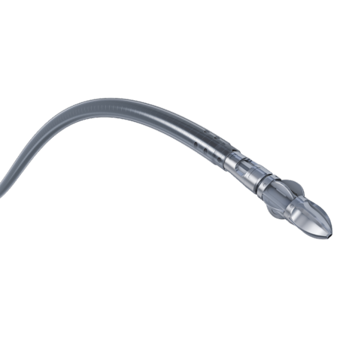
Debulking Devices BTK
Rotational atherectomy (JETstream, Boston Scientific ; Phoenix atherectomy cath, Volcano corp)
No specific data related to specific BTK use
(JET registry ; EASE registry)

Slide 30
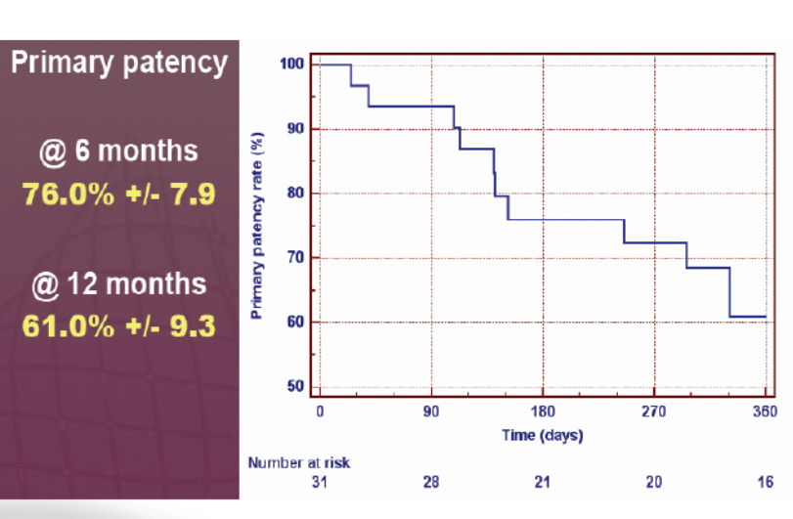
Atherotomy: Angiosculpt

Slide 31
Atherotomy: Chocolate™ PTA Balloon Catheter

Slide 32
Atherotomy: Chocolate™ PTA Balloon Catheter

Slide 33
Atherotomy: Chocolate™ PTA Balloon Catheter

Slide 34
Shockwave lithotripsy – disrupt btk
Pilot study of N=20 patients to evaluate the safety and feasibility of IVL in treating calcified infrapopliteal stenoses
Prospective, non-randomized, multicenter trial (3 participating sites)
N=15 with Rutherford class 5and all patients with moderate-severe calcification
Acute reduction in diameter stenosis of 46.5%
No major adverse events at 30 days; 1 type B dissection treated with 2 stents
Successful in 19/20 patients
Brodmann M et al. J Endovasc Ther. 2018;25(4):499-503.

