Slide 1
Structural Heart Live Cases
Supported by:
Medtronic Inc.
Bard Inc.
Terumo Medical Corp.

Slide 2
Faculty Involved and Disclosures
Samin K. Sharma, MD, FACC, MSCAI
Speaker’s Bureau – BSC, Abbott Vascular Inc, CSI
Annapoorna S. Kini, MD, FACC
Nothing to disclose
Gilbert Tang, MD, MSc, MBA, FACC
Physician Proctor and consultant for Medtronic
Stamatios Lerakis, MD, PhD, FACC, FAHA (Imaging)
Nothing to disclose
Pedro Moreno, MD, PhD [Moderator]
Nothing to disclose
Cardiac Anesthetist
Eric Fried MD

Slide 3
September 8th 2020 - Structural Heart Live Case #37: GT, 61 y/o M
Presentation: Progressive fatigue and DOE NYHA Class III for 2mths
PMH: ETOH abuse, hepatitis and cirrhosis s/p Liver transplant in 6/2019 at MSH with postop course notable for AKI requiring dialysis (last dialysis 7/6/2019), Hypertension, Anemia, Former smoker, CKD stage III
Medications: Aspirin, Amlodipine, Entecavir, Everolimus, Tacrolimus, MV/Thia
Labs: Hgb 8.9, PLT 181K, K 5.1, Cr 2.21, INR 1.1
EKG (7/31/20): NSR, PR 142ms
TTE (8/3/20): Newly reduced EF to 33% and severe low flow low gradient severe AS ( PG/MG/AVA/PV: of 34/19/0.77/3, SVI 22 ml/m2), Mild AI and Mild MR
Cath (6/21/19): Normal coronaries

Slide 4
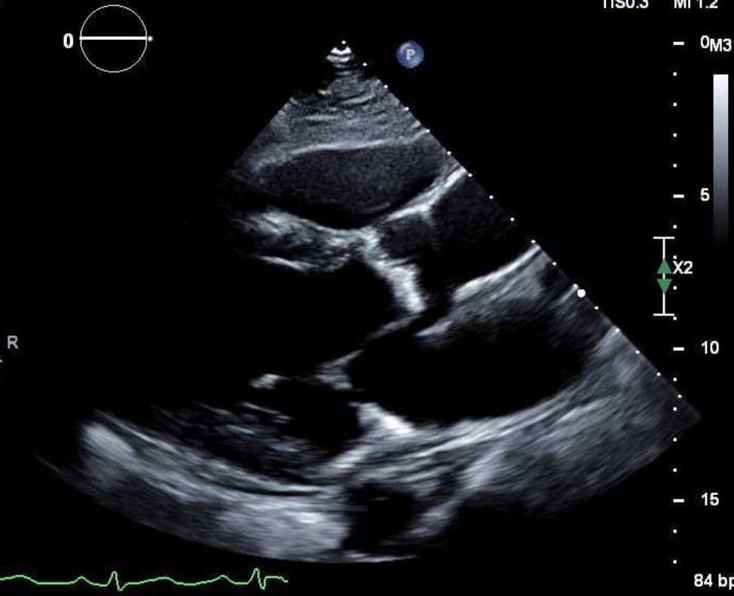
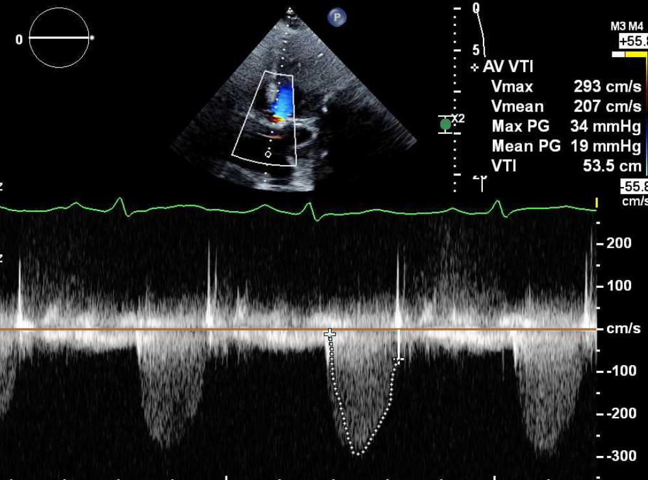
TTE
Severe Calcified Aortic Stenosis
Severe low flow low gradient AS (PG/MG/AVA = 34/19/0.7)
AV Peak velocity = 3m/s

Slide 5
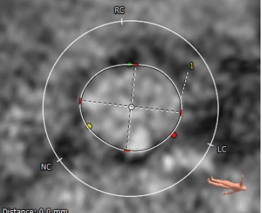
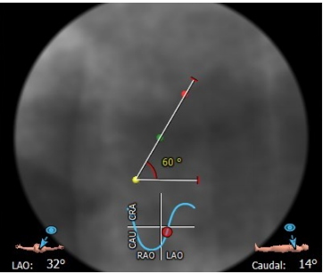
MRI: Aortic Annulus
Annulus
Aortic Annulus
Min: 24.7 mm
Max: 29.0 mm
Mean: 26.8 mm
Perimeter = 84.5 mm
Area = 562.3 mm²
Annular angle = 60°
Diameter- 24.7 mm X 29.0 mm (mean 26.8mm), Perimeter- 84.5 mm, Area -562.3 mm2
Annulus Angle: 30°

Slide 6
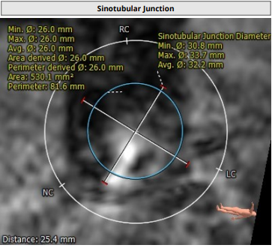
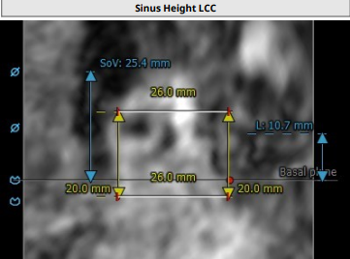
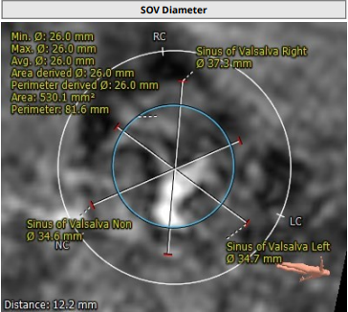
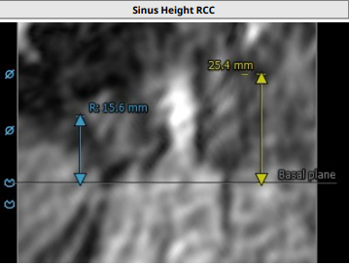
MRI: SOV, STJ, LVOT, Coronary Ostia
Sinus of Valsalva
RCC = 37.3 mm
LCC = 34.7 mm
NCC = 34.6 mm
STJ Height (above annulus) = 32.2 mm
STJ Diameter = 30.8 x 33.7 mm (mean 32.2 mm)
SOV Height = 25.4 mm
LVOT = 25.2 x 29.5 mm (mean 27.3mm)
LM Height: 10.7mm
STJ 30.8 mm x 33.7 mm
Left Main: 10.7 mm
RCC: 37.3
LCC: 34.7
NCC: 34.6
RCA: 15.6 mm

Slide 7
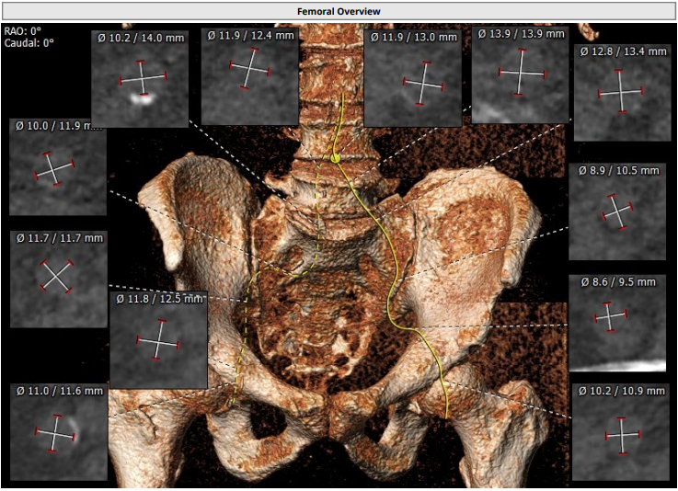
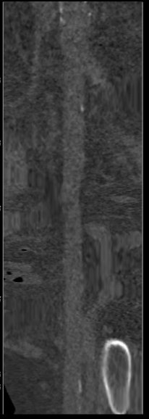
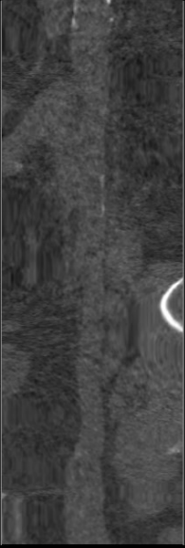
CTA non contrast: Femoral Arterial Access
Longitudinal View
Right Iliac/Femoral
Longitudinal View
Left Iliac/Femoral
Access 3D

Slide 8
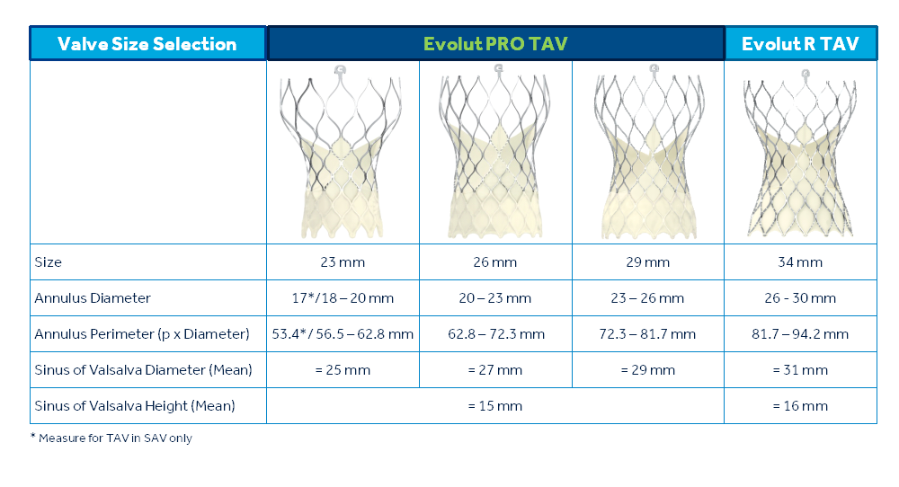
Medtronic Evolut-Pro+ CoreValve Patient Selection
Our Patient
Annulus
Max: 24.7 mm
Min: 29.0mm
Mean: 26.8 mm
Perimeter = 84.5 mm

Slide 9
Summary of Case
Presentation: 61 year old male with NYHA Class III DOE and fatigue for 2M
TTE: Newly reduced EF to 33% and severe low flow low gradient severe
AS (PG/MG/AVA/PV of 34/19/0.77/3, SVI 22 ml/m2)
STS risk mortality: 3.6%
Course: Patient was evaluated by Heart Team and determined to be high risk for surgical AVR due to aortic root anatomy and associated medical comorbidities
Plan: The patient is here for TF-TAVR using 34mm Evolut Pro+ CoreValve via left percutaneous femoral approach with Sentinel cerebral protection device using minimal contrast

Slide 10
Latest Issues in Transcatheter Structural Heart Interventions
Update in antithrombotic therapy post TAVR/TAVI:
POPular TAVI EU Clinical Trial

Slide 11
Optimal Antithrombotic Treatment After TAVR
AT+
AT-
OAC-based strategy
(VKA or NOAC)
Bleeding
Risk
Thrombo-embolic
Risk
Mortality
Structural Valve
Deterioration
DAPT
(ASA+Clopidogrel)
SAPT
(ASA or Clopidogrel alone)
Empirically Aspirin 81mg lifelong and Clopidogrel 75mg daily for 3-6M is recommended

Slide 12
Major Ongoing Trials of Anti-thrombotics in TAVR/TAVI
 | Treatment Comparison | Number of Patients | NVAF | Status
GALILEO | RIVA vs DAPT/SAPT | 1520 | Excluded | Enrolment completed
ATLANTIS | VKA vs Apixaban DAPT/SAPT vs Apixaban | 1510 | Included (stratified) | Enrolment almost done
ENVISAGE | EDOXABAN | 1400 | only | Ongoing
POPULAR | VKA vs VKA+clopi DAPT vs ASA | 1510 | Included and stratified | Ongoing
AVATAR | VKA vs VKA+APT | 170 | Included (stratified) | Ongoing
AUREA | VKA vs DAPT | 124 | Excluded | Ongoing

Slide 14
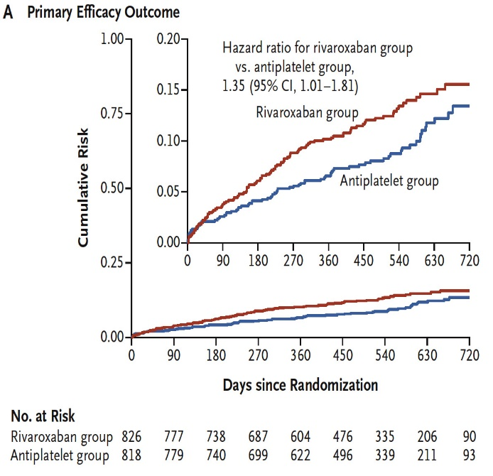
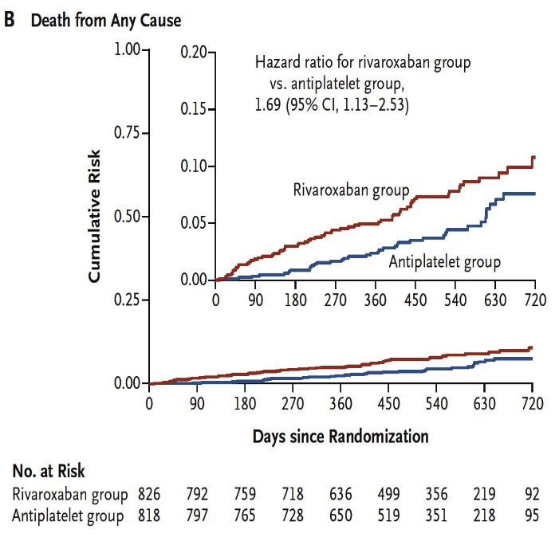
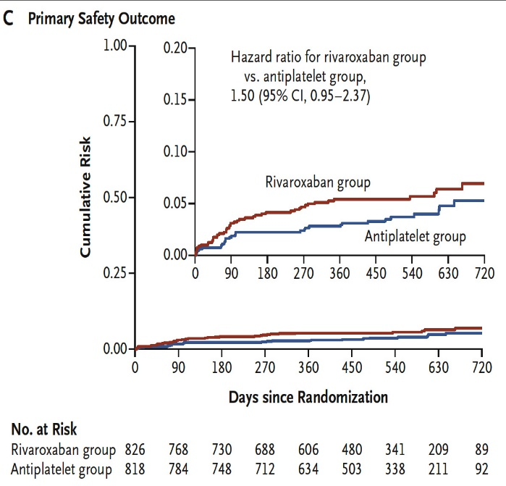
GALILEO Trial: Primary Efficacy and Safety Endpoints
At 2-Yr Follow-Up
Dangas et al., N Engl J Med 2019;382:120

Slide 15
GALILEO Trial: Clinical Results
The primary efficacy endpoint of the trial is a composite of all-cause death, stroke, systemic embolism, MI, pulmonary embolism, DVT, or symptomatic valve thrombosis. The primary safety endpoint is a composite of life-threatening or disabling bleeding (BARC types 5 and 3b/3c) or major bleeding (BARC type 3a)
Rivaroxaban group (n=826)
Rivaroxaban 10 mg + aspirin 75-100 mg for 90 days, maintenance 10 mg rivaroxaban
Antiplatelet group (n=818)
Aspirin 75-100 mg + 75 mg clopidogrel for 90 days, followed by aspirin monotherapy
%
Dangas et al., N Engl J Med 2019;382:120

Slide 16
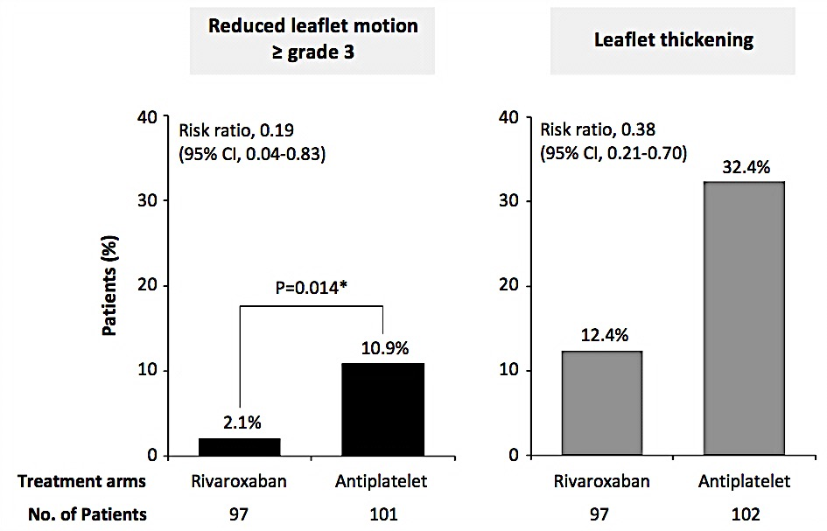
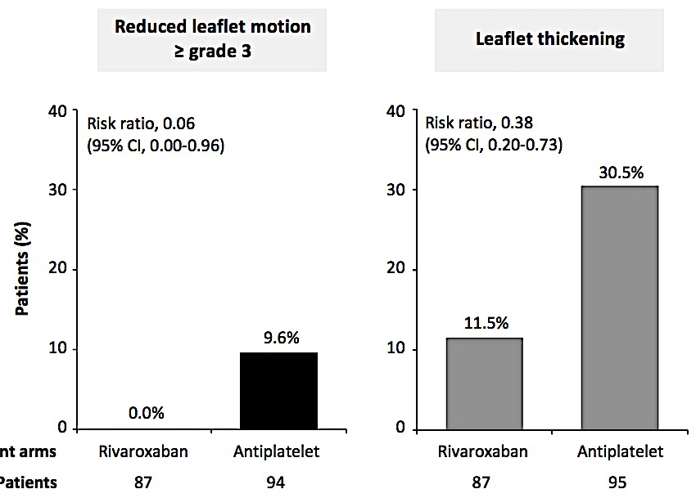
GALILEO 4D: Reduced Leaflet Motion and Leaflet Thickening- ITT/PP Analysis
Intention-to-treat (ITT)
Per-protocol (PP)
Reduced leaflet motion
≥ grade 3
Leaflet thickening
Dangas et al., N Engl J Med 2019;382:120

Slide 17
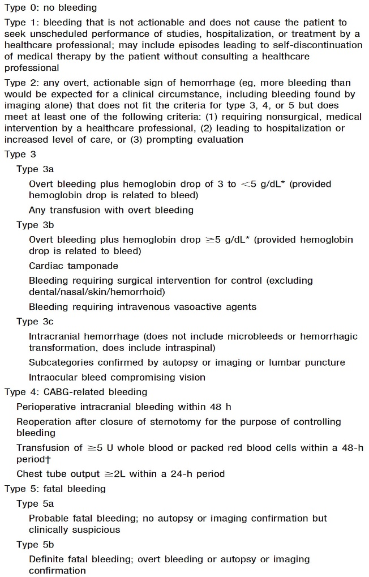
BARC Bleeding Definitions
Mehran et al., Circulation 2011;123:2736

Slide 18
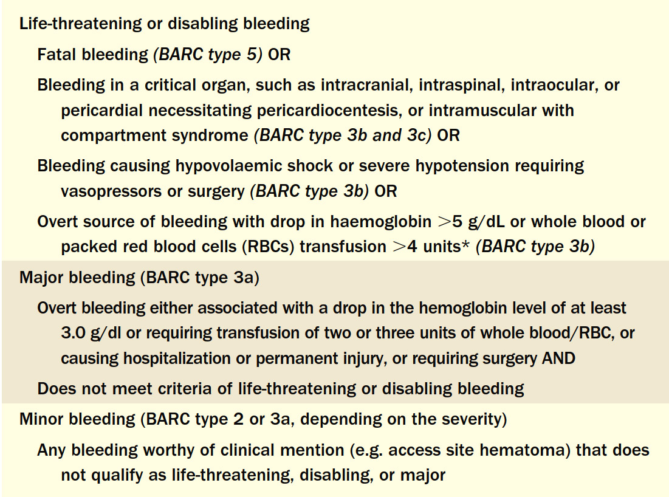
VARC Bleeding Definitions
Kappeteinet al., J Am Coll Cardiol 2012;60:1438

Slide 19
POPULAR TAVI: Background
and ACC/AHA
POPULAR TAVI COHORT A
PATIENTS WITHOUT OAC
N=665
3-6M
POPULAR TAVI COHORT B
PATIENTS WITH OAC
N=313
for 3-6M

Slide 20
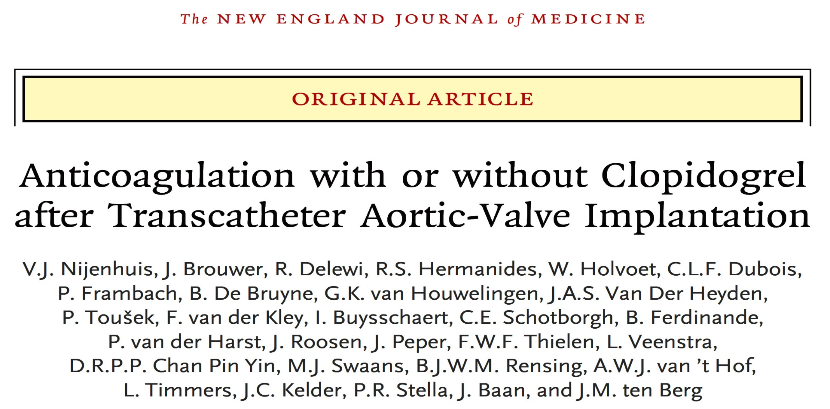

Slide 21
POPULAR TAVI (Cohort B): Hypothesis
OAC alone vs. OAC + 3 months clopidogrel, is:
Superior for bleeding (primary outcome),
Non-inferior for the composite of CV death, stroke, MI, non-procedural bleeding (secondary outcome),
Non-inferior for the composite of CV death, ischemic stroke, MI (secondary outcome).
Nijenhuis V, ACC 2020

Slide 22
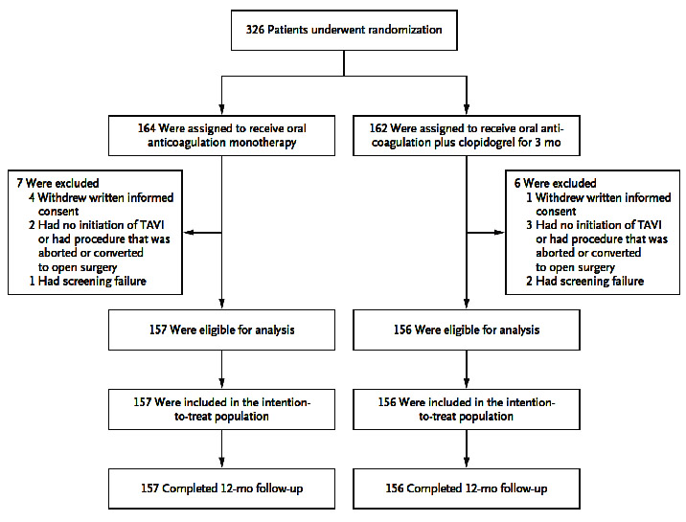
POPULAR TAVI (Cohort B): Trial Design
Nijenhuis et al., N Engl J Med 2020;382:1696

Slide 23
POPULAR TAVI: Bleeding Definitions
The outcomes were primarily defined according to the Valve Academic Research Consortium (VARC) definitions.
Because the VARC definitions do not distinguish between procedure-related and non-procedure-related bleeding.
Procedure-related bleeding was classified as Bleeding Academic Research Consortium (BARC) type 4 severe bleeding, which characterized by any of the following:
Intracranial bleeding within 48 hrs after surgical procedure
Reoperation after closure of sternotomy for the purpose of controlling bleeding
Transfusion of at least 5 units PRBC within 8 hrs, or chest-tube output of at least 2 liters within a 24-hr period
Non-procedure-related bleeding all bleeding excluding BARC type 4 bleeding.
Most bleeding at the TAVI puncture site was not classified as BARC type 4 but was counted separately and included in the outcome of non-procedure-related bleeding.

Slide 24
POPULAR TAVI (Cohort B): Anticoagulation
 | OAC (N=157) | OAC + CLOPIDOGREL (N=156)
Vitamin K antagonist, (%) | 75.2 | 70.5
Acenocoumarol | 61.8 | 58.3
Phenprocoumon | 11.5 | 10.3
Warfarin | 1.9 | 1.9
Direct oral anticoagulant, (%) | 23.6 | 29.5
Apixaban | 8.9 | 16.0
Dabigatran | 4.5 | 2.6
Edoxaban | 2.5 | 2.6
Rivaroxaban | 7.6 | 7.6
Low molecular weight heparin, (%) | 1.3 | 0.0
Nijenhuis et al., N Engl J Med 2020;382:1696

Slide 25
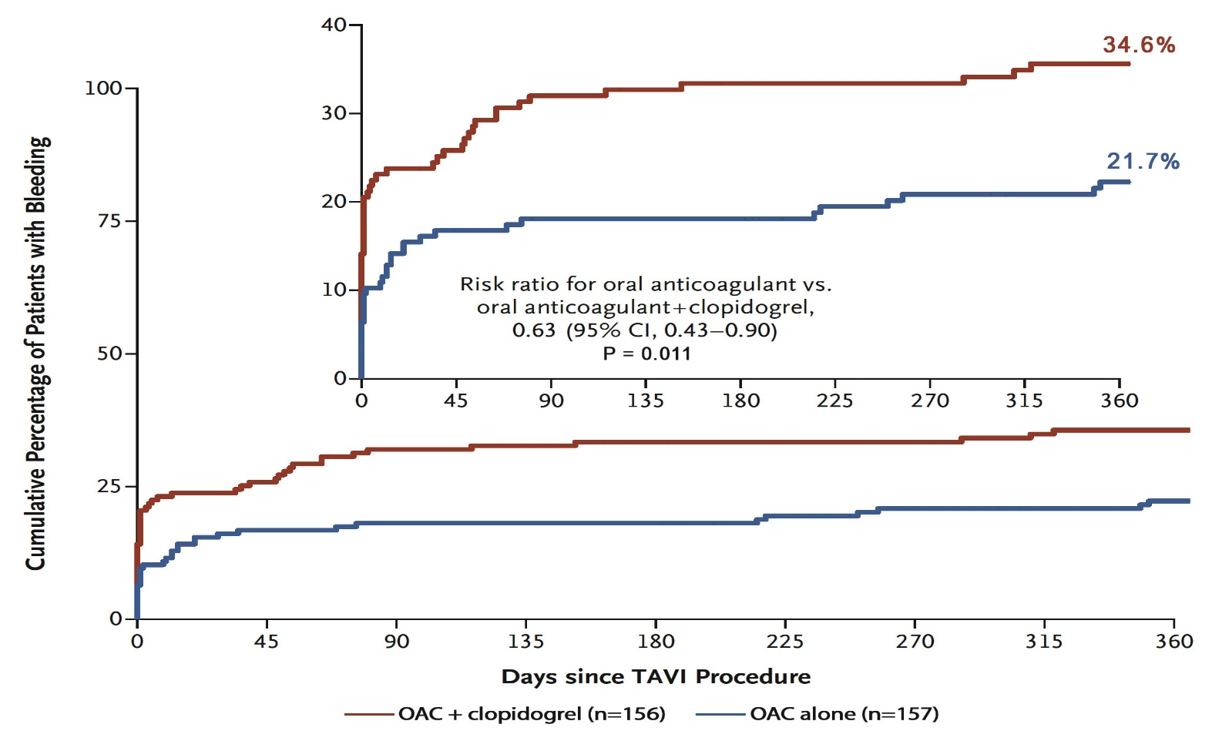
POPULAR TAVI (Cohort B): All Bleeding
Nijenhuis et al., N Engl J Med 2020;382:1696

Slide 26
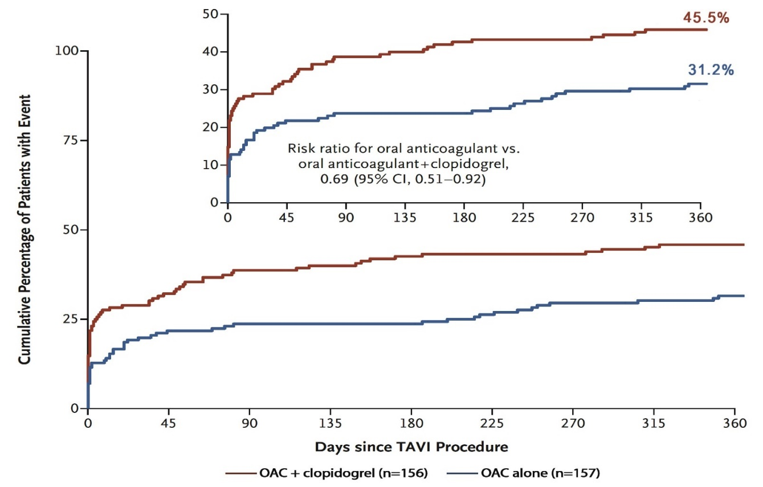
POPULAR TAVI (Cohort B): CV Mortality, Non-Procedural Bleeding, Stroke, MI
Secondary Composite 1
Non-inferiority Margin +7.5%
AD: -14.3 (-25.0 to -3.6)
AD – Absolute Difference
Nijenhuis et al., N Engl J Med 2020;382:1696

Slide 27
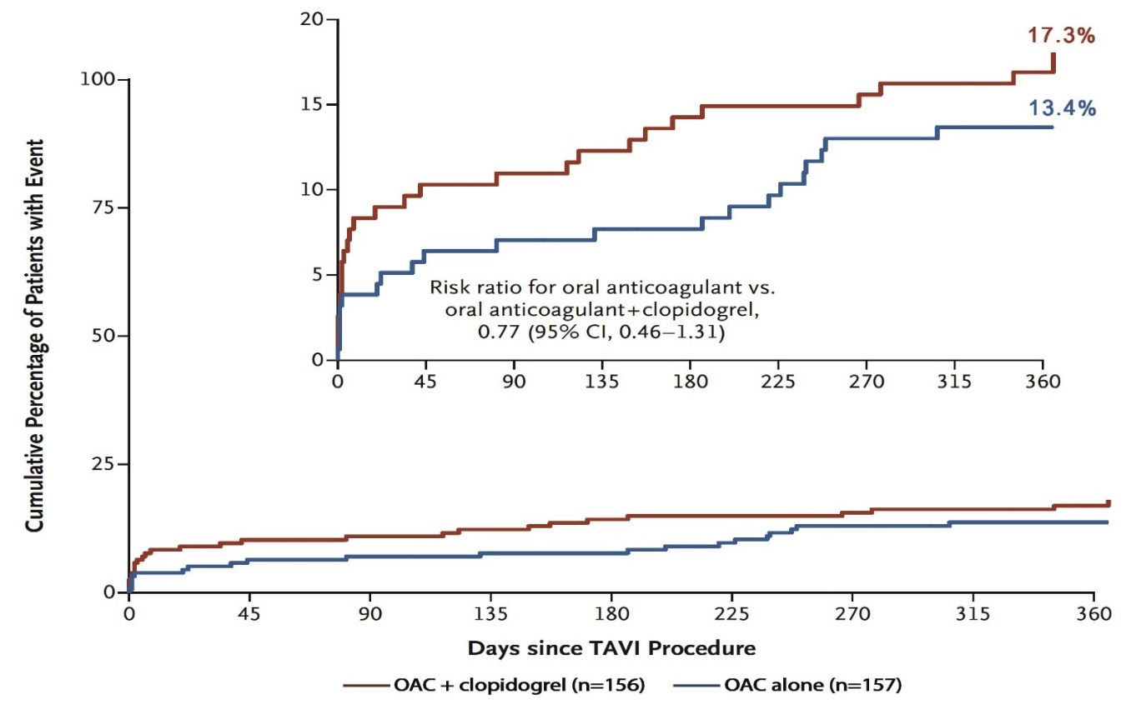
POPULAR TAVI (Cohort B): CV Mortality, Ischemic Stroke, MI
Secondary Composite 2
Non-inferiority Margin +7.5%
AD: -3.9 (-11.9 to 4.0)
AD – Absolute Difference
Nijenhuis et al., N Engl J Med 2020;382:1696

Slide 28
POPULAR TAVI (Cohort B): Secondary Outcomes
 | OAC (N=157) | OAC + CLOPIDOGREL (N=156) | RISK RATIO (95% CI)
Death (%)
Death from any cause | 13.4 | 15.4 | 0.87 (0.51 to 1.50)
Death from cardiovascular causes | 8.3 | 12.8 | 0.65 (0.33 to 1.25)
Stroke (%)
Ischemic | 5.1 | 5.8 | 0.88 (0.35 to 2.23)
Hemorrhagic | 0.6 | 0.0
Myocardial infarction (%) | 0.6 | 0.6 | 0.99 (0.06 to 15.75)
VARC-2 Bleeding (%)
Major, life-threatening, or disabling | 8.9 | 16.7 | 0.54 (0.29 to 0.99)
Minor (%) | 12.7 | 17.9 | 0.71 (0.42 to 1.21)
Nijenhuis et al., N Engl J Med 2020;382:1696

Slide 29
Conclusions POPULAR TAVI - COHORT B
In patients with an established indication for OAC undergoing TAVI, OAC alone as compared to OAC + clopidogrel:
- Reduces the rate of bleeding events, including
major, life-threatening, or disabling bleeding
- Does not increase the rate of thrombotic events

Slide 30
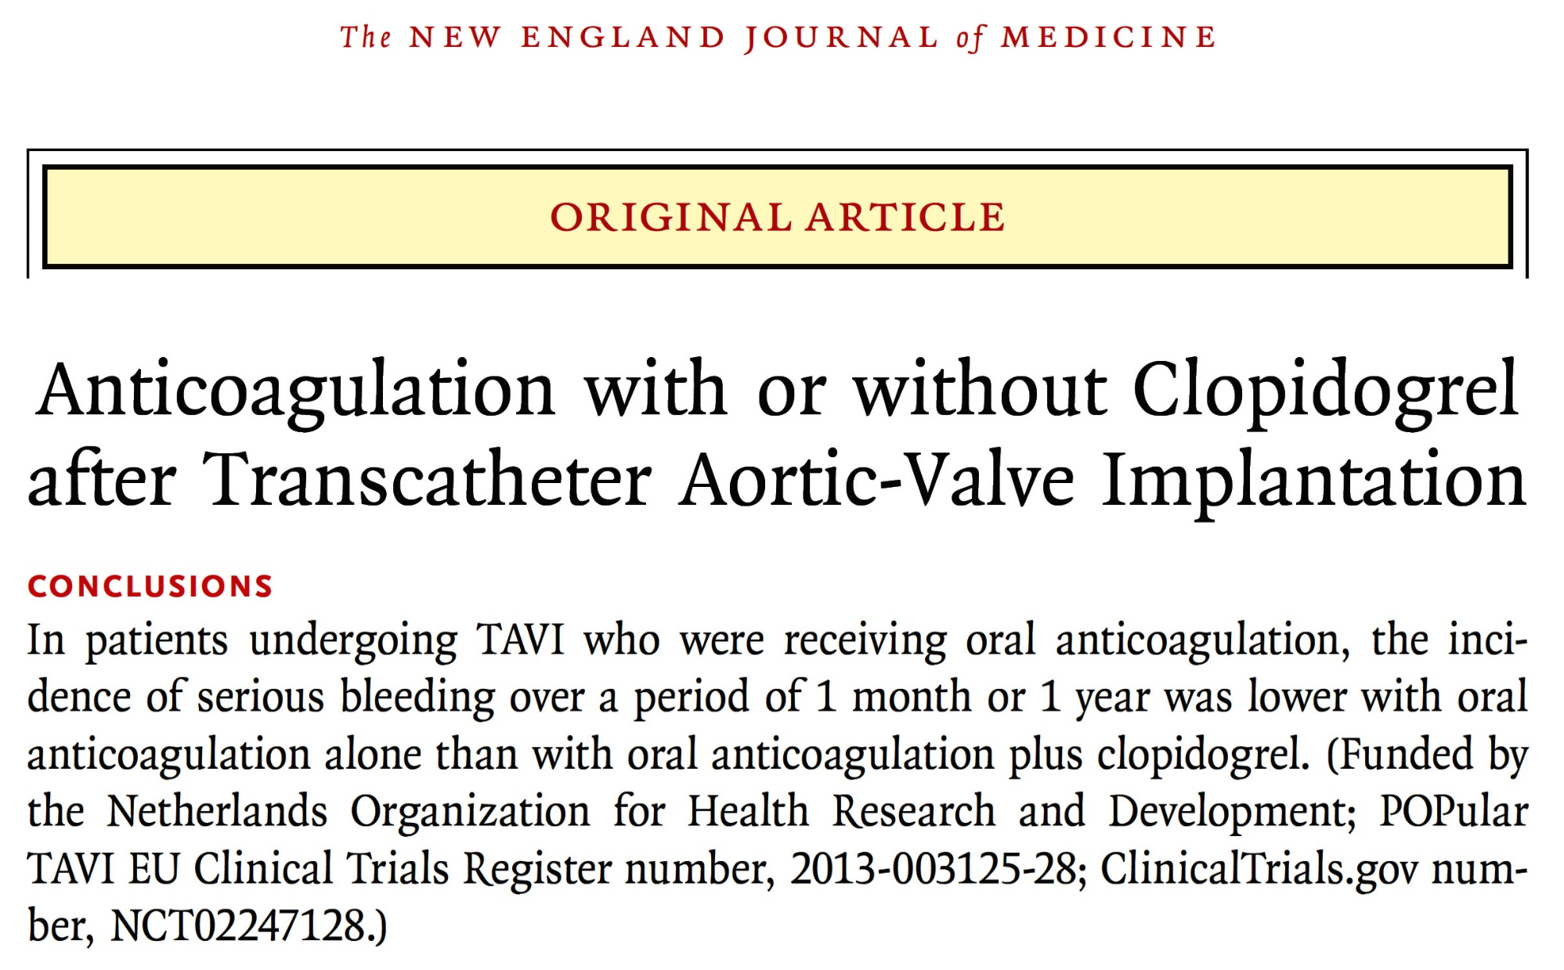

Slide 31
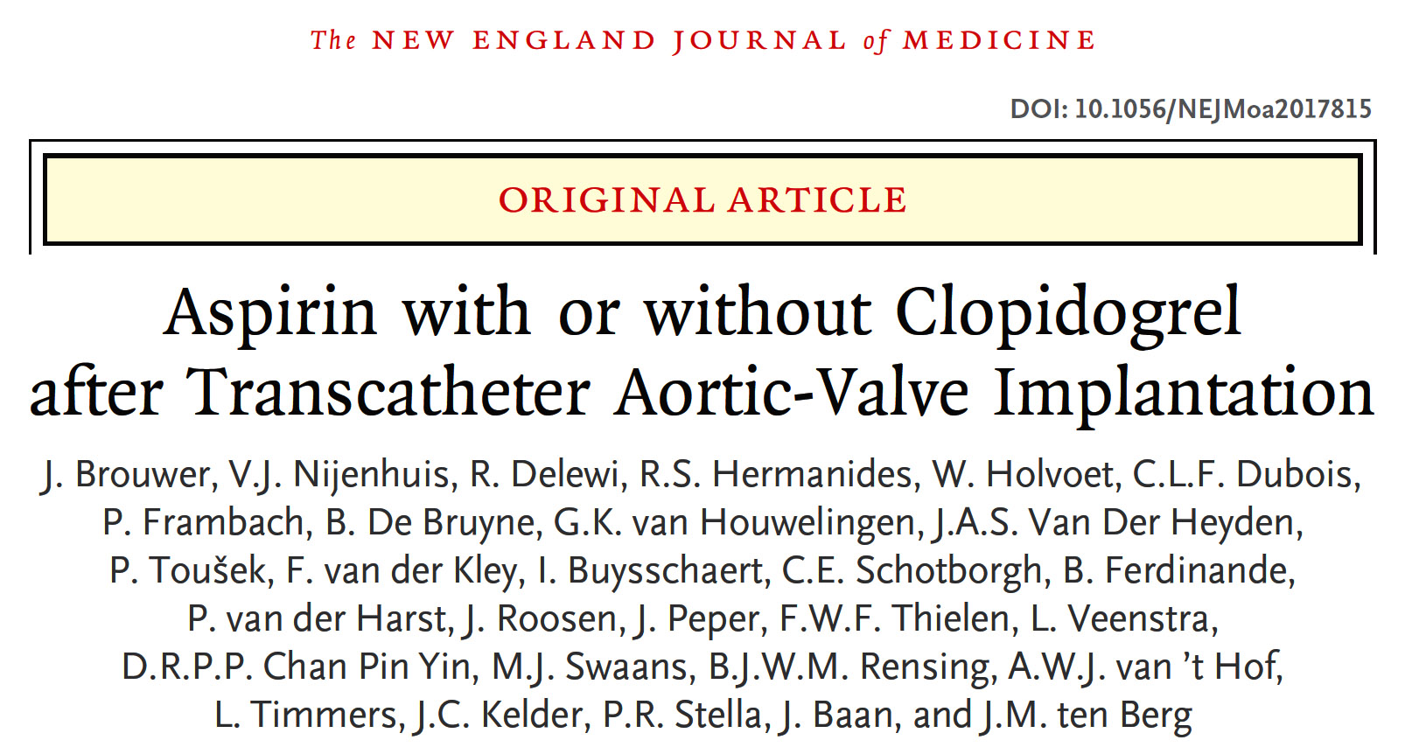

Slide 32
POPULAR TAVI (Cohort A): Hypothesis
Aspirin alone, as compared to aspirin + 3 months clopidogrel, is:
Superior for bleeding (primary outcome),
Non-inferior for the composite of cardiovascular (CV) mortality, non-procedural bleeding, stroke, or myocardial infarction (MI) (secondary outcome)
Non-inferior for the composite of CV mortality, ischemic stroke, or MI (secondary outcome)
Brouwer J ESC 2020

Slide 33
POPULAR TAVI (Cohort A): Randomization and Follow-Up
Brouwer J ESC 2020

Slide 34
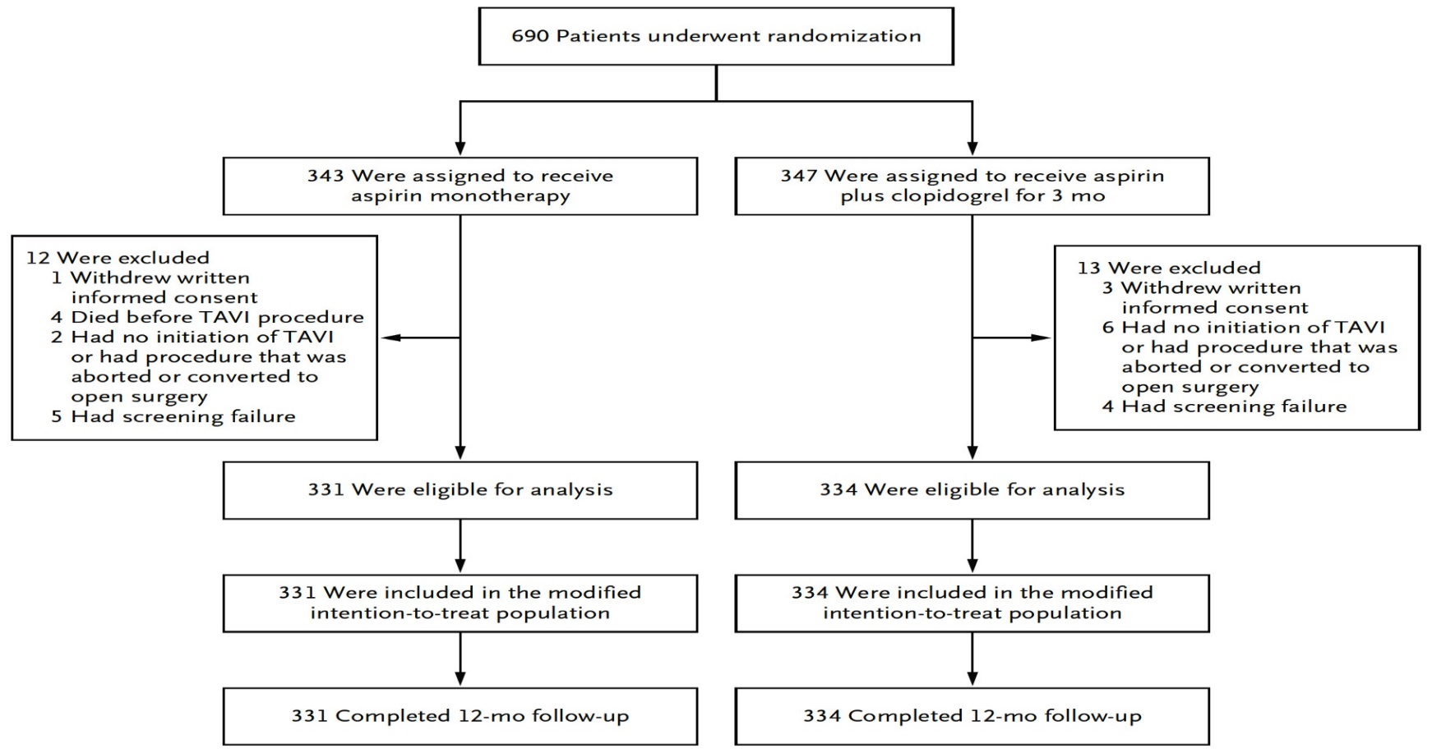
POPULAR TAVI (Cohort A): Randomization and Follow-Up
Brouwer et al., N Engl J Med 2020 Aug 30 [Epub ahead of print]

Slide 35
Popular TAVI (Cohort A): Procedural Characteristics
 | Aspirin (N=331) | Aspirin + Clopidogrel (N=334)
Approach
Transfemoral | 302 (91.2) | 292 (87.4)
Other | 29 (8.8) | 42 (12.6)
Unfractionated heparin – no. (%) | 331 (100.0) | 334 (100.0)
Maximal ACT – seconds [IQR] | 272 (218-306) | 259 (224-312)
Prosthesis – no. (%)
Sapien 3, Edwards Lifesciences | 149 (45.0) | 147 (44.0)
CoreValve Evolut R/Pro, Medtronic | 127 (38.4) | 120 (35.9)
Other | 55 (16.6) | 67 (20.1)
Embolic protection device use – no. (%) | 19 (5.7) | 17 (5.1)
Brouwer J ESC 2020

Slide 36
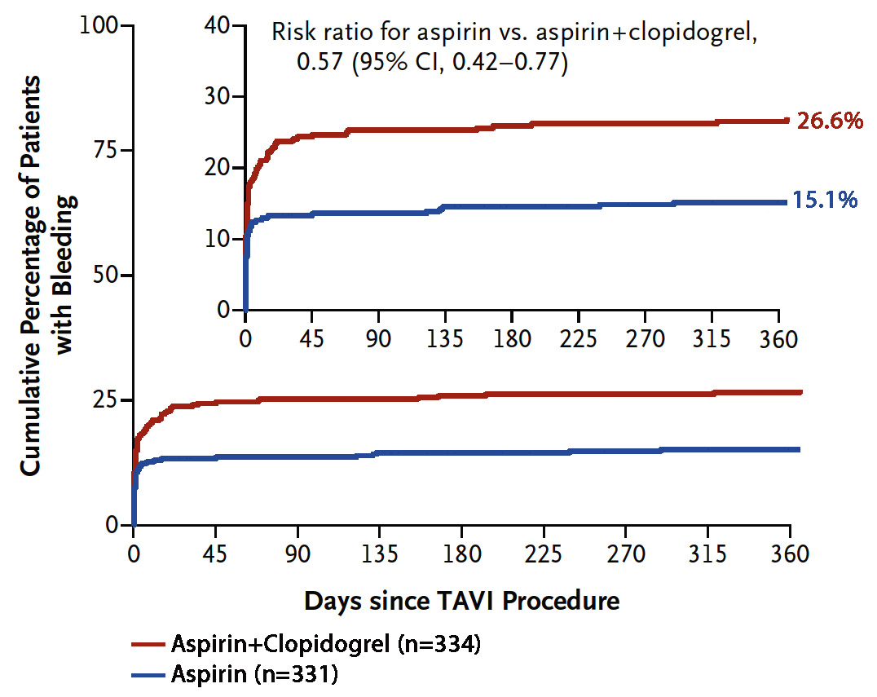
POPULAR TAVI (Cohort A): Primary Outcome of
All Bleeding
P = 0.001
Brouwer et al., N Engl J Med 2020 Aug 30 [Epub ahead of print]

Slide 37
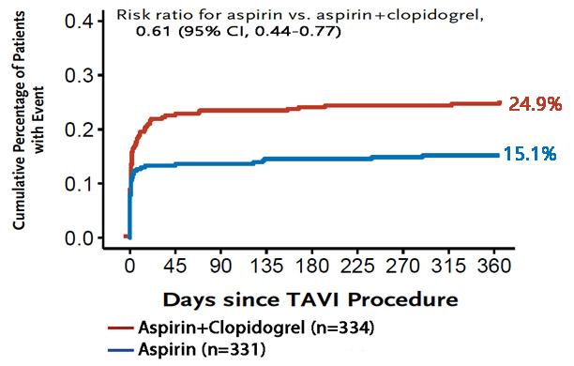
POPULAR TAVI (Cohort A): Non-Procedural Bleeding
P = 0.005
Brouwer et al., N Engl J Med 2020 Aug 30 [Epub ahead of print]

Slide 38
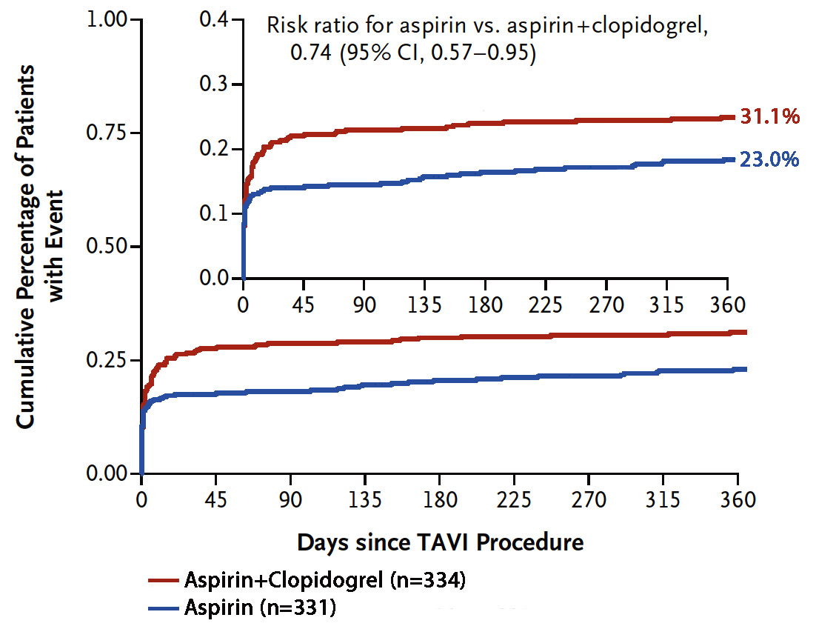
POPULAR TAVI (Cohort A): CV Mortality, Non-Procedural Bleeding, Stroke, MI
Secondary Composite 1
P = 0.04
Non-inferiority Margin +7.5%
AD: -8.2 (-14.9 to -1.5)
P<0.001
AD – Absolute Difference
Brouwer et al., N Engl J Med 2020 Aug 30 [Epub ahead of print]

Slide 39
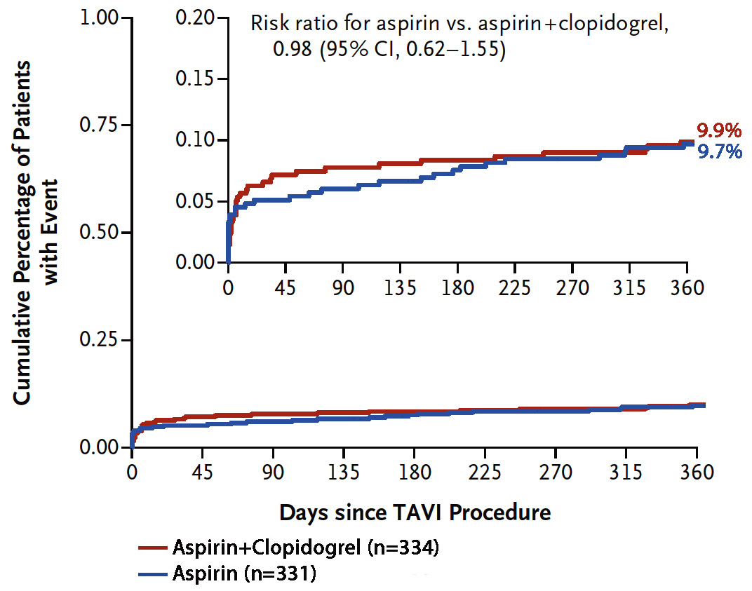
POPULAR TAVI (Cohort A): CV Mortality, Ischemic Stroke, MI
Secondary Composite 2
P = 0.93
Non-inferiority Margin +7.5%
AD: -0.2 (-4.7 to 4.3)
P=0.04
AD – Absolute Difference
Brouwer et al., N Engl J Med 2020 Aug 30 [Epub ahead of print]

Slide 40
POPULAR TAVI (Cohort A): Primary and Secondary Outcome Components
 | Aspirin (N=331) | Aspirin + Clopidogrel (N=334) | Risk Ratio (95% CI)
Death
Death from any cause | 21 (6.3) | 19 (5.7) | 1.12 (0.61 to 2.04)
Death from cardiovascular causes | 14 (4.2) | 13 (3.9) | 1.09 (0.52 to 2.28)
Stroke
Ischemic | 17 (5.1) | 18 (5.4) | 0.95 (0.50 to 1.82)
Hemorrhagic | 0 (0) | 1 (0.3)
Myocardial infarction | 4 (1.2) | 6 (1.8) | 0.67 (0.19 to 2.36)
VARC-2 bleeding
Major, life-threatening, or disabling | 17 (5.1) | 36 (10.8) | 0.48 (0.27 to 0.83)
Minor | 33 (10.0) | 56 (15.9) | 0.63 (0.42 to 0.94)
VARC-2 vascular complications
Major | 11 (3.3) | 23 (6.9)
Minor | 22 (6.6) | 33 (9.9)
Brouwer et al., N Engl J Med 2020 Aug 30 [Epub ahead of print]

Slide 41
Conclusions POPULAR TAVI - COHORT A
In patients without an indication for OAC, aspirin alone as compared to aspirin + 3 months clopidogrel:
Reduces the rate of bleeding events, including major, life-threatening, or disabling bleeding
Does not increase the rate of thromboembolic events

Slide 42
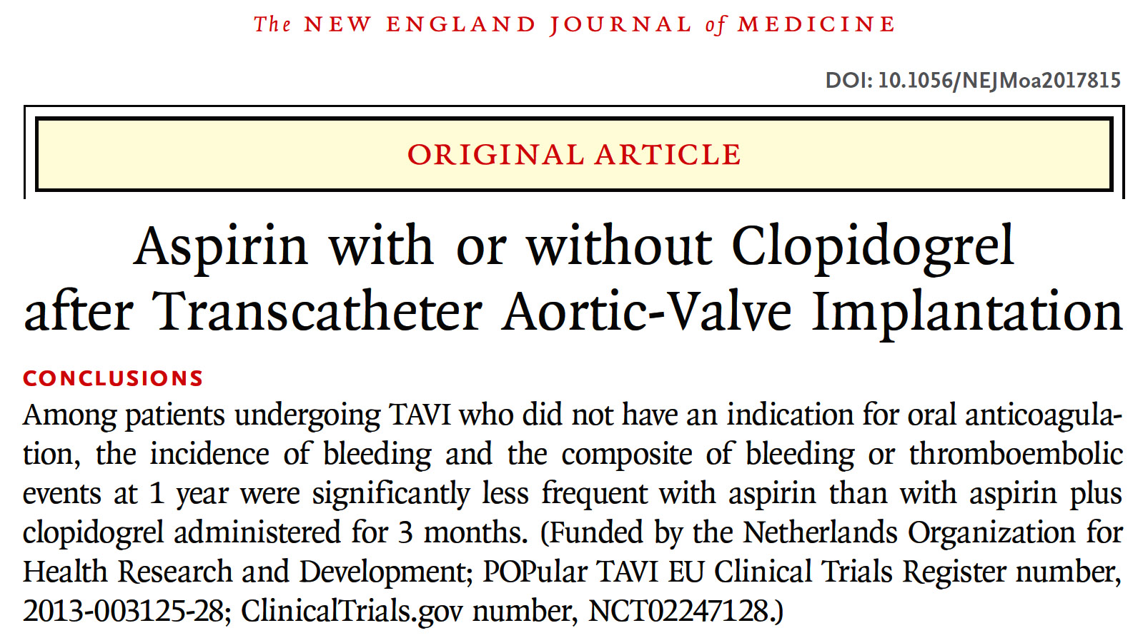

Slide 43
Take Home Messages
Update in antithrombotic therapy post TAVI/TAVR
POPular TAVI trial (cohort B) showed that OAC alone is superior to OAC+Clopidogrel in terms of reducing various all, procedural, non-procedural, major and minor bleeding events without any increase in thromboembolic events (CV death, MI or stroke)
POPular TAVI trial (cohort A) showed that aspirin alone is superior to aspirin+Clopidogrel in terms of reducing various all, procedural, non-procedural, major and minor bleeding events without any increase in thromboembolic events (CV death, MI or stroke)

Slide 44
Question # 1
Following is the true statements regarding POPular TAVI trial results except:
OAC is superior to OAC+Clop in reducing all bleeding
OAC has higher stroke rates vs OAC+Clop
OAC has similar thromboembolic rates vs OAC+Clop
OAC has lower non-procedural bleeding vs OAC+Clop
Correct answer: B

Slide 45
Question # 2
Following is the true statements regarding POPular TAVI trial results except:
Aspirin alone has lower all bleedings vs Aspirin+Clop
Aspirin alone has similar thromboembolic events vs Aspirin+Clop
Aspirin alone has higher stroke rates vs Aspirin+Clop
Aspirin alone has similar life-threatening bleeding vs Aspirin+Clop
Correct answer: C

Slide 46
Question # 3
Following are the true statements regarding GALILEO trial except:
A. Higher 2-yr mortality in Rivaroxaban gp vs APT
B. Higher major bleeding in Rivaroxaban gp vs APT
C. Higher major bleeding and thromboembolic events in Rivaroxaban gp vs APT
D. Higher structural valve deterioration in Rivaroxaban gp vs APT
Correct answer: D

