Slide 1
Division of Endovascular Interventions Mount Sinai Hospital New York 06-24-2020

Slide 2
Patient history
68 M with HTN, DM, hyperlipidemia and smoking.
Presents with L>R, Life style limiting claudication (Rutherford 4) that has progressed to pain at rest.
Medication: Insulin, aspirin, Amlodipine, metoprolol, Lisinopril, atorvastatin and Cilastazol
ABI with exercise: Exercised for 1:30 mins and terminated due to muscle pain. (R): 0.95 and 0.96 (L): 0.92 and 0.78
Doppler: Chronic total occlusion of the Left popliteal artery
Angiogram: Subsequent angiogram and referred for further intervention.

Slide 3
ANGIOGRAPHY
LLE Run-off
DSA Left Foot

Slide 4
ANGIOGRAPHY
DSA LAO VIEW
DSA RAO VIEW

Slide 5
Strategy
Contralateral CFA access vs Ipsilateral Pedal access
Glide-Wire with catheter support for crossing
True-lumen vs Sub-intimal Tracking and Reentry
Switching to an .014 wire for intervention
Atherectomy
Balloon angioplasty
Stenting (Bailout; Dissection, recoil)

Slide 6
Challenges of POP artery Intervention
Pop artery is embryologically distinct from SFA due to its origin from Sciatic system.
It is subjected to significant biomechanical torsional forces related to the repetitive knee flexion and extension.
Consequently affects patency rates associated with the popliteal artery bypass or endovascular stenting, in that biomechanical stress can lead to stent fractures.
Moreover, supplies important communication above (SFA) and below the knee (Tibials) through sural and genicular branches that can serve as important collaterals incase of acute occlusion
Intervention at this site via surgical and endovascular intervention can compromise these branches and turn CLI to ALI.

Slide 7
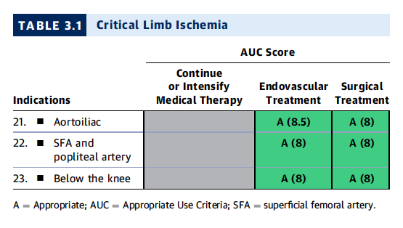
ACC/AHA/SCAI/SIR/SVM 2019 Appropriate Use Criteria for Peripheral Artery Intervention
AUC suggests Endovascular and surgical intervention as equally appropriate in patients with CLI
JACC. 2019 Jan 22;73(2):214-237

Slide 8
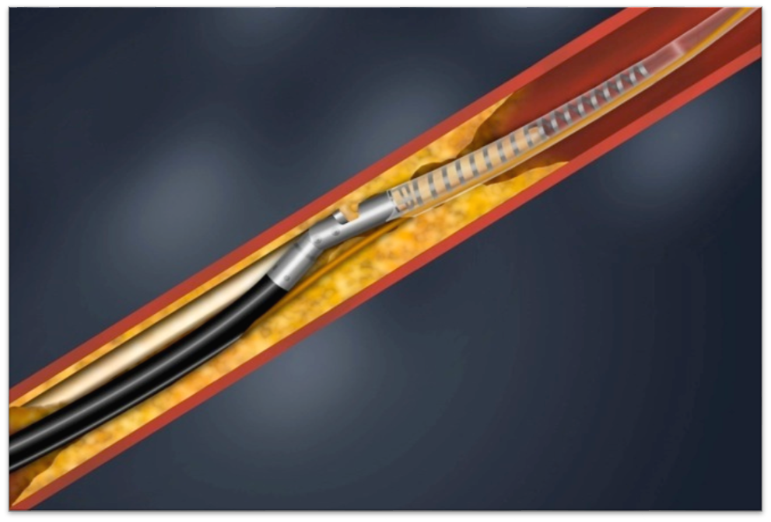
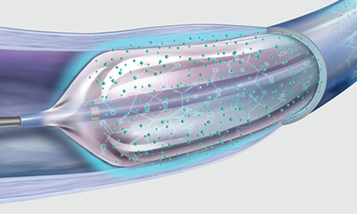
Vessel Prep and Endovascular Intervention
PTA alone
PTA with DCB
PTA with stenting
DAART: Directional atherectomy anti-restenotic therapy

Slide 9
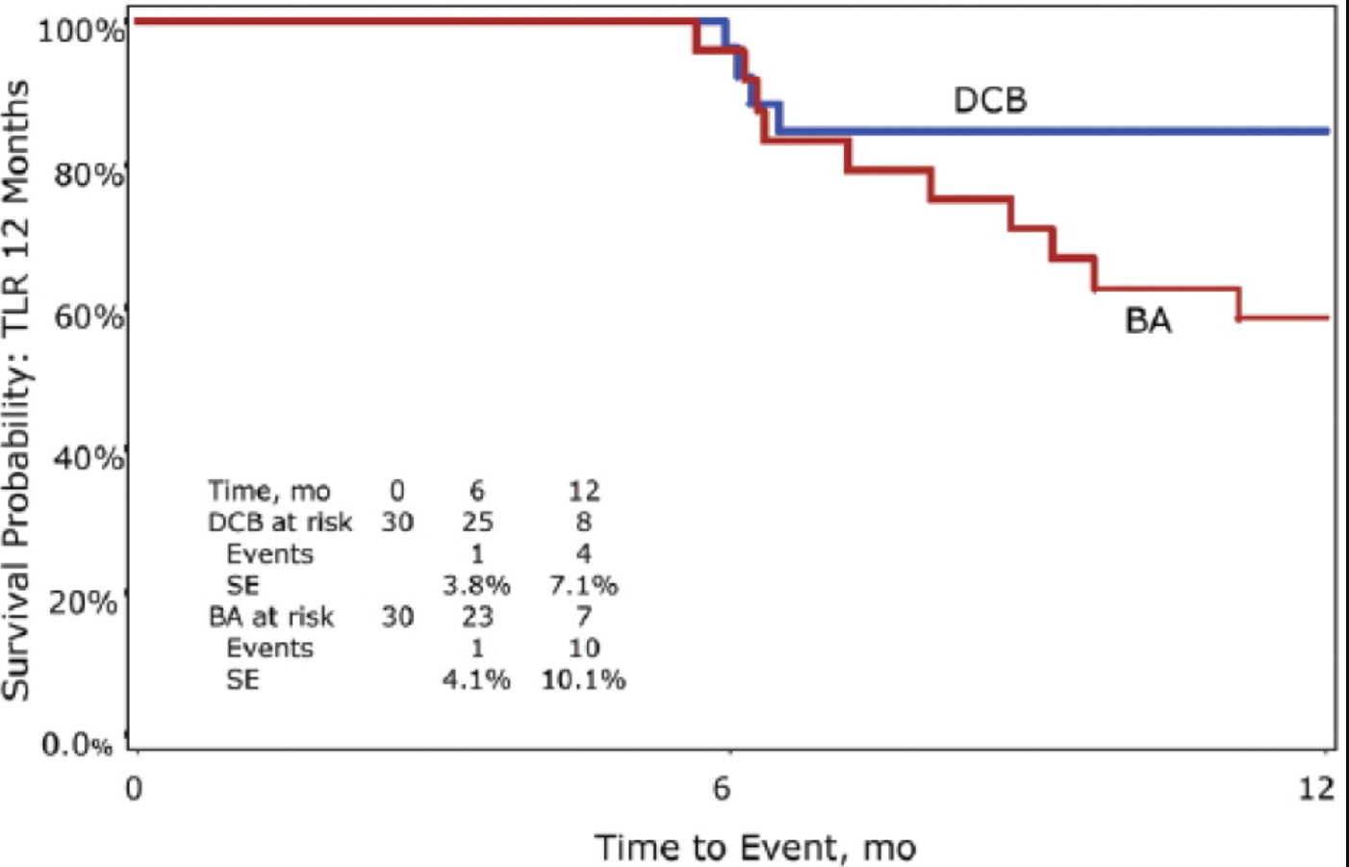
DCB vs PTA
Prospective, international, multicenter, RCT.
60 pts, 5 European centers, randomized 1:1 to DCB vs PTA
Restenotic lesions (>70%), 30-200 mm in the SFA and prox Popliteal artery were studied.
LLL was (0.51±0.72 vs. 1.04±1.00 mm, p=0.033) for DCB vs PTA @ 6 months.
Binary restenosis (11.5% vs. 34.6%, p=0.048) for DCB vs PTA @ 6 months
CD-TLR (ITT) (15.4% vs. 41.7%, p=0.064) for DCB vs PTA @ 1 year
CD-TLR was (6.0% vs. 52.9%, p=0.020) for the as-treated population, in favor for DCB
Improvement of at least one Rutherford category was seen in 72.0% of the DCB patients vs. 65.2% of the BA patients (p=0.846)

Slide 10
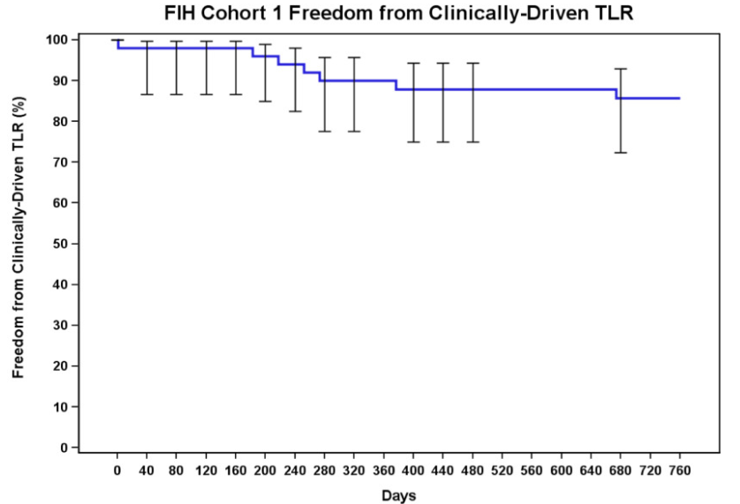
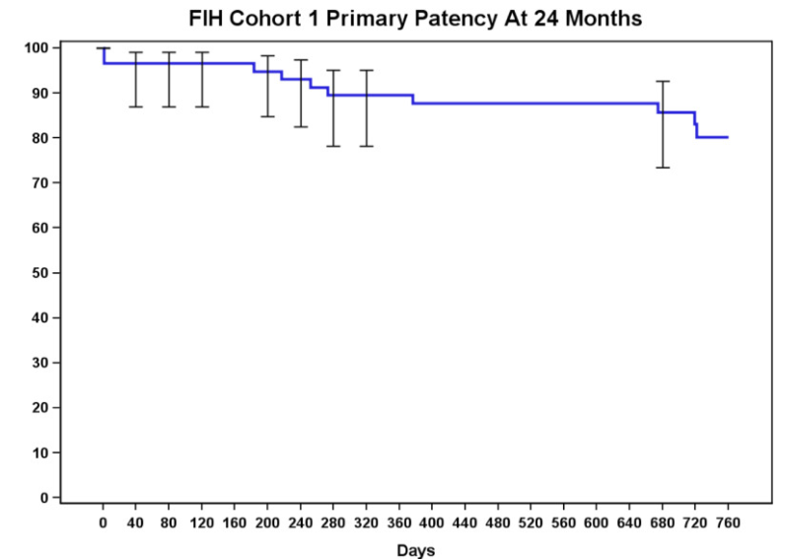
DCB
Prospective, single‐arm, multicenter study.
50 patients with 58 lesions were enrolled.
Mean lesion length was 7.2 cm and baseline stenosis was 75.1%.
62.1% of lesions were calcified and 12.1% were occluded.
MAE rate was 4% and the mean LLL was 0.54 mm @ 6 months
Primary patency rate was 89.5% at 12 months and 80.3% @ 24 months.
Freedom from CD-TLR rate was 90.0% at 12 months and 85.8% at 24 months.
There were no amputations or CV deaths reported through 24 months.

Slide 11
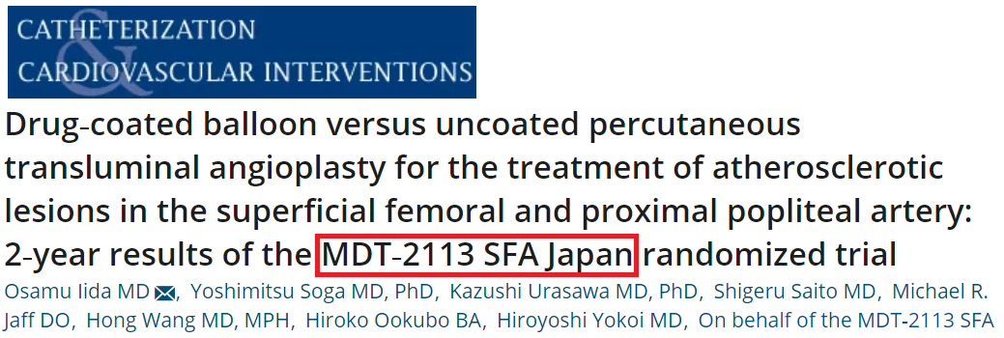
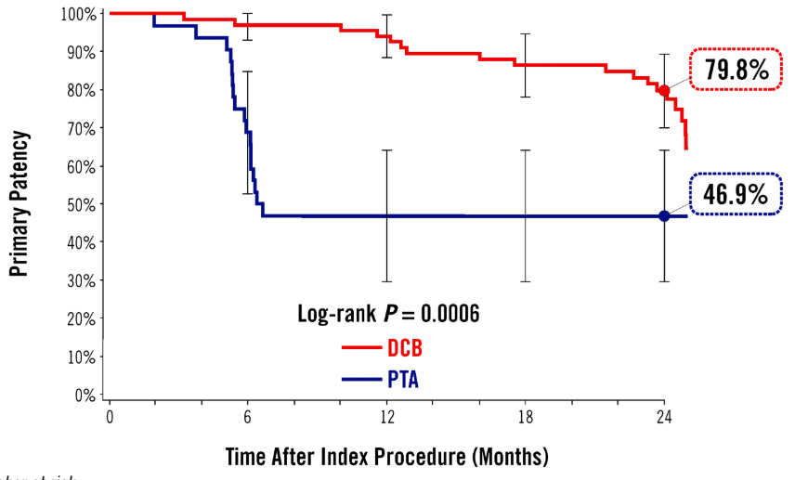
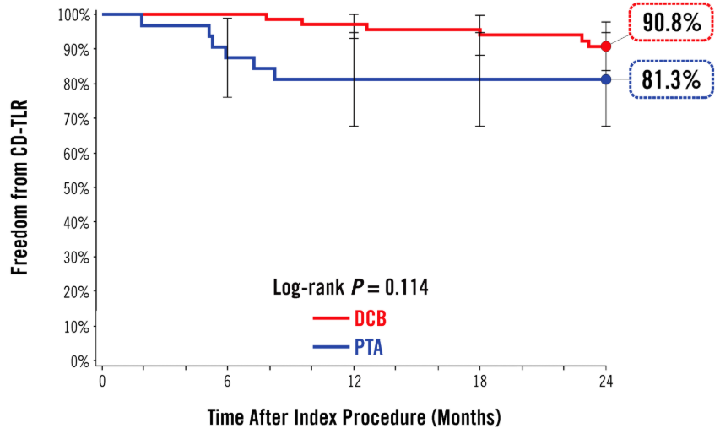
DCB vs PTA
Independently‐adjudicated, prospective, multicenter, randomized, single‐blinded trial.
100 pts assigned by 2:1 randomization to IN.PACT Admiral DCB (n = 68) or PTA (n = 32).
Symptomatic de novo re-stenotic lesions in the SFA and/or proximal popliteal artery were studied.
Mean lesion length was 9.15 ± 5.85 and 8.89 ± 6.01 cm for DCB vs PTA.
Primary patency was 79.8% vs. 46.9%; log rank P < 0.001 for DCB vs PTA @ 24 months.
CD-TLR was 9.1% vs 20.7% , P = 0.177 for DCB vs PTA @ 24 months.
There were no device‐ or procedure‐related deaths, major amputations, or thromboses in either group.

Slide 12
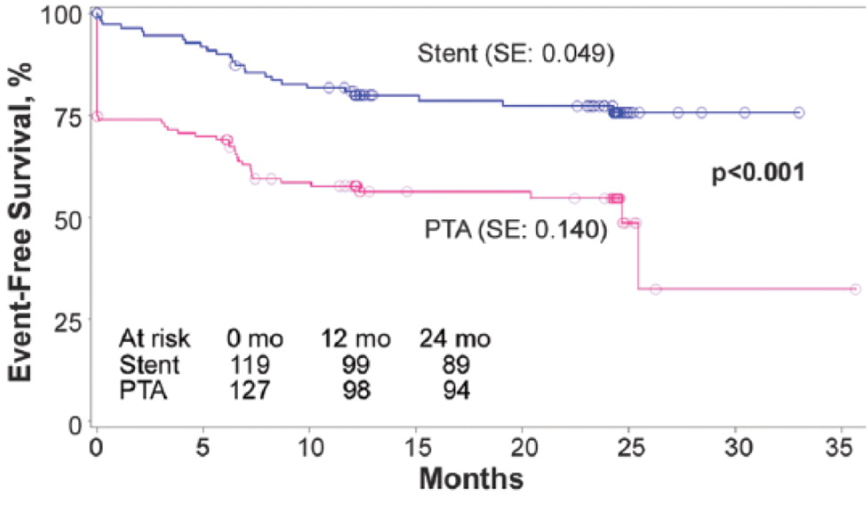
Popliteal artery stenting (ETAP study)
Prospective, multi-center, randomized clinical trial.
246 pts were 1:1 randomized to nitinol stent (119) vs PTA (127).
Mean lesion length was 42.3 mm.
Primary patency rate was (64.2% vs 31.3%, p=0.0001) for BMS vs PTA @ 24 months.
TLR rate were (22.4% vs 59.5%, p=0.0001) for BMS @ 24 months.
Secondary Patency Rate was (78.3% vs 77.8%, p=1.0) for BMS vs PTA.
Incidence of stent fracture was 4.6%
Significant improvement in ABI and Rutherford category was observed at 2 years in both groups.

Slide 13
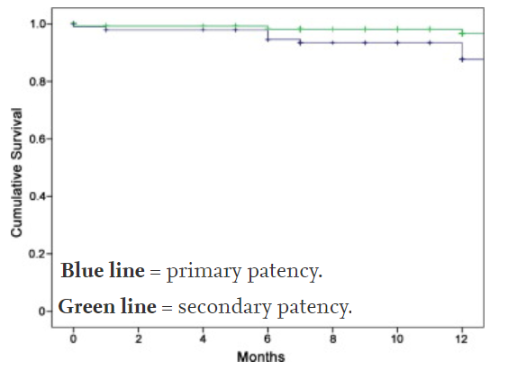
Popliteal artery stenting (Supera Registry)
Retrospective, registry data review at a single center.
101 pts with 125 stents at the popliteal artery were followed for 12 months with US, XR, RC and ABI.
A <30% residual stenosis was achieved in 98.0% of procedures.
Primary Patency was 94.6 ± 2.3% and 87.7 ± 3.7% @ 6 and 12 months, respectively.
Secondary patency rates were 97.9 ± 1.5% and 96.5 ± 2.0% @ 6 and 12 months, respectively.
Mean ABI increased from 0.58 ± 0.15 to 0.97 ± 0.18, p<0.001)
Mean RC decreased from 3.1 ± 0.9 to 1.4 ± 0.8, p < 0.001)
No incidence of stent fracture was observed @ 15.2 month follow up.

Slide 14
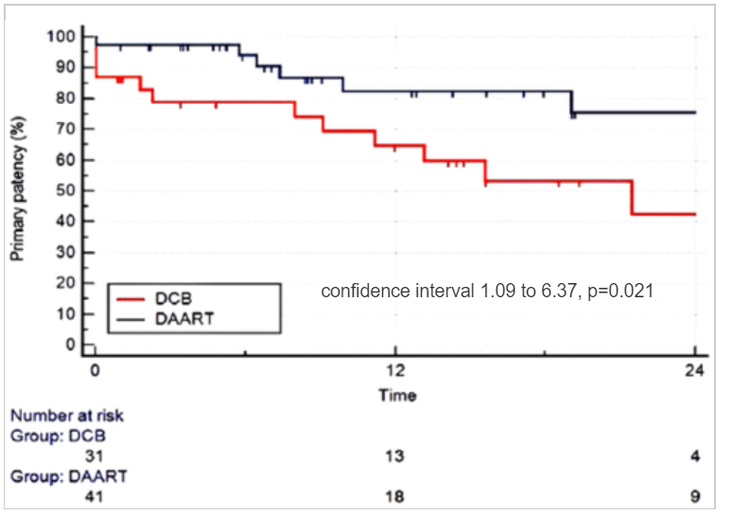
DAART vs DCB
Single-center study comparing DCB (31) vs DAART (41) subjects.
Intervention on Isolated popliteal artery stenotic disease was studied.
Mean lesion length was 47 mm (DCB) vs 42 mm (DAART), respectively.
Primary Patency was 65% (DCB) vs 82% (DAART), p=0.021.
Freedom from TLR was 82% (DCB) vs 94% (DAART), p=0.072.
Secondary Patency was 96% for both groups.
Bailout stenting was higher with DCB and aneurysmal formation with DAART(not significant)
Distal Embolization rates were similar for DCB (3%) vs DAART (5%), p=0.99

Slide 15
CONCLUSION
Popliteal artery CTO intervention remains a challenging entity due to its anatomic location.
Both surgical and endovascular revascularization strategies are appropriate and equally effective in treating these lesions.
PTA alone has as low as 65% patency rates at 1 year.
DCB is superior to PTA alone
Directional atherectomy anti-restenotic therapy (DAART) appears to be more suitable for high risk lesions such calcific, long lesions (> 2 cm) and restenotic lesions.
Stenting offers improved patency, at the expense of risk of stent fracture, thrombosis and compromise of future surgical options.
Thus, stenting should be reserved for bailout in case of flow limiting dissections, residual stenosis > 30% and recoil.

