Slide 1
Vascular Case Presentations

Slide 2
Case Presentation
CC: right leg pain
HPI: 37 year-old female who presented with acute onset of right leg pain and numbness. Of note, attests to mild URI symptoms 1-2 weeks prior
PMH: HTN, DM
PSH: none
Medications: Norvasc, aspirin 81
Notes:
E798685

Slide 3
Case Presentation
Physical Exam:
Vitals: HR: 112, BP: 152/96, RR: 12, Tmax: 37.2
G: NAD, A&Ox3
RLE: monophasic pedal signals, pale and cool. Decreased sensation, intact motor.
COVID-19 Positive (PCR)
Notes:
E798685

Slide 4
Case Presentation
IMAGING
Notes:
E798685

Slide 5
Notes:
E798685

Slide 6
Notes:
E798685

Slide 7
Notes:
E798685

Slide 8
Notes:
E798685

Slide 9
Notes:
E798685

Slide 10
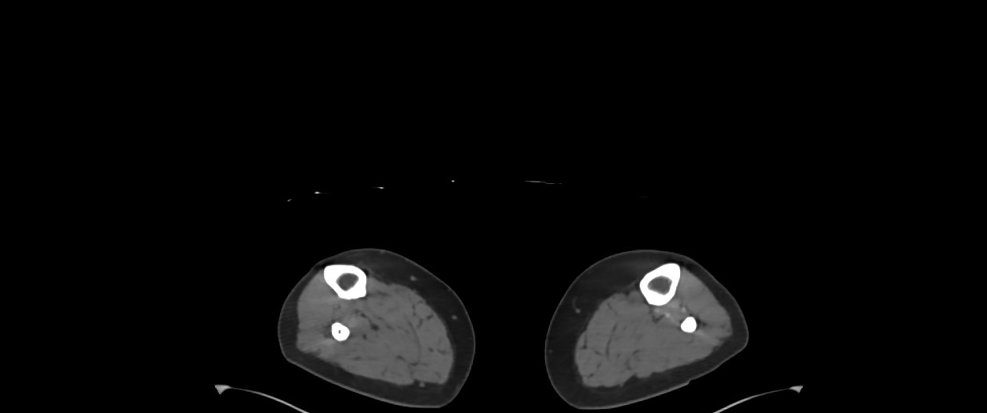
Notes:
E798685

Slide 11
Case Presentation
Extensive filling defects within the RIGHT lower extremity arterial
system as described above, likely compatible with arterial
thrombosis, likely acute. There is severe/subtotal stenosis of the
distal RIGHT common femoral artery as well as total occlusion of the
RIGHT superficial femoral artery and popliteal artery.
No in-line flow to the RIGHT infrapopliteal vessels. There is partial
reconstitution of the RIGHT posterior tibial and peroneal arteries
distally via collateral vasculature.
Notes:
E798685

Slide 12
Case Presentation
A/P: 37 year-old female who presented with acute onset of right leg pain and numbness consistent with right leg acute limb ischemia in setting of COVID-19 infection
POD 0: underwent right leg angiogram, angiojet thrombectomy, placement of lytic catheter overnight
POD 1: Right leg angiogram, open surgical femoral embolectomy
Notes:
E798685

Slide 13
Notes:
E798685

Slide 14
Case Presentation
CC: left leg pain
HPI: 84 year-old male admitted for COVID-19 pneumonia initially requiring NRB now on NC. Developed acute onset left leg pain
PMH: HTN, HLD
PSH: none
Medications: asa, simvastatin, BB
Hospital: hydroxychloroquine, steroids, azithromycin
Notes:
E799463

Slide 15
Case Presentation
Physical Exam:
Vitals: HR: 96, BP: 130/84, RR: 18, O2: 96 on 4L NC, Tmax: 37.2
G: NAD, A&Ox3
LLE: no pedal signals, pale and cool. Decreased sensation and motor
Notes:
E798685

Slide 16
Case Presentation
IMAGING
Notes:
E798685

Slide 17
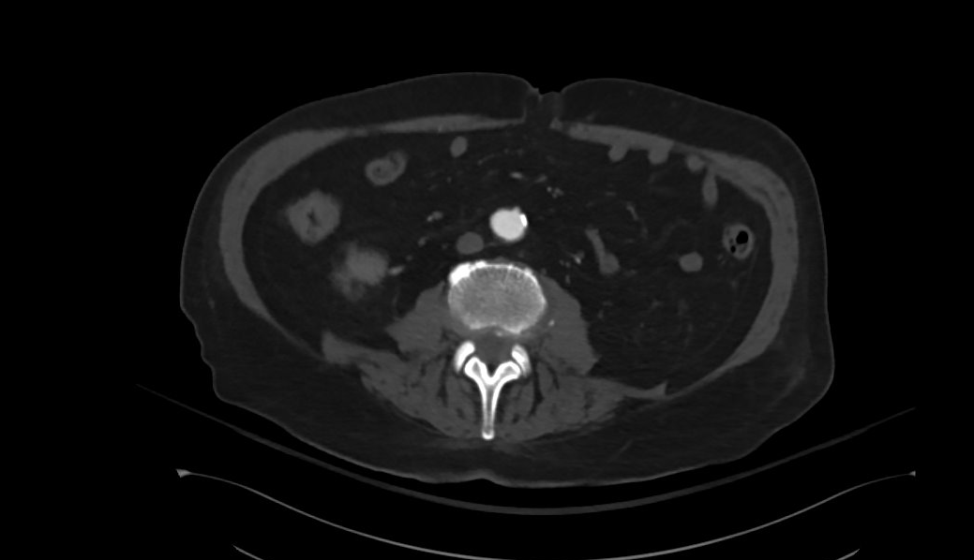
Notes:
E798685

Slide 18
Notes:
E798685

Slide 19
Notes:
E798685

Slide 20
Notes:
E798685

Slide 21
Notes:
E798685

Slide 22
Notes:
E798685

Slide 23
Notes:
E798685

Slide 24
Notes:
E798685

Slide 25
Case Presentation
A/P: 84 year-old male admitted for COVID-19 pneumonia initially requiring NRB now on NC. Developed acute onset left leg pain consistent with ALI
POD 0: under left iliac embolectomy, left femoral embolectomy, left AT embolectomy, 4-compartment fasciotomies
POD 1: Remains in ICU, intubated, increasing pressor requirements
POD 2 – Present: HDS, off pressors, s/p trach for respiratory failure. LLE with palpable DP. On floor awaiting PEG tube and disposition
Notes:
E798685

Slide 26
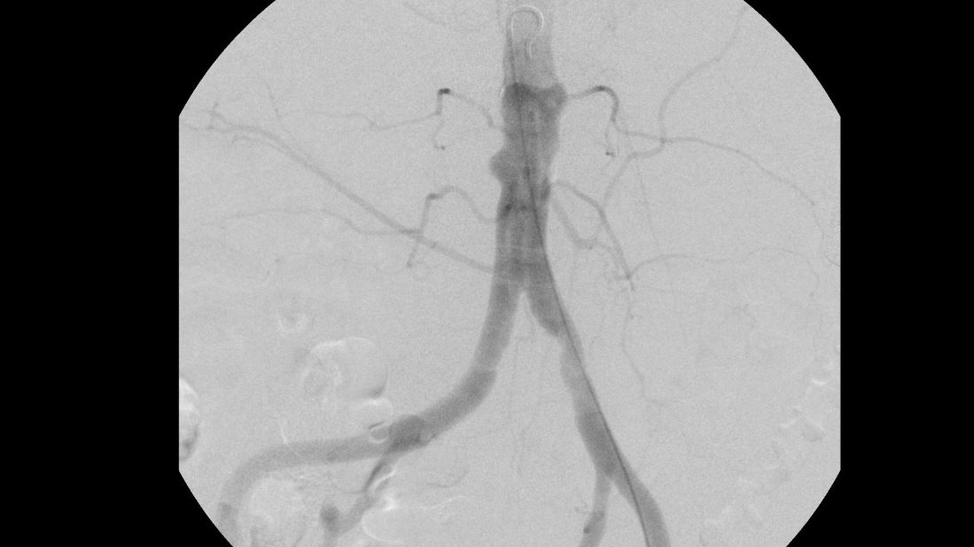
Notes:
E798685

Slide 27
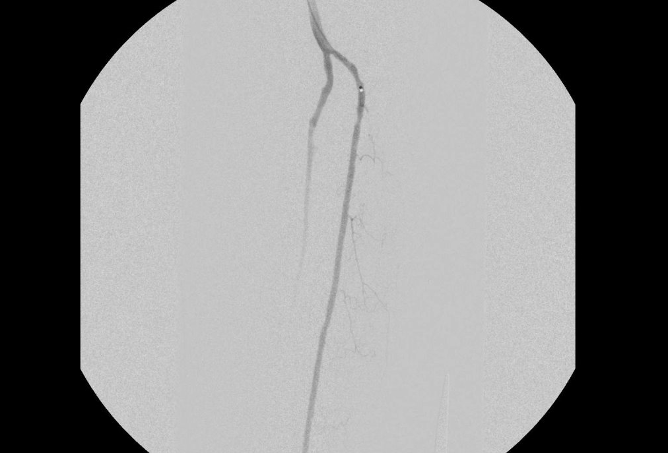
Notes:
E798685

Slide 28
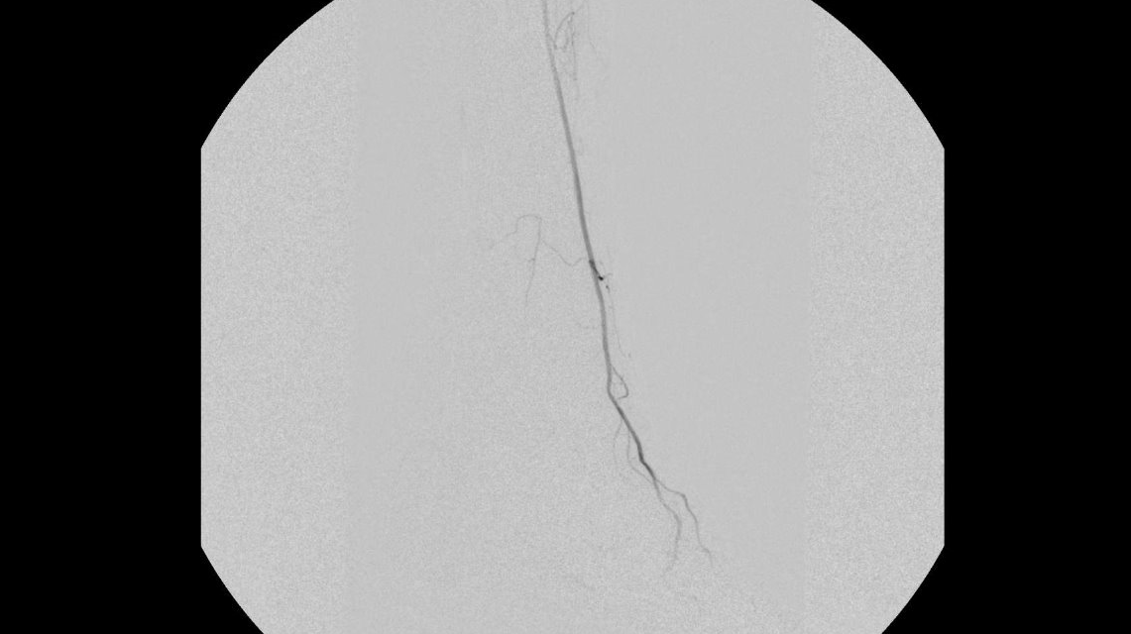
Notes:
E798685

Slide 29
Division of Endovascular Interventions Mount Sinai Hospital New York 05/27/2020

Slide 30
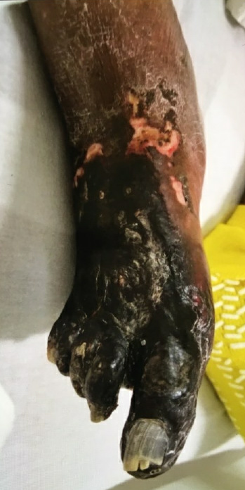
Patient history
87 F with HTN, DM, HLD, CKD III, CAD referred for evaluation of non-healing ulcer to the right foot for 4 weeks.
Due to current situation with COVID, she could not follow up with the podiatry office and referred to MSH for further care.
Medication: Insulin, aspirin, Amlodipine, metoprolol, Lisinopril, atorvastatin and Cilastazol
US: Elevated velocities at the Popliteal and TPT and monophasic waveforms BTK.
SARS-COV 2 PCR test negative and referred for peripheral angiography.

Slide 31
Run Off
Patent SFA stent
Severe disease at the popliteal artery
Occluded PT, Occluded AT and short segment CTO of the Peroneal artery

Slide 32
Subsequent management
Endovascular Intervention +/- TMA
Amputation (TMA vs BTK)

