Slide 1
Division of Endovascular Interventions Mount Sinai Hospital New York 09/25/2019

Slide 2
Patient history
79 Male with
HTN, HLD, NIDDM, CAD (s/p CABG at outside hospital) and smoking
P/W worsening L>R LE Caludication (½ block), Rutherford 4, now progressed to pain at rest.
ASA, Clopidogrel, Atenalol, Losartan, Ranolazine, Atorvastatin
ABI (R) 0.71 (L): 0.68

Slide 3
Non-invasive Imaging
RIGHT
Moderate atherosclerotic disease of the distal SFA, Popliteal and below the knee vessels.
LEFT:
Severe atherosclerotic disease of the distal SFA, occluded Popliteal and severe below the knee vessels.

Slide 4
Angiogram with Run-off

Slide 5
Strategy
Contralateral CFA access vs Ipsilateral Pedal access
GlideWire with catheter support
True-lumen vs Sub-intimal Tracking and Reentry
Switching to a 014 wire for intervention
Atherectomy (directional)
PTA
IVUS guided Stenting

Slide 6
Fem-pop arteries CTO
CTOs frequently are encountered (40-50%) in the SFA distribution of patients with claudication and CLI; however, those with CLI often have multilevel occlusions.
CTO revascularization of the Fem-Pop is feasible with the use of wire catheter and dedicated CTO crossing and re-entry devices in indicated patients with medically refractory claudication or advanced limb ischemia.

Slide 7
Approach for endovascular treatment of femoropopliteal CTO
J INVASIVE CARDIOL 2019;31(4):111-119.

Slide 8
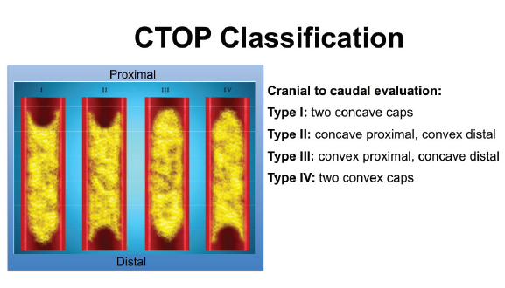
Classification of CTO based on morphology
J INVASIVE CARDIOL 2019;31(4):111-119.

Slide 9
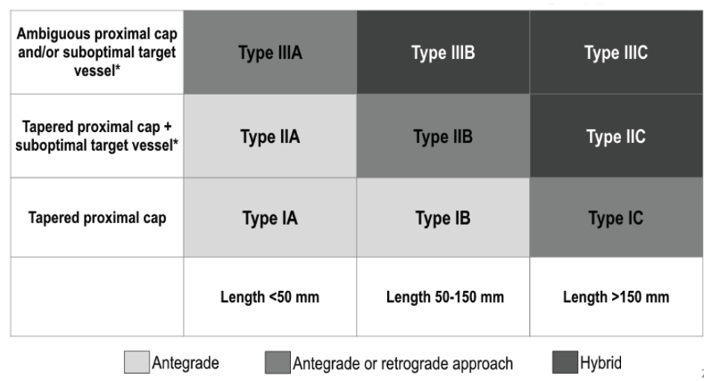
FP CTO Classification & Initial Crossing Approach
J INVASIVE CARDIOL 2019;31(4):111-119.

Slide 10
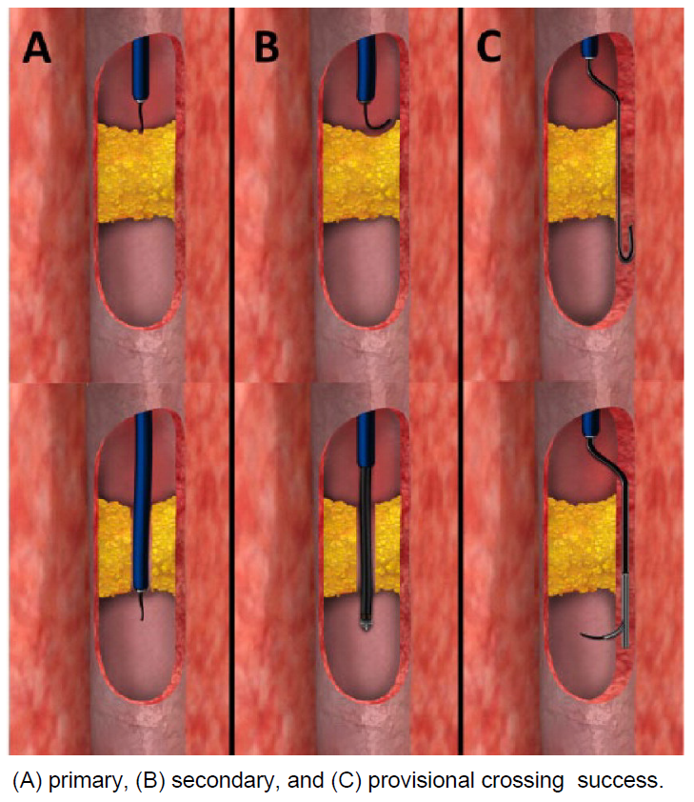
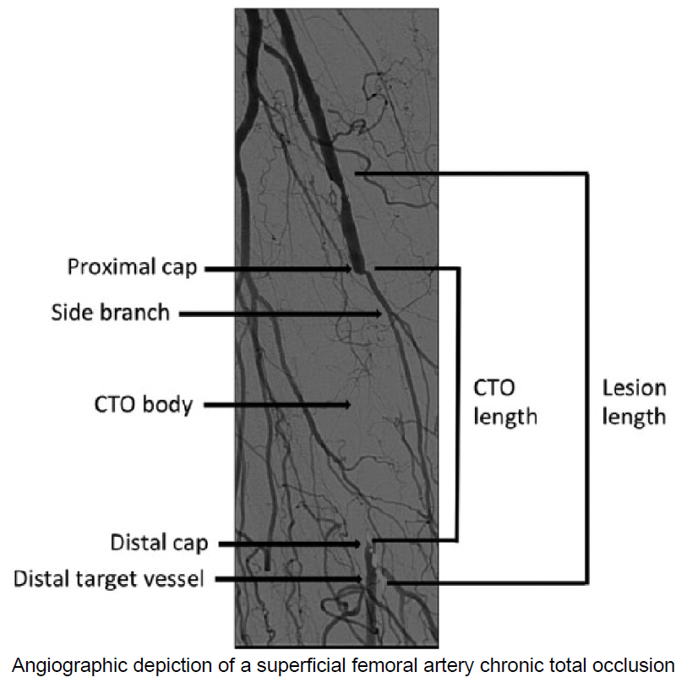
CTO Crossing techniques
J Endovasc Ther. 2015 Aug;22(4):525-34.

Slide 11
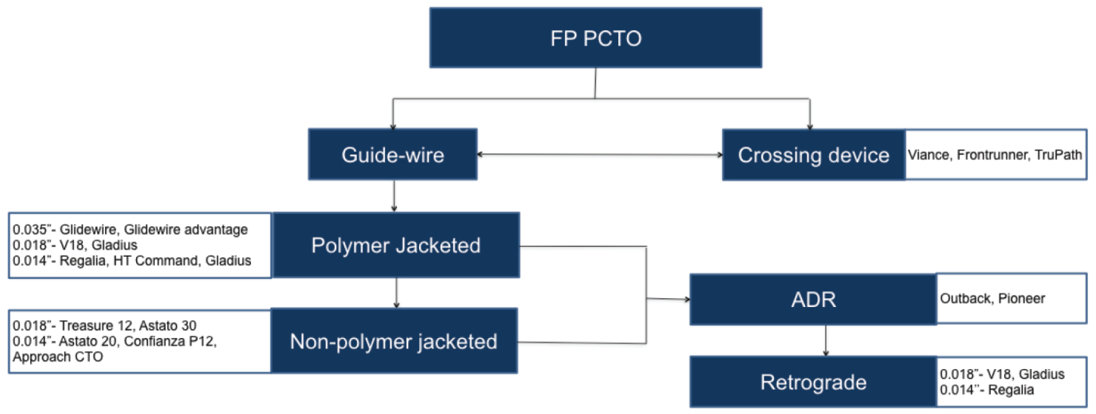
Equipment Selection:
0.035" PLATFORM
Designed to provide highest support & stability
Compatible with most SFA balloons/stents
0.018" PLATFORM
Least Traumatic
More steerable and flexible
0.014" PLATFORM
Least Traumatic
Least support
Re-Entry
J INVASIVE CARDIOL 2019;31(4):111-119

Slide 12
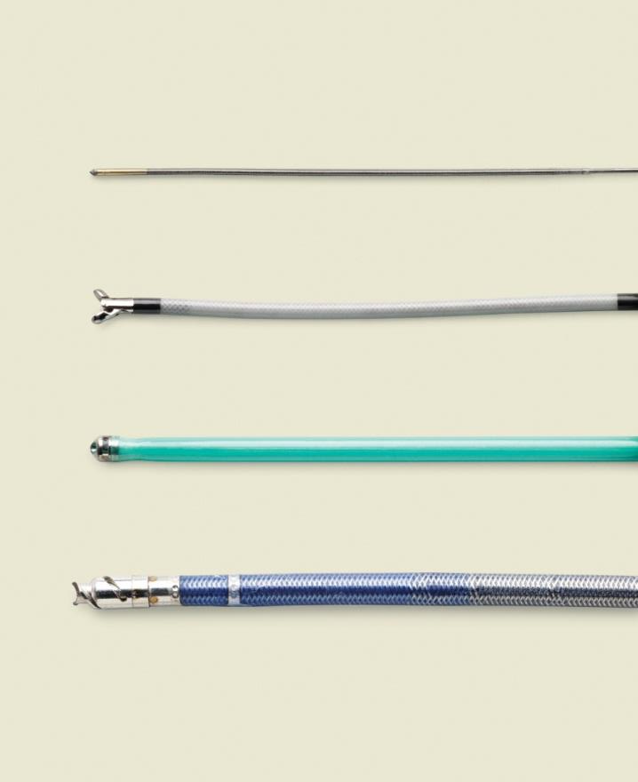
Crossing devices (true lumen)
TruePath
Front Runner
Crossing devices
Gentle forward pressure
Let device do the work
Exploit micro-channels
Mechanical or vibrational energy to break up calcium
Crosser
WildCat

Slide 13
Sub-Intimal Dissection with Re-Entry
Enteer
Pioneer
Re-entry often occurs at transition to healthy vessel
Re-entry devices can assist this process:
Outback (Cordis)
Enteer (Medtronic)
Off-Road (Boston Scientific)
Pioneer (Volcano)
Outback
Off-Road

Slide 14
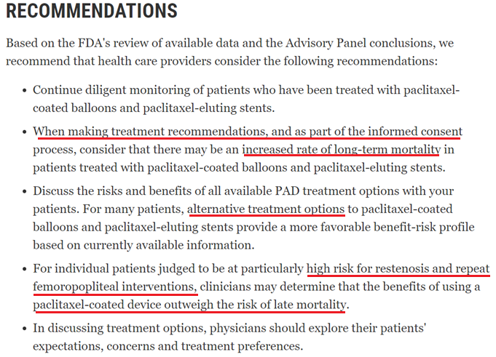

Slide 15
Bare metal stents:
Supera interwoven nitinol stent
Nitinol stent studies
Vascular Health and Risk Management 2015:11

Slide 16
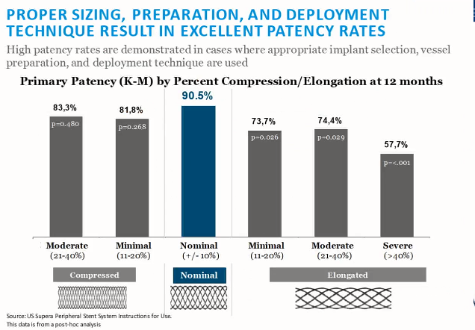
Supera stent (BMS):
Source: US Supera Peripheral Stent System Instructions for US
Post-hoc analysis

Slide 17
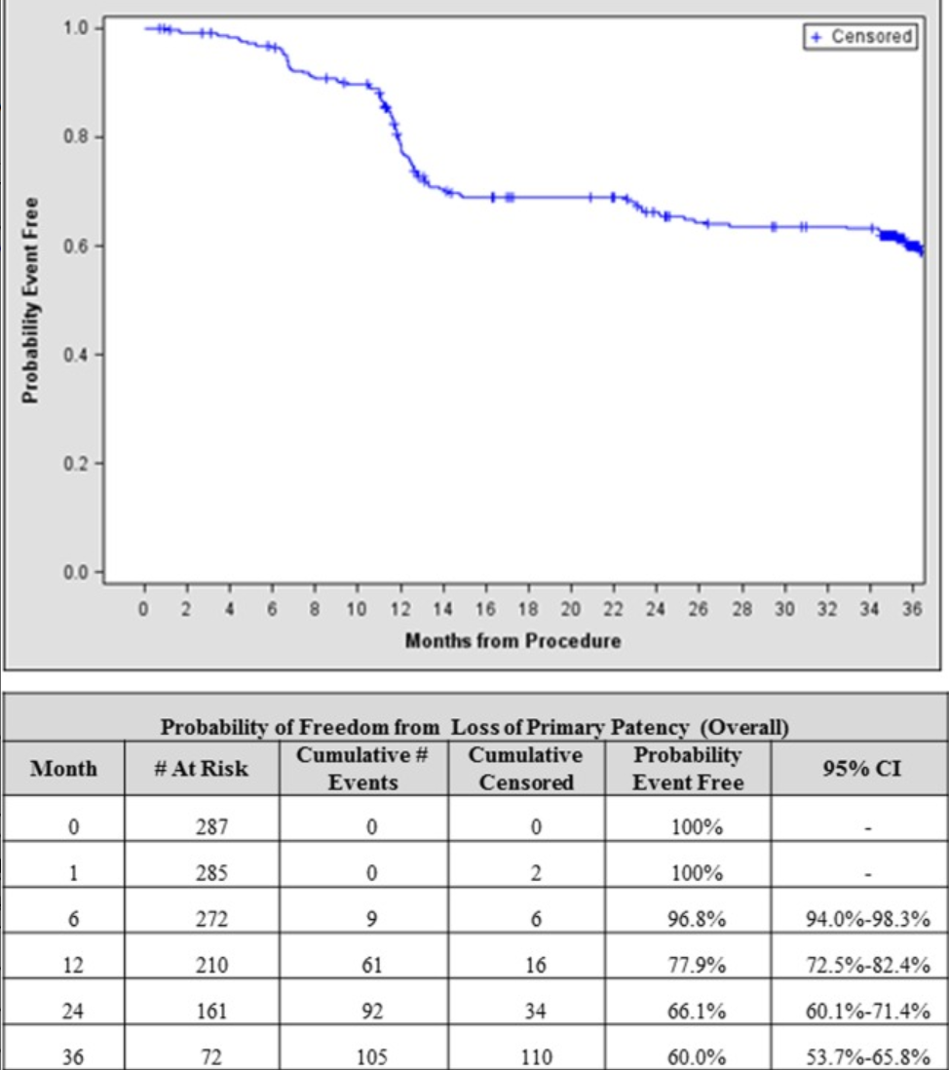
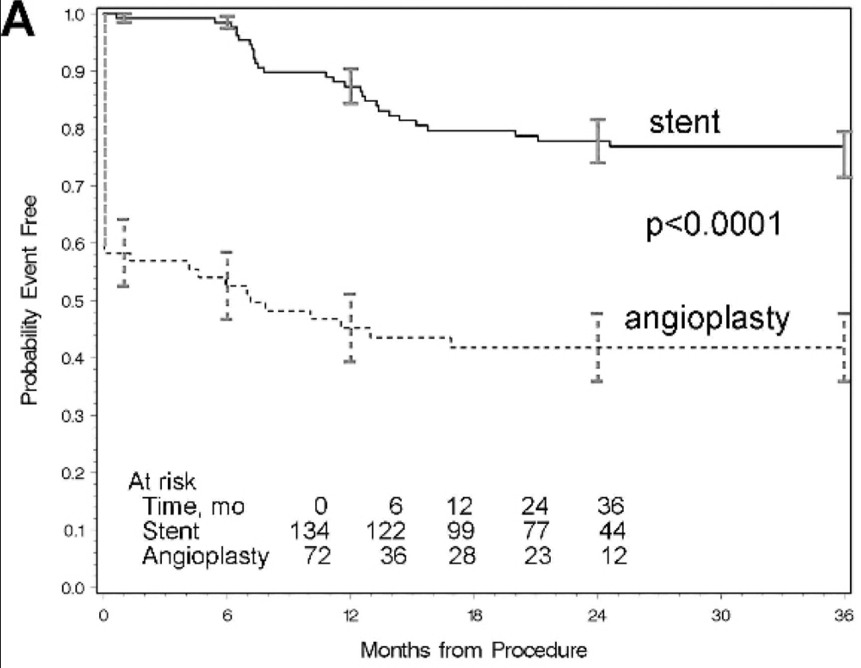
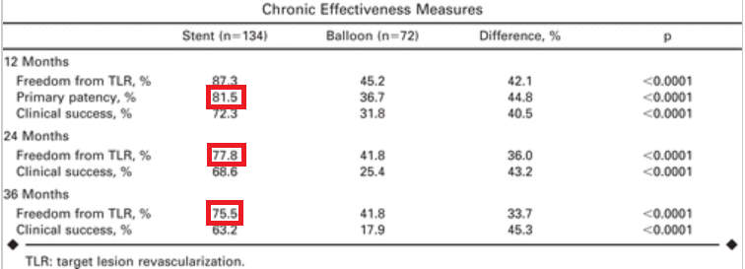
DURABILITY II - primary 3 year
EverFlex Self-expanding Peripheral Stent
J Vasc Surg. 2015 Jul;58(1):73-83
RESILIENT TRIAL - 3 year Follow up
LifeStent™ Vascular Stent
J Endovasc Ther. 2012 Feb;19(1):1-9

Slide 18
Acknowledgement:
Prakash Krishnan
Rheoneil Lascano
Reza Masoomi

Slide 19
Cardiovascular Research Technologies (CRT) 2019 Town Hall
Katsanos and colleagues’ systematic review
A study-level meta-analysis is a common methodological practice, but it provides less robust results than a patient-level analysis.
At two and five years, the total number of patients studied was 2,316 and 863, respectively.
At one year, the risk of death did not differ significantly between the use of P-DCB or P-DES and the control arms (2.3% vs 2.3%; risk ratio [RR] 1.08, 95% CI: 0.72-1.61).
After >1-year follow-up only 12 of the 28 studies and 3 of 28 studies had two-year and five-year clinical event data, respectively.
There are 24 P-DCB trials and only four P-DES trials. Because the amount of paclitaxel on P-DES is approximately 10% to 20% of the total amount on a P-DCB, it may not be appropriate to pool these studies.
For the statistical analysis, the authors did not adjust for a non-parametric (skewed) distribution. This could potentially lead to different conclusions.
Lastly, overall, 10% to 15% of patients in the PTA arm were exposed to paclitaxel at one year. This percentage could be even higher because, in the Zilver PTX study, which is included in the meta-analysis, 40% of patients in the PTA group were treated with a Zilver PTX stent after the randomization. (EuroIntervention 2019;15:e317-e319)

