Slide 1
CCC Live Case
Chip India Summit 2019
Patient Demographics
77 yrs, F
Stable angina/ DOE
Present Clinical Presentation
Cresendo angina for last 2
months despite MMT. Known severe 3 V CAD, CTS declined
CAD Risk Factors
Hypertension
CKD Stage III
Hyperlipidemia
Morbid Obesity
Severe OA b/l Knee
Clinical Variables
Redistribution Thallium: Ant, Lat
and Inf viability, Apical scar
Echo: LVEF 25%, Mod MR
AICD
S/p DES PCI of RCA July
2018 with IABP assist
Medications
Aspirin, Clopidogrel, Metoprolol, ISMN, Atorvastatin,
Losartan/HCTZ, Aldactone
Cath: 3 V CAD, Occluded RPDA, multiple calcific 8-90% LAD lesions, 90% D1, 80% pLCx, EF 24%, Syntax score 24, STS 5.4
Plan: Impella assisted PCI of LAD/LCx using rotational atherectomy

Slide 2
AUC 2017: Revascularization to Improve Survival
Compared with Medical Therapy in ULM or complex CAD
STS score: 5.4; SYNTAX score: 24
Patel et al., J Am Coll Cardiol 2017;69:17

Slide 3
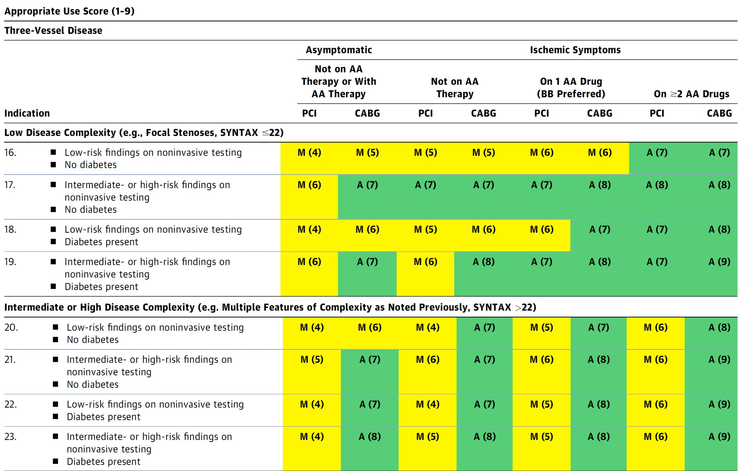
AUC 2017: Three-Vessel Disease
Patel et al., J Am Coll Cardiol 2017;69:17

