Slide 1
Serdar Farhan, MD, FESC
Assistant professor of Medicine
Icahn School of Medicine at Mount Sinai
New York

Slide 2
Case presentation
Female, 57y/o, Hx of CAD with s/p PCI of RCA 8/2019 and PA with s/p PTA/DES of right SFA CTO 9/2019 (due o failed conservative management of PAD).
CVRF: DM, HTN, HLP and active smoking
Medication: DAPT (ASA and Clopidogrel), Carvedilol, Lisinopril, Metformin, Insulin, Nicoderm.
IC progression to resting pain in the last 5-7 days
No fever, cough or SOB. No contact to COVID-19 suspected people

Slide 3
PVR

Slide 4
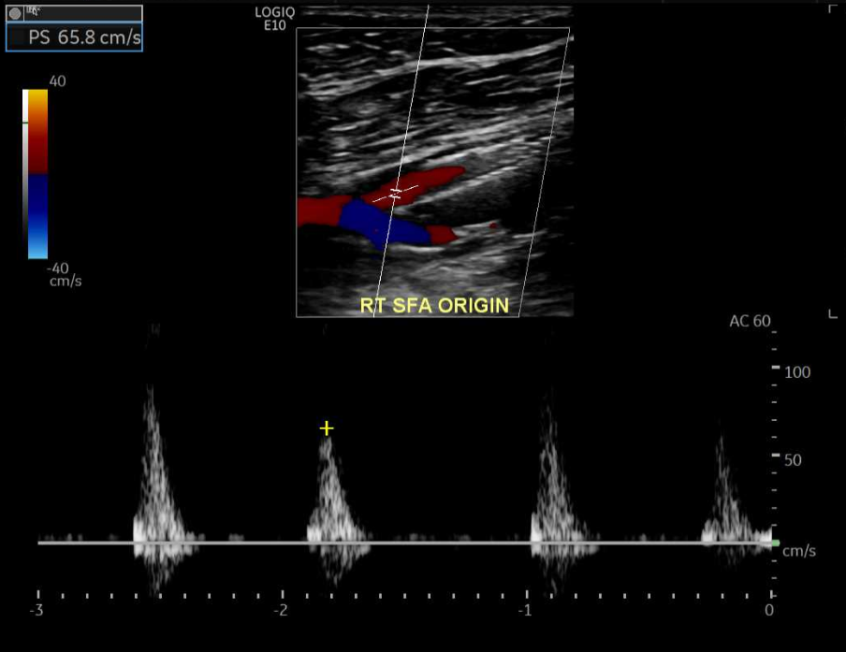
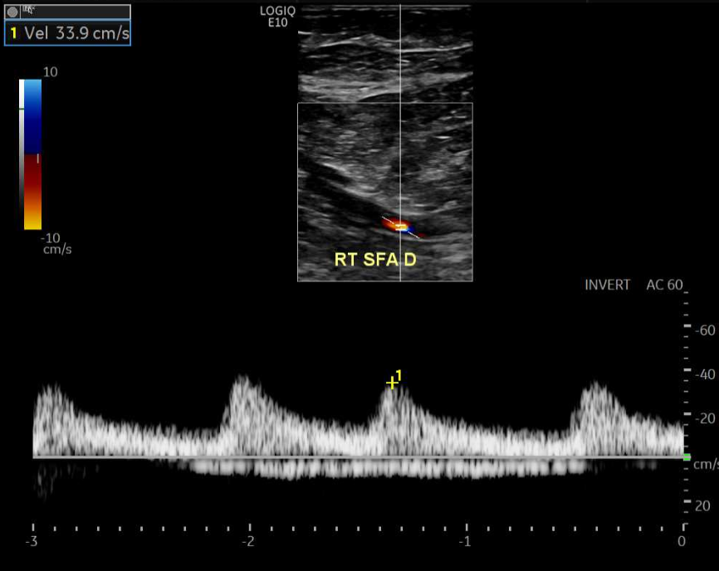
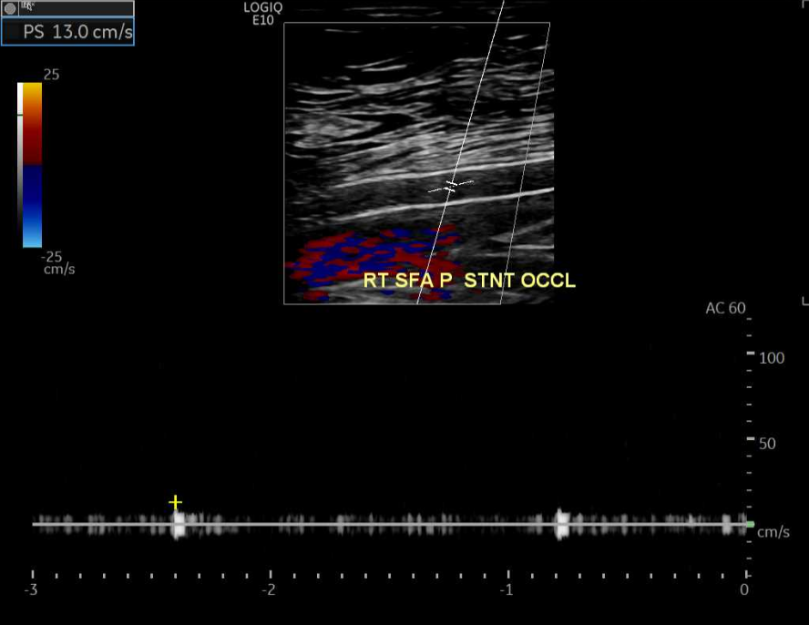
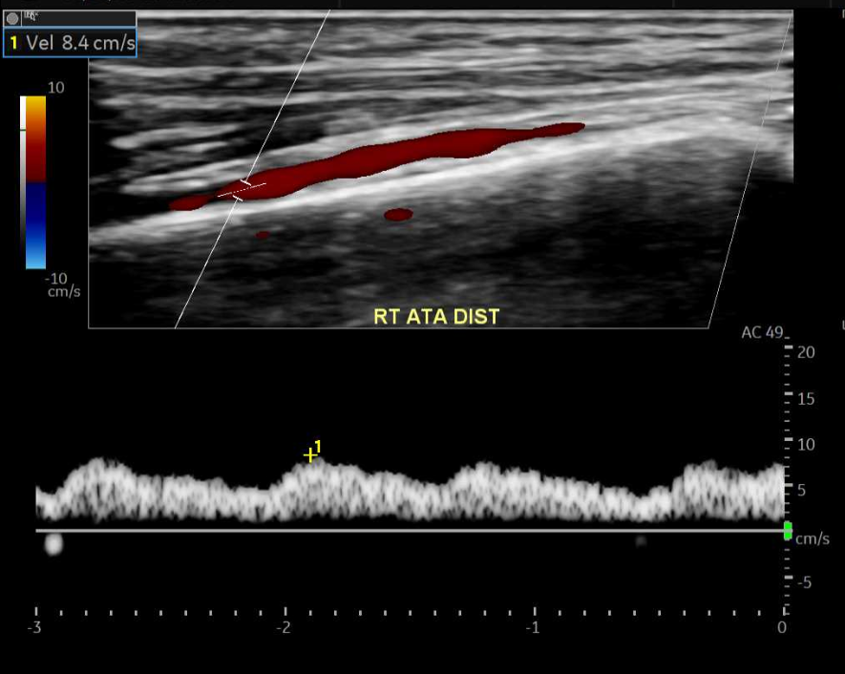
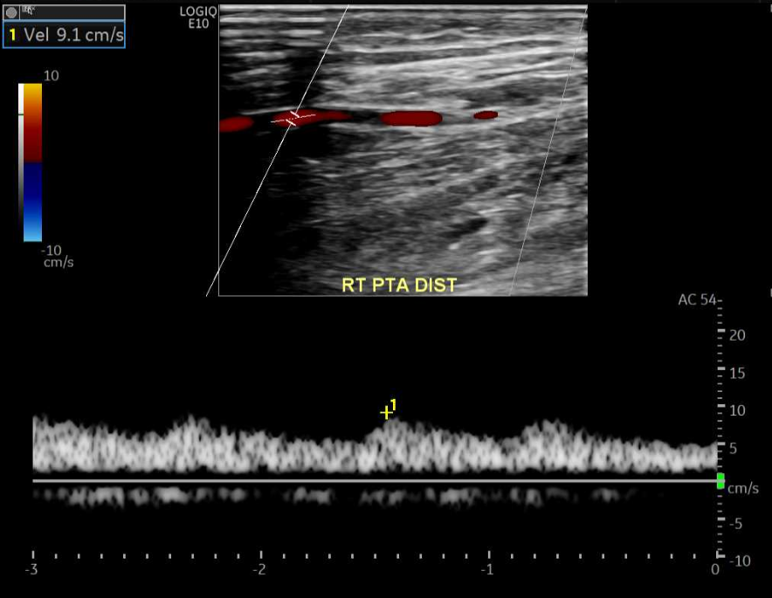
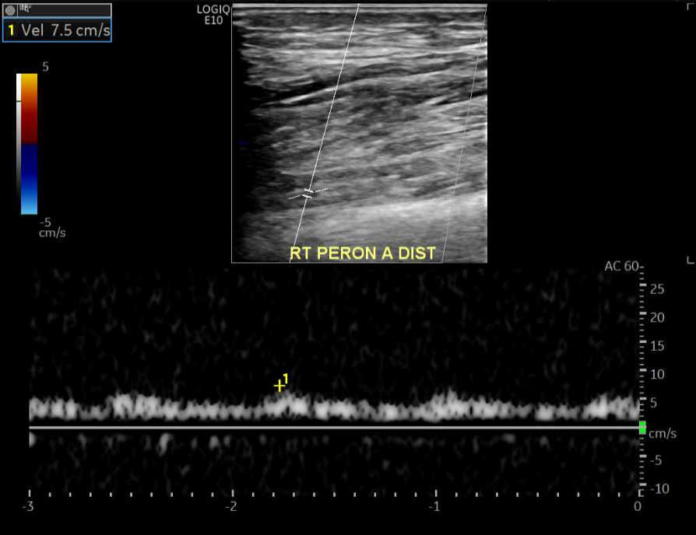
Doppler US
Ostial SFA
SFA (Stented segment
Distal SFA
ATA
PTA
Peroneal

Slide 5
Peripheral angiogram

