Slide 1
Structural Heart Live Cases
Supported by:
Edwards Life Sciences
Terumo Medical Corp

Slide 2
Disclosures
Samin K. Sharma, MD, FACC
Speaker’s Bureau – Boston Scientific Corp,
Abbott Vascular Inc, ABIOMED, CSI
Annapoorna S. Kini, MD, FACC
Nothing to disclose
Gilbert Tang, MD
Physician proctor for Edwards, Medtronic
Pedro Moreno, MD, FACC Moderator
Nothing to disclose

Slide 3
Nov 12th 2019- Structural Heart Live Case # 32: DM, 90 y/o F
Presentation: Worsening dyspnea on exertion, NYHA class III symptoms for the last few months
PMH: Rheumatic heart disease with severe MR s/p bio-prosthetic MVR with 31mm bovine pericardial valve with 3 V CABG ( LIMA-LAD, SVG to diagonal and SVG to OM) along with LAA resection in 09/2003. Other history includes HTN, DJD, renal insufficiency (CKD-3), moderate carotid atherosclerosis, arthroscopy of b/l knee and hernia repair
Medications: Amlodipine, Enalapril, Carvedilol, Warfarin, Furosemide, Atorvastatin
EKG (10/21/2019): Atrial fibrillation with controlled ventricular rate
CT Scan (10/16/2019): Patent grafts

Slide 4
Structural Heart Live Case # 32: DM, 90 y/o F
TEE (03/27/2019): LVEF-60%, severe prosthetic mitral stenosis with PG/MG 22/11 mmHg. 3D imaging showed MVA of 1.2cm2 with mod-to-severe TR and moderate pulm hypertension, no evidence of paravalvular mitral regurgitation;

Slide 5
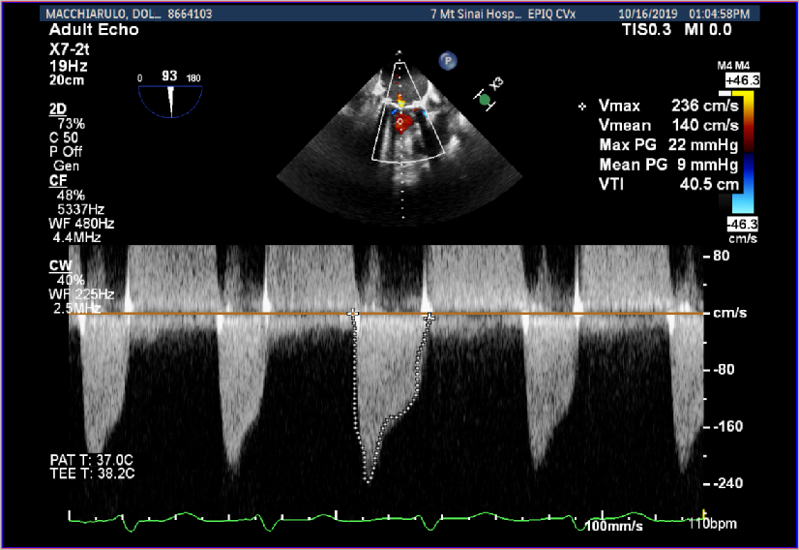
Trans-esophageal Echocardiogram
TEE showing degenerated MV bio-prosthesis with thickened restricted leaflets and elevated gradients across degenerated mitral prosthesis

Slide 6
3D TEE
3D TEE of degenerated thickened restricted bio-prosthetic MV leaflets

Slide 7
Structural Heart Live Case # 32: DM, 90 y/o F
STS risk mortality: 15.1%
EuroScore II risk: 14.6%
Logistic Euroscore mortality: 31.4%
Course: Patient evaluated by Heart Team and due to multiple co-morbidities and frailty, the patient was determined to be EXTREME risk for 2nd time reoperation for surgical MVR
Plan: Patient determined to be a suitable candidate for mitral ViV TMVR

Slide 8
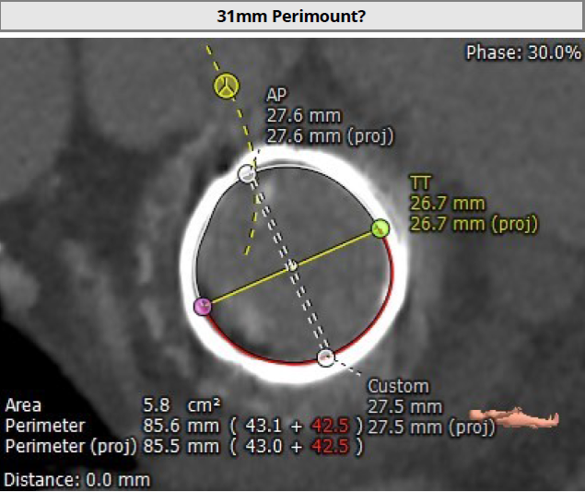
CT Angiogram

Slide 9
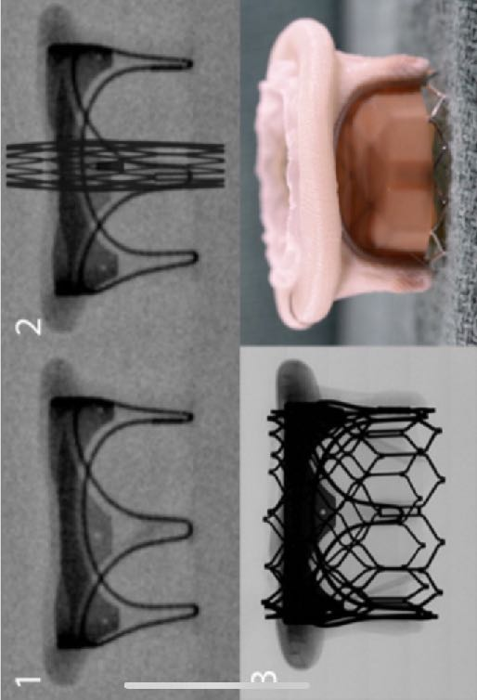
#31 mm Edwards Bovine pericardial valve 6900 P: Perimount
Suggested ViV Sapien-3 Valve
Size: 29
Valve in Valve Positioning

Slide 10
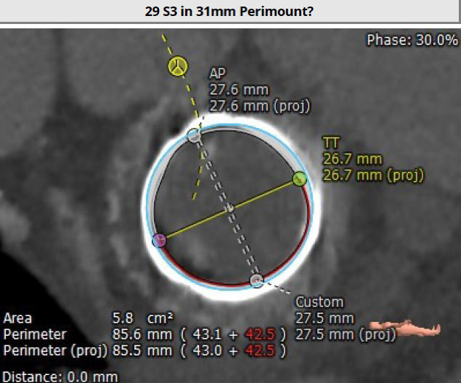
CTA- 3D Reconstruction of Mitral ViV TMVR with 29mm Sapien-3 Valve

Slide 11
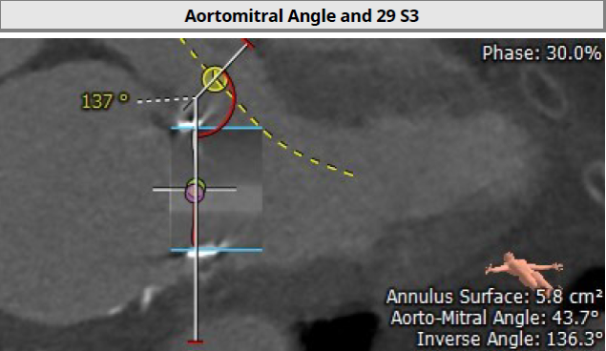
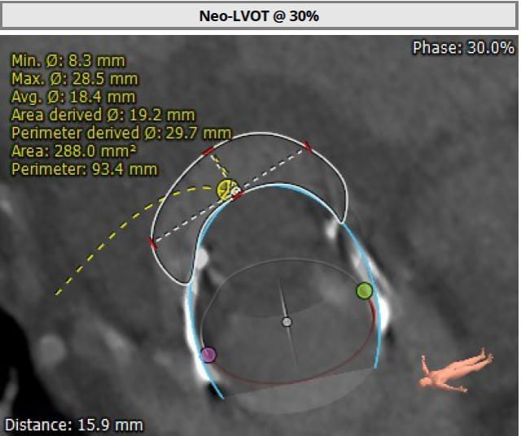
CTA - 3D Reconstruction of Mitral ViV TMVR with 29 mm Sapien-3 Valve
Aorto-Mitral angle- 137 ^{O}
Neo LVOT area-288 sq.cm

Slide 12
Summary of Case
- 90 year old female with a degenerated #31 mm Perimount MV bio-prosthesis, presented with worsening NYHA Class III CHF symptoms
- TEE: Degenerated MV bioprosthesis with severe MS and moderate to severe TR with moderate PA hypertension
- STS risk mortality: 15.1%
EuroScore II risk: 14.65%
Logistic Euroscore mortality: 31.38 %
- CTA: Valve anatomy suitable for TMVR with low chance of neoLVOT obstruction
- Course: Patient evaluated by Heart Team and due to multiple co-morbidities the patient was determined to be extreme risk for 2nd time reoperation for surgical MVR
Plan: Patient determined to be a suitable candidate for mitral ViV TMVR with 29mm (+3cc) Sapien-3 valve

Slide 13
Notes:
TranseptAID is teaching how to perform transseptal puncture for various procedures. It describes the anatomy of transseptal punctures and all the tools used during the procedure.

Slide 14
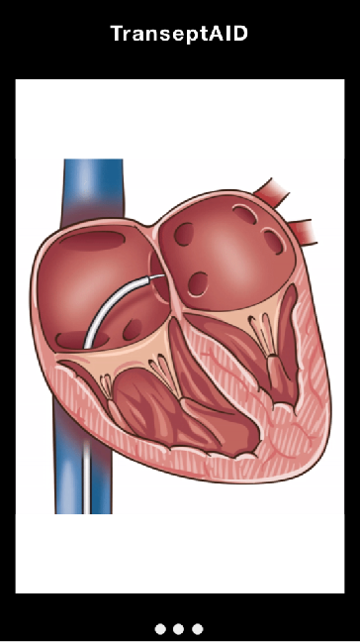
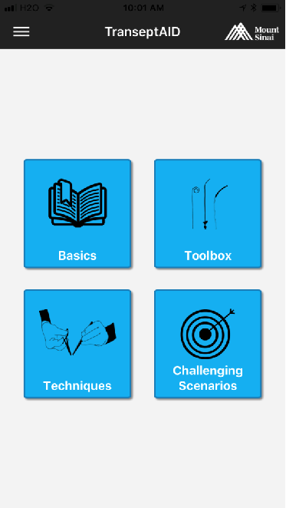
TranseptAID App
Free Download

Slide 15
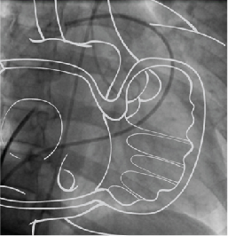
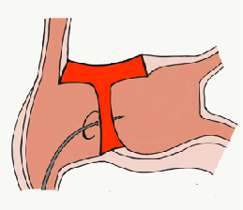
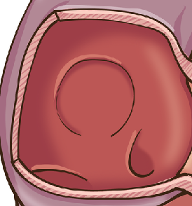
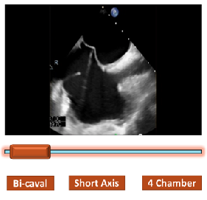
Animations
Hybrid images
TranseptAID
Interactive illustrations
Interactive videos
Notes:
The app describes the techniques of transseptal puncture for MitraClip, TMVR, and BMV among other procedures using animations, interactive illustrations and imaging.

Slide 16
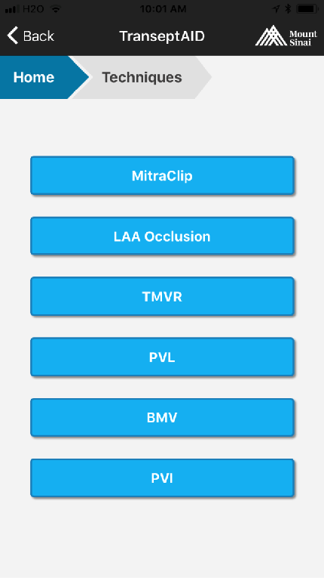
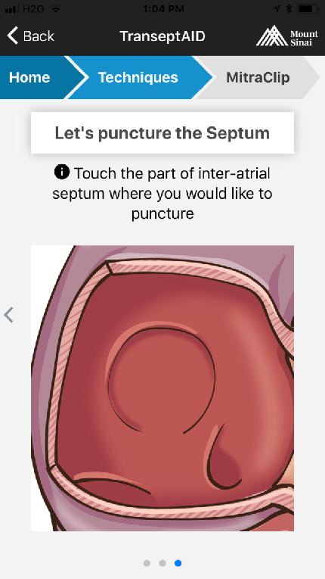

Slide 17
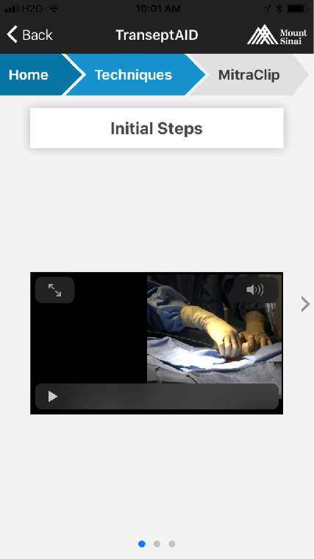

Slide 20
Issues Related To The Case
Update on Sapien TMVR for ViV outcomes

Slide 21
Specific Challenges with TMVR
Domain | TAVR | TMVR
Epidemiology | Single: degenerative sclerotic AS | Complex: non-rheumatic DMR and ischemic FMR
Existing gold-standard of treatment | SAVR; TAVR accomplishes the same thing | Mostly mitral valve repair; TMVR equivalent of surgical replacement only
Unmet need and high-risk patients | Common | Uncommon in overall MR population
Durability of bioprosthetic valve | Good in aortic position | Poor in mitral position
Impact of suboptimal results (PVL, PPM, risk of obstruction) | Low (in older patients; higher in younger patients) | High (generally younger patients; LVOT obstruction; systolic pressure gradient)
Heterogeneity of substrate for implant | Low | High
Other pathologies that need to be addressed | Uncommon | Common (A-fib, TR)
Trial enrollment and progress | Fast (prohibitive risk; previously untreated population) | Slow (strict inclusion criteria; uncommon demographic; competing devices)

Slide 22
Risk of TMVR
Undersized valve
Valve embolization
Oversized valve
LVOT obstruction
Difficult landing zone for the valve
Severe peri-valve leak
Procedural death

Slide 23
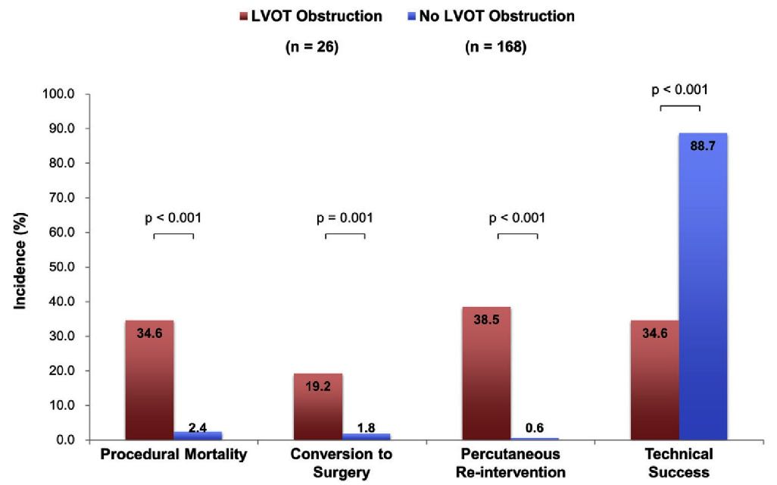
Procedural Outcomes and LVOT Obstruction
Yoon et al., J Am Coll Cardiol Intv 2019;12:182

Slide 24
Potential Treatments for LVOT Obstruction during TMVR
Alcohol Septal ablation
Perfusion Balloon inflation in LVOT
AML laceration (LAMPOON procedure)

Slide 25
Outcomes of TMVR for Degenerated Biprostheses, Failed Annuloplasty Rings and Mitral Annular Calcification
Objective
We aimed to evaluate and compare the procedural and clinical outcomes of patients undergoing TMVR for degenerated bioprostheses (valve-in-valve [ViV]),
failed annuloplasty rings (valve-in-rings [ViR]) and severe MAC (valve-in-MAC [ViMAC])

Slide 26
Clinical Outcomes at 30-Days
p<0.001
ViV (n=322)
ViR (n=141)
ViMAC (n=58)
p<0.001
%
p=0.03
p=0.07
p=0.05
p=0.15
Yoon SH, EHJ 2018;40:441

Slide 27
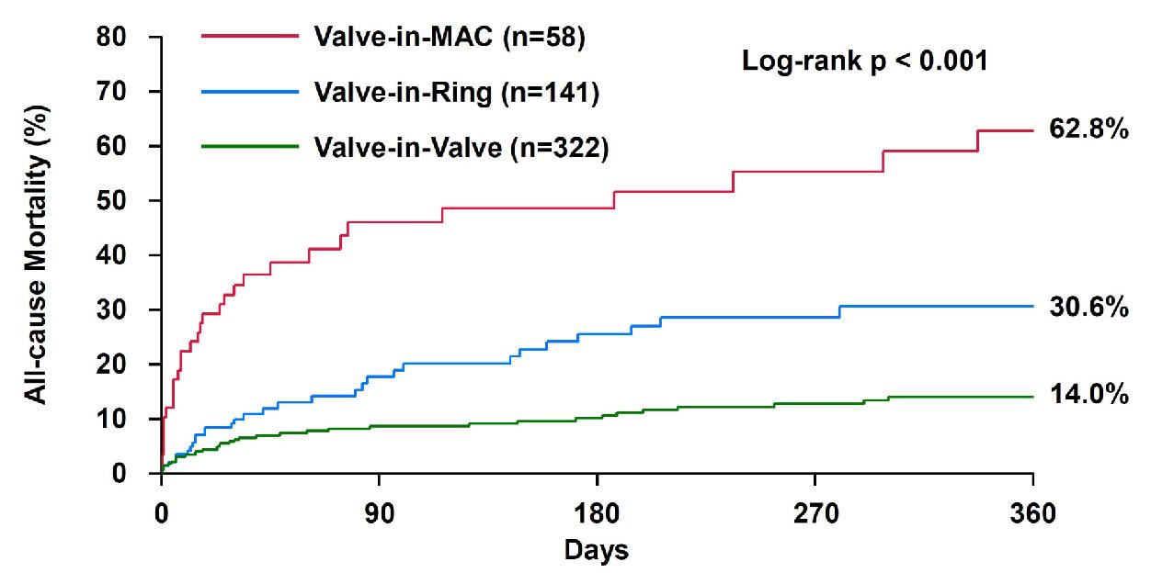
All-Cause Mortality According to TMVR
Yoon SH, EHJ 2018;40:441

Slide 28
1-Year Outcomes of Mitral Valve-in-Valve Using the SAPIEN 3 Aortic Transcatheter Heart Valve
Data from the STS/ACC/TVT Registry
Gurrero M et al
TCT 2019

Slide 29
Background
SAPIEN 3 Mitral Valve-in-Valve Background
6.3% elective
17.8% emergent
1,973 patients
Vancouver CA¹
12.8%
96 patients
Istanbul, Turkey²
11-15%
53 patients
Texas³
8.2%
182 young patients age 49.2 ± 27.4
Bursa, Turkey⁴
12%
48 patients
Southampton, UK⁵
12%
1,627 patients from Medicare database⁶
11.1%
1,096 patients from STS database⁷
1Jamieson et al, Circulation 2003;108[suppl II]:II-98-II-102
2Albeyoglu, et al. Thorac Cardiovasc Surg 2006;54:244
3Toker et al, Tex Heart Inst J 2009; 26:557
4Ozyazicioglu et al, Turkish J Thorac Cardiovasc Surg 2012;20:497
5Vohra et al, Interact Cardiovasc Thorac Surg 2012 May;14:575
6Kwedar et al, Ann Thorac Surg 2017;104:1516
7Mehaffey et al, Heart 2018;104:652

Slide 30
SAPIEN 3 MViV: 30-day Mortality in
Early Experience
%
Not Reported
n=349 (18.5% TS)
Dvir et al TVT 2016
n=586 (49% TS)
Guerrero et al AHA 2017
n=30 (100% TS)
Guerrero et al AHA 2017
Guerrero M, TCT 2019

Slide 31
SAPIEN 3 MViV: Trends for Mitral ViV
%
Guerrero M, TCT 2019

Slide 32
SAPIEN 3 MViV: Procedure Volume Growth and Cases Per Site
# of MViV cases
# of sites
# of MViV cases
Median # of MViV cases per site=4, IQR [1, 8]
Sites
Guerrero M, TCT 2019

Slide 33
SAPIEN 3 MViV: Patient Flow
2,144 TMVR procedures using SAPIEN 3 in TVT Registry
(June 2015 – Aug 2019)
MViR
n=206
MAC
n=183
Unknown
n=179
MViV with S3
n = 1,576
*
Transseptal
n = 1,326
Transapical
n = 203
Transatrial
n=6
Unspecified
n=41
*Unknown patient vital status after CMS linkage: 5.3% at 30 days and 17.1% at 1 year.
Guerrero M, TCT 2019

Slide 34
SAPIEN 3 MViV: Baseline Characteristics
 | TRANSSEPTAL n=1,326 | TRANSAPICAL n=203 | p value
Age | 73.4 (±11.86) | 72.6 (±11.66) | 0.36
Female | 785 (59.2%) | 119 (58.6%) | 0.88
NYHA III & IV | 1041 (86.5%) | 184 (91.1%) | 0.07
Atrial Fibrillation | 952 (71.85%) | 130 (64%) | 0.02
Prior Stroke | 232 (17.5%) | 31 (15.3%) | 0.45
COPD | 607 (46.2%) | 95 (47%) | 0.82
Currently on dialysis | 70 (5.3%) | 12 (5.9%) | 0.71
Prior CABG | 442 (33.4%) | 84 (41.4%) | 0.03
Prior AVR | 315 (23.8%) | 49 (24.1%) | 0.91
Hostile chest | 223 (16.8%) | 45 (22.2%) | 0.06
STS score | 11 (±8.58) | 11.7 (±9.46) | 0.3
n(%), or mean (±SD)
Guerrero M, TCT 2019

Slide 35
SAPIEN 3 MViV: Procedural Outcomes
 | TRANSSEPTAL n=1,326 | TRANSAPICAL n=203 | p value
20 mm | 3 (0.2%) | 0 (0%) | 1
23 mm | 101 (7.6%) | 18 (8.9%) | 0.54
26 mm | 553 (41.7%) | 80 (39.4%) | 0.54
29 mm | 669 (50.5%) | 105 (51.7%) | 0.74
Procedural time | 125.8 (±64.3) | 138.4 (±73.9) | 0.02
Fluoroscopy time | 37 (±25.7) | 18.2 (±12.9) | <0.0001
Procedure aborted | 7 (0.5%) | 1 (0.5%) | 1
Device Embolization | 3 (0.2%) | 1 (0.5%) | 0.43
LVOT Obstruction | 11 (0.8%) | 4 (2%) | 0.1
Cardiac perforation | 14 (1.1%) | 3 (1.5%) | 0.48
Conversion to Open Surgery | 9 (0.7%) | 5 (2.5%) | 0.03
n(%), or mean (±SD)
Valve Size
Guerrero M, TCT 2019

Slide 36
SAPIEN 3 MViV: Primary Endpoints
Primary Safety Endpoint:
Technical Success
Primary Effectiveness Endpoint:
All-Cause Mortality at 1 year
NS
TS (n=1326)
Log-Rank p= 0.0324
TA (n=203)
HR: 0.67 [95% CI: 0.47-0.97]
21.7%
%
All-Cause Mortality (%)
15.8%
Guerrero M, TCT 2019

Slide 37
SAPIEN 3 MViV: In-Hospital Outcomes
p=0.06
p=0.18
%
p=0.30
p=1.0
p=0.35
p=0.51
p=0.51
Guerrero M, TCT 2019

Slide 38
SAPIEN 3 MViV: 30-Day and 1-Year Outcomes
30-Day Outcomes
1-Year Outcomes
p=0.07
p=0.03
%
%
p=0.44
p=0.95
p=0.44
p=0.91
p=0.82
p=0.49
p=0.78
p=0.17
Guerrero M, TCT 2019

Slide 39
SAPIEN 3 MViV: NYHA
p < 0.0001
p < 0.0001
p < 0.0001
p < 0.0001
NS
NS
NS
%
Baseline 30-Day 1-Year
Guerrero M, TCT 2019

Slide 40
SAPIEN 3 MViV: Predictors of 1-Year All Cause Mortality
UNIVARIATE
MULTIVARIATE
 | HR 95% CI | p-value | HR 95% CI | p-value
Baseline Covariates
Transseptal vs Transapical | 0.67 [0.47-0.97] | 0.033 | 0.58 [0.37-0.9] | 0.014
Baseline KCCQ Overall Score | 0.98 [0.97-0.99] | <0.0001 | 0.98 [0.97-0.99] | 0.002
Baseline GFR (mL/min/1.73 m²) | 0.98 [0.98-0.99] | <0.0001 | 0.98 [0.97-0.99] | <0.0001
Cardiogenic shock within 24 hrs | 6.13 [4.18-8.98] | <0.0001 | 2.28 [1.14-3.03] | 0.020
Mod/Sev Tricuspid Insufficiency | 1.54 [1.13-2.1] | 0.006 | 1.81 [1.16-2.84] | 0.009
Procedural Covariates
Perforation with or without tamponade | 21.56 (12.19-38.15] | <0.0001 | 70.58 [28.51-174.7] | <0.0001
Conversion to Open Heart Surgery | 9.01 [4.61-17.62] | <0.0001 | 3.59 [1.34-9.62] | 0.010
n(%), or mean (±SD)
Guerrero M, TCT 2019

Slide 41
SAPIEN 3 MViV: Increase in Transseptal Access and Decrease in 30-Day Mortality
Transseptal vs Transapical Rate
30-Day All-Cause Mortality
Guerrero M, TCT 2019

Slide 42
SAPIEN 3 MViV: Summary
TMVR using the SAPIEN 3 is associated with high technical success, low complication rate and 30-day mortality lower than predicted by the STS score.
Most patients experienced significant improvement of symptoms and Quality of Life, which were maintained at 1 year.
Valve performance was maintained at 1 year.
Transseptal access was associated with lower mortality compared with transapical access and was an independent predictor of lower mortality at 1 year.
Guerrero M, TCT 2019

Slide 43
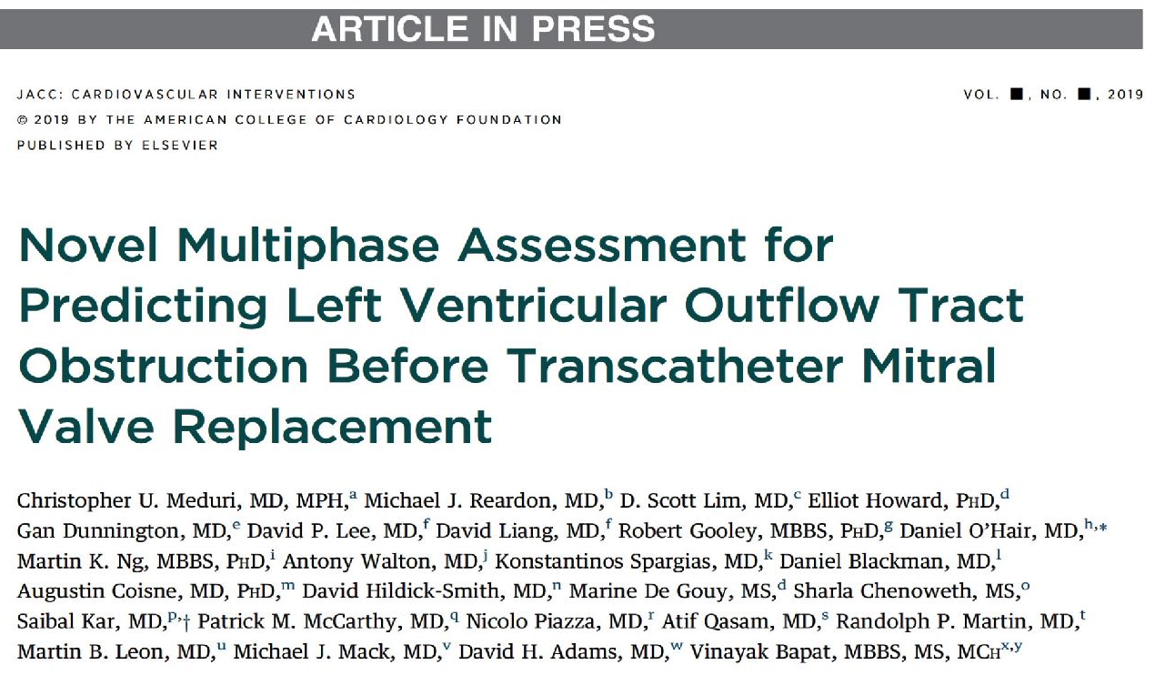

Slide 44
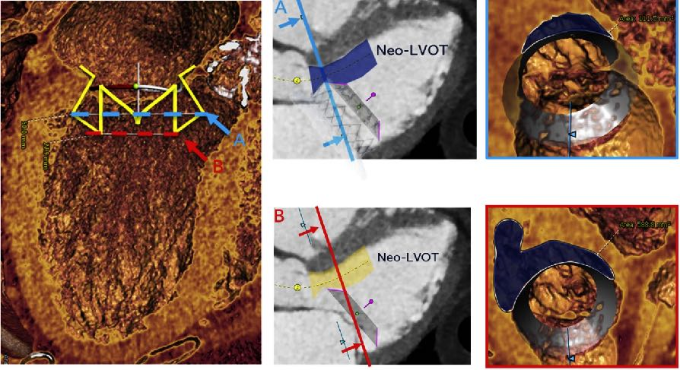
Methods of Neo-LVOT Are Measurement for the Intrepid TMVR Implant
neo-LVOT area is measured at 2 locations along the device:
Location where device diameter is largest
The most ventricular, outflow end of the device
Meduri et al., J Am Coll Cardiol Intvn 2019 Oct 11 Epub ahead of print

Slide 45
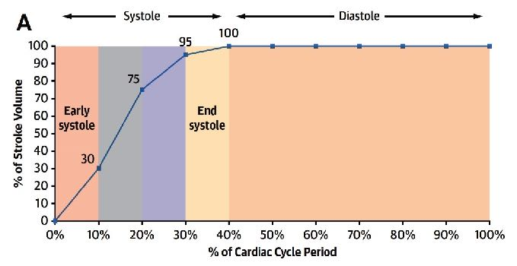
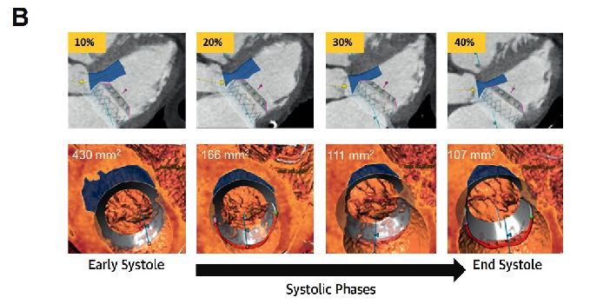
Multiphase and Early Systolic LVOT Assessment
Majority of Stroke Volume is Ejected in Early Systole
Cardiac Output Through the Different Phases of Systole
Meduri et al., J Am Coll Cardiol Intvn 2019 Oct 11 Epub ahead of print

Slide 46
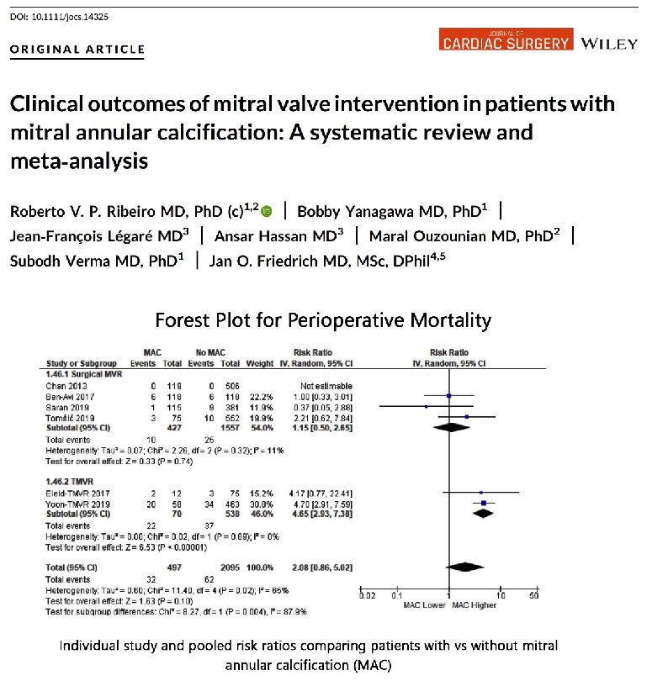

Slide 47
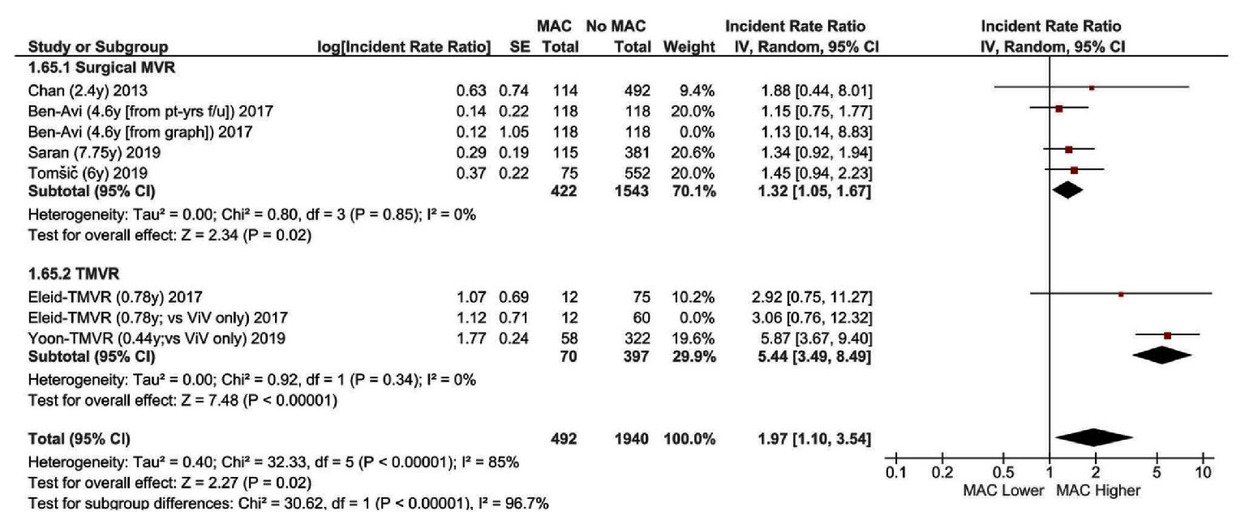
Forest Plots for Midterm Mortality
Ribeiro et al., J Card Surg 2019 Nov 6 Epub ahead of print

Slide 48
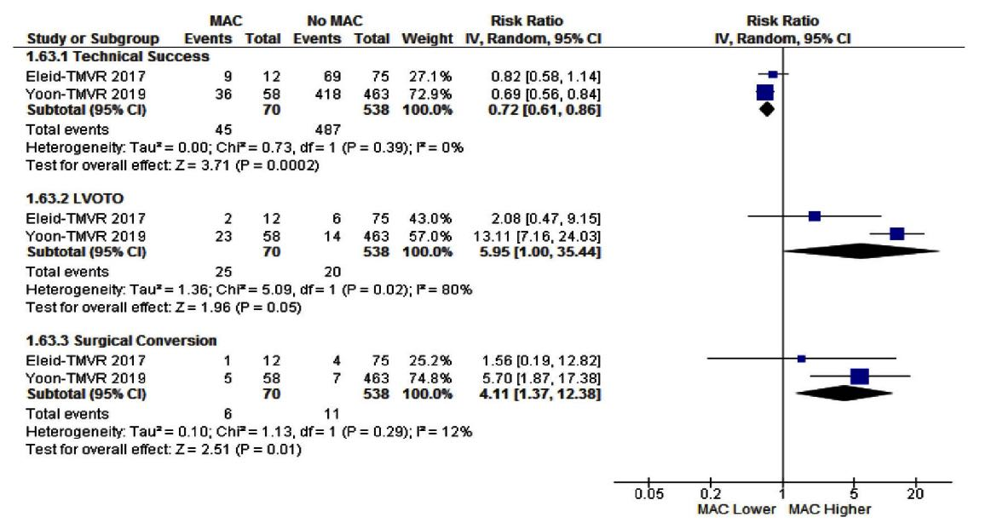
Perioperative Outcomes of TMVR: Technical Success, LVOTO, and Need for Conversion to Surgery
Ribeiro et al., J Card Surg 2019 Nov 6 Epub ahead of print

Slide 49
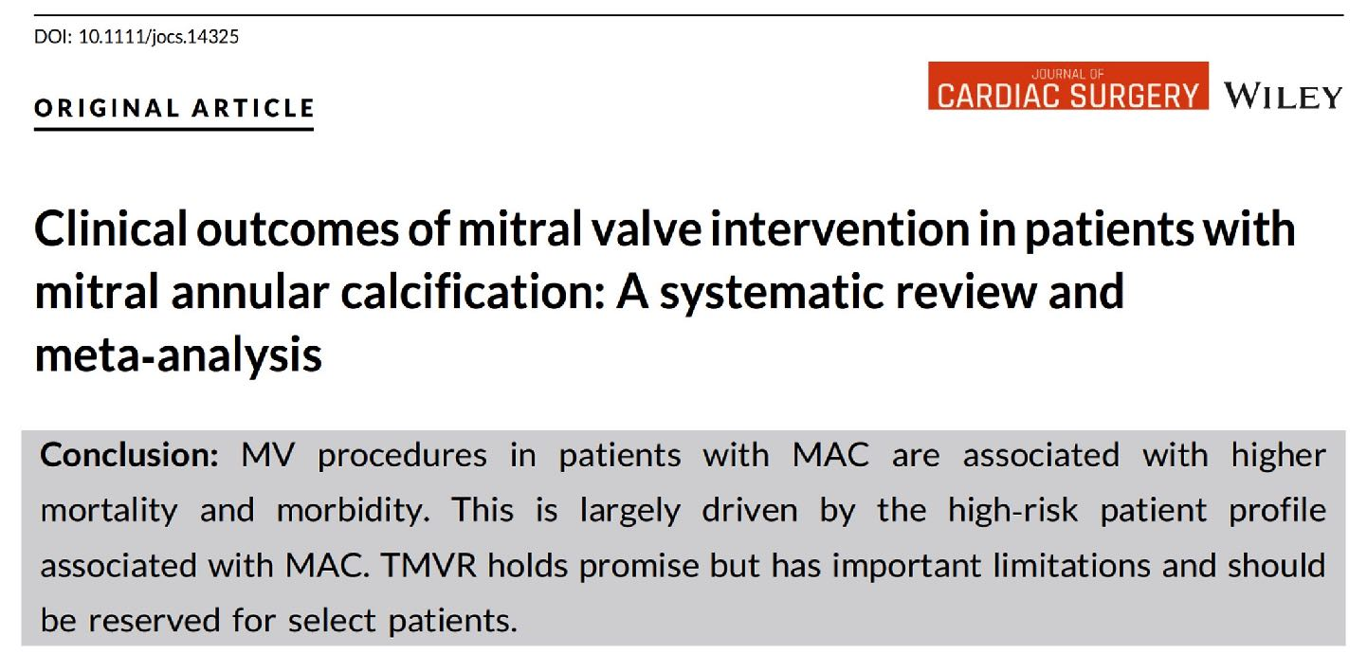

Slide 50
The INTREPID TMVR Program - 2019
APOLLO Trial Expansion, Device Updates, and Transfemoral EFS

Slide 51
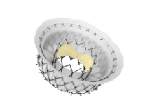
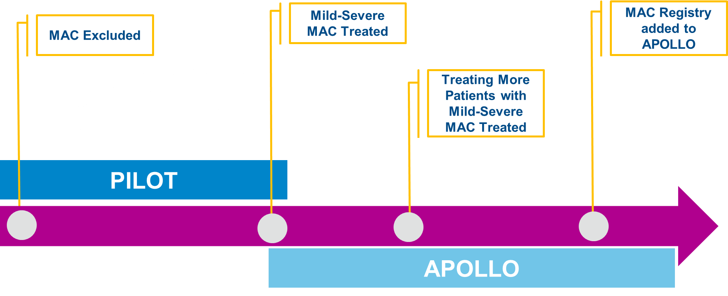
APOLLO Trial Expansion
Single Arm MAC Registry
Leon M, TCT 2019

Slide 52
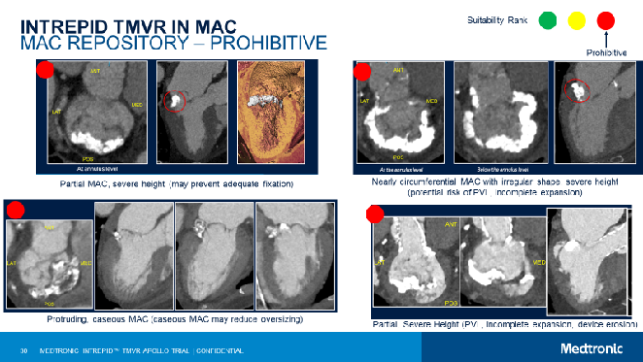
APOLLO Trial Expansion
Single Arm MAC Registry
APOLLO MAC Experience
Careful Additional Anatomic Screening
PATIENTS CONSENTED WITH MAC
276
DISAPPROVED
86
APPROVED
96
MILD
75
MODERATE
18
SEVERE
3
Leon M, TCT 2019

Slide 53
APOLLO Trial Expansion
Edge-to-Edge in the RCT Control Arm
Status Update
Modifying the study design to include a contemporary control (edge-to-edge repair) as part of the trial
Leon M, TCT 2019

Slide 54
Transfemoral EFS
A Complete “System” Modification
Leon M, TCT 2019

Slide 55
Transfemoral EFS
Continuous Innovation
Leon M, TCT 2019

Slide 57
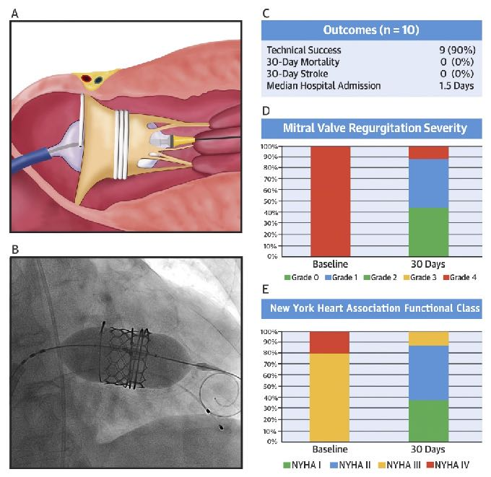
Transseptal Transcatheter Mitral Valve Replacement System
Transseptal TMVR ensemble
Fluoroscopic imaging post-deployment
Selected outcomes at 30 days (n=10)
MR severity at baseline and 30 days
NYHA functional class at baseline and 30 days
Webb et al., J Am Coll Cardiol 2019;73:1239

Slide 58
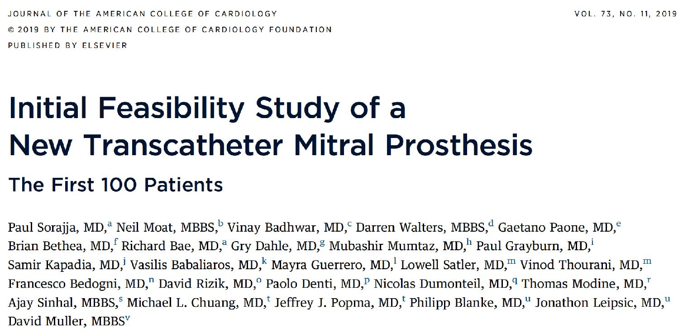

Slide 59
Clinical Outcomes with TMVR with the Prosthesis
Sorajja et al., J Am Coll Cardiol 2019;73:1250

Slide 61
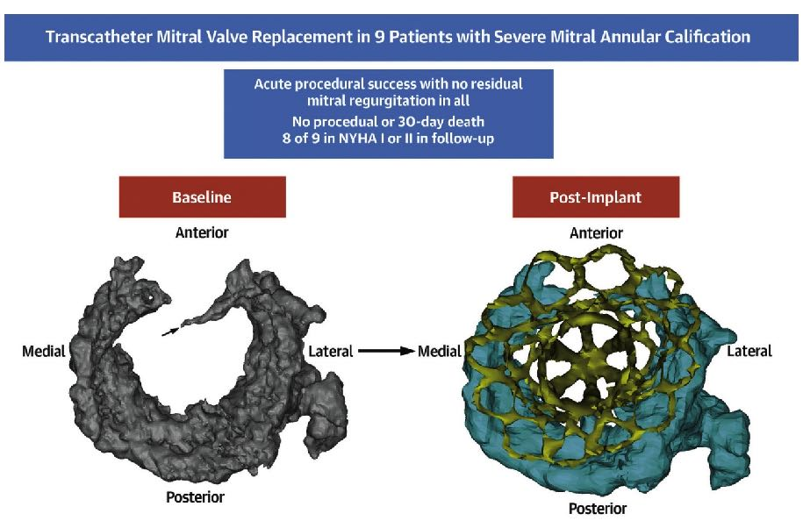
Transcatheter Mitral Valve Replacement in Severe Mitral Annular Calcification
Sorajja et al., J Am Coll Cardiol 2019;74:1431

Slide 62
Take Home Messages
Update in Sapien TMVR for ViV Outcomes
With increasing success of TMVR in ViV amongst various MV diseases, Sapien-3 valve implantation (by trans-septal technique) is poised to become a dominant preferred strategy in treatment of these pts. Technical challenges of smaller neo-LVOT (<170-250mm2) causing LVOT obstruction causing higher MACE remains a major limitation
Newer TMVR devices (Intrepid in APOLLO Trial, Tendyne prosthesis by Abbott, Sapien M3 with Dock) have great promise especially in the setting of MS/MR caused by MAC where current Sapient-3 TMVR has higher short and long-term complication. Currently only one RCT is ongoing comparing newer TMVR device to SMVR (APOLLO trial) in intermediate surgical risk (STS) pts and results will not be available for atleast next 3-5 yrs.

Slide 63
Question # 1
Following are the potential common complications of current TMVR system except:
Paravalvular leak
LVOT obstruction
Valve embolization
Coronary obstructions
Correct answer: D

Slide 64
Question # 2
Following MV disease and procedural techniques have worst outcomes after Sapien TMVR system:
Trans-septal approach
MAC TMVR procedure
ViV TMVR procedure
ViR TMVR procedure
Correct answer: B

Slide 65
Question # 3
Following are the potential predictors of LVOT obstructions during TMVR except:
Smaller neo-LVOT area
Aorto-mitral angle
Displacement of AML
Thin Interventricular septum
Correct answer: D

Slide 66
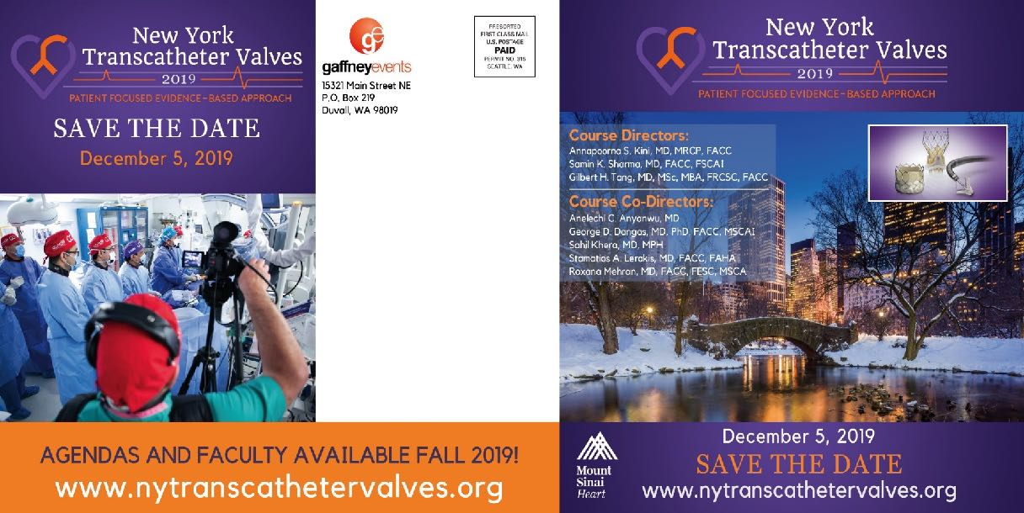
2019 New York Transcatheter Valves

