Slide 1
Division of Endovascular Interventions Mount Sinai Hospital New York 10/23/2019

Slide 2
Patient history
68 F with HTN, DM, hyperlipidemia and smoking.
Presents with BL (L>R), Life style limiting claudication (Rutherford 4) that has progressed to pain at rest.
Medication: Insulin, aspirin, Amlodipine, metoprolol, Lisinopril, atorvastatin and Cilastazol
ABI with exercise: (R): 0.95 and 0.89(L): 0.92 and 0.67
US: Long segment occlusion of the left SFA, patent vessels below the knee.

Slide 3
PRIOR ANGIOGRAMS

Slide 4
STRATEGY AND APPROACH
Contralateral CFA access vs Ipsilateral Pedal access
Wire-catheter technique for lesion crossing
True-lumen vs Sub-intimal Tracking and Reentry
Switching to a 035 wire for intervention
Balloon Angioplasty
Stenting depending on the results

Slide 5
SFA CTO INCIDENCE
SFA CTOs lesions are frequently encountered (40-50%) in patients with claudication and CLI; however, those with CLI often have multilevel occlusions.
CTO revascularization of the SFA is feasible with the use of wire catheter and dedicated CTO crossing and re-entry devices in indicated patients with medically refractory claudication or advanced limb ischemia.

Slide 6
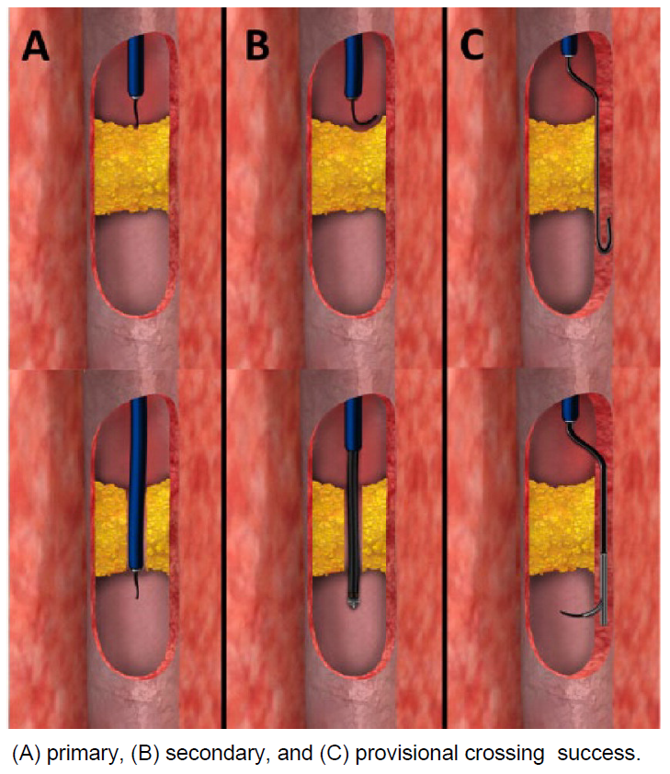
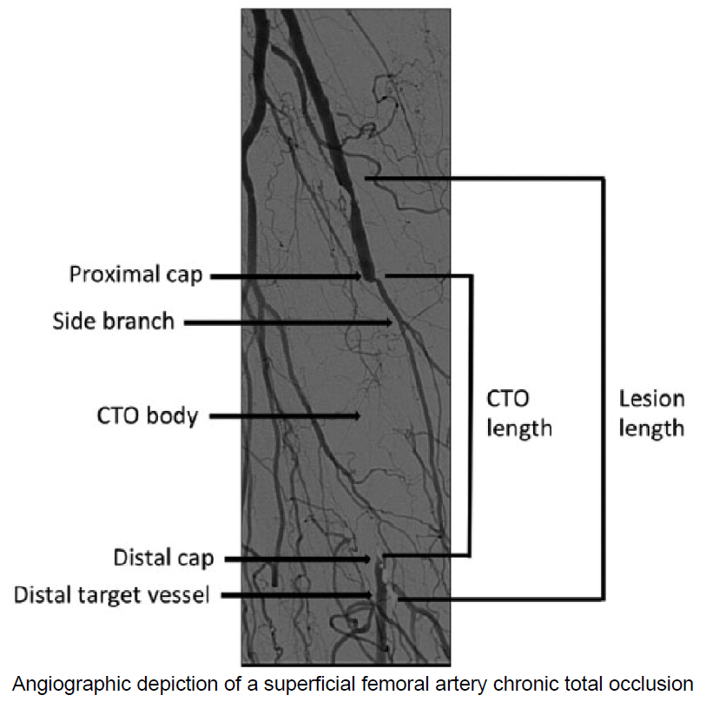
SFA CTO Crossing techniques
Wire-Catheter Technique
Crossing Devices
Sub-Intimal Tracking
J Endovasc Ther. 2015 Aug;22(4):525-34.

Slide 7
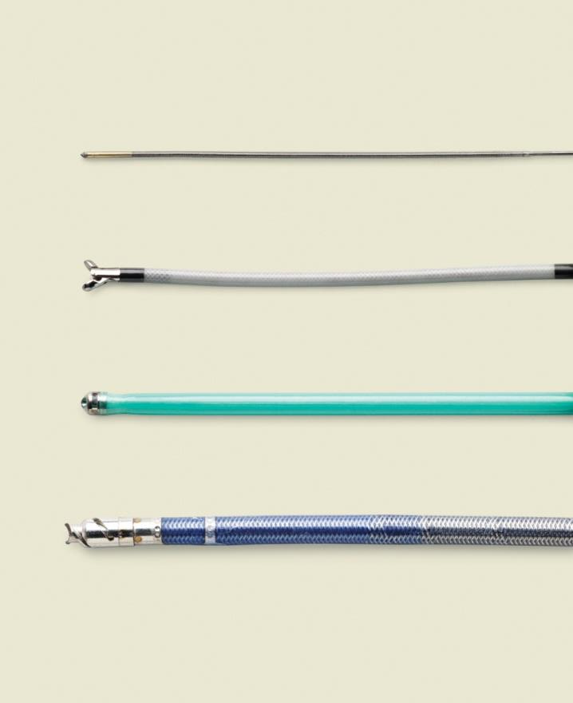
Crossing devices (true lumen)
TruePath
Front Runner
Crossing devices
Gentle forward pressure
Let device do the work
Exploit micro-channels
Mechanical or vibrational energy to break up calcium
Crosser
WildCat

Slide 8
Treatment options
Endoprosthesis
Plain Balloon Angioplasty
Drug Coated Balloon Angioplasty
Bare Metal Stent
Drug Eluting Stent

Slide 9
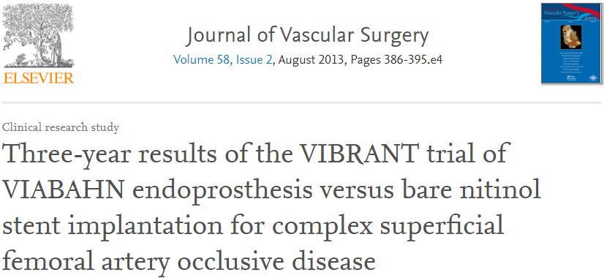
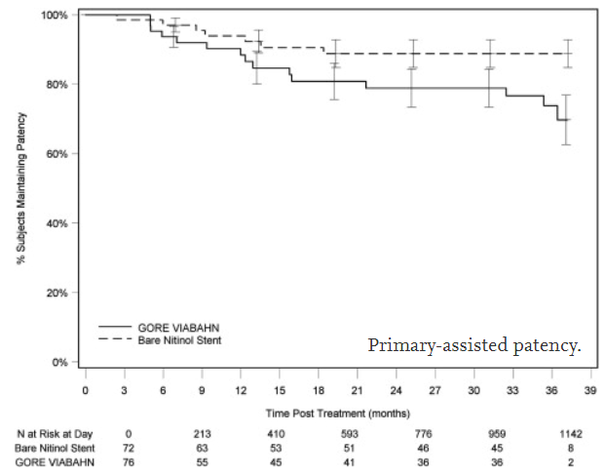
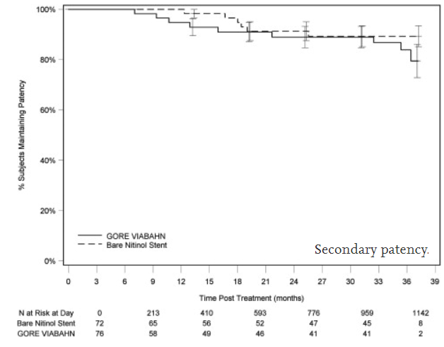
ENDOPROSTHESIS vs BMS
Randomized Multicenter Trial, 3 year outcome
148 Pts, complex SFA disease (TASC C/D), > 8 cm lesion length.
Bare nitinol stent implantation (76 patients) or nonheparin-bonded VIABAHN endoprosthesis deployment (72 patients).
Prespecified 36-month data showed no significant difference in restenosis rates (Viabahn 24.2% vs. bare nitinol stent 25.9%; p = 0.392).
Primary-assisted patency higher for bare nitinol stents (88.8% vs 69.8%; P = .04).
Secondary patency rates did not differ between nitinol stent and stent graft recipients (89.3% vs 79.5%; P = .304).

Slide 10
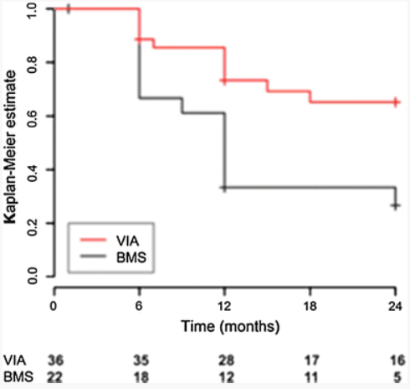
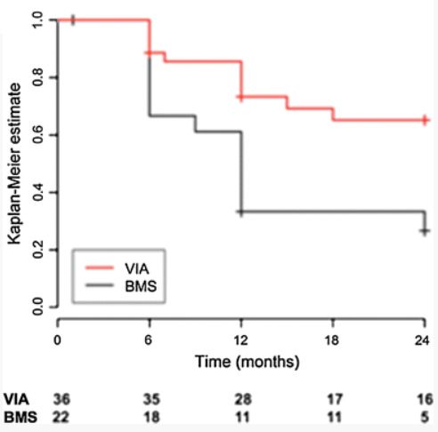
ENDOPROSTHESIS VS BMS
Prospective, randomized, single-blind, multicenter study.
141 patients with symptomatic peripheral arterial disease.
Primary patency in lesions ≥20 cm at 24 months was 65.2 (VB) vs 26.7% (BMS ,p=0.004).
Freedom of re-intervention (TLR and bypass surgery) in lesions ≥20 cm was 80 (VB) vs 61.9 %(BMS) (p=0.13)
For Long SFA lesions, VB showed improved primary patency over BMS without impact on TLR or clinical outcomes.

Slide 11
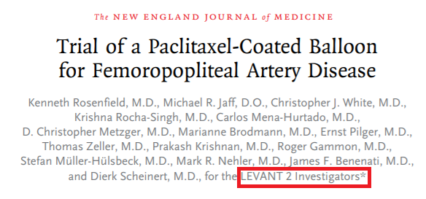
DCB vs PTA DATA
Although Use of DCB has been called into question due to the recent signal associated with mortality. DCB angioplasty application in long , calcified and complex lesions has shown remarkable maintenance of upto 12-month of primary patency with reduced bailout stent rates
LEVANT 2 TRIAL:
Single-blind randomized trial, 476 patients with IC or ischemic pain.
2:1 Randomization to paclitaxel-coated balloon or PTA.
The 12-month rate of primary patency with DCB angioplasty was superior to conventional angioplasty (65.2% vs. 52.6%, p = 0.02)
No differences in functional outcomes, death, amputation, thrombosis, or re-intervention.
IN.PACT SFA TRAIL:
331 patients with symptomatic (RC 2/4) Fem-Pop lesions up to 18 cm in length.
2:1 ratio to treatment with DCB or PTA upto The 24-month.
Primary patency for DCB 78.9% vs. 50.1%; p < 0.001
CD-TLR were 9.1% and 28.3% (p < 0.001) for the DCB
Both groups showed similar functional improvement at 2 years

Slide 12
CONCLUSION
Recanalization of long occlusive SFA disease, while challenging, is now possible in >95% of cases due to the availability of advancement in new wires, crossing and re-entry devices.
Polytetrafluoroethylene (PTFE)-covered nitinol stents (e.g., Viabahn) are useful as a bailout for perforations or the treatment of long and ISR lesions.
With longer lesions (i.e., >5 cm), stenting traditionally has performed superior to angioplasty alone and should be favored.
For ostial SFA lesions or disease that extends into the popliteal artery, where stenting should be avoided, atherectomy low-pressure angioplasty (2-4 atm) may be preferred strategy.

Slide 13
THANK YOU

