Slide 1
Division of Endovascular Interventions Mount Sinai Hospital New York 08/28/2019

Slide 2
Patient history
59 Male with
HTN, IDDM, CAD (PCI-LAD/6-19), smoking
P/W worsening B/L Caludication (½ block), Rutherford 4, on OMT failed exercise therapy
ASA, Clopidogrel, Atenalol, Losartan, Ranolazine, Rosuvastatin, Omeprazole, Insulin
ABI (R) 0.68 (L): 0.79

Slide 3
Non-invasive Imaging
R=Profunda: 50-99% stenosis;
SFA: Proximal to mid SFA is occluded and reconstitutes in the distal vessel. Long segment occlusion.
L=Profunda: 50-99%;
SFA: Small-segment occlusion of the mid to distal SFA.
There is a 50-99% stenosis in the distal vessel.

Slide 4
Previous angiogram
SFA PROX
SFA DISTAL

Slide 5
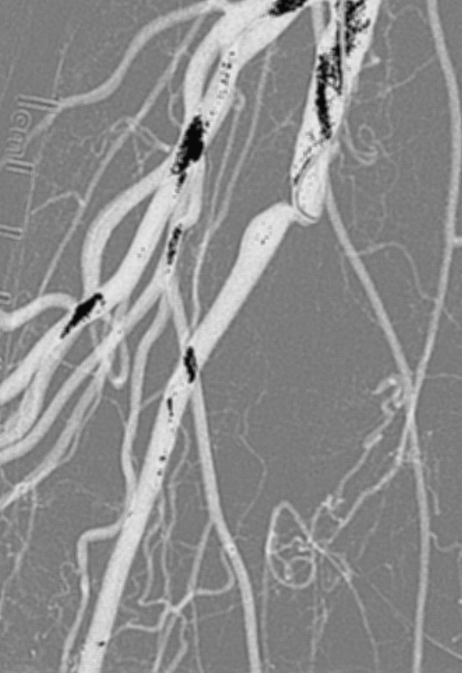
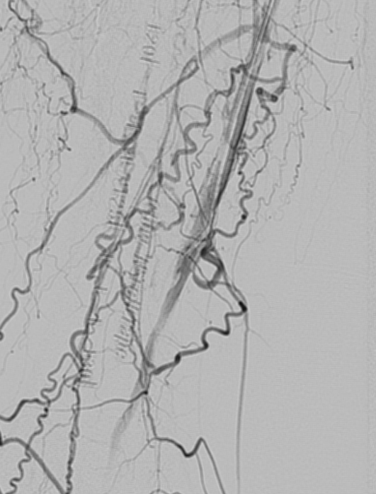

Slide 6
Strategy
Contralateral CFA access vs Ipsilateral Pedal access
GlideWire with catheter support
True-lumen vs Sub-intimal Tracking and Reentry
Switching to a 014 wire for intervention
Atherectomy (directional)
PTA
IVUS guided Stenting

Slide 7
Fem-pop arteries CTO
CTOs frequently are encountered (40-50%) in the SFA distribution of patients with claudication and CLI; however, those with CLI often have multilevel occlusions.
CTO revascularization of the SFA is feasible with the use of wire catheter and dedicated CTO crossing and re-entry devices in indicated patients with medically refractory claudication or advanced limb ischemia.

Slide 8
Approach for endovascular treatment of femoropopliteal CTO
J INVASIVE CARDIOL 2019;31(4):111-119.

Slide 9
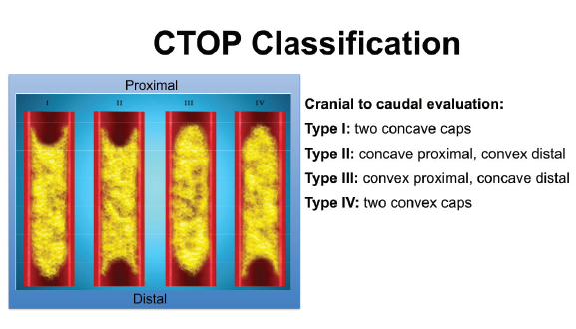
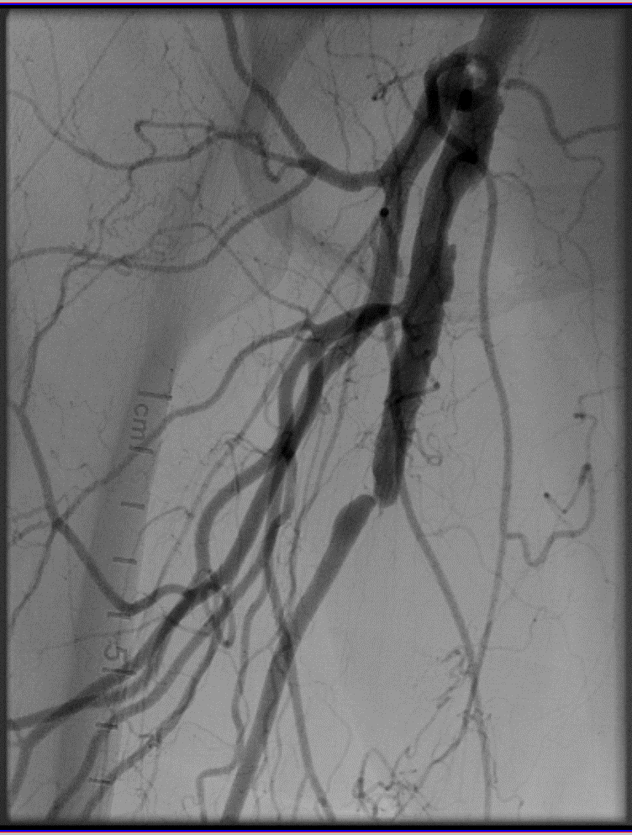
Classification of CTO based on morphology
J INVASIVE CARDIOL 2019;31(4):111-119.

Slide 10
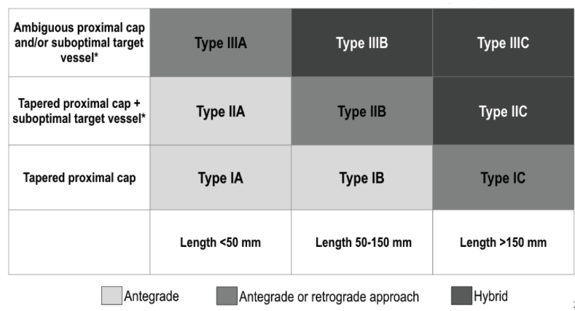
FP CTO Classification & Initial Crossing Approach
J INVASIVE CARDIOL 2019;31(4):111-119.

Slide 11
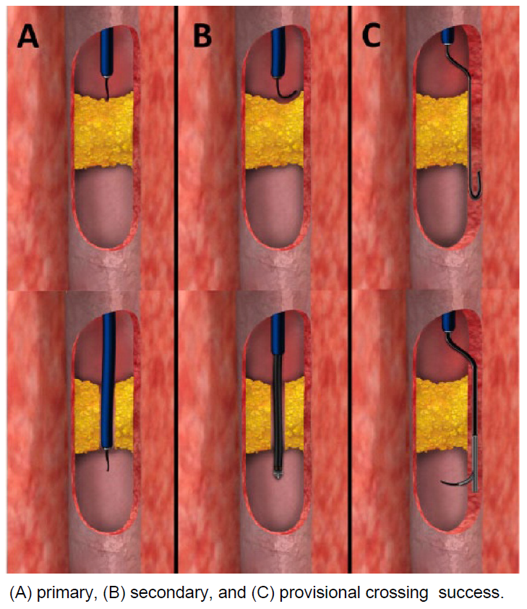
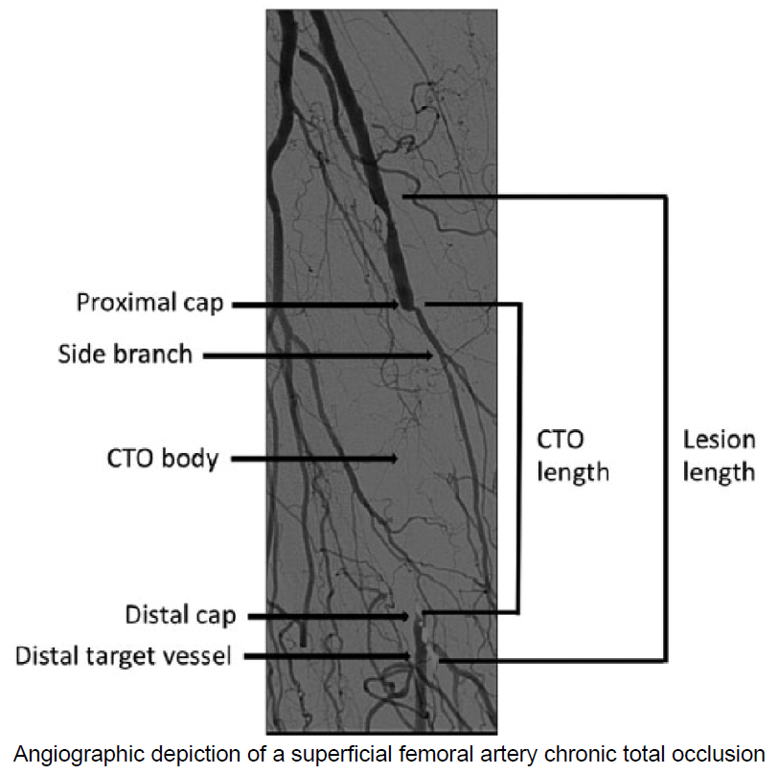
SFA CTO Crossing techniques
J Endovasc Ther. 2015 Aug;22(4):525-34.

Slide 12
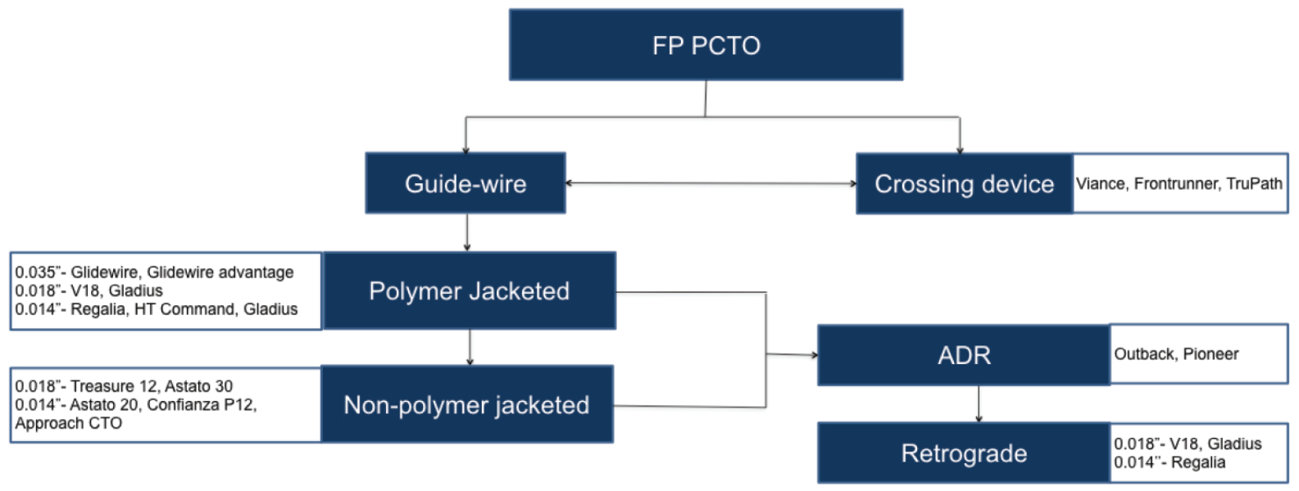
Equipment Selection:
0.035" PLATFORM
Designed to provide highest support & stability
Compatible with most SFA balloons/stents
0.018" PLATFORM
Least Traumatic
More steerable and flexible
0.014" PLATFORM
Least Traumatic
Least support
Re-Entry
J INVASIVE CARDIOL 2019;31(4):111-119

Slide 13
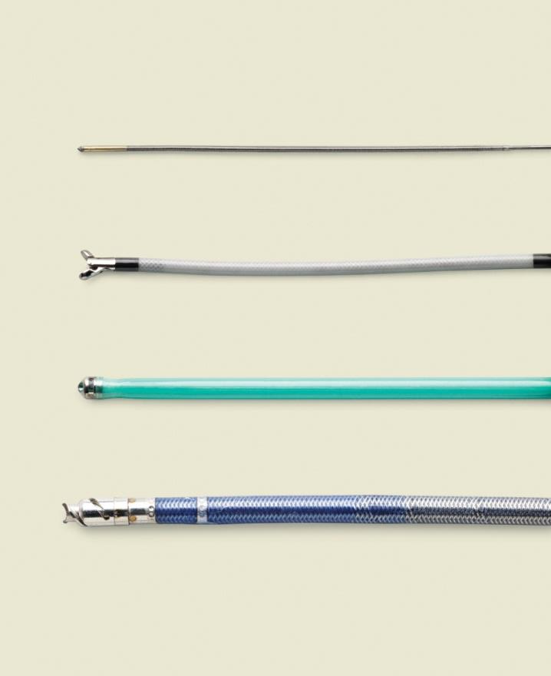
Crossing devices (true lumen)
TruePath
Front Runner
Crossing devices
Gentle forward pressure
Let device do the work
Exploit micro-channels
Mechanical or vibrational energy to break up calcium
Crosser
WildCat

Slide 14
Sub-Intimal Dissection with Re-Entry
Enteer
Pioneer
Re-entry often occurs at transition to healthy vessel
Re-entry devices can assist this process:
Outback (Cordis)
Enteer (Medtronic)
Off-Road (Boston Scientific)
Pioneer (Volcano)
Outback
Off-Road

Slide 15
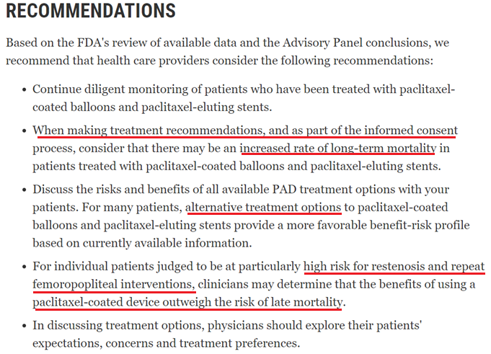

Slide 16
Bare metal stents:
Supera interwoven nitinol stent
Nitinol stent studies
Vascular Health and Risk Management 2015:11

Slide 17
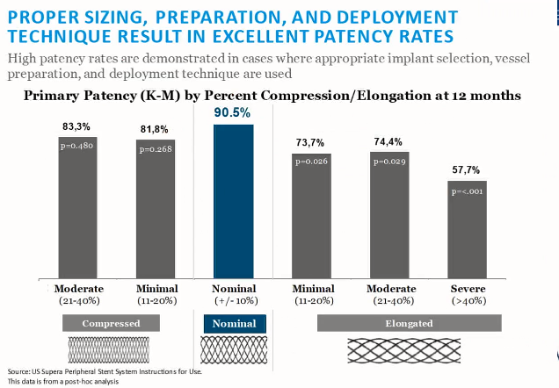
Supera stent (BMS):
Source: US Supera Peripheral Stent System Instructions for US
Post-hoc analysis

Slide 18
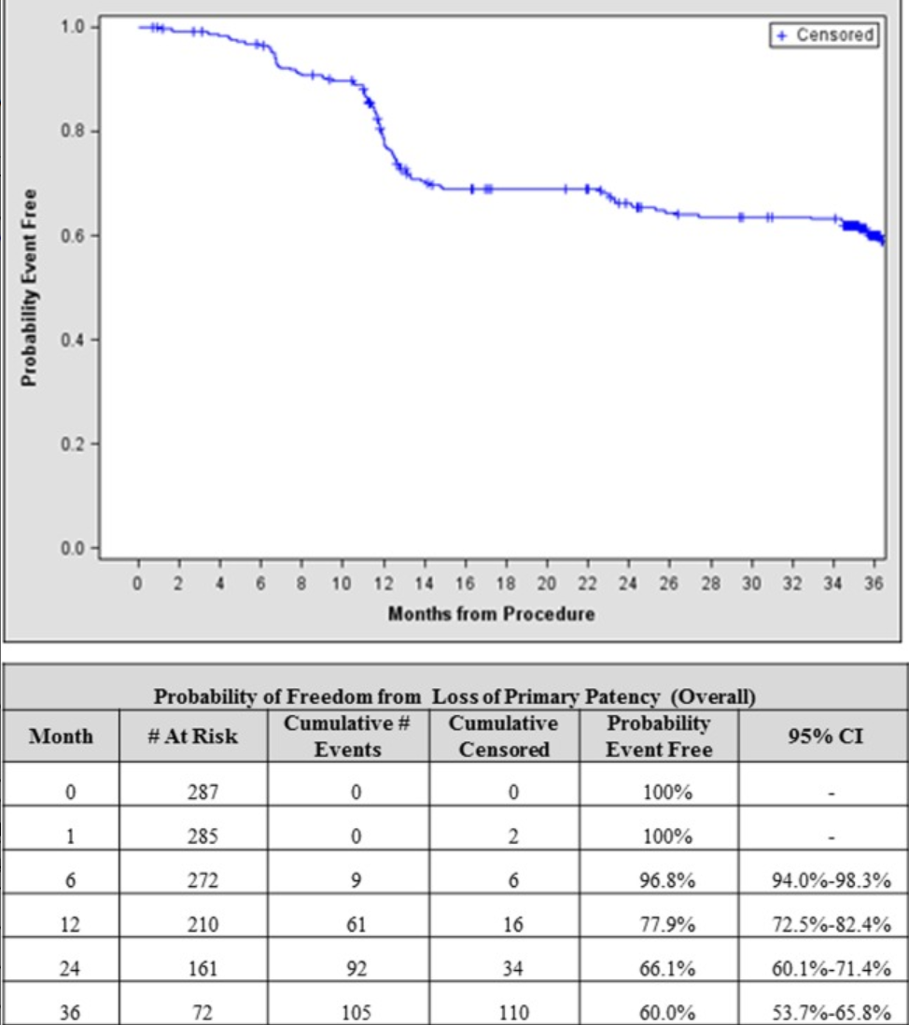
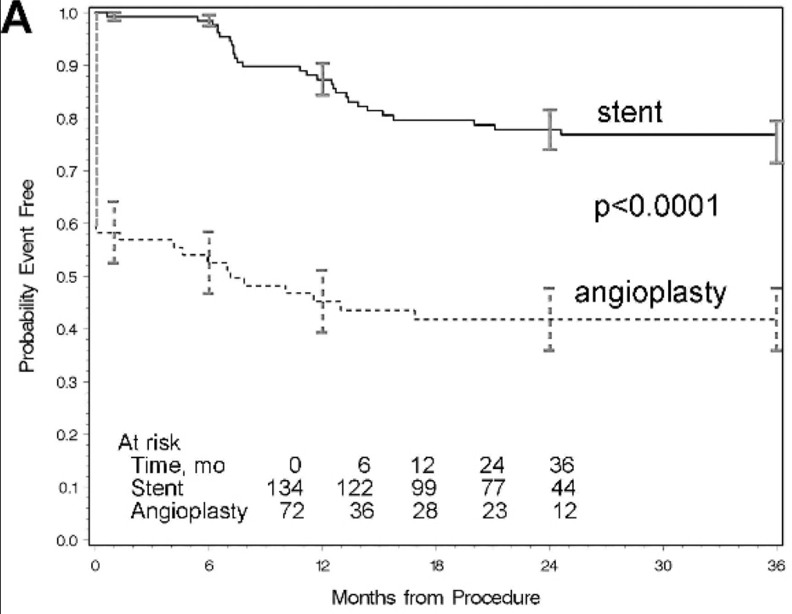
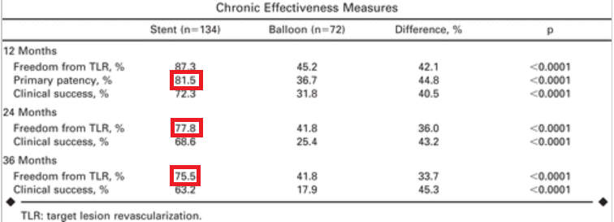
DURABILITY II - primary 3 year
EverFlex Self-expanding Peripheral Stent
J Vasc Surg. 2015 Jul;58(1):73-83
RESILIENT TRIAL - 3 year Follow up
LifeStent™ Vascular Stent
J Endovasc Ther. 2012 Feb;19(1):1-9

Slide 19
Acknowledgement:
Serder Farhan
Rheoneil Lascano
Prakash Krishnan

