Slide 1
Division of Endovascular Interventions Mount Sinai Hospital New York 06/19/2019

Slide 2
Patient history
74 year old female Patient has She underwent diagnostic angiogram and attempted (failed) intervention of right AT CTO.
Complains of a non-healing wound on the tip of the great toe despite GDMT (Rutherford 5)
PMH: HTN, HLD, DM2 (Insulin therapy), Hypothyroidism.
Medication: insulin, semaglutide, aspirin, Amlodipn, metoprolol, aldactone, pravastatin, synthroid.

Slide 3
Non-invasive Imaging
ABI:
R 0.53 abd L 0.61
Vascular US
Severe atherosclerotic plaque in the AT

Slide 4
Previous angiogram

Slide 5
CLI
It is defined by the presence of rest pain and/or tissue loss for at least 2 to 4 weeks that can be attributed to occlusive arterial disease.
Approximately 120,000 amputations are performed annually
The estimated lifetime direct healthcare cost for an amputee patient is $794,027
When aggregated for the total number of lower extremity amputation patients annually, the expected lifetime cost is estimated at roughly $95.2 billion USD
1 year after primary treatment for CLI
Eur. J. Vasc. Surg. 6 (Suppl. A), 1–32 (1992)
Norgren. (2008). JVS; 45,1, Suppl S

Slide 6
Diagnostic approach for CLI
Circulation. 2017;135:e726–e779

Slide 7
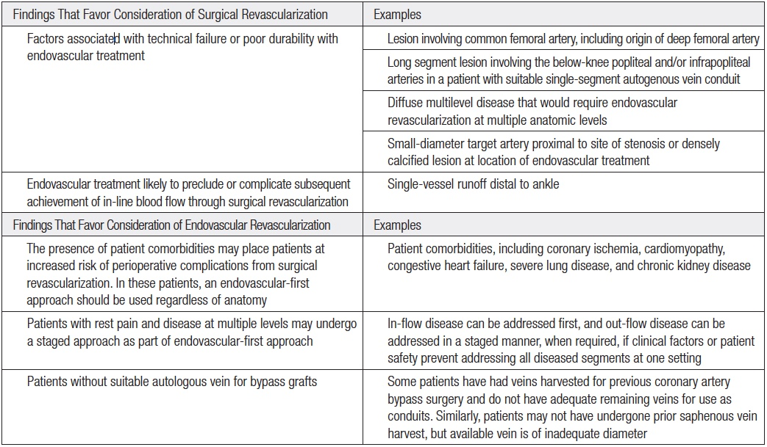
Therapy for CLI: Findings That Prompt Consideration of Surgical or Endovascular Revascularization
Circulation. 2017;135:e726–e779

Slide 8
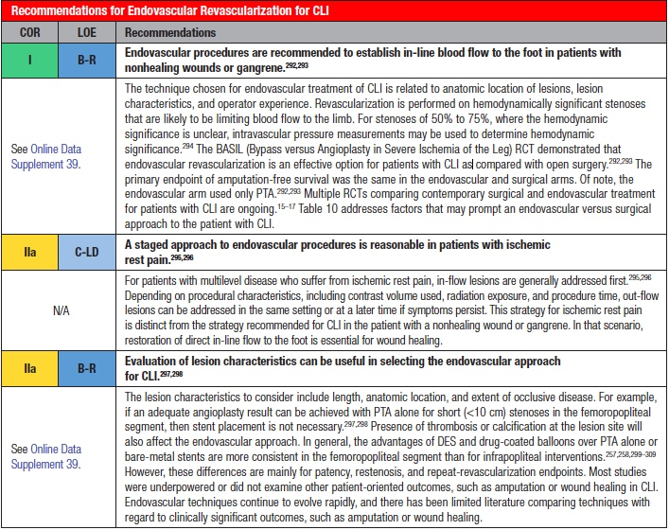
ACC/AHA guideline recommendation for treatment of PAD
Circulation. 2017;135:e726–e779

Slide 9
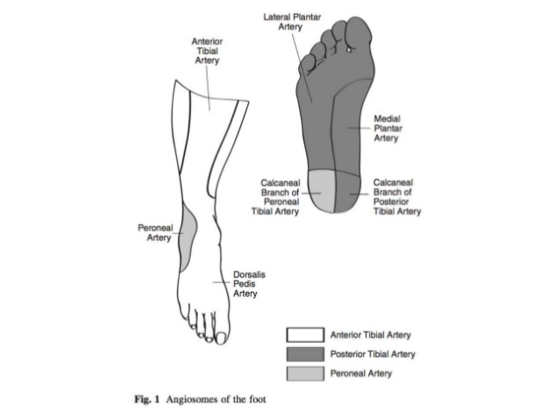
ACC/AHA guideline recommendation for treatment of PAD
Circulation. 2017;135:e726–e779

Slide 10
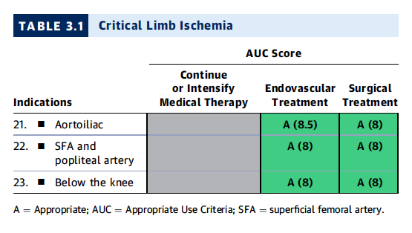
ACC/AHA/SCAI/SIR/SVM 2018 Appropriate Use Criteria for Peripheral Artery Intervention
JACC. 2019 Jan 22;73(2):214-237

Slide 11
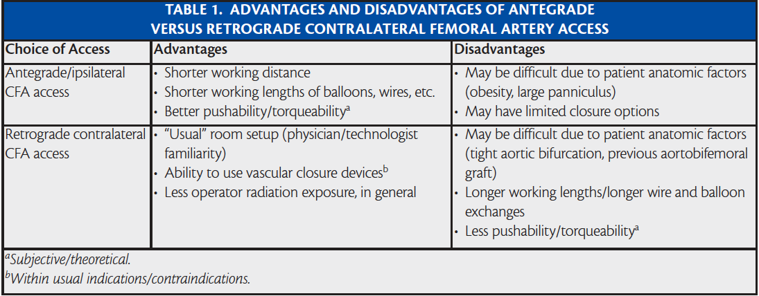
Access: CFA ante- vs. retro-grade

Slide 12
Tibiopedal access

Slide 13
Patient selection for tibiopedal access
Advanced PAD or CLI
Inability to lie flat for prolonged periods of time (severe osteoarthritis, lower back pain, CHF, COPD)
Hostile groins: morbid obesity, infected groins, severely scarred/ fibrotic groins.
Flush occlusion of the ostium of the SFA
The proximal CTO cap has an antegrade convex morphology.
Long suprapopliteal CTO

Slide 14
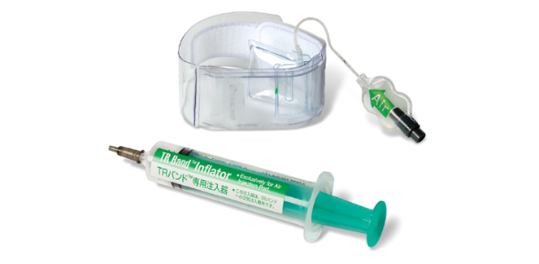
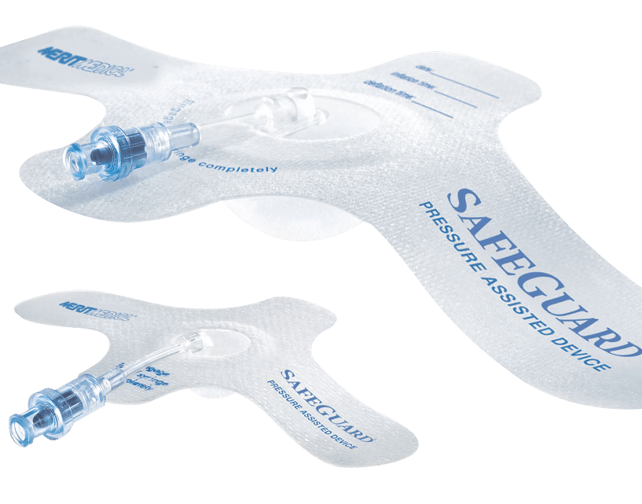
Important steps to consider for tibiopedal access
Puncture site selection (US or Flouroscopy guidance)
Vasodilators (NTG and verapamil)
Puncture needle (21-gauge perhaps echogenic needle)
Sheath (3-Fr micropuncture sheath)
Catheter microcatheter
OTW balloons are also recommended since they give the abilty to dilate the corssed lesion (single-marker 1.5/20mm)
Wires: 0.018 (recommended) or 0.014
Rendezvous: pedal access wire externalization either manipulate into guide-cathter or snare
Access site hemostasis: manual compression, TR-band or safegurad
Semin Intervent Radiol. 2014 Dec; 31(4): 313–319.

Slide 15
BTK Clinical Challenges
Smaller Vessels
Vast majority of BTK cases involve Calcium
Large # of CTOs
Diabetic patients
Vessel Tortuosity
Distal Embolization is a big concern

Slide 16
Treatment options
Plain Balloon Angioplasty
Drug Coated Balloon Angioplasty
Bare Metal Stent
Drug Eluting Stent
Atherotomy/Atherectomy

Slide 17
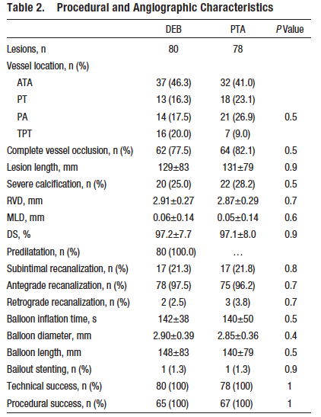
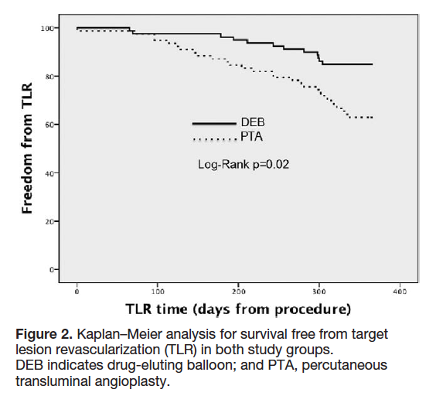

Slide 18
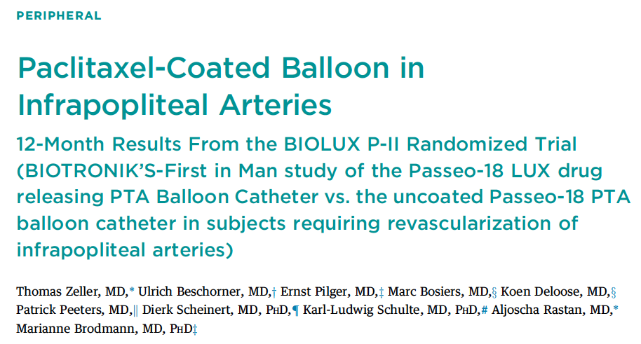
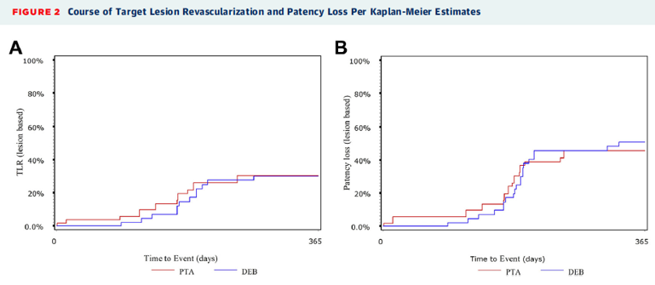
JACC interv. 2015 Oct;8 (12):1614-22

Slide 19
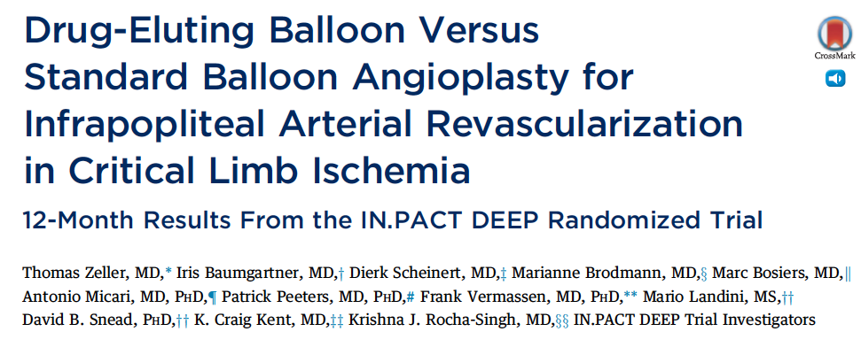
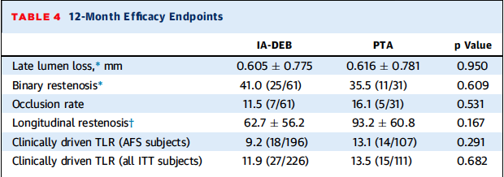
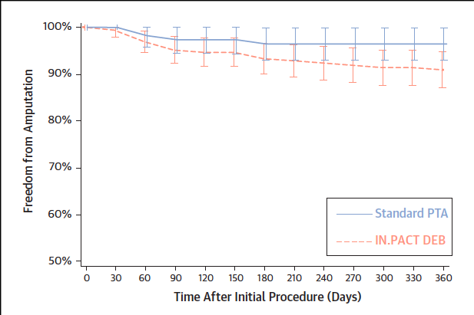
Prospective Randomized Independently adjudicated and Monitored trial of infrapopliteal therapy for critical limb ischemia
JACC 2014 Oct 14;64(15):1568-76

Slide 20
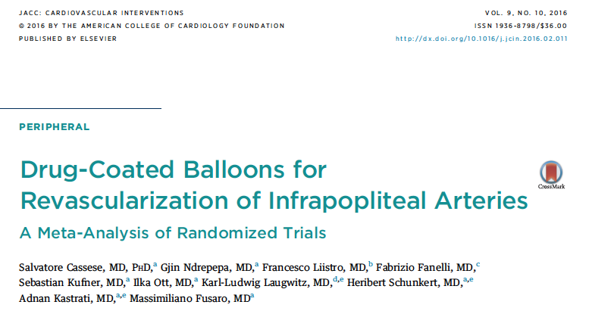
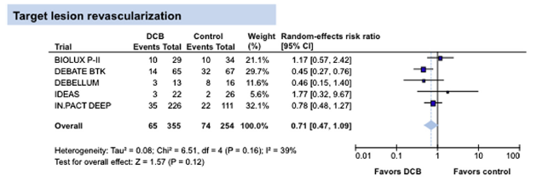
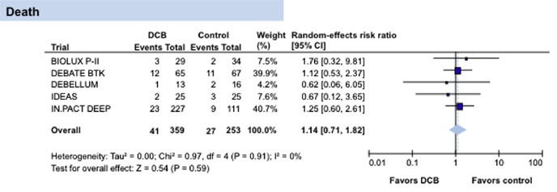

Slide 21
Randomized trials for DES-BTK
Achilles
Sirolimus eluting (Cypher) stent vs. POBA
Yukon
Sirolimus eluting (Yukon/no polymer) stent vs. BMS
Destiny
Everolimus eluting stent (Xience) vs. BMS (Multilink Vision)
JACC 2012, 60: 2290-2295
JACC 2012, 60: 587-91
JVS 2012, 55: 390

Slide 22
Summary of DES-BTK randomized trials 12 month Patency
Trial DES PTA/BMS Lesion length
Achilles 80.6% 58.1% 25-27mm
Yukon 80.6% 55.6% 31mm
Destiny 85.2% 54.4% 16-19mm
JACC 2012, 60: 2290-2295
JACC 2012, 60: 587-91
JVS 2012, 55: 390

Slide 23
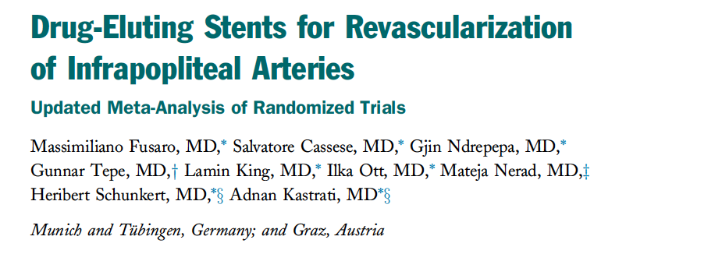
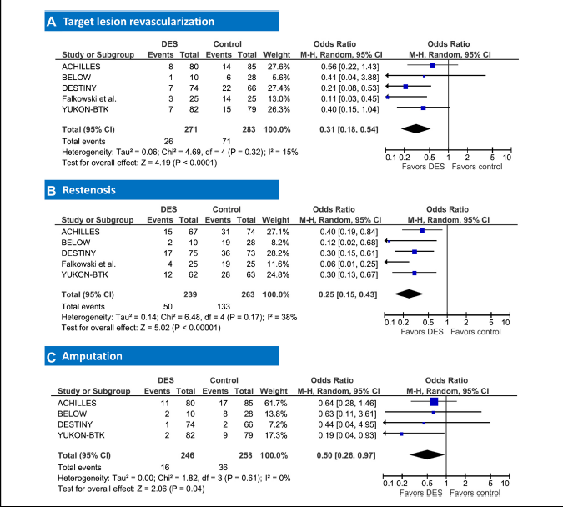
JACC interv. 2013;6(12):1284-93.

Slide 24
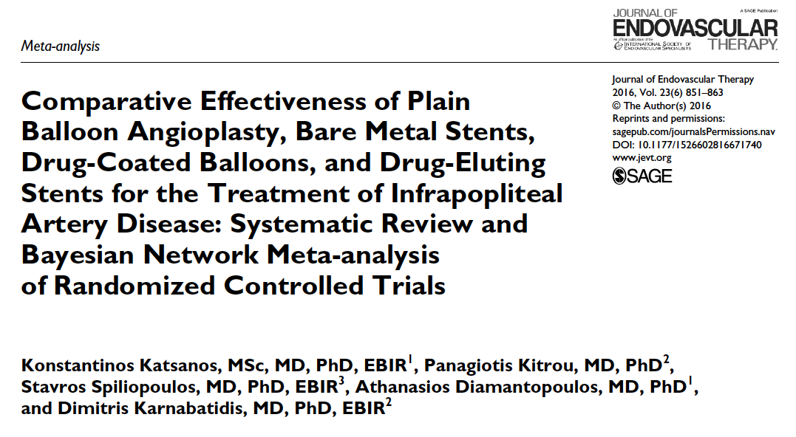
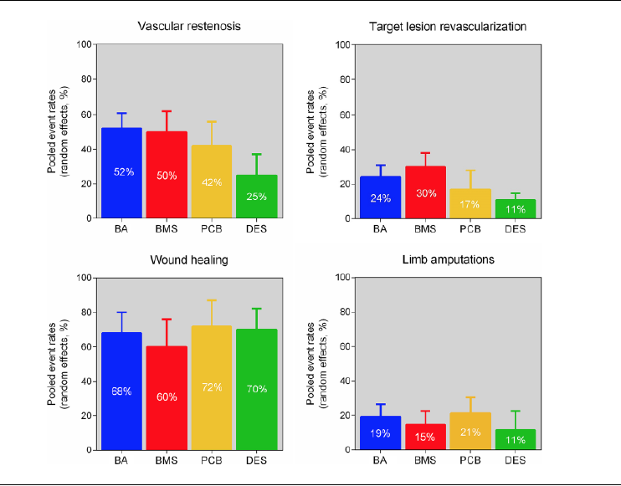

Slide 25
Role of vessel Preparation
Modification or debulking of plaque facilitating passage of devices
Reducing bail-out stenting
Improving clinical outcome

Slide 26
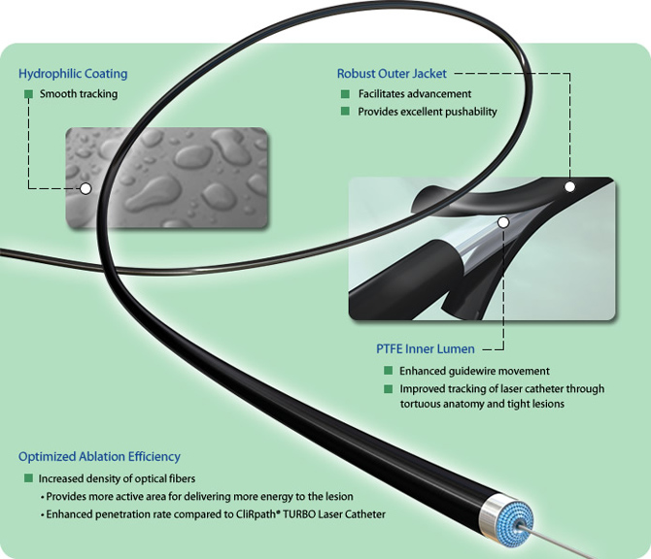
Atherectomy Devices BTK
CVX-300 Excimer laser (Spectranetics)
LACI trial
Multicenter, prospective trial
145 patients, 155 CLI-limbs
Laser + POBA
41% in BTK
45% bailout stenting in toto, 16% BTK
Procedural success rate 86%
LSR @6m : 93%
Laird JR et al, J Endovasc Ther 2006 Feb;13(1):1-11.

Slide 27
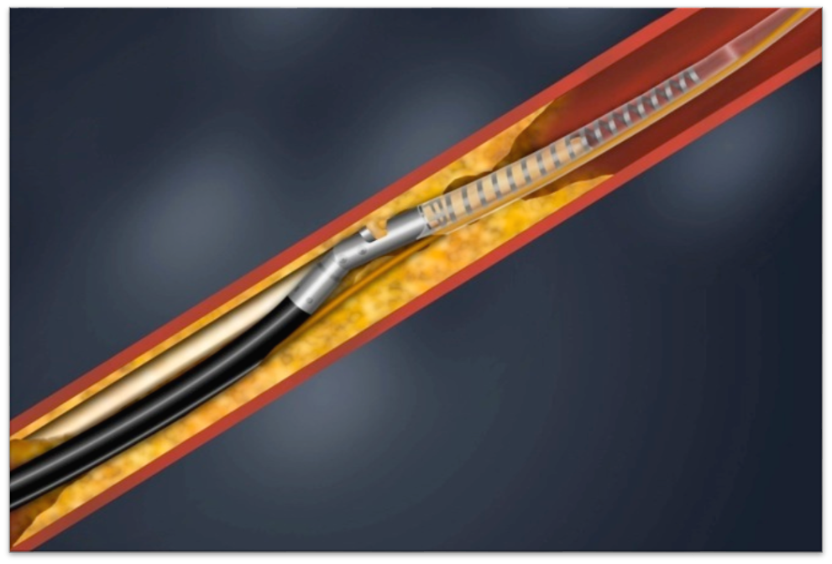
Atherectomy Devices BTK
Excisional Atherectomy (SilverHawk/TurboHawk; Covidien-Medtronic)
DEFINITIVE LE trial
800 Patients | 47 Centers
Characteristics | CLI (RCC 4-6)
Number of Patients | 201
Number of Lesions | 279
Mean Length (cm) | 7.2
Baseline Stenosis (%) | 76
Occlusions (%) | 30
SFA | 48% (135)
Popliteal | 17% (48)
Infrapopliteal | 34% (96)
Claudication 598 Patients* |  | Critical Limb Ischemia 201 Patients
Primary Patency by Duplex US at 12 months |  | Freedom From Major Unplanned Amputation at 12 months
33% post-atherectomy POBA
MC Kinsey JM et al. JACC CardioVasc Int, 2014 Aug;7(8):923-33.

Slide 28
Atherectomy Devices BTK
Excisional Atherectomy (SilverHawk/TurboHawk ; Covidien-Medtronic)
DEFINITIVE LE trial
Primary patency (PSVR < 2.4) : 71%
Wound healing % @ 3-6-12 m : 52%-61%-72%
Limb Salvage @12m : 95%
Especially in diabetics promising results
MC Kinsey JM et al. JACC CardioVasc Int, 2014 Aug;7(8):923-33.

Slide 29
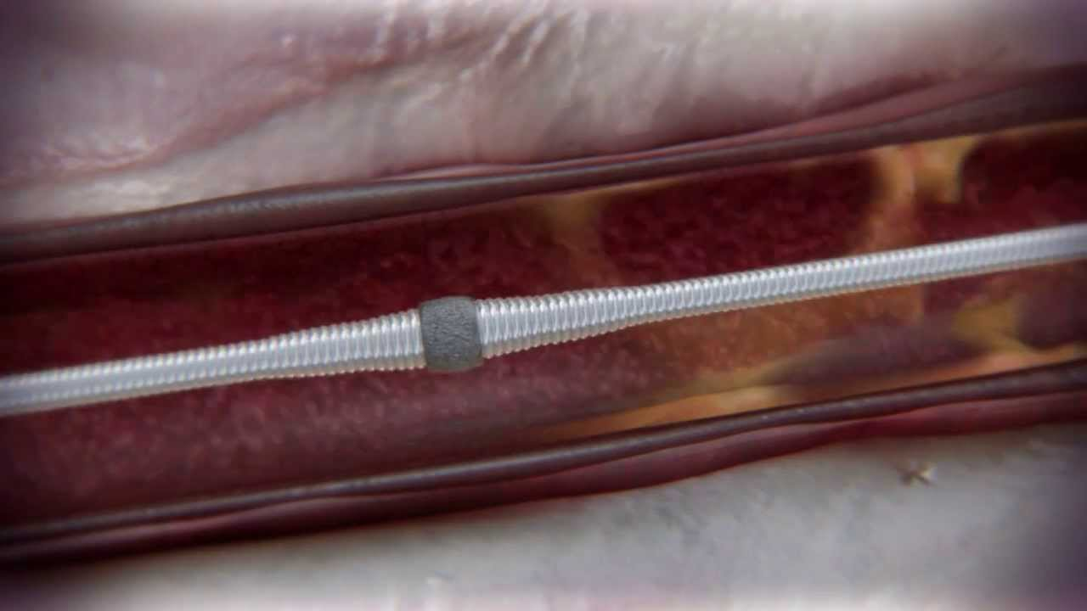
Atherectomy Devices BTK
Orbital atherectomy (Diamondback 360° ; Cardiovascular Systems)
Calcium 360 randomized pilot trial
Multicenter, randomized, prospective trial
50 patients, PA + BTK lesions
RB classification 4-6
Orbital atherectomy + POBA vs POBA
Shammas NW et al. J Endovasc Ther 2012, Aug;19(4):480-8

Slide 30
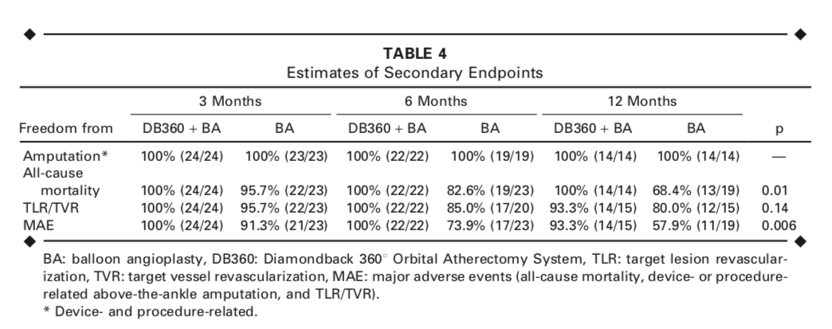
Atherectomy Devices BTK
Orbital atherectomy (Diamondback 360°; Cardiovascular Systems)
Calcium 360 randomized pilot trial
Shammas NW et al. J Endovasc Ther 2012, Aug;19(4):480-8

Slide 31
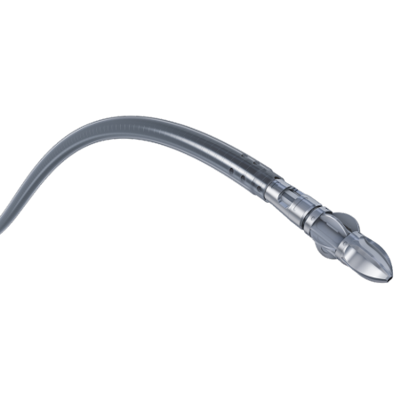
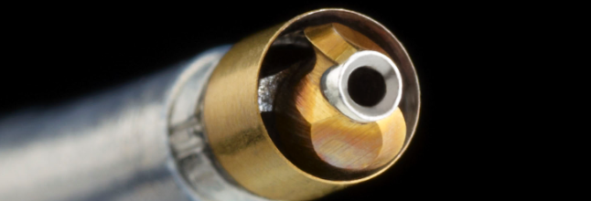
Debulking Devices BTK
Rotational atherectomy (JETstream, Boston Scientific ; Phoenix atherectomy cath, Volcano corp)
No specific data related to specific BTK use
(JET registry ; EASE registry)

Slide 32
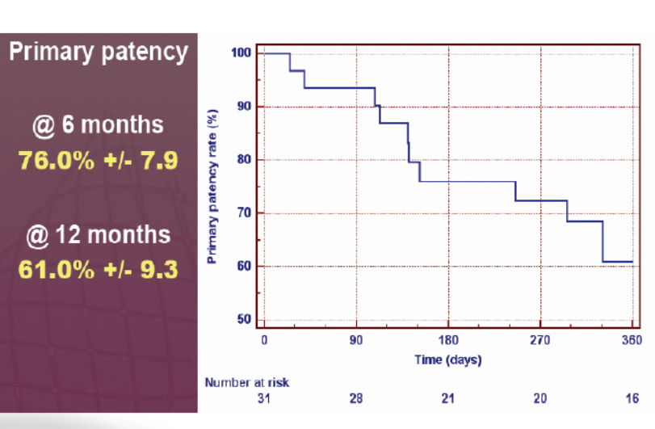
Atherotomy: Angiosculpt

Slide 33
Athrotomy: Chocolate™ PTA Balloon Catheter

Slide 34
Athrotomy: Chocolate™ PTA Balloon Catheter

Slide 35
Athrotomy: Chocolate™ PTA Balloon Catheter

Slide 36
Thank you

