Slide 1
Structural Heart Live Cases
Supported by:
Edwards Lifesciences
Bard Inc
Terumo Medical Corp

Slide 2
Disclosures
Samin K. Sharma, MD, FACC
Speaker’s Bureau – Boston Scientific Corp., Abbott Vascular Inc, ABIOMED, CSI
Annapoorna S. Kini, MD, FACC
Nothing to disclose
Farzan Filsoufi, MD, CT Surgeon
Nothing to disclose
Gilbert Tang, MD: Moderator
Physician proctor for Edwards Lifesciences

Slide 3
March 12th 2019- Structural Heart Live Case #28: KS, 79 yo M
Presentation: Severe dyspnea on exertion NYHA Class III x 3 months
PMH: Bentall procedure (2011) with 25 mm Carpentier-Edwards pericardial valve (Perimount 2700) inside 30 mm Hemashield tube for symptomatic bicuspid aortic stenosis and dilated ascending aorta, Atrial Fibrillation, Hypertension, Dyslipidemia
Medications: Warfarin, Digoxin, Carvedilol, Simvastatin, Furosemide, Pantoprazole, Doxepin, Lisinopril
Labs: Hgb 10.1, PLT 275, K 4.7, Cr 1.1, INR 1.9
EKG (3/04/19): AF, LBBB
Cath (12/31/18): Non-obstructive coronaries
TEE (01/10/19): EF 35%, moderate to severe trans-valvular aortic regurgitation with degenerative leaflets, mild MR, mild TR, possible small thrombus in LAA

Slide 4
Trans-Esophageal Echo (TEE)
Severe trans-valvular AR with eccentric jet
Severe trans-valvular AR

Slide 5
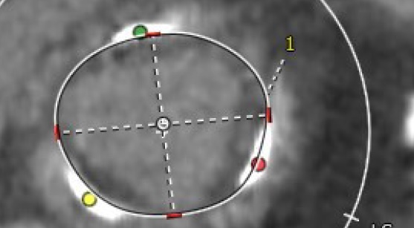
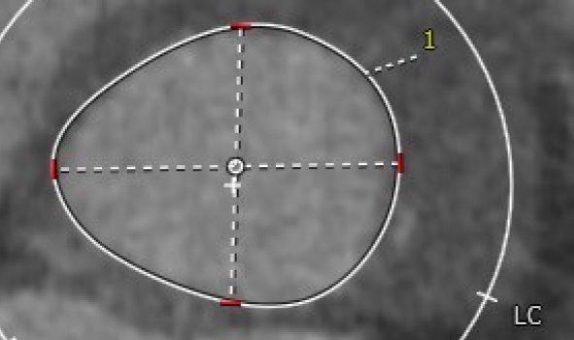
CTA: Aortic Annulus and LVOT
Annulus and LVOT
Aortic Annulus
Max: 25.7 mm
Min: 22.1 mm
Mean: 23.9 mm
Perimeter = 76 mm
Area = 454.8 mm²
LVOT
Max: 25.6 mm
Min: 31.1 mm
Mean: 28.3 mm
Perimeter = 88.9 mm
Area = 611 mm²
Annulus: 22.1x25.7 mm
Area: 454.8 mm2 Perimeter: 76 mm
LVOT: 25.6X31.1 mm
Area: 611 mm2 Perimeter: 88.9 mm

Slide 6
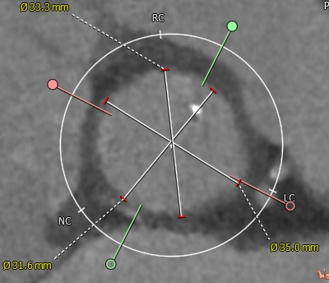
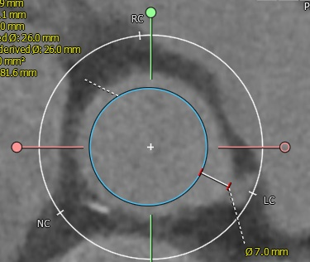
CTA: SOV, VTC
RCC: 33.3 mm
Sinus of Valsalva
RCC = 33.3 mm
LCC = 35 mm
NCC = 32 mm
Virtual THV-coronary (VTC) distance
VTC = 7.0 mm
NCC: 32 mm
LCC: 35 mm
26 mm THV
VTC: 7.0 mm

Slide 7
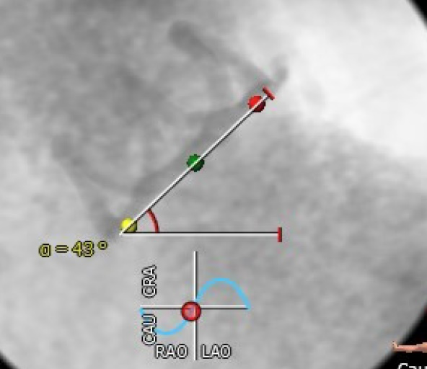
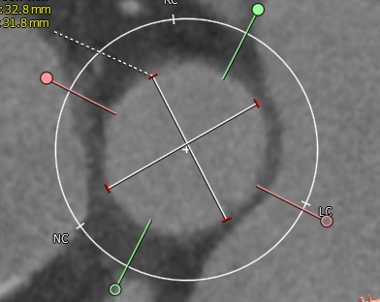
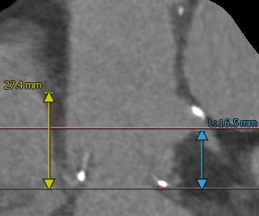
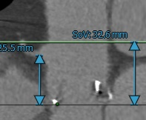
CTA: STJ, Coronary Ostia
Root angle: 43 deg
STJ: 31.7x32.8 mm
Coronary heights
LCA = 16.5 mm
RCA = 25.5 mm
STJ height (above annulus) = 32 mm
STJ = 31.7 x 32.8 mm (mean 31.8)
Root angle = 43 deg
Ascending aorta = 33 x 32.1 mm
LCA: 16.5mm
RCA: 25.5mm

Slide 8
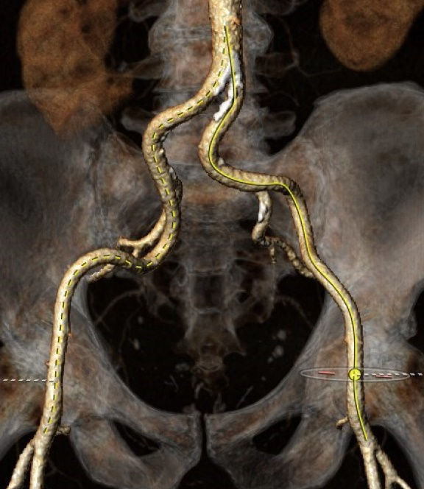
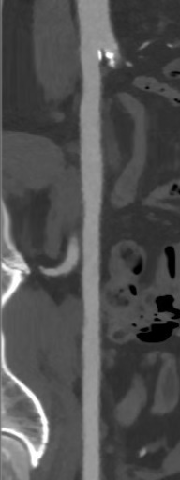
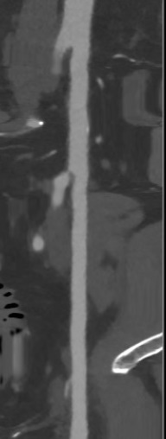
Femoral Arterial Access
10x11.6
9.4x11.4
8.1x8.6
8.3x7.5
7.8x9.1
7.5x8.8
Access 3D
Longitudinal View RFA and RIA
Longitudinal View LFA and LIA

Slide 9
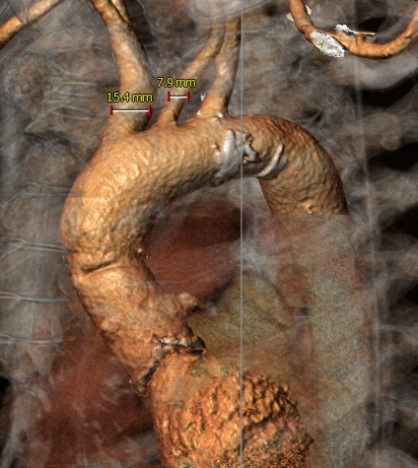
Great Vessel Anatomy for Cerebral Protection Device
LAO: 40°
Caudal: 0°
RAO: 30°
Caudal: 10°

Slide 10
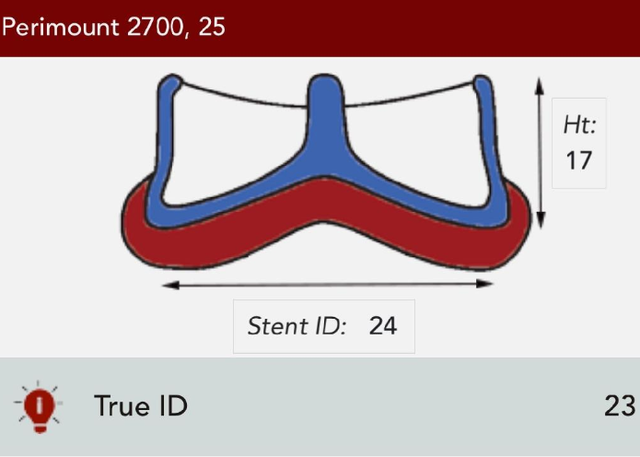
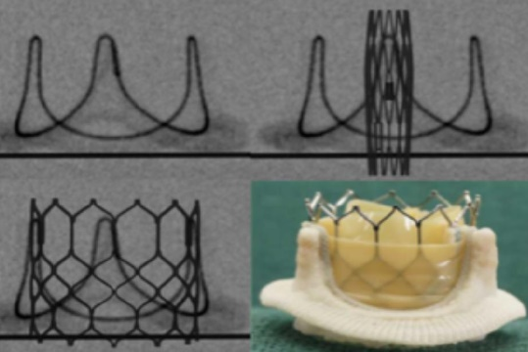
Sapien-3 Valve selection of ViV TAVR

Slide 11
Biometrics and Indexed Effective Orifice area (iEOA) to predict PPM
Biometrics
Height = 180 cm
Weight = 87.1 Kg
BMI = 26.88 Kg/m²
BSA = 2.07 m²
iEOA (calculated) for 26 mm Sapien-3 Valve
In-Vitro iEOA = 1.1 cm²/m²
In-Vivo iEOA = 0.82 cm²/m²
Hahn RT et al. JACC Cardiovasc Imaging. 2019;12(1):25.

Slide 12
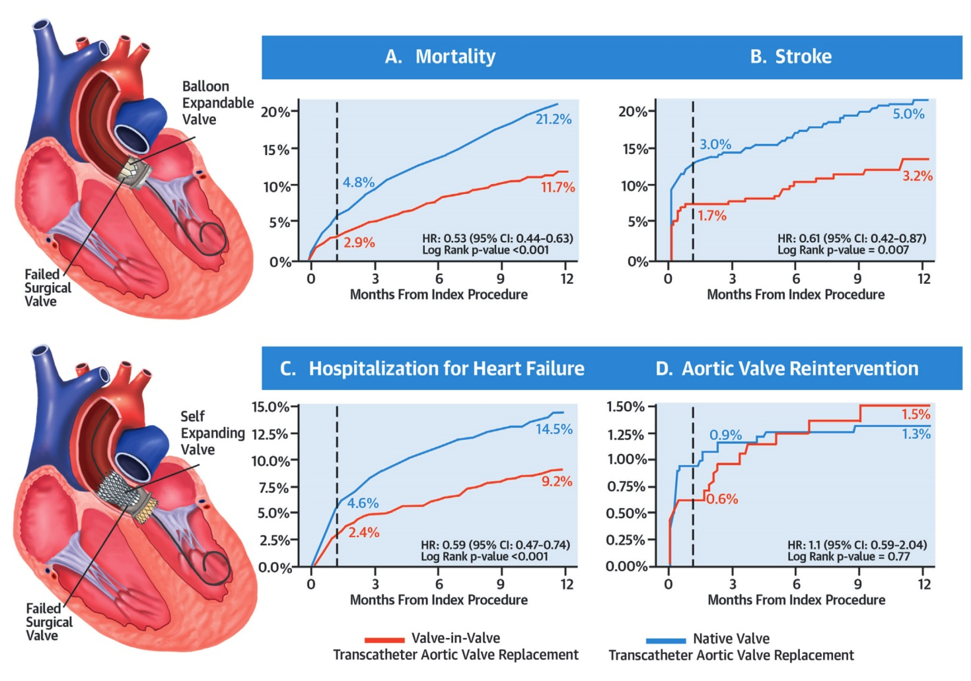
Valve-in-Valve TAVR vs Native Valve TAVR for AS
Tuzcu et al., J Am Coll Cardiol 2018;72:370

Slide 13
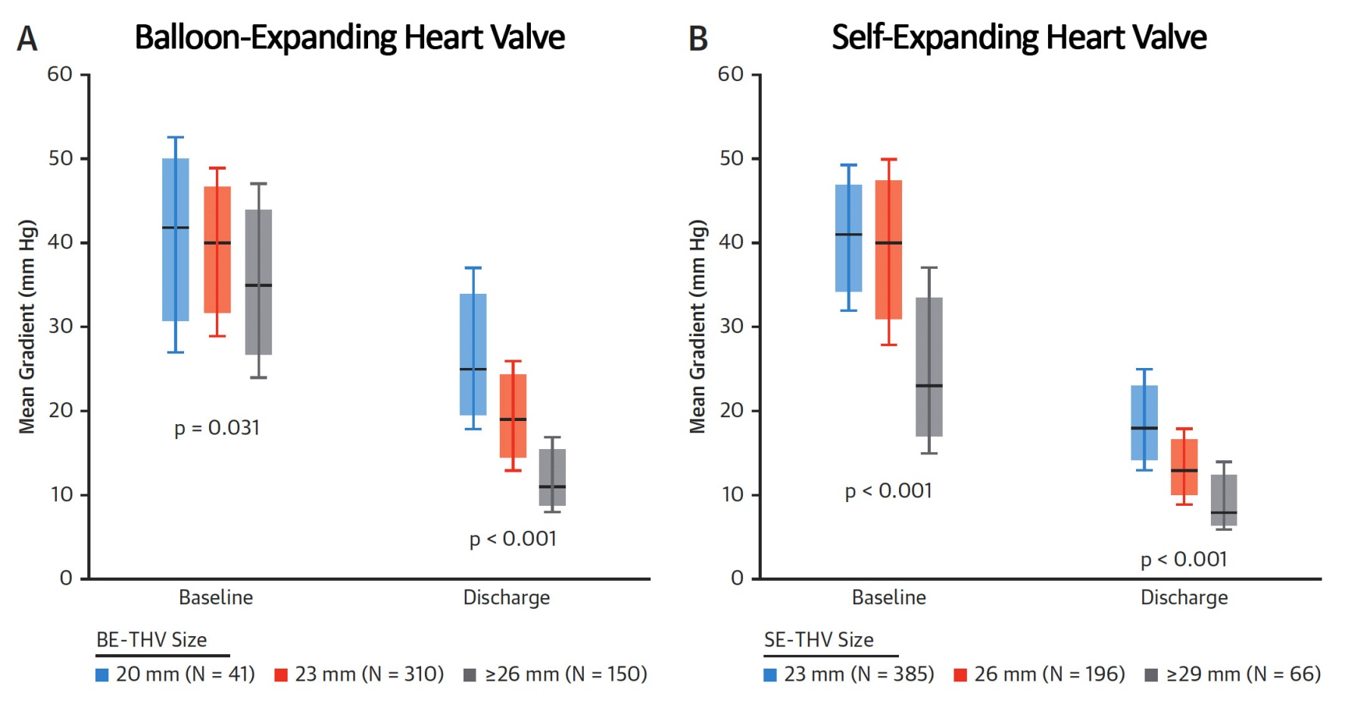
Mean Gradients at Baseline and Discharge
ViV-TAVR by Transcatheter Heart Valve (THV) Type
Tuzcu et al., J Am Coll Cardiol 2018;72:370

Slide 14
Summary of Case
Presentation: 79 year old male with NYHA Class III DOE and HF admissions
TTE: EF 35%, severe trans-valvular aortic regurgitation due to degenerative bio-prosthetic leaflets
STS risk mortality: 8.3 %
EuroScore II risk: 6.10%
Logistic Euroscore mortality: 19.37%
Course: Patient was evaluated by Heart Team and due to co-morbidities and frailty status, the patient was determined to be High Risk for reop SAVR.
Plan: The patient is referred here for Valve-in-Valve TAVR with 26 mm Sapien-3 Valve +/- bio-prosthetic valve fracture technique via left percutaneous femoral approach with Sentinel cerebral protection device.

Slide 15
Issues Related To The Case
TAVR vs SAVR valve durability
Bio-prosthetic Valve Fracture (BVF)

Slide 16
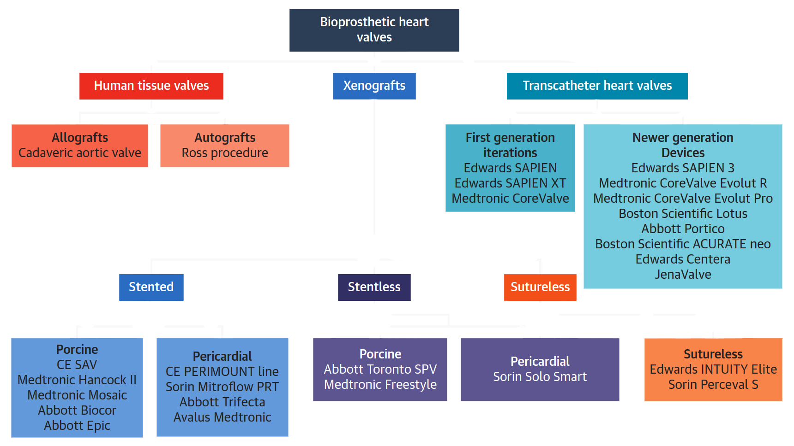
General Classification of Bioprosthetic Valves
Rodriguez-Gabella et al., J Am Coll Cardiol 2017;70:1013

Slide 17
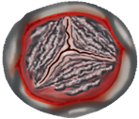
Structural Valve Degeneration Following Surgical
or Transcatheter Aortic Bio-prosthesis Implantation
Redo
Surgery
Aortic Bioprosthetic Valve Replacement
Surgical/
Transcatheter
Younger Age
Cardiovascular Risk Factors
Bioprosthetic Valve-Related Factors
Clinically Relevant Structural Valve Degeneration
(<15% at 10 Years Post-SAVR)
Valve Calcification/ Leaflet Degradation
Valve Stenosis and/or Regurgitation
Valve-in-Valve
TAVR

Slide 18
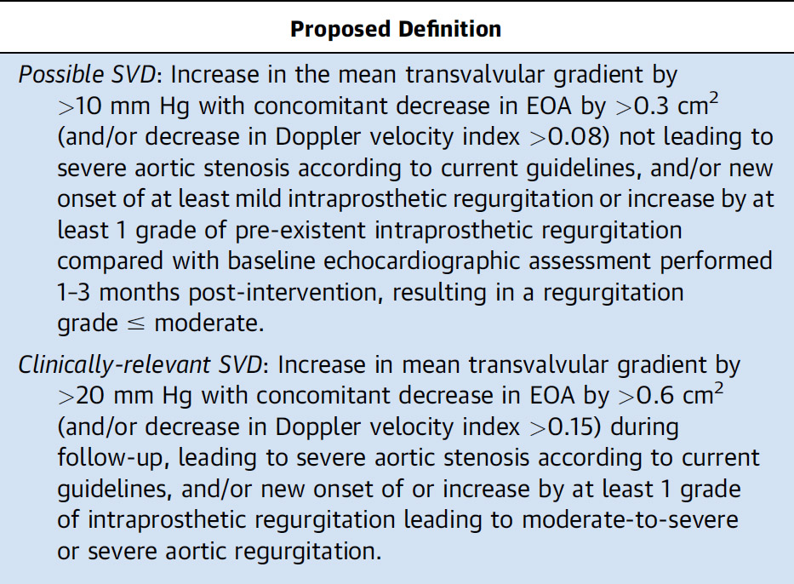
Definitions of Structural Valve Degeneration

Slide 19
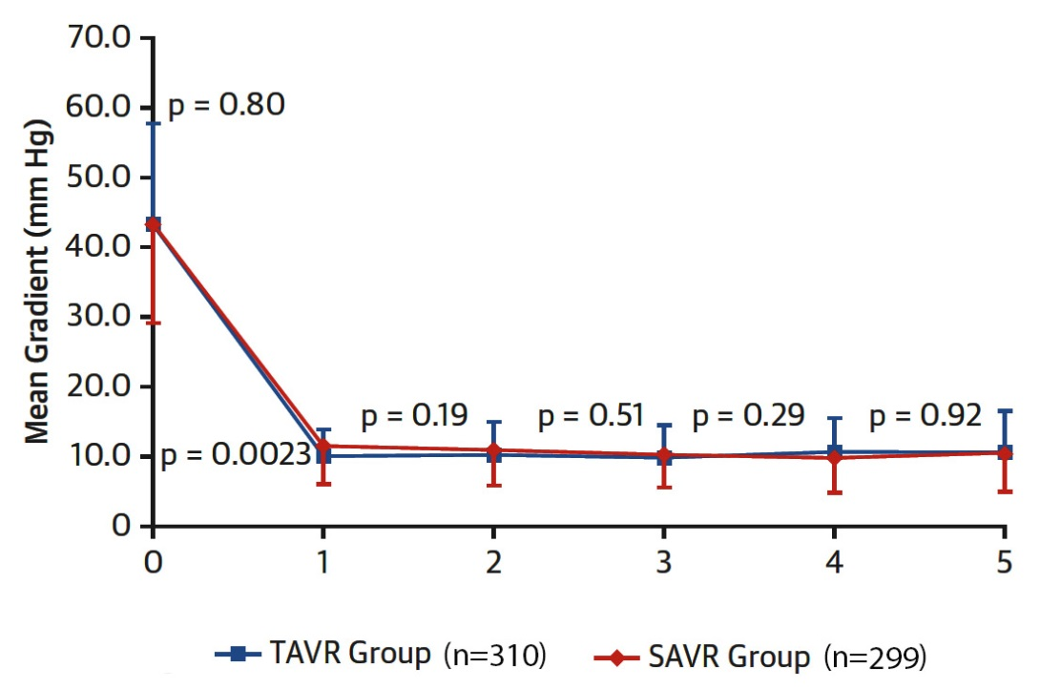
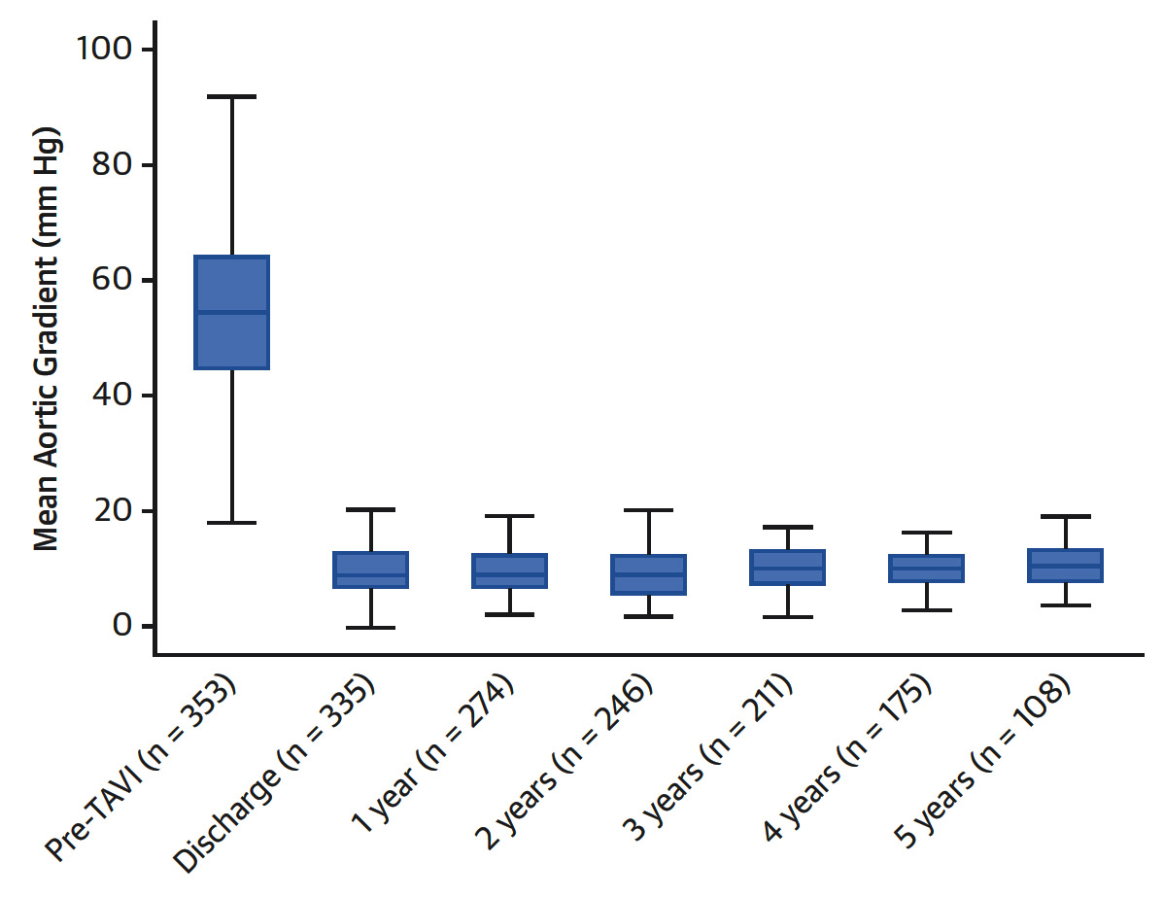
Partner 5-Yr F/U
CoreValve 5-Yr F/U
Echo Evaluation
Echo evaluation
Rodriguez-Gabella et al., J Am Coll Cardiol 2017;70:1013
Rodriguez-Gabella et al., J Am Coll Cardiol 2017;70:1013

Slide 20
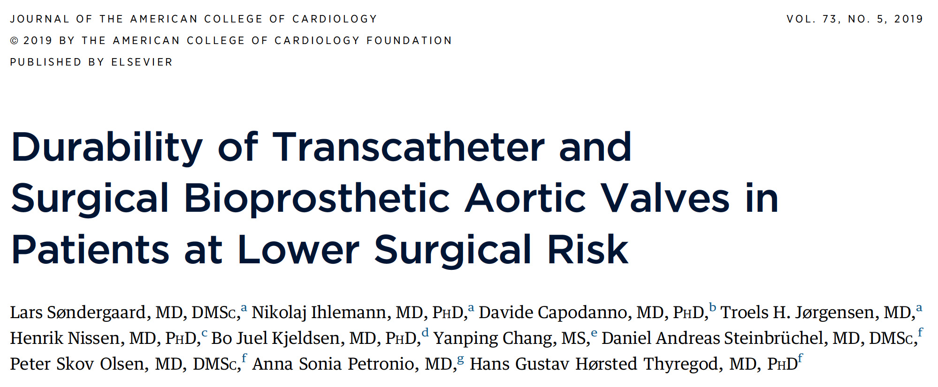
Defined as Mean Gradient of ≥20 mmHg and an Increase in Mean Gradient ≥10 mmHg After 3 Months Post-Procedure

Slide 21
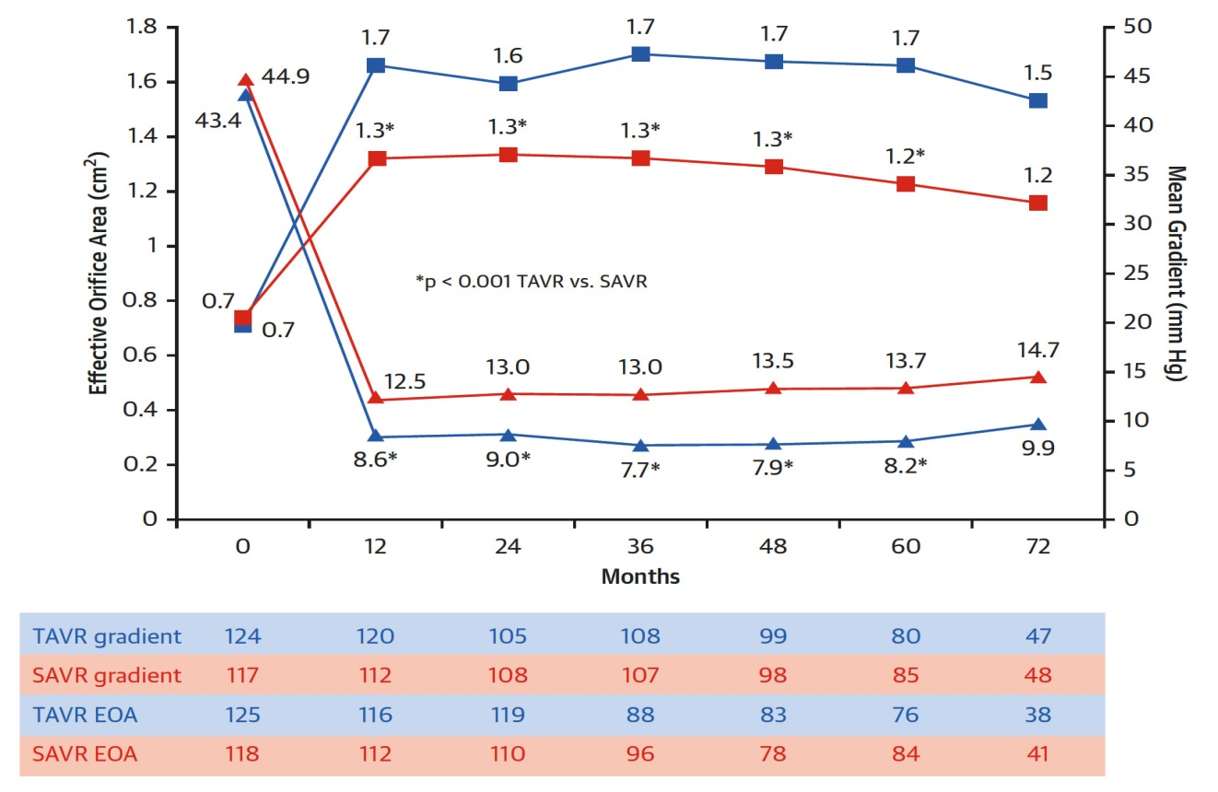
NOTION Trial: Mean Gradient and Effective Orifice
Area of Transcatheter and Surgical Bioprosthetic Aortic Valves Annually Through 6 Years
Søndergaard et al., J Am Coll Cardiol 2019;73:546

Slide 22
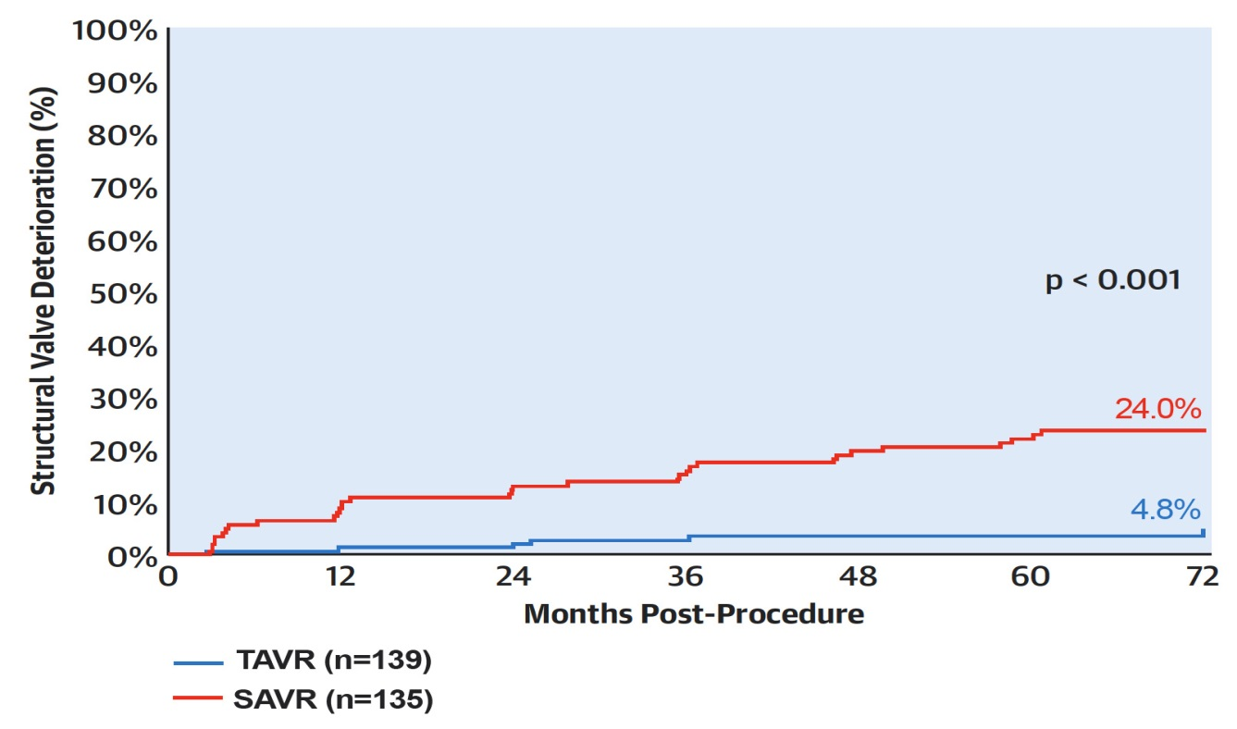
NOTION Trial: Cumulative Incidence of Structural Valve Deterioration Through 6 Years
The cumulative incidence of SVD was significantly lower after TAVR compared with SAVR through 6 years follow-up
Defined as Mean Gradient of ≥20 mmHg and an Increase in Mean Gradient ≥10 mmHg After 3 Months Post-Procedure
Søndergaard et al., J Am Coll Cardiol 2019;73:546

Slide 23
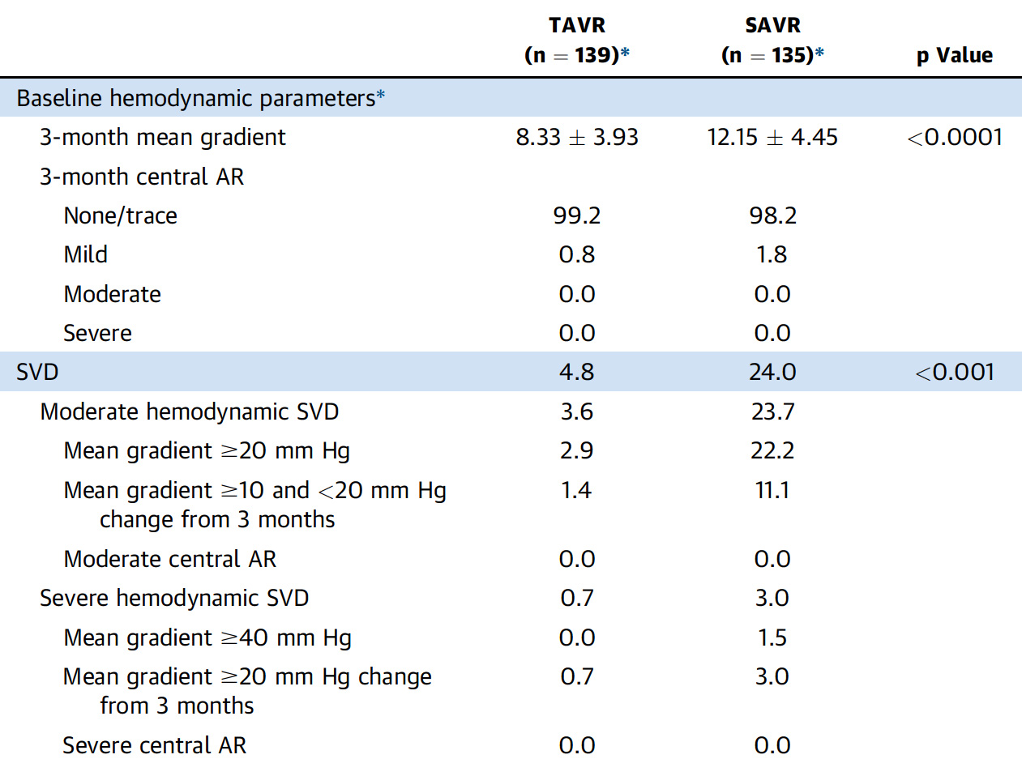
NOTION Trial: Structural Valve Deterioration and
Its Components Through 6 Years
*The 3-month echo measurements are the first post-procedure measurements in NOTION
Søndergaard et al., J Am Coll Cardiol 2019;73:546

Slide 24
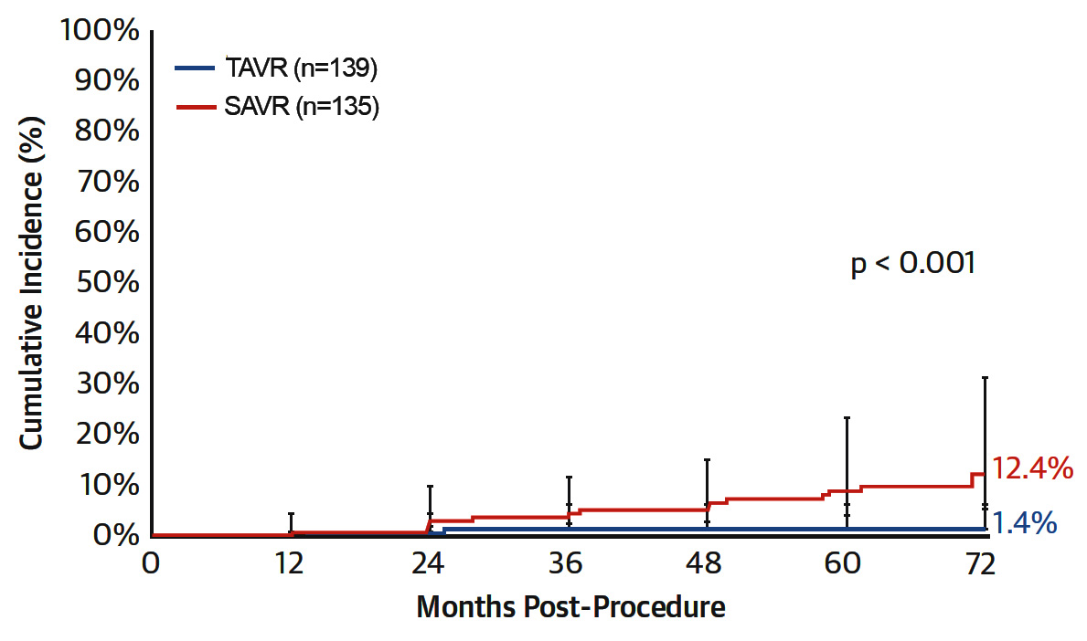
NOTION Trial: Cumulative Incidence of SVD
Defined as Mean Gradient of ≥20 mmHg and an Increase in Mean Gradient ≥10 mmHg After 3 Months Post-Procedure
Rate of SVD by this definition is lower for SAVR but remains significantly greater than the SVD rate for TAVR through 6 years
Søndergaard et al., J Am Coll Cardiol 2019;73:546

Slide 25
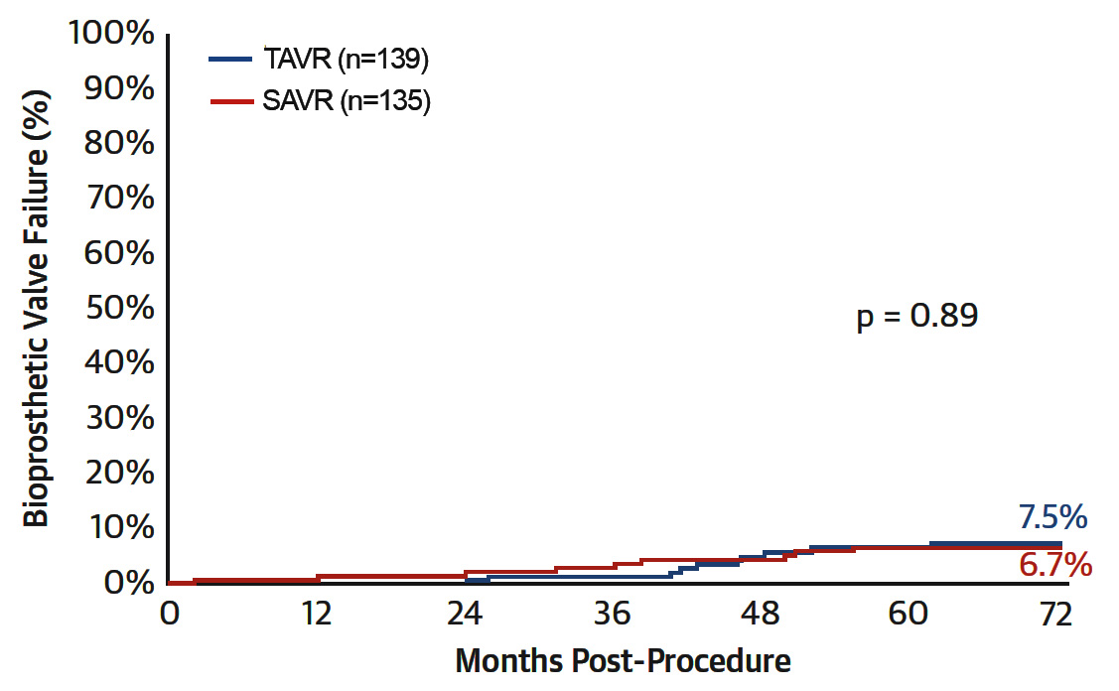
NOTION Trial: Cumulative Incidence of
Bioprosthetic Valve Failure Through 6 Years
No significant difference in BVF between TAVR and SAVR through 6 years
Søndergaard et al., J Am Coll Cardiol 2019;73:546

Slide 26
NOTION Trial: Aortic Valve Durability at 6 Years
%
Søndergaard et al., J Am Coll Cardiol 2019;73:546

Slide 28
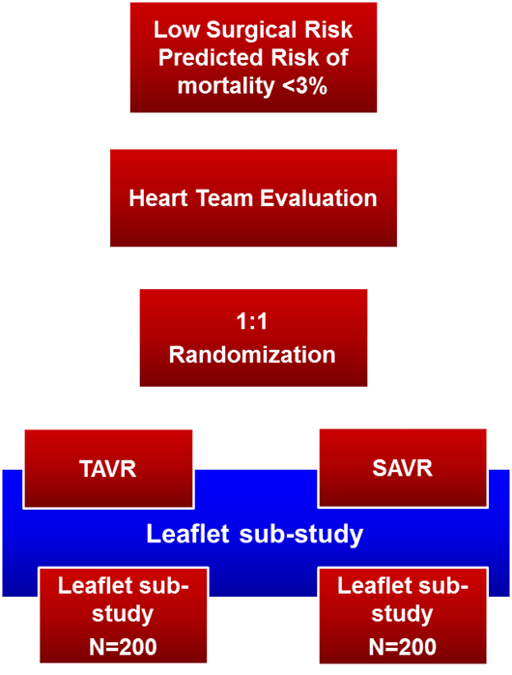
The PARTNER 3 Trial
Evolut Low Risk Trial
Symptomatic Severe Calcific AS
Low Risk ASSESSMENT by Heart Team
(STS < 3%, TF only)
1:1 Randomization (n=1228)
Results in ACC 2019
TF - TAVR
(SAPIEN 3)
Surgery
(Bioprosthetic Valve)
CT Imaging Sub-Study (n=200)
CT Imaging Sub-Study (n=200)
QOL Data
Primary Endpoint:
Composite of all-cause mortality, all strokes, or re-hospitalization at 1 year
Primary Endpoint:
Composite of all-cause mortality and strokes at 2 year
Follow-up: 30 days, 6 mos, 1 year and annually through 10 years

Slide 30
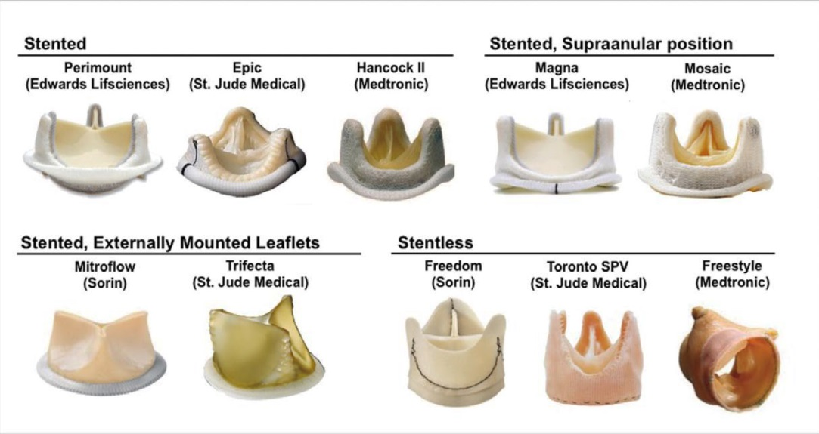
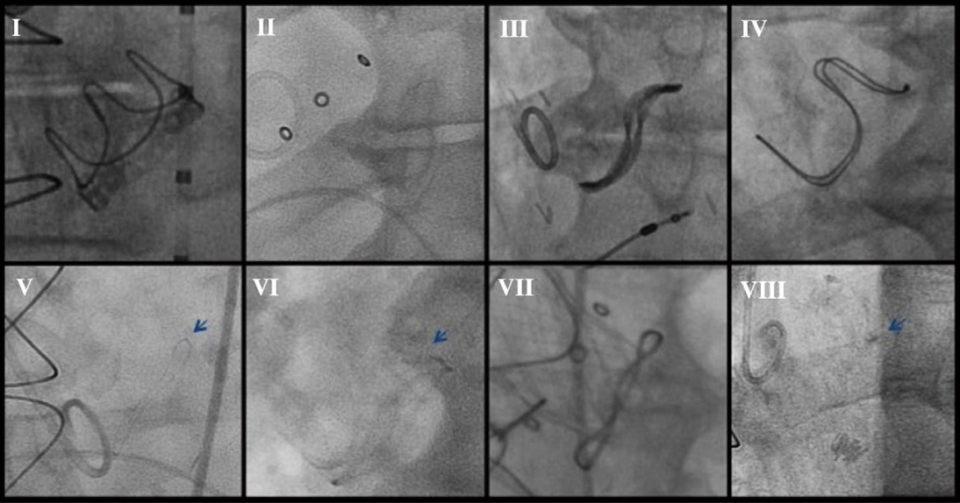
Bioprosthetic Surgical Valves
A. Common Bioprosthetic Surgical Valves
B. Fluoroscopic Images of Common Stented Bioprosthetic Valves
Perimount Mosaic Mitroflow Carpentier-Edwards
Epic Trifecta Hancock II Freestyle
Dvir et al., Circ J 2015;79:695

Slide 31
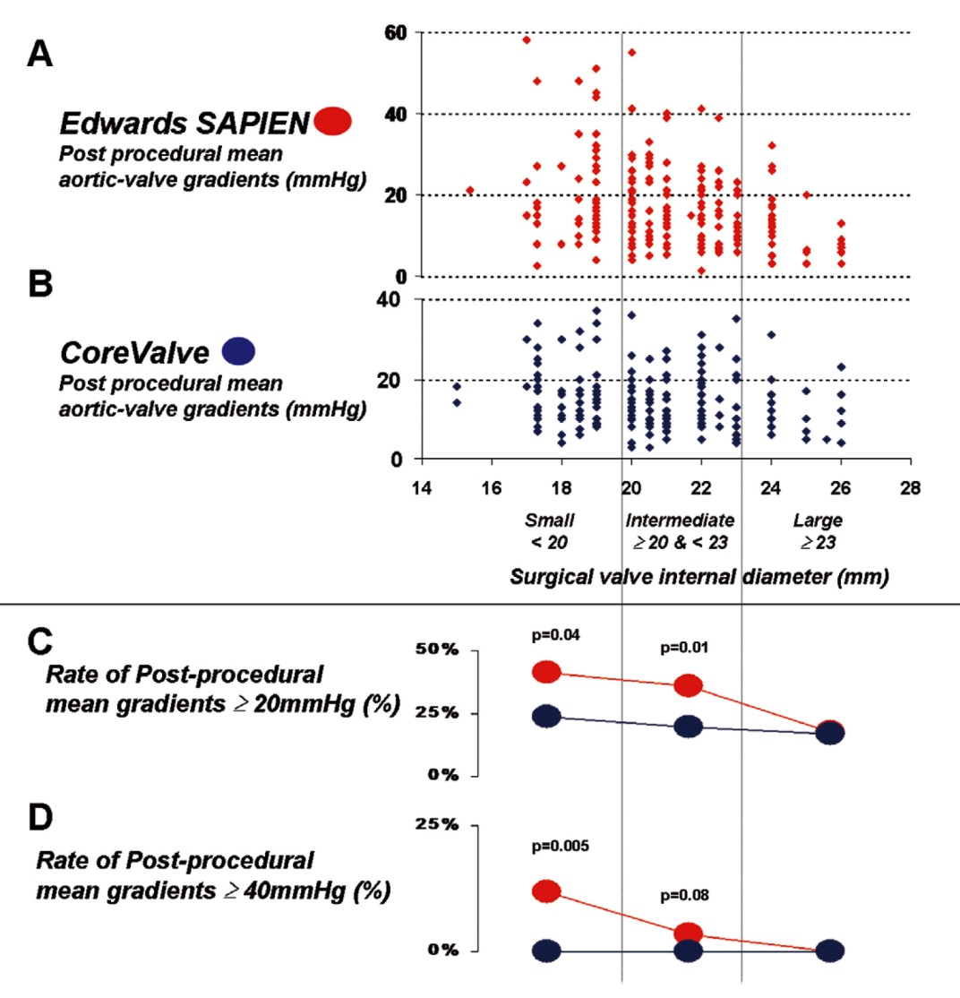
Analysis of Post-Procedure Gradients After VIV Procedures According to Surgical Bioprosthesis Size
Small (internal diameter <20 mm), Intermediate (≥20 mm and <23 mm) and Large (≥23 mm)
Dvir et al., Circ J 2015;79:695

Slide 32
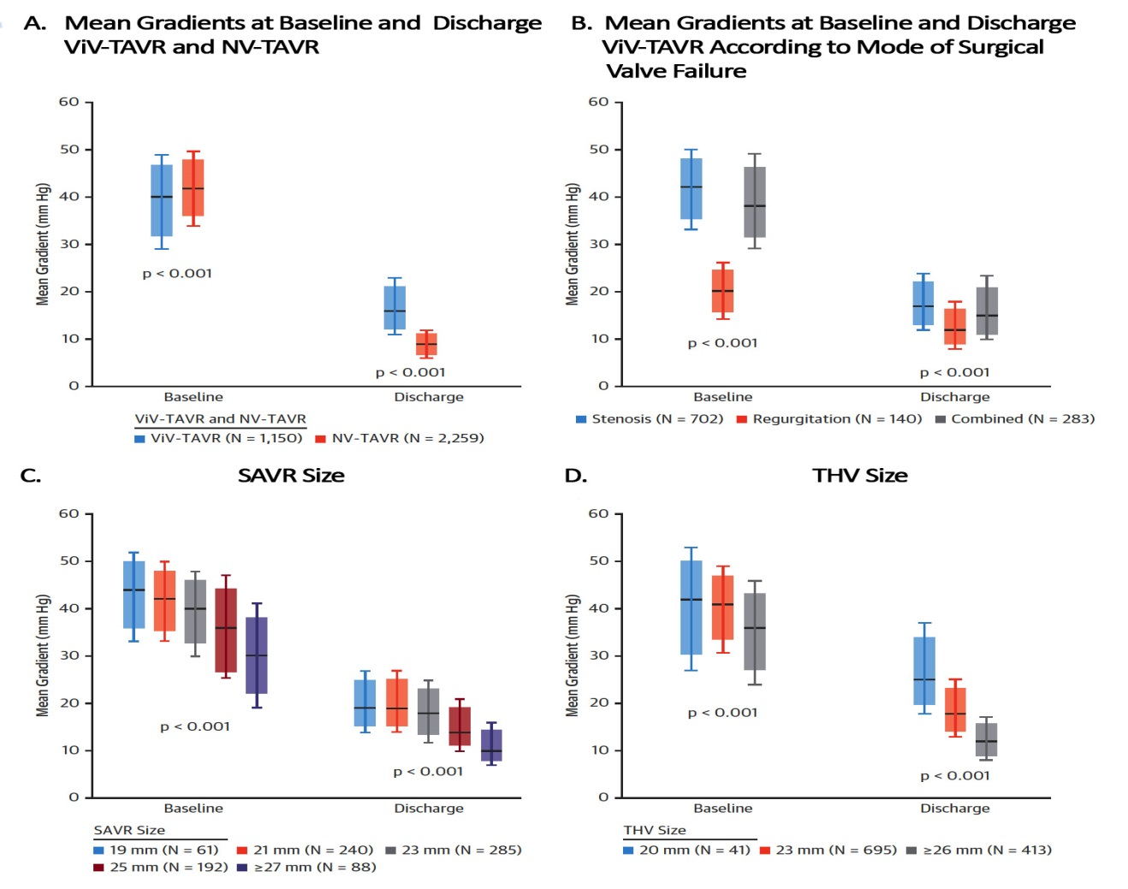
Echocardiographic Outcomes
Tuzcu et al., J Am Coll Cardiol 2018;72:370

Slide 33
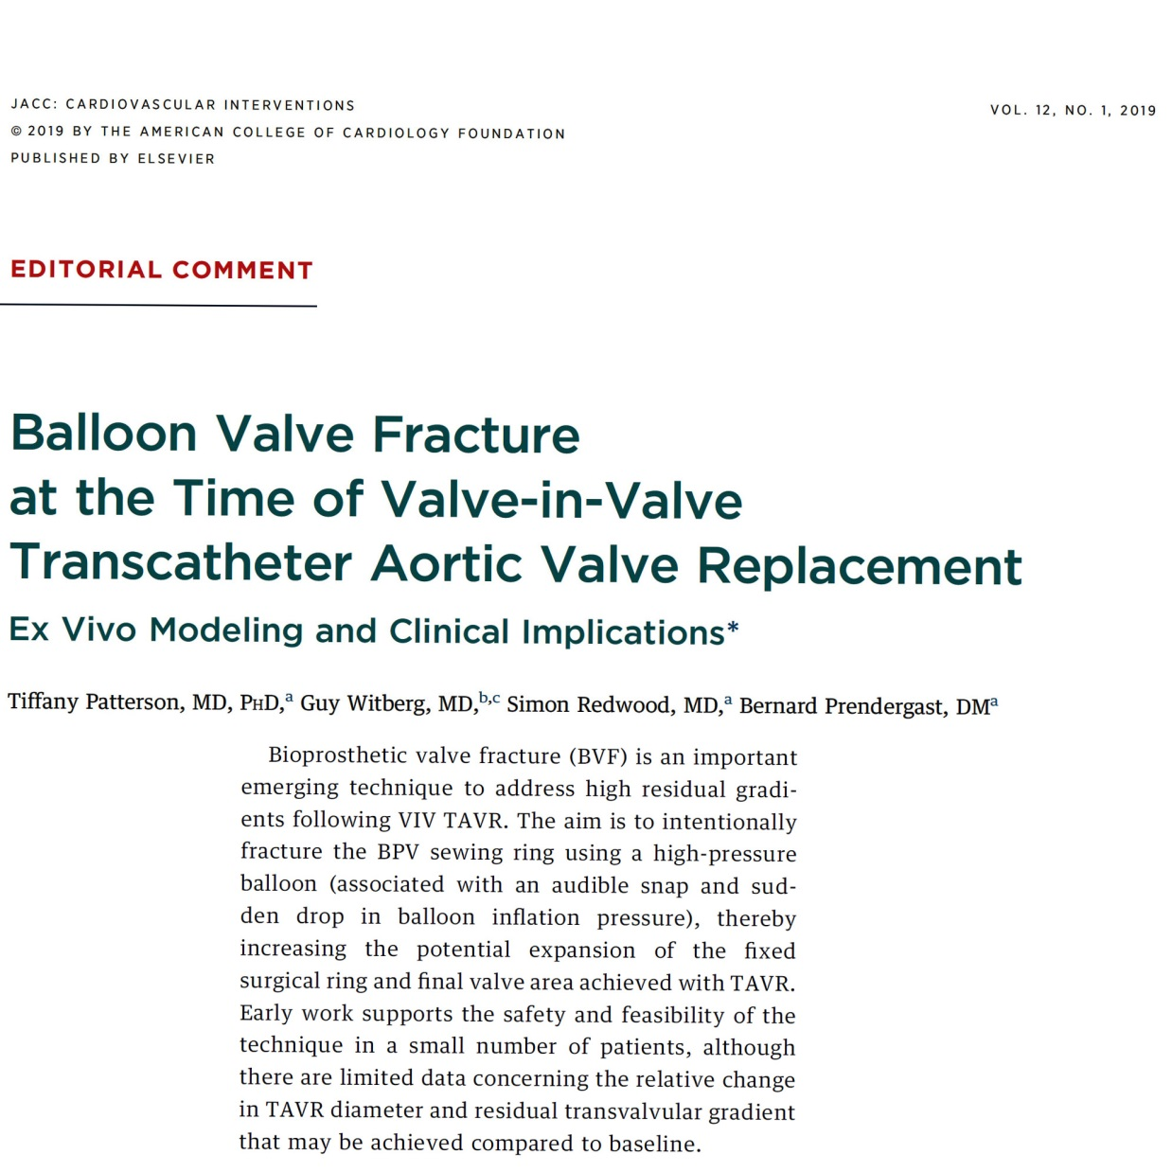

Slide 34
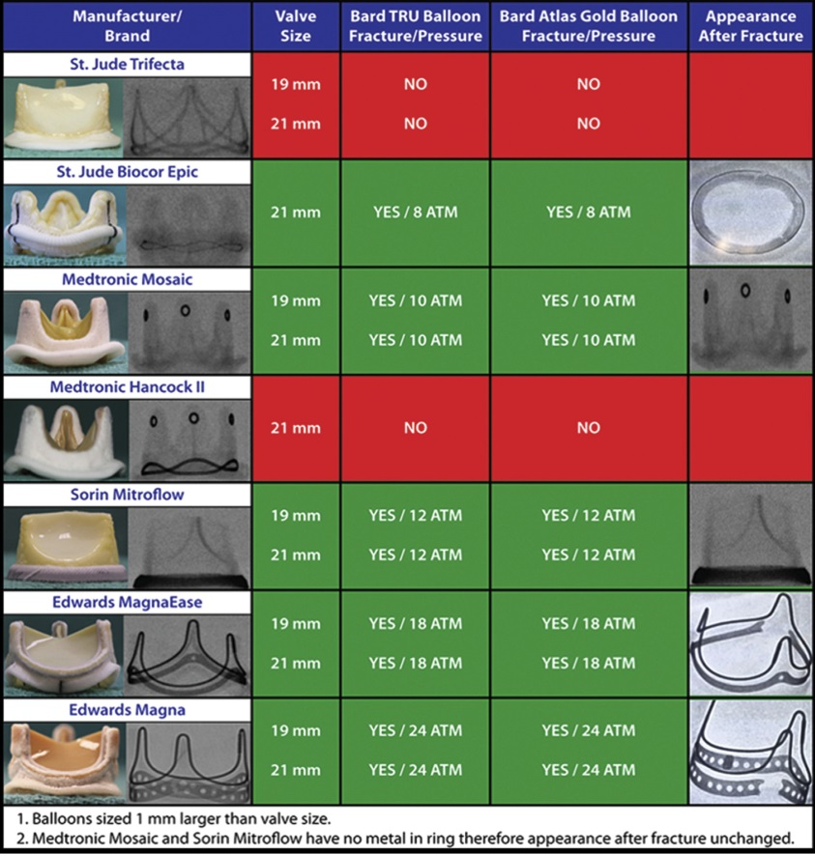
Summary of Bench Testing in High Pressure
Balloon Inflation to Fracture the Valve Frame of Surgical Tissue Valves
Allen et al., Ann Thorac Surg 2017;104:1501

Slide 35
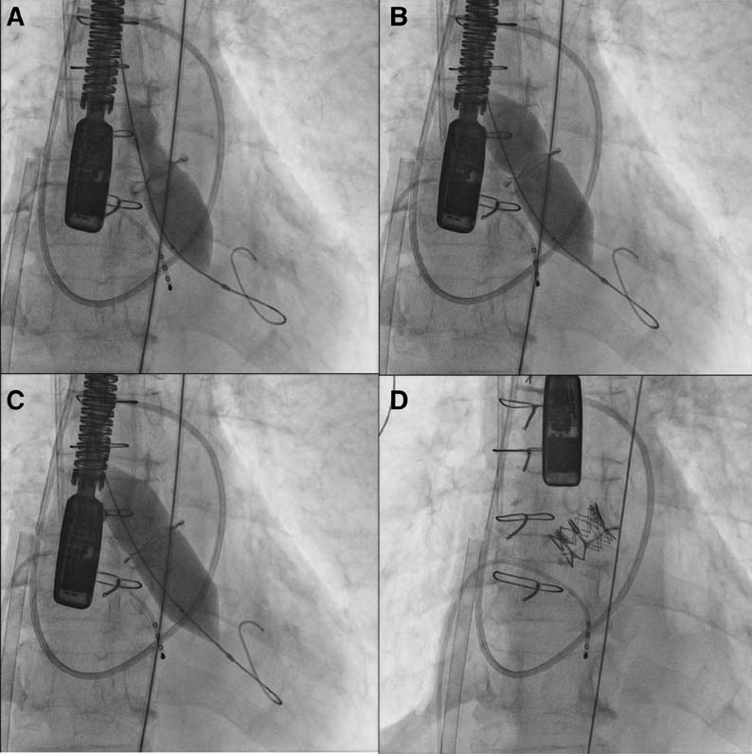
Bio-prosthetic Valve Fracture after Sapien XT 20mm

Slide 36
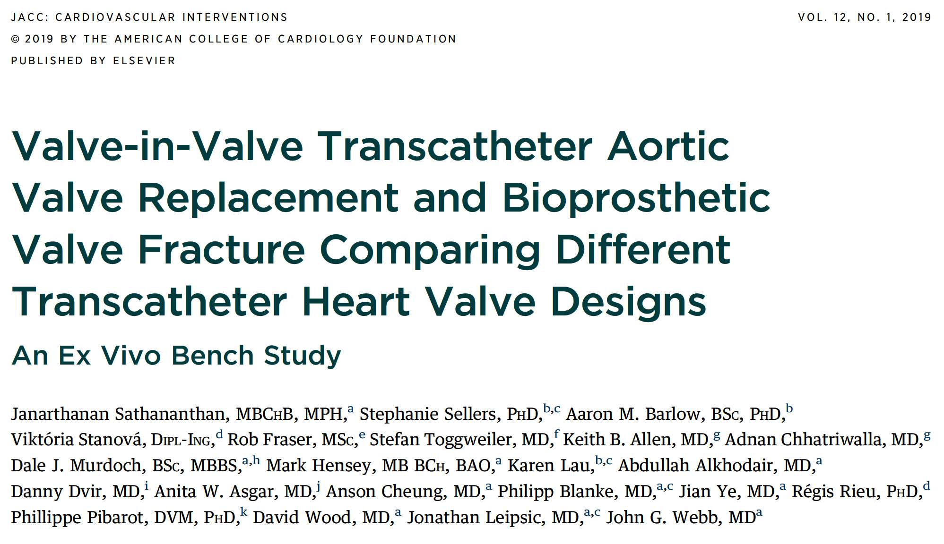

Slide 37
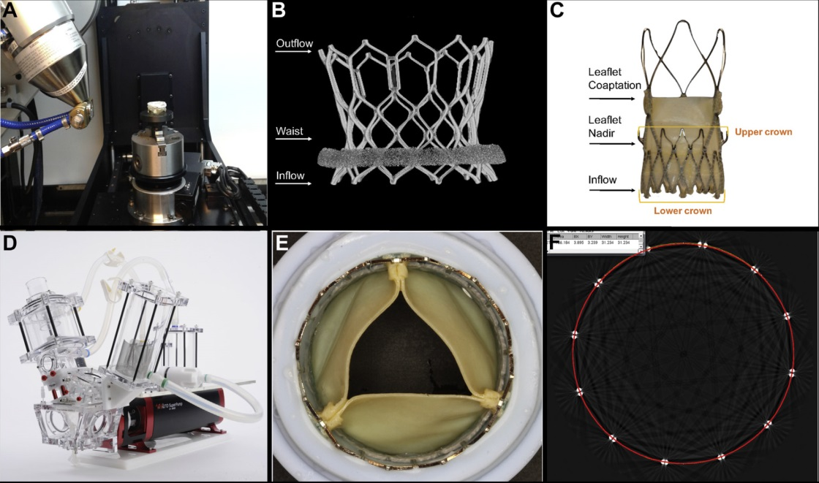
Ex Vivo Bench Testing Methodology
Micro CT used to scan THVs
Micro CT image of Sapien 3 THV (arrows indicate measurement made at inflow, middle and outflow of valve)
ACURATE neo THV (arrows indicate measurements made at inflow, leaflet nadir, and leaflet coaptation level of the valve)
Pulse duplicator used for hydrodynamic testing
THV silicon holder
Mid-strut measurements of THV
Sathananthan et al., J Am Coll Cardiol Intv 2019;12:65

Slide 38
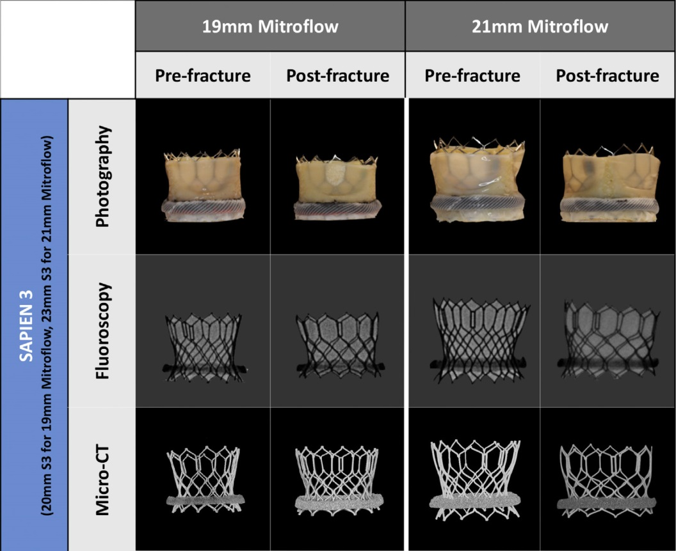
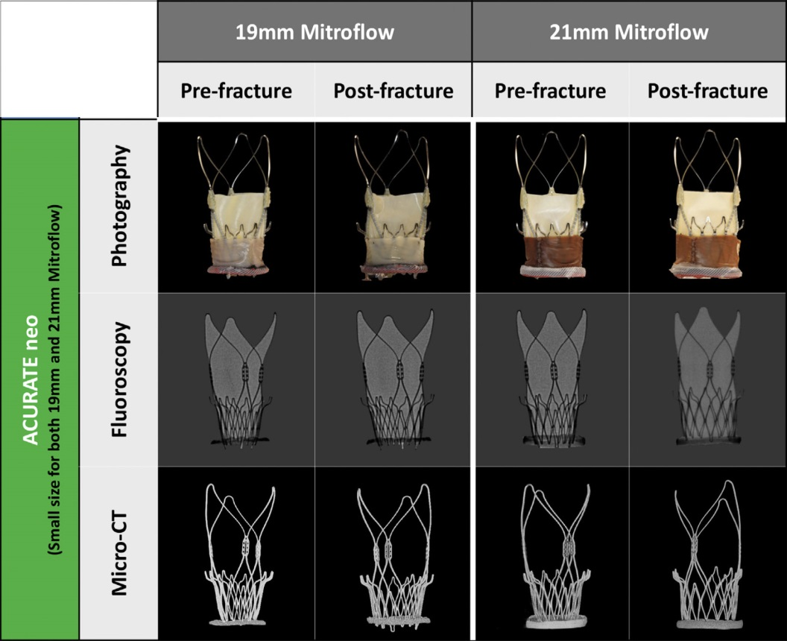
Ex Vivo Bench Study: Multimodality Imaging
Pre- and Post-BVF
Sathananthan et al., J Am Coll Cardiol Intv 2019;12:65

Slide 39
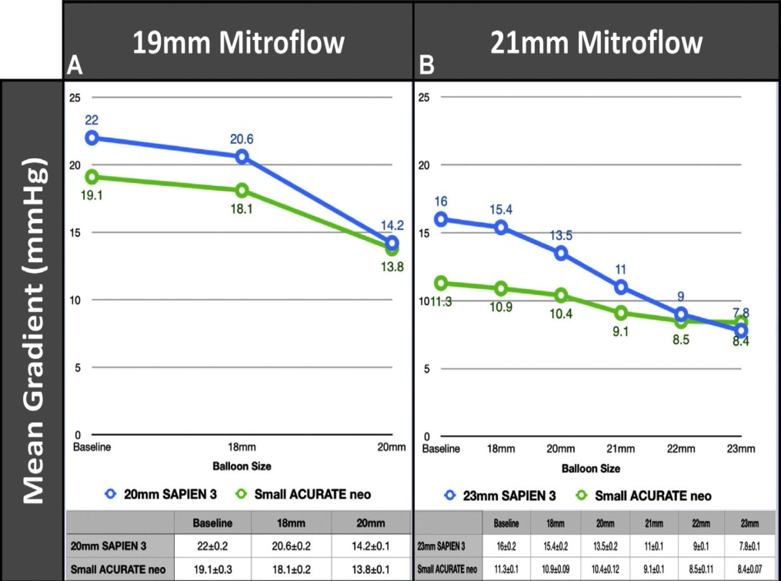
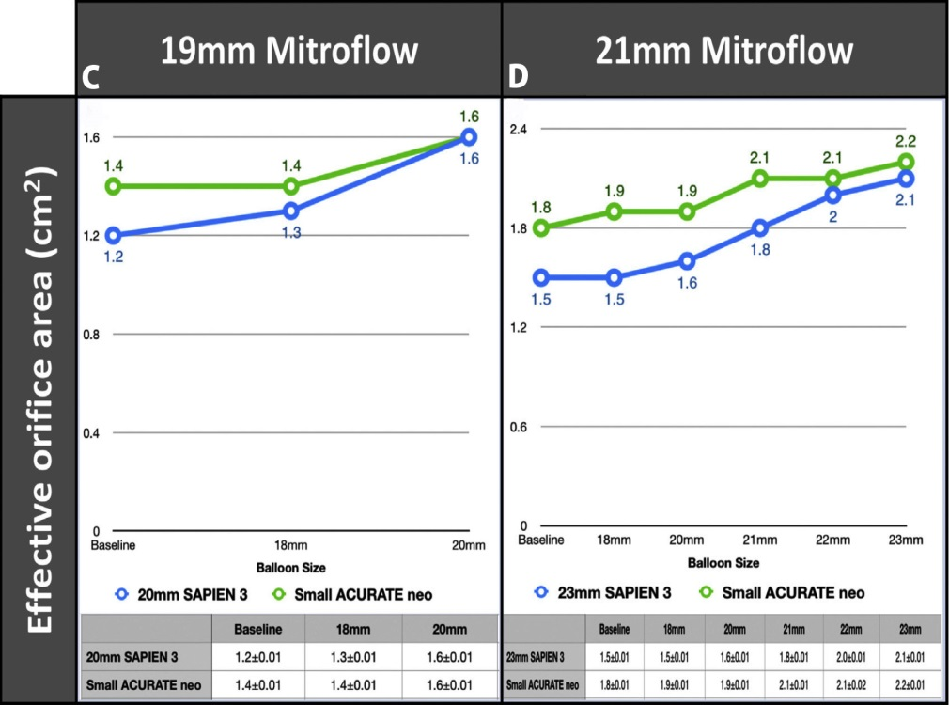
Ex Vivo Bench Study: Hydrodynamic Function at Baseline Following VIV TAVR and With Sequential Post-Dilatation and BVF
Sathananthan et al., J Am Coll Cardiol Intv 2019;12:65

Slide 40
Ex Vivo Bench Study: Pin-Wheeling Index (%)
Pre- and Post-Fracture
Pin-wheeling, as defined by the International Standards Organization guideline for THV testing, refers to twisting of the leaflet redundancy.
Sathananthan et al., J Am Coll Cardiol Intv 2019;12:65

Slide 41
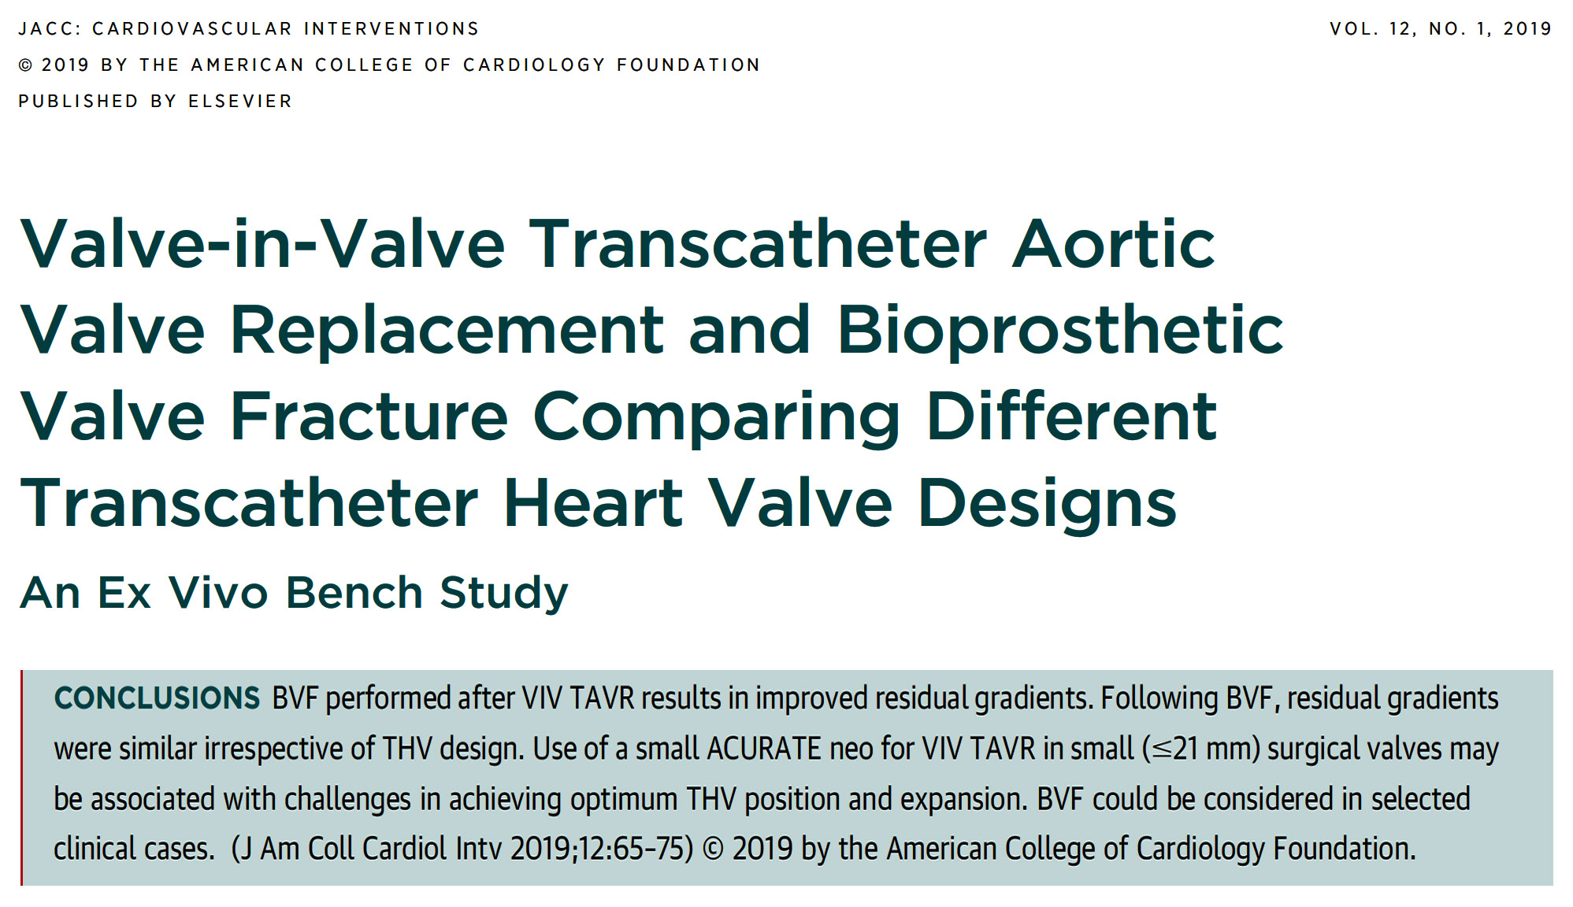

Slide 42
Take Home Messages for TAVR vs SAVR valve durability and Valve fracture technique
First RCT data on comparative outcomes of valve durability at 6yrs have shown lower structural valve deterioration with TAVR valve vs SAVR valve. Overall valve failure (degeneration) rate is 5-7% at 6yrs and is similar between 2 approaches. These data are very reassuring when we start implanting TAVR in younger lower risk AS patients.
Selected degenerated bio-prosthetic valves can safely undergo valve fracture technique to reduce residual gradient at the time of TAVR implantation (before or after TAVR). Long-term results on the TAVR valve durability are awaited after valve fracture technique.

Slide 43
Question # 1
Following is the true statement regarding comparative long-term durability of TAVR vs SAVR valve:
TAVR valve has lower structural valve deterioration
SAVR valve has lower structural valve deterioration
TAVR valve has lower valve failure
SAVR valve has lower valve failure
Correct answer: A

Slide 44
Question # 2
Following is the incidence of aortic valve failure/degenaration after TAVR/SAVR in the NOTION trial at 6yrs :
<5%
6-8%
9-10%
>10%
Correct answer: B

Slide 45
Question # 3
Following are the true statements regarding bio-prosthetic valve fracture (BVF) technique except:
A. BVF cause significant decrease in the residual gradient
B. BVF can be done with all types of bio-SAVR
C. BVF is associated with low complication rates
D. BVF usually does not cause injury to the TAVR valve
Correct answer: B

