Slide 1

Structural Heart Live Cases
Supported by:
Medtronic inc
Bard Inc
Terumo Medical Corp

Slide 2

Disclosures
Samin K. Sharma, MD, FACC
Speaker’s Bureau – Boston Scientific Corp., Abbott Vascular Inc, ABIOMED, CSI
Annapoorna S. Kini, MD, FACC
Nothing to disclose
Gilbert Tang, MD. CTS
Physician Proctor for Medtronics
Pedro Moreno, MD, FACC. Moderator
Nothing to disclose

Slide 3
January 8th 2019- Structural Heart Live Case # 27: PT, 79 yo M
Presentation: Severe dyspnea on exertion NYHA Class III x 4 mths
PMH: CAD s/p CABG (SVG to RPL and SVG to D1), Bio-prosthetic AVR (25mm Perimount 2700) in March 2004, Atrial Flutter s/p ablation
Labs: Hgb 11.7, PLT 207K, K 4.2, SCr 0,8, INR 1.1
Medications: Aspirin, Eztimibe, Simvastatin
EKG (8/28/18): NSR with 1st degree AV block, LAFB, PVCS, LVH
TTE (12/24/18): Severe prosthetic AR & moderate prosthetic AS (PG/MG/AVA/PV = 41/20/0.9/3.2), mild MR and LVEF 40-45%
Cath (12/14/18):2 V CAD with patent grafts to RCA and LAD, Nl LCx

Slide 4
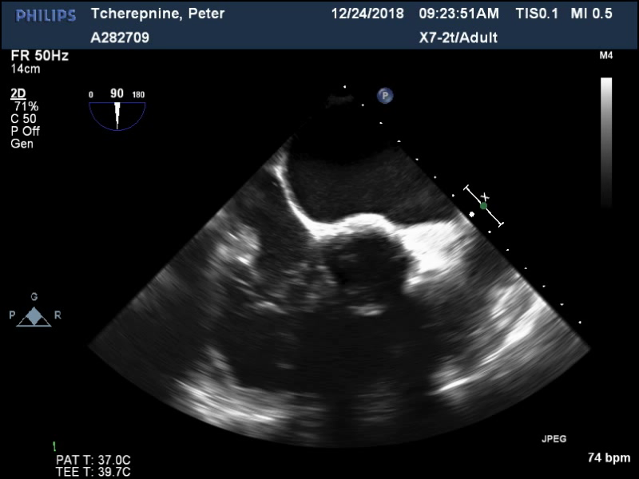
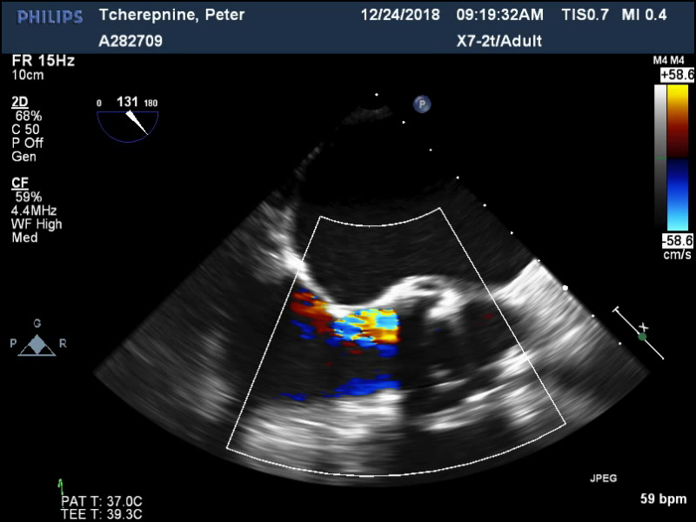
TEE
Severe Prosthetic Aortic Regurgitation due to degenerated leaflet with coaptation gap

Slide 5
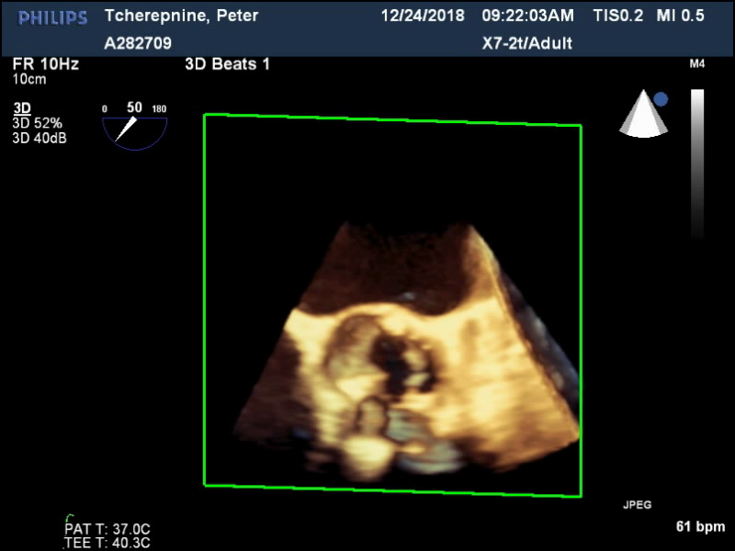
3D TEE
Coaptation Gap

Slide 6

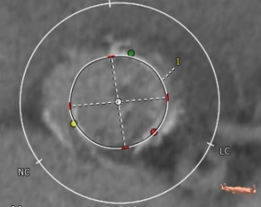
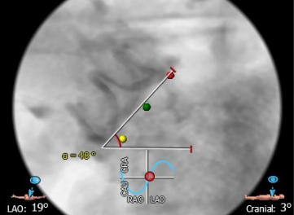
CTA: Aortic Annulus
Annulus
Aortic Annulus
Max: 24.6 mm
Min: 23.1 mm
Mean: 23.9 mm
Perimeter = 75.3 mm
Area = 449.9 mm²
Annular angle = 48°
Annulus: 23.1mmx24.6 mm
Area: 449.9 mm² Perimeter: 75.3 mm
Annulus Angle: 48°

Slide 7
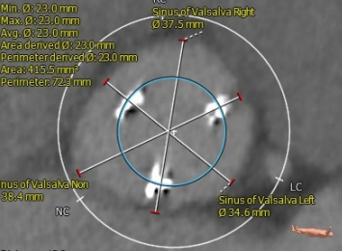
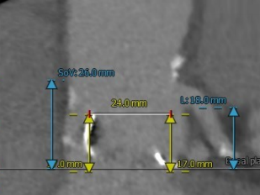
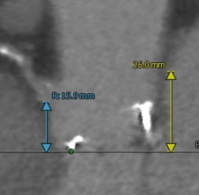
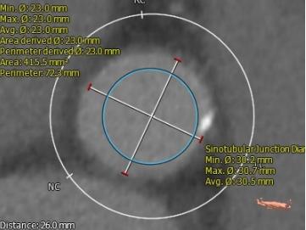
CTA: SOV, STJ, Coronary Ostia
LM: 18 mm
RCC: 37.5
Sinus of Valsalva
RCC = 37.5 mm
LCC = 34.6 mm
NCC = 38.4 mm
STJ height (above annulus) = 26mm
STJ = 30.2 x 30.8 mm (mean 30.5)
LVOT = 24.7 x 32.6 mm (mean 28.6)
Ascending aorta = 34.2 x 35.8 mm
(mean 35 mm)
NCC: 38.4
LCC: 34.6
RCA: 15.9 mm
STJ: 30.2x30.7 mm

Slide 8
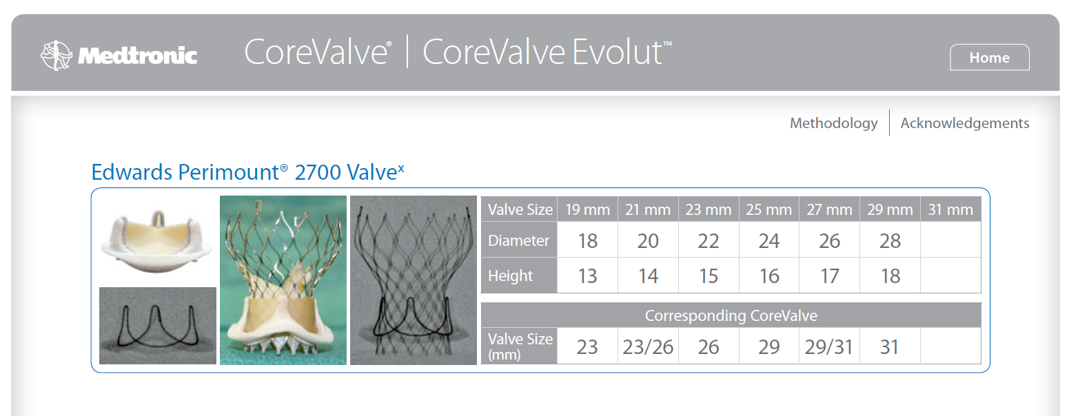

Slide 9
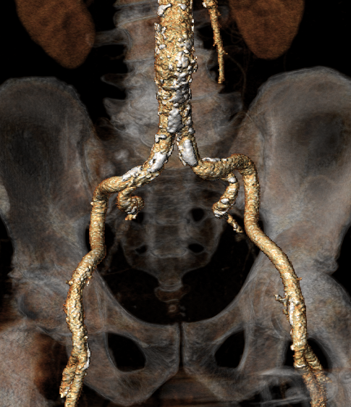
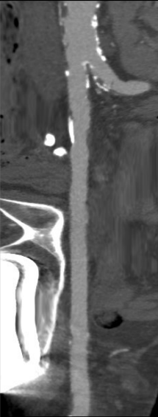
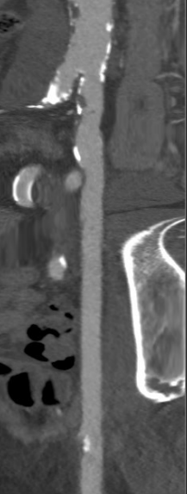
Femoral Arterial Access
9x9.5mm
10x11 mm
10x11 mm
10x10mm
11x11mm
11x11mm
Longitudinal View
Right Iliac/Femoral
Longitudinal View
Left Iliac/Femoral
Access 3D

Slide 10
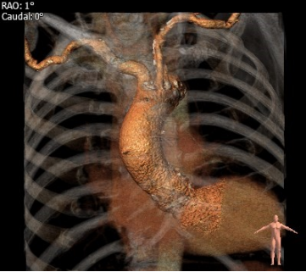
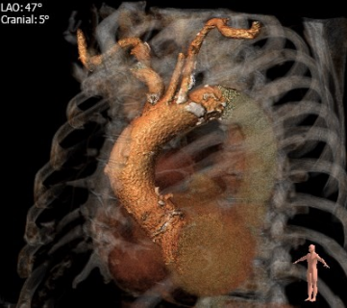
Great Vessel Anatomy for Cerebral Protection Device Consideration
Innominate: 13.9x14.1 mm
Left common carotid: 7.6x7.2 mm

Slide 11
Summary of Case
Presentation: 79 year old male with NYHA Class III DOE
TEE: EF 40-45%, degenerated bio-prosthetic aortic leaflet with severe prosthetic regurgitation & moderate prosthetic AS
STS risk mortality: 3.45%
EuroScore risk: 5.2%
Logistic Euroscore mortality: 19.4%
Course: Due to his multiple co-morbidities and frailty status, the patient was determined to be High Risk for SAVR
Plan: The patient is here for TAVR with a 29mm Evolut-R CoreValve via transfemoral access (left percutaneous) with possible Sentinel cerebral protection.

Slide 12

Issues Related To The Case
Valve-in-Valve (ViV) TAVR for aortic surgical Bio-prosthetic valve degeneration

Slide 13

Emerging Indications of TAVR
Pts with Moderate to severe AS
ViV
Bioprosthetic Degenration TAVR
LFLG AS
Bicuspid AS
Watch TAVR
TAVR in pure AI
Moderate AS with CHF; Unload
Early TAVR in asymptomatic severe AS

Slide 14

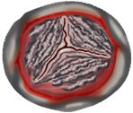







Structural Valve Degeneration Following Surgical
or Transcatheter Aortic Bio-prosthesis Implantation
Redo
Surgery
Aortic Bioprosthetic Valve Replacement
Surgical/
Transcatheter
Younger Age
Cardiovascular Risk Factors
Bioprosthetic Valve-Related Factors
Clinically Relevant Structural Valve Degeneration
(<15% at 10 Years Post-SAVR)
Valve Calcification/ Leaflet Degradation
Valve Stenosis and/or Regurgitation
Valve-in-Valve
TAVR

Slide 15
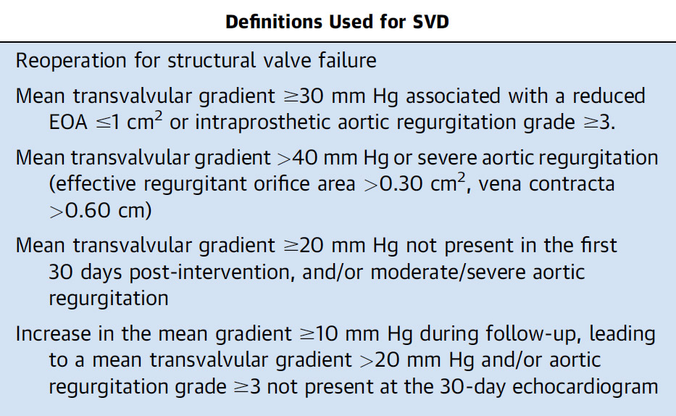
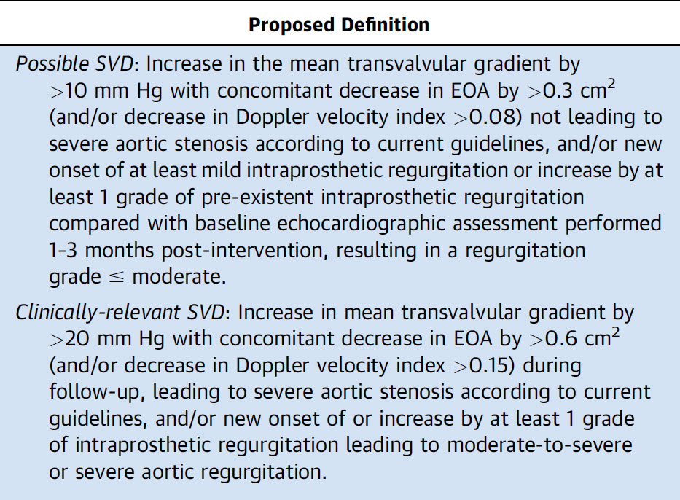
Definitions of Structural Valve Degeneration

Slide 16
Structural Valve Degeneration Following Surgical
or Transcatheter Aortic Bio-prosthesis Implantation
Redo
Surgery
Aortic Bioprosthetic Valve Replacement
Surgical/
Transcatheter
Younger Age
Cardiovascular Risk Factors
Bioprosthetic Valve-Related Factors
Clinically Relevant Structural Valve Degeneration
(<15% at 10 Years Post-SAVR)
Valve Calcification/ Leaflet Degradation
Valve Stenosis and/or Regurgitation
Valve-in-Valve
TAVR

Slide 17
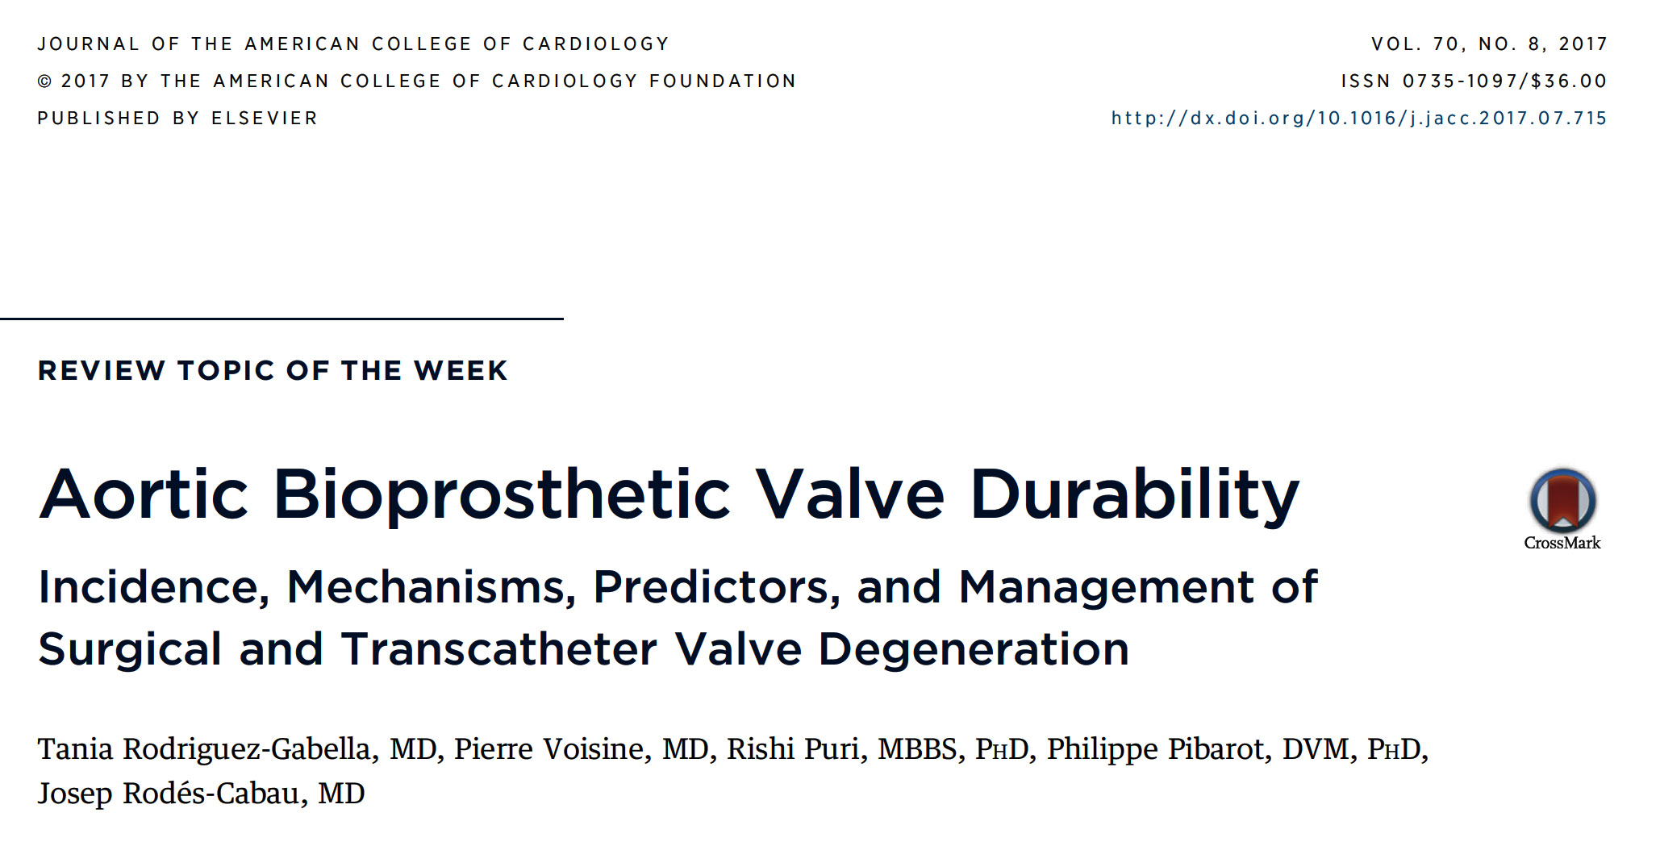

Slide 18
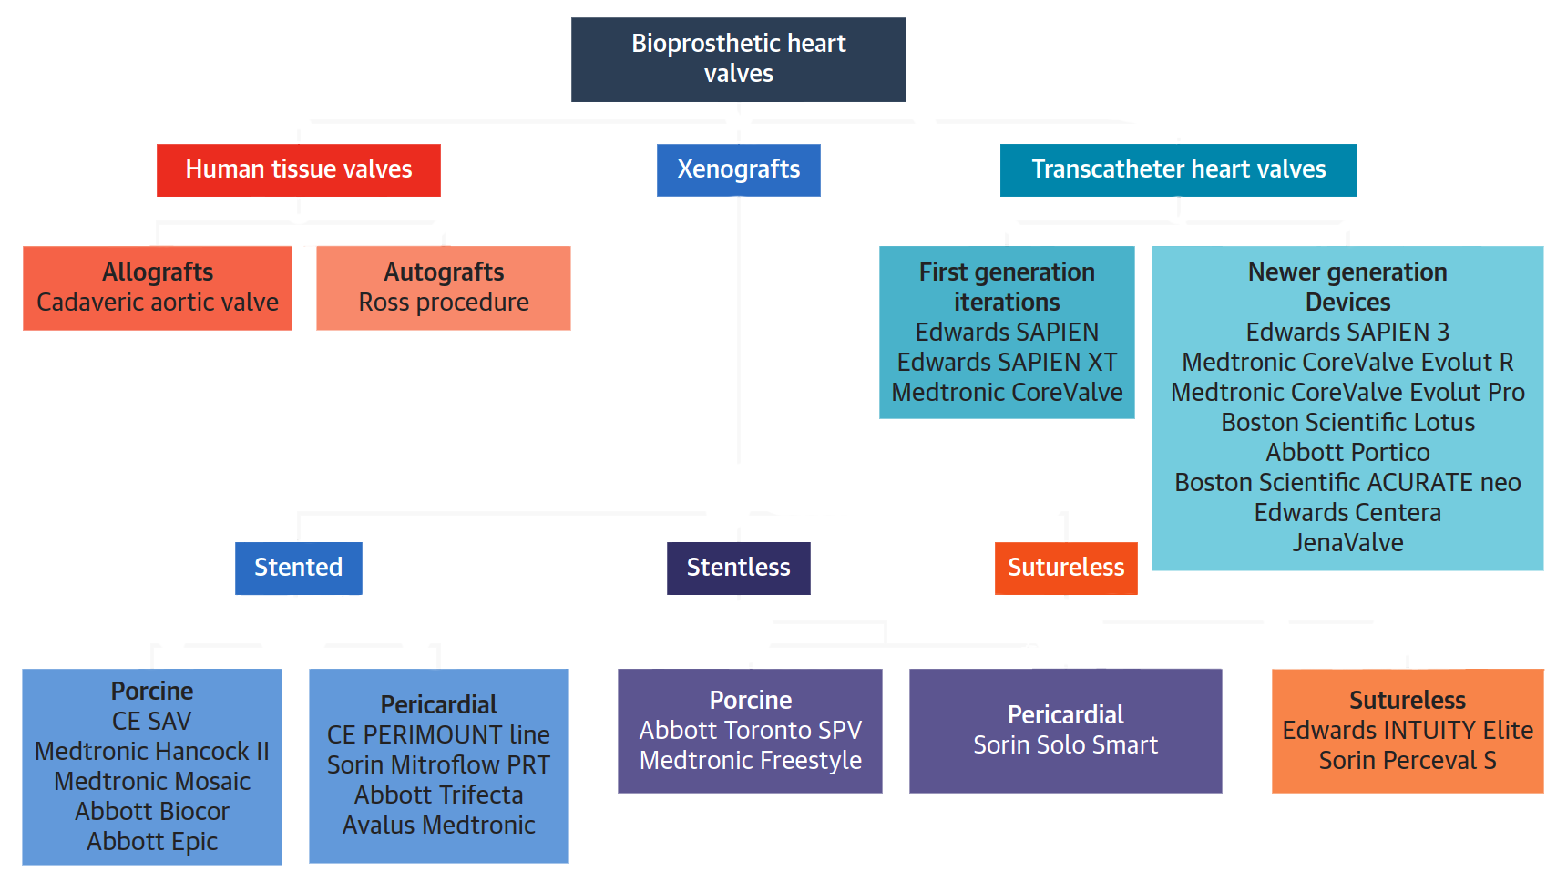
General Classification of Bioprosthetic Valves
Rodriguez-Gabella et al., J Am Coll Cardiol 2017;70:1013

Slide 19
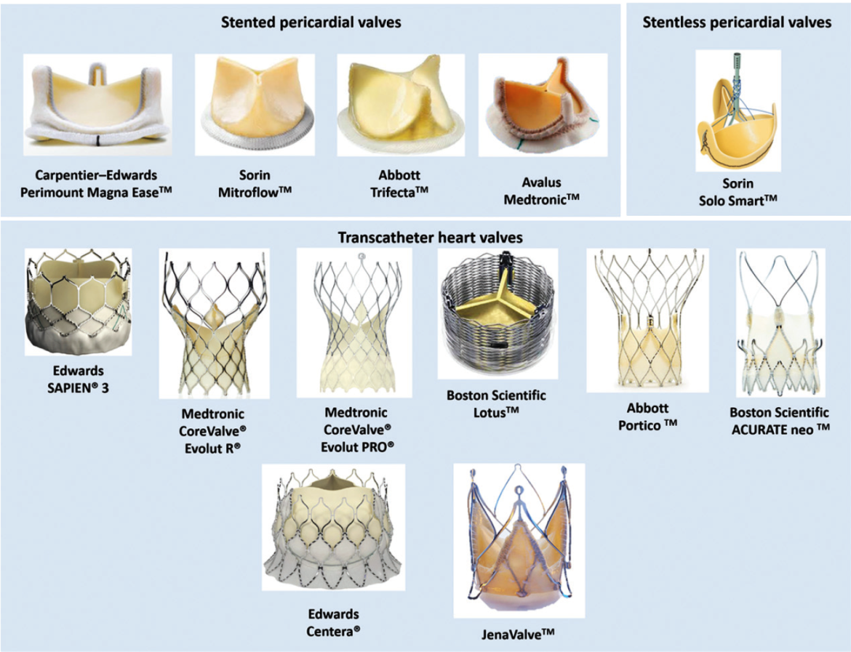
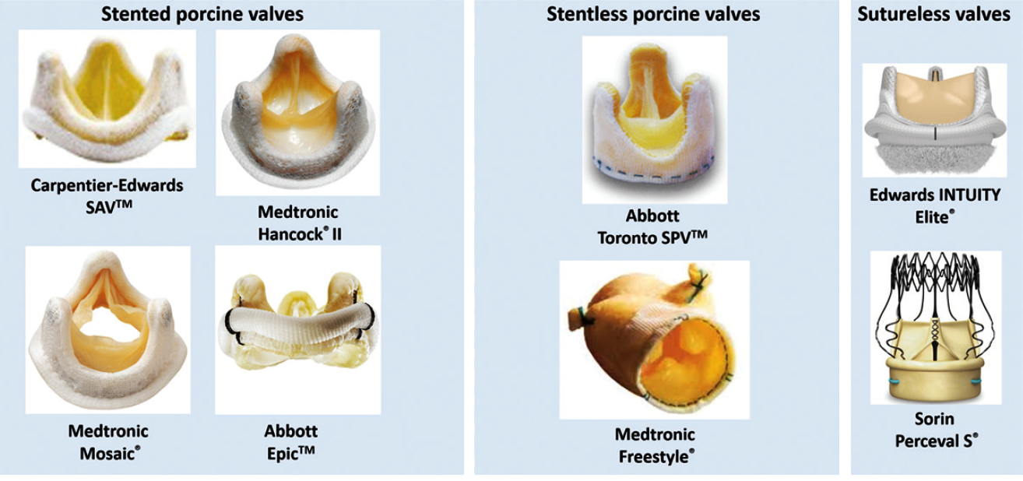
Various Types of Surgical and Transcatheter
Heart Valves
Rodriguez-Gabella et al., J Am Coll Cardiol 2017;70:1013

Slide 20
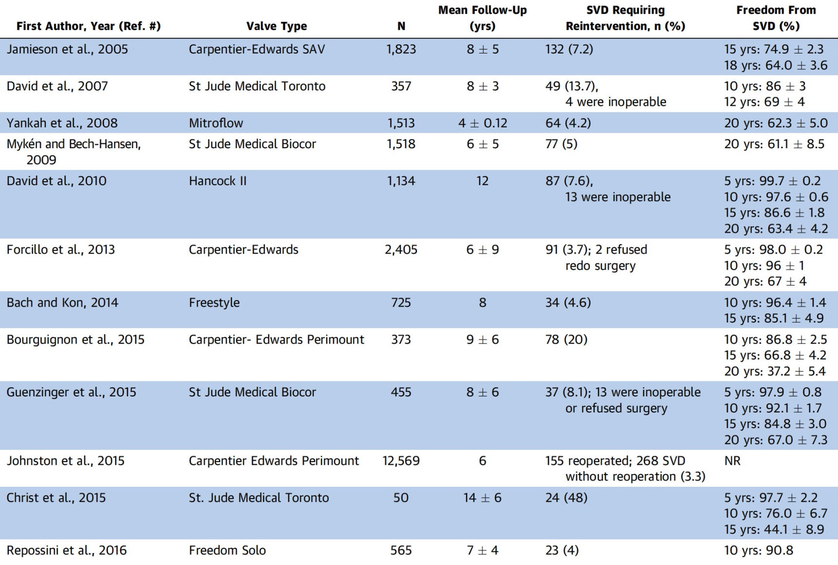
Studies on Surgical Bioprosthesis Durability
Rodriguez-Gabella et al., J Am Coll Cardiol 2017;70:1013

Slide 21
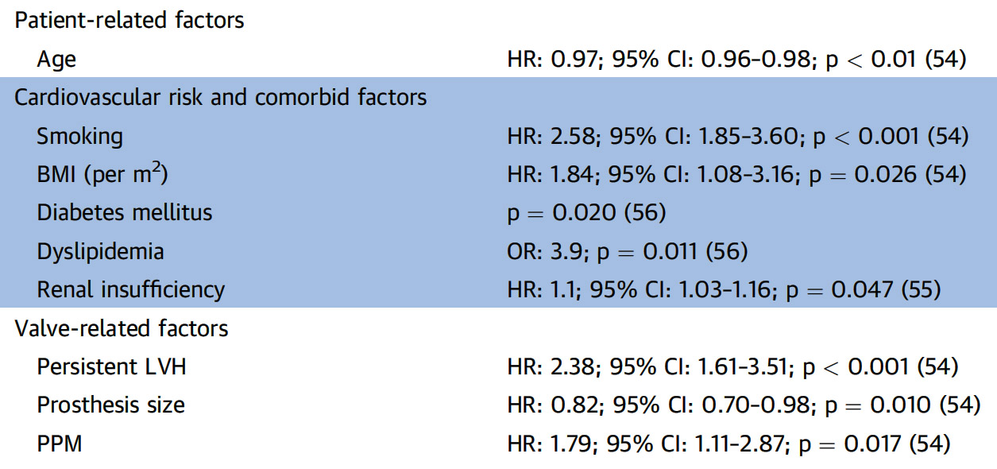
Predictors of Structural Valve Degeneration (Aortic Bioprosthesis)
Rodriguez-Gabella et al., J Am Coll Cardiol 2017;70:1013

Slide 22
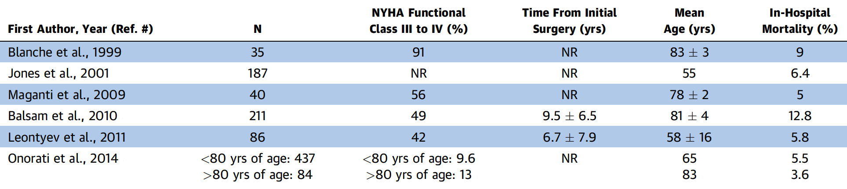
Selected Series of Re-operative Isolated SAVR
Rodriguez-Gabella et al., J Am Coll Cardiol 2017;70:1013

Slide 23
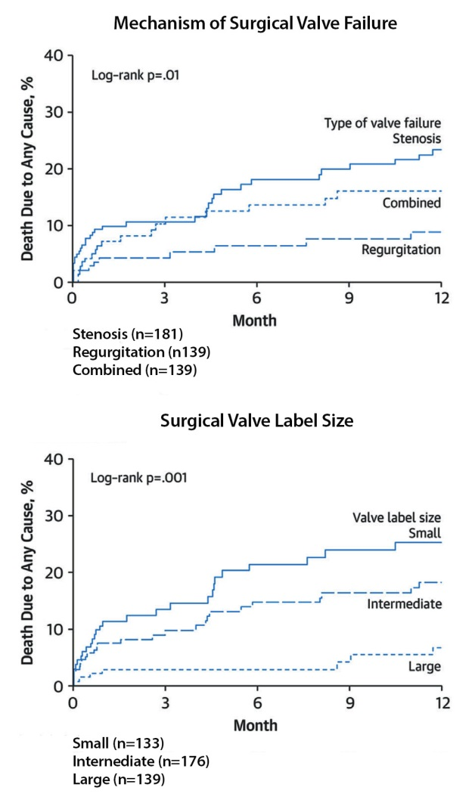
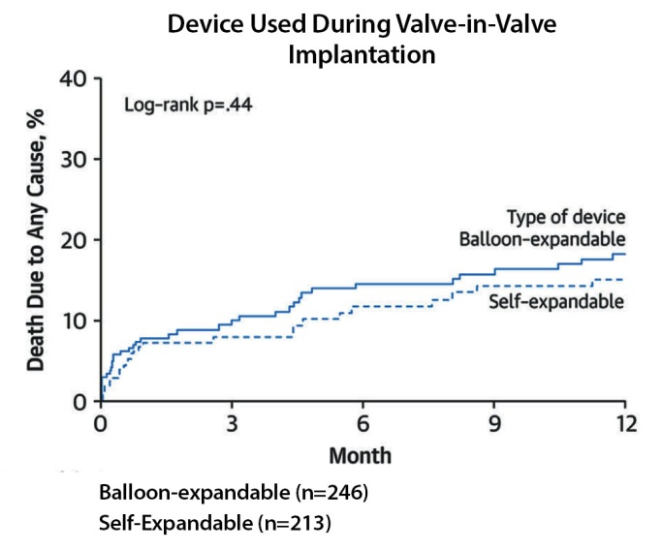
Valve-in-Valve Procedures: 1-Yr Follow-Up Mortality Rates
Rodriguez-Gabella et al., J Am Coll Cardiol 2017;70:1013

Slide 24
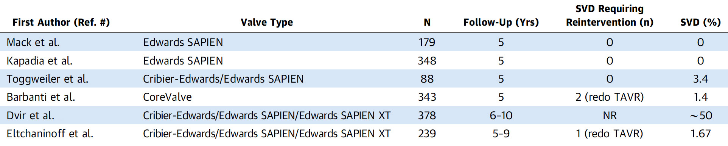
Studies on Transcatheter Valve Durability
5.0

Slide 25
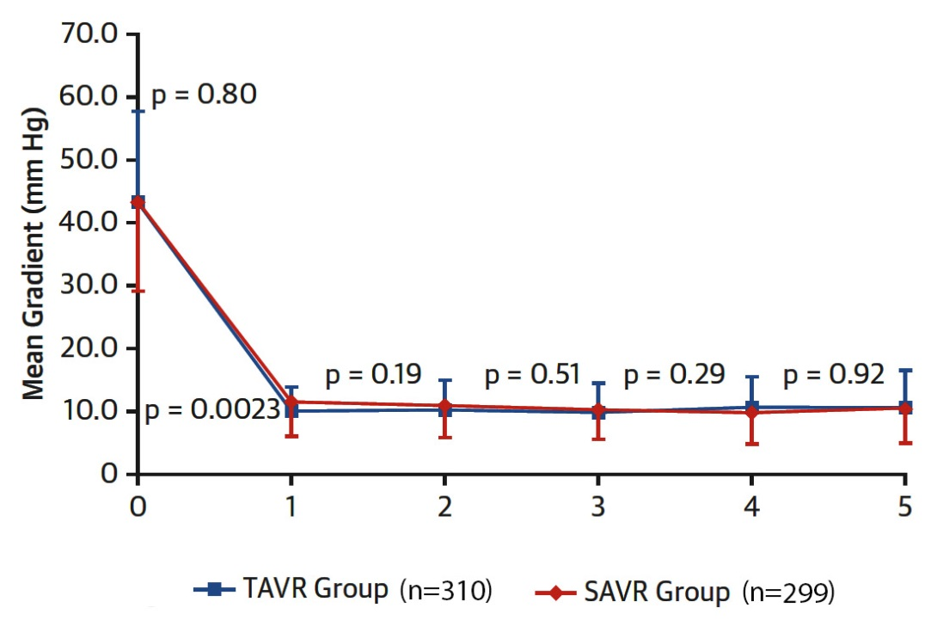
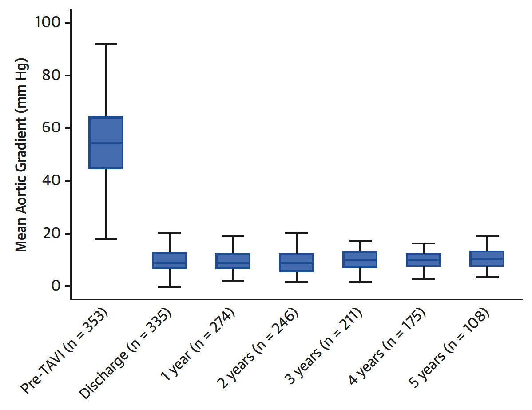
Partner 5-Yr F/U
CoreValve 5-Yr F/U
Echo Evaluation
Echo evaluation
Rodriguez-Gabella et al., J Am Coll Cardiol 2017;70:1013
Rodriguez-Gabella et al., J Am Coll Cardiol 2017;70:1013

Slide 26
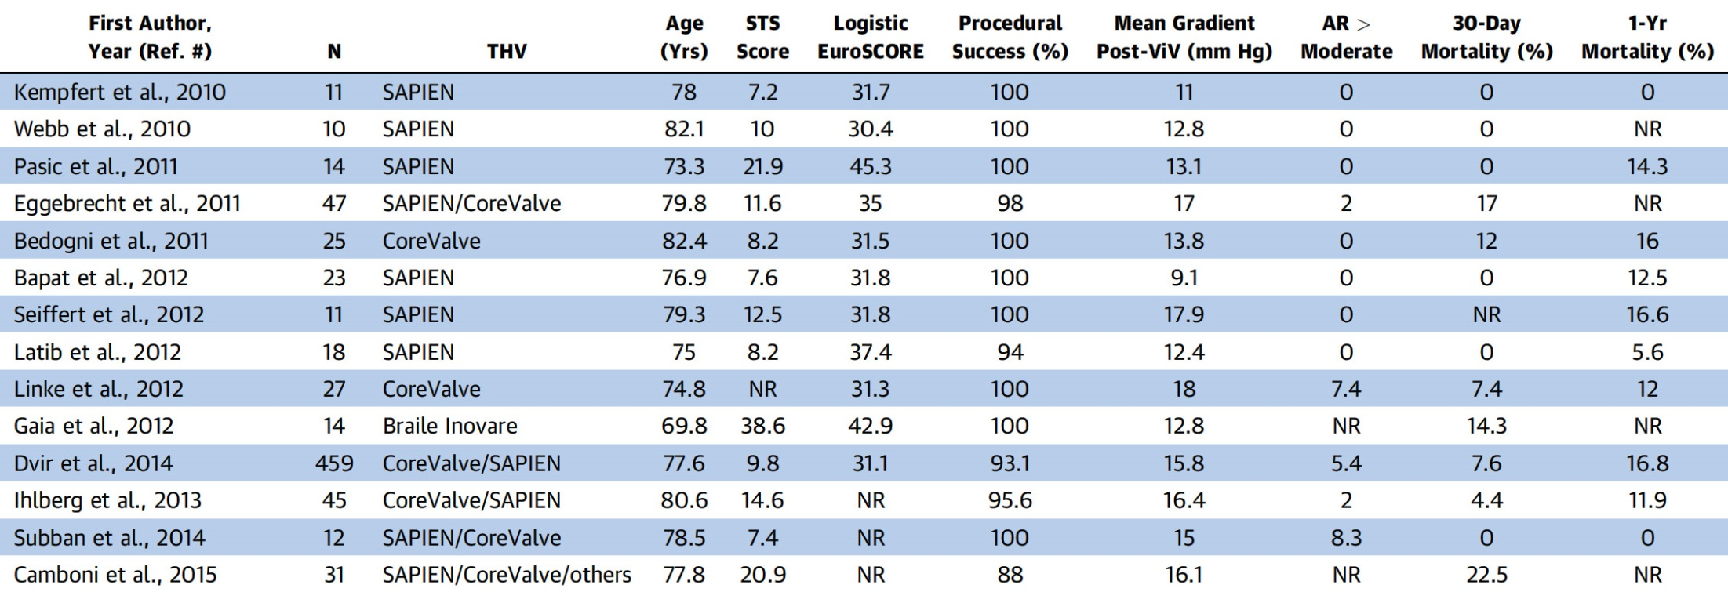
Studies in ViV TAVR Procedures
Rodriguez-Gabella et al., J Am Coll Cardiol 2017;70:1013

Slide 27
Main Complications Associated with Aortic
ViV Procedures & Conventional Native Valve TAVR
Complications | Valve-in-valve TAVR | Native Valve TAVR
Elevated post-procedural gradients | +++ | +
Coronary obstruction | +++ | +
Malpositioning | ++ | +
Vascular complications | + | ++
Permanent pacemaker | + | +++
Paravalvular leak | - | ++
Annulus rupture | - | +

Slide 28
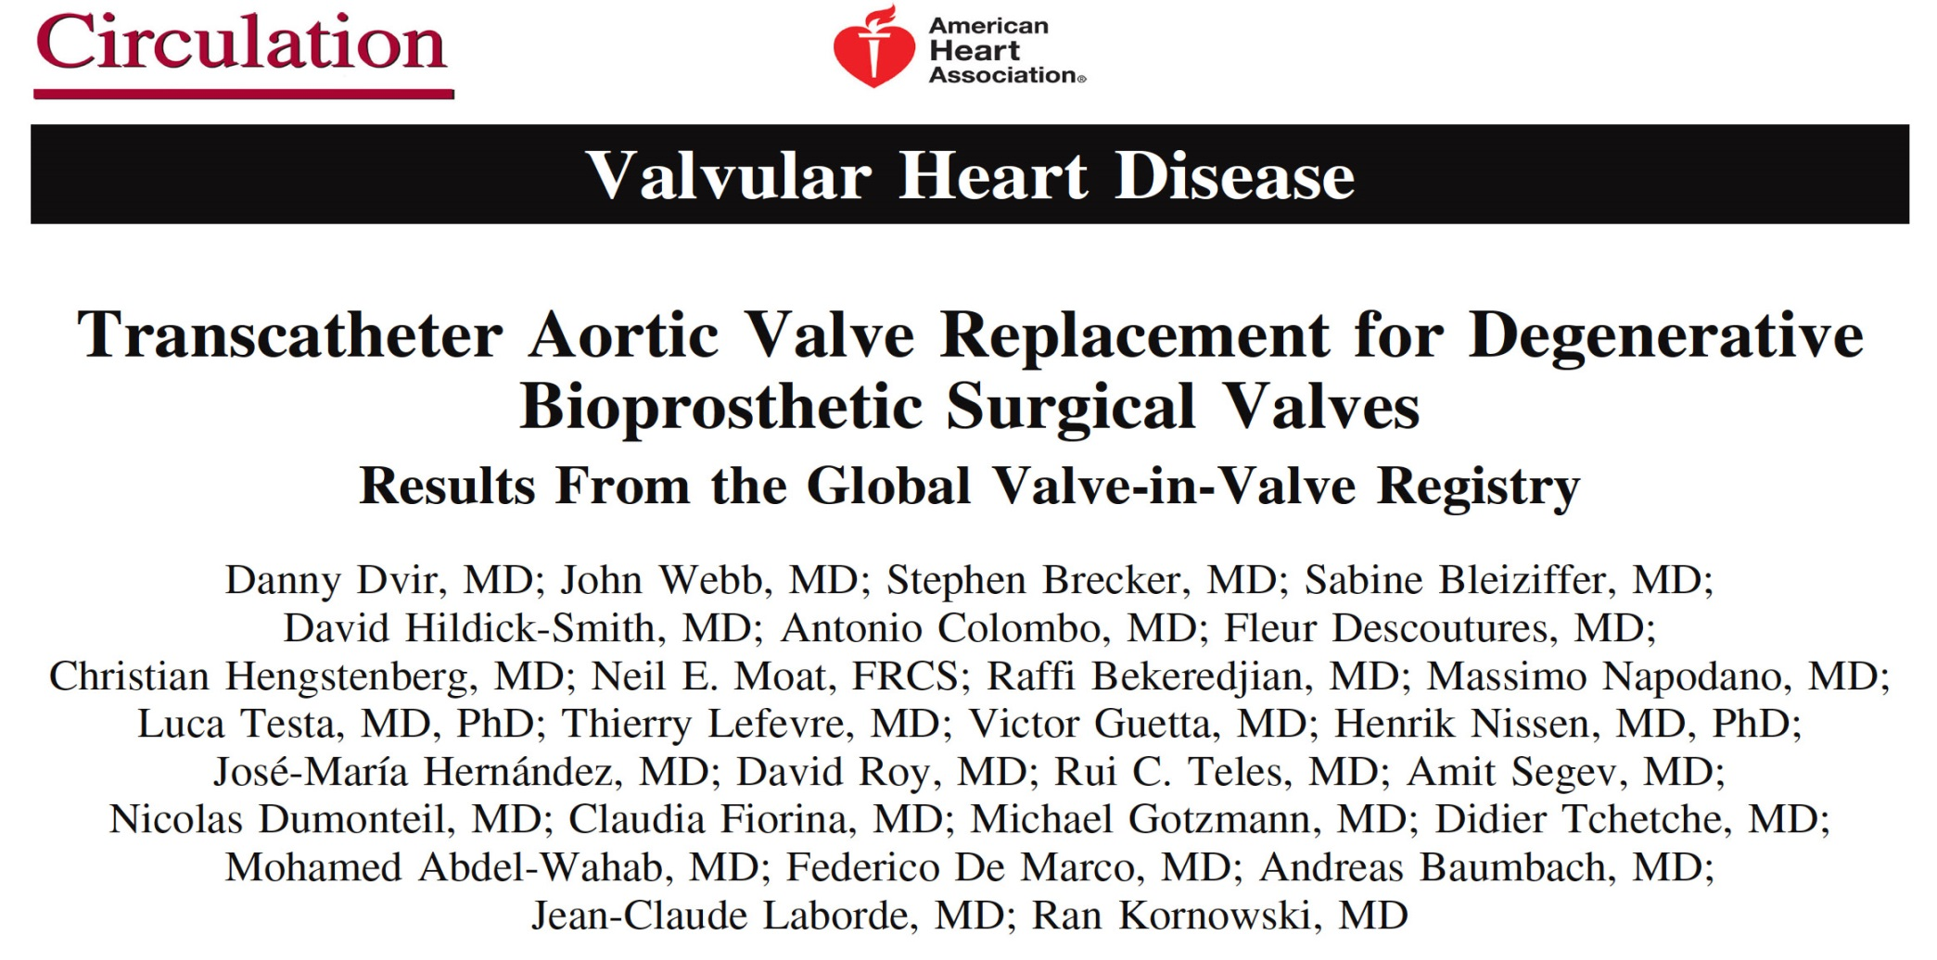

Slide 29
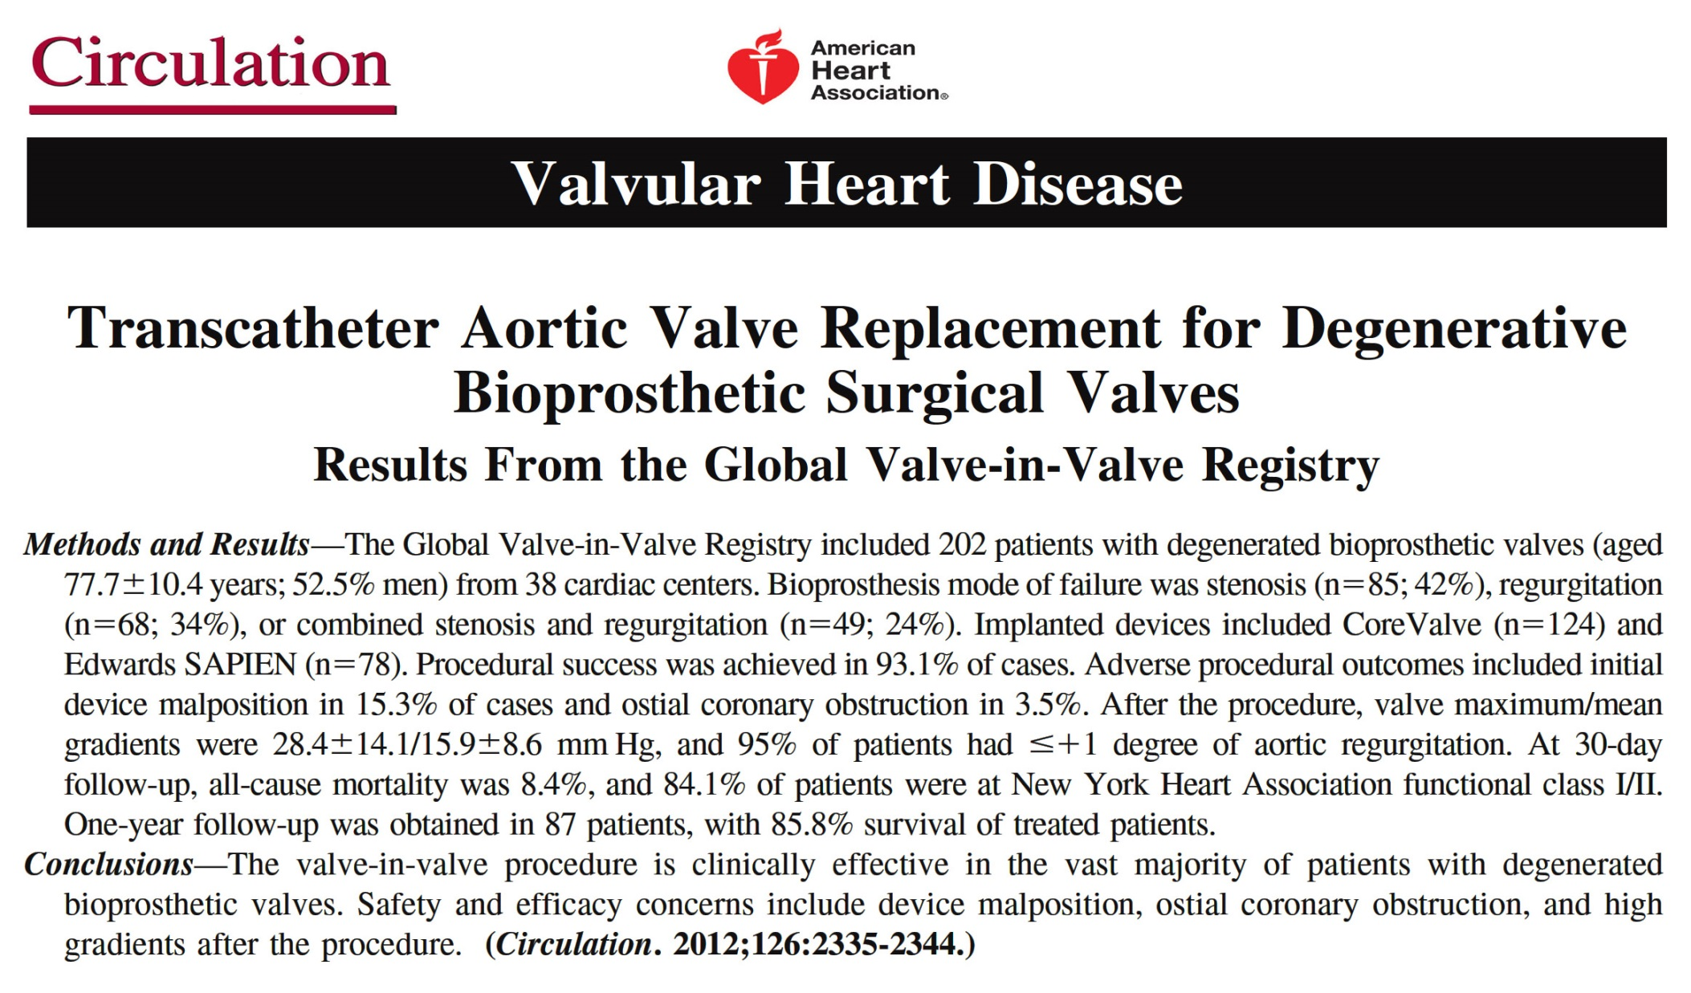

Slide 30
TAVR for Bio-prosthetic Valve Failure:
Valve-in-Valve TAVR
365 high-risk patients with aortic bio-prosthesis failure treated with TAVR
30-day and 1-yr all-cause mortality was 2.7% and 12.4% respectively
Webb et al., J Am Coll Cardiol 2017;69:2253

Slide 31
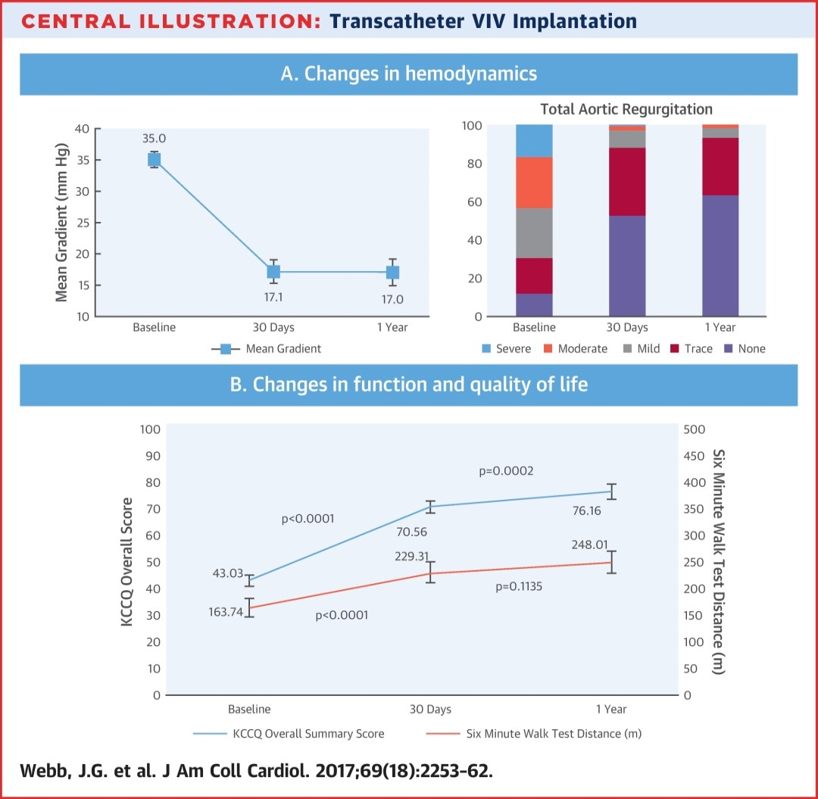
TAVR for Bio-prosthetic Valve Failure:
Valve-in-Valve TAVR
Webb et al., J Am Coll Cardiol 2017;69:2253

Slide 32
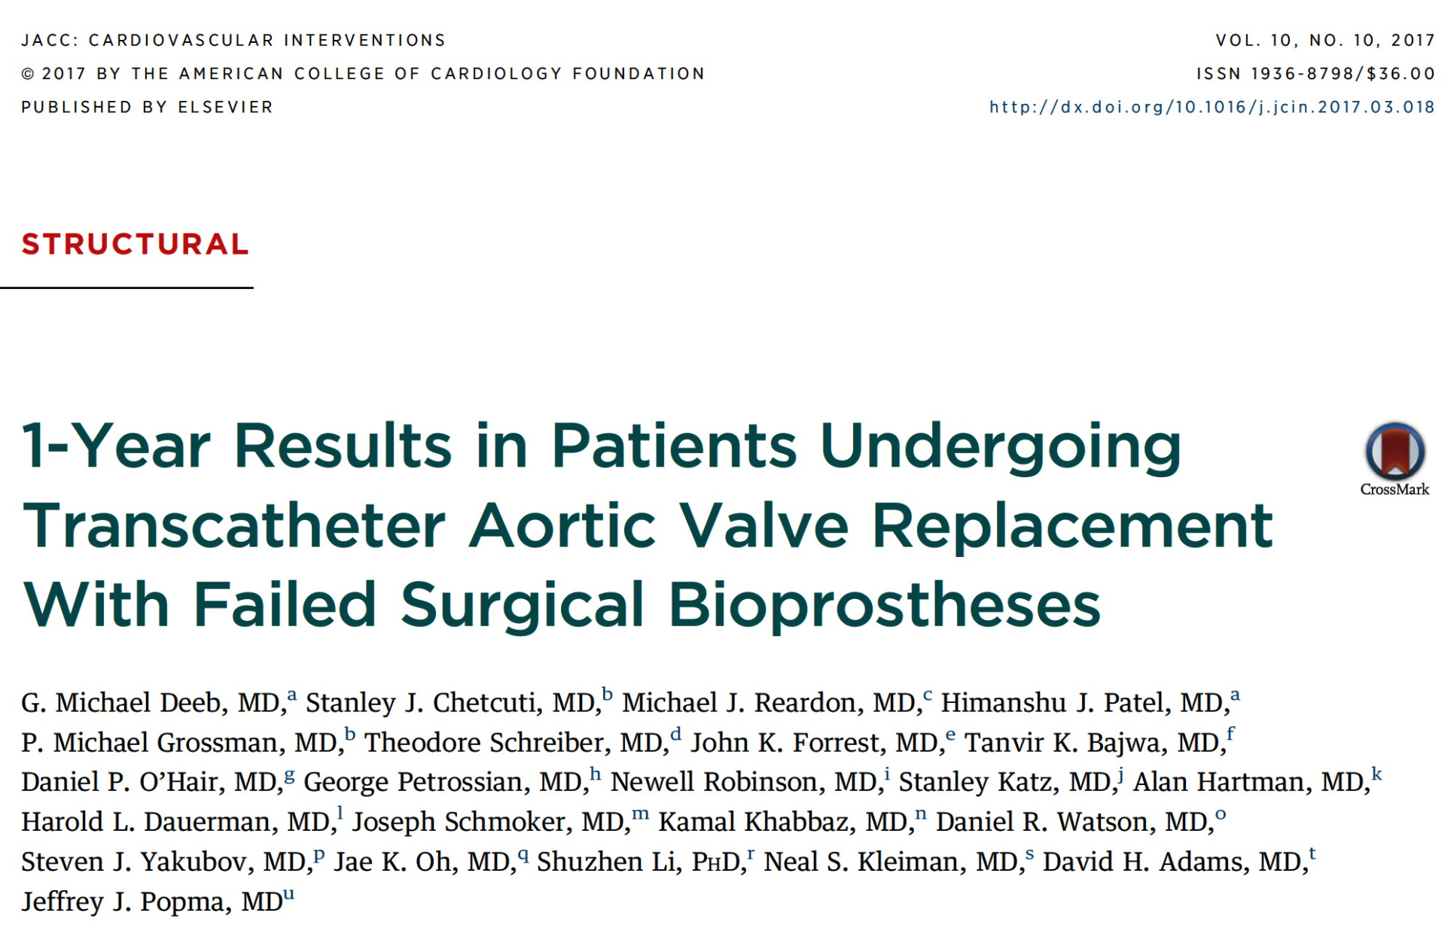

Slide 33
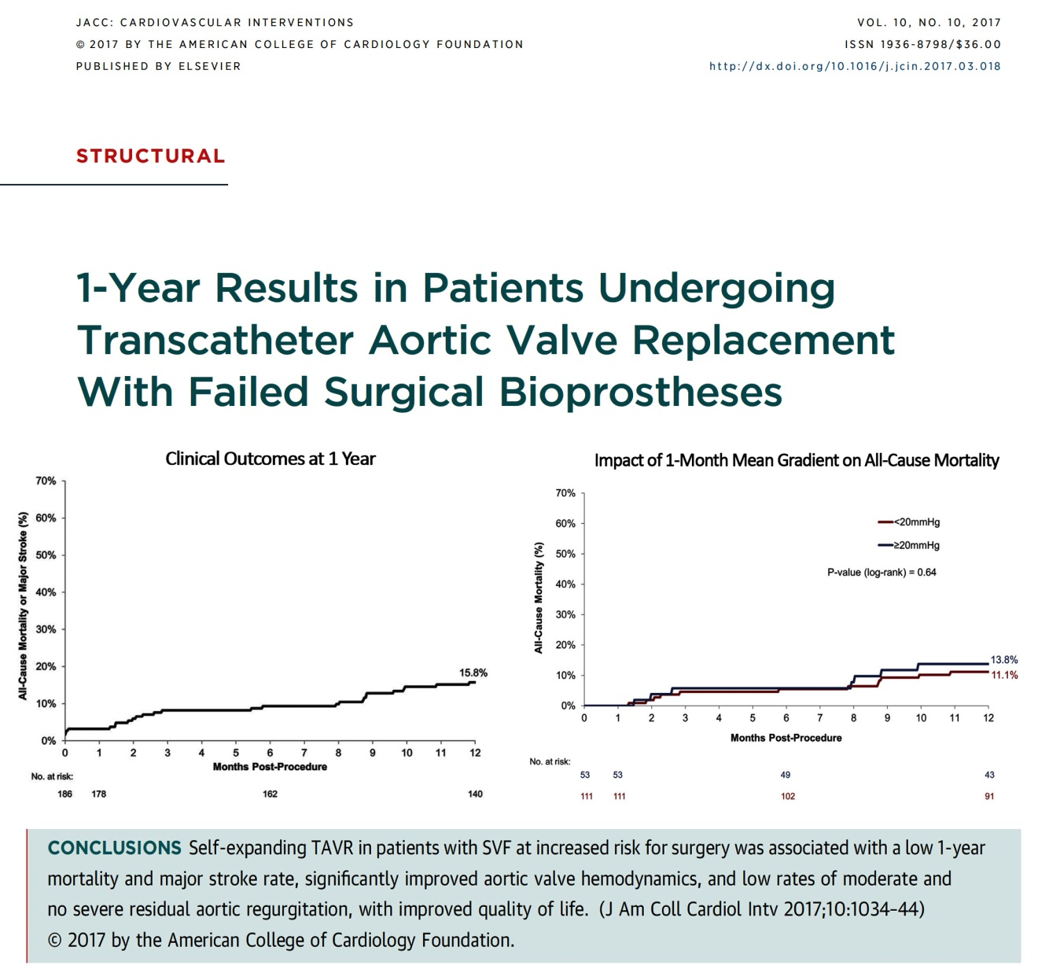

Slide 34
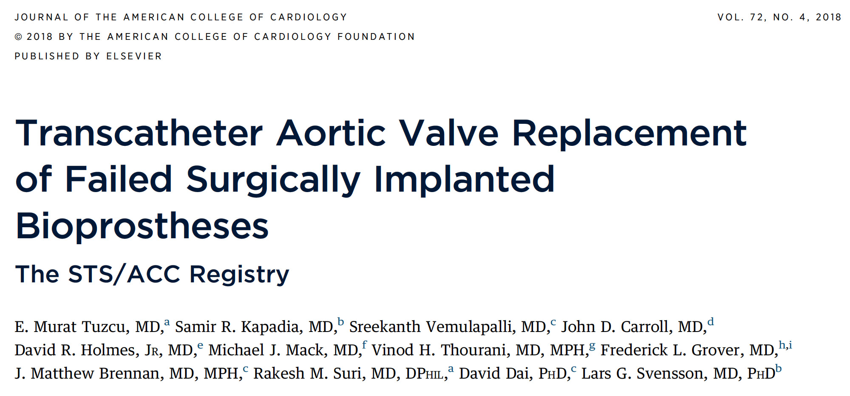

Slide 35
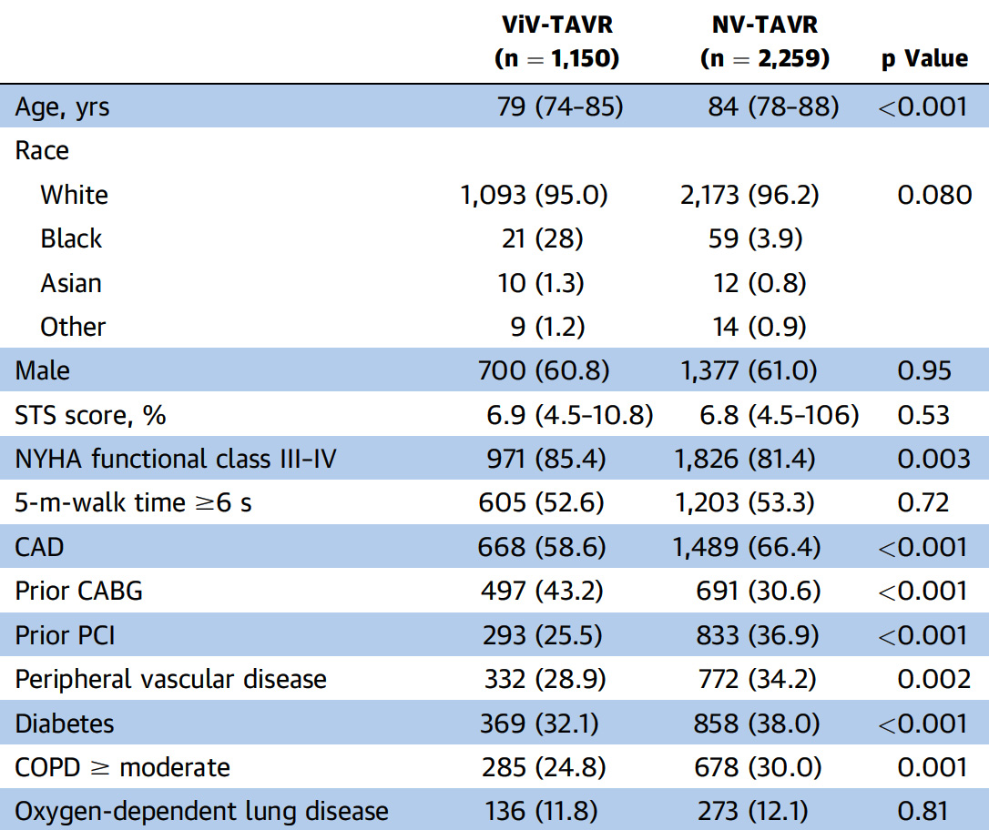
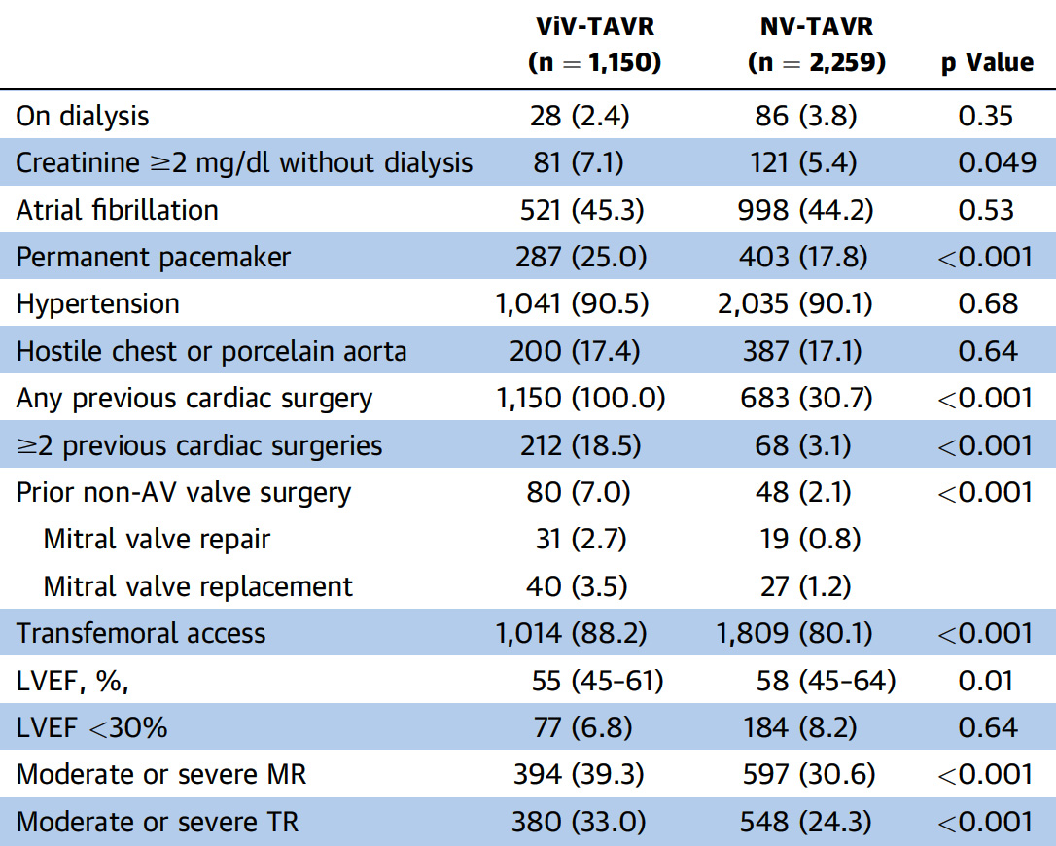
Baseline Characteristics of the Patients
Tuzcu et al., J Am Coll Cardiol 2018;72:370

Slide 36
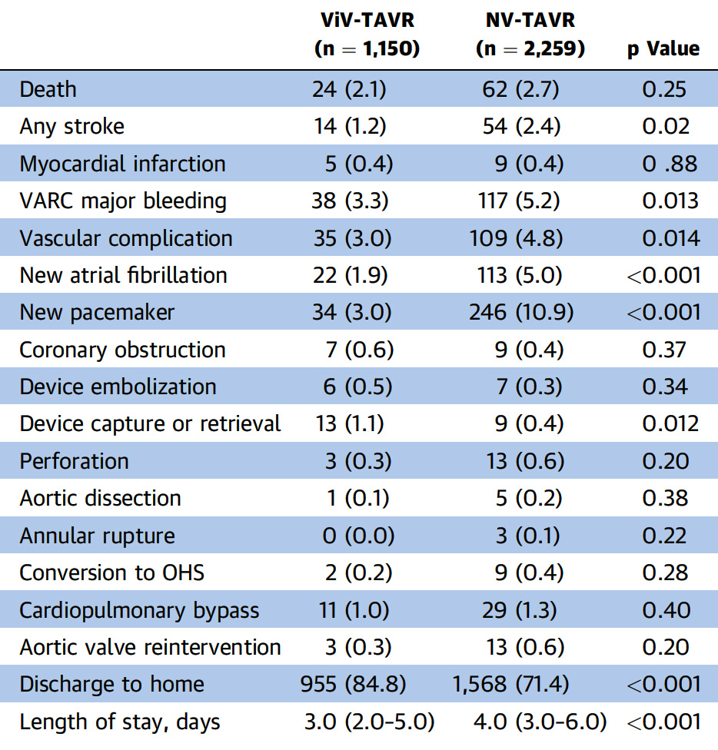
In-Hospital Outcomes
Tuzcu et al., J Am Coll Cardiol 2018;72:370

Slide 37
Post-TAVR In-Hospital Echocardiographic Measurements
Measurement | ViV (n=1,150) | NV (n=2,259) | p Value
AVG mean, mm Hg | 16.0 (10.0-22.0) | 9.0 (6.0-12.0) | <0.001
AVA, cm² | 1.3 (1.1-1.8) | 1.8 (1.4-2.2) | <0.001
Aortic regurgitation, % |  |  | <0.001
None | 55.0 | 37.4
Trace | 24.7 | 26.0
Mild | 16.8 | 30.0
Moderate | 3.0 | 5.8
Severe | 0.5 | 0.8
Tuzcu et al., J Am Coll Cardiol 2018;72:370

Slide 38
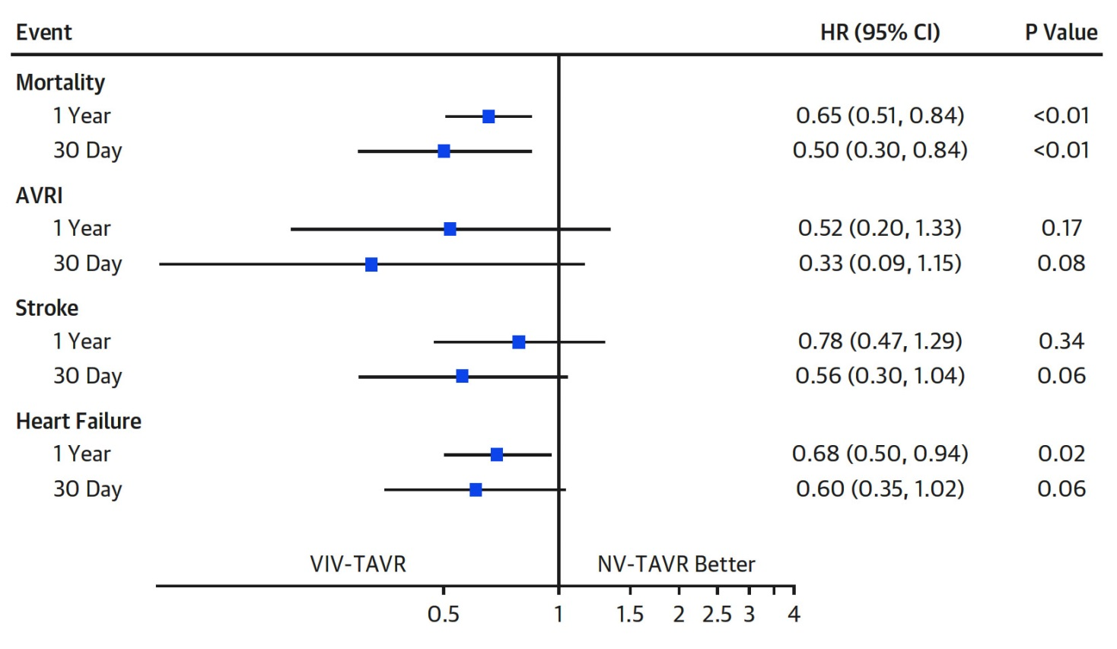
30-Day and 1-Year Hazard Ratios
For All-cause mortality, Stroke, Hospitalization for HF, and AVRI in ViV-TAVR and Matched NV-TAVR Patients
AVRI – aortic valve re-intervention
NV – native valve
Tuzcu et al., J Am Coll Cardiol 2018;72:370

Slide 39
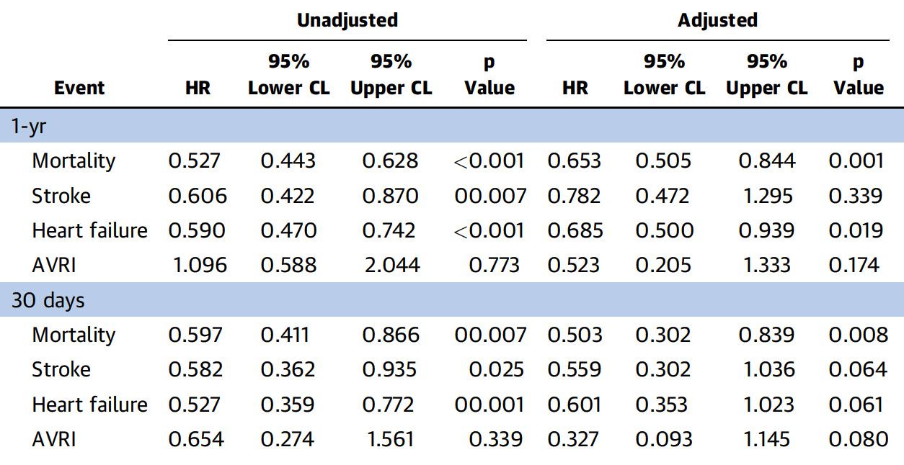
Unadjusted and Adjusted 30-Day and
1-Year Outcomes
Tuzcu et al., J Am Coll Cardiol 2018;72:370

Slide 40
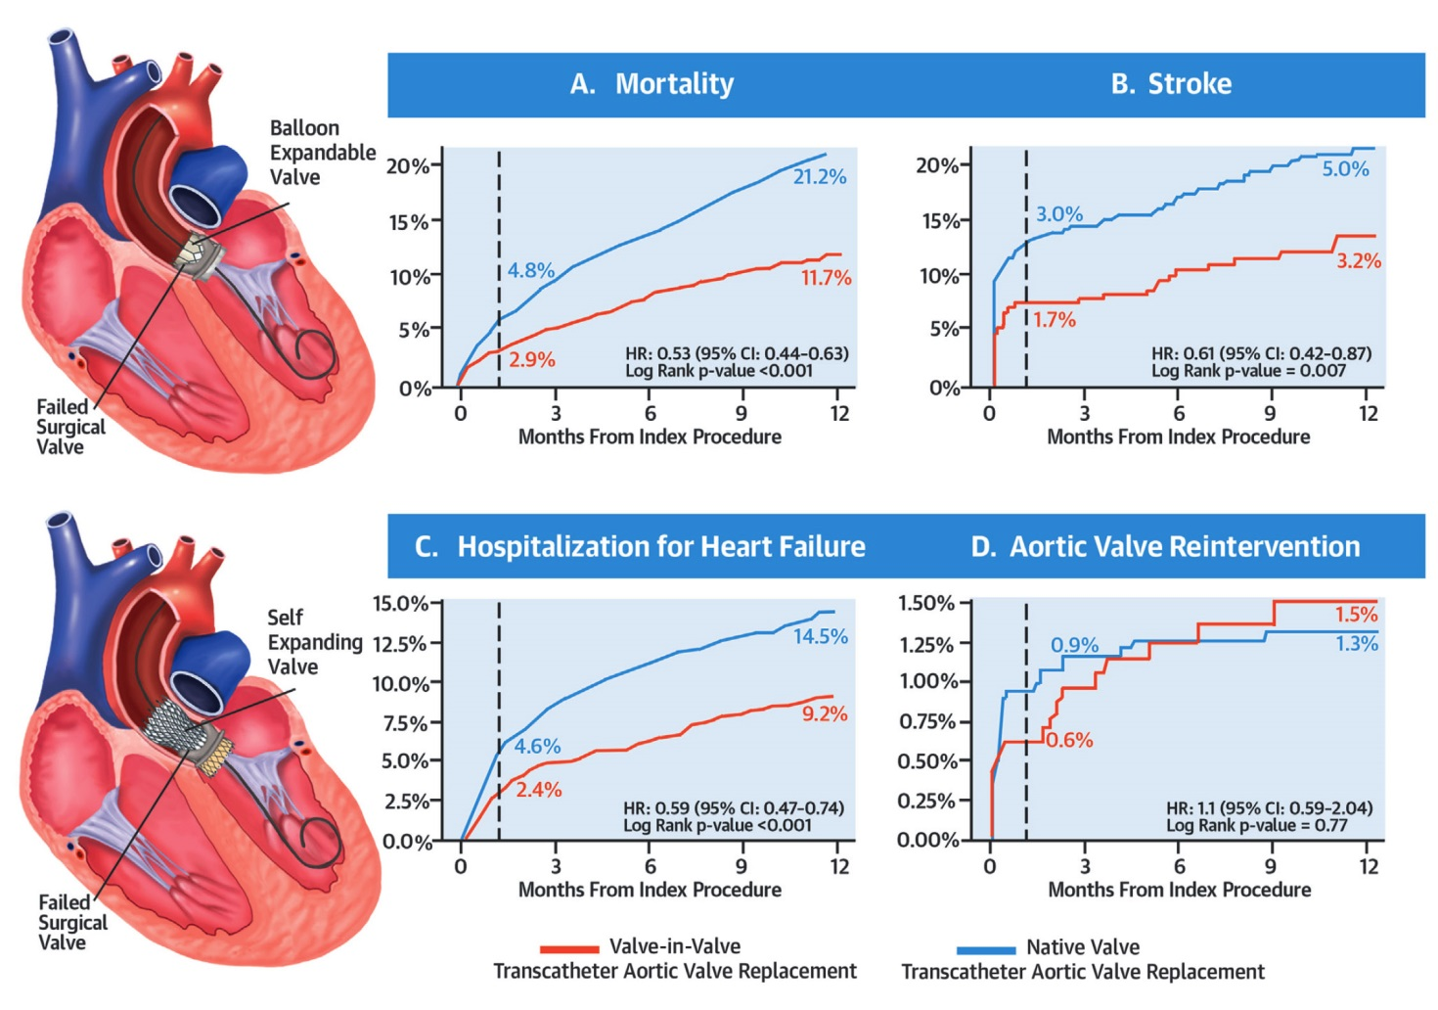
Valve-in-Valve TAVR vs Native Valve TAVR for AS
Tuzcu et al., J Am Coll Cardiol 2018;72:370

Slide 41
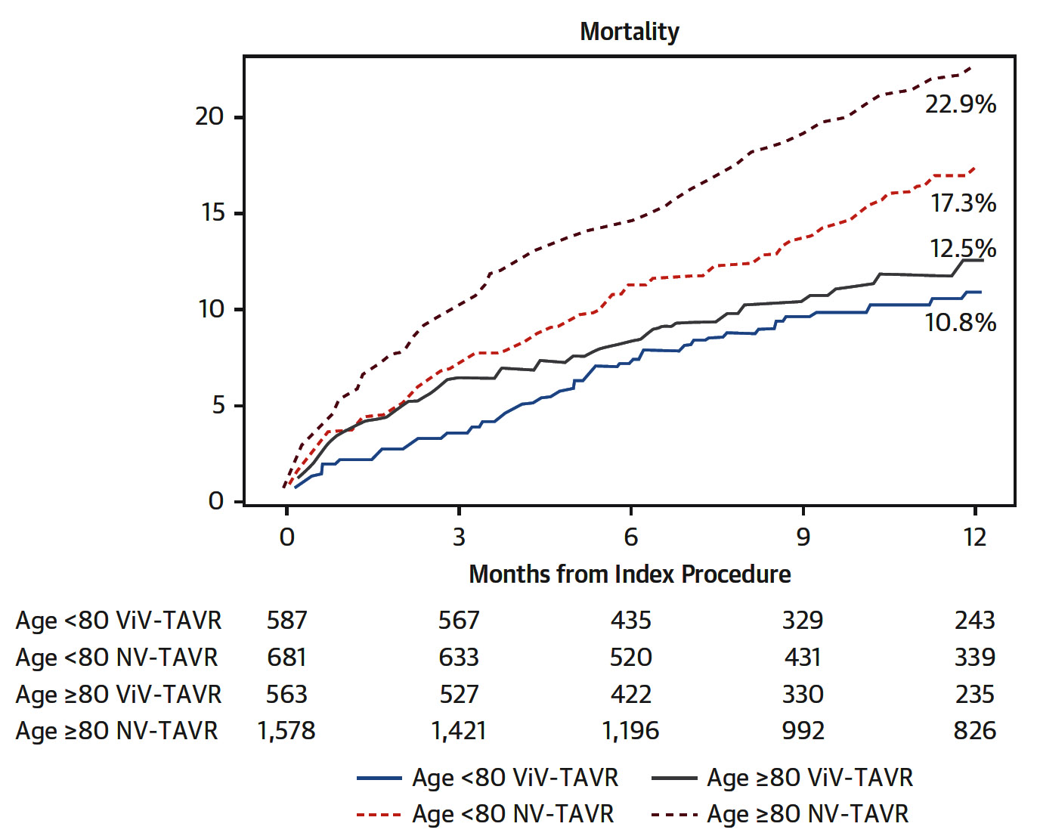
Cumulative Incidence Curves of All-Cause
Mortality in ViV-TAVR and Matched NV-TAVR Patients
(<80 yrs and >80 Yrs of Age)
Tuzcu et al., J Am Coll Cardiol 2018;72:370

Slide 42
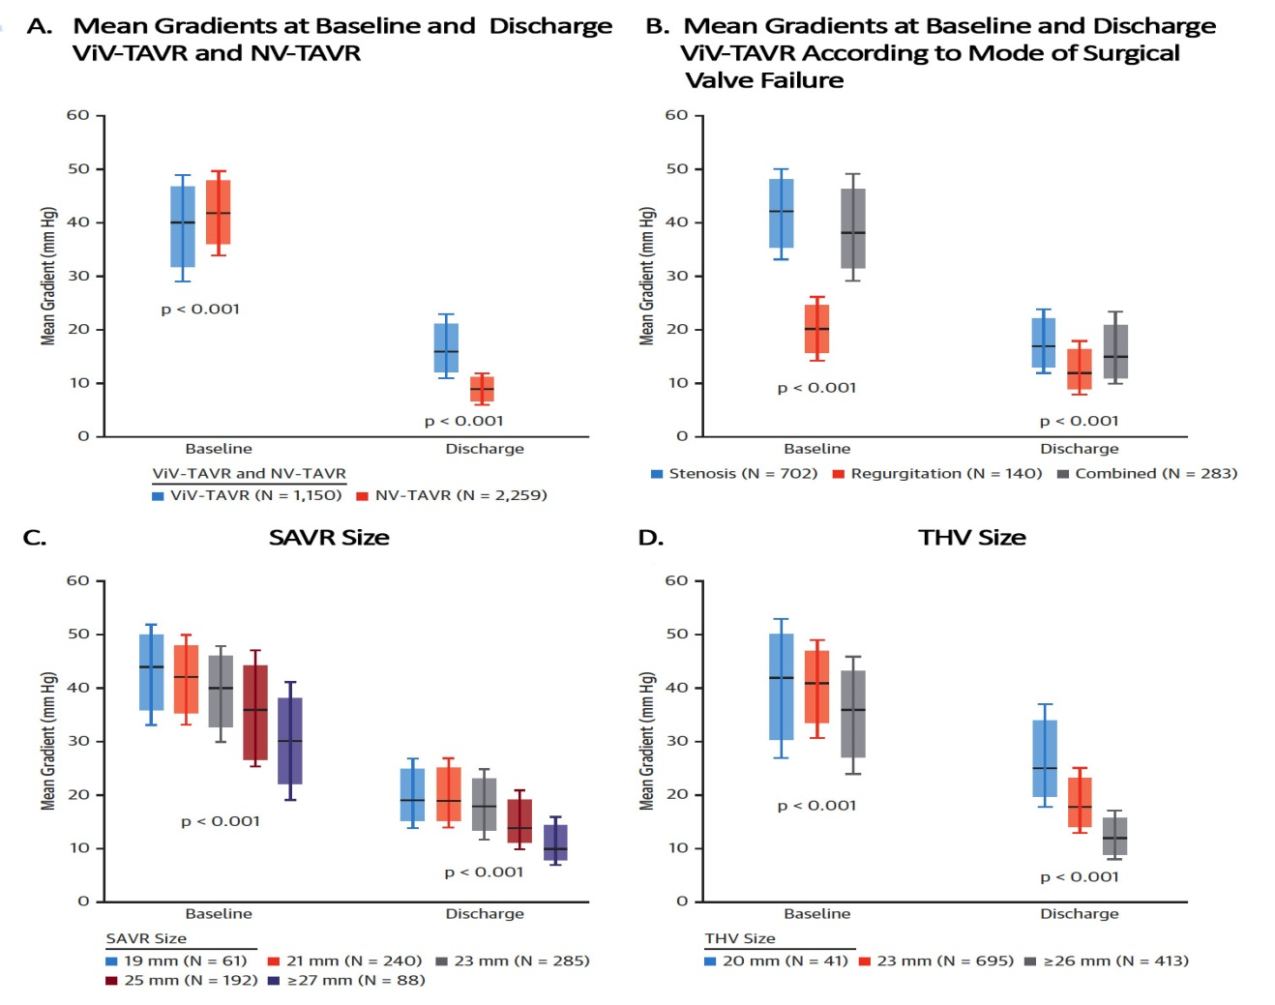
Echocardiographic Outcomes
Tuzcu et al., J Am Coll Cardiol 2018;72:370

Slide 43
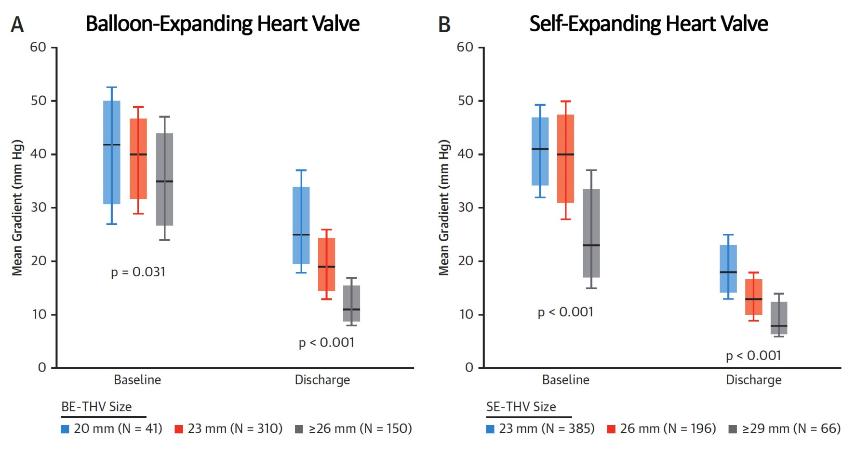
Mean Gradients at Baseline and Discharge
ViV-TAVR by Transcatheter Heart Valve (THV) Type
Tuzcu et al., J Am Coll Cardiol 2018;72:370

Slide 44
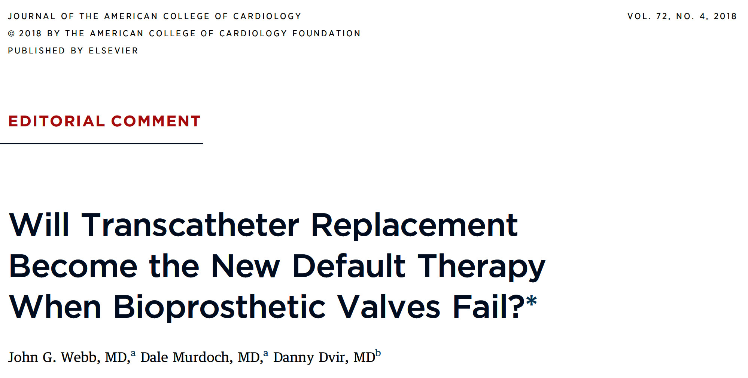

Slide 45
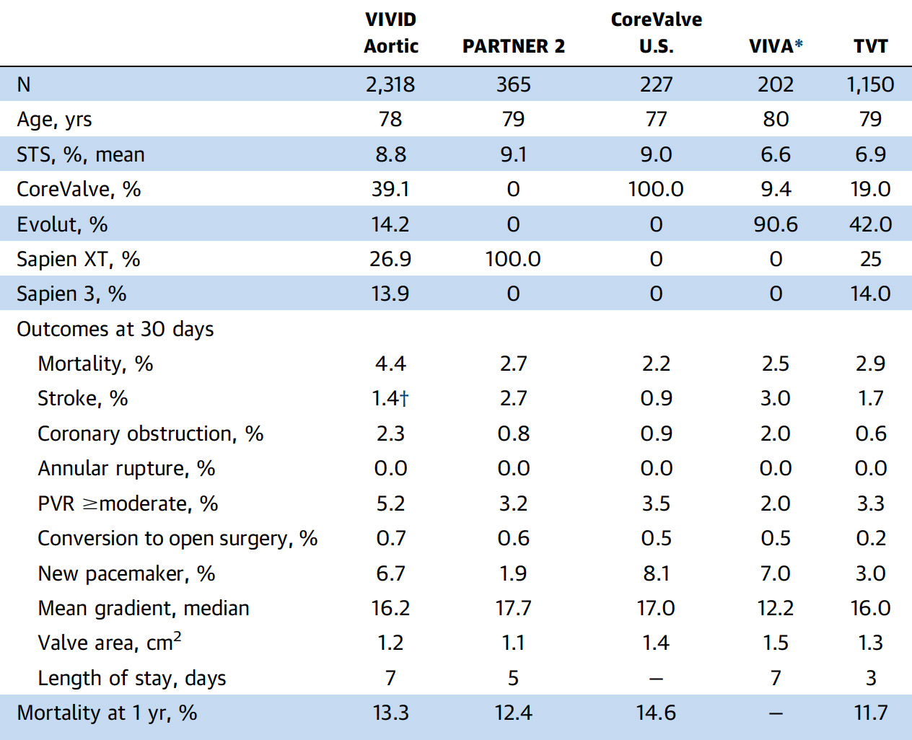
Large Multicenter Studies of Aortic ViV-TAVR in High-Risk Patients
Webb et al., J Am Coll Cardiol 2018;72:383

Slide 46
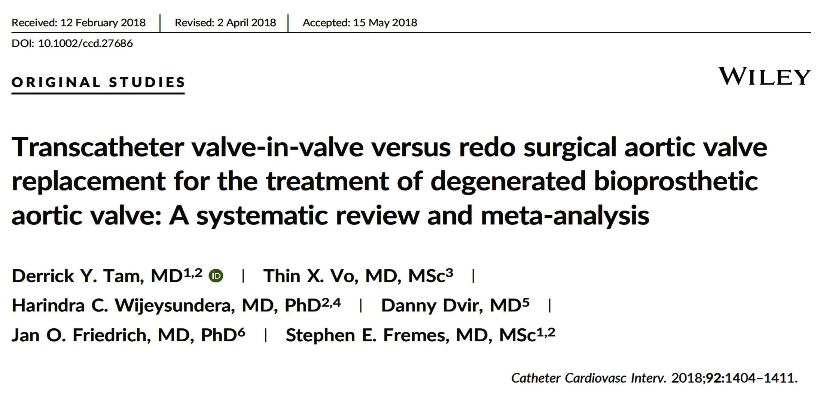

Slide 47
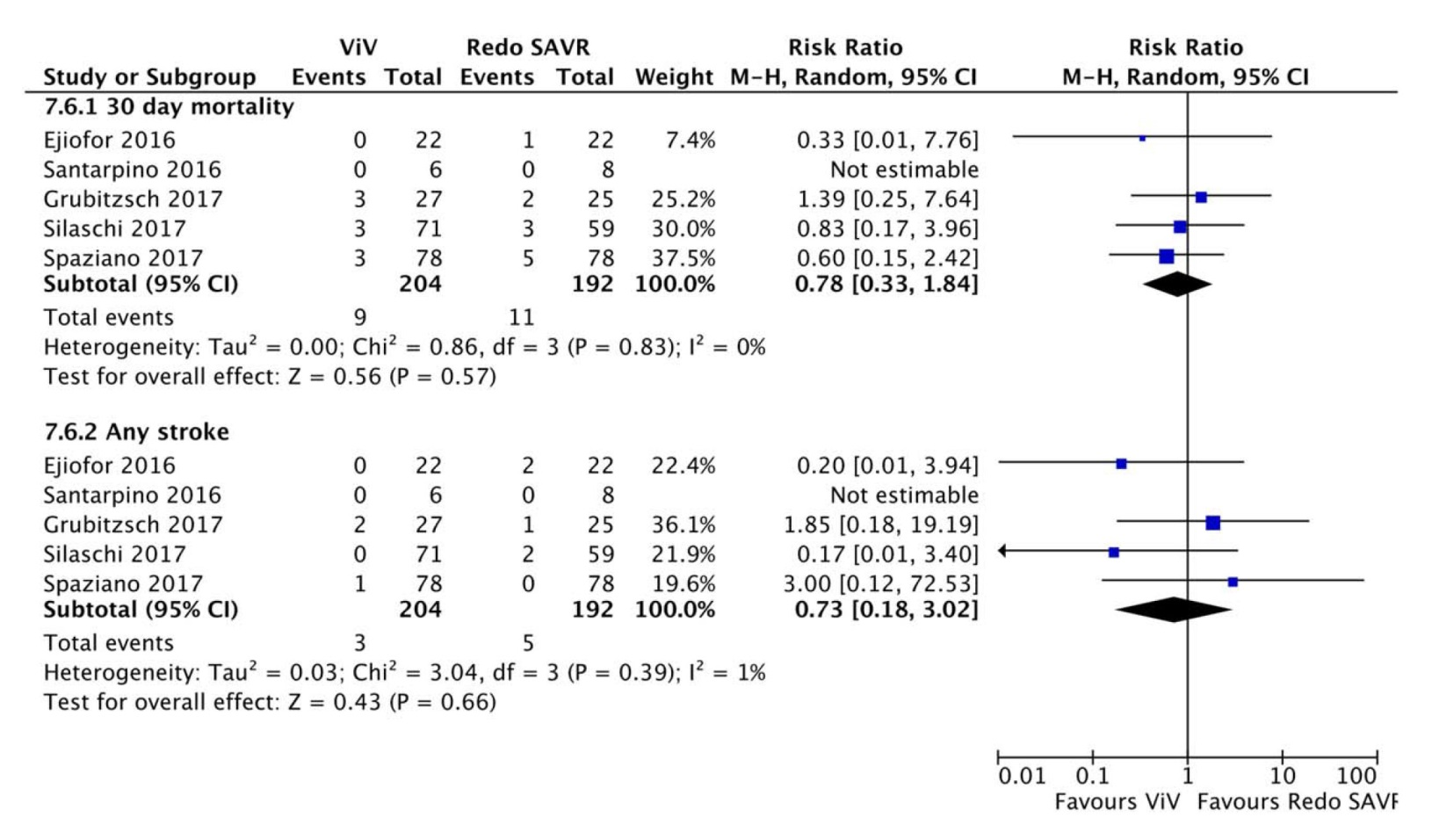
Perioperative Mortality and Stroke Between Valve-in-Valve TAVR and Redo SAVR
Tam et al., Catheter Cardiovasc Interv 2018;92:1404

Slide 48


Slide 49
Take Home Messages for Valve-in-Valve TAVR
Bio-prosthetic aortic valve degeneration is becoming an emerging entity undergoing TAVR (ViV TAVR) especially in high risk pts. ViV TAVR data are encouraging with better outcomes vs native valve AS TAVR. Technically TAVR procedure is also simpler in these pts with very low procedural complications except for higher coronary obstructions
The choice of TAVR valve in ViV cases suggests better hemodynamics after self-expanding vs balloon-expandable TAVR valve likely due to supra-annular valve position in the CoreValve frame. Mid-term mortality and MACE in the published literature appears to be similar but long-term data (5yrs+) are awaited.

Slide 50

Question # 1
Following are the true statements regarding ViV TAVR vs Native valve AS TAVR are true except:
  ViV has lower mortality
  ViV has lower PPM rate
  ViV has lower coronary obstruction
  ViV has higher residual aortic gradient
Correct answer: C

Slide 51

Question # 2
Following is the RCT of TAVR vs SAVR in ViV for degenerated bio-prosthetic AV:
  PARTNER-3
  SURTAVI
  GALALIEO
  NONE
Correct answer: D

Slide 52
Question # 3
Following is the true statement regarding results of valve type in ViV TAVR:
  A. SE valve have lower mortality vs BE valve
  B. SE valve have higher CVA vs BE valve
  C. SE valve have lower residual gradient vs BE valve
  D. SE valve have higher dysfunction vs BE valve
Correct answer: C

