Slide 1
Structural Heart Live Cases
Supported by:
Medtronic inc
Bard Inc
Terumo Medical Corp

Slide 2
Disclosures
Samin K. Sharma, MD, FACC
Speaker’s Bureau – Boston Scientific Corp., Abbott Vascular Inc, ABIOMED, CSI
Annapoorna S. Kini, MD, FACC
Nothing to disclose
Gilbert Tang, MD
Physician proctor for Medtronic
Arash Salemi, MD
Physician proctor for Medtronics

Slide 3
March 13th 2018 Structural Heart Live #22: MW, 94 yo F
Presentation: Worsening dyspnea on exertion NYHA Class III, orthopnea, PND and LE edema x 3 weeks
PMH: Hypertension, hyperlipidemia, s/p PCI on 1/9/18 (pLAD and D1), chronic AFib, CKD stage IV, cardiac cath complicated by RSFA perforation s/p Viabahn covered stent, frailty
Medications: ASA, Atorvastatin, Clopidogrel, Diltiazem, Metoprolol, Rivaroxaban, Furosemide, Synthroid
EKG (10/09/17): Atrial fibrillation at 80 bpm, No BBB
TTE (02/21/18): EF 60%, mild LVH, paradoxical LFLG severe AS (PG/MG/AVA= 38/19/0.73), dimensionless index = 0.22, mild AR, decreased RVSF with dilated RV, severe TR, PASP 71 mmHg.
Cath (01/09/18): II V AD: CTO pRCA, LAD/D1 lesion s/p PCI and BAV with 20 mm Z-Med II valvuloplasty balloon

Slide 4
Trans Thoracic Echo
Severe AS
Mild AR

Slide 5
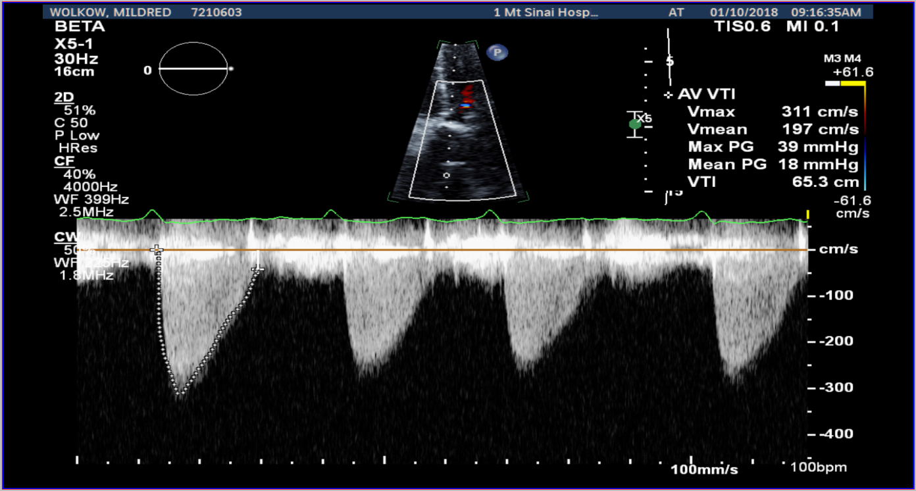
Trans Thoracic Echo
Paradoxical Low Flow, Low Gradient Severe AS
PG/MG/AVA = 39 mmHg/ 18 mmHg/ 0.7cm2
Dimensionless index = 0.22
LVEF 60%

Slide 6
March 13th 2018 Structural Heart Live # 22: MW, 94 yo F
STS risk mortality: 9.3%
EuroScore II risk: 5.8%
Logistic Euroscore mortality: 32.1%
CT Angiography: Mean aortic annulus diameter of 22.3mm and bilateral lower extremity peripheral arterial accesses have minimal diameters 5.5-6.0 mm with heavy calcification; R > L

Slide 7
CTA: Aortic Annulus
Aortic Root
Aortic Root Angle = 63°
Annulus
Min: 19.8 mm
Max: 24.8 mm
Mean: 22.3 mm
Perimeter = 70.7 mm
Area = 386.5 mm²

Slide 8
CTA: STJ and Coronary Ostium
STJ Height = 20 mm
LMCA Height = 13.5 mm
RCA Height = 14.6 mm

Slide 9
Femoral Artery Access

Slide 10
Femoral Artery Access
Right Iliac/Femoral Anatomy
Major Access
Right CFA

Slide 11
Femoral Artery Access
Left Iliac/Femoral Anatomy
Minor Access
Left CFA

Slide 12
Great Vessel Anatomy for Sentinel Device

Slide 13
March 13th 2018 Structural Heart Live # 22: MW, 94 yo F
STS risk mortality: 9.3%
EuroScore II risk: 5.8%
Logistic Euroscore mortality: 32.1%
CT Angiography: Mean aortic annulus diameter of 22.3mm and bilateral lower extremity peripheral arterial accesses have minimal diameters 5.5-6.0 mm with heavy calcification
Course: Patient was evaluated by Heart Team and due to her multiple co-morbidities and frailty status, the patient was determined to be High Risk for SAVR
Plan: The patient was referred for TAVR

Slide 14
Medtronic Evolut-PRO Patient Selection
Our
Patient
22.3
70.7
25.8
20.0

Slide 15
Summary of Case
Presentation: 94 year old F with worsening NYHA Class III
TTE: Paradoxical Low Flow, Low Gradient Severe AS (PG/MG/AVA=38/19/0.73), dimensionless index = 0.22
STS risk mortality: 9.29 %
EuroScore II risk: 5.81%
Logistic Euroscore mortality: 32.1%
Course: Patient was evaluated by Heart Team and due to her multiple co-morbidities and frailty status, the patient was determined to be High Risk for SAVR
Plan: For TAVR with a 26mm Medtronic Evolut-Pro Corevalve via transfemoral access (right percutaneous) with planned Sentinel cerebral protection

Slide 16
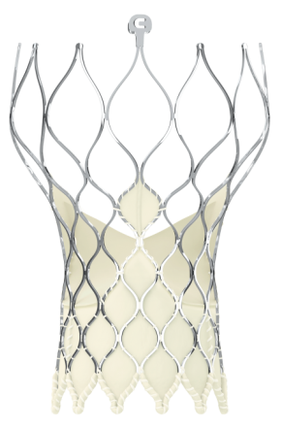
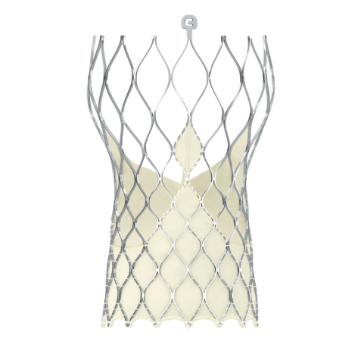
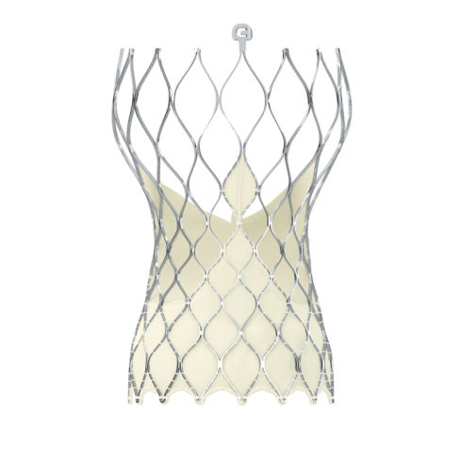
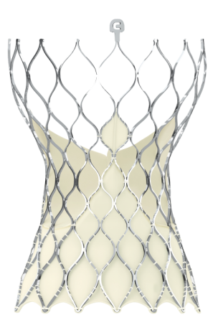
EVOLUT-R 29 MM Patient Selection Matrix
Criteria
Valve Size Selection
CoreValve Evolut R TAVR
Size | 23 mm | 26 mm | 29 mm | 34 mm
Annulus Diameter | 18 – 20 mm | 20 – 23 mm | 23 – 26 mm | 26 - 30 mm
Annulus Perimeter (π x Diam) | 56.5 – 62.8 mm | 62.8 – 72.3 mm | 72.3 – 81.7 mm | 81.7 – 94.2 mm
Sinus of Valsalva Diameter (Mean) | ≥ 25 mm | ≥ 27 mm | ≥ 29 mm | ≥ 31 mm
Sinus of Valsalva Height (Mean) | ≥ 15 mm | ≥ 15 mm | ≥ 15 mm | ≥ 16 mm
Our
Patient
23.6
75.8
35.8
23.4

Slide 17
Issues Related To The Case
TAVR vs SAVR in Low Risk Patients

Slide 18
Randomized TAVR Trials by Risk Group
Trial | STS Score (%) |  | Mortality (%) |  | Stroke (%) |  | >Mild AR (%) |  | Pacemaker (%)
 | TAVR | ST | TAVR | ST | TAVR | ST | TAVR | ST | TAVR | ST
PARTNER 1B | 11.2 | 12.1 | 30.7 | 50.7 | 10.0 | 4.5 | 10.5 | 4.2 | 4.5 | 7.8
CoreValve ER | 10.3 | - | 24.3 | - | 7.0 | - | 13.8 | - | 21.6 | -
Groups | TAVR | SAVR | TAVR | SAVR | TAVR | SAVR | TAVR | SAVR | TAVR | SAVR
PARTNER 1A | 11.8 | 11.7 | 24.2 | 26.8 | 6.0 | 3.1 | 6.8 | 1.9 | 5.7 | 5.0
CoreValve | 7.3 | 7.5 | 14.2 | 19.1 | 8.8 | 12.6 | 7.1 | 1.4 | 22.3 | 11.3
PARTNER 2A SURTAVI | 5.8 | 5.8 | 16.7 | 18.0 | 9.5 | 8.9 | 3.7 | 0.4 | 11.8 | 10.3
 | 4.5 | 4.2 | 11.4 | 11.6 | 6.2 | 8.4 | 5.3 | 0.6 | 25.9 | 6.6
Notion | 2.9 | 3.1 | 4.9 | 7.5 | 2.9 | 4.6 | 15.7 | 0.9 | 38.0 | 2.4
Extreme
Risk
High
Risk
Intermediate
Risk
Lower
Risk

Slide 19
TAVR for Low Risk AS patients
STS mortality risk of <3-4%
One Trial OUS: Notion Trial (Completed)- CoreValve
Two Trials in US have also completed:
PARTNER-3 of Sapien-3 vs SAVR (n=1228)
Evolut-R/Pro CoreValve vs SAVR (n=1200)
Trials

Slide 20
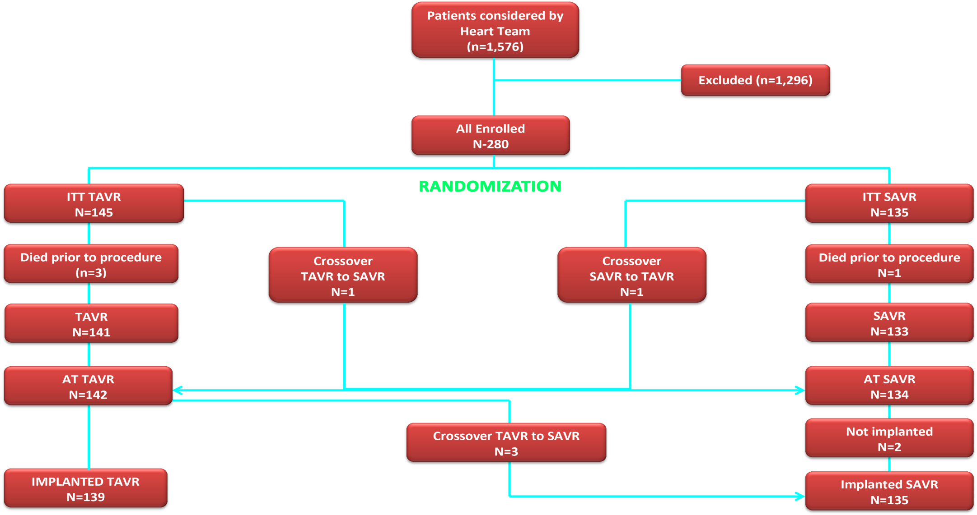
NOTION Trial: Patient Flow
Thyregod et al., J Am Coll Cardiol 2015;65:2184

Slide 21
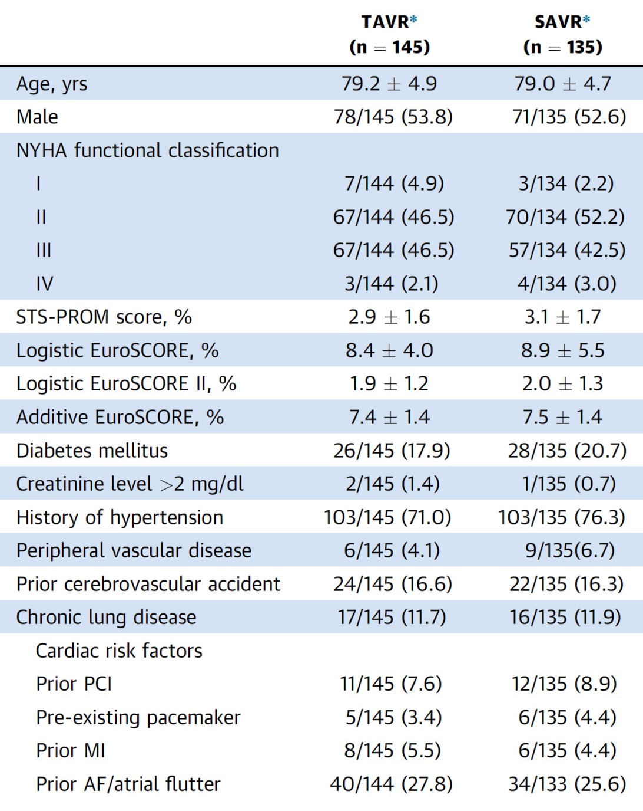
NOTION Trial: Baseline Characteristics
Thyregod et al., J Am Coll Cardiol 2015;65:2184

Slide 22
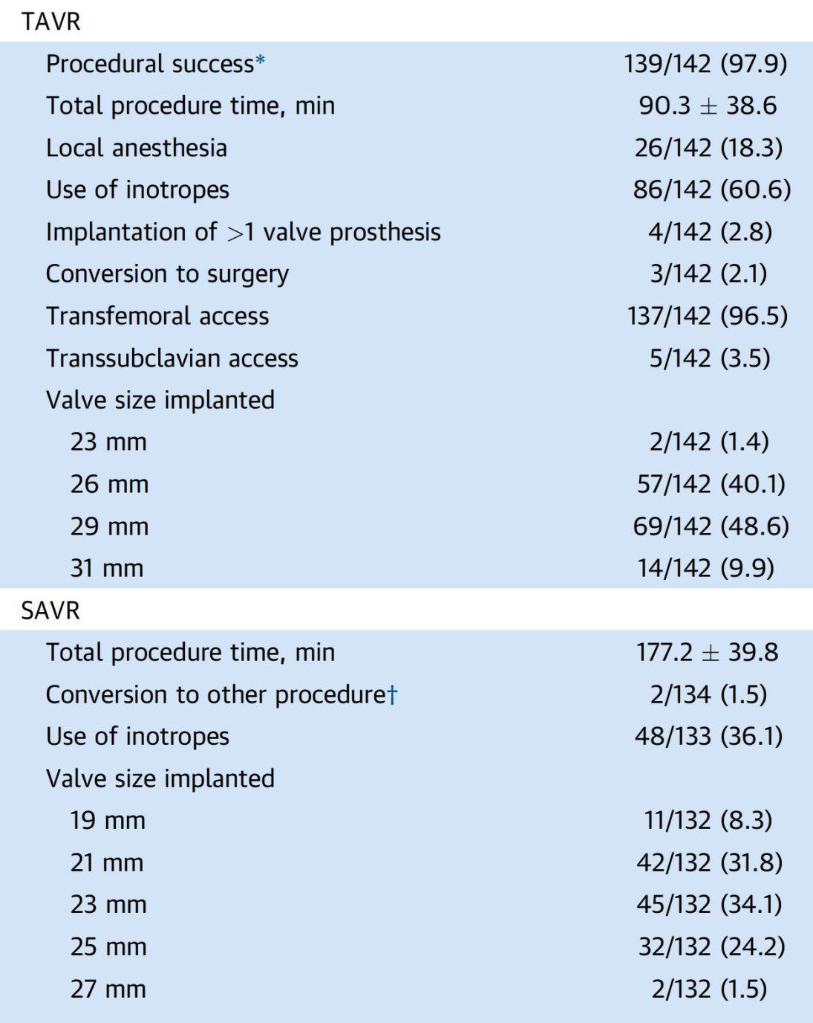
NOTION Trial: Procedural Characteristics
Thyregod et al., J Am Coll Cardiol 2015;65:2184

Slide 23
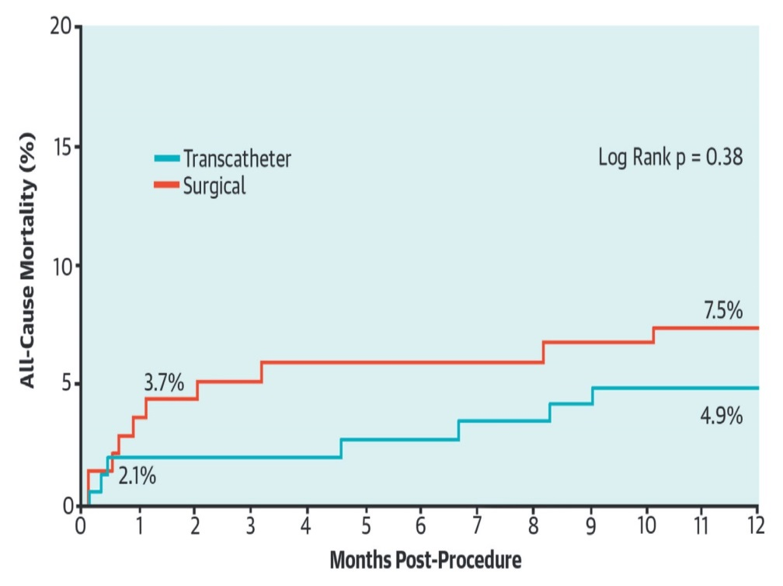
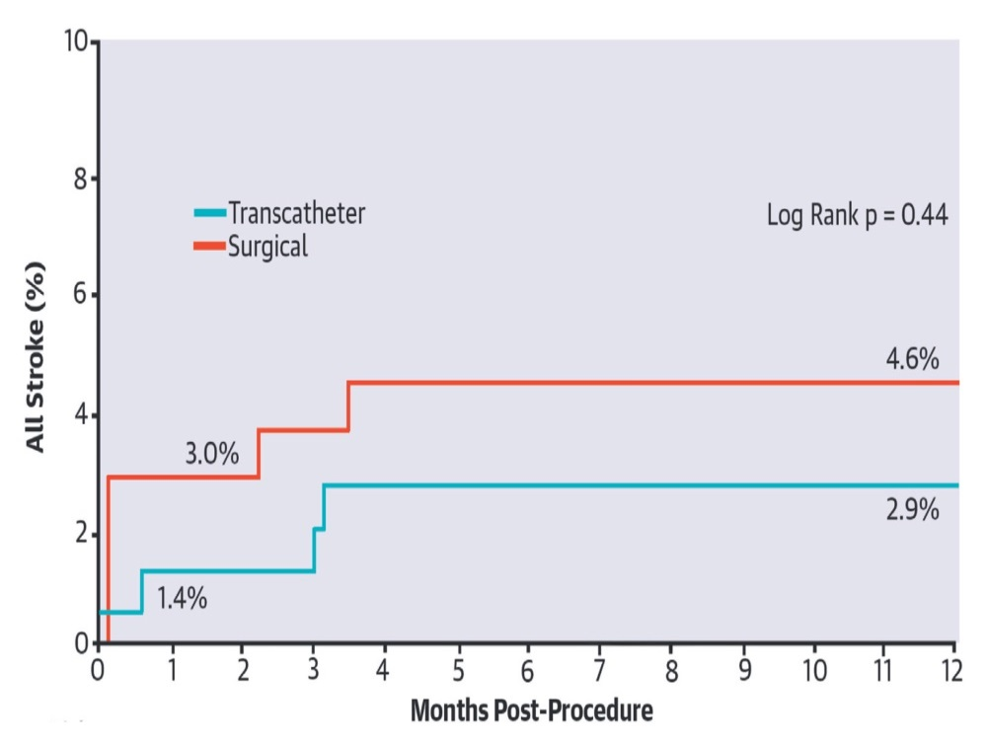
NOTION Trial: TAVR vs SAVR in Severe
Aortic Valve Stenosis
All-Cause Morality at 1 Year
All-Strokes at 1 Year
Thyregod et al., J Am Coll Cardiol 2015;65:2184

Slide 24
NOTION Trial: Clinical Outcomes at 1 Year
TAVR (n=145)
SAVR (n=135)
p=<0.001
p=0.03
%
p=0.38
p=0.10
p=0.44
p=0.47
Death Stroke Major vasc Major, life- PPM implant Valve
compl threatening endocarditis
bleed
Thyregod et al., J Am Coll Cardiol 2015;65:2184

Slide 25
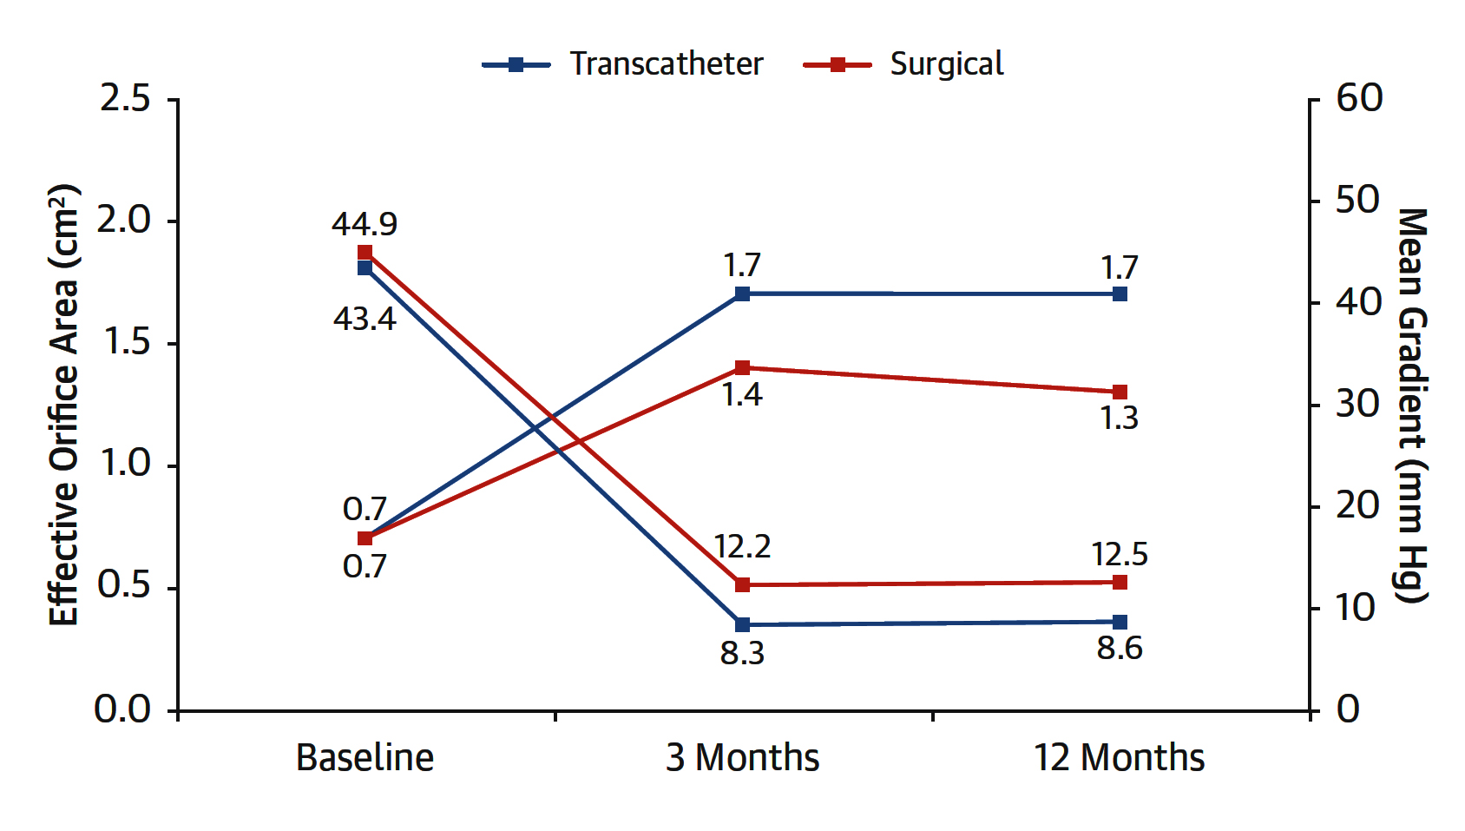
NOTION Trial: Aortic Valve Hemodynamics
Thyregod et al., J Am Coll Cardiol 2015;65:2184

Slide 27
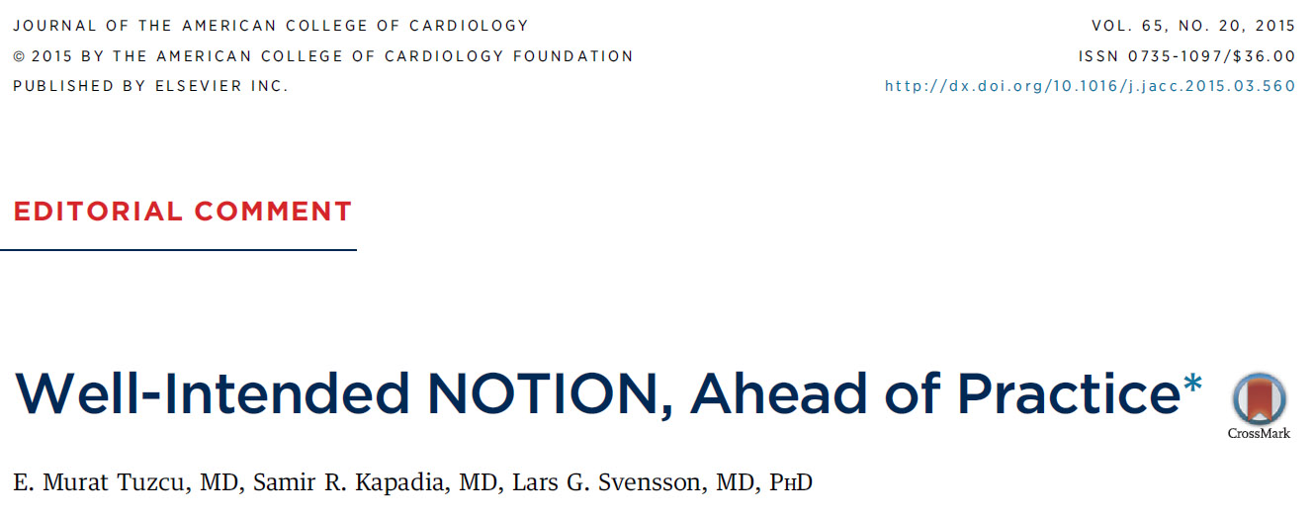

Slide 28
NOTION Trial: Clinical Outcomes at 4 Years
280 patients with severe AS at low surgical risk for SAVR or TAVR with self-expanding CoreValve
TAVR (145)
SAVR (135)
p=<0.001
p=0.47
p=0.56
%
p=0.85
p=0.87
Sondergaard, ESC 2017

Slide 29
ACC 2018
Five-Year Outcomes From All-Comers Nordic Aortic Valve Intervention Randomized Clinical Trial in Patients with Severe Aortic Valve Stenosis:
NOTION Trial

Slide 30
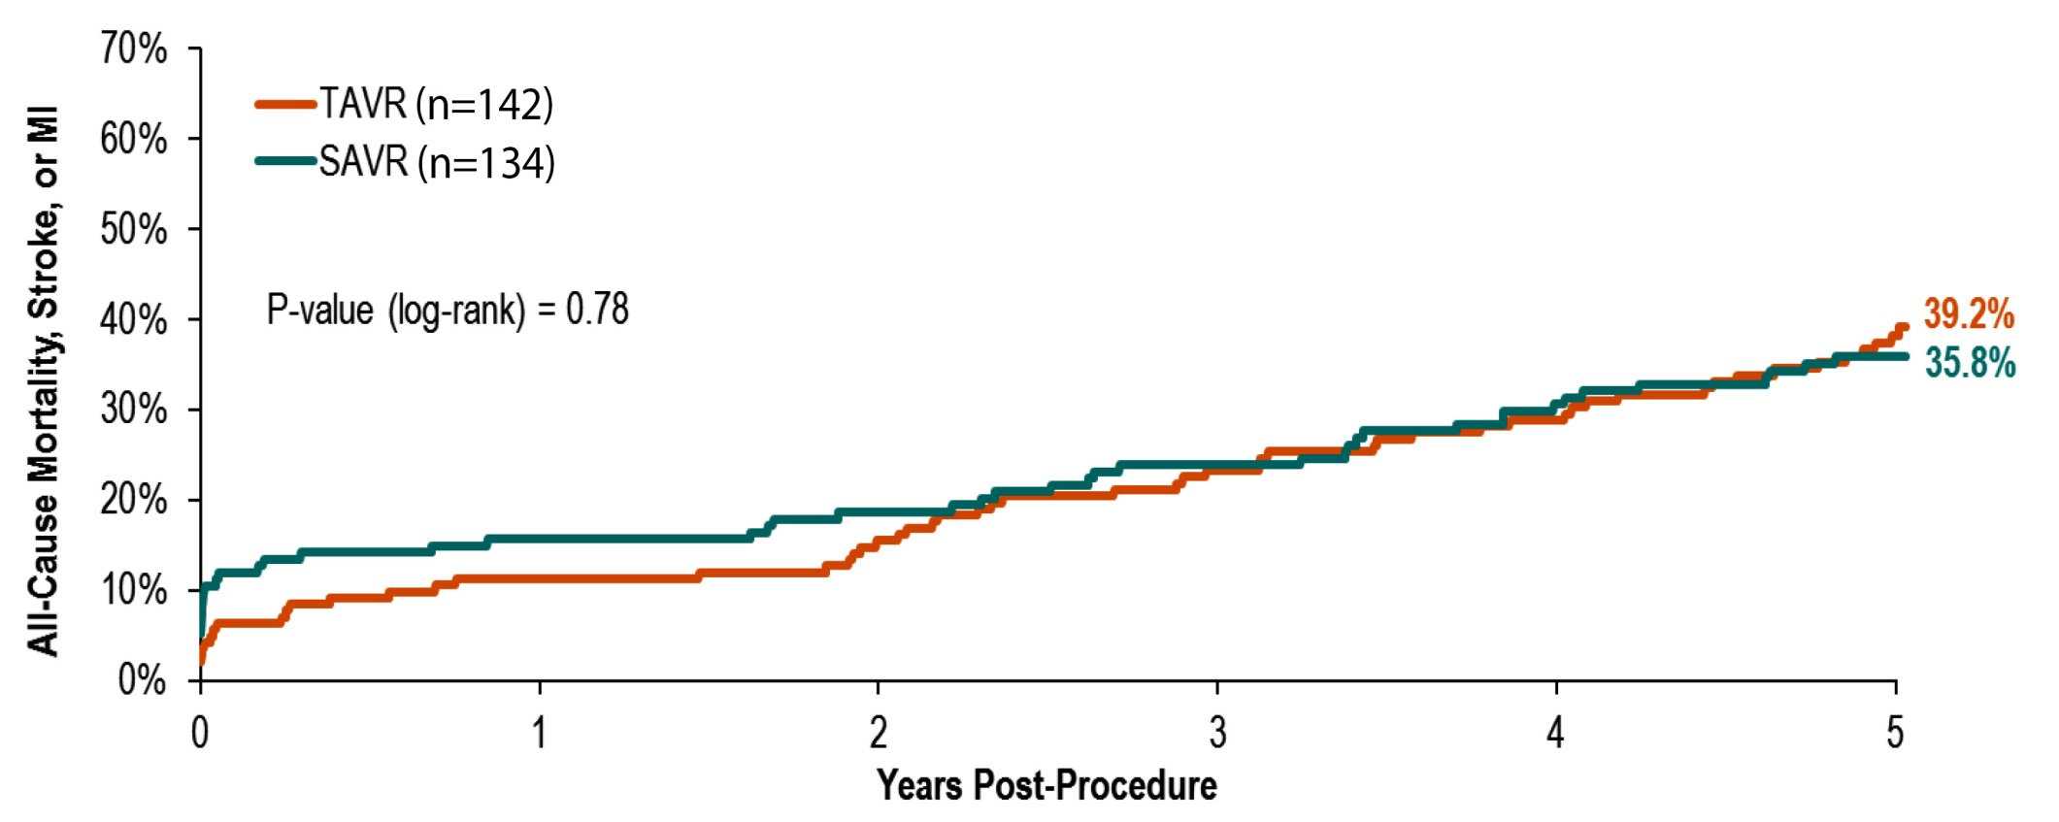
NOTION Trial 5-Year Clinical Outcomes
All-Cause Mortality, Stroke, or MI
Thyregod, ACC 2018

Slide 31
NOTION Trial: Clinical Outcomes at 5 Years
276 patients with severe AS at low surgical risk for SAVR or TAVR with self-expanding CoreValve
TAVR (145)
SAVR (135)
p<0.001
p=0.90
%
p=0.67
p=0.10
p=0.87
p=0.09
Thyregod, ACC 2018

Slide 32
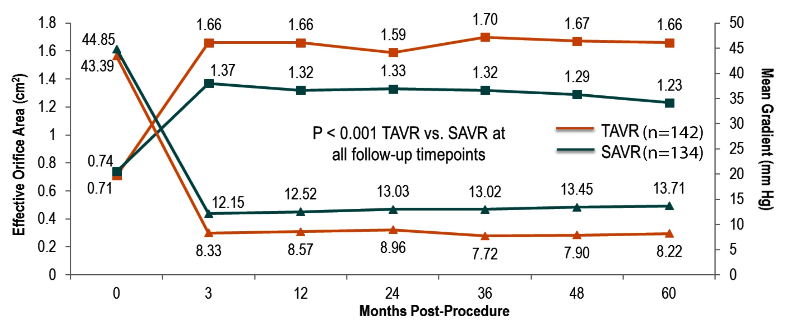
NOTION Trial: Clinical Outcomes at 5 Years
Aortic Valve Performance
Thyregod, ACC 2018

Slide 33
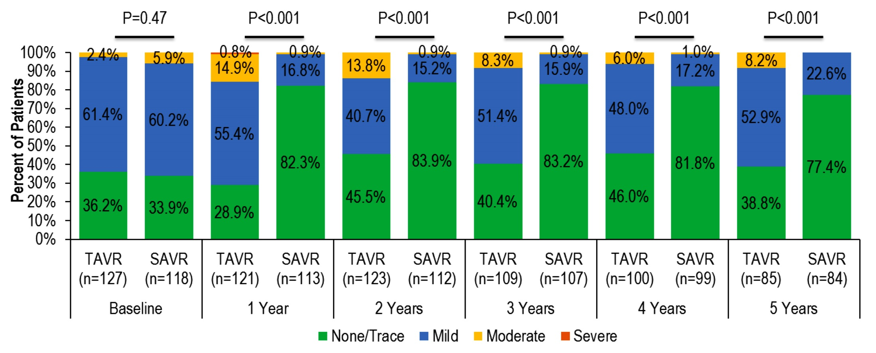
NOTION Trial: Clinical Outcomes at 5 Years
Aortic Valve Regurgitation
Thyregod, ACC 2018

Slide 34
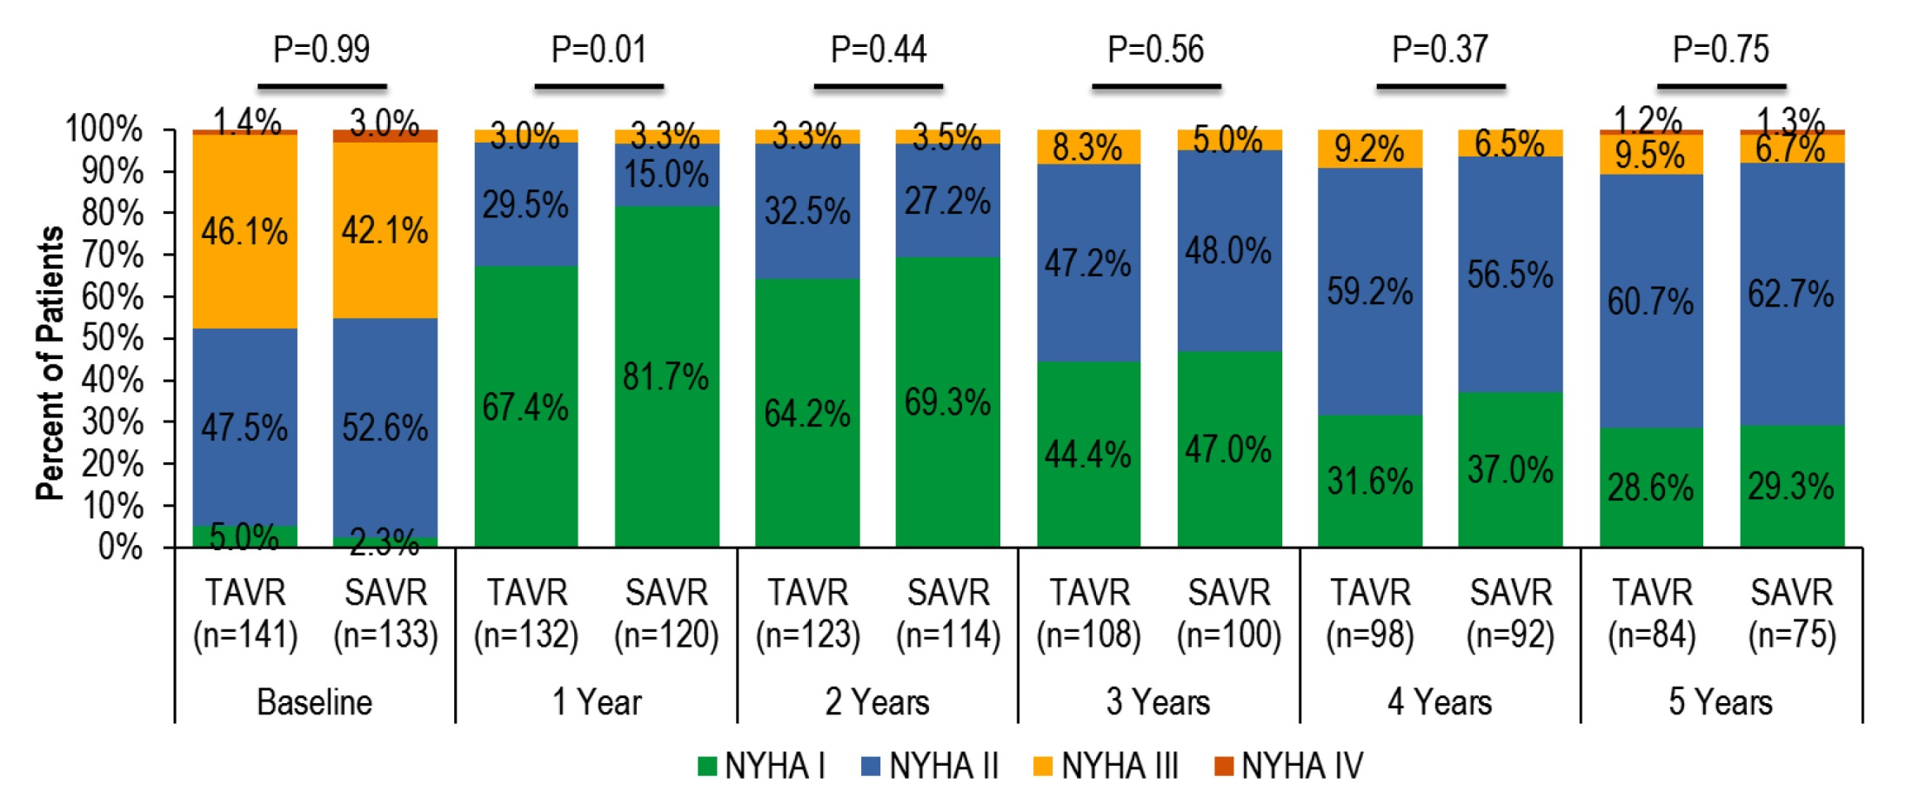
NOTION Trial: Clinical Outcomes at 5 Years
NYHA Class
Thyregod, ACC 2018

Slide 35
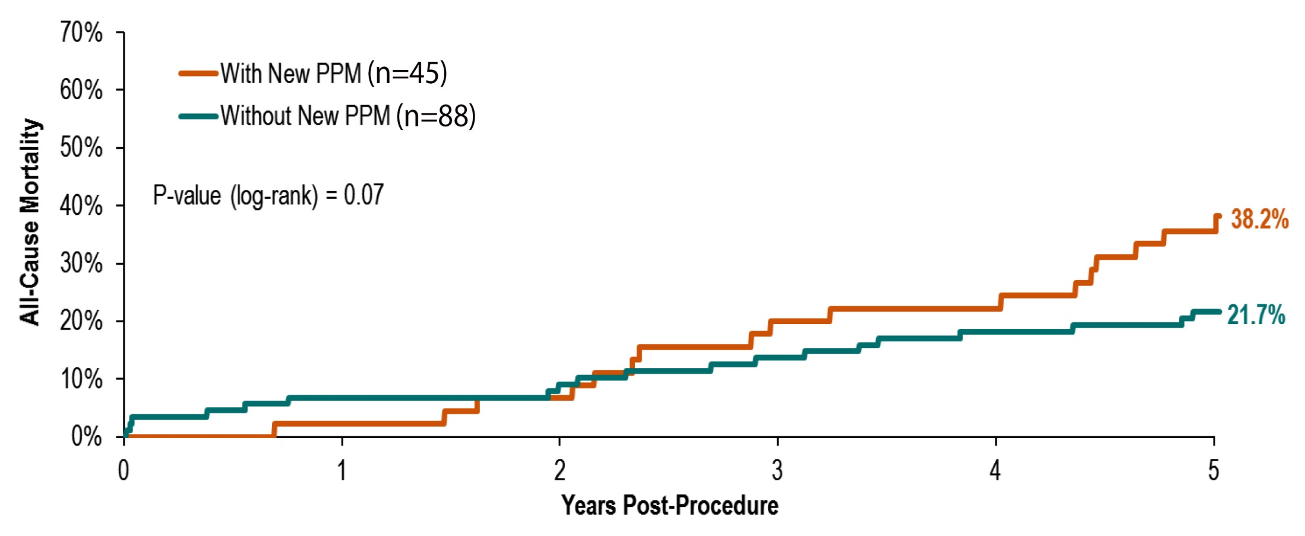
NOTION Trial: Clinical Outcomes at 5 Years
Association of New Pacemaker with Mortality for TAVR
Thyregod, ACC 2018

Slide 36
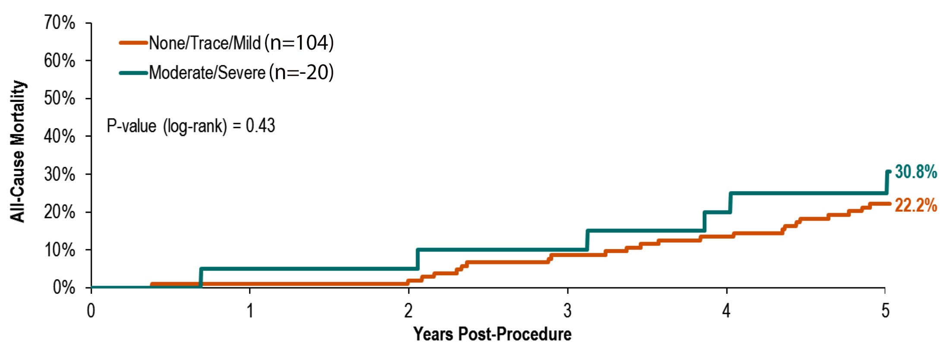
NOTION Trial: Clinical Outcomes at 5 Years
All-Cause Mortality by 3-Month AR Severity
Thyregod, ACC 2018

Slide 37
NOTION Trial: Conclusions
NOTION is the first trial to report on 5-year outcomes after TAVR vs SAVR in lower risk pts
After 5 years, there were no differences in all-cause mortality, stroke, MI, or these combined
There were no difference in prosthetic valve-re-intervention
Prosthetic opening area was larger and mean gradient lower for TAVR at 5 year
TAVR continued to have more mild/moderate PR
New pacemaker implantation after TAVR trended to be associated with increased mortality
Determining the longevity of TAVR prostheses will require longer term follow-up

Slide 38
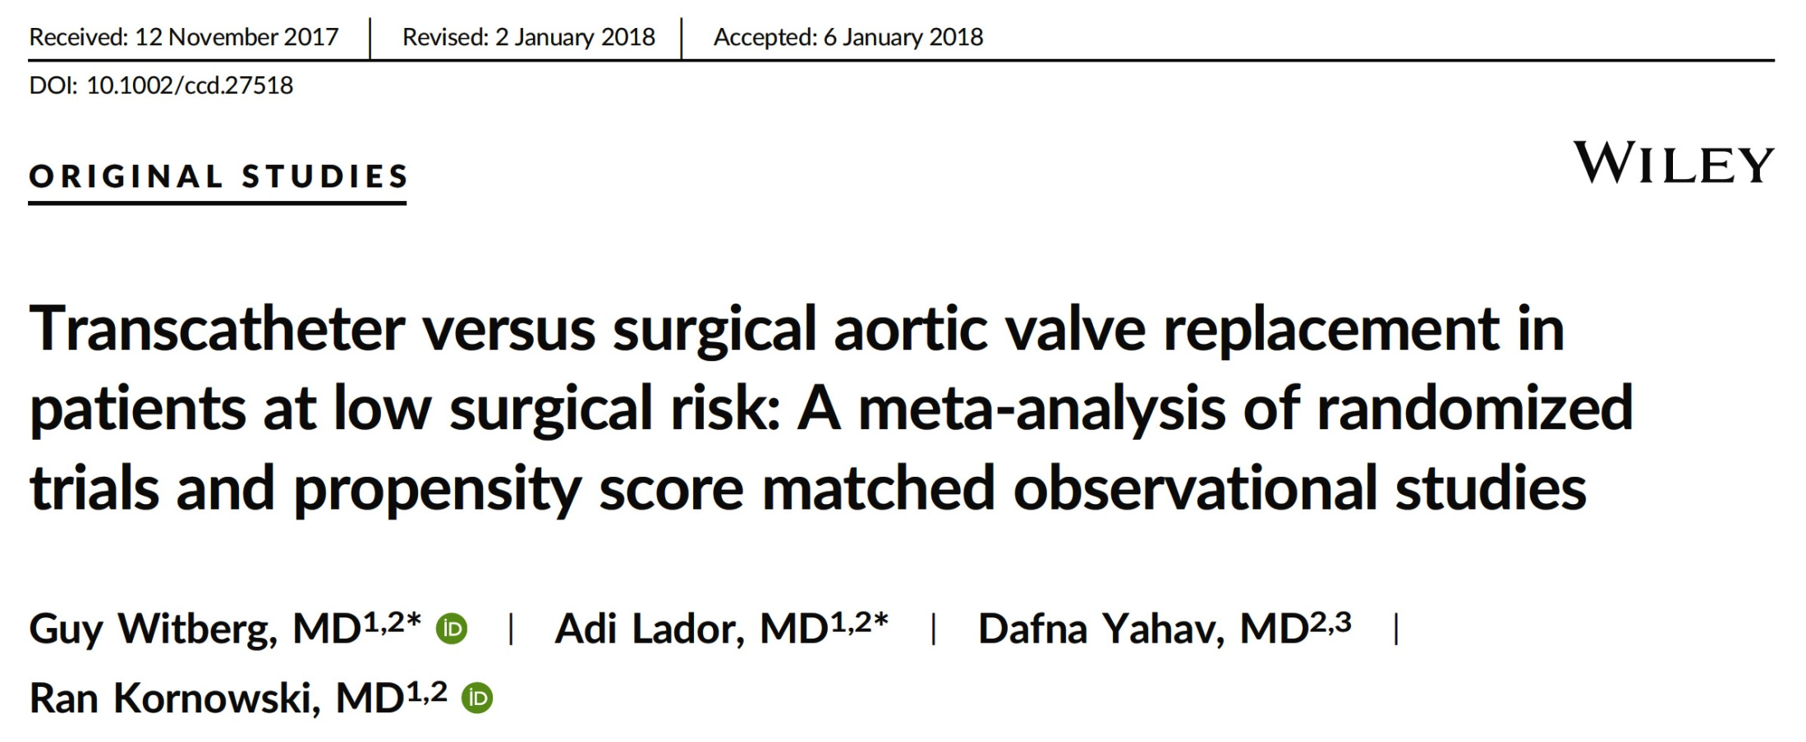

Slide 39
Study Selection Process
Initial search results
1783 titles
Excluded by title
1730
Excluded – 46 studies
High/intermediate surgical risk (n=17)
Compared to medical Tx (n=9)
No clinical outcomes (n=7)
No PSM (n=5)
SAVR with sutureless valves only (n=3)
Review articles (n=2)
No STS/Euroscore reported (n=1)
Only women (n=1)
Only reduced LV function (n=1)
Full text articles assessed for eligibility
53 publications
Studies fulfilling inclusion criteria
7 studies
Duplicate publications
1 study
Studies included in final meta-analysis
6 studies
Witberg et al., Catheter Cardiovasc Interv Feb. 1, 2018 [Epub ahead of print]

Slide 40
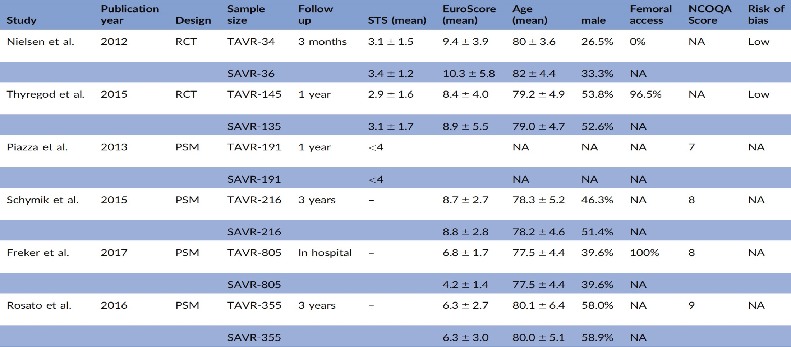
Characteristics of Studies Included in the
Meta-Analysis
Witberg et al., Catheter Cardiovasc Interv Feb. 1, 2018 [Epub ahead of print]

Slide 41
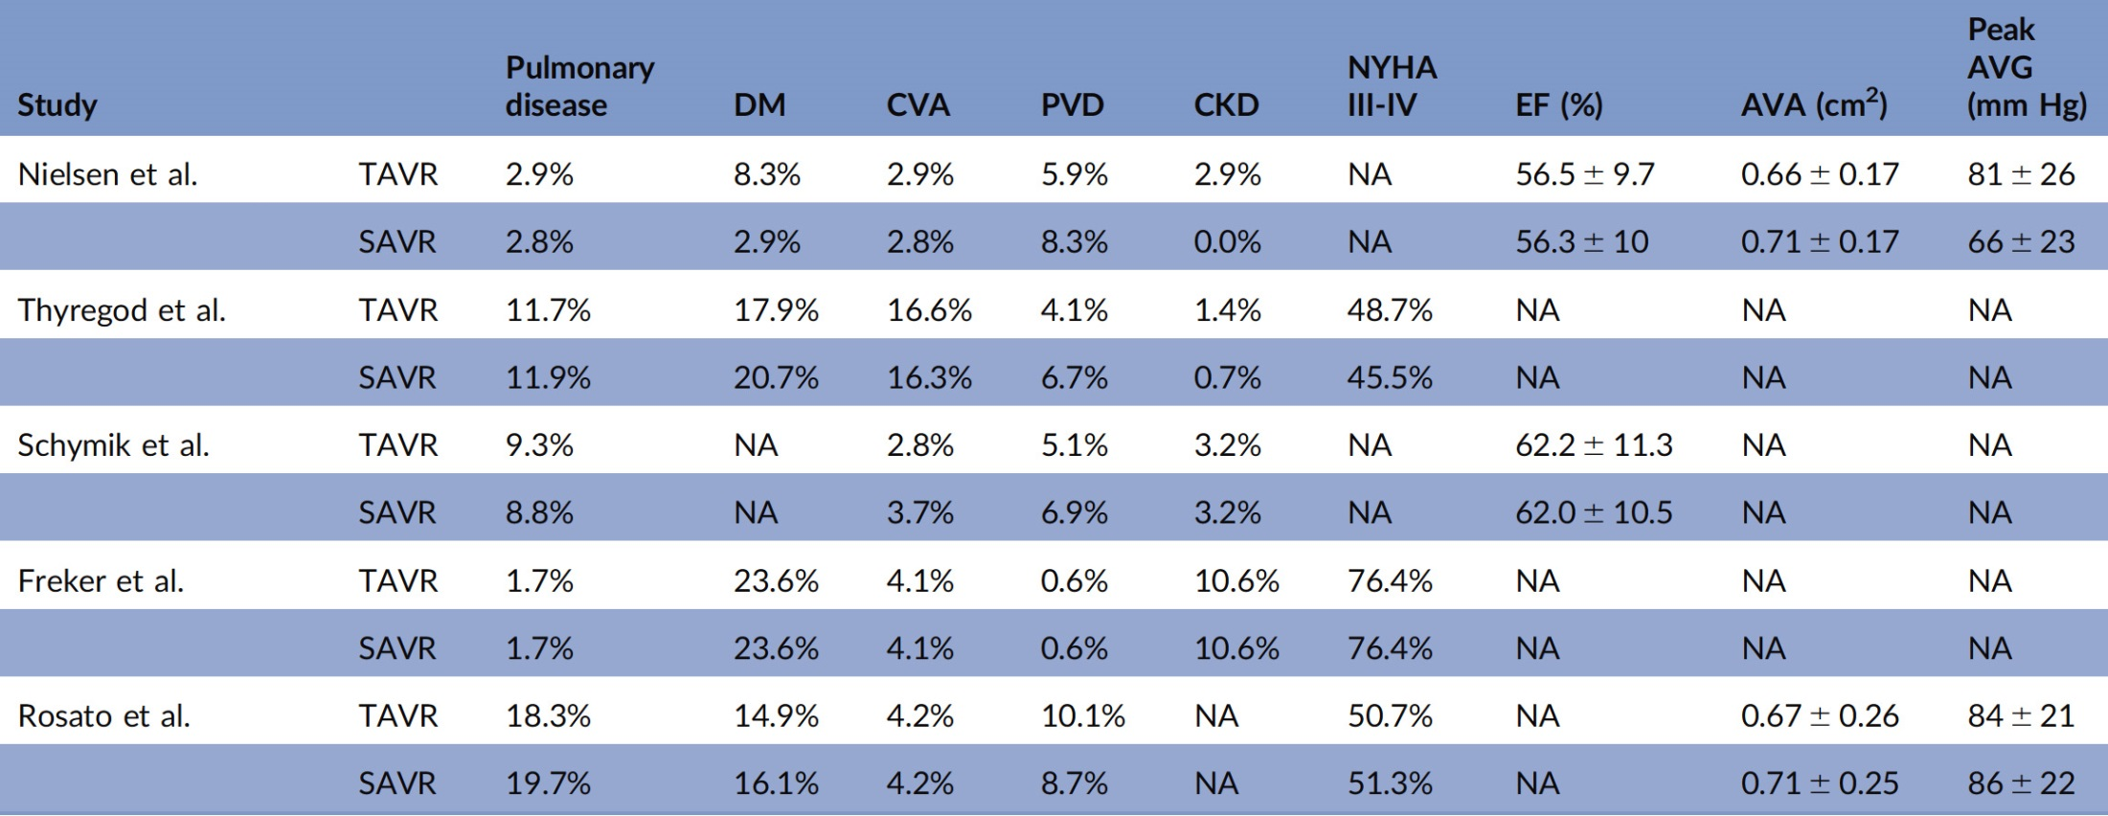
Baseline Characteristics of Patients Included in the
Meta-Analysis
Witberg et al., Catheter Cardiovasc Interv Feb. 1, 2018 [Epub ahead of print]

Slide 42
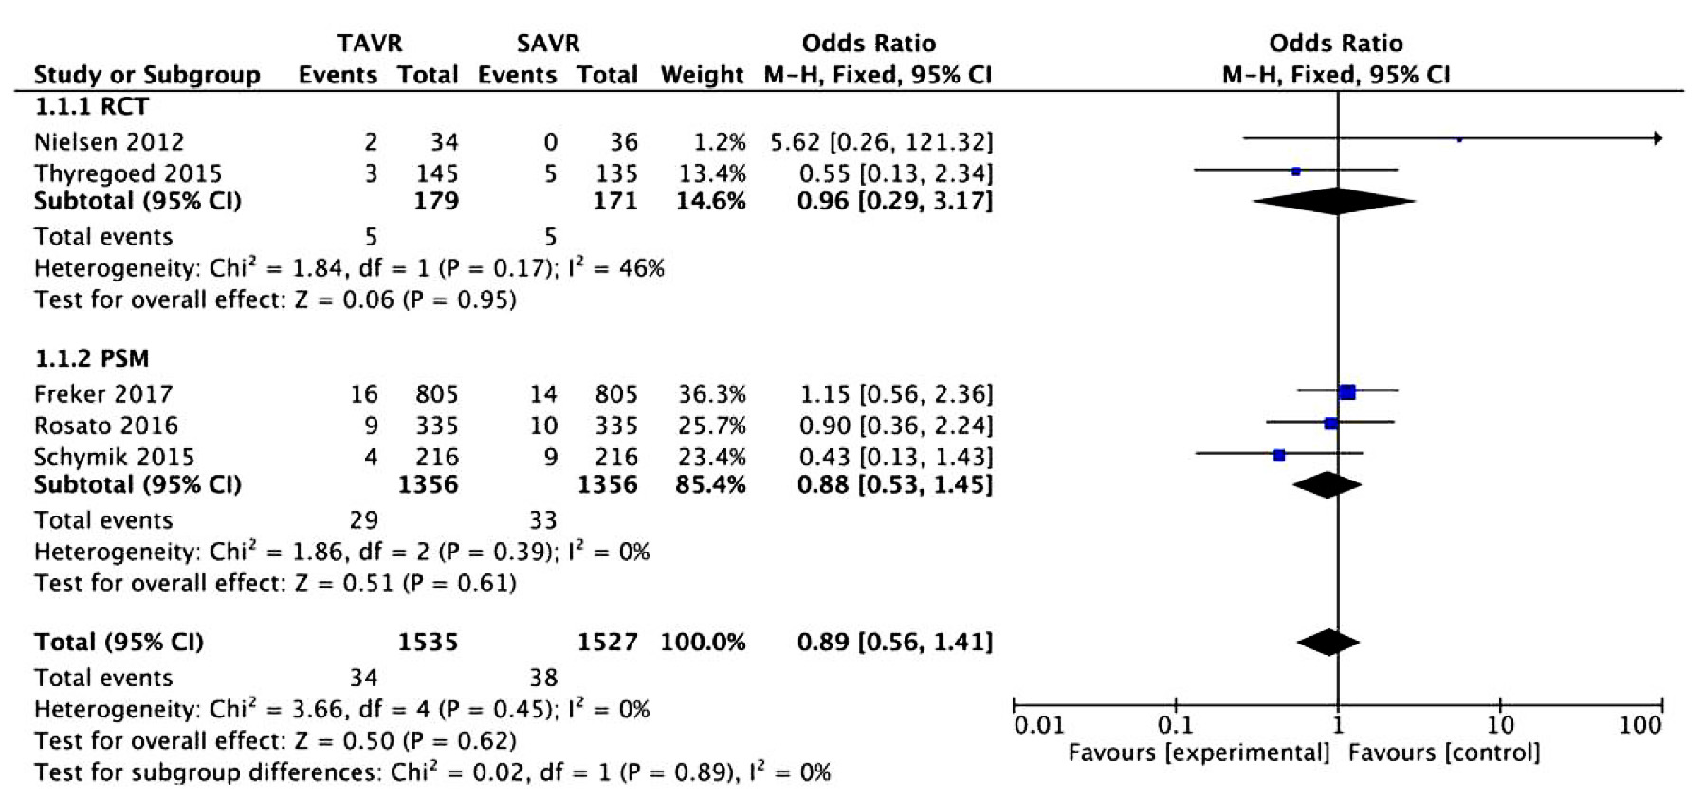
Forest Plots of Mortality After TAVR and SAVR
Risk Ratio for Mortality at Short-Term Mortality for TAVR vs SAVR
Witberg et al., Catheter Cardiovasc Interv Feb. 1, 2018 [Epub ahead of print]

Slide 43
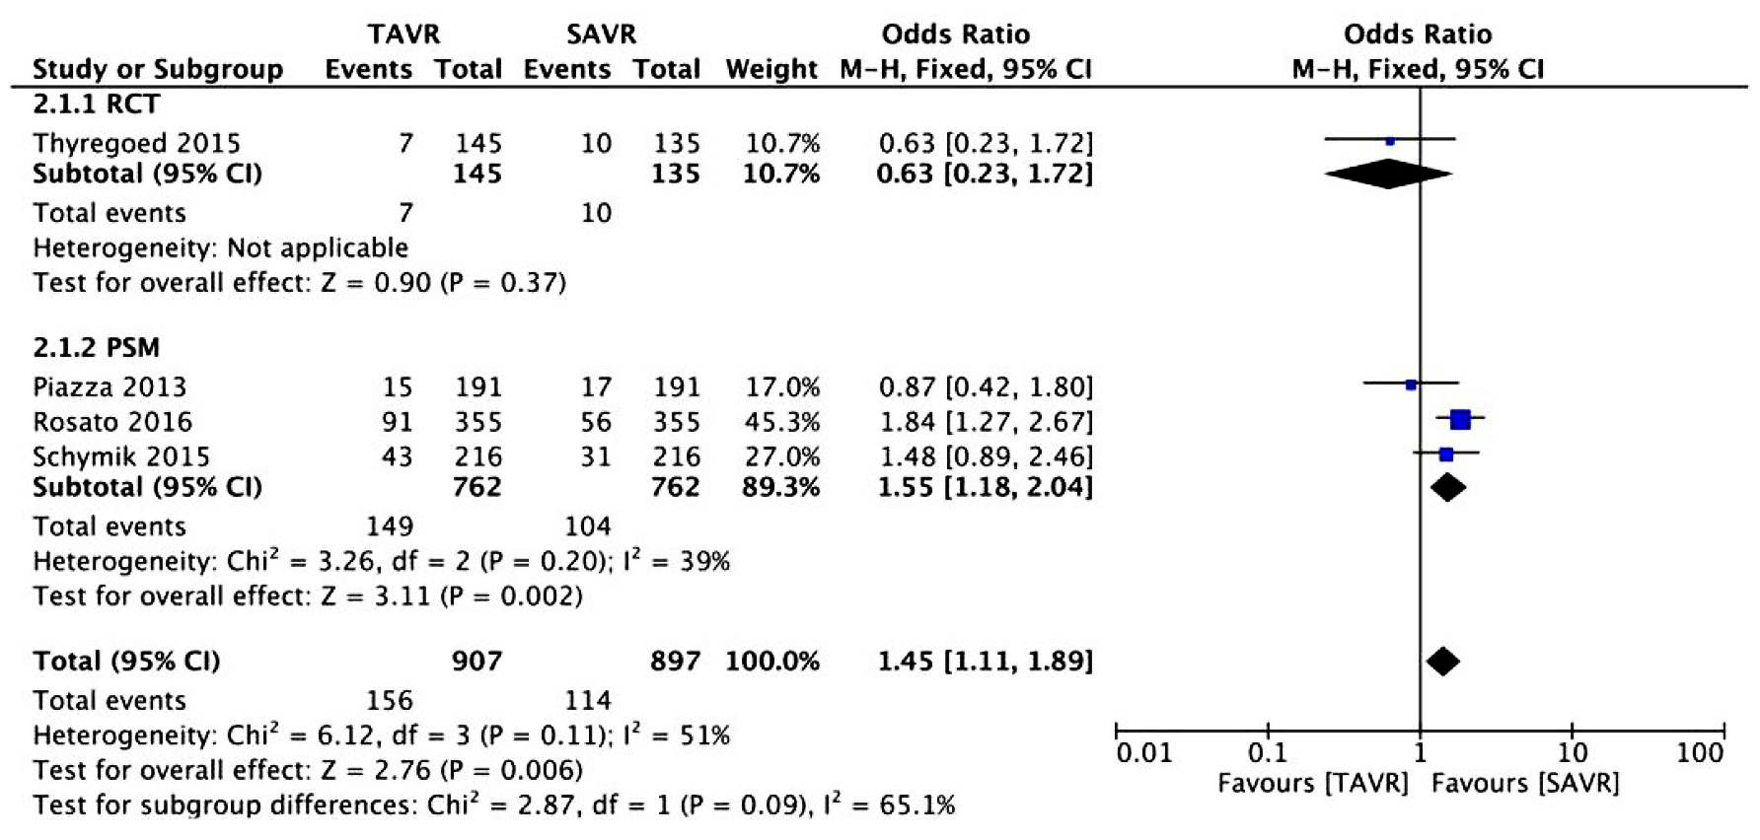
Forest Plots of Mortality After TAVR and SAVR
Risk Ratio for Mortality at Late Mortality for TAVR vs SAVR
Witberg et al., Catheter Cardiovasc Interv Feb. 1, 2018 [Epub ahead of print]

Slide 44
Clinical Outcomes
TAVR
SAVR
RR 1.45, 95%CI 1.11-1.89
P=0.006
%
RR 0.89, 95%CI 0.56-1.41
P=0.62
(5 studies; 3102 patients) (4 studies; 1804 patients)
Witberg et al., Catheter Cardiovasc Interv Feb. 1, 2018 [Epub ahead of print]

Slide 45
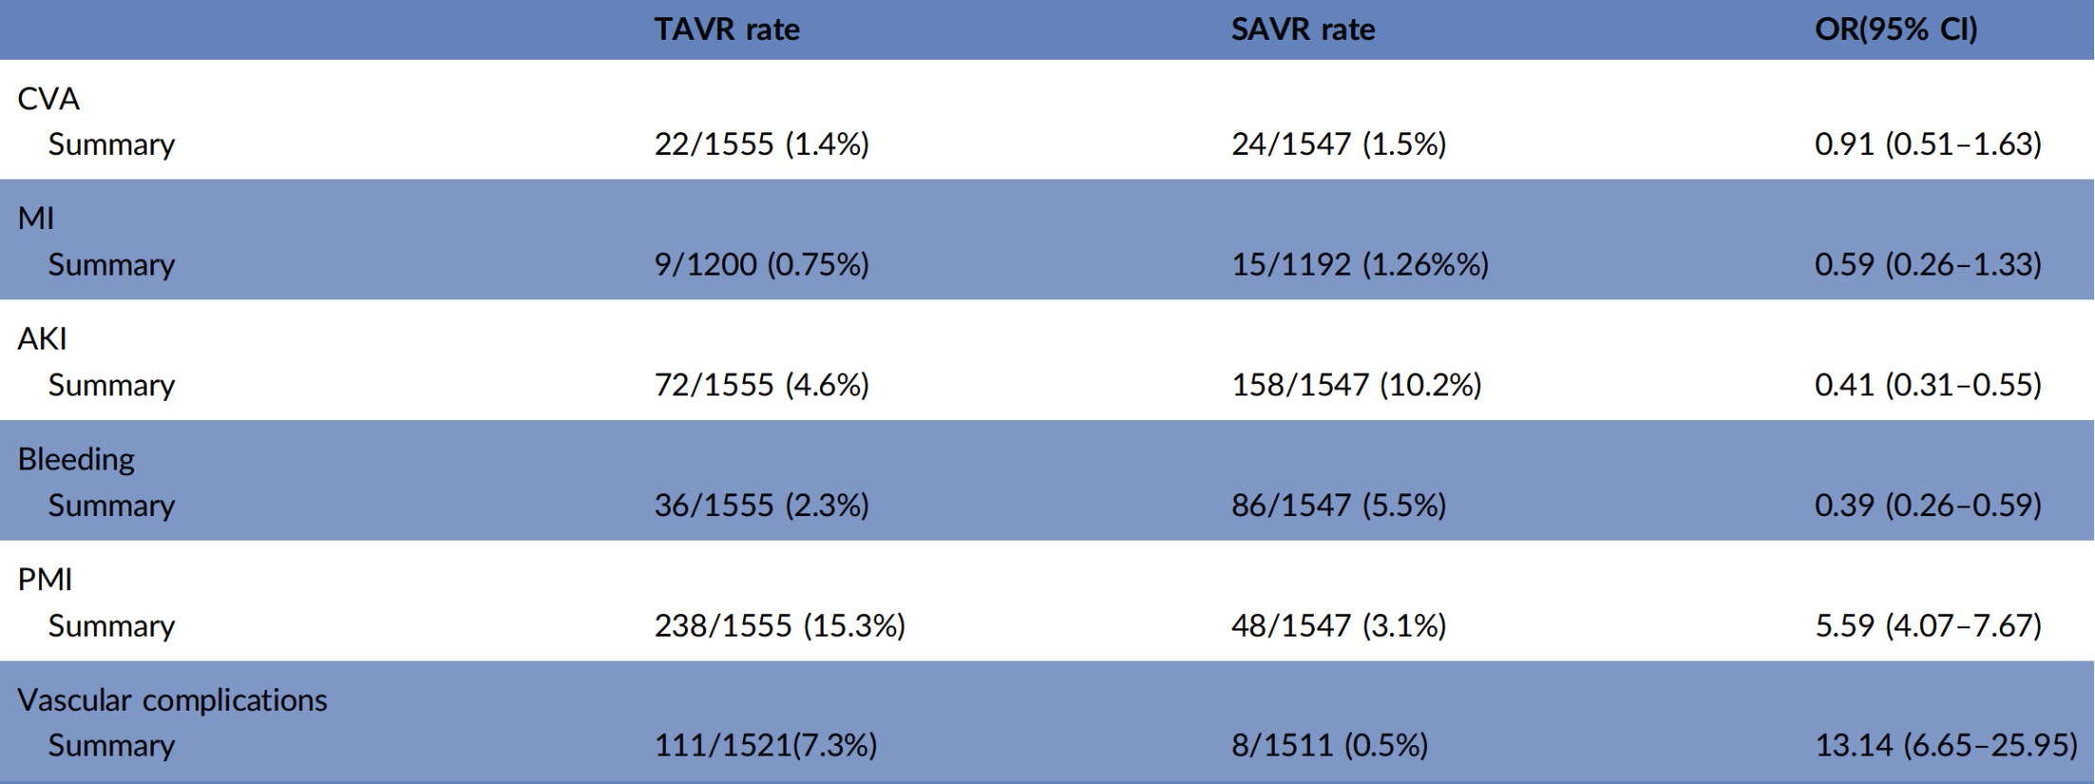
Summary of Periprocedural Complications
Witberg et al., Catheter Cardiovasc Interv Feb. 1, 2018 [Epub ahead of print]

Slide 46
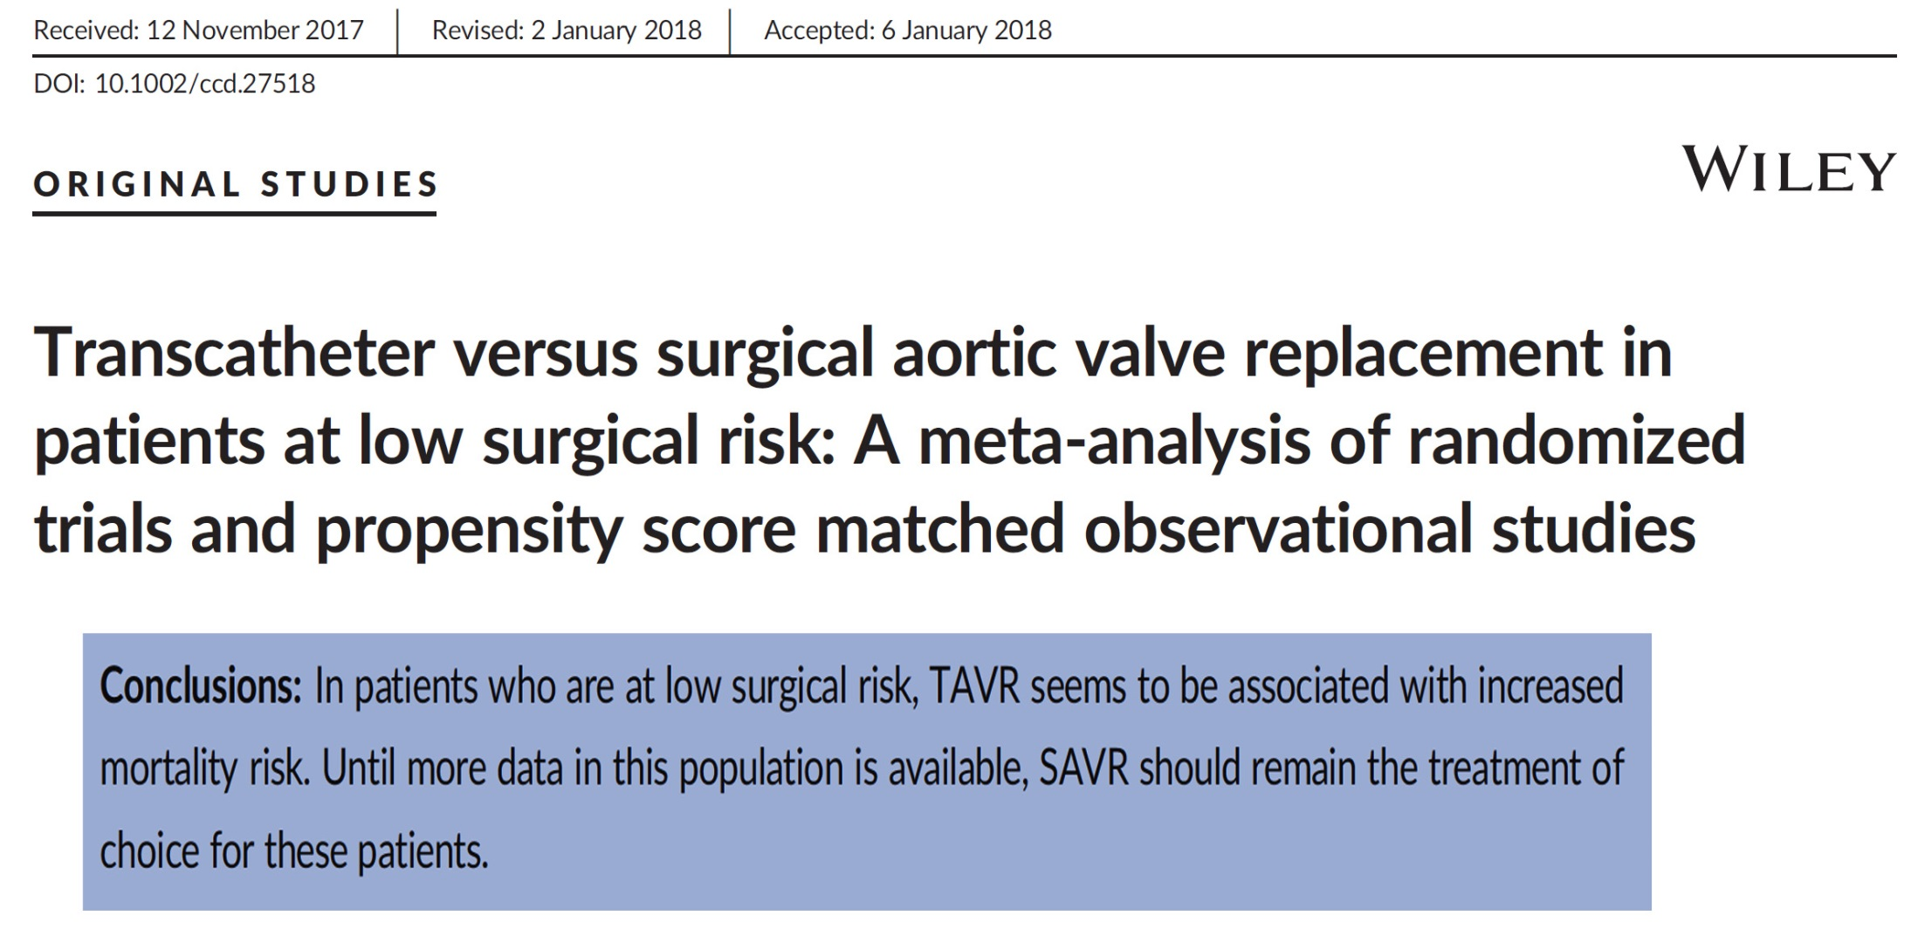

Slide 47
The PARTNER 3 Trial: Study Design
Symptomatic Severe Calcific Aortic Stenosis
Age <65yrs
Low Risk ASSESSMENT by Heart Team
(STS < 4%, TF only)
- Enrollment completed in Sept 2017
- Plan to present results in ACC 2019
PARTNER 3 Registries
1:1 Randomization (n=1228)
Alternative Access (n=100) (TA/TAo/Subclavian)
TF - TAVR
(SAPIEN 3)
Surgery
(Bioprosthetic Valve)
CT Imaging Sub-Study (n=200)
CT Imaging Sub-Study (n=200)
Bicuspid Valves
(n=100)
Actigraphy/QoL Sub-Study (n=100)
Actigraphy/QoL Sub-Study (n=100)
Primary Endpoint:
Composite of all-cause mortality, all strokes, or
re-hospitalization at 1 year post-procedure
ViV (AV and MV)
(n=100)
Follow-up: 30 days, 6 mos, 1 year and annually through 10 years

Slide 48
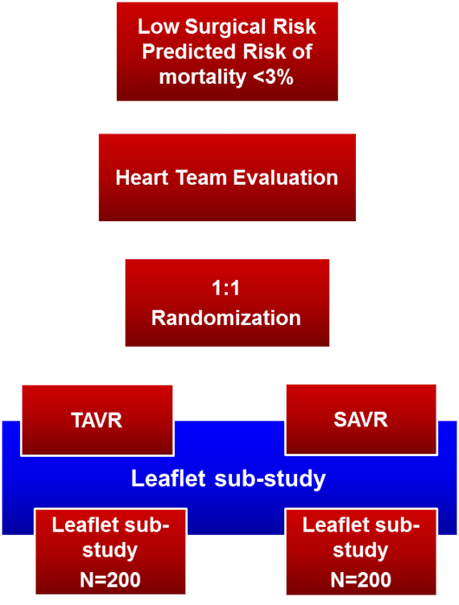
Medtronic TAVR in Low Risk Patients
Trial Design & leaflet Sub-study
Patient Population: Low Risk Cohort
Determined by Heart Team to be low surgical risk
Primary Endpoint:
Safety: Death, all stroke, life-threatening bleed, major vascular complications or AKI at 30 days
Efficacy: Death or major stroke at 2 yrs
Sample Size: ~1200 Subjects
Follow-up Evaluations:
30-days, 6-month , 18-month, and
1 through for 5 years
Number of Sites: Up to 80 sites
Enrollment completed on 3/12/2018
Plan to present results in ACC 2020

Slide 49
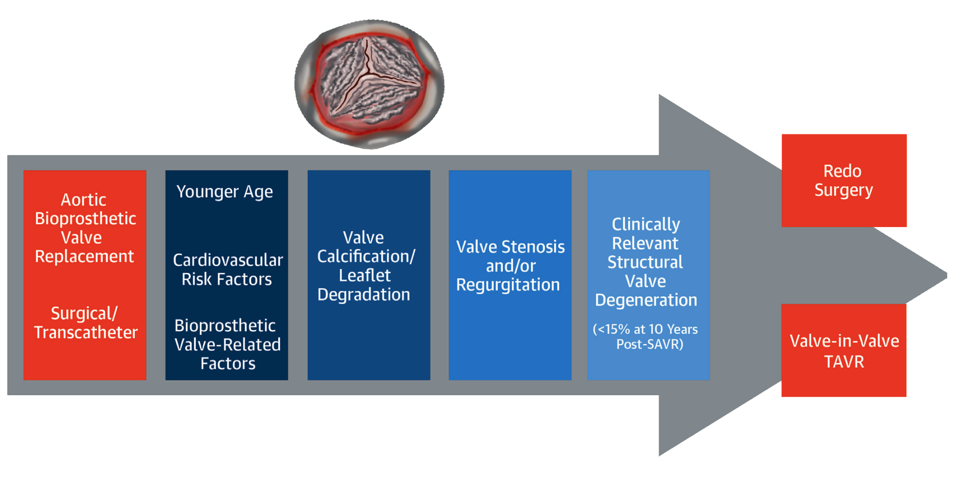
Structural Valve Degeneration Following Surgical
or Transcatheter Aortic Bio-prosthesis Implantation
Rodriguez-Gabella et al., J Am Coll Cardiol 2017;70:1013

Slide 50
Take Home Message: TAVR vs SAVR in Low risk AS Pts
Encouraging results of the Notion trial reporting 5-year outcomes comparing TAVR vs SAVR, showed similar mortality, stroke and MACE outcomes with higher residual AR/PR and PPM. These data have provided the glimpses of other low risk trial results
Future efforts need to focus on reducing the need of PPM and PR after TAVR, both of which can be associated with higher mortality at follow-up. Also prospective long-term follow-up for 5-10 yrs with special focus on TAVR leaflet thickening/ deterioration will be required to really establish TAVR use in younger pts.

Slide 51
Question # 1
Following are the 5-year true outcomes of the NOTION trial comparing TAVR vs SAVR in low risk AS pts except:
Similar mortality between 2 groups
Similar mod-severe AR/PR between 2 groups
Similar aortic valve intervention between 2 groups
Similar stroke rates between 2 groups
Higher PPM rates with TAVR vs SAVR
Correct answer: B

Slide 52
Question # 2
Following are the true statement regarding the NOTION trial comparing TAVR vs SAVR:
Trial included AS pts with STS <3
CoreValve TAVR was used in the trial
Pt who required PPM had higher mortality at f/U
TAVR pts had higher aortic valve area vs SAVR at f/U
All are correct
Correct answer: E

Slide 53
Question # 3
Following issues needs to be considered carefully regarding TAVR use in younger and low risk pts except:
A. TAVR leaflet thickening and deterioration
B. Need for PPM
C. Residual PR/AR
D. Coronary reaccess
E. Effective aortic valve area
Correct answer: E

