Slide 1
Division of Endovascular Interventions
Mount Sinai Hospital
New York
2/26/17

Slide 2
History and Physical
84 year, Female
HTN, type 2 DM, CAD
< 100 feet claudication distance x 2 months. Also reports pain with elevation of the right foot and relieved with dependency.
BP - 144/76 mmHg
Pulse - 64/min
Right DP and PT - monophasic signal on doppler exam

Slide 3
Labs and work up
Hb- 11.0 g/dl
Platelets- 131K
INR- 1.1
Creatinine- 1.85
ABI - right 0. 46, left 0. 68

Slide 4
Strategy
Left CFA access
6F,45 cm crossover sheath
Therapeutic anticoagulation- Bivalirudin
Lesion crossing - Antegrade wire escalation
Pedal access for retrograde approach
Directional atherectomy followed by Balloon angioplasty
Drug eluting stent for flow limiting dissection

Slide 5
Critical Limb Ischemia (CLI)
Critical limb ischemia is defined as presence of rest pain, ulcer or gangrene attributable to objectively proven arterial occlusive disease.
Symptom duration >2 weeks
Physiological testing
- Ankle pressure <40 mmHg, Toe pressure < 30 mmHg, ABI <0.4 (Rest pain)
- Ankle pressure <70 mmHg, Toe pressure < 50 mmHg (for tissue loss)
- TcPo2 < 30 mmHg

Slide 6
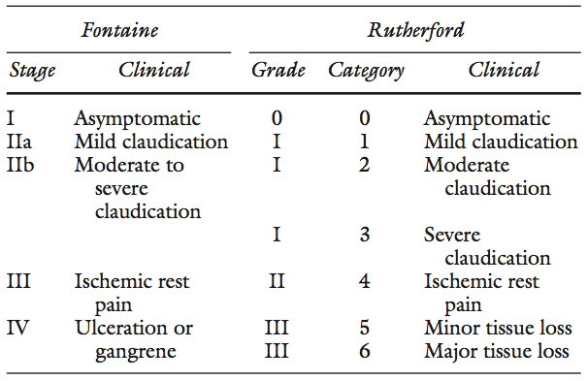
Critical limb ischemia (CLI)

Slide 7
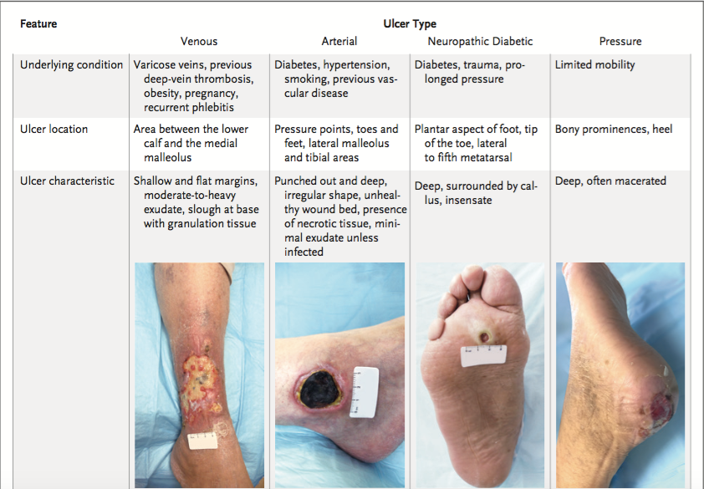
Not every lower extremity ulcer is arterial

Slide 8
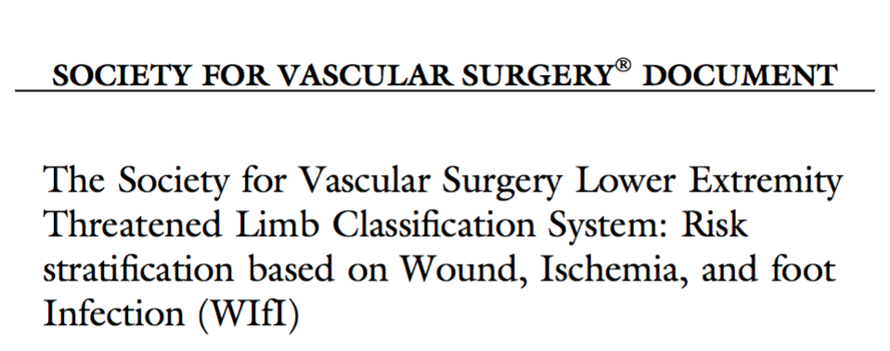
Wifi classification

Slide 9
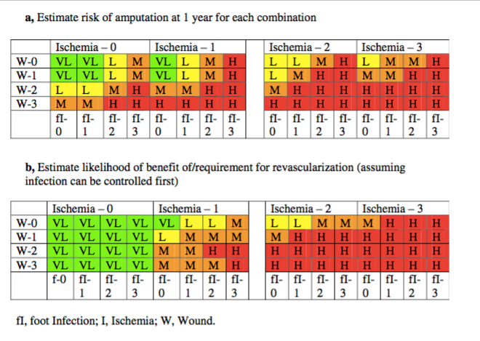
Wound, Ischemia, Foot infection

Slide 10
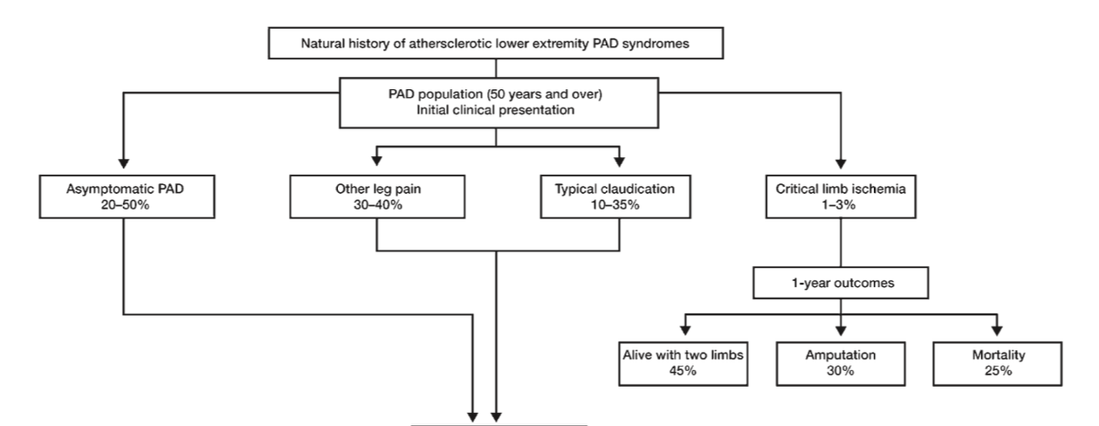
Spectrum of lower extremity PAD presentations

Slide 11
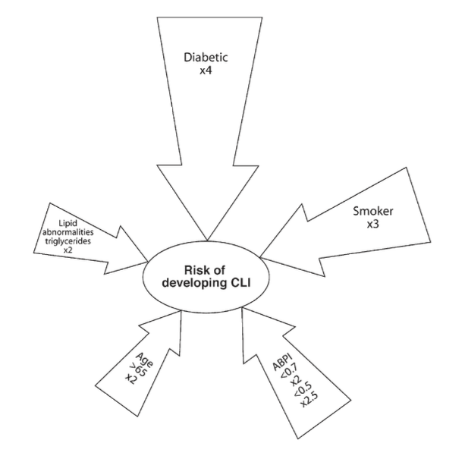
Risk factors for CLI

Slide 12
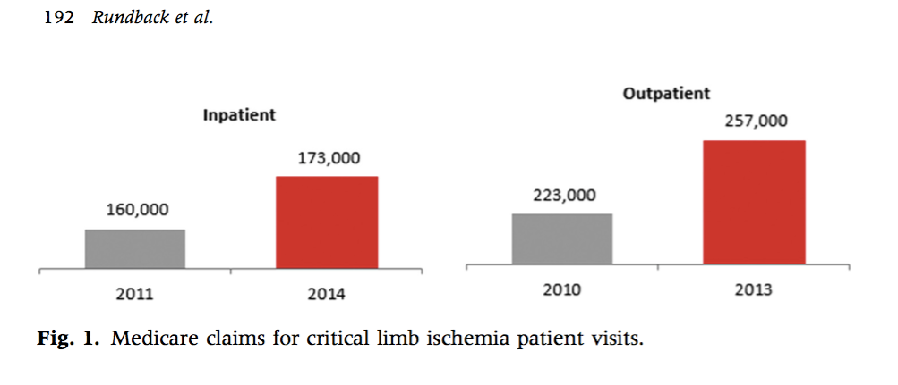
Incidence and Prevalence of CLI
Incidence 0.35%, Prevalence 1.33%

Slide 13
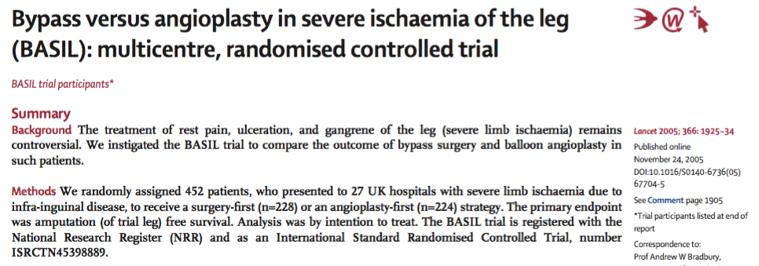
Bypass vs. Endovascular

Slide 14
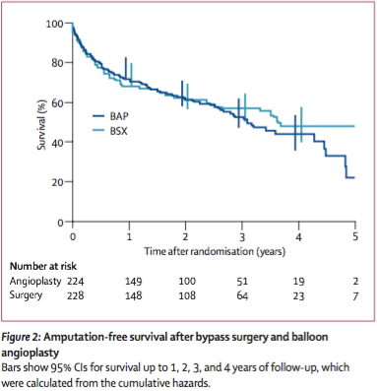
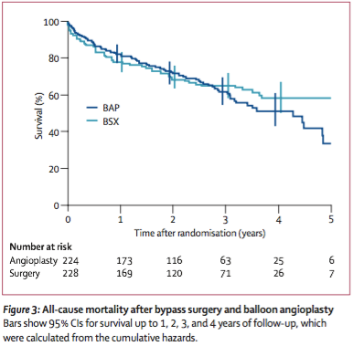
BASIL

Slide 15
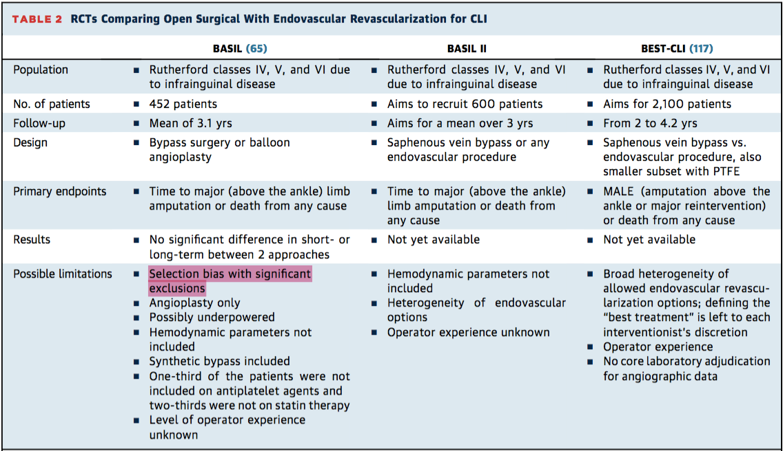
Ongoing RCT’s

Slide 16
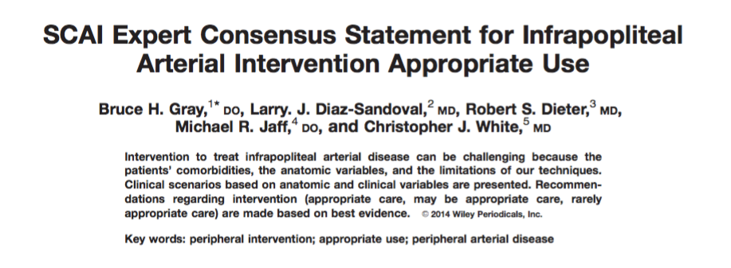
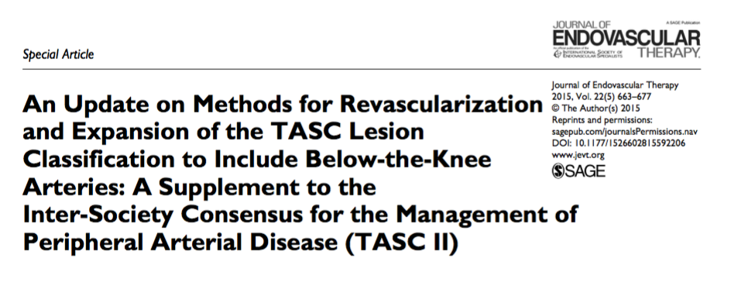
Infrapopliteal disease - guidelines

Slide 17
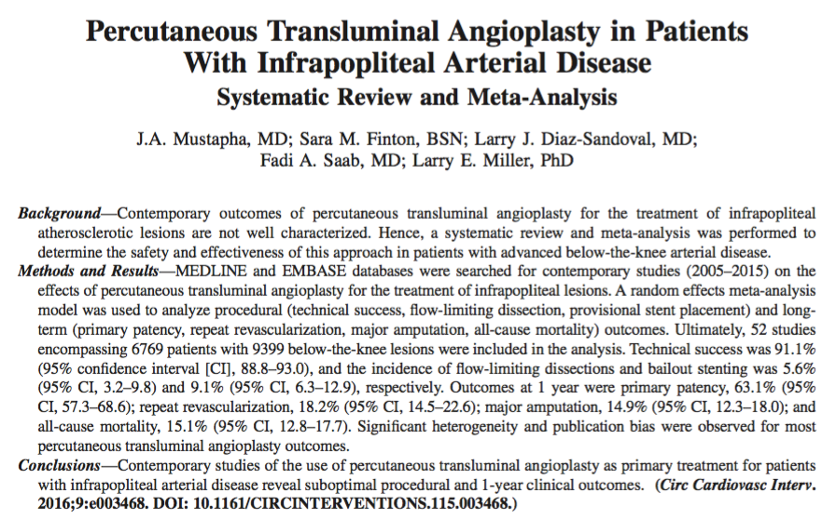
Percutaneous Transluminal Angioplasty

Slide 18
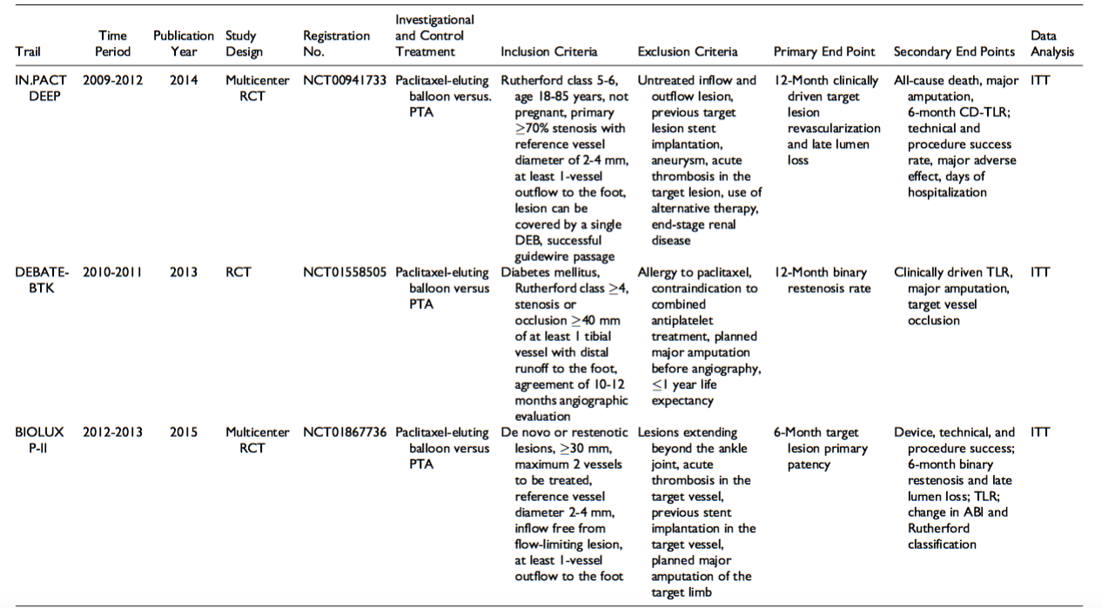
Drug Eluting Balloon trials

Slide 19
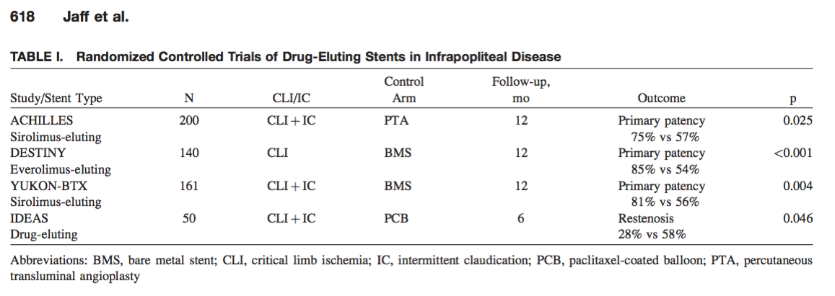
Drug eluting stent trials

Slide 20
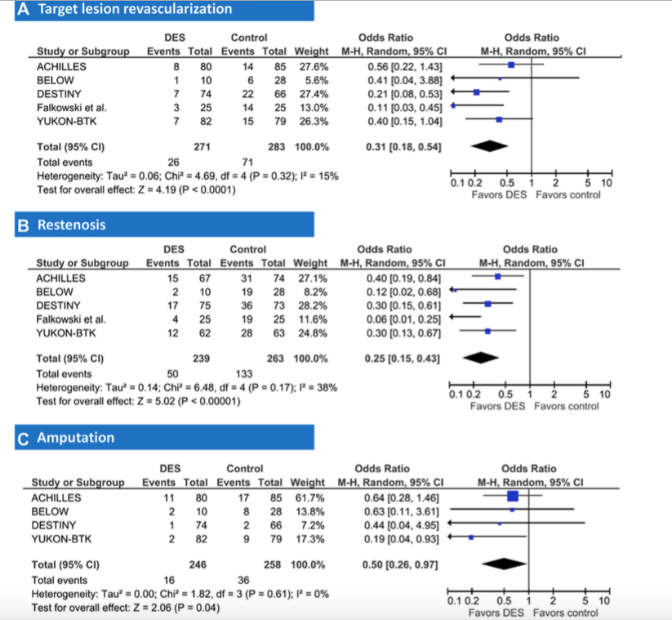
Drug eluting stent meta-analysis

Slide 21
PADI - 5 year outcomes

Slide 22
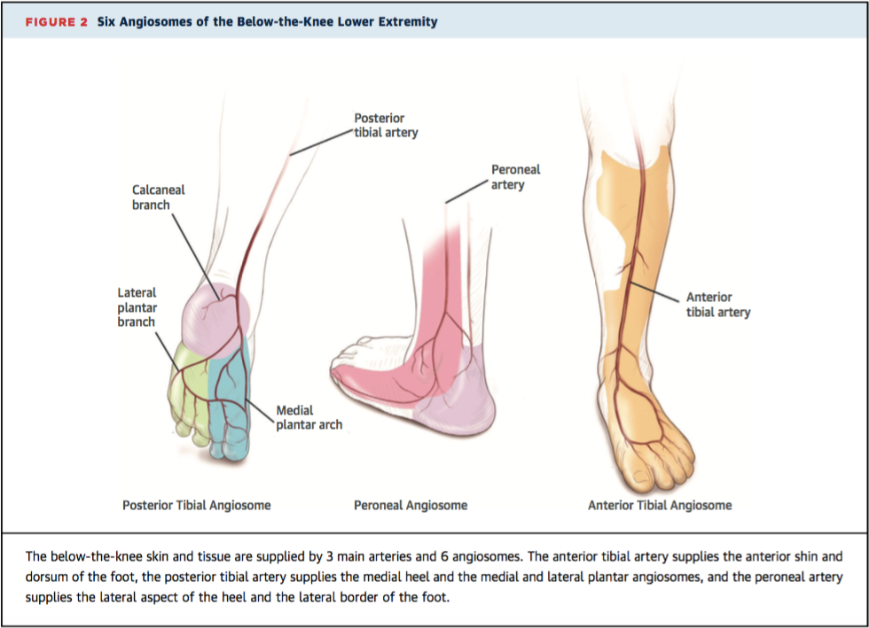
Angiosome directed therapy

Slide 23
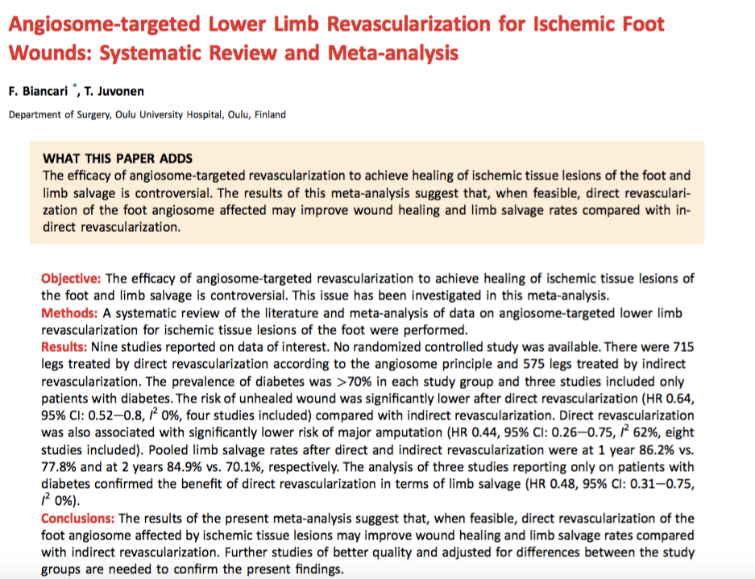
Angiosome directed therapy

Slide 24
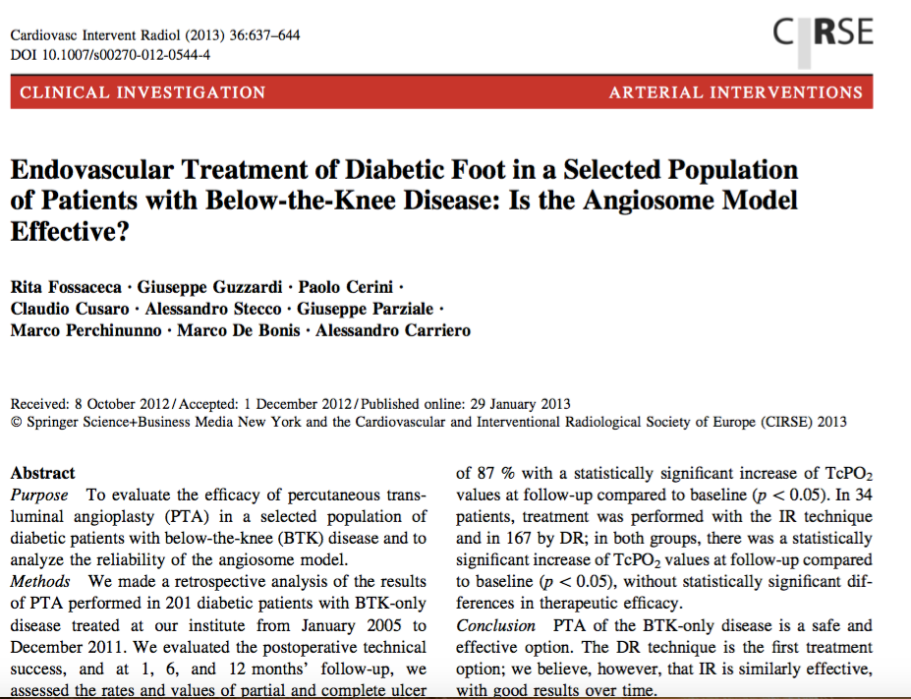
Angiosome directed therapy

Slide 25
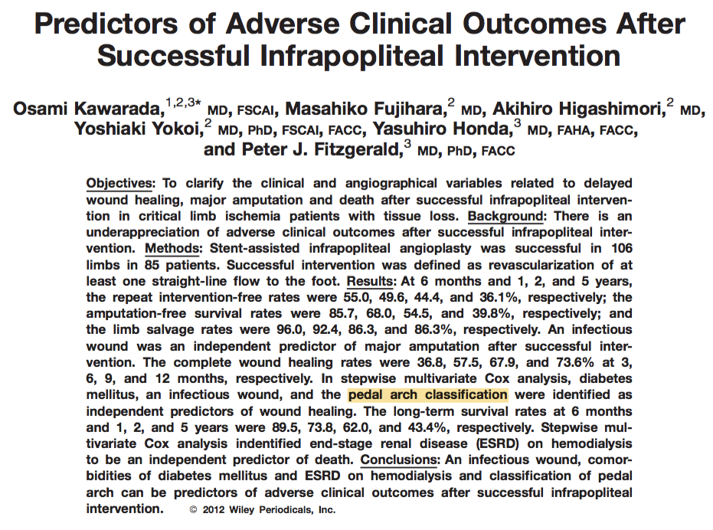
Importance of Pedal-plantar arch

Slide 26
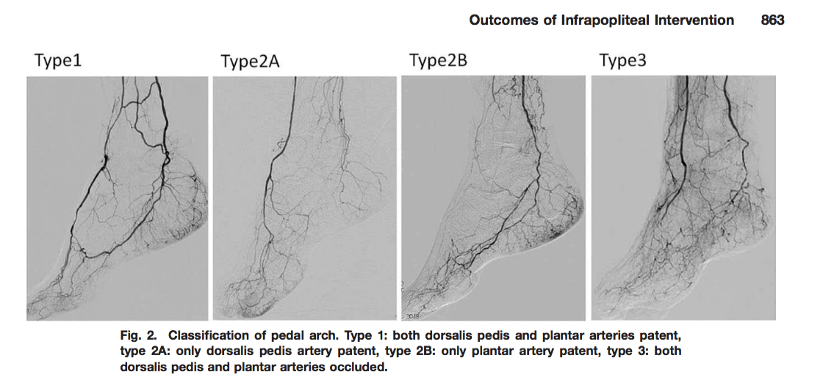
Importance of Pedal-plantar arch

Slide 27
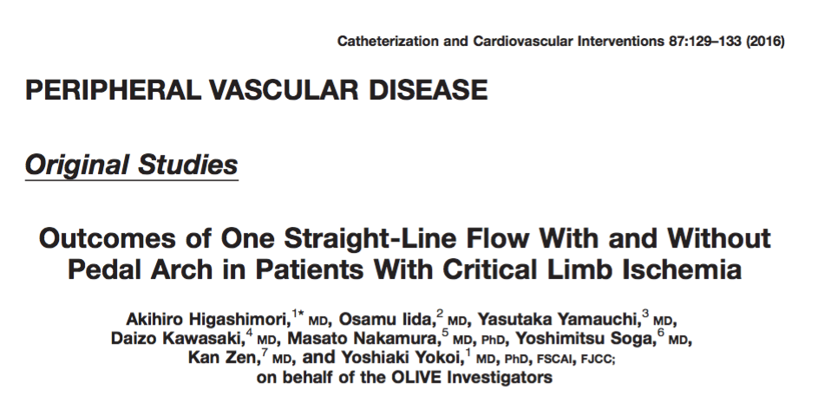
Pedal plantar loop and single patent below knee vessel

Slide 28
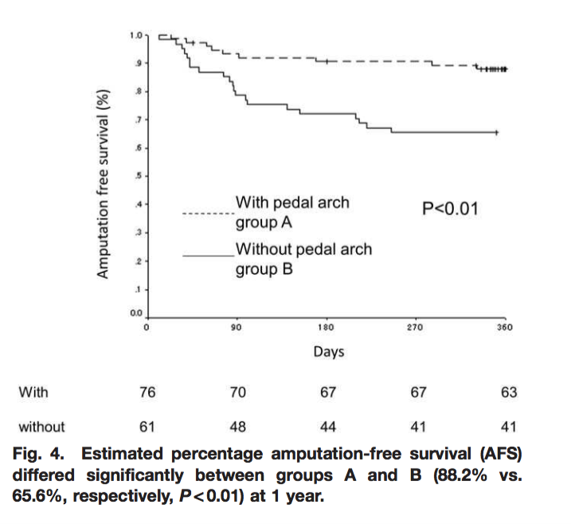
Pedal plantar loop and single patent below knee vessel

Slide 29
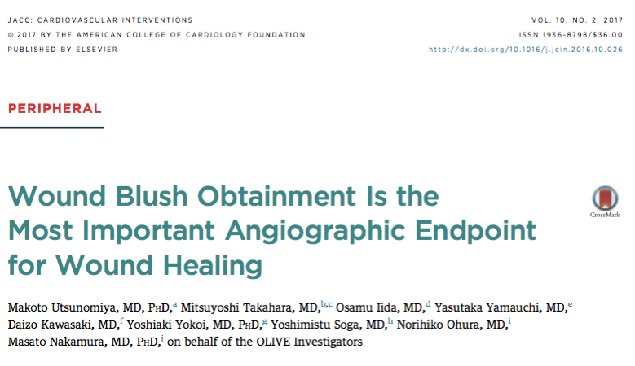
Wound blush and healing

Slide 30
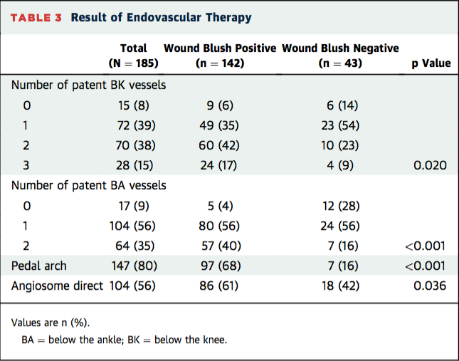
Wound blush and healing

Slide 31
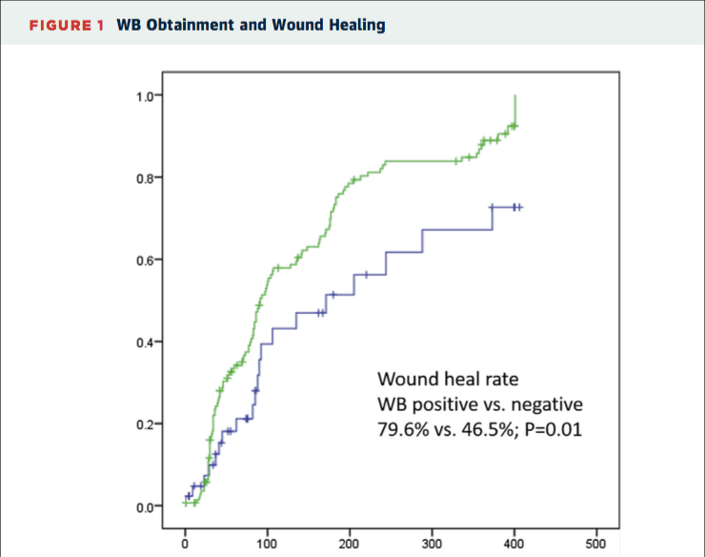
Wound blush and healing

Slide 32
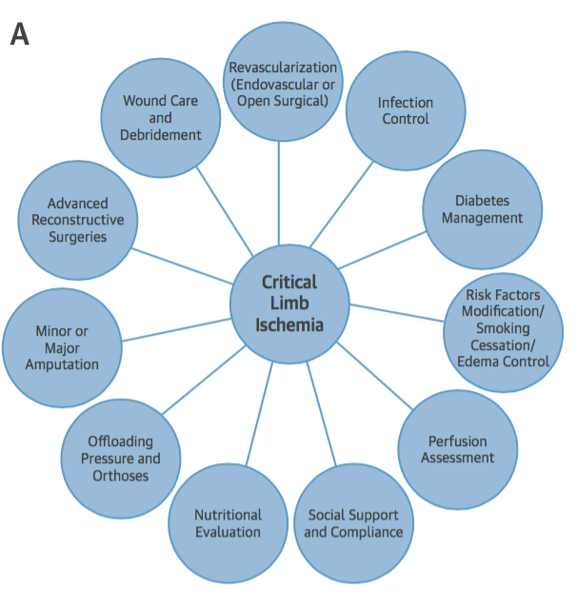
Multidisciplinary field

Slide 36
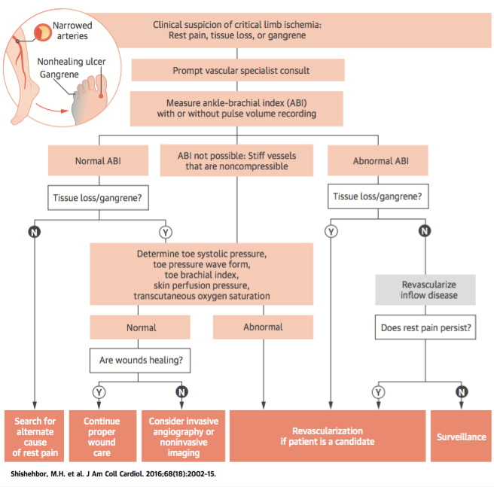
Overall management strategy

Slide 37
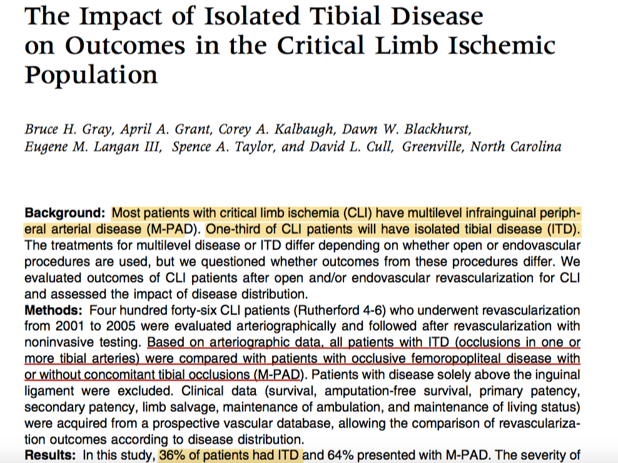
Isolated Tibial disease vs. Multilevel disease

Slide 38
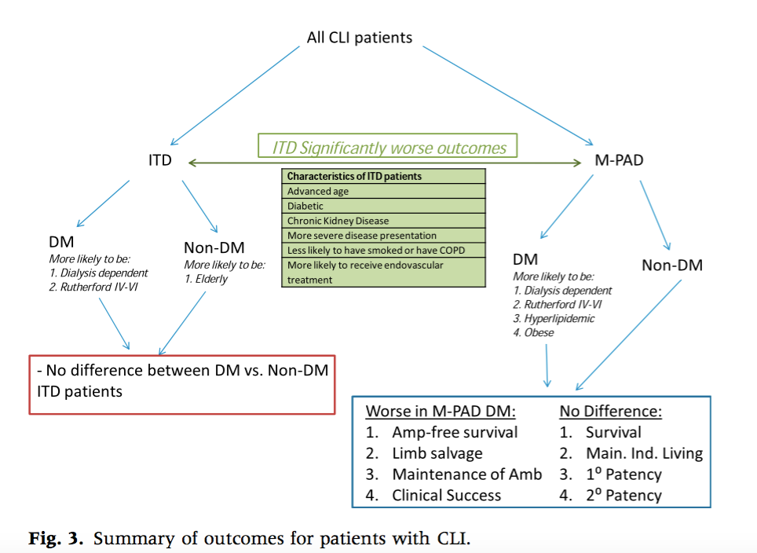
Isolated Tibial disease vs. Multilevel disease

