Slide 1
Division of Endovascular Interventions
Mount Sinai Hospital
New York
12/06/17

Slide 2
History and Physical
75 year old, male
HTN, type 2 DM
Gangrene of the first, fourth and fifth toes of the right foot
BP - 144/76 mmHg
Pulse - 64/min
Right PT and AT- faint monophonic signal, Left AT and PT- biphasic signal

Slide 3
Labs and work up
Hb- 11.0 g/dl
Platelets- 131K
INR- 1.1
Creatinine- 1.85
ABI - right 0.38, left 0.63

Slide 4
Inflow

Slide 5
Right leg run off

Slide 6
Below knee

Slide 7
Leg run off

Slide 8
Ankle level

Slide 9
Post revacularization – knee level

Slide 10
Post revascularization- Foot

Slide 11
Strategy
Left CFA access
6F,45 cm crossover sheath
Lesion crossing with 0.014 wire platform
PTA
Drug eluting stent for flow limiting dissection

Slide 12
Critical Limb Ischemia (CLI)
Critical limb ischemia is defined as presence of rest pain, ulcer or gangrene attributable to objectively proven arterial occlusive disease.
Symptom duration >2 weeks
Physiological testing
- Ankle pressure <40 mmHg, Toe pressure < 30 mmHg, ABI <0.4 (Rest pain)
- Ankle pressure <70 mmHg, Toe pressure < 50 mmHg (for tissue loss)
- TcPo2 < 30 mmHg

Slide 13
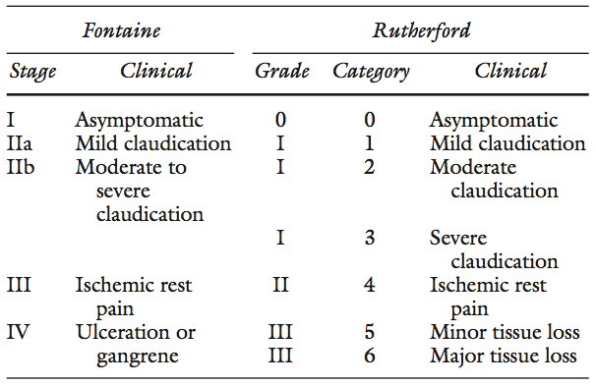
Critical limb ischemia (CLI)

Slide 14
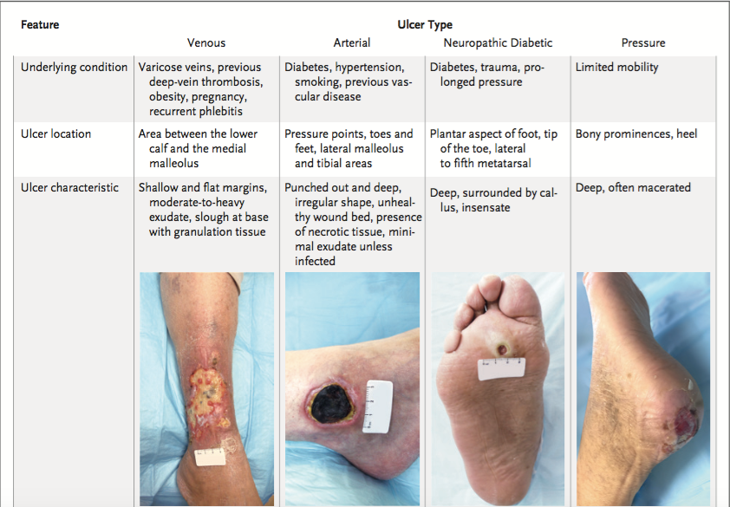
Not every lower extremity ulcer is arterial

Slide 15
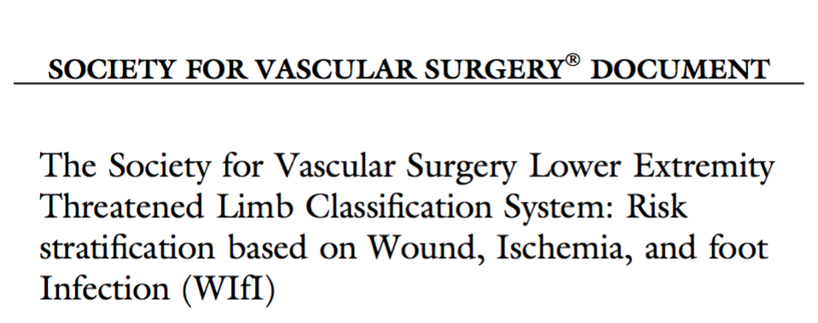
Wifi classification

Slide 16
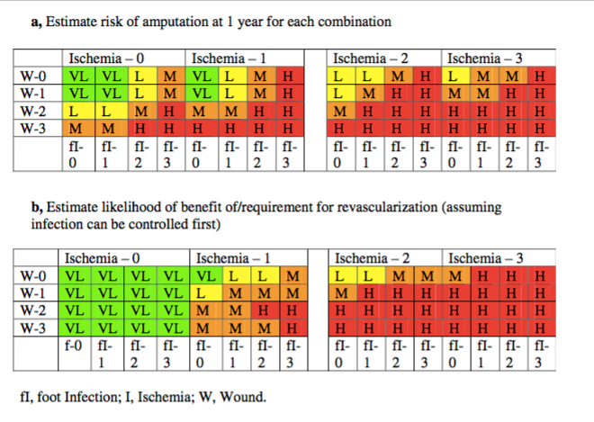
Wound, Ischemia, Foot infection

Slide 17
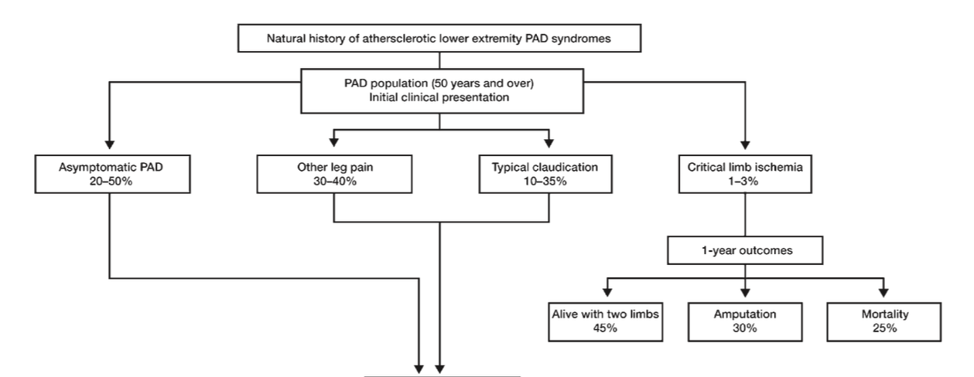
Spectrum of lower extremity PAD presentations

Slide 18
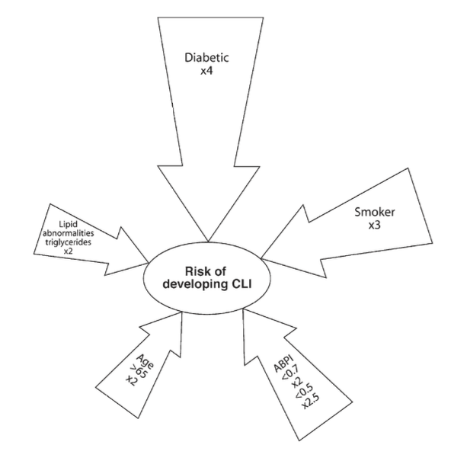
Risk factors for CLI

Slide 19
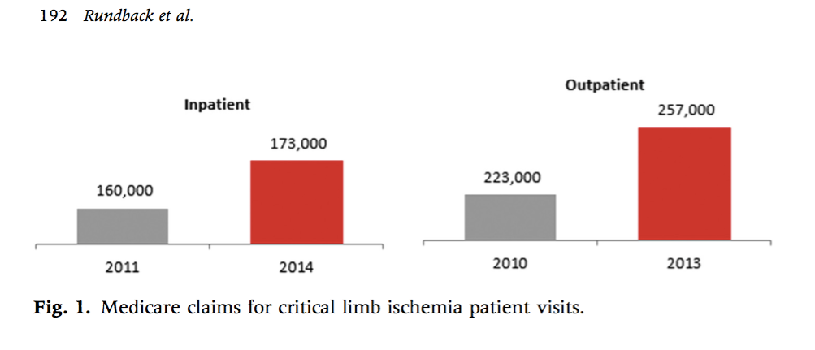
Incidence and Prevalence of CLI
Incidence 0.35%, Prevalence 1.33%

Slide 20
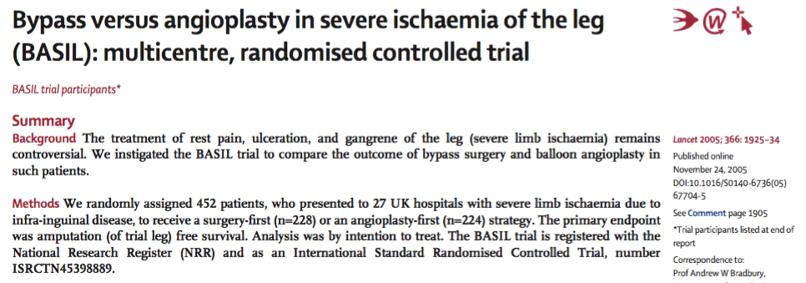
Bypass vs. Endovascular

Slide 21
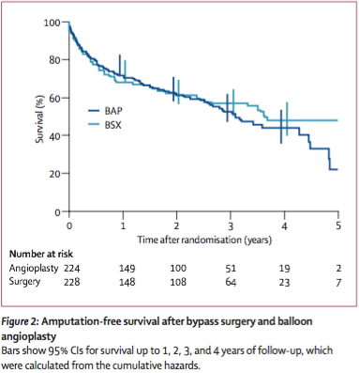
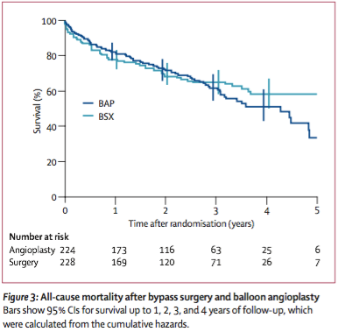
BASIL

Slide 22
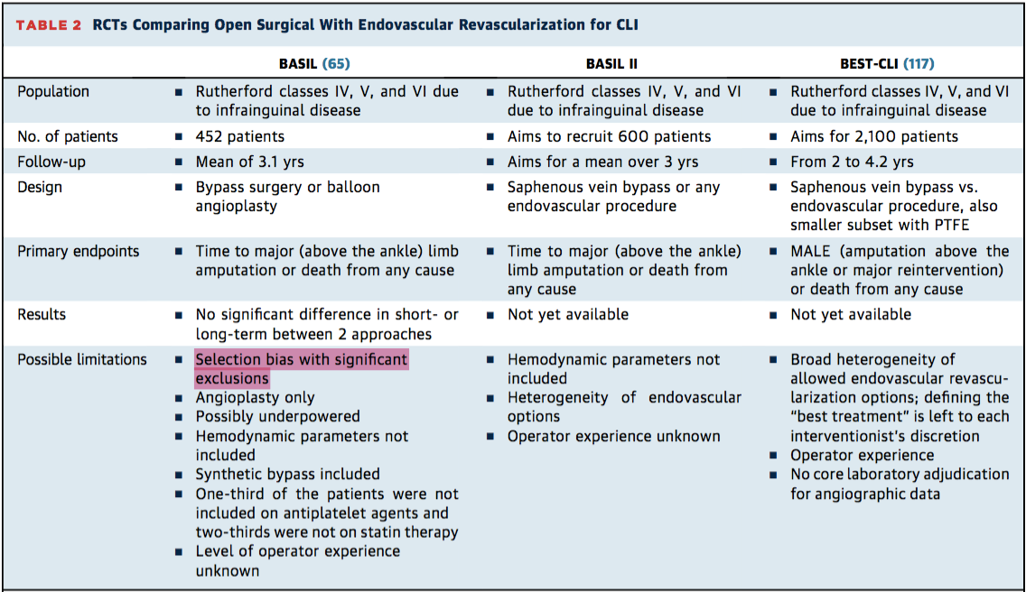
Ongoing RCT’s

Slide 23
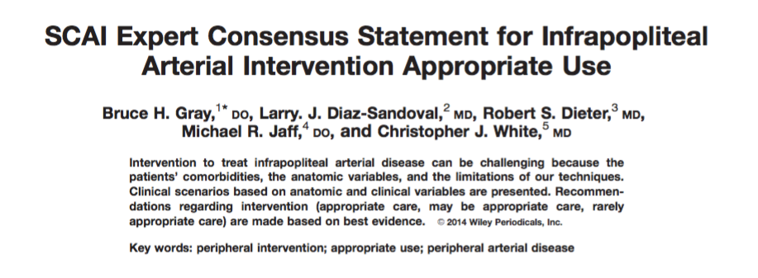
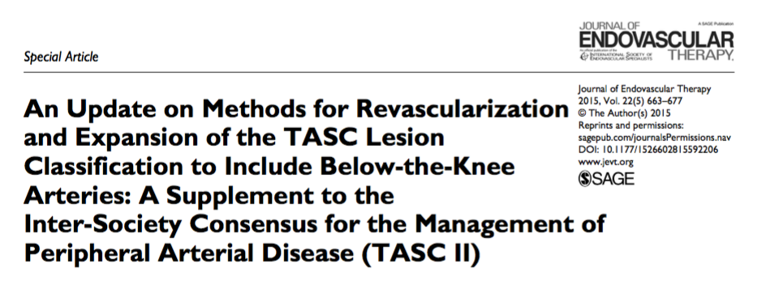
Infrapopliteal disease - guidelines

Slide 24
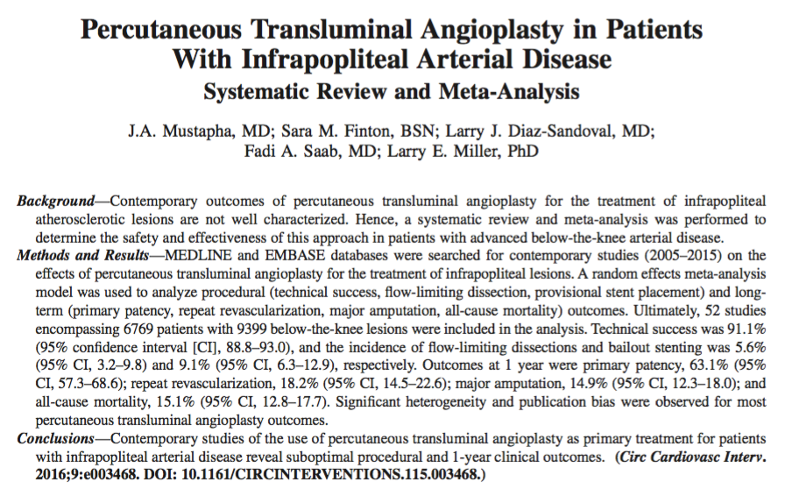
Percutaneous Transluminal Angioplasty

Slide 25
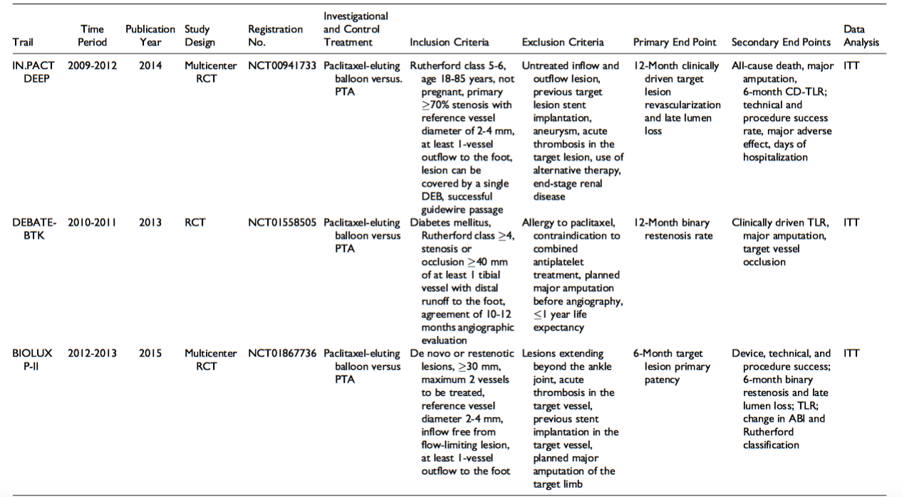
Drug Eluting Balloon trials

Slide 26
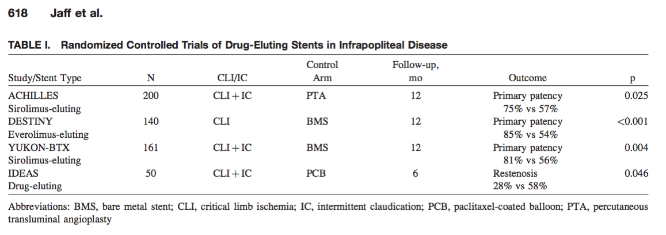
Drug eluting stent trials

Slide 27
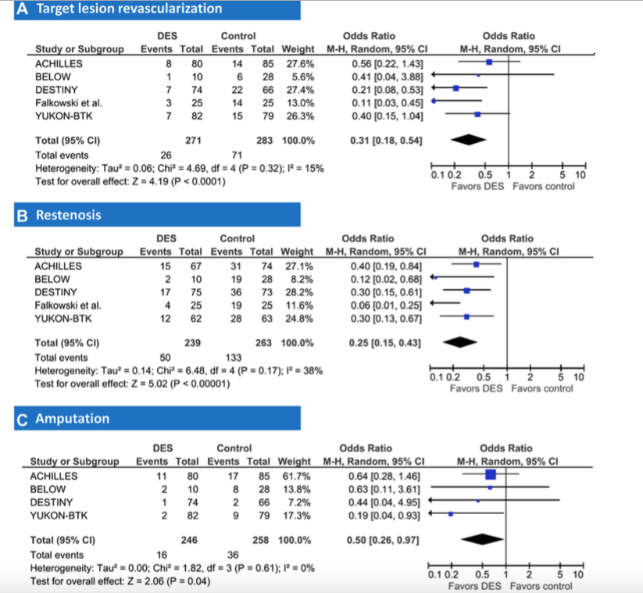
Drug eluting stent meta-analysis

Slide 28
PADI - 5 year outcomes

Slide 29
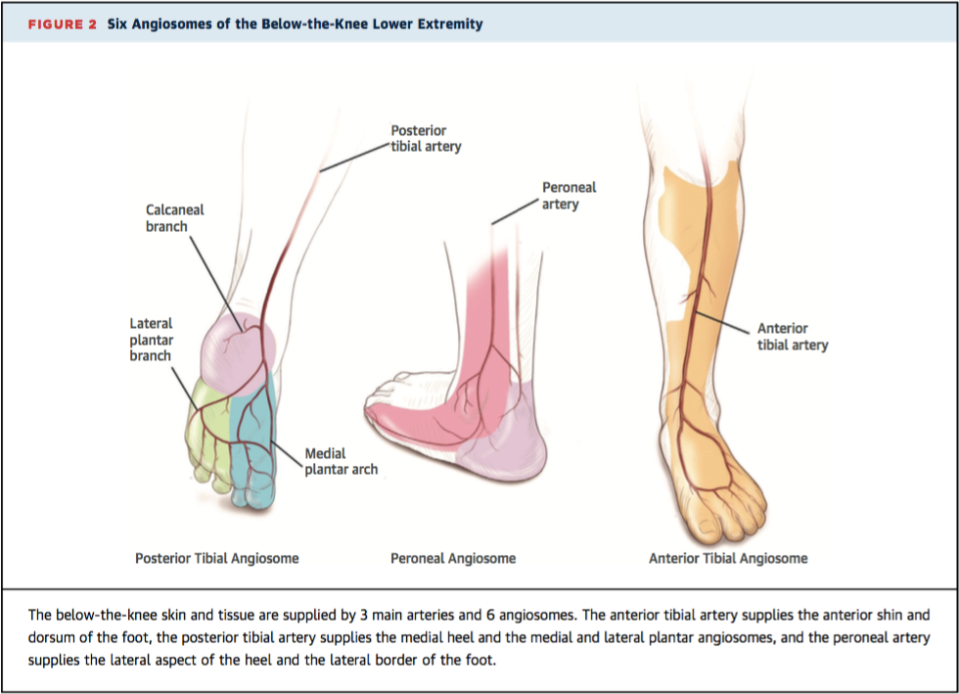
Angiosome directed therapy

Slide 30
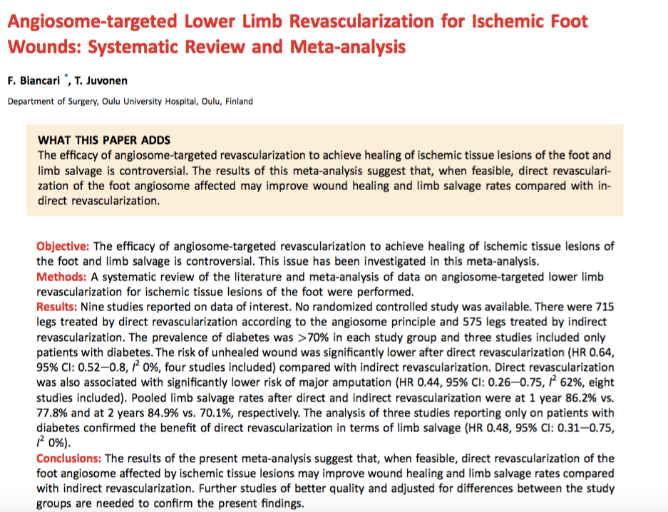
Angiosome directed therapy

Slide 31
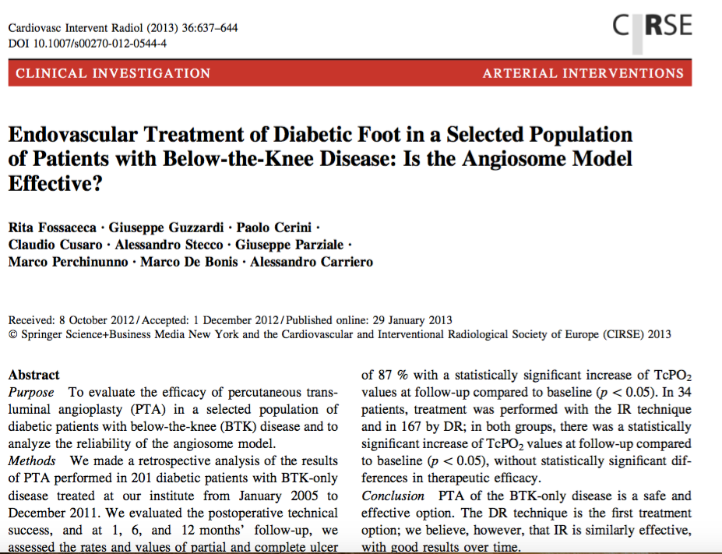
Angiosome directed therapy

Slide 32
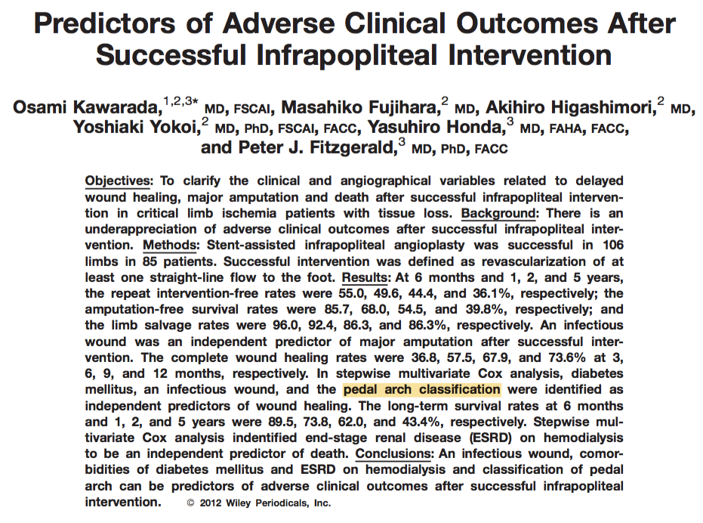
Importance of Pedal-plantar arch

Slide 33
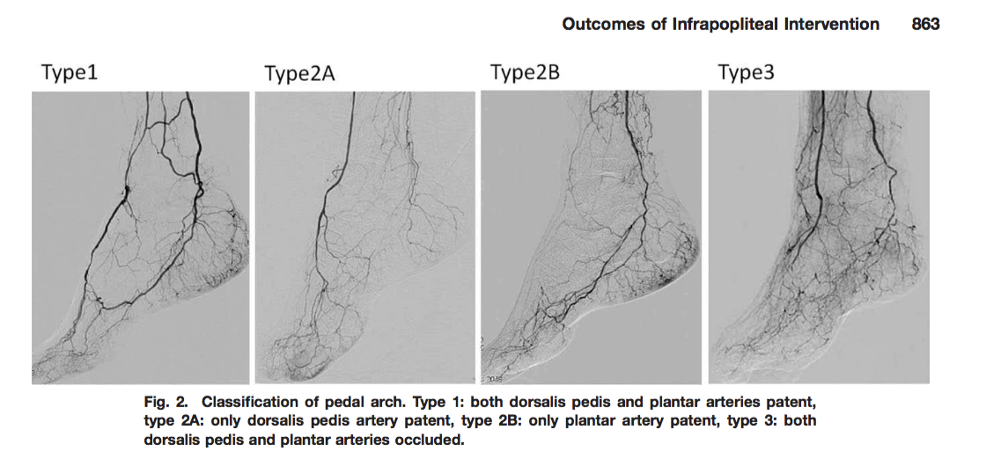
Importance of Pedal-plantar arch

Slide 34
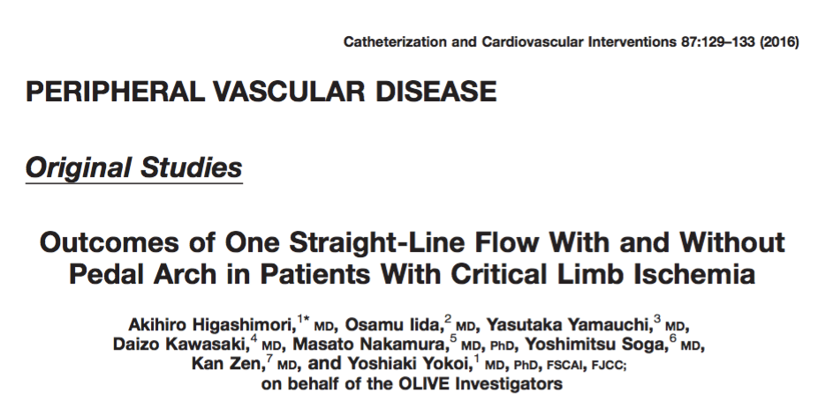
Pedal plantar loop and single patent below knee vessel

Slide 35
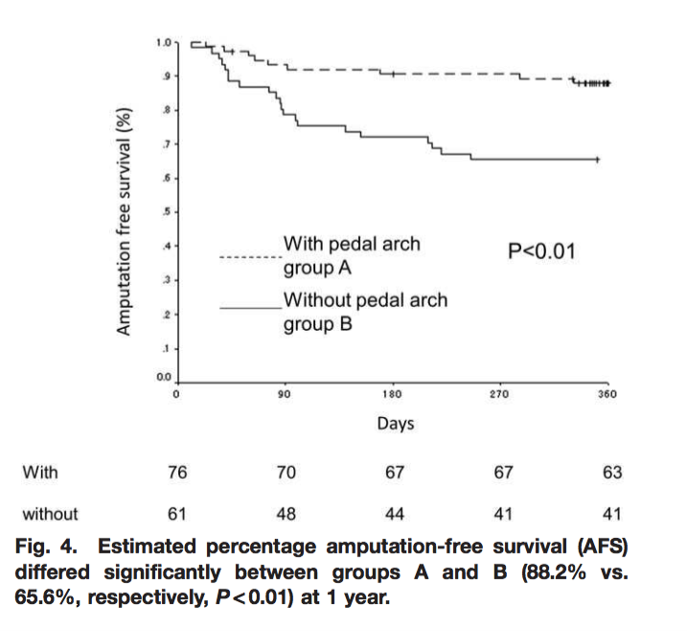
Pedal plantar loop and single patent below knee vessel

Slide 36
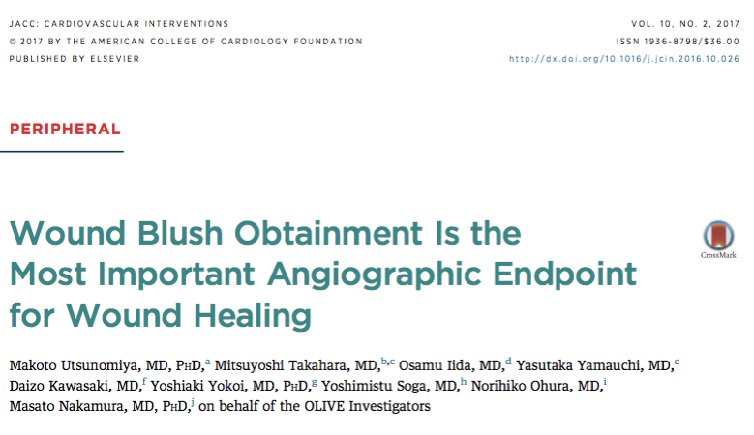
Wound blush and healing

Slide 37
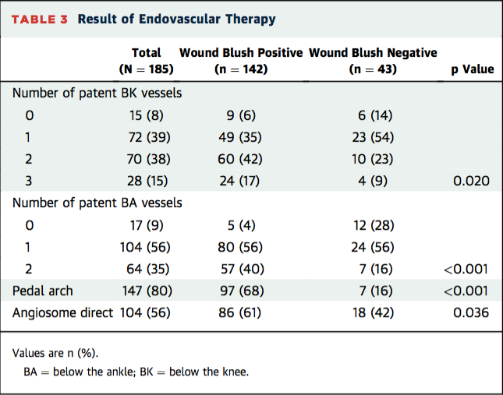
Wound blush and healing

Slide 38
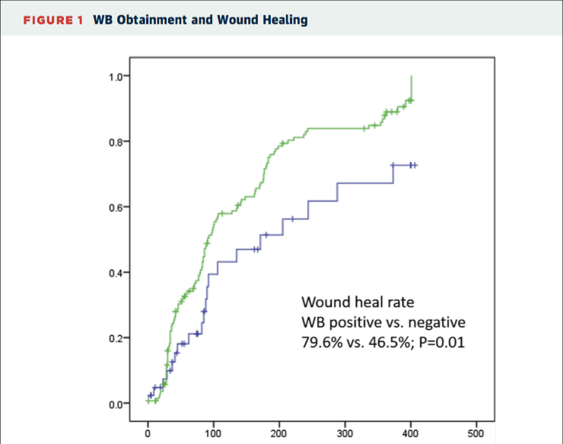
Wound blush and healing

Slide 39
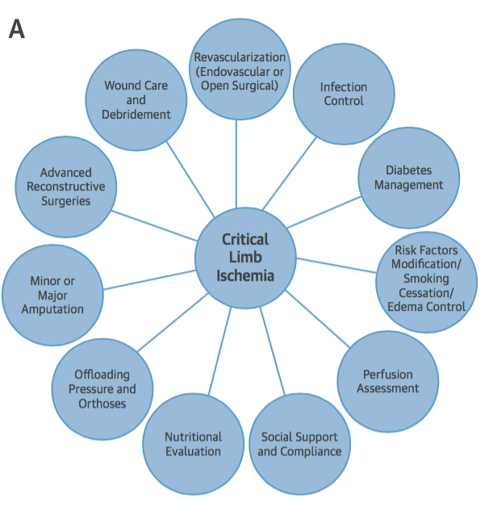
Multidisciplinary field

Slide 40
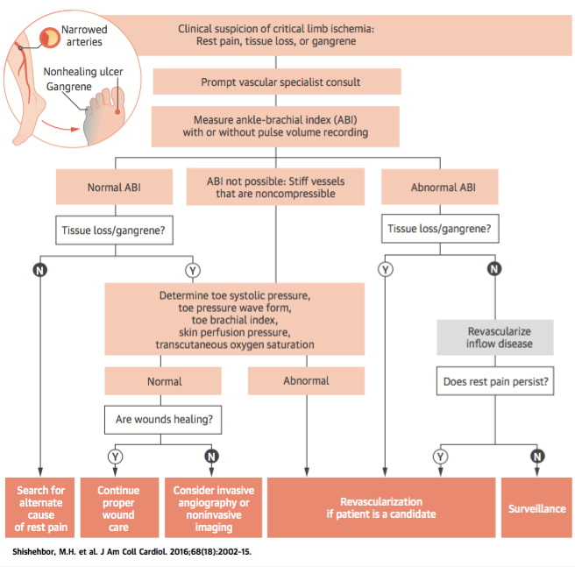
Overall management strategy

Slide 41
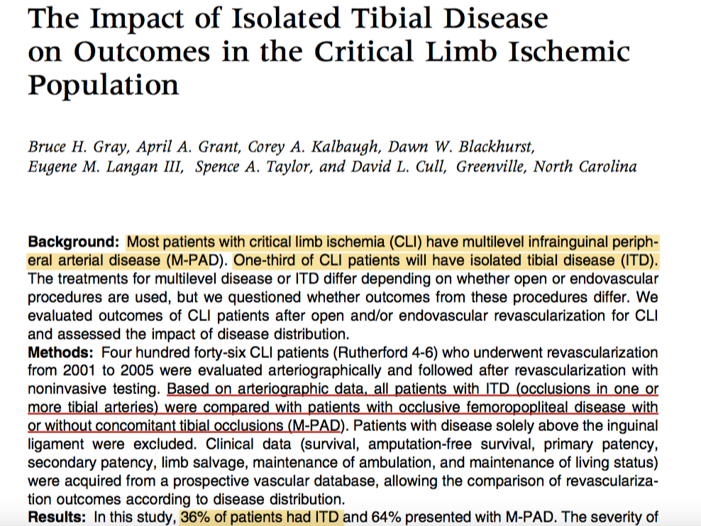
Isolated Tibial disease vs. Multilevel disease

Slide 42
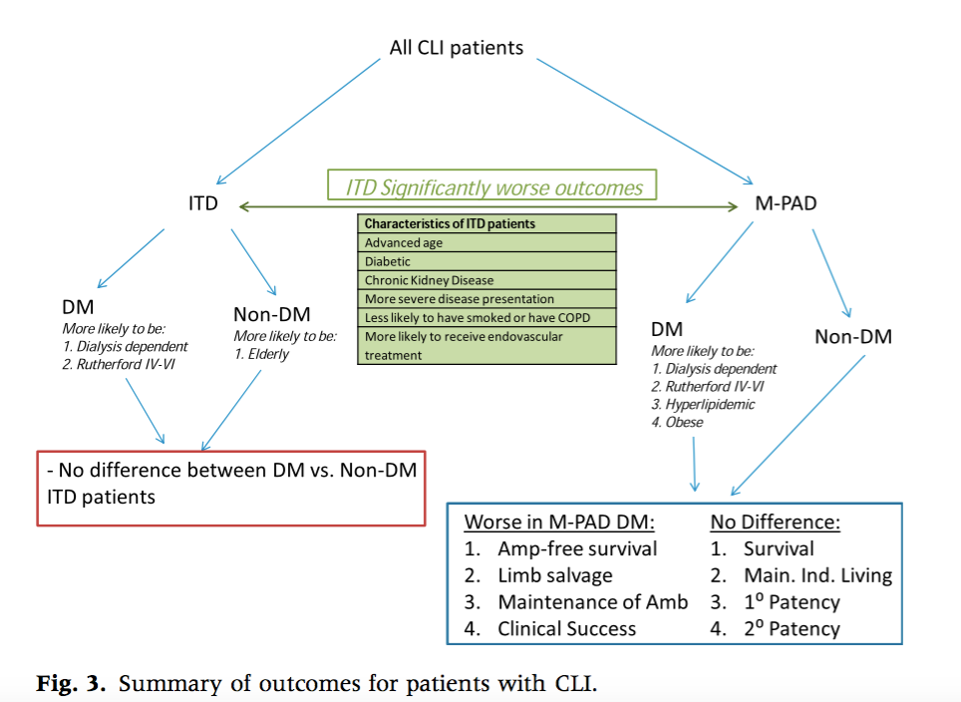
Isolated Tibial disease vs. Multilevel disease

