Slide 1
Structural Heart Live Cases
Supported by:
Medtronic inc
Bard Inc
Terumo Medical Corp

Slide 2
Disclosures
Samin K. Sharma, MD, FACC
Speaker’s Bureau – Boston Scientific Corp., Abbott Vascular Inc, ABIOMED, CSI
Annapoorna S. Kini, MD, FACC
Nothing to disclose
Allan Stewart, MD
Nothing to disclose for today’s presentation
Gilbert Tang, MD
Physician proctor for Medtronic Inc

Slide 3
Sept 12th 2017 Structural Heart Live #19: MD, 79 yr. F
Presentation: Worsening dyspnea on exertion NYHA class III
PMH: CAD (previous PCI), Diabetes, hypertension, hypercholesterolemia, hepatitis C, Non-hodgkins lymphoma, hypothyroidism, DJD spine
Medications: Aspirin, Rosuvastatin, Metoprolol XL, Insulin, Thyroxine.
TTE (07/25/17): Severe AS; PG/MG/AVA = 74/50 mmHg / 0.57 cm², Ao peak velocity = 4.3 m/s, LVEF 58%
EKG (08/23/17): SR, non-specific ST-T wave changes
Cath (01/10/16): One vessel CAD (medical management)

Slide 4
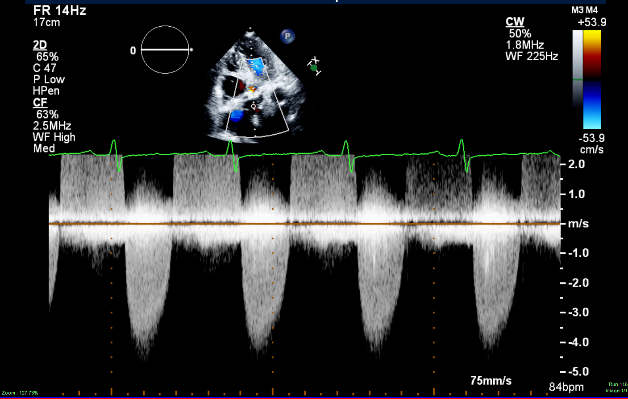
Transthoracic Echo
Severe aortic stenosis: peak gradient = 74 mmHg, mean gradient = 50 mmHg, Doppler valve area = 0.57cm², Ao peak CW velocity = 4.3m/sec, LVEF 58%

Slide 5
Sept 12th 2017 Structural Heart Live #19: MD, 79 yr. F
Contd….
CT Angiography: The bilateral lower extremity and left subclavian peripheral arterial accesses have minimal diameters < 6.0 mm. Right subclavian access have minimal diameters >6.0mm.
STS risk mortality: 3.6 %
EuroScore II risk: 9.5%
Logistic Euroscore mortality: 8.9%
Course: Patient is determined to be high risk for surgical AVR due to comorbidities and frailty

Slide 6
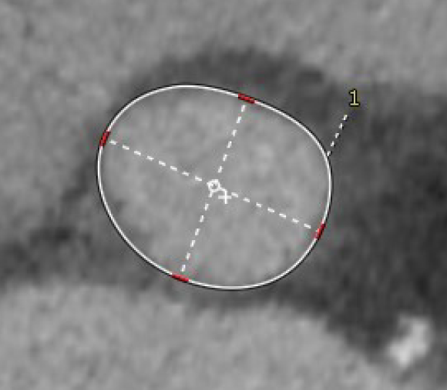
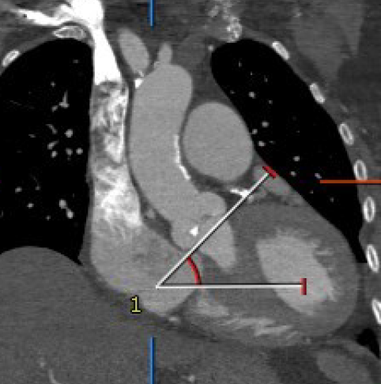
CTA: Aortic Annulus
Annulus
Max: 26.0 mm
Min: 21.2 mm
Mean: 23.6 mm
Perimeter = 75.8 mm
Area = 447 mm²
Annular angle = 45°
Annulus: 26x21mm
Perimeter: 75.8mm °
Annulus angle: 54°°

Slide 7
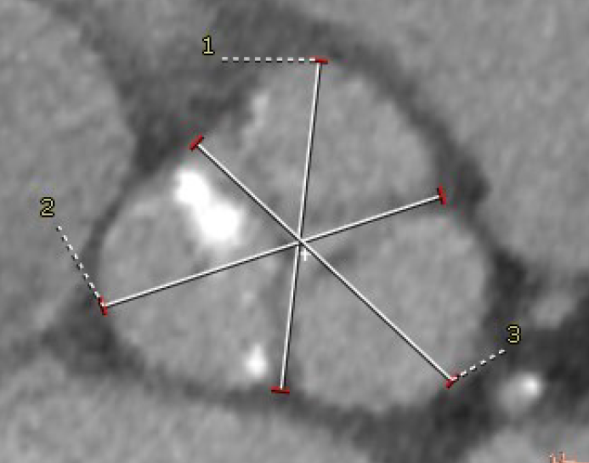
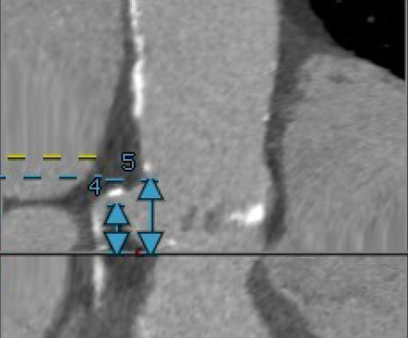
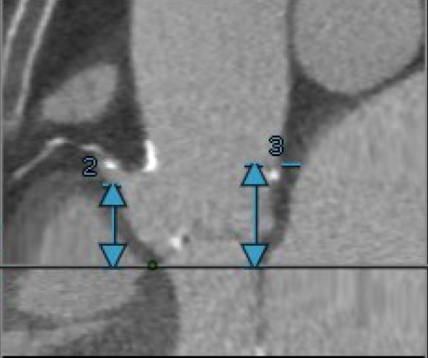
CTA: SOV, STJ, Coronary Ostia
Sinus of Valsalva
RCC = 33.5 mm
LCC = 35.2 mm
NCC = 35.9 mm
Sino-tubular junction height (above annulus) = 23.0 mm
Ascending aorta = 34x36mm
33.5mm
35.9 mm
35.2mm
LM: 11.7 mm RCA: 19.0 mm

Slide 8
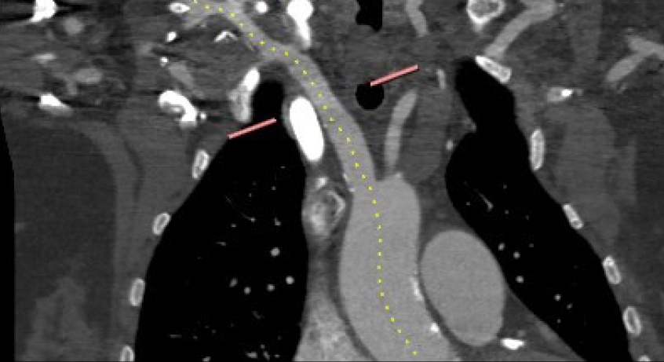
CTA: Access – 3D
Rt Subclavian >5.5mm
9.5 mm
9.7 mm
6.4 mm
6.0 mm
7.9 mm
6.7 mm

Slide 9
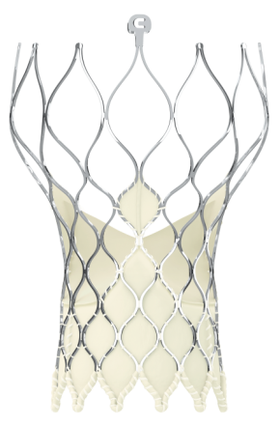
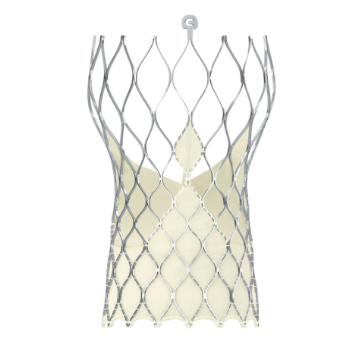
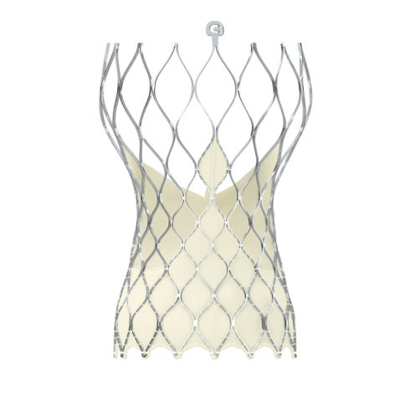
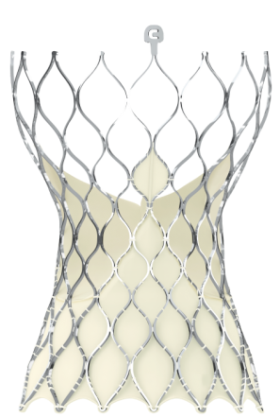
EVOLUT-R 29 MM Patient Selection Matrix
Criteria
Valve Size Selection
CoreValve Evolut R TAVR
Size | 23 mm | 26 mm | 29 mm | 34 mm
Annulus Diameter | 18 – 20 mm | 20 – 23 mm | 23 – 26 mm | 26 - 30 mm
Annulus Perimeter (π x Diam) | 56.5 – 62.8 mm | 62.8 – 72.3 mm | 72.3 – 81.7 mm | 81.7 – 94.2 mm
Sinus of Valsalva Diameter (Mean) | ≥ 25 mm | ≥ 27 mm | ≥ 29 mm | ≥ 31 mm
Sinus of Valsalva Height (Mean) | ≥ 15 mm | ≥ 15 mm | ≥ 15 mm | ≥ 16 mm
Our
Patient
23.6
75.8
35.8
23.4

Slide 10
Summary of Case
- 79 year old female
- NYHA Class III
- TTE: AS – mean gradient 50 mmHg
- STS risk mortality: 3.6%
- EuroScore II risk: 9.5%
- Logistic Euroscore mortality: 8.9%
- Patient is determined to be high risk for
surgical AVR due to age and frailty
- For 29 mm Medtronic Evolut-R CoreValve via right subclavian cut-down.

Slide 11
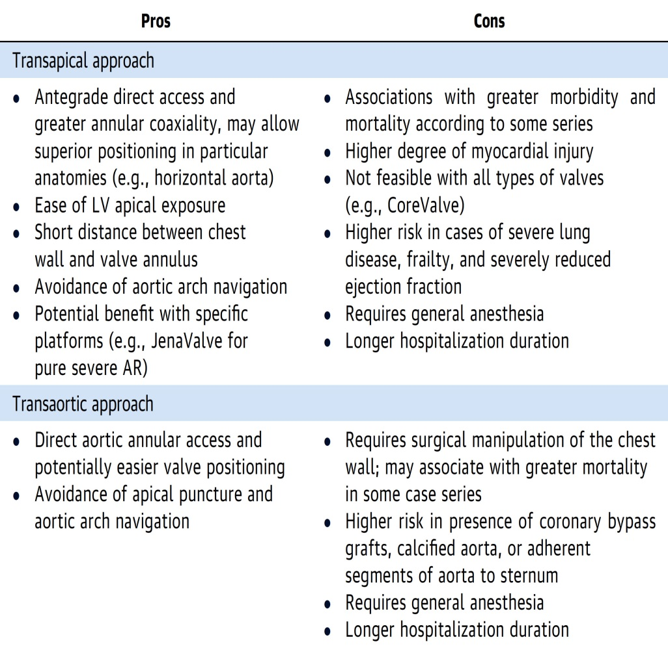
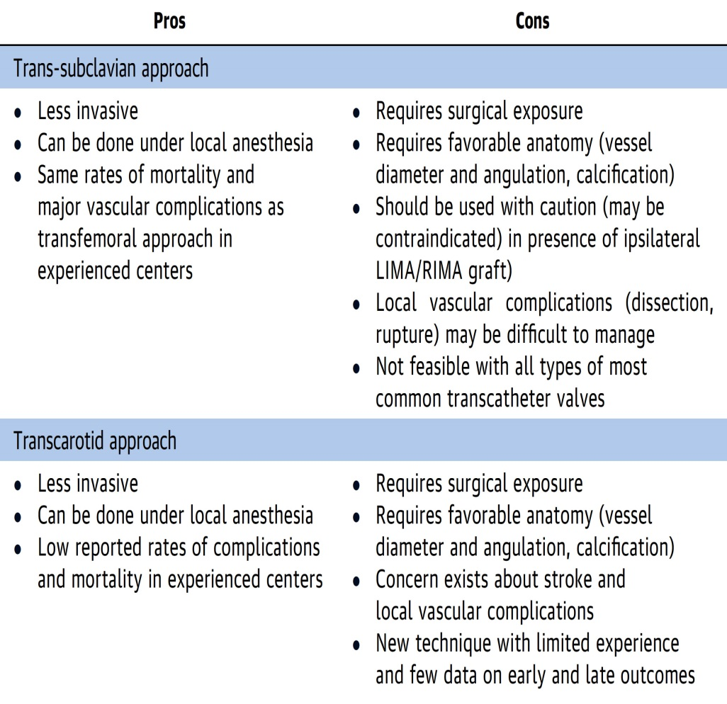
Summary of the Advantage and Disadvantages
of Different Alternative Approaches for Non-TF-TAVR
Rodés-Cabau et al., J Am Coll Cardiol 2017;69:522

Slide 12
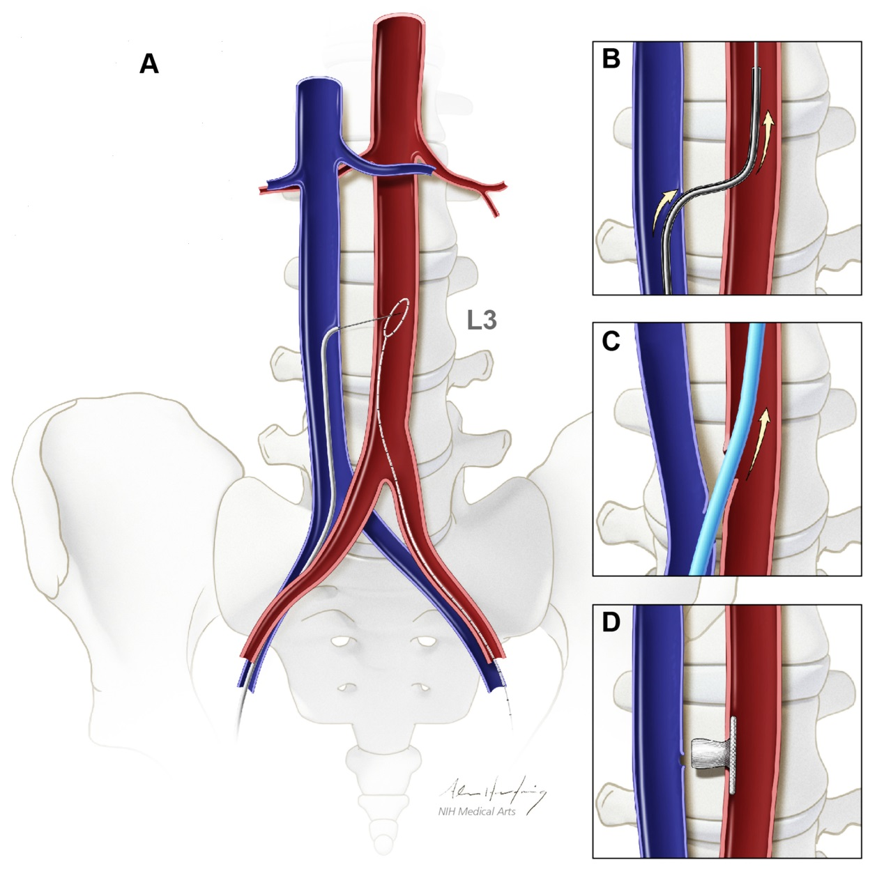
Transcaval Access Technique for TAVR
Transcaval access obtained over an electrified guidewire
Microcatheter delivered to exchange for a stiff guidewire
Transcathter heart valve introducer sheath is advanced
Aorto-caval access site is closed with nitinol cardiac occluder
Greenbaum et al., J Am Coll Cardiol 2017;69:511

Slide 13
Issues Related To The Case
Structural Valve Deterioration post TAVR vs SAVR

Slide 14
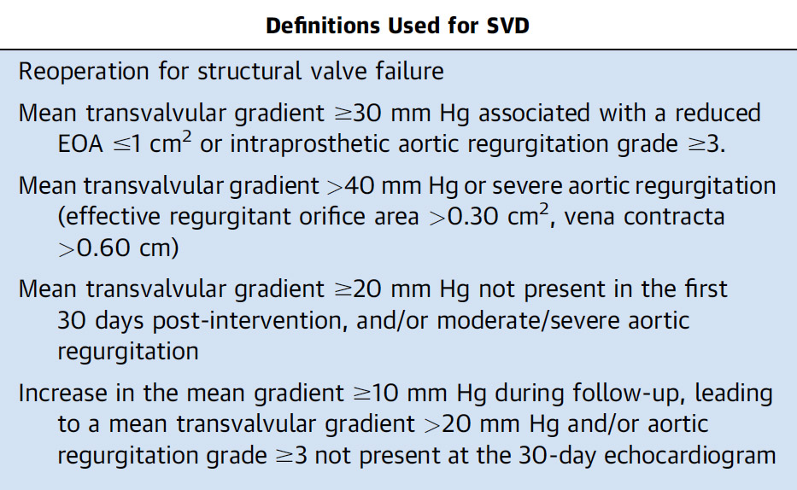
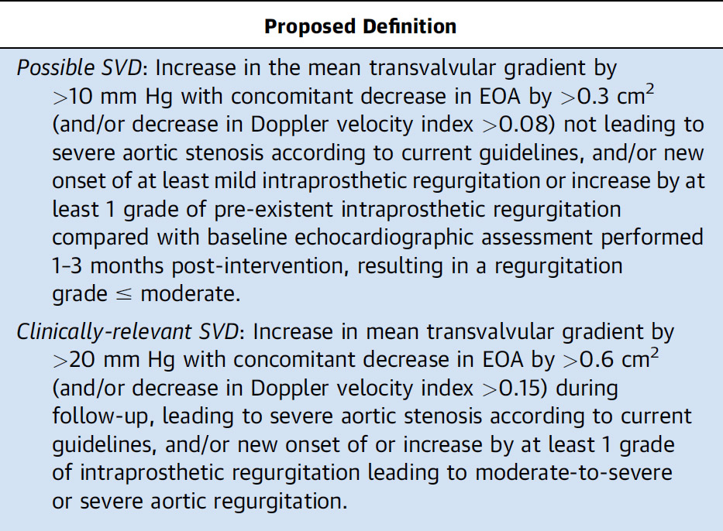
Definitions of Structural Valve Degeneration
Rodriguez-Gabella et al., J Am Coll Cardiol 2017;70:1013

Slide 16
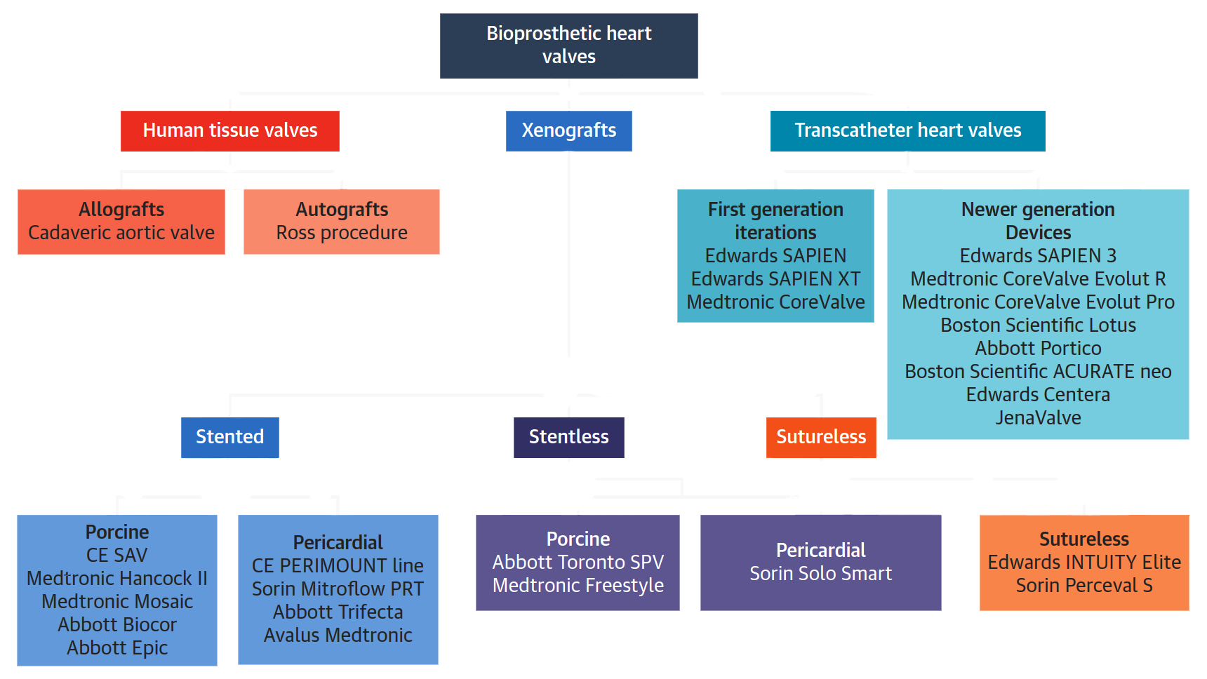
General Classification of Bioprosthetic Valves
Rodriguez-Gabella et al., J Am Coll Cardiol 2017;70:1013

Slide 17
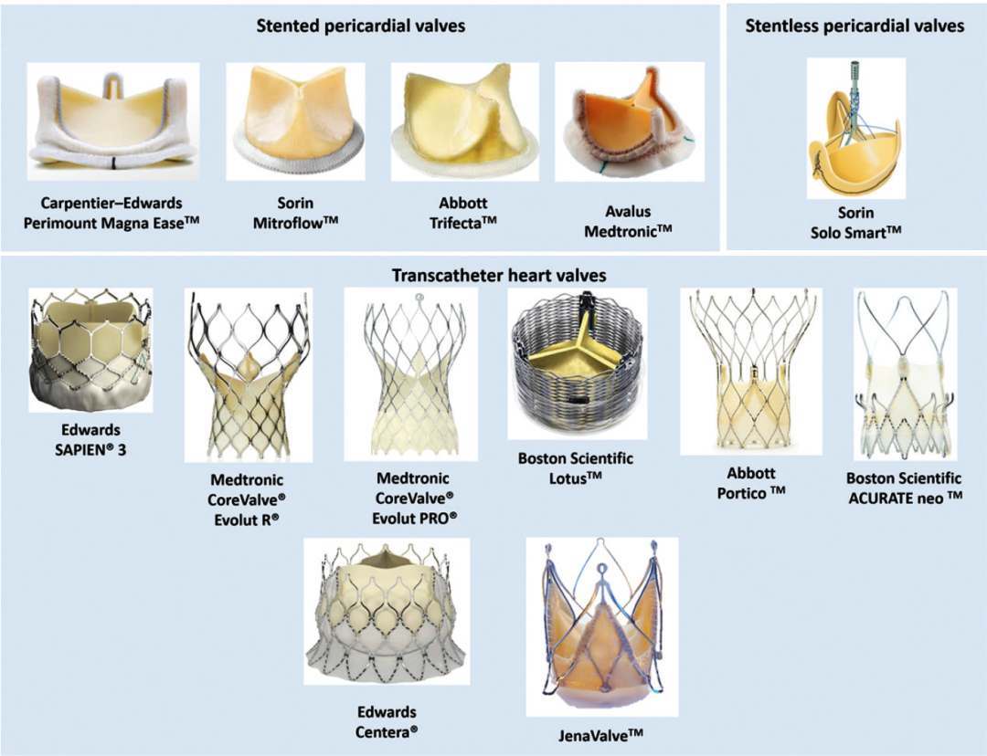
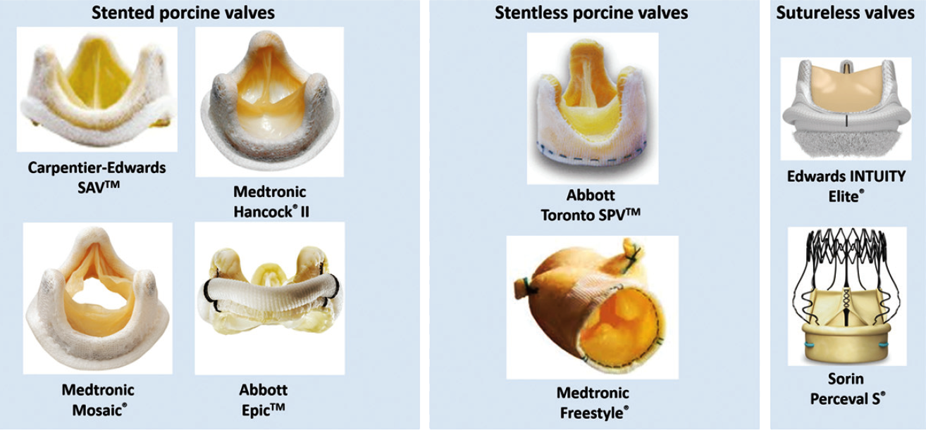
Various Types of Surgical and Transcatheter
Heart Valves
Rodriguez-Gabella et al., J Am Coll Cardiol 2017;70:1013

Slide 18
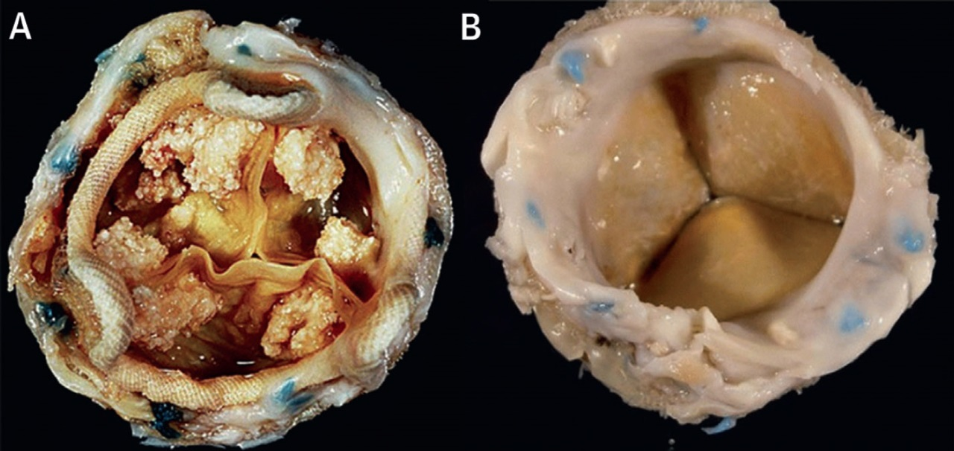
Examples of Bioprosthetic Degeneration
Bioprosthetic porcine valve. Bulky calcifications nodules on the leaflets surface leading to severe AS.
Bioprosthetic pericardial valve. Excessive pannus overgrowth, with a fibrotic reaction encasing the sewing ring sutures.
Rodriguez-Gabella et al., J Am Coll Cardiol 2017;70:1013

Slide 19
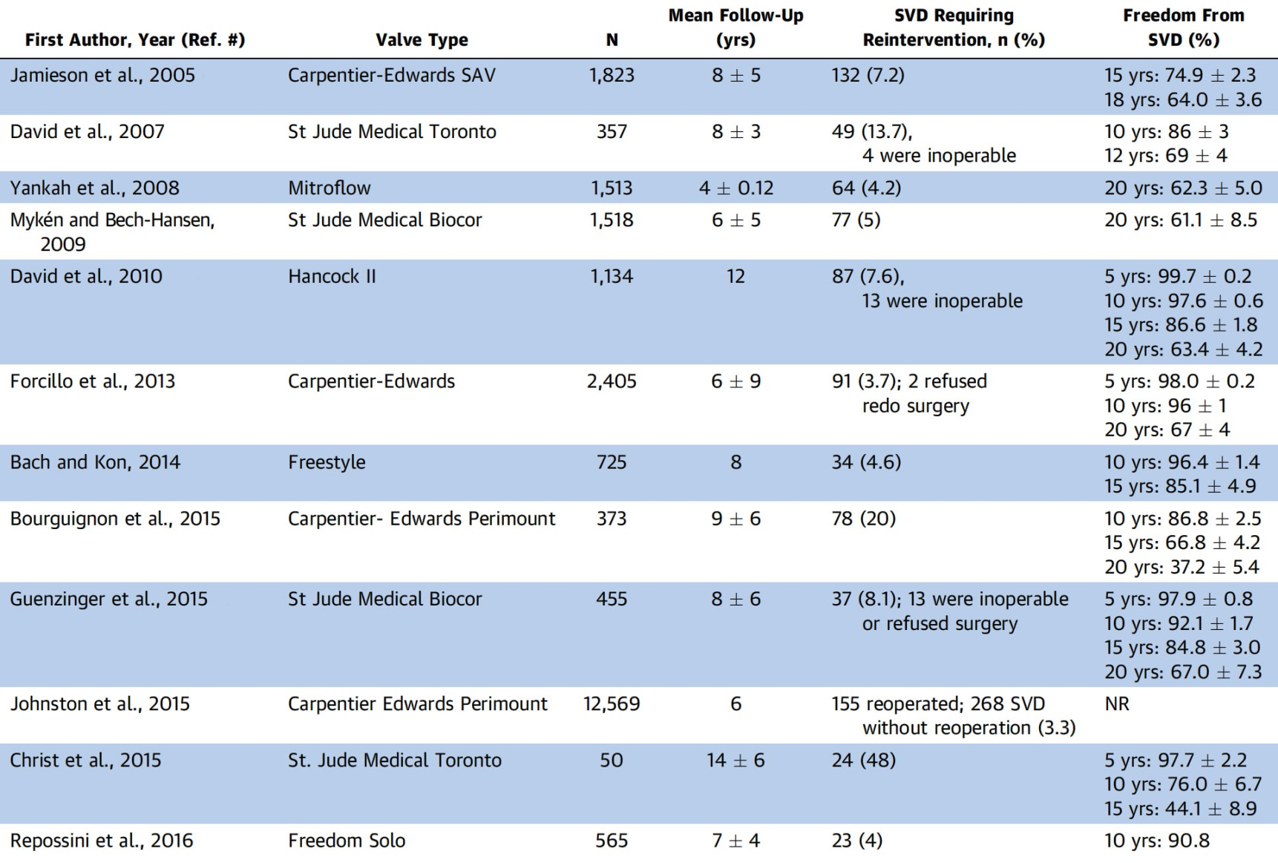
Studies on Surgical Bioprosthesis Durability
Rodriguez-Gabella et al., J Am Coll Cardiol 2017;70:1013

Slide 20
Studies on Transcatheter Aortic Valve Durability
Rodriguez-Gabella et al., J Am Coll Cardiol 2017;70:1013

Slide 21
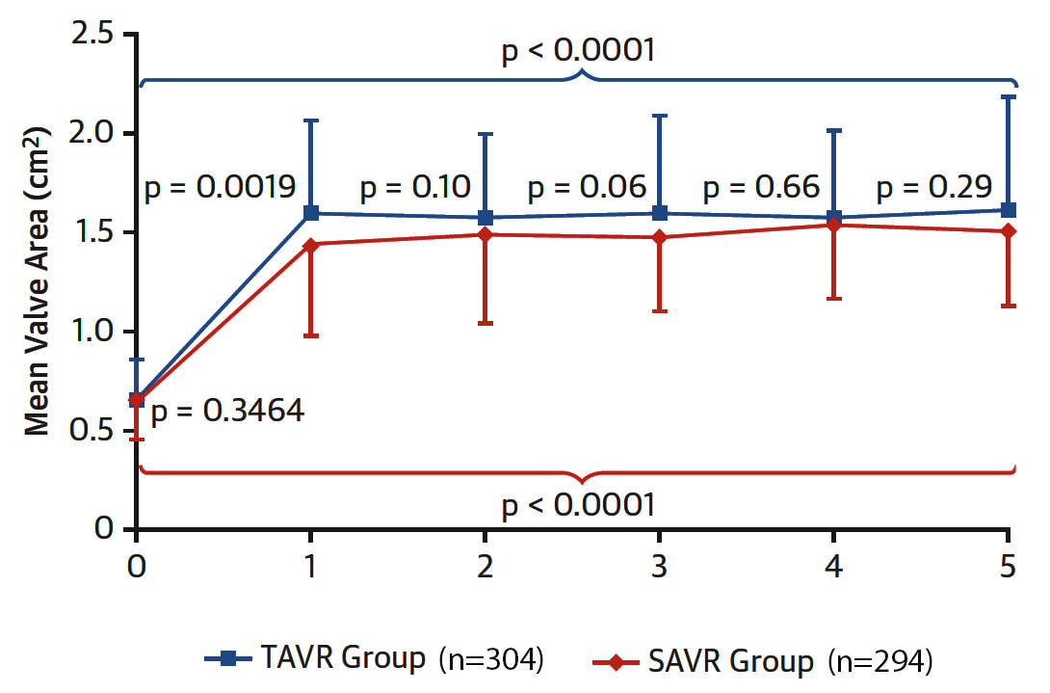
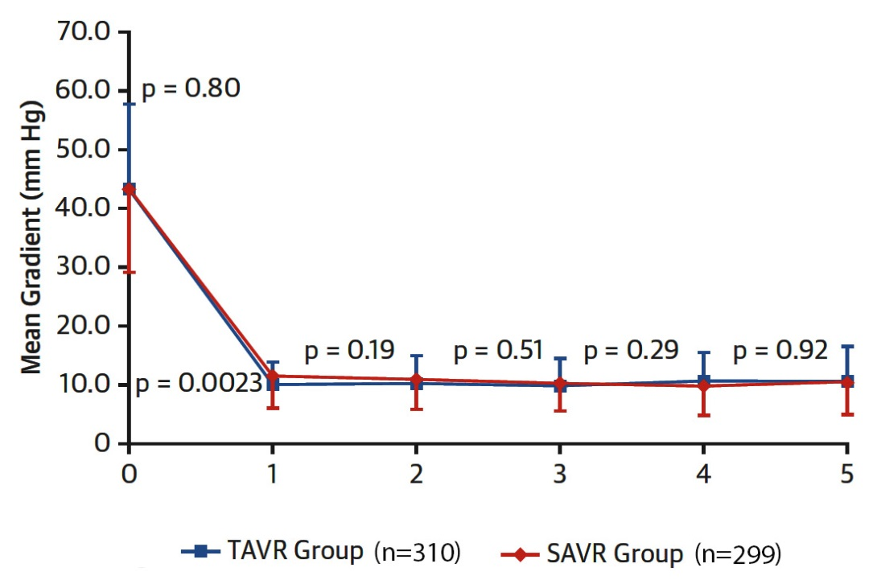
PARTNER 5-Yr Echocardiographic Prosthetic Performance
Aortic Valve Area
Mean Transvalvular Gradient
Rodriguez-Gabella et al., J Am Coll Cardiol 2017;70:1013

Slide 22
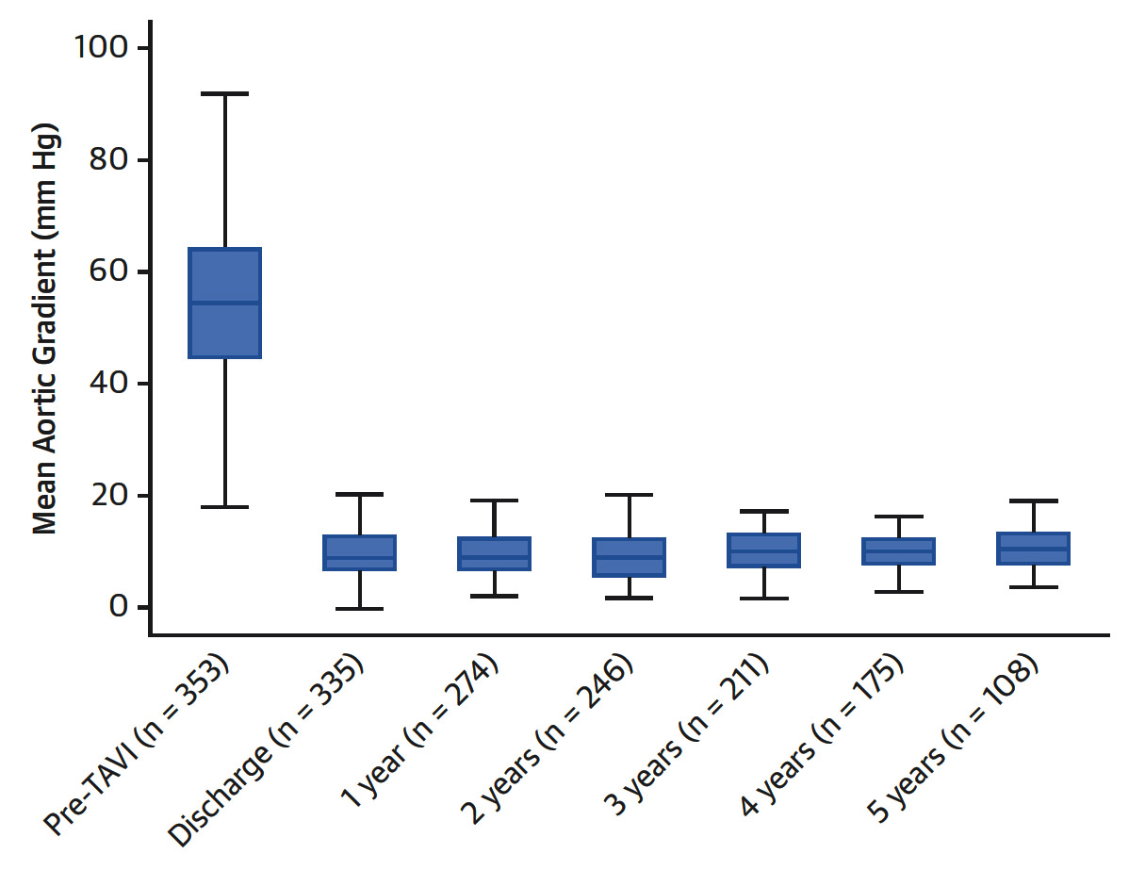
CoreValve 5-Yr Follow-Up
Echo evaluation of the CoreValve system performance
Rodriguez-Gabella et al., J Am Coll Cardiol 2017;70:1013

Slide 23
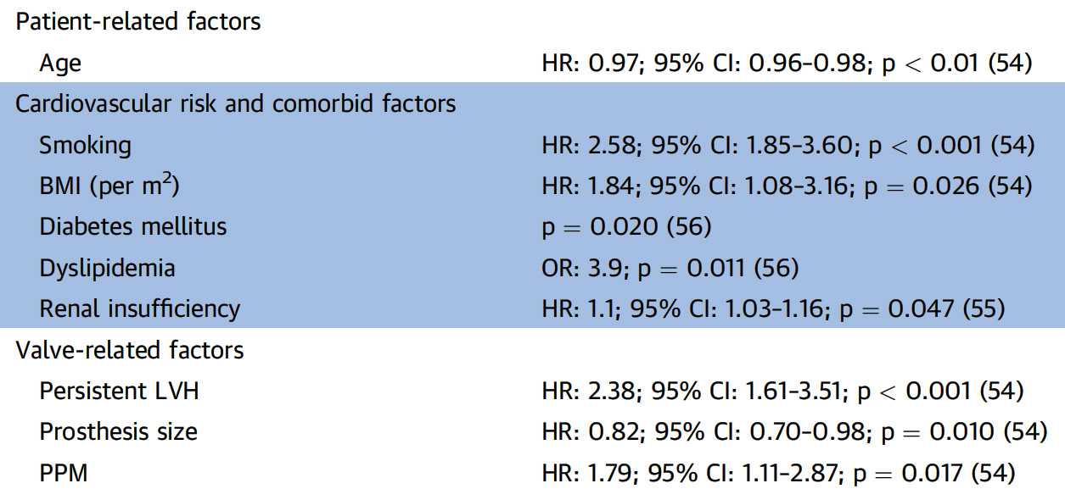
Predictors of Structural Valve Degeneration (Aortic Bioprosthesis)
Rodriguez-Gabella et al., J Am Coll Cardiol 2017;70:1013

Slide 24
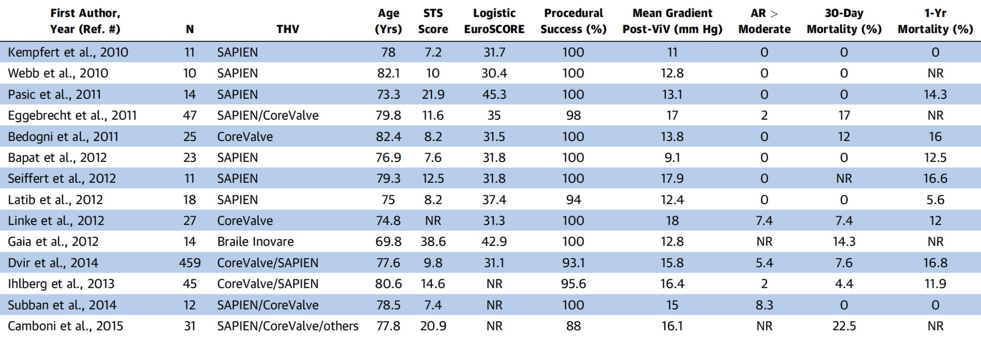
Studies in ViV TAVR Procedures
Rodriguez-Gabella et al., J Am Coll Cardiol 2017;70:1013

Slide 25
Main Complications Associated with Aortic ViV Procedures and Conventional TAVR
Complications | ViV | Conventional TAVR
Elevated post-procedural gradients | +++ | +
Coronary obstruction | +++ | +
Malpositioning | ++ | +
Vascular complications | ++ | ++
Permanent pacemaker | + | ++
Paravalvular leak | - | ++
Annulus rupture | - | +
Rodriguez-Gabella et al., J Am Coll Cardiol 2017;70:1013

Slide 26
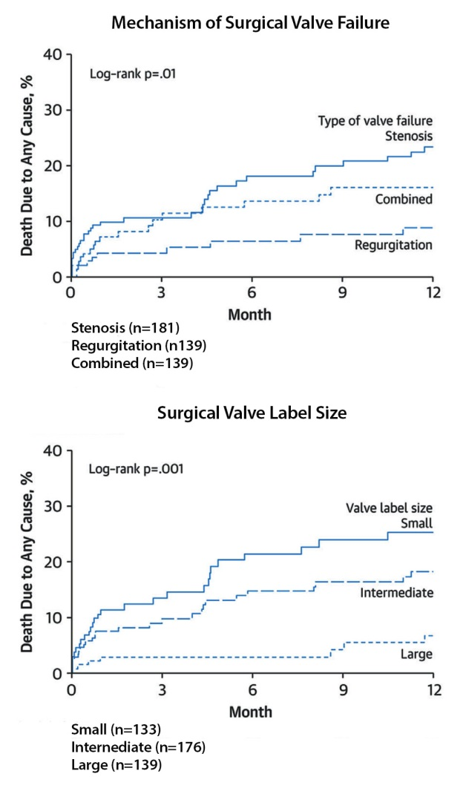
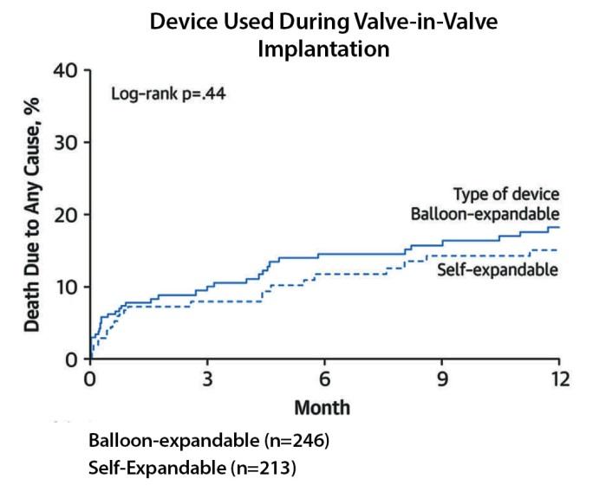
Valve-in-Valve Procedures: 1-Yr Follow-Up Mortality Rates
Rodriguez-Gabella et al., J Am Coll Cardiol 2017;70:1013

Slide 27
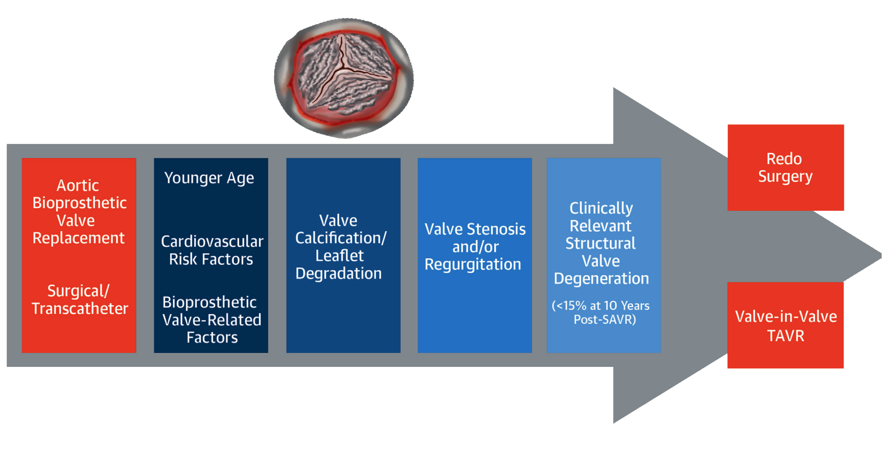
Structural Valve Degeneration Following Surgical
or Transcatheter Aortic Bio-prosthesis Implantation
Rodriguez-Gabella et al., J Am Coll Cardiol 2017;70:1013

Slide 28
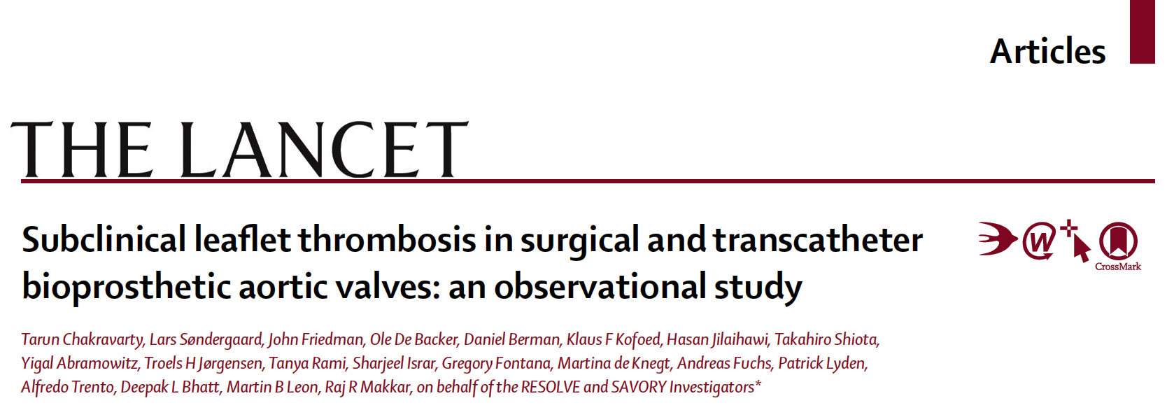
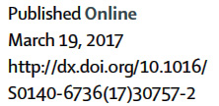

Slide 29
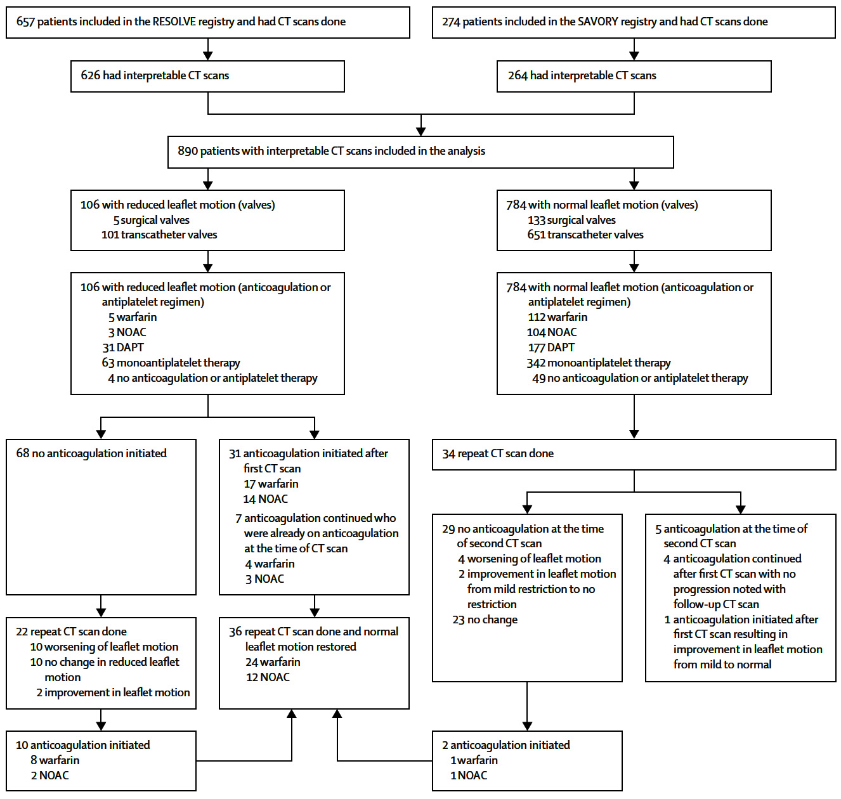
RESOLVE and SAVORY Registries:
Study Design and Effect of Anticoagulation on Reduced Leaflet Motion
Chakravarty et al., Lancet 2017;389:2383

Slide 30
Subclinical Leaflet Thrombosis
in Surgical and Transcatheter Bioprosthetic Aortic Valves
Results from RESOLVE and SAVORY Registries

Slide 31
RESOLVE and SAVORY Registries:
Valve Types and Timing to CT
890 patients with interpretable CTs
Median time from AVR to CT
83 days (IQR 32-281 days)
752 transcatheter valves Median time from TAVR to CT 58 days (IQR 32-236 days)
138 surgical valves
Median time from SAVR to CT
162 days (IQR 79-417 days)
Time from TAVR to CT vs. SAVR to CT: p=<0.0001

Slide 32
RESOLVE and SAVORY Registries:
Prevalence of Reduced Leaflet Motion
Transcatheter vs. Surgical Bioprosthetic Aortic Valves: p=0.001
Reduced leaflet motion was present in 106 patients (N=890)
11.9%
Transcatheter valves (N=752)
13.4%
Surgical valves
(N=138)
3.6%

Slide 33
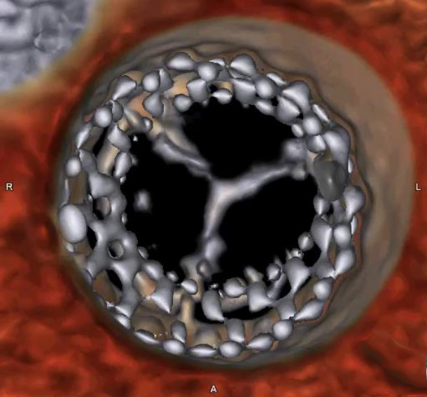
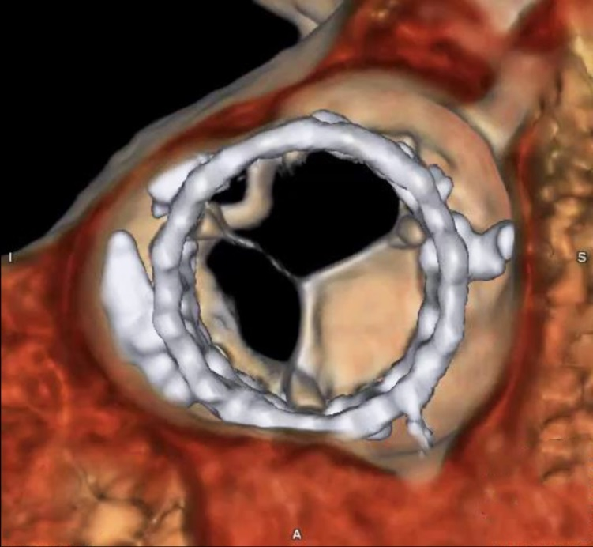
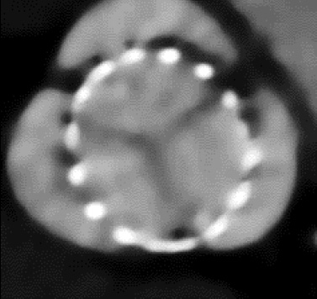
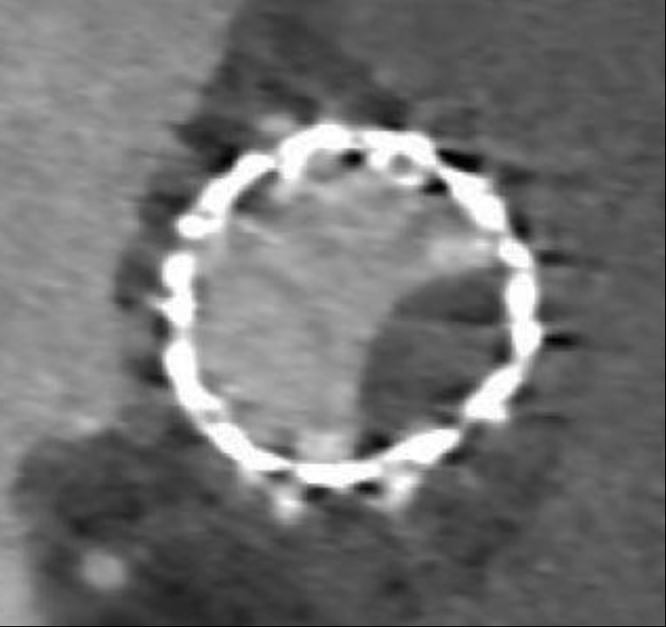
RESOLVE and SAVORY Registries:
Presence of 50% Restriction of Leaflet Motion in Reduced Leaflet Motion
Normal Leaflet Motion
Reduced Leaflet Motion

Slide 34
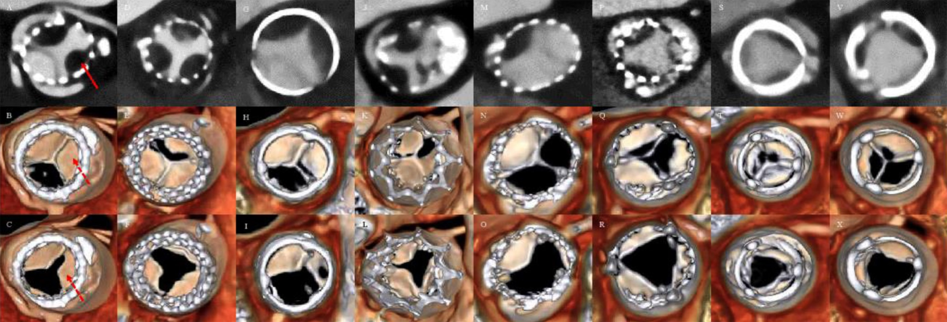
RESOLVE and SAVORY Registries:
Hypoattenuating Opacities and Reduced Leaflet Motion in Multiple Bioprosthetic Valve Types
Sapien | Evolut R | Lotus | Portico | Centera | Symetis | Perimount | Magna
Hypoattenuating opacities (solid arrow)
Reduced leaflet motion (dashed arrows)

Slide 35
RESOLVE and SAVORY Registries:
Severity of Reduced Leaflet Motion
Surgical vs. Transcatheter Valves
Leaflet Thickness
Leaflet Motion Restriction
Leaflet thickness (mm)
p=0.0004
Leaflet motion restriction (%)
p=0.0004

Slide 36
RESOLVE and SAVORY Registries:
Anticoagualtion and Reduced Leaflet Motion
Anticoagulation vs. No Anticoagulation
Prevalence of Reduced Leaflet motion (%)
Anticoagulation vs. No anticoagulation: p=<0.0001
NOACs vs. no anticoagulation: p=0.0002
Warfarin vs. no anticoagulation: p=0.001
NOACs vs. warfarin: p=0.72
8/224
3/107
5/117
98/666

Slide 37
RESOLVE and SAVORY Registries:
Anticoagualtion and Reduced Leaflet Motion
Anticoagulation vs. Antiplatelet Therapy
Prevalence of Reduced Leaflet motion (%)
Anticoagulation vs. DAPT: p=<0.0001
Anticoagulation vs. Monoantiplatelet therapy: p=<0.0001
8/224
3/107
5/117
31/108
63/405

Slide 38
RESOLVE and SAVORY Registries:
Multivariate Predictors of Reduced Leaflet Motion
 | Odds Ratio (95% CI) | P Value
Age | 1.04 (1.01-1.07) | 0.01
Ejection fraction | 0.98 (0.97-1.00) | 0.02
Surgical vs. transcatheter valve | 0.33 (0.11-0.96) | 0.04
Anticoagulation | 0.24 (0.10-0.58) | 0.002
Time to CT | 1.00 (0.98-1.02) | 0.67
Atrial fibrillation | 0.62 (0.31-1.23) | 0.17
BMI | 0.97 (0.93-1.02) | 0.17
All variables with a p-value <0.20 in univariate model were entered into the multivariate analysis. Time from AVR to CT was forced into the model; despite p-value >0.20 in univariate analysis

Slide 39
RESOLVE and SAVORY Registries:
Impact of Initiation of Anticoagulation on Reduced Leaflet Motion
Prevalence of Reduced Leaflet motion (%)
36/36
Resolution in 36 out of 36 patients treated with anticoagulation (NOACs n=12; warfarin n=24)
Persistence/progression in 20 out of 22 patients not treated with anticoagulation p=<0.0001
20/22
2/22
0/36
Resolution
No change or progression
Resolution
No change or progression
Anticoagulation initiated
No anticoagulation initiated

Slide 40
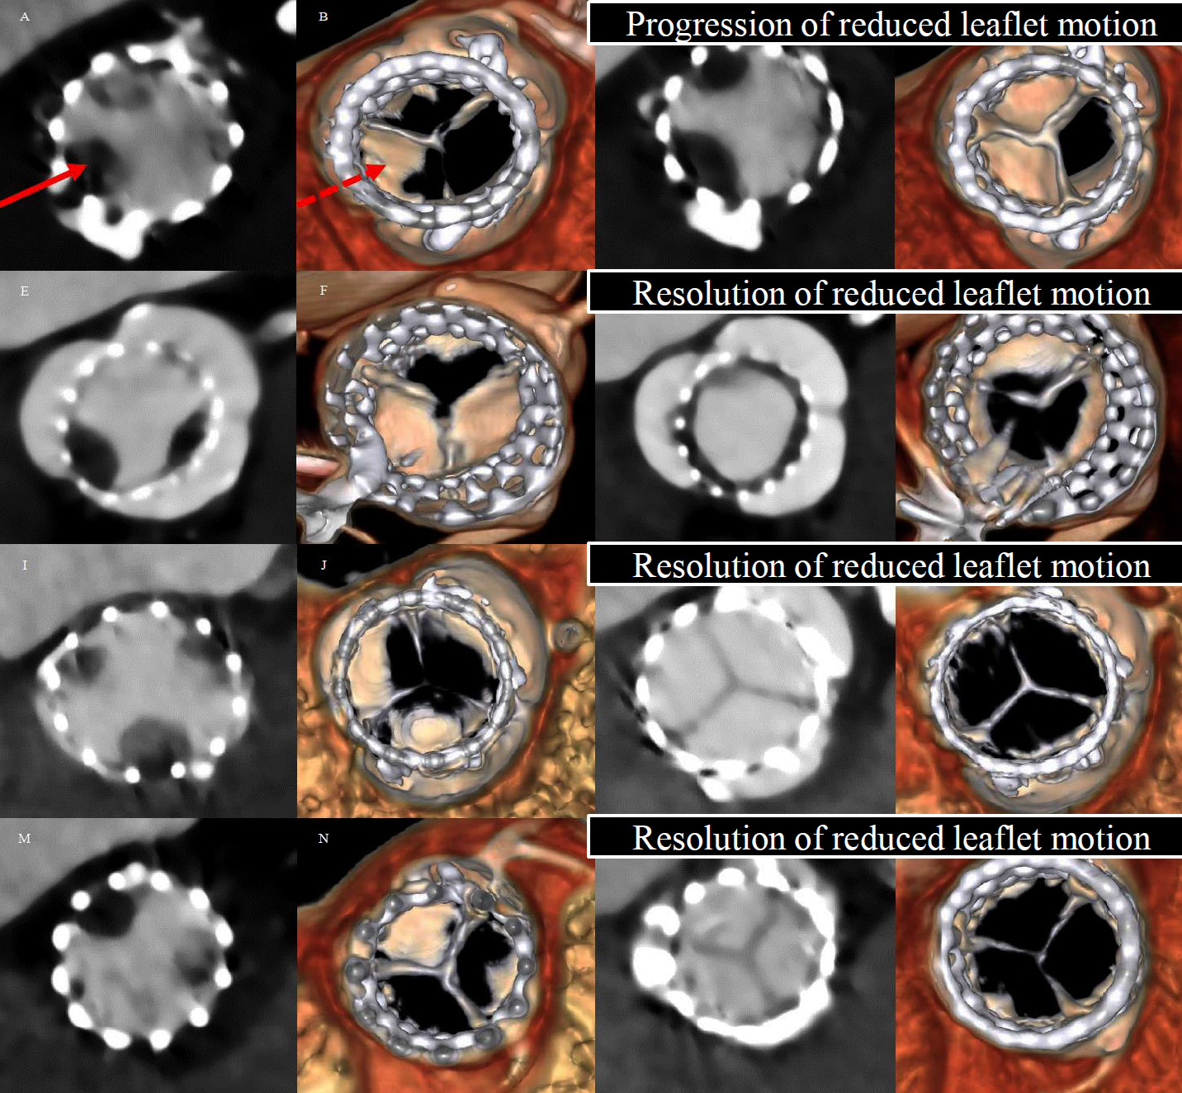
RESOLVE and SAVORY Registries:
Effect of Anticoagulation vs. DAPT on Hypoattenuation Opacities and Reduced Leaflet Motion
Index CT | Follow-up CT
DAPT continued after index CT
Warfarin Initiated after Index CT
Rivaroxaban Initiated after Index CT
Apixaban Initiated after Index CT
Solid arrow – Hypoattenuating opacities
Dashed arrow – Reduced leaflet motion

Slide 41
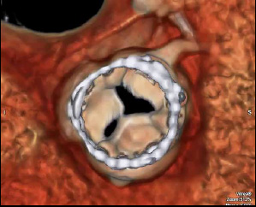
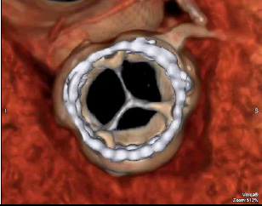
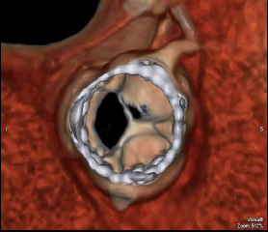
RESOLVE and SAVORY Registries:
Recurrence of Reduced Leaflet Motion Following Discontinuation of Anticoagulation
6 mos following discontinuation of Xarelto
Reduced leaflet motion
Baseline
Reduced leaflet motion
s/p Xarelto 10 mg x3 mos
Normal leaflet motion
Reduced leaflet motion recurred in 4 out of 8 patients in whom anticoagulation was discontinued
Mean time from discontinuation of anticoagulation to recurrence of reduced leaflet motion was 164 ± 109 days

Slide 42
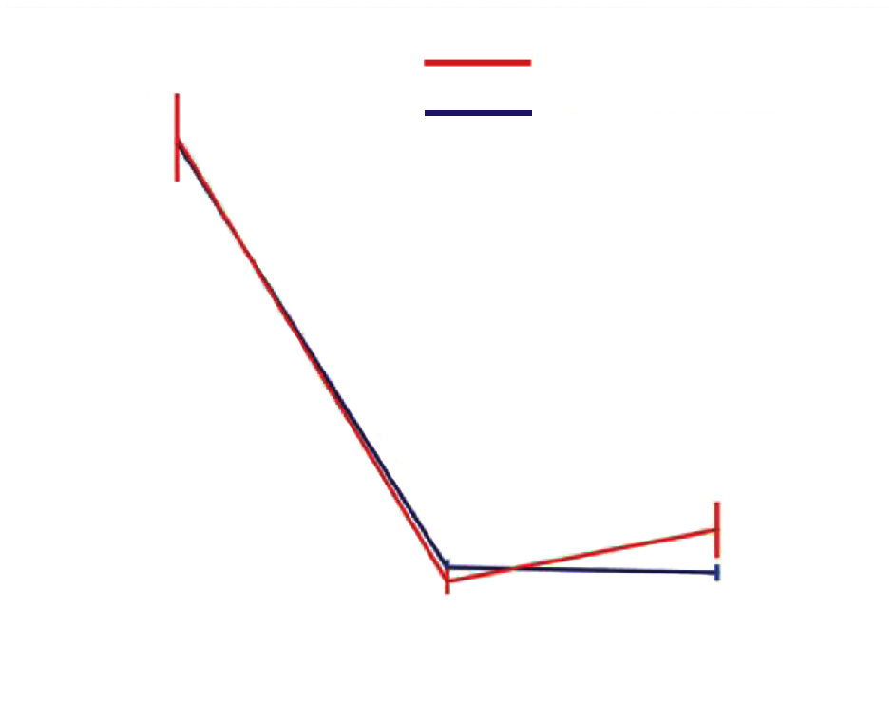
RESOLVE and SAVORY Registries:
Trends in Aortic Valve Mean Gradient
Mean gradient
P=0.83
Reduced leaflet motion
Increased mean gradient at the time of CT in patients with reduced leaflet motion
13.8 ± 10.0 mmHg vs.
10.4 ± 6.3 mmHg p=0.0004
Normal leaflet motion
P=0.0004
P=0.021
Baseline Pre-discharge At the time of CT

Slide 43
RESOLVE and SAVORY Registries:
Echocardiographic Characteristics
Increased Gradients in Patients with Reduced Leaflet Motion
p=0.0002
p=<0.0001
p=<0.0001
Prevalence (%)
40/714
15/96
9/632
13/88
7/632
12/88
Normal Reduced
leaflet motion
Normal Reduced
leaflet motion
Normal Reduced
leaflet motion
Mean aortic gradient
>20 mmHg
Increase in gradients
>10 mmHg
Mean Ao gradient > 20 mmHg and
Increase in gradients >10 mmHg
Chakravarty et al., Lancet 2017;389:2383

Slide 44
RESOLVE and SAVORY Registries:
Clinical Outcomes
All Clinical Events Post-TAVR/SAVR Included
Normal leaflet motion (n=784)
Reduces leaflet motion (n=106)
p=0.0005
p=0.10
p=0.94
%
p=0.56
Chakravarty et al., Lancet 2017;389:2383

Slide 45
Subclinical Leaflet Thrombosis:
Clinical Implications
The imaging findings in our analysis question the current standard of care (dual antiplatelet therapy post-TAVR); thus DAPT can be considered dispensable in the appropriate clinical setting. Our findings raise the issue if anticoagulation is more appropriate in certain patients.
Our data call for clinical trials of routine CT imaging and anticoagulation as TAVR moves into lower risk patients and for the first time provide evidence on the efficacy of NOACs on bio-prosthetic aortic valve thrombosis.
In the appropriate clinical setting such as TIAs, stroke, new onset heart failure; or even small increase in gradients post-procedure should lead to vigilance and CT imaging.
The reduced leaflet motion observed on CT secondary to leaflet thrombosis and increase in gradients may provide insights into a preventable mechanism of structural valve deterioration in some patients.

Slide 46
Take Home Message: Structural Valve Deterioration/Degeneration post TAVR/SAVR
Structural valve deterioration/degeneration (SVD) occurs with time after both surgical and trans-catheter aortic bio-prosthetic valves; similar incidence at 5 year of RCT of TAVR vs SAVR by echo and clinical f/u.
Subclinical leaflet thrombosis, likely a precursor to future SVD, occurs more commonly after trans-catheter vs surgical bio-prosthesis and is associated with higher CVA/TIA rates without any impact on death or MI. OAC involving both warfarin or NOACs during TAVR procedure is associated with lower leaflet thrombosis and once started can result in resolution of restricted leaflet motions in the majority of cases.

Slide 47
Question # 1
Following are the true components of structural valve deterioration:
Trans-aortic gradient of >20 mmHg at f/u not present at 30 days
> 3+ Aortic/Paravalvular regurgitation
Reoperation for structural valve failure
Mean transvalvular gradient >40 mmHg or severe AI at anytime after valve replacement
All of the above
Correct answer: E

Slide 48
Question # 2
Following are the true statements regarding subclinical leaflet thrombosis after TAVR or SAVR except:
It occurs less commonly after TAVR vs SAVR
It may be associated with higher trans-aortic gradient
It may be associated with higher CVA or TIA
It is associated with similar death and MI at f/u
Correct answer: A

Slide 49
Question # 3
Following are the true statements regarding subclinical leaflet thrombosis except:
A. NOACs are as effective as warfarin in reducing leaflet thrombosis
B. It is more frequent amongst pts receiving DAPT vs OAC
C. It can resolve in almost all cases after starting OAC
D. It can recur after discontinuation of OAC
Correct answer: B

